Slide 1
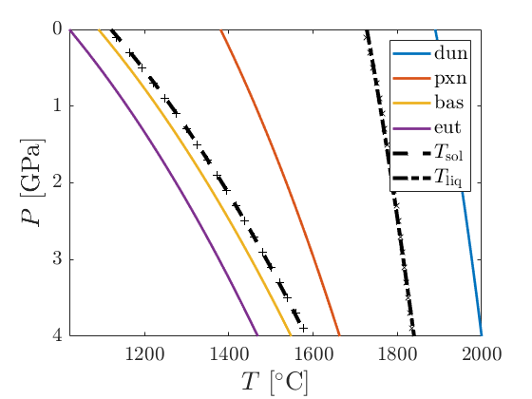
Calibration
The components melting curves are also calibrated to fit a bulk liquidus and solidus from Johnson et al. 2021 ( cross lines ).

Slide 2
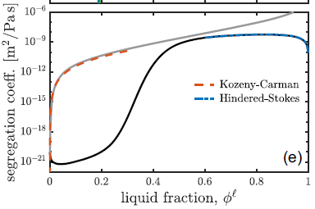
Segregtion coefficient from Keller and Suckale 2019

