Slide 1
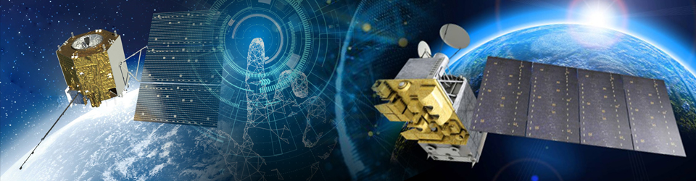
EGU 2023
Progress on FCDR of MWRI onboard FY-3 Series Satellites
Shengli WU ¹, Ling SUN ¹, Hongxin XU ², Jiakai HE ², Fenglin SUN ¹, Songyan Gu ¹and Peng ZHANG ^{1*}
1 National Satellite Meteorological Center, Beijing 100081, China
2 Shanghai Institute of Space Communication Technology, Shanghai 201109, China

Slide 2
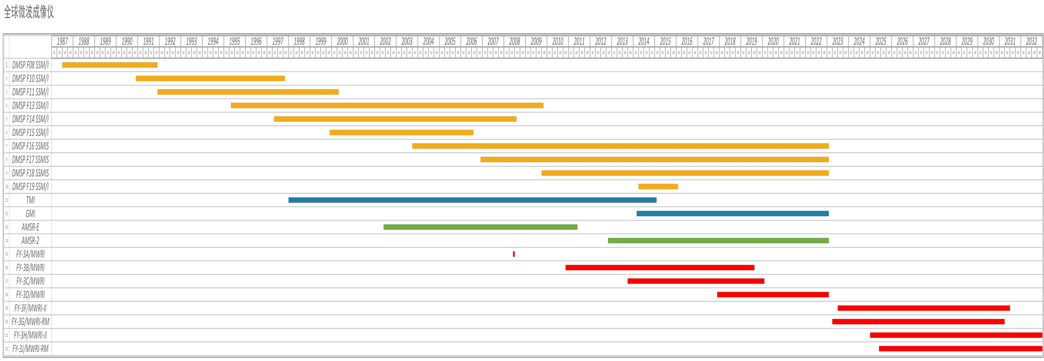
Global Microwave Imagers
 | sensors | Freq Range | Total
 | SSMI/SSMIS | 18-89GHz | 10
 | TMI/GMI | 10-183GHz | 2
 | AMSR | 6-89GHz | 2+1
 | MWRI | 10-183GHz | 4+4

Slide 3

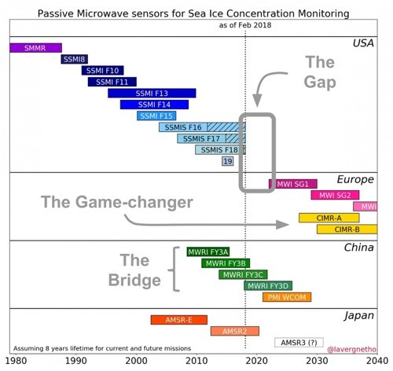
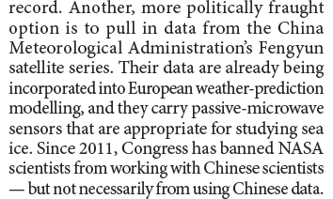
Potential Application in Climate Change

Slide 4

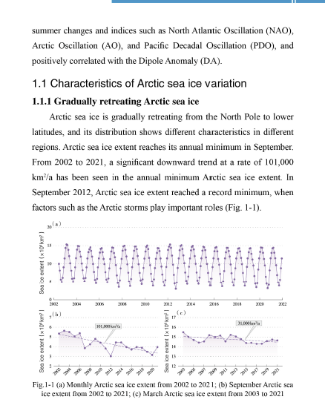
Sea Ice Concerntration Monitoring using MWRI

Slide 5
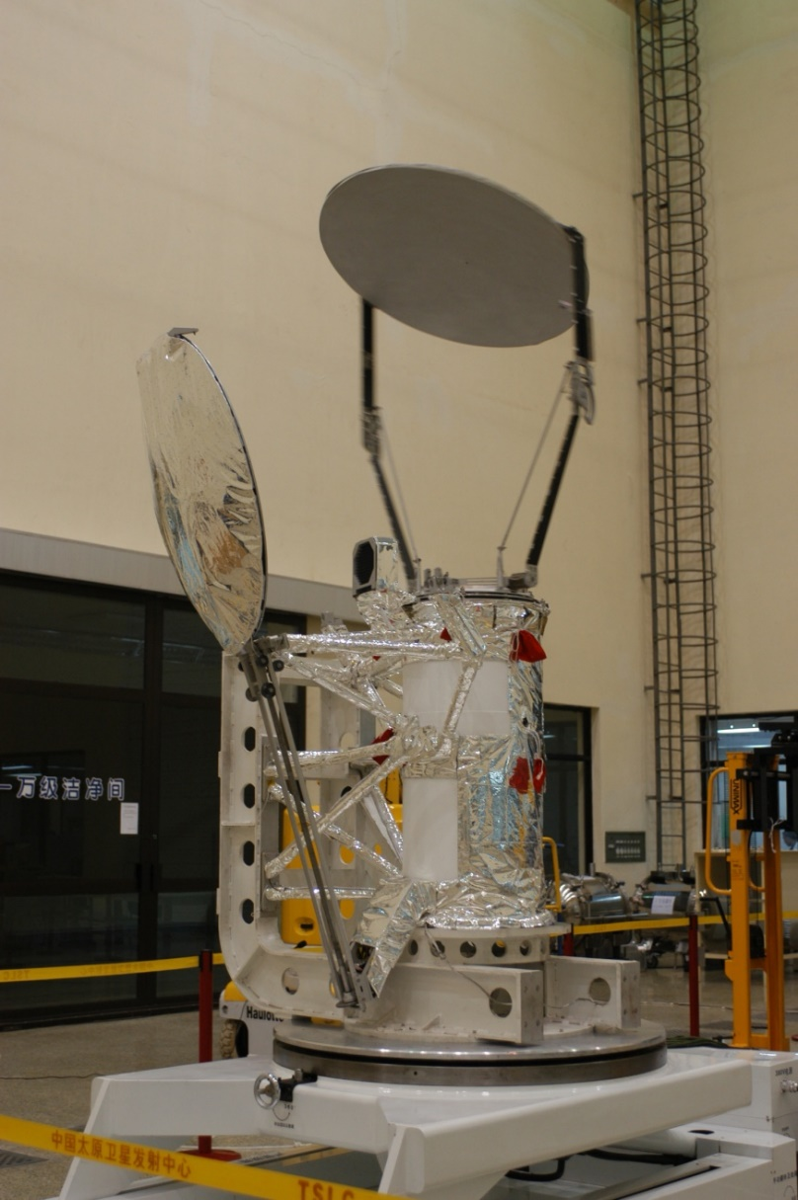
FY-3/MWRI Introduction （A/B/C/D）
Frequency(GHz) | 10.65 | 18.7 | 23.8 | 36.5 | 89
Polarization | V.H | V.H | V.H | V.H | V.H
Band Width(MHz) | 180 | 200 | 400 | 900 | 2×2300
NeDT(k) | 0.5 | 0.5 | 0.5 | 0.5 | 0.8
Accurancy(k) | 2.0 | 2.0 | 2.0 | 2.0 | 2.0
BT Range(k) | 3～340
Scan Points | 266(1.8s)
Black Body Stability | 0.3K
Nonlinear | <1K
Main Beam | ≥90%
Resolution ≤(km×km) | 51×85 | 30×50 | 27×45 | 18×30 | 9×15
Beam of different Channel | <0.07°
Scan | Conic
Orbit Width(Km) | ≥1400
Antenna angle(°) | 45
Scan Period(s) | 1.8±0.1（1.7/2.0）
Scan Period Stability(ms) | ≤0.36ms*（2 Scan lines）
 | ≤1ms(30 minutes)

Slide 6
MWRI-II/MWRI-RM
MWRI-II
Morning orbit/Afternoon orbit
MWRI-RM
Drift orbit

Slide 7
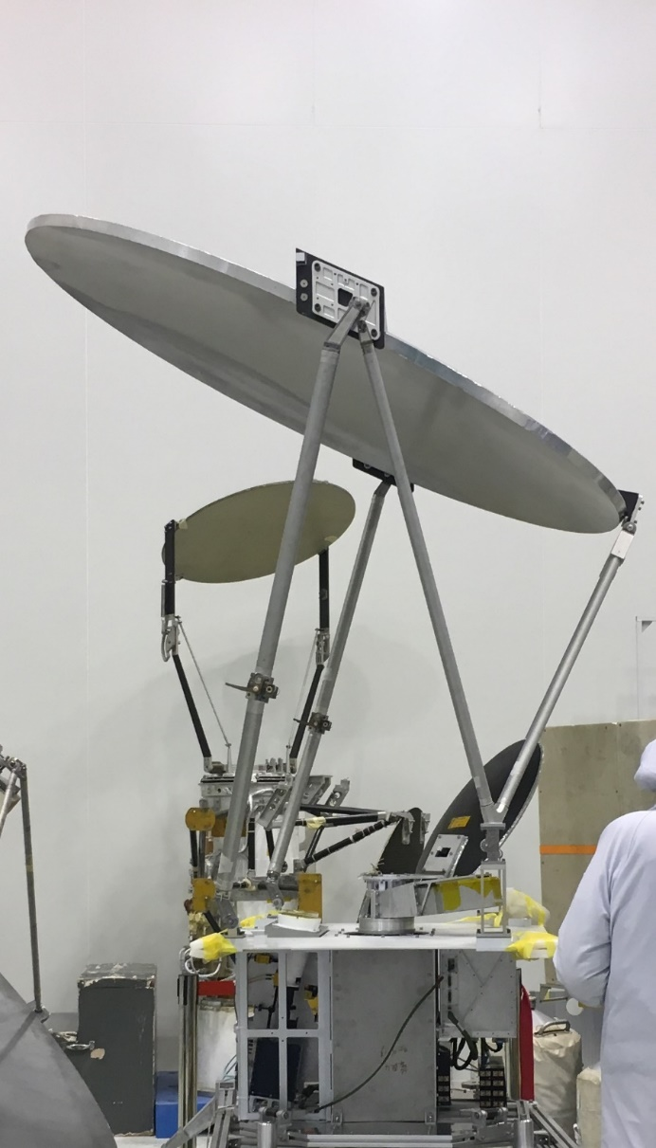
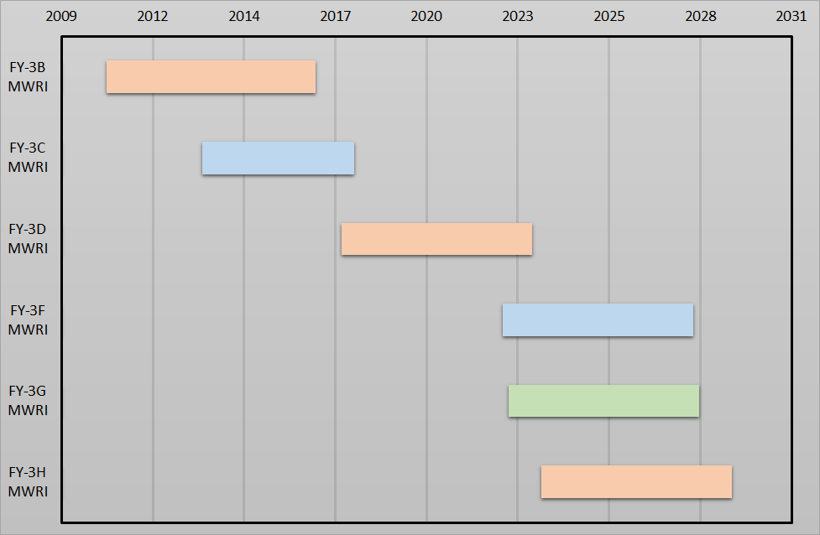
MWRI-II/MWRI-RM
一、研制进展情况
 | MWRI | MWRI-II/RM | GMI | AMSR2 | MWI | SSMIS
Nation | China | China | US | Japan | EU | US
Antenna size(m) | 1 | 1.6/1.2 | 1.2 | 2 | 0.75 | 0.6
Main beam(%) | 90 | 95 | 90 | 90 | 90 | 90
Frequency range(GHz) | 10-89 | 10-183 | 10-183 | 6.9-89 | 18-183 | 18-183
Channels | 10 | 26 | 13 | 16 | 18 | 24
NedT | 0.5-0.8 | 0.5-0.8 | 0.6-1.5 | 0.4-1.4 | 0.6-1.2 | 0.4-1.9
7
  2022:FY-3F(Morning orbit, Antenna size: 1.6m);
  2022:FY-3G(Drift orbit, Antenna size: 1.2m);
  2023:FY-3H(Afternoon orbit, Antenna size: 1.6m);
  Antenna performance and NedT improved based on FY-3A/B/C/D

Slide 8
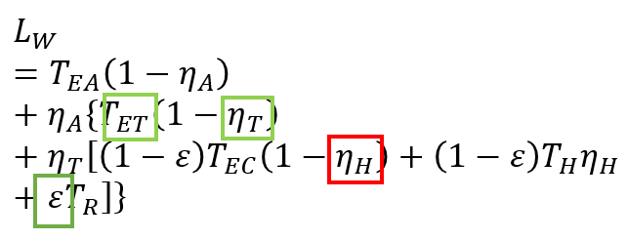
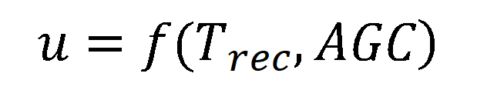
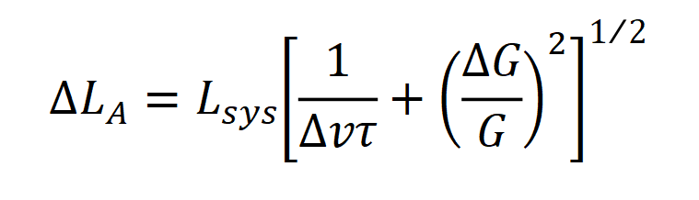

Calibration Equation and Parameters
$$L_{O}=L_{W}+\frac{L_{W}−L_{C}}{C_{W}−C_{C}}×\left(C_{O}−C_{W}\right)+L_{nl}+∆L_{A}$$
Receiver
Calibration Target
$$\left.L_{nl}=u×G^{2}×(C_{O}−C_{C})×(C_{O}−C_{W}\right)$$
$$\left.u=f(T_{rec},AGC\right)$$
$$∆L_{A}=L_{sys}{\left[\frac{1}{∆vτ}+{\left(\frac{∆G}{G}\right)}^{2}\right]}^{1/2}$$
Parameters type
Reflector
Receiver
Source

Slide 9
MWRI Recalibration Algorithm
Algorithm | V1.0 | V2.0
 |  | V1.1 | V1.2
Back lobe | Using single orbit get back lobe factor | Global data | Improve data quality control
Hot reflector | Correction based on A/D Bias | Correction based on difference of physical temperature of hotload and hot reflector | Improve data quality control
Hot load | - | Using rain forest data to get better hot load parameter | Using data near the hotload temperature
Nonlinear | - | Using new back lobe, hot reflector and hot load parameters, and double difference data of ocean surface, do the correction of u, and the releation ship between u and receiver temperature. | Using different AGC
 | Re-cal Parameters | Re-cal time series
FY-3B/MWRI | 2014 | 2010-2019
FY-3C/MWRI | 2014 | 2013-2019
FY-3D/MWRI | 2018 | 2017-2019

Slide 10
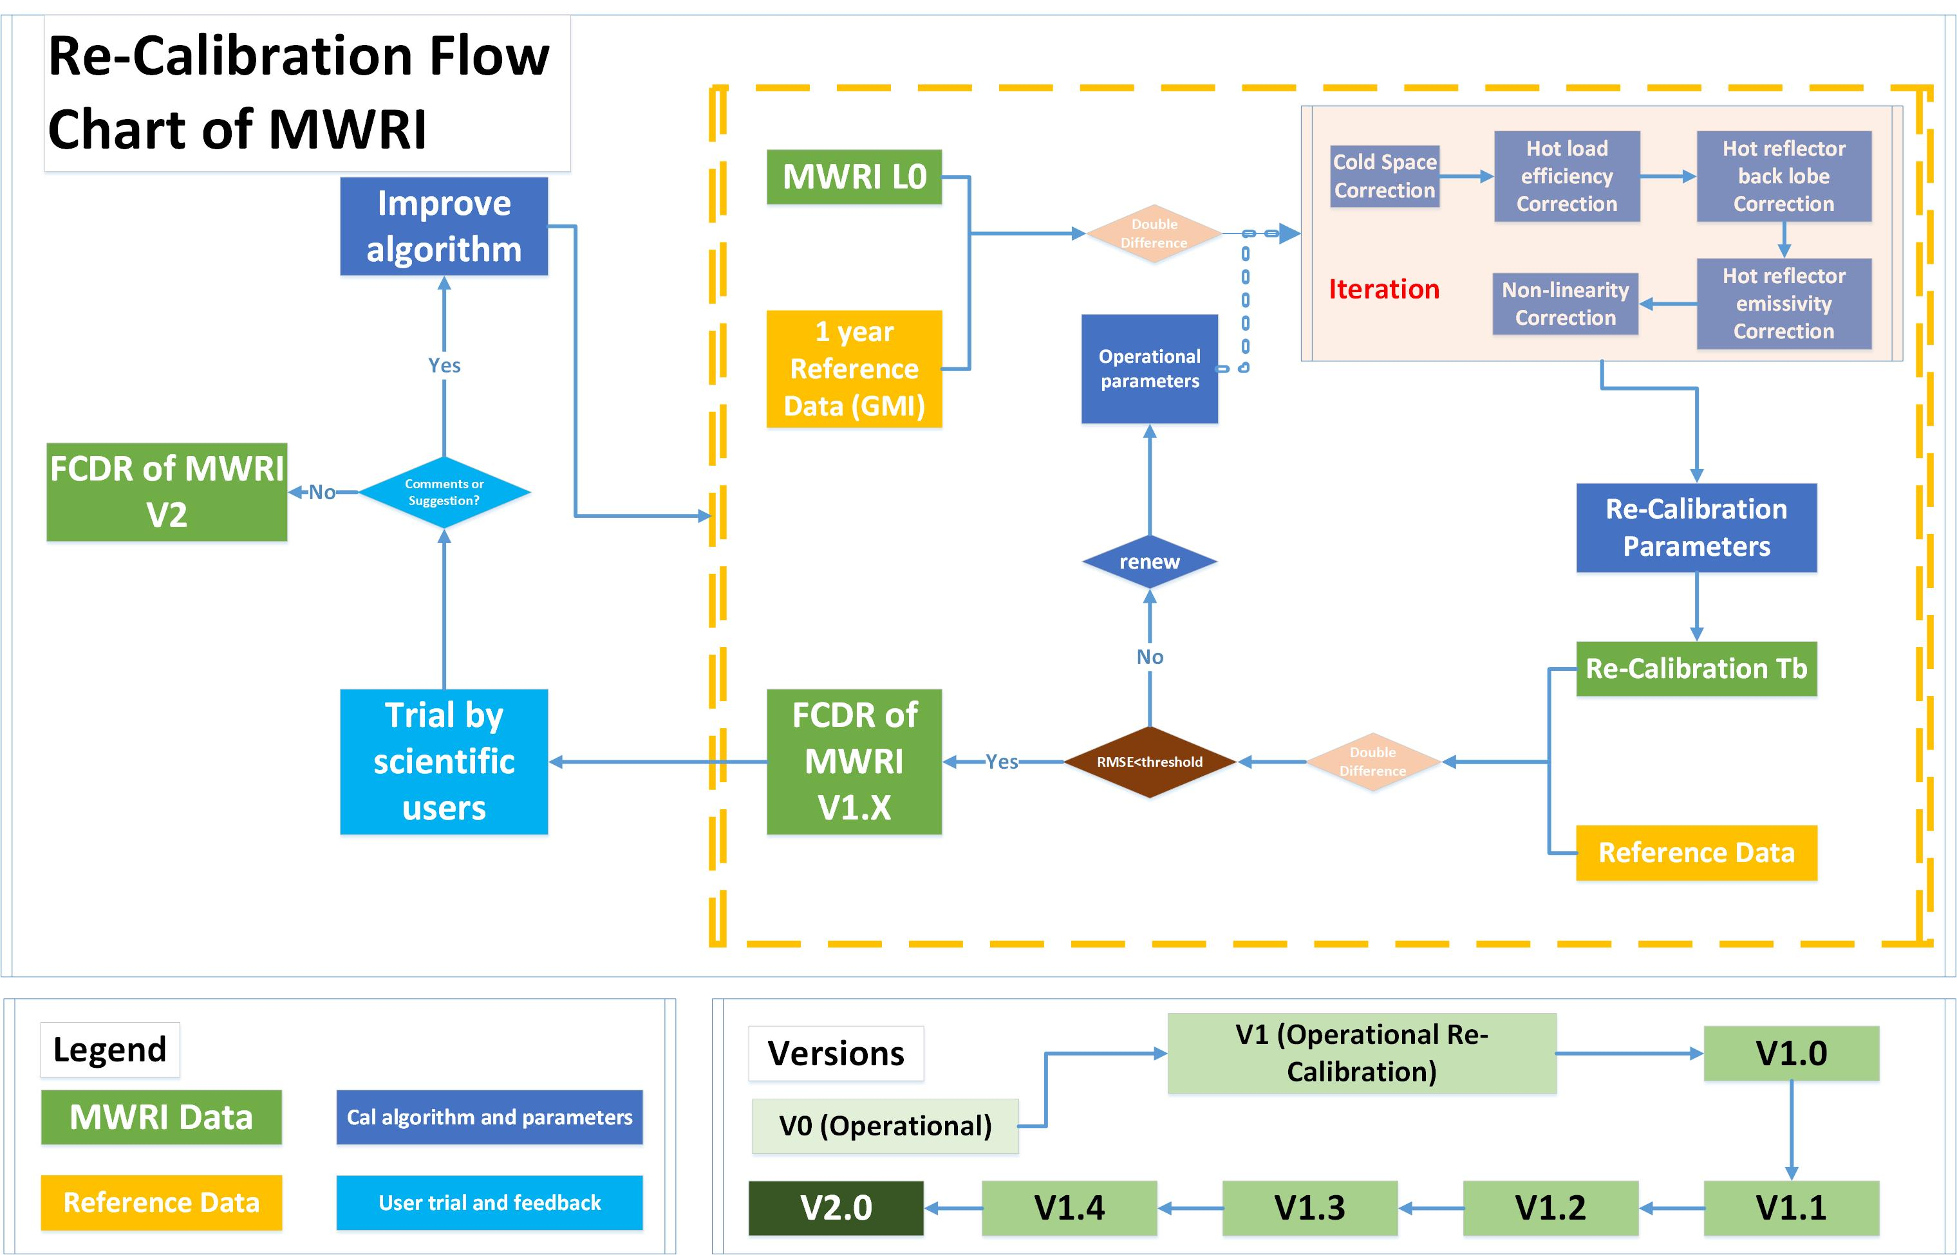

Slide 11
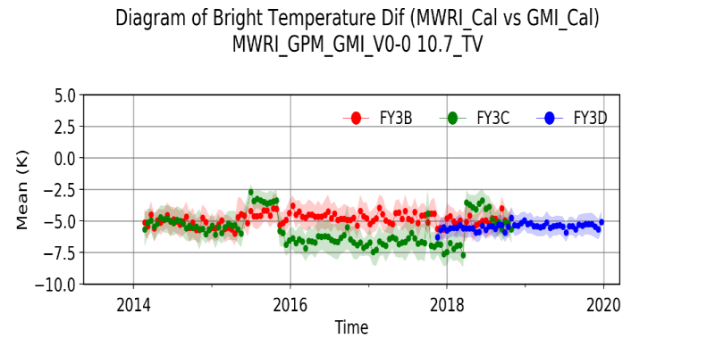
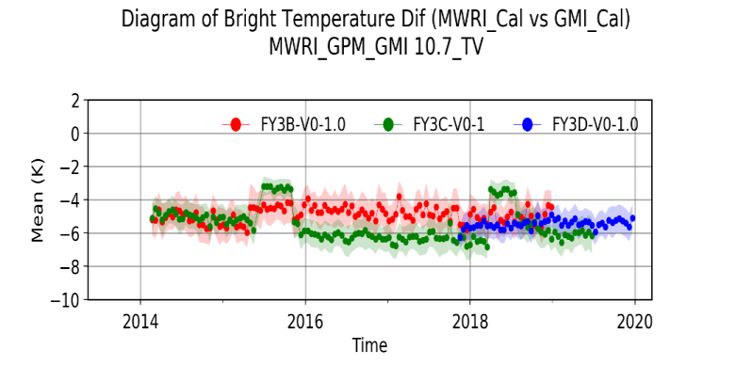
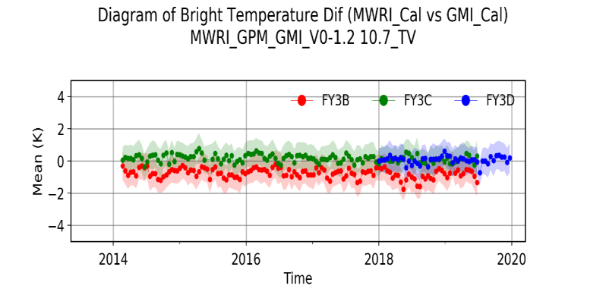
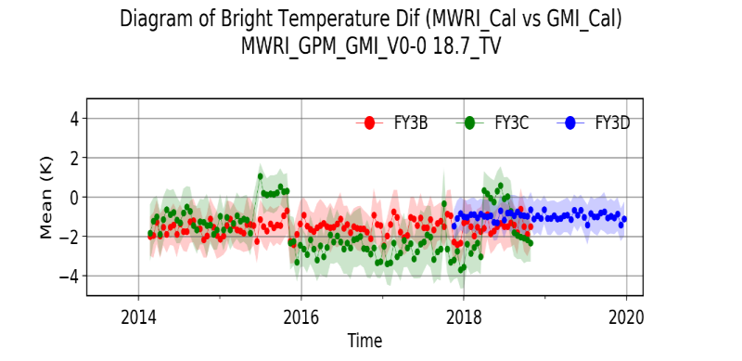
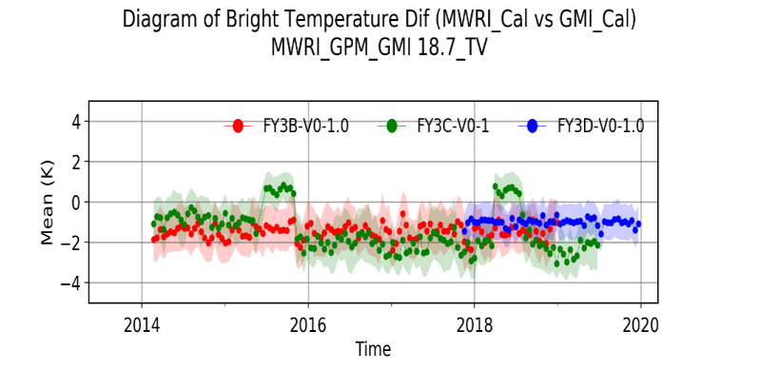
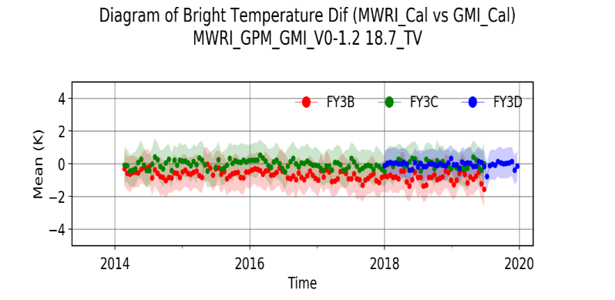
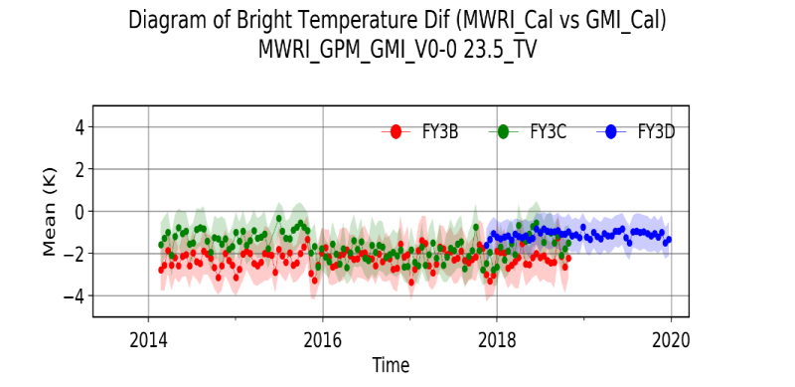
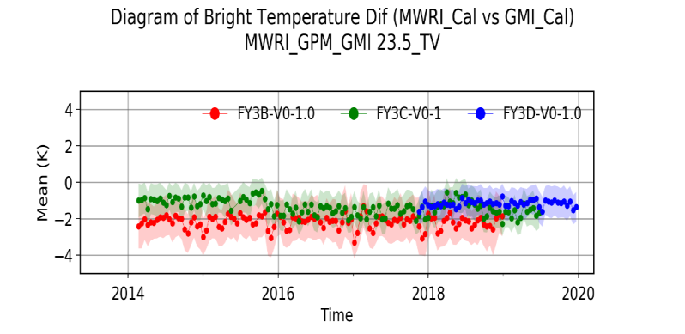
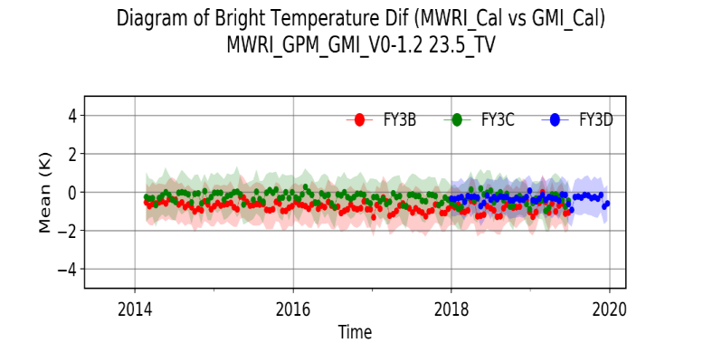
FY-3B/C/D MWRI time series
Operational
Recal V1.0
Recal V2.0

Slide 12
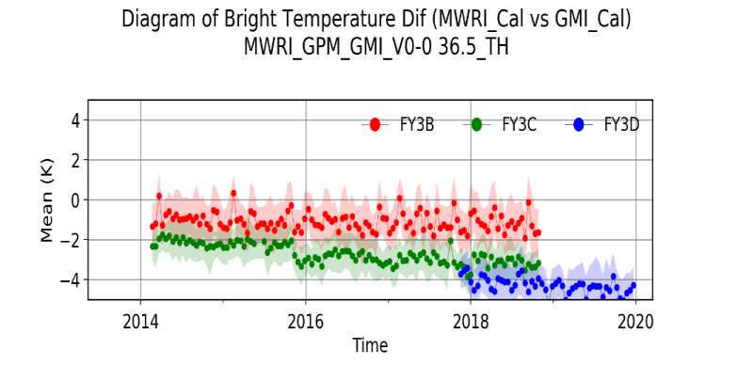
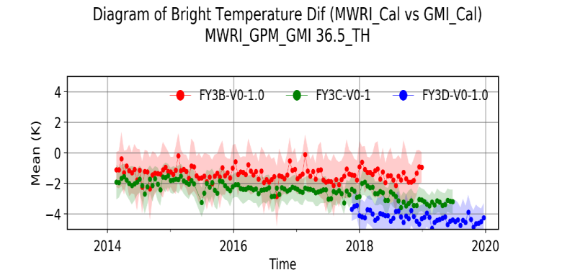
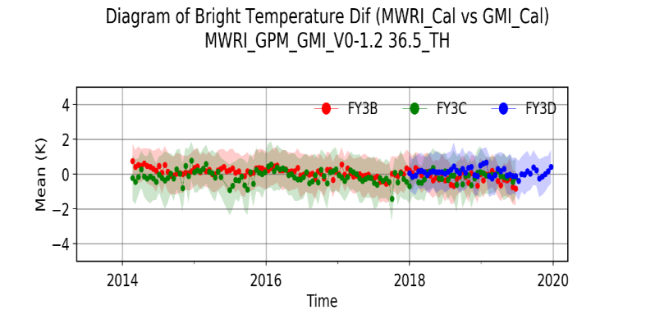
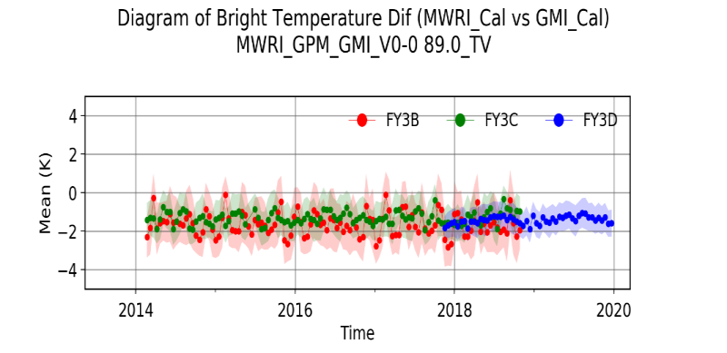
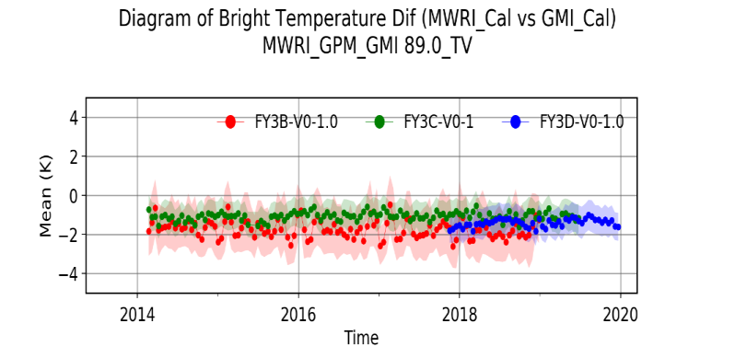
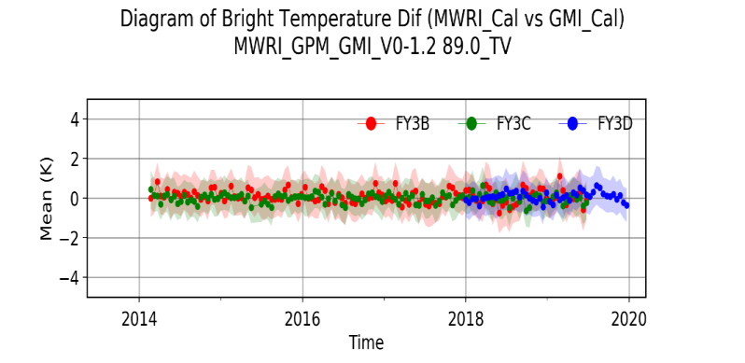
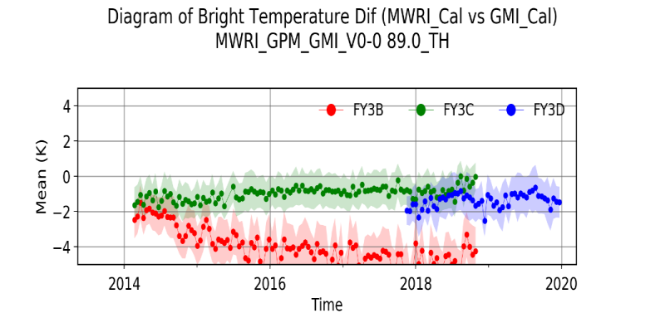
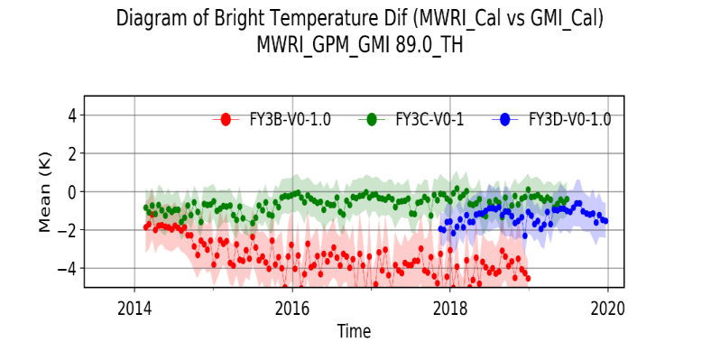
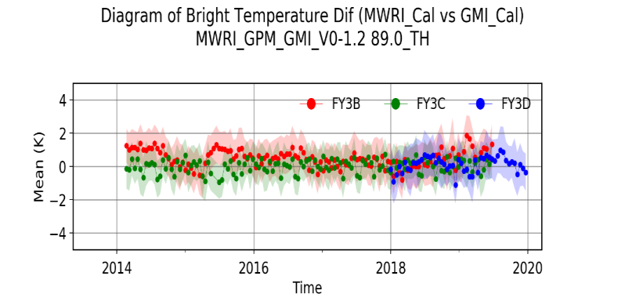
Operational
Recal V1.0
Recal V2.0
Notes:
最小统计单元：15天

Slide 13
FY-3B/C/D MWRI
channel | Typical BT (K) | Mean of RMSE (K)
 |  | operational | Recal V1.0 | Recal V2.0
FY-3B
10V | 166.2 | 5.00 | 5.00 | 1.15
10H | 91.8 | 5.66 | 5.68 | 1.21
18V | 119.4 | 1.91 | 1.87 | 1.26
18H | 127.5 | 3.12 | 3.15 | 1.34
23V | 224 | 2.51 | 2.46 | 1.29
36V | 223.5 | 5.76 | 5.59 | 0.94
36H | 172.1 | 1.62 | 2.03 | 1.10
89V | 268.8 | 2.13 | 2.19 | 1.02
89H | 248.8 | 4.24 | 3.85 | 1.34
FY-3C
10V | 166.2 | 5.85 | 5.85 | 0.88
10H | 91.8 | 8.12 | 8.15 | 0.91
18V | 119.4 | 2.27 | 2.72 | 1.07
18H | 127.5 | 2.13 | 2.13 | 1.08
23V | 224 | 1.95 | 1.95 | 1.10
36V | 223.5 | 3.69 | 3.69 | 1.04
36H | 172.1 | 2.87 | 2.87 | 1.26
89V | 268.8 | 1.62 | 1.62 | 0.88
89H | 248.8 | 1.38 | 1.38 | 1.15
FY-3D
10V | 166.2 | 5.51 | 5.51 | 0.91
10H | 91.8 | 6.80 | 6.87 | 1.04
18V | 119.4 | 1.32 | 1.33 | 0.93
18H | 127.5 | 1.79 | 1.80 | 1.08
23V | 224 | 1.41 | 1.45 | 1.02
36V | 223.5 | 4.28 | 4.24 | 0.94
36H | 172.1 | 4.41 | 4.39 | 1.09
89V | 268.8 | 1.64 | 1.63 | 0.93
89H | 248.8 | 1.82 | 1.76 | 1.33

Slide 14

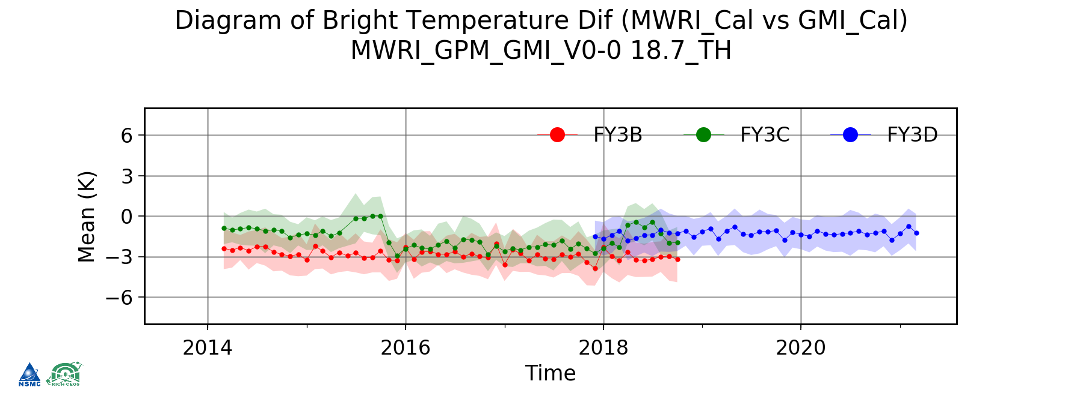
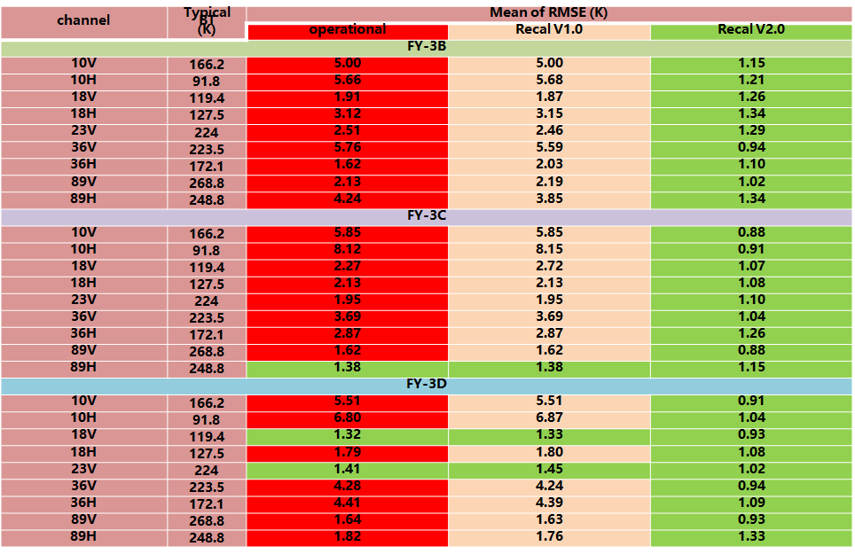
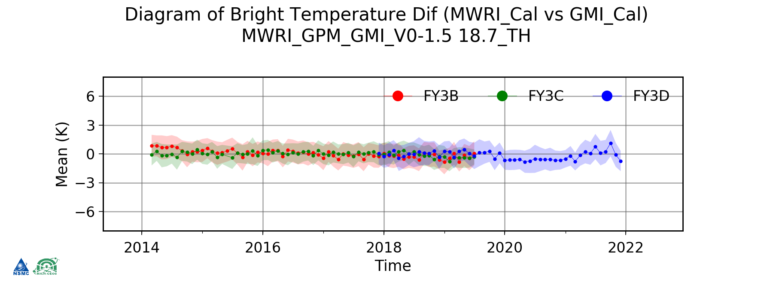
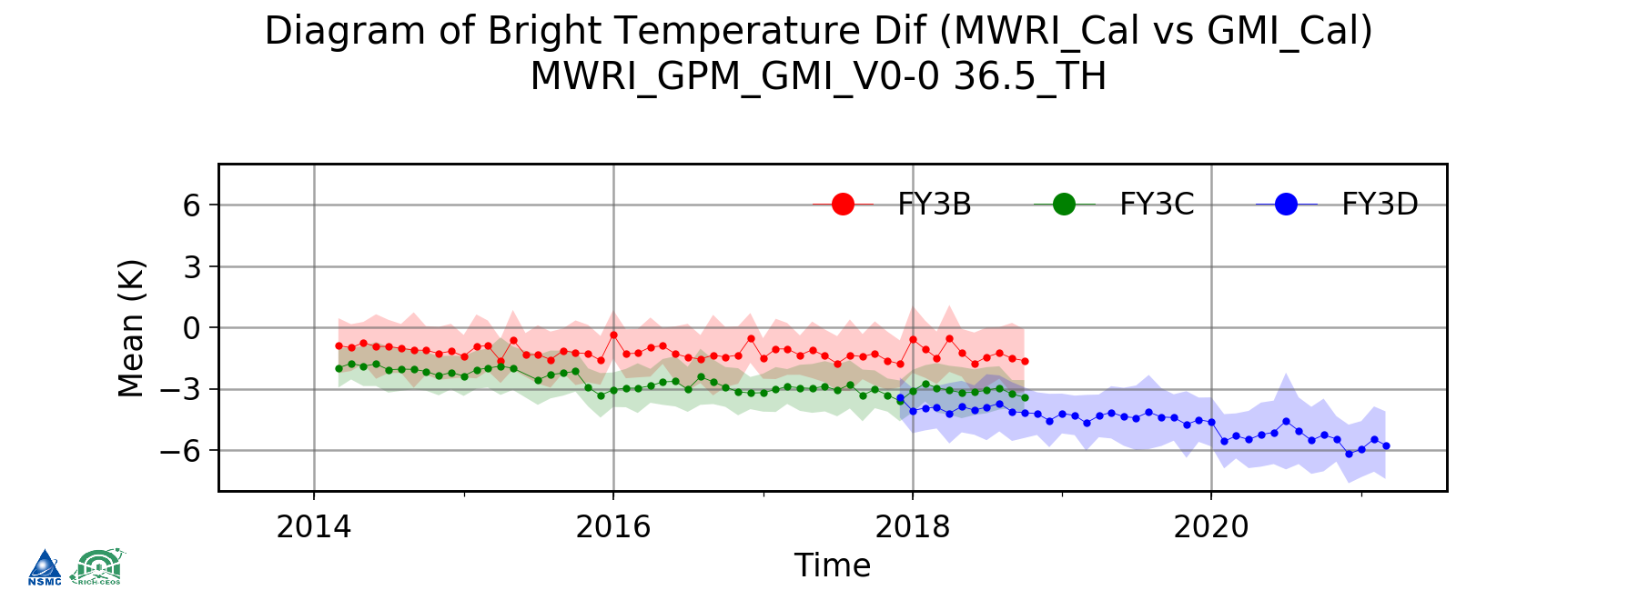
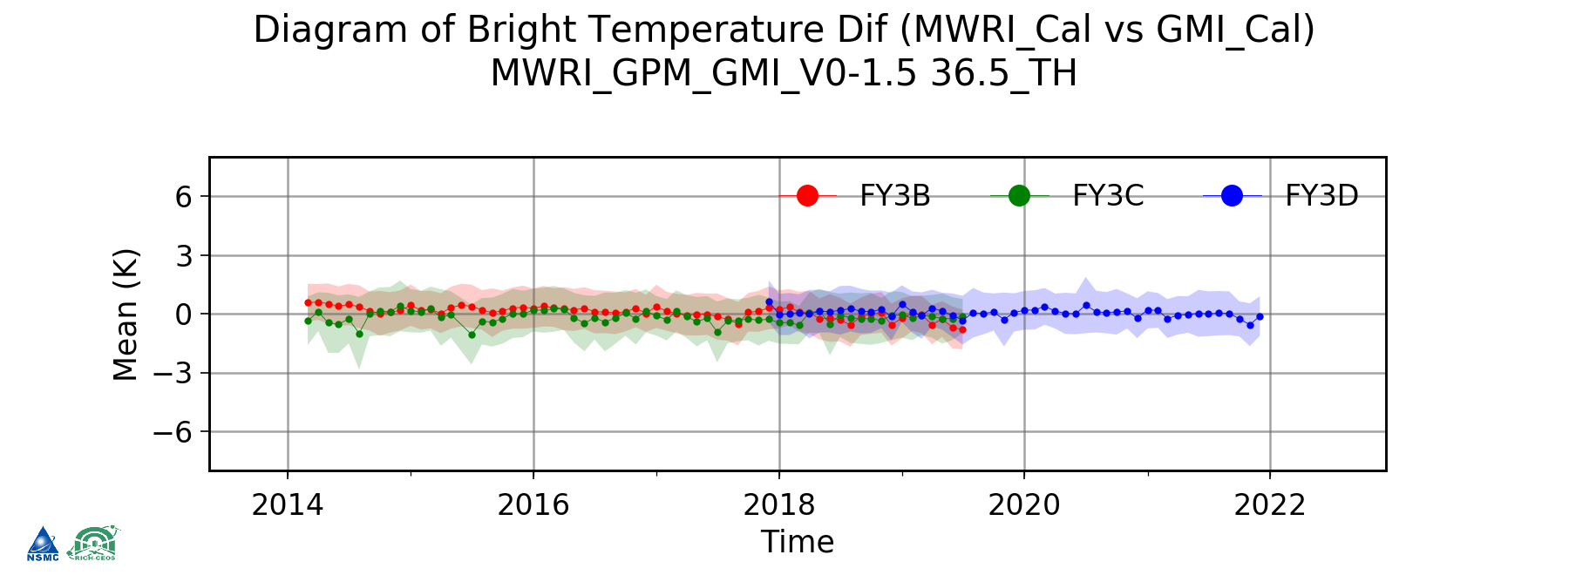
FCDR of MWRI
Name | MWRI FCDR
Platform | FY-3B, FY-3C, FY-3D
Range | 2011-2021
Coverage | Global
Temporal Resolution | Daily
Spatial Resolution | 25km
wusl@cma.gov.cn
Operational (status jump)
Re-Calibrated
Operational (attenuation)
Re-Calibrated
Papers JMR 2023; TGARS 2022; AAS 2022,2023; ATMOSPHERE 2022; ESSD 2023;
Data DOI:10.12185/NSMC.RICHCEOS.FCDR.MWRIRecalOrb.FY3.MWRI.L1.GBAL.POAD.NUL.010KM.HDF.2021.2.V1

Slide 15
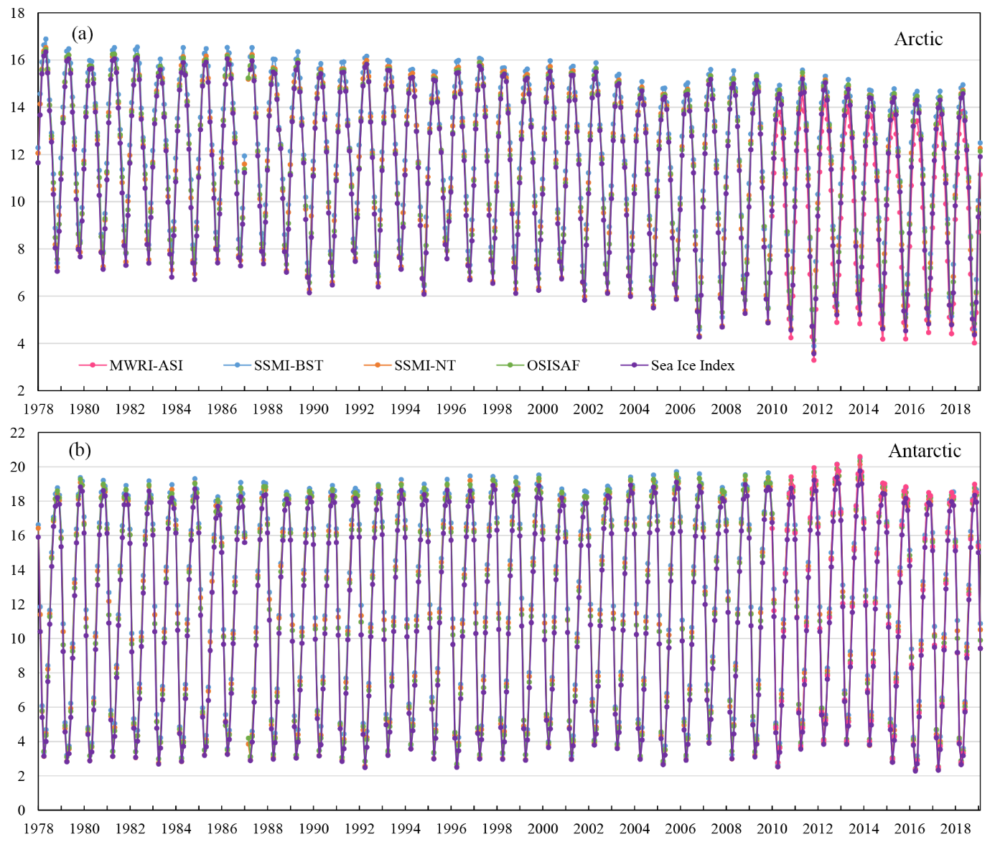
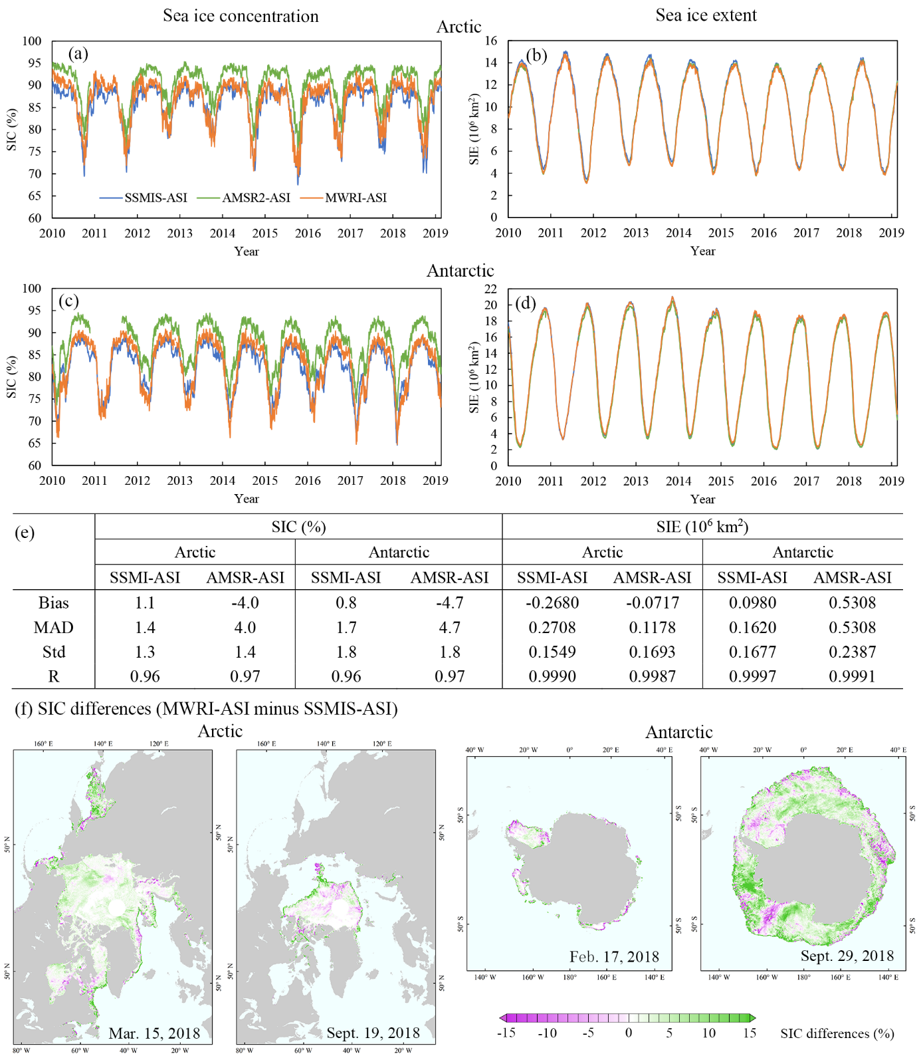
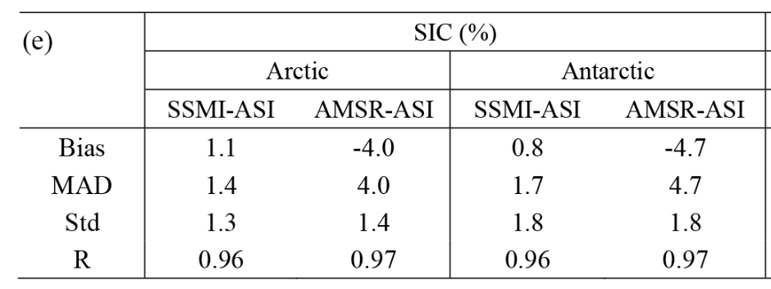
FY-3 MWRI ASI sea ice concentration
Monthly sea ice extent
MWRI-ASI SIC – SSMIS-ASI SIC
Zhao 2023
MWRI-ASI SIC has lower difference with SSMI ASI SIC
Notes:
左上图为MWRI ASI算法海冰密集度与SSMIS ASI海冰密集度差异，1-4子图时间分别为2018年北极海冰范围较大的时期（3月15日），北极海冰范围较小的时期（9月19日），南极海冰范围较小时期（2月17日），南极海冰范围较大时期（9月29日）
左下图为MWRI ASI算法海冰密集度与SSMI ASI算法，AMSR ASI算法日均海冰密集度、日海冰范围比较。时间为2010年11月-2019年
右图为基于MWRI ASI算法，SSMI Bootstrap算法，SSMI Nasa Team算法，OSISAF，Sea Ice Index算法的海冰密集度数据得到1978-2019年的月平均海冰范围，风云系列数据的每月海冰范围从2010年11月开始。
表格为MWRI ASI算法海冰密集度与SSMI ASI算法，AMSR ASI算法日均海冰密集度比较的统计结果（偏差，绝对差异，标准差，相关系数）

Slide 16
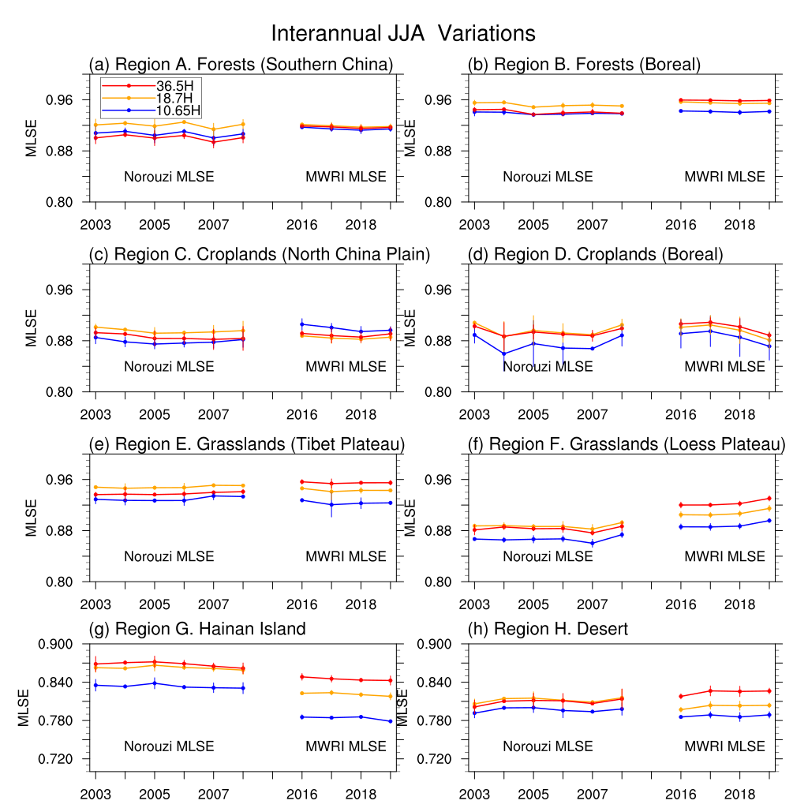
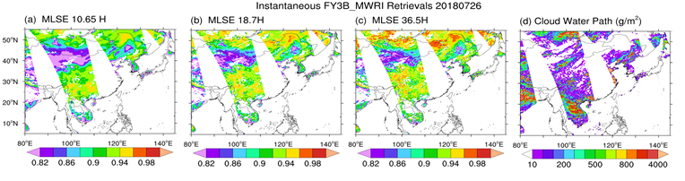
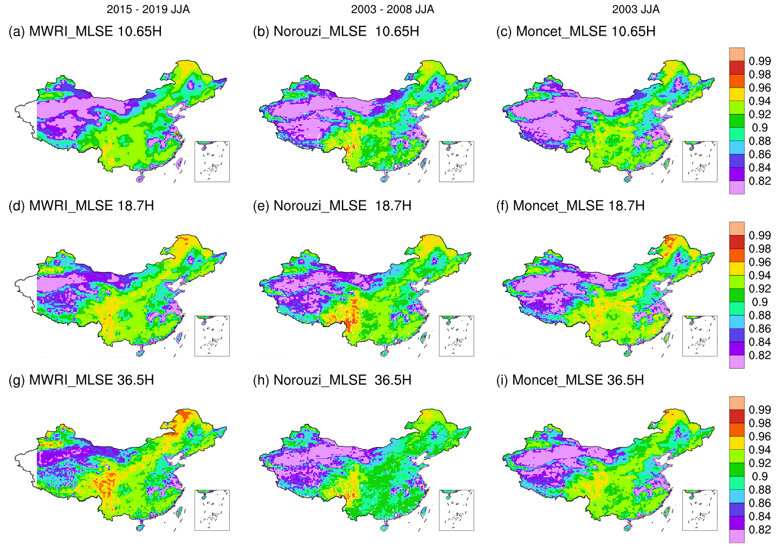
FY-3 MWRI MLSE
MLSE Retrieval Result
MLSE Retrieval Result (average)
Hu et al., 2021, Satellite Retrieval of Microwave Land Surface Emissivity under Clear and Cloudy Skies in China Using Observations from AMSR-E and MODIS. Remote Sensing. https://doi.org/10.3390/rs13193980
Li et al., 2021, Spatiotemporal Variations of Microwave Land Surface Emissivity (MLSE) over China derived from 4-Year Recalibrated Fengyun 3B MWRI data. Advances in Atmospheric Sciences (minor revision)
Notes:
中国科学技术大学的李锐教授团队专注于使用被动微波遥感对地气系统之间的碳水和能量交换进行研究。先后使用AMSR-E，GMI和风云卫星搭载的MWRI等仪器的观测进行微波地表比辐射率这一关键微波参数的反演，其大致的反演流程如图所示。其联合使用了MWRI L1级再定标微波亮温产品，葵花8-AHI静止卫星云产品，ERA-Interim再分析资料反演MLSE产品. 经过时空匹配，降水扣除，云水匹配等过程和微波辐射传输计算来扣除大气中的云水和各种气体的辐射贡献，进而反演出地表的微波比辐射率。
瞬时反演结果结合葵花8的即时云水分布可以看出，云的影响得到了合理的扣除。并且在多年平均分布上，该MLSE数据集和Norouzi et al., 2011以及Moncet et al.,2011的结果在10年尺度上具有较高的一致性。

Slide 17
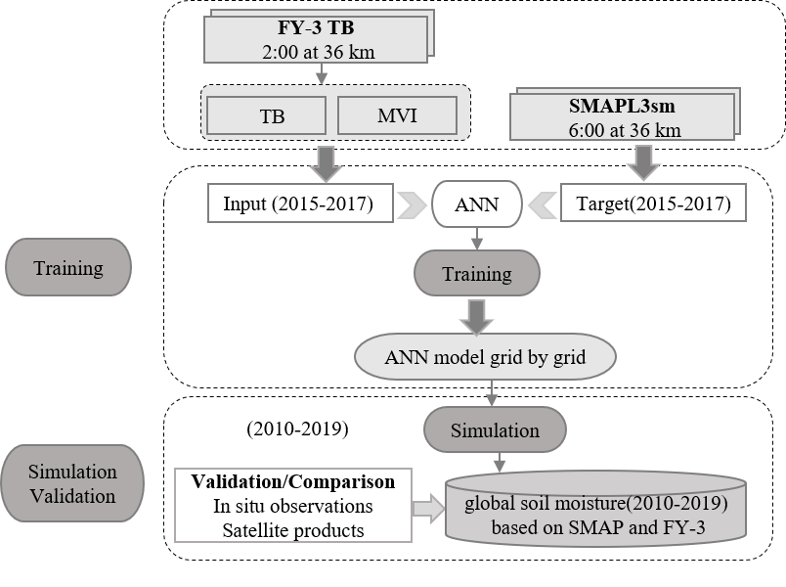
A global daily soil moisture dataset derived from FY-3B MWRI and SMAP(2010-2019)
Selected SMAP SSM as reference，using artificial neural networks (ANN)approach, and FY-3B MWRI TB data with as input, intend to transfer high accuracy in soil moisture of L band to C/X band
The trend of FYNNsm(Blue) is consistent with that of SMAPsm(red)and in situ SM (Obs-sm,grey), and FYNNsm well capture the temporal dynamic and annual variation of in situ SM. The performance of FYNNsm relative to Obs-sm is similar to SMAP as shown over most sites.
Yao, 2023

Slide 18
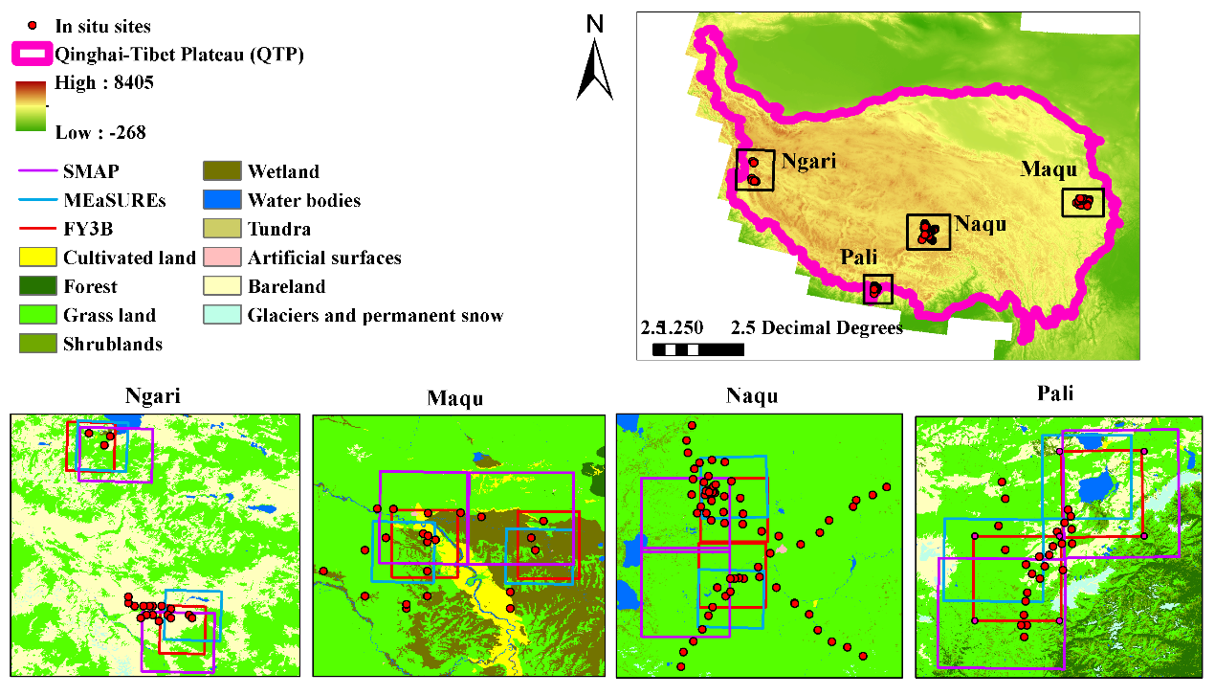
F/T detection Using MWRI
Accuracy and performance:
F/T algorithm | Seasons |  |  |  | Overall
 | Spring | Summer | Autumn | Winter
New (FY-3D) | 68% | 97% | 77% | 91% | 83.49%
AMSR2 | 56% | 92% | 69% | 89% | 76.74%
SMAP | 67% | 87% | 85% | 93% | 83.03%
MEaSUREs | 37% | 85% | 45% | 94% | 65.99%
Study area | Time range | F/T products | Time range
Ngari | 2010.7-2019 | AMSR | 2010.1-2019.12
Mqau | 2008.6-2019 | FY-3B(3D) | 2010.11-2019.6 2017.12-2019.12
Naqu | 2010.8-2016.12, 2017.12-2019.12 | MEaSUREs | 2010.1-2019.12
Pali | 2015.6-2016.12, 2017.12-2019.12 | SMAP | 2015.4-2019.12
Evaluation：New (FY-3D)>SMAP>AMSR2>MEaSUREs
L-band is more sensitive to F/T detection;
The new algorithm developed in this study improves the F/T monitoring capability with high frequencies.
Wang 2022

Slide 19

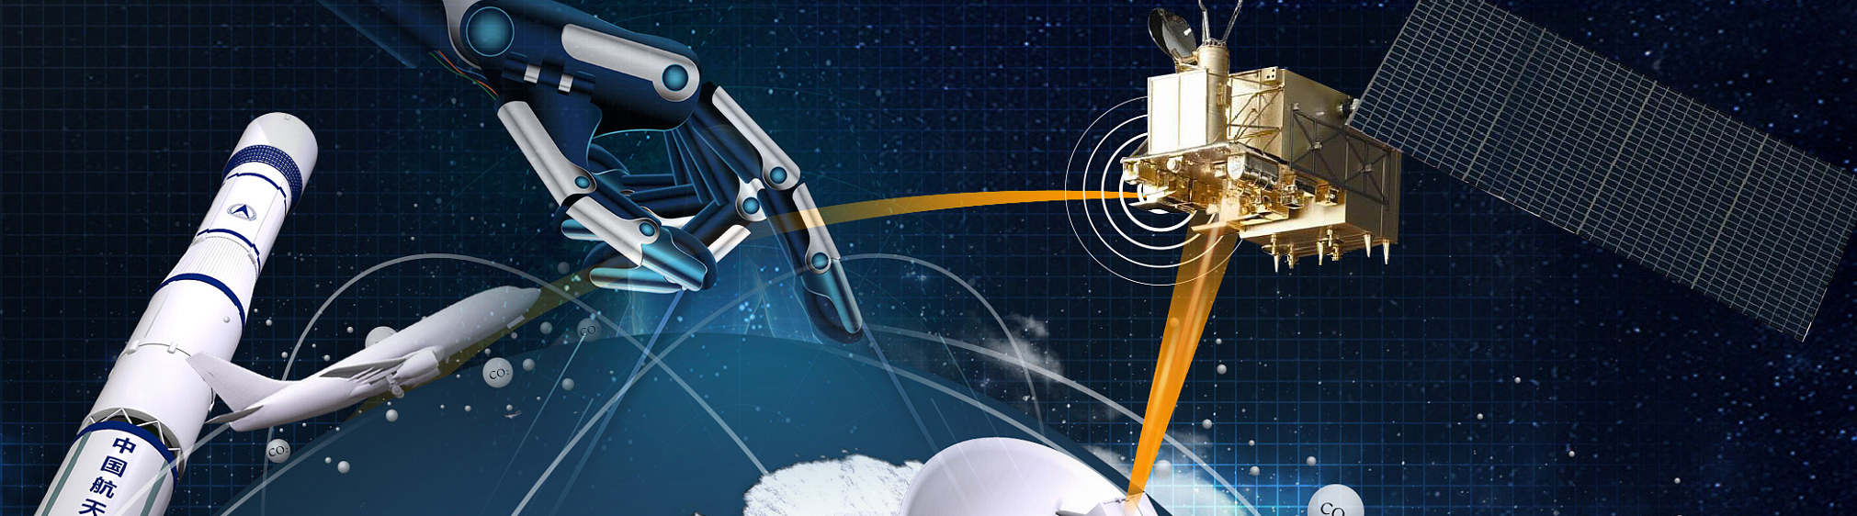
Thanks
Shengli Wu
wusl@cma.gov.cn

