Slide 1
Estimating the risk of large investments using Hurst-Kolmogorov dynamics in interest rates Supplementary material
National Technical University of Athens
School of Civil Engineering
David Markantonis, Panayotis Dimitriadis, G.-Fivos Sargentis, Theano Iliopoulou, Nikos Mamassis, Demetris Koutsoyiannis
April 2023

Slide 2
Supplementary-Introduction
Infrastructures are vital for our survival and our prosperity. Society uses economics and money to organize itself [1,2] and achieve economies of scale with the help of infrastructure [3,4]. Investing in infrastructures presents certain risks. These may originate in the macroeconomic environment, disrupting the organization of society [5,6]. Interest rates are among the most important elements in the calculation of the unit cost of infrastructure. However, engineers commissioned to estimate the cost of infrastructure must depend on very broad assumptions of fixed interest rates. In this presentation we use stochastic modeling to realistically simulate the macroeconomic environment.
The calculation of unit cost is ultimately the most important factor in the decision-making process. The aim is to present a range of possible unit costs to decision makers. Under no circumstances should we aim to provided a single prediction which would likely not be precise given the unpredictability of real life.

Slide 3
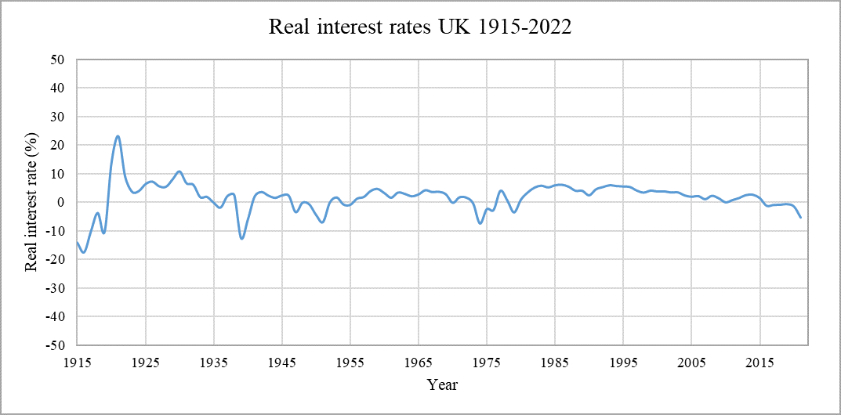
Supplementary-Choosing the data
To properly adjust the methodology, we chose monthly historical interest rates from the United kingdom for the period of 1915-2022 [7].
The timeseries was chosen for its reliability as well as for its excellent representation of the impact of a variety of historical events to the interest rate. During the period in question [8], the following events took place:
World War 1
World War 2
The Spanish Influenza Pandemic
The COVID-19 Pandemic
The Great Depression
The Great Recession
We insist that in such models the data series includes
pre-WW2 data, since the recent period of economic
stability has been historically unprecedented.
Real interest rates are derived from the Fisher equation [9]
in which the inflation rate is subtracted from the nominal
interest rate of government treasury bonds.

Slide 4
Supplementary-SMA method
The SMA scheme [10,11] is appropriate to preserve any type of dependence.
With the use of the SMA method (Symmetric Moving Average) we can reproduce the HK behavior.
Based on the climacogram we chose the GHK (Generalized Hurst-Kolmogorov) process, which is a particular case of the HHK in which:
$$γ\left(k\right)=\frac{λ}{{\left(1+k/q\right)}^{2−2H}}$$
Where $γ\left(k\right)$is variance, k is the time scale, λ is the variance at this timescale k, H is the hurst parameter and q is the characteristic time parameter.
The previous methodology [12] uses the Marcovian framework, in which we produce an Autoregressive Model with Lag 1, therefore AR(1).
The AR(1) model was used in a case study of the water supply system of Western Mani [13-19].

Slide 5
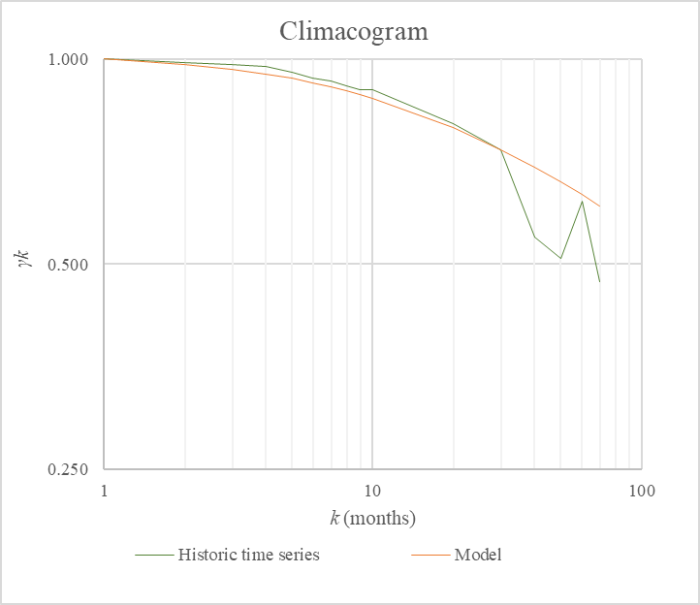
Supplementary-Hurst Kolmogorov behavior
The data clearly present Hurst Kolmogorov behavior.
We note that even longer timeseries would be required to produce better models.
We use the GHK model and estimate the parameters:
H=0.85
q=15.36
The monthly data do not present seasonality, which gives us the opportunity to use their averages in annual timeseries.

Slide 6
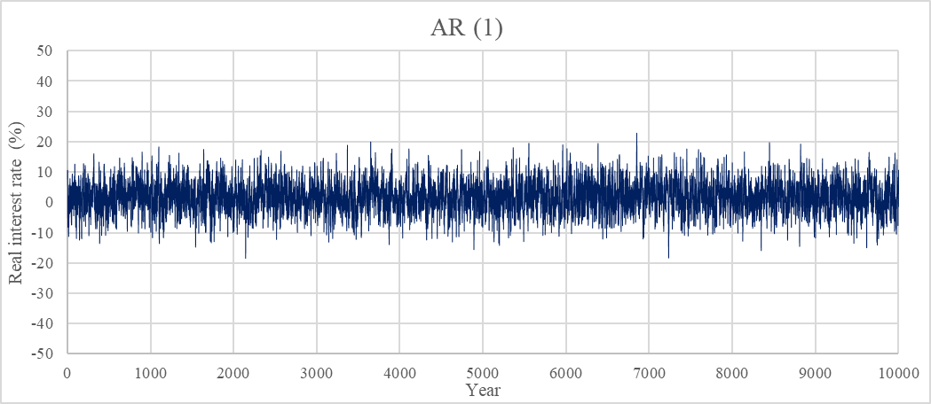
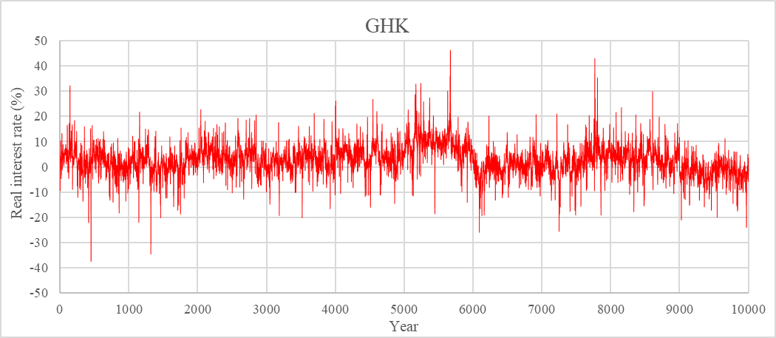
Supplementary-Synthetic timeseries
With the use of the parameters, we produce synthetic timeseries [20].
The AR(1) and GHK models produce different results. In particular, the AR(1) model seems unable to reproduce macroeconomic events such as periods of extraordinary prosperity or the economic aftermath of major wars.
In general, we note the existence of prolonged periods of persistently high or persistently low interest rates, a fact that is not reflected in the AR(1) model but is approximated in the GHK model.

Slide 7
Supplementary-Toy Model
We used a simple toy model to simulate the construction and operation of a large infrastructure project with the lifetime of 50 years.
The cost analysis uses the real interest rate as the discount rate to determine the present value of all income and expenses [21] and thus determine the cost.
We produced 200 simulations with 50-year long timeseries for each model and calculated the unit cost.

Slide 8
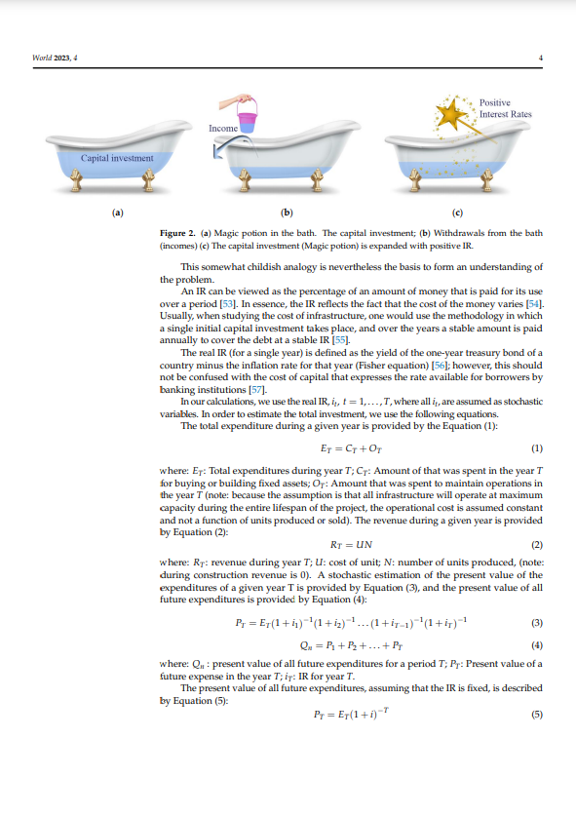
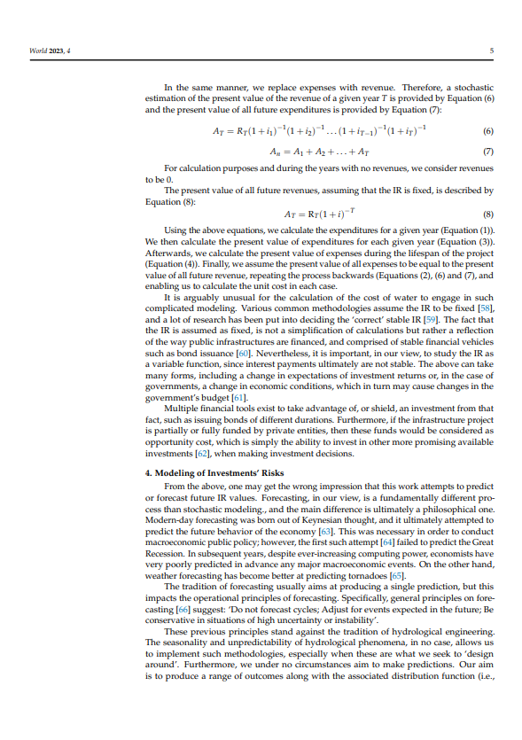
Supplementary-Unit cost calculation
Markantonis, D.; Sargentis, G.-F.; Dimitriadis, P.; Iliopoulou, T.; Siganou, A.; Moraiti, K.; Nikolinakou, M.; Meletopoulos, I.T.; Mamassis, N.; Koutsoyiannis, D.
Stochastic Evaluation of the Investment Risk by the Scale of Water Infrastructures—Case Study:
The Municipality of West Mani (Greece).
World 2023, 4, 1-20. https://doi.org/10.3390/world4010001

Slide 9
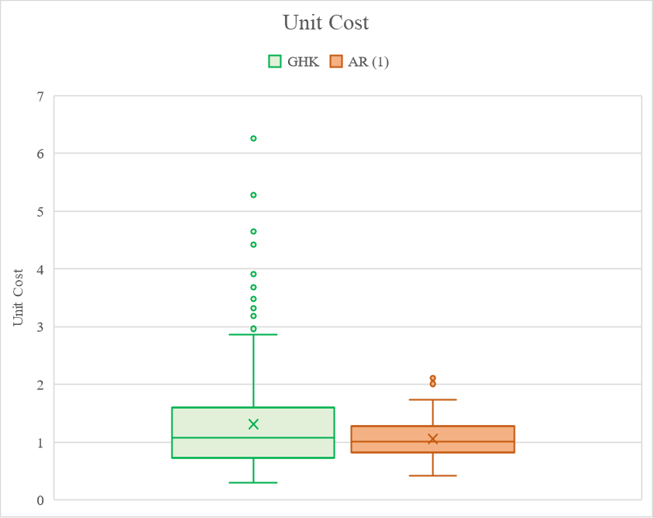
Supplementary-Results
The unit cost presents significant larger variation in the GHK model.
The existence of periods of consistently high interest rates produce instances in which the unit cost is many times higher than the median.
The distribution of the unit costs has a particularly “fat tail” in which unlikely events may take place and radically increase the unit cost.

Slide 10
Supplementary-Discussion and conclusions
The unit cost is extremely sensitive to interest rates.
Furthermore, interest rates present very high Long-Term Persistence (LTP).
Therefore, this characteristic needs to be included in long term economic calculations of infrastructure investments to properly simulate the financial risk.
Commitment towards an infrastructure project is an extremely risky act, in a financial sense. As such, infrastructure investments require both long-term thinking and confidence.
Confidence from decision makers relies in public participation, rationality and competence. Properly designed built and operated infrastructure can survive extraordinary financial events.

Slide 11
References (1/2)
Sargentis, G.-F.; Iliopoulou, T.; Dimitriadis, P.; Mamassis, N.; Koutsoyiannis, D. Stratification: An Entropic View of Society’s Structure. World 2021, 2, 153-174. https://doi.org/10.3390/world2020011
Sargentis, G.-F.; Koutsoyiannis, D. The Function of Money in Water–Energy–Food and Land Nexus. Land 2023, 12, 669. https://doi.org/10.3390/land12030669
Sargentis, G.-F.; Defteraios, P.; Lagaros, N.D.; Mamassis, N. Values and Costs in History: A Case Study on Estimating the Cost of Hadrianic Aqueduct’s Construction. World 2022, 3, 260-286. https://doi.org/10.3390/world3020014
G.-F. Sargentis, P. Siamparina, G.-K. Sakki, A. Efstratiadis, M. Chiotinis, and D. Koutsoyiannis, Agricultural land or photovoltaic parks? The water–energy–food nexus and land development perspectives in the Thessaly plain, Greece, Sustainability, 13 (16), 8935, doi:10.3390/su13168935, 2021.
Sargentis, G.-F.; Iliopoulou, T.; Sigourou, S.; Dimitriadis, P.; Koutsoyiannis, D. Evolution of Clustering Quantified by a Stochastic Method—Case Studies on Natural and Human Social Structures. Sustainability 2020, 12, 7972. https://doi.org/10.3390/su12197972
G.-F. Sargentis, D. Koutsoyiannis, A. N. Angelakis, J. Christy, and A.A. Tsonis, Environmental determinism vs. social dynamics: Prehistorical and historical examples, World, 3 (2), 357–388, doi:10.3390/world3020020, 2022.
A millennium of macroeconomic data, Bank of England, Available online: https://www.bankofengland.co.uk/-/media/boe/files/statistics/research-datasets/a-millennium-of-macroeconomic-data-for-the-uk.xlsx (accessed on 18 of April 2023)
Story of England, English heritage, Available online: https://www.english-heritage.org.uk/learn/story-of-england/ (accessed on 24 of April 2023)
Fisher Equation, Corporate Finance Institute. Available online: https://corporatefinanceinstitute.com/resources/knowledge/economics/fisher-equation/ (accessed on 22 September 2022)
Koutsoyiannis, D.; Dimitriadis, P. Towards Generic Simulation for Demanding Stochastic Processes. Sci 2021, 3, 34. https://doi.org/10.3390/sci3030034
Koutsoyiannis, D. The Hurst phenomenon and fractional Gaussian noise made easy, Hydrological Sciences Journal, (2002) 47:4, 573-595, https://doi.org/10.1080/02626660209492961
Markantonis, D.; Sargentis, G.-F.; Dimitriadis, P.; Iliopoulou, T.; Siganou, A.; Moraiti, K.; Nikolinakou, M.; Meletopoulos, I.T.; Mamassis, N.; Koutsoyiannis, D. Stochastic Evaluation of the Investment Risk by the Scale of Water Infrastructures—Case Study: The Municipality of West Mani (Greece). World 2023, 4, 1-20. https://doi.org/10.3390/world4010001
Iliopoulou, T.; Dimitriadis, P.; Siganou, A.; Markantonis, D.; Moraiti, K.; Nikolinakou, M.; Meletopoulos, I.T.; Mamassis, N.; Koutsoyiannis, D.; Sargentis, G.-F. Modern Use of Traditional Rainwater Harvesting Practices: An Assessment of Cisterns’ Water Supply Potential in West Mani, Greece. Heritage 2022, 5, 2944-2954. https://doi.org/10.3390/heritage5040152
Siganou, A., Nikolinakou, M., Markantonis, D., Moraiti, K., Sargentis, G.-F., Iliopoulou, T., Dimitriadis, P., Chiotinis, M., Mamassis, N., and Koutsoyiannis, D.: Stochastic simulation of hydrological timeseries for data scarce regions - Case study at the Municipality of Western Mani , EGU General Assembly 2022, Vienna, Austria, 23–27 May 2022, EGU22-3086, https://doi.org/10.5194/egusphere-egu22-3086, 2022.

Slide 12
References (2/2)
Nikolinakou, M., Moraiti, K., Siganou, A., Markantonis, D., Sargentis, G.-F., Iliopoulou, T., Dimitriadis, P., Meletopoulos, I. T., Mamassis, N., and Koutsoyiannis, D.: Investigating the water supply potential of traditional rainwater harvesting techniques used – A case study for the Municipality of Western Mani, EGU General Assembly 2022, Vienna, Austria, 23–27 May 2022, EGU22-3063, https://doi.org/10.5194/egusphere-egu22-3063, 2022.
Moraiti, K., Markantonis, D., Nikolinakou, M., Siganou, A., Sargentis, G.-F., Iliopoulou, T., Dimitriadis, P., Meletopoulos, I. T., Mamassis, N., and Koutsoyiannis, D.: Optimizing water infrastructure solutions for small-scale distributed settlements – Case study at the Municipality of Western Mani., EGU General Assembly 2022, Vienna, Austria, 23–27 May 2022, EGU22-3055, https://doi.org/10.5194/egusphere-egu22-3055, 2022.
Markantonis, D., Siganou, A., Moraiti, K., Nikolinakou, M., Sargentis, G.-F., Dimitriadis, P., Chiotinis, M., Iliopoulou, T., Mamassis, N., and Koutsoyiannis, D.: Determining optimal scale of water infrastructure considering economical aspects with stochastic evaluation – Case study at the Municipality of Western Mani, EGU General Assembly 2022, Vienna, Austria, 23–27 May 2022, EGU22-3039, https://doi.org/10.5194/egusphere-egu22-3039, 2022.
Markantonis, D.; Moraiti, K.; Nikolinakou, M.; Siganou, A. Water Supply for the Municipality of Western Mani; Department of Water Resources and Environmental Engineering—National Technical University of Athens: Athens, Greece, 2022; Available online: https://www.itia.ntua.gr/en/docinfo/2244/ (accessed on 24 February 2022)
G.-F. Sargentis, I. Meletopoulos, T. Iliopoulou, P. Dimitriadis, E. Chardavellas, D. Dimitrakopoulou, A.,Siganou, D. Markantonis, K. Moraiti, K. Kouros, M.,Nikolinakou, and D. Koutsoyiannis, Modelling water needs; from past to present. Case study: The Municipality of Western Mani, IAHS 100th Anniversary –11th IAHS-AISH Scientific Assembly 2022, Montpellier, France, IAHS2022-400, International Association of Hydrological Sciences, 2022.
Dimitriadis, P.; Koutsoyiannis, D. Stochastic synthesis approximating any process dependence and distribution. Stoch Environ Res Risk Assess 32, 1493–1515 2018. https://doi.org/10.1007/s00477-018-1540-2
Blank, L.T.; Tarquin, A.J. Engineering Economy; McGraw-Hill: New York, NY, USA, 2012; Available online: https://www.hzu.edu.in/engineering/engineering%20economy.pdf (accessed on 25 July 2022)

