Slide 1
Simulating the Effects of Ice-Nucleating Particles in Antarctica in COSMO-CLM²
Florian Sauerland,
Niels Souverijns, Anna Possner, Heike Wex, Preben Van Overmeiren, Alexander Mangold, Kwinten Van Weverberg, and Nicole van Lipzig

Slide 2
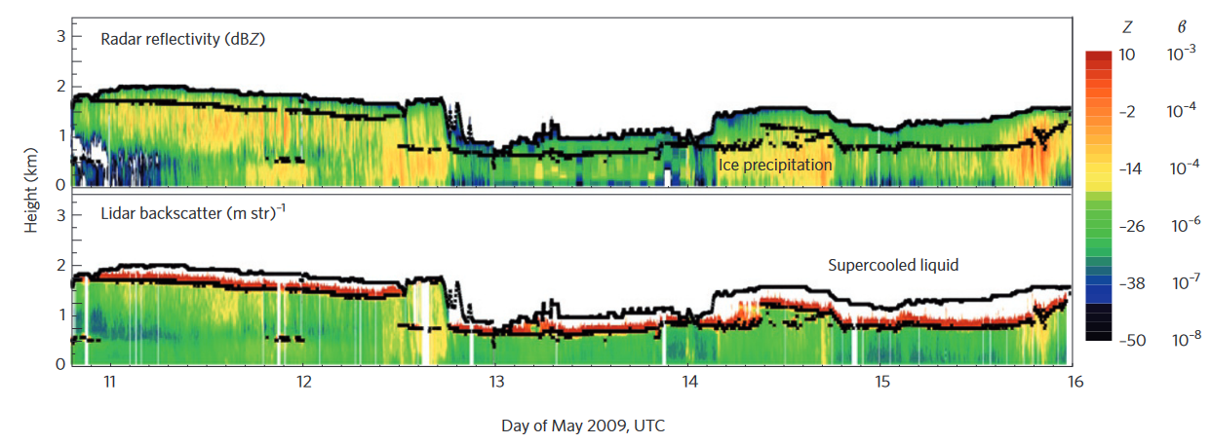
Motivation
Visualization by Morrison et al., 2012

Slide 3
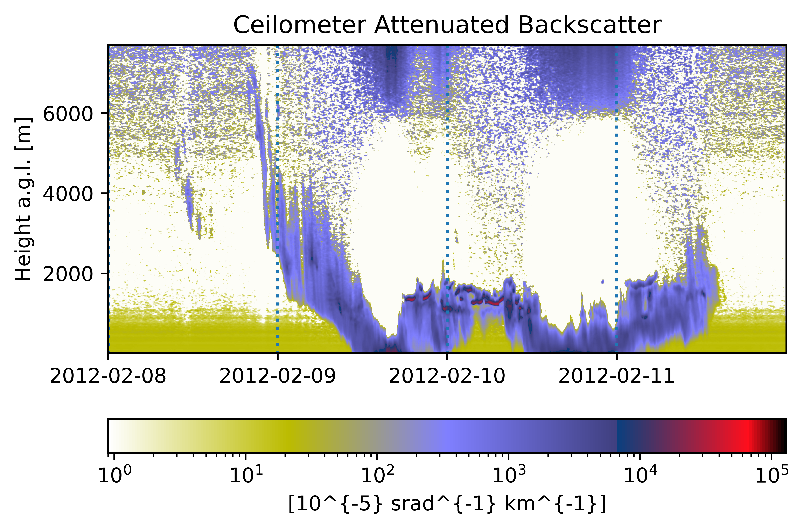
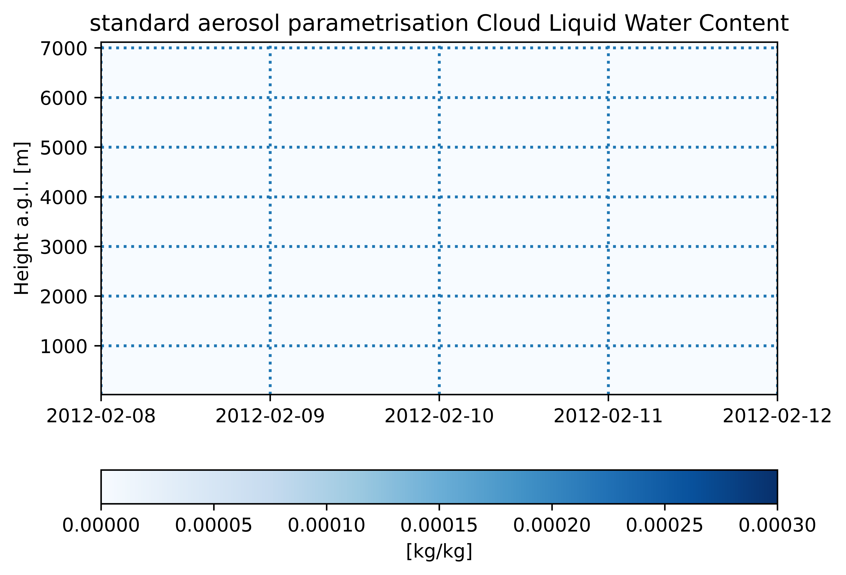
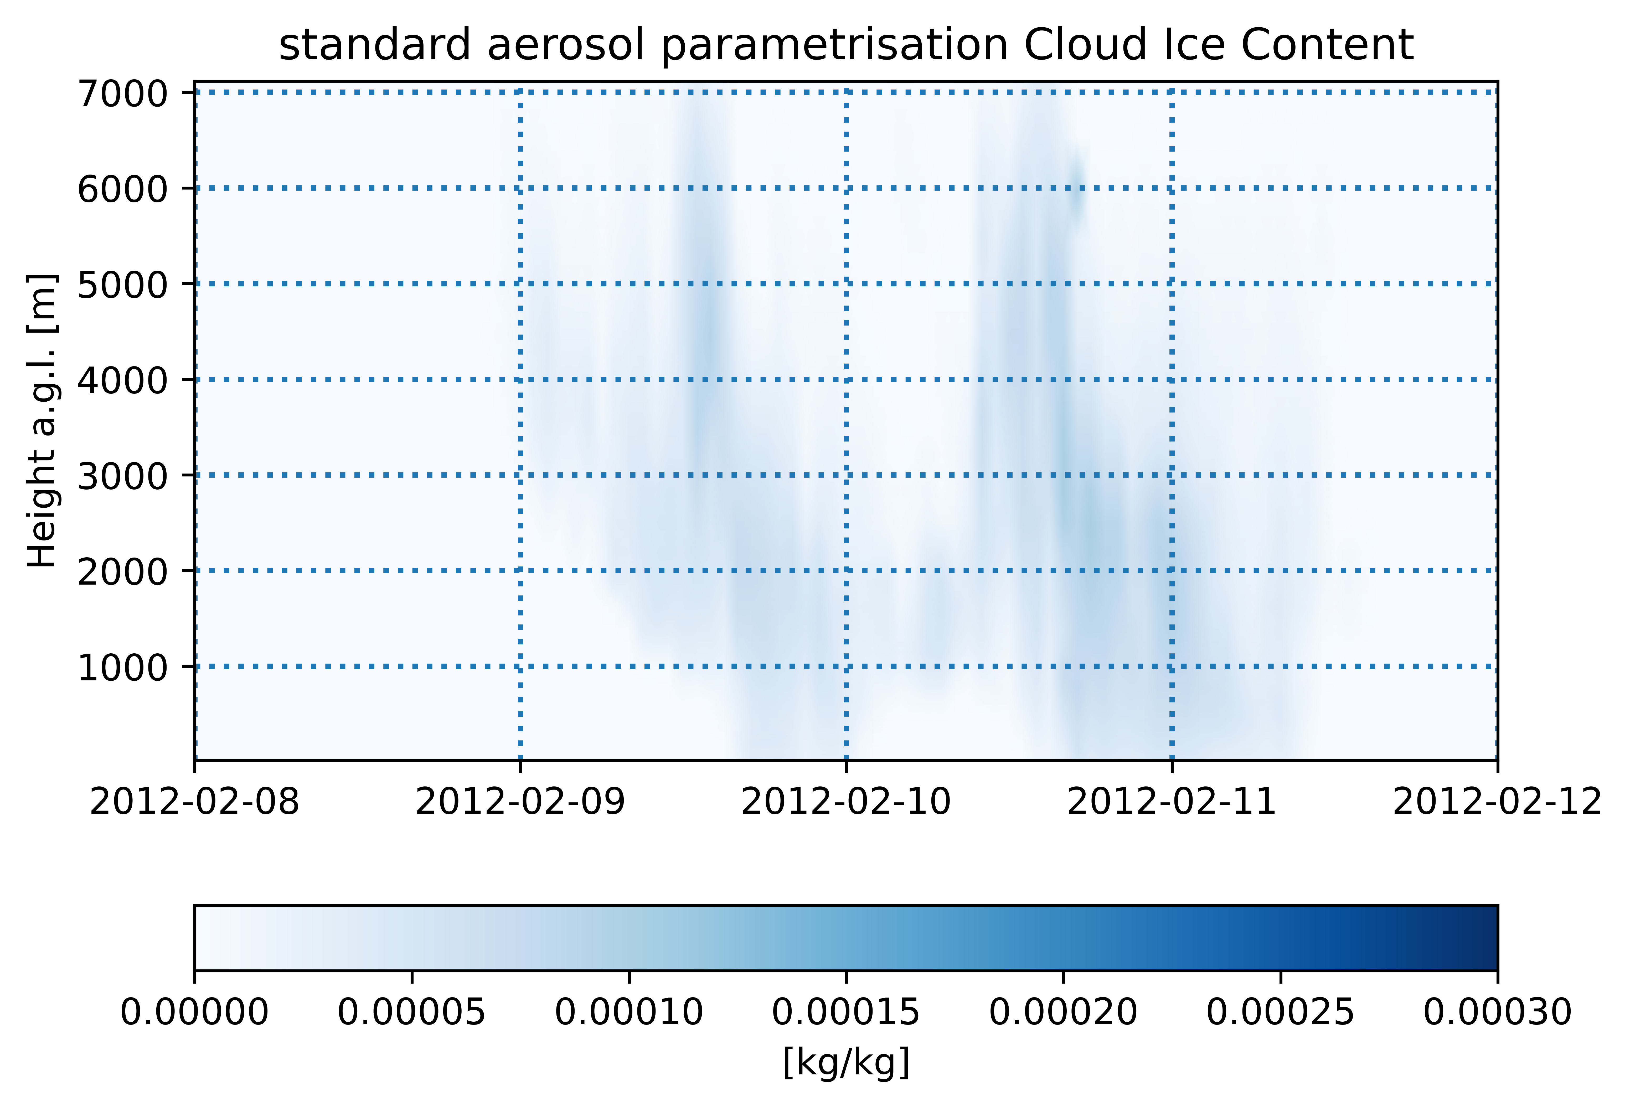
Motivation

Slide 4
Model Configuration
0.025° x 0.025° (3 km) resolution
centered at PEA
forced by ERA-5 (3 hr)
2 cases:
6 weeks, summer 2011/12
3 weeks, winter 2015
5 levels of INP concentrations
Aerosol scheme by Possner et al. (2017)
plus control run with standard aerosol parametrisation

Slide 5
INP concentrations
„very low“: 1·10⁻⁵ per liter – low end of observed concentrations in Antarctica
„low“: 5·10⁻³ per liter – high end of observed concentrations in Antarcitca
„medium“: 5·10⁻² per liter – maritime values, and augmentation for missing secondary ice processes
„high“: 2·10⁻¹ per liter – continental concentrations
„very high“: 2 per liter – high continental concentrations
All at -20°C

Slide 6
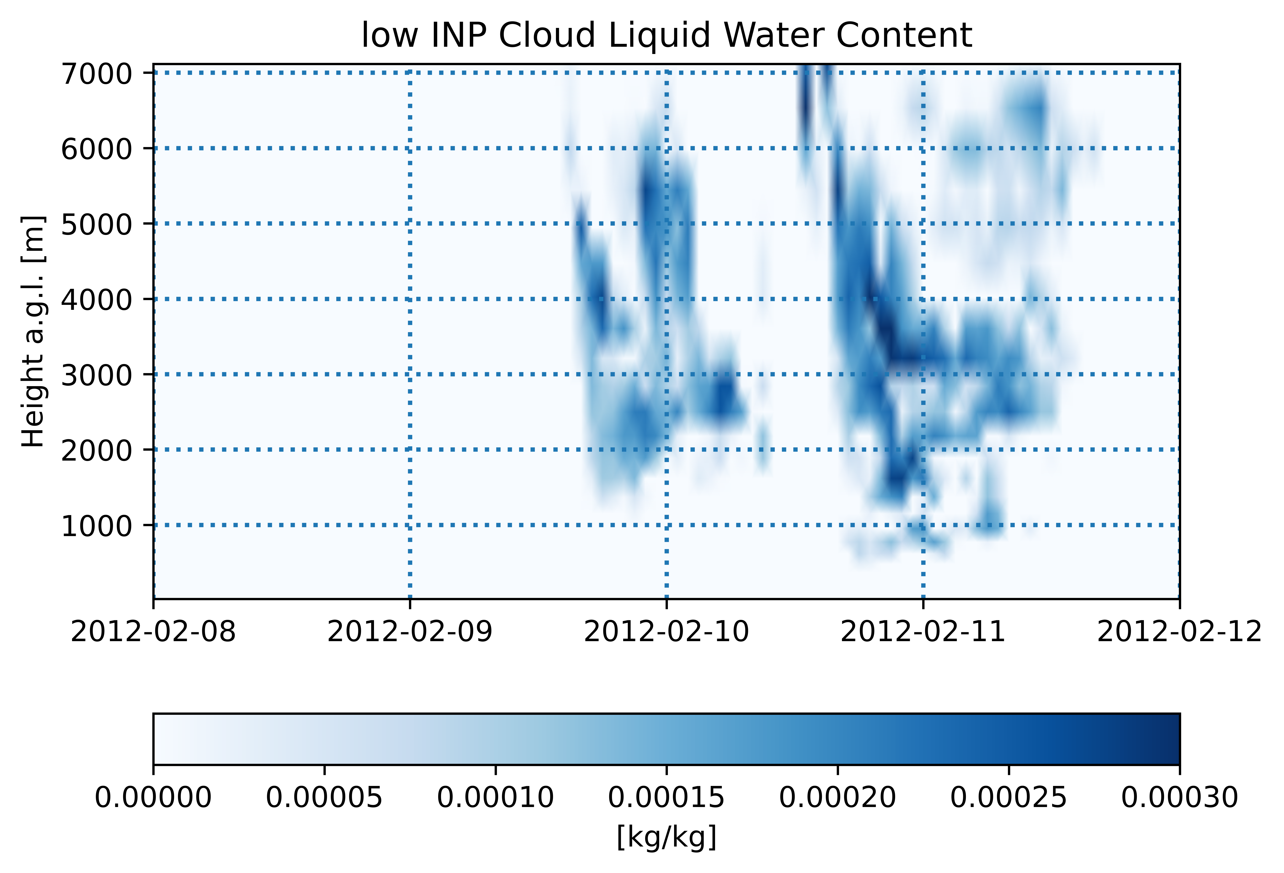
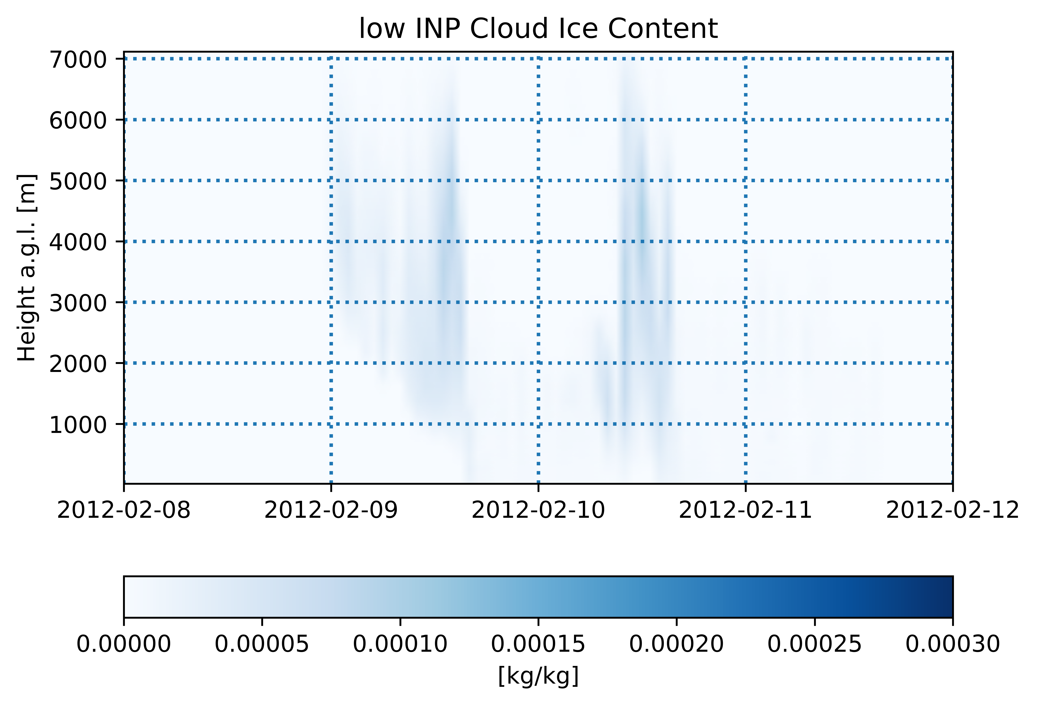
Results: Cloud Structure

Slide 7
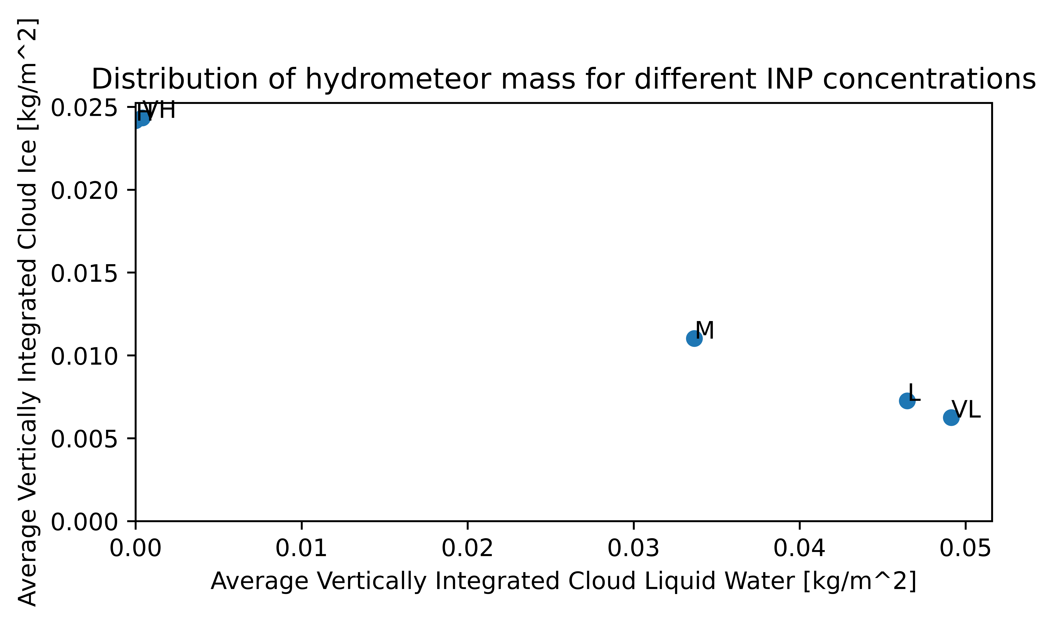

Slide 8
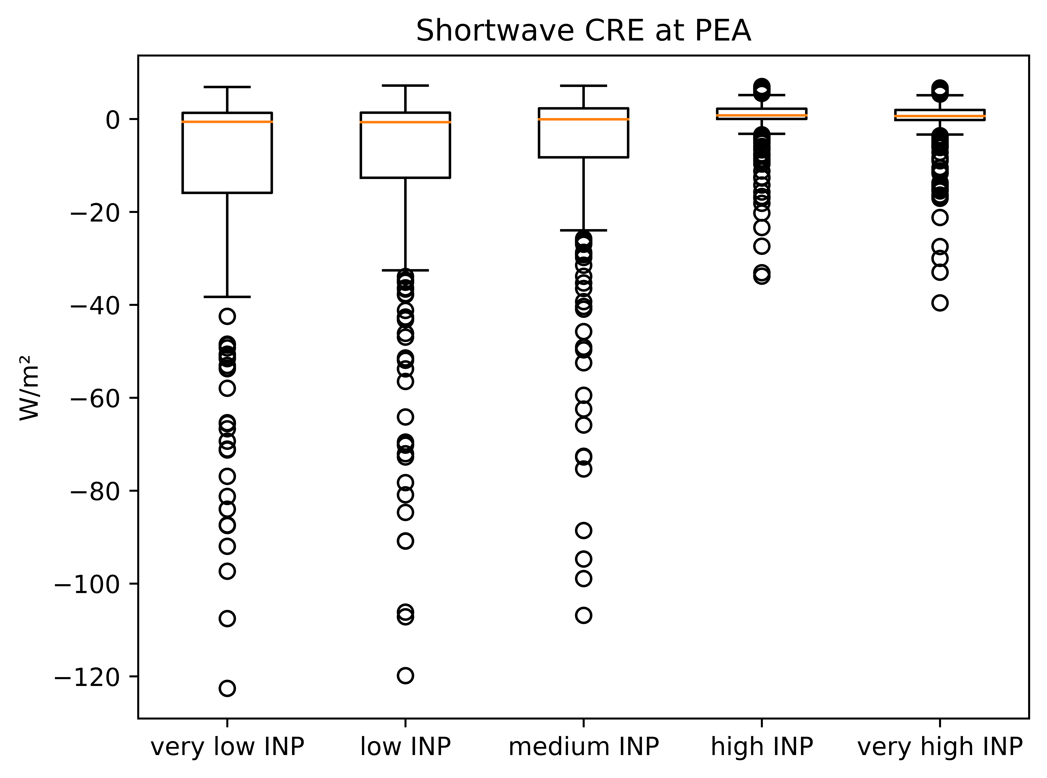
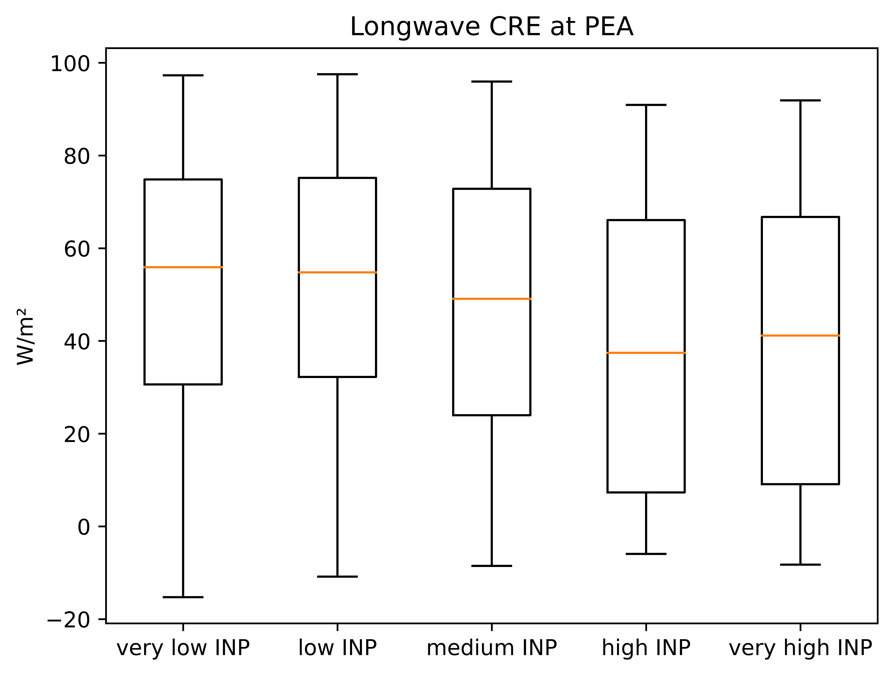
Results: Radiative Effects (Summer)

Slide 9
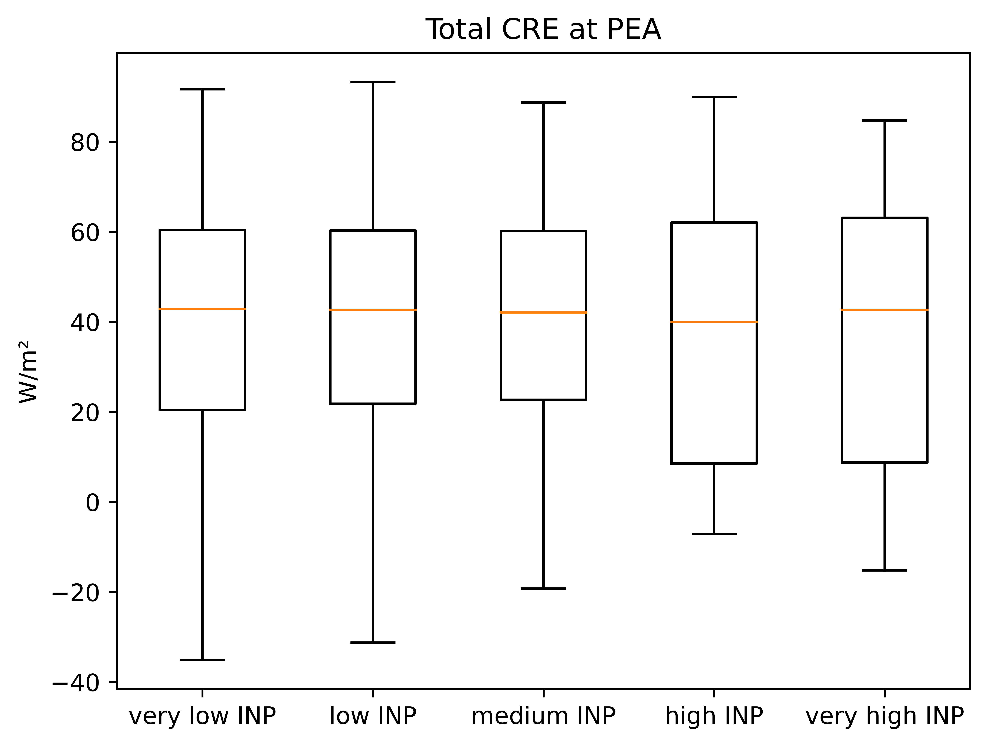
Results: Radiative Effects (Summer)

Slide 10
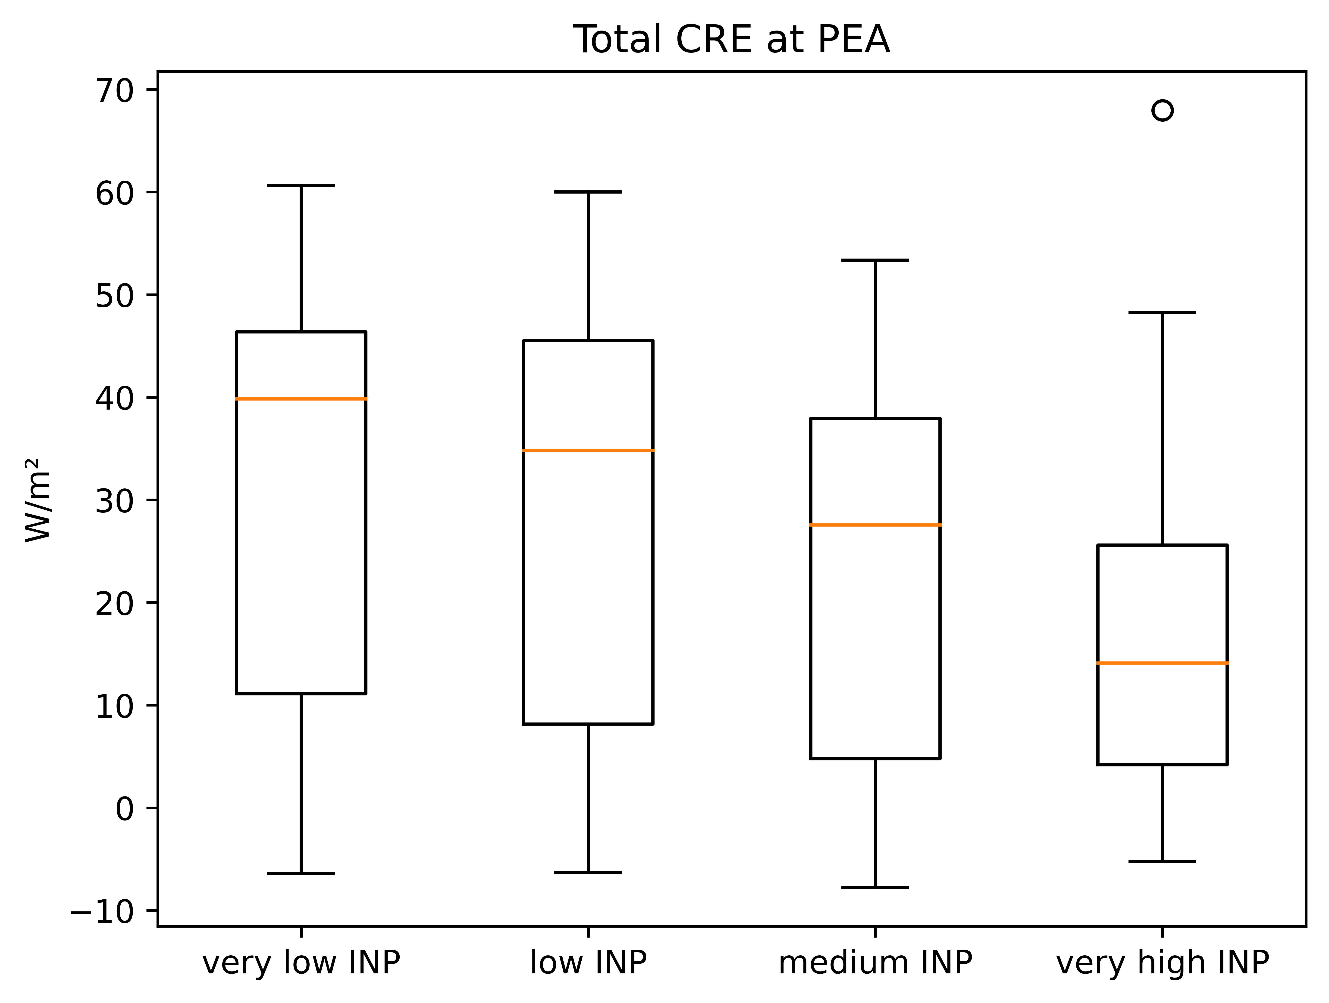
Results: Radiative Effects (Winter)

Slide 11
Conclusion
Improved representation of cloud water in COSMO-CLM²
but: two-moment scheme is very expensive → not suitable for climate simulations
but: within INP values realistic for Antarctica, little variation
Impact on radiative effects is significant
radiative balance balances out for different settings in summer, despite differences in optical thickness
in winter, a higher INP concentration leads to a decrease in radiative forcing

Slide 12
Thanks! florian.sauerland@kuleuven.be

