Slide 1
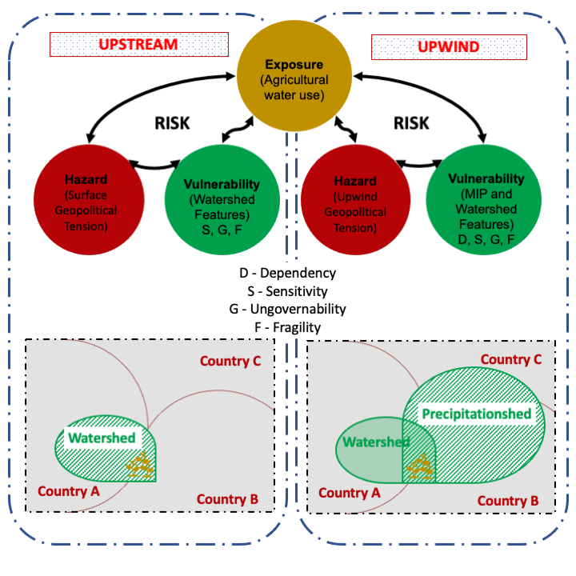
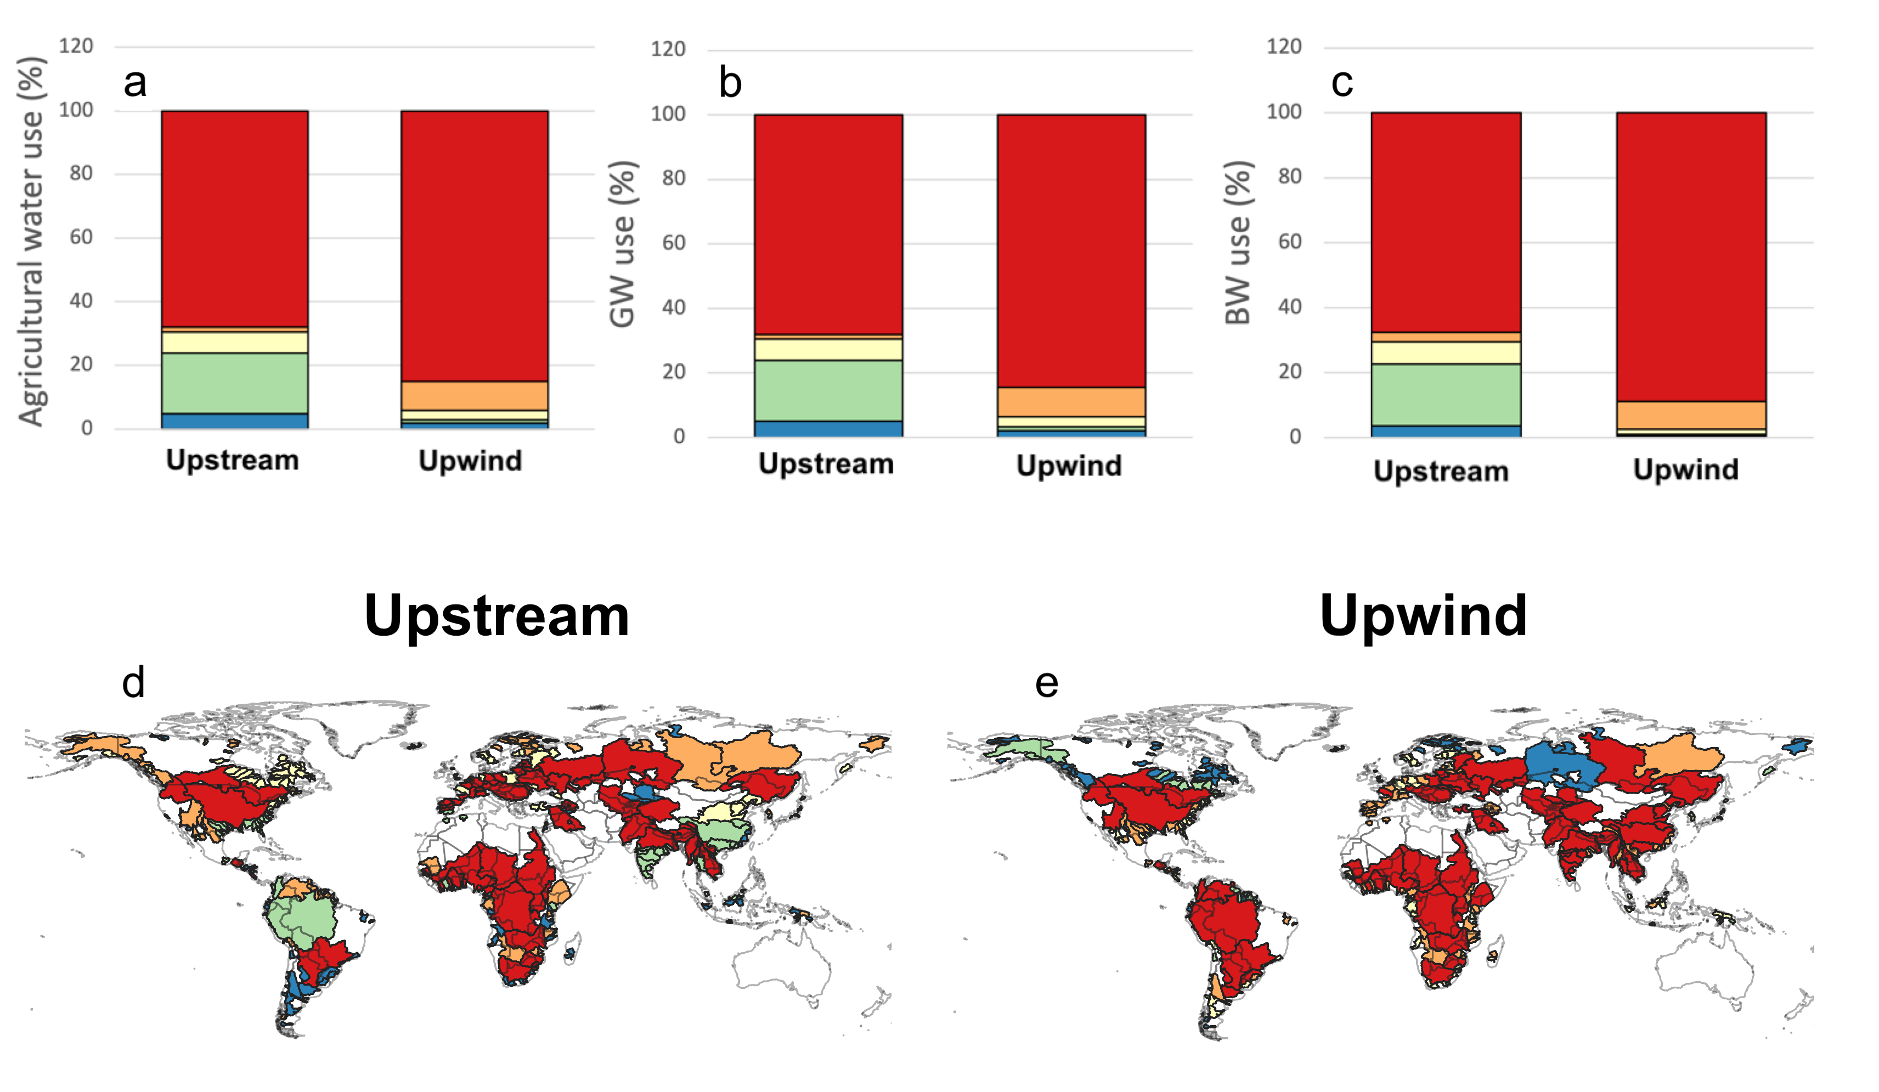
Geopolitical risk induced by terrestrial moisture supply to agricultural hotspots
Jose Andrés Posada-Marín, Juan Fernando Salazar, Lan Wang-Erlandsson, Maria Cristina Rulli³, and Fernando Jaramillo
RISK FRAMEWORKS
RESULTS
67%
84%
68%
84%
66%
89%
Agricultural water use (%)
Green water use (%)
Blue water use (%)
Comparing risk to water security for both perspectives, results in a considerably underestimated risk from the upstream perspective.

Slide 2
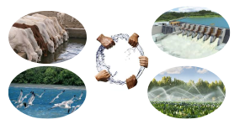
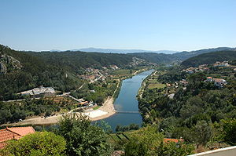
CONTEXT
Water security refers to the ability of a society to ensure access access.
Water scarcity and control may lead to geopolitical pressures and conflicts.
Commonly, transboundary water security is mainly approached from an upstream perspective underlooking terrestrial moisture recycling dependency.
We estimate the risk of transboundary water security from the perspective of upwind moisture flows and compare it to an upstream perspective.

Slide 3
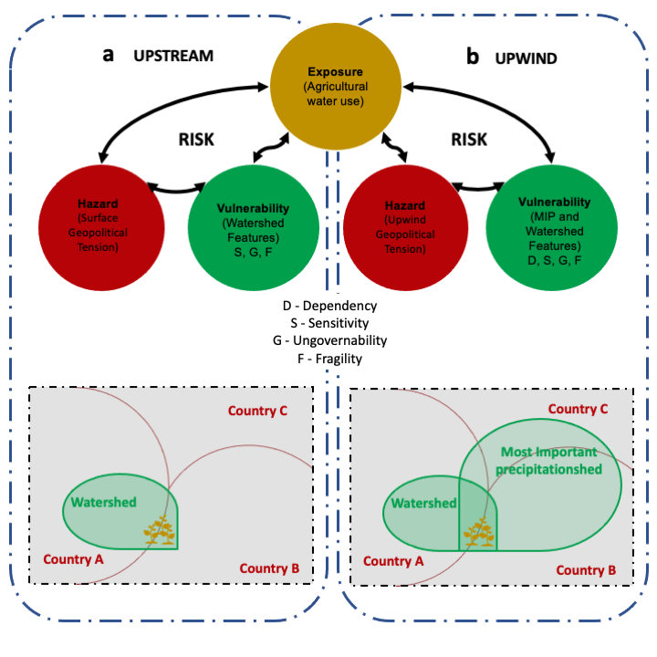
METHODOLOGY
Figure. Risk assessment framework from (a) upstream and (b) upwind perspectives.

Slide 4
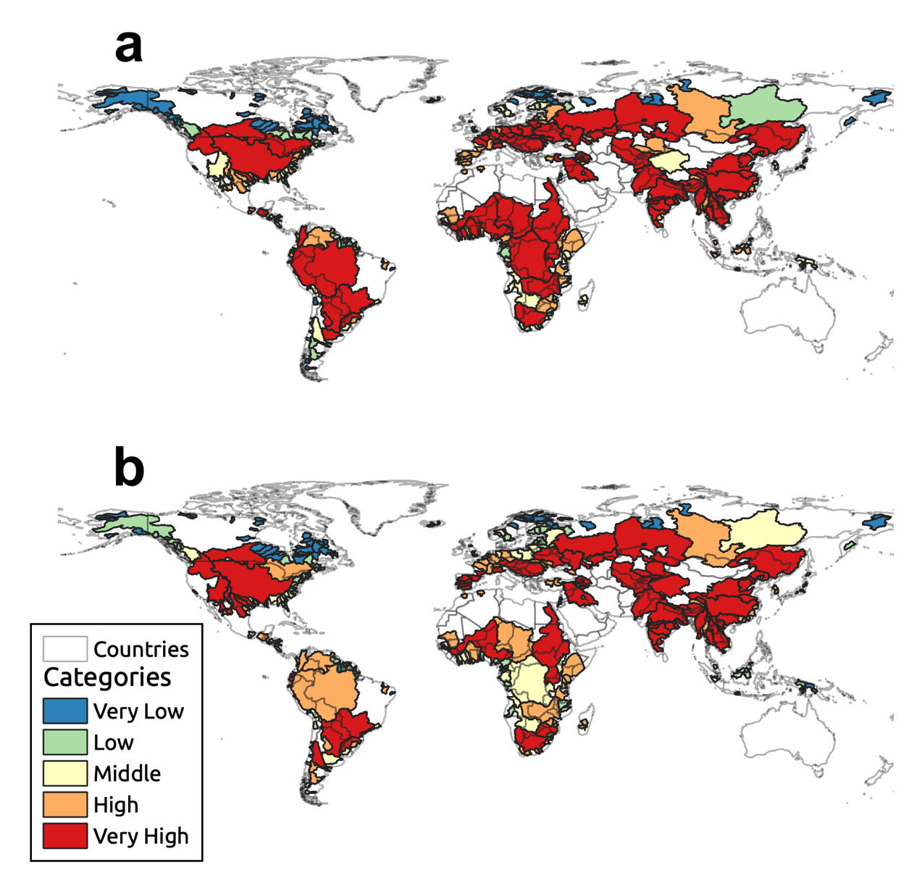
RESULTS - EXPOSURE
Agriculture
Green water
Blue water
Higher requirements imply a larger agriculture exposure to changes in upwind-upstream moisture supply.

Slide 5
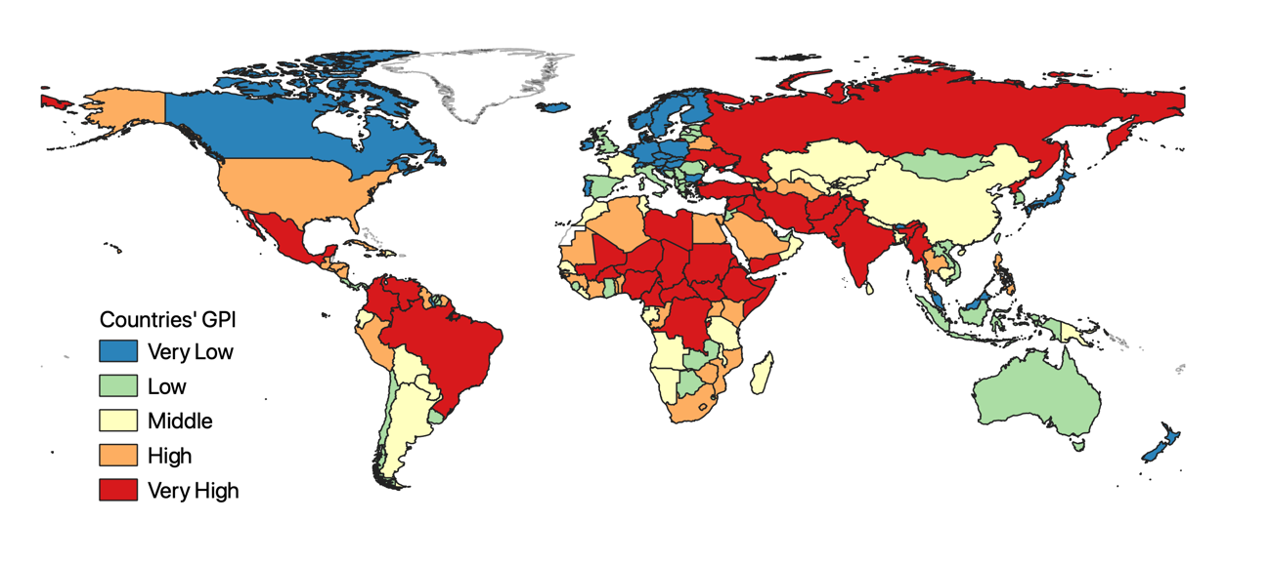
RESULTS - HAZARD
Countries’ GPI
A high GPI implies that the countries sharing a hydrological basin may encounter more conflict when solving a water supply problem than countries with lower GPIs.

Slide 6
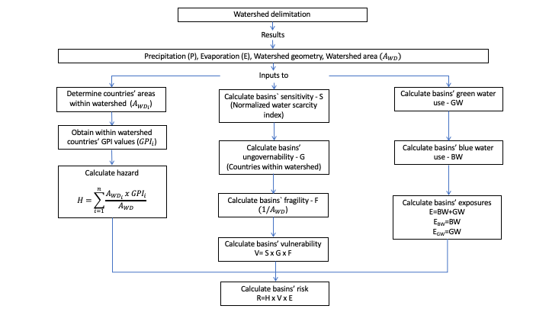
METHODOLOGY (UPSTREAM)
Figure. Employed procedure in risk assessment from upstream perspective.

Slide 7
RESULTS – VULNERABILITY (UPSTREAM)
Ungovernability
Sensitivity
Fragility

Slide 8
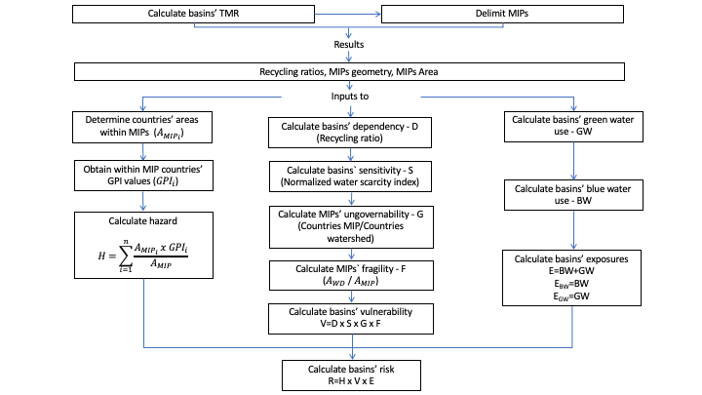
METHODOLOGY (UPWIND)
Figure. Employed procedure in risk assessment from uowind perspective.

Slide 9
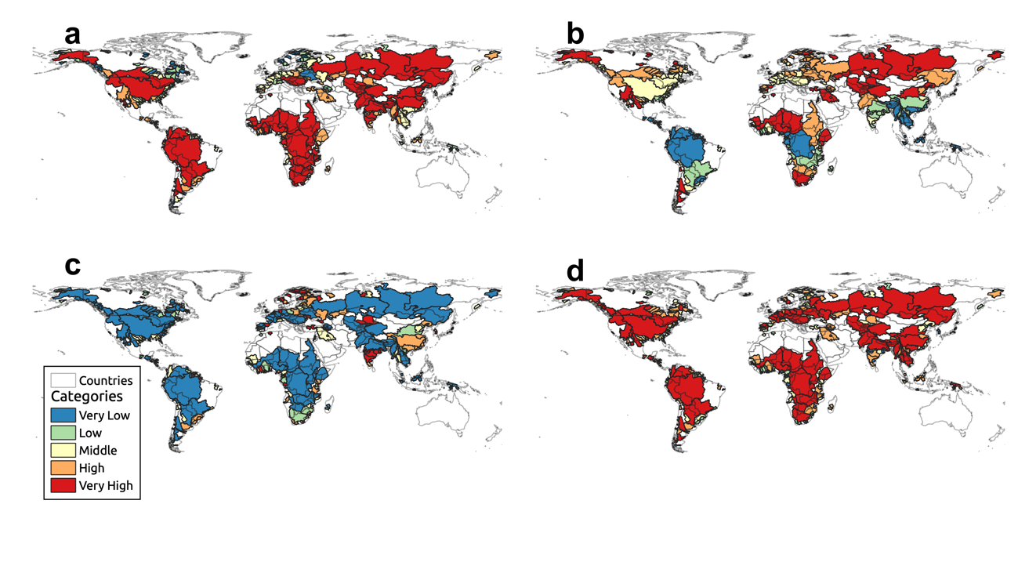
RESULTS – VULNERABILITY (UPWIND)
Dependency
Sensitivity
Ungovernability
Fragility

Slide 10
RESULTS – VULNERABILITY
Vulnerability to water supply changes increases from the upstream to the upwind perspective

Slide 11
RESULTS - RISK
In the upstream perspective, about 76% of agricultural exposure in the hydrological basins is under middle to very high risk, with the number increasing to 97% in the upwind perspective

Slide 12
RESULTS - RISK
Comparing risk to water security from the multiplication of exposure, hazard and vulnerability for both perspectives, results in a considerably underestimated risk from the upstream perspective.

Slide 13
CONCLUSIONS
Upwind geopolitical pressures can indeed increase the risks to water security.
The vulnerability (TMR dependency) appears to be the most influential component increasing risk when shifting from an upstream to an upwind perspective.
Conservation efforts should be focused on these areas where continental moisture originates.
Water security assessments should consider the water supply dependency on upwind moisture recycling.
Understanding countries codependence could improve the hydro-cooperation between nations.
Our results highlight the need to establish an earth system governance.

