Slide 1
Lithospheric modeling in Iran from gravity and magnetic data including seismic tomographic data: first results.
Gerardo Maurizio¹, Carla Braitenberg¹, Daniele Sampietro², and Martina Capponi²
1. Trieste University Trieste University, Dept. of Mathematics and Geosciences, Italy
2. Geomatics Research & Development srl, Lomazzo, Italy
to PICO presentation

Slide 2
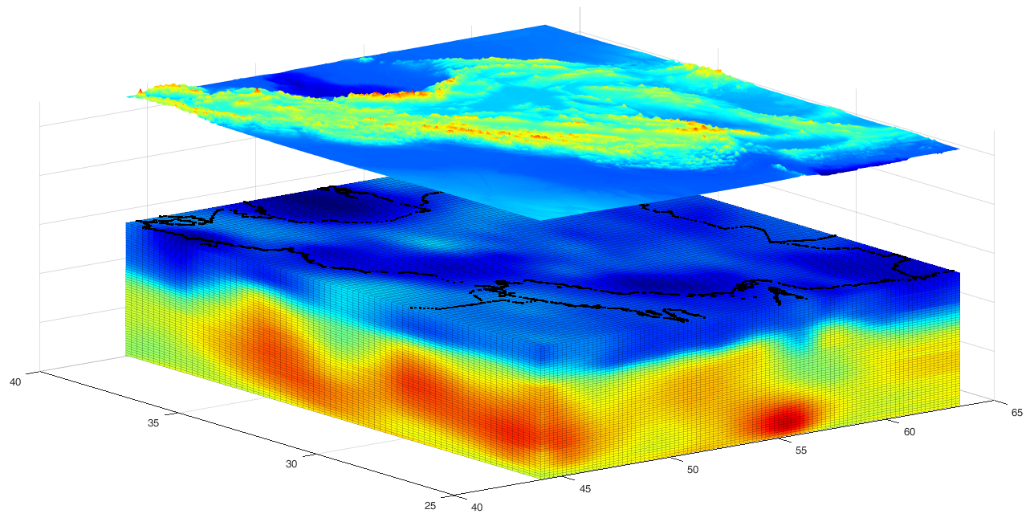
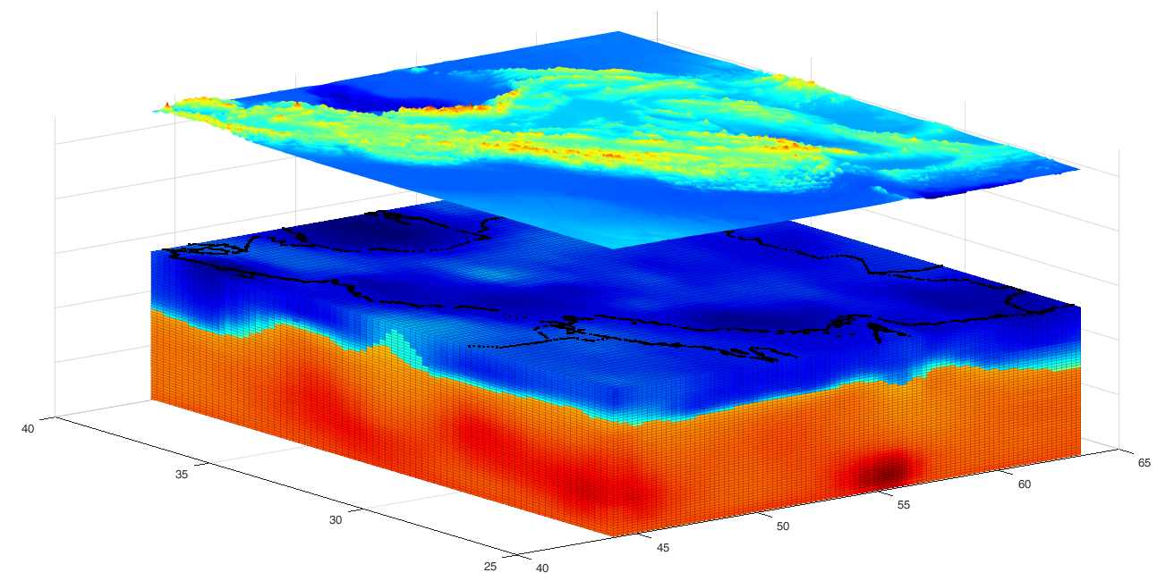
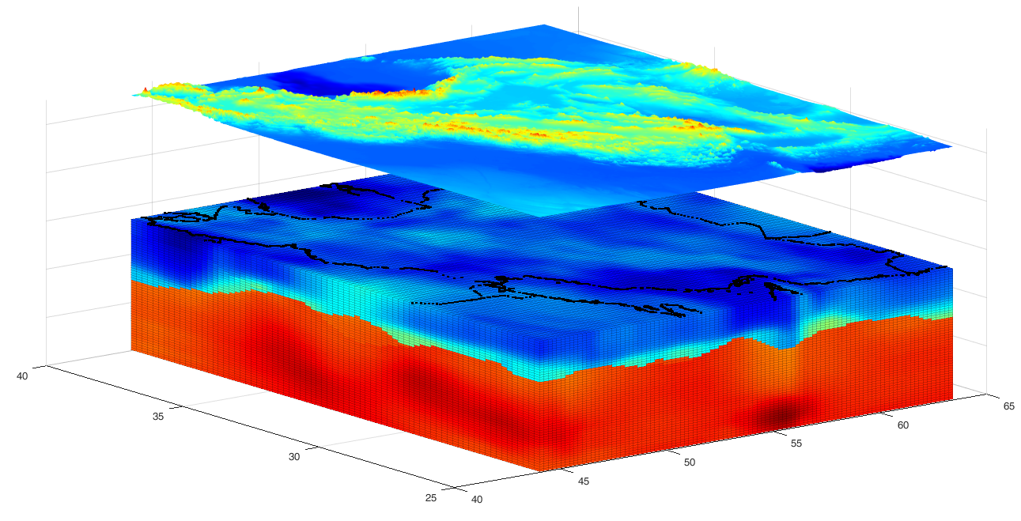
Seismic tomography starting model
(top of the cube at 20 km depth)
Vs min: 2.06 km/s
Vs max: 4.98 km/s
3D joint gravity-magnetic bayesian inversion
Recalculated Brocher relation + Perple_X mantle modeling
Final density model
rho min: 2324.3 kg/m³
rho max: 3413.5 kg/m³

Slide 3
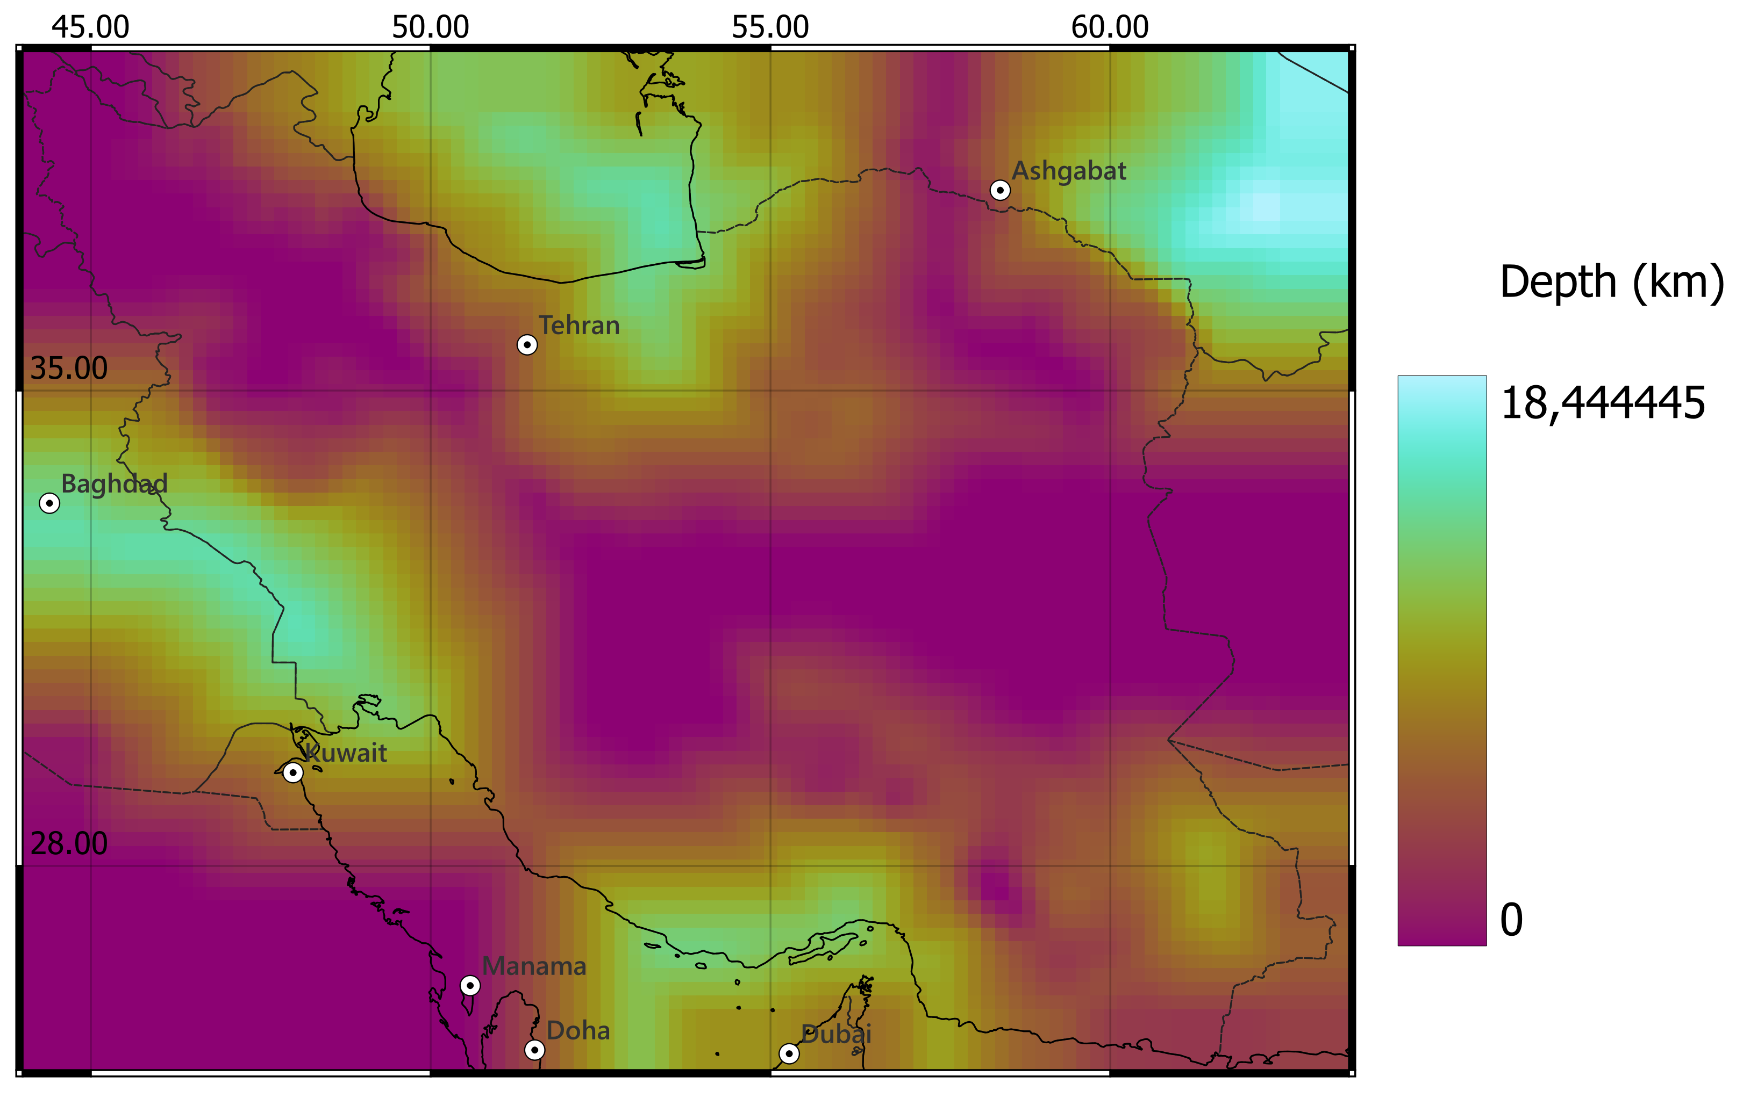
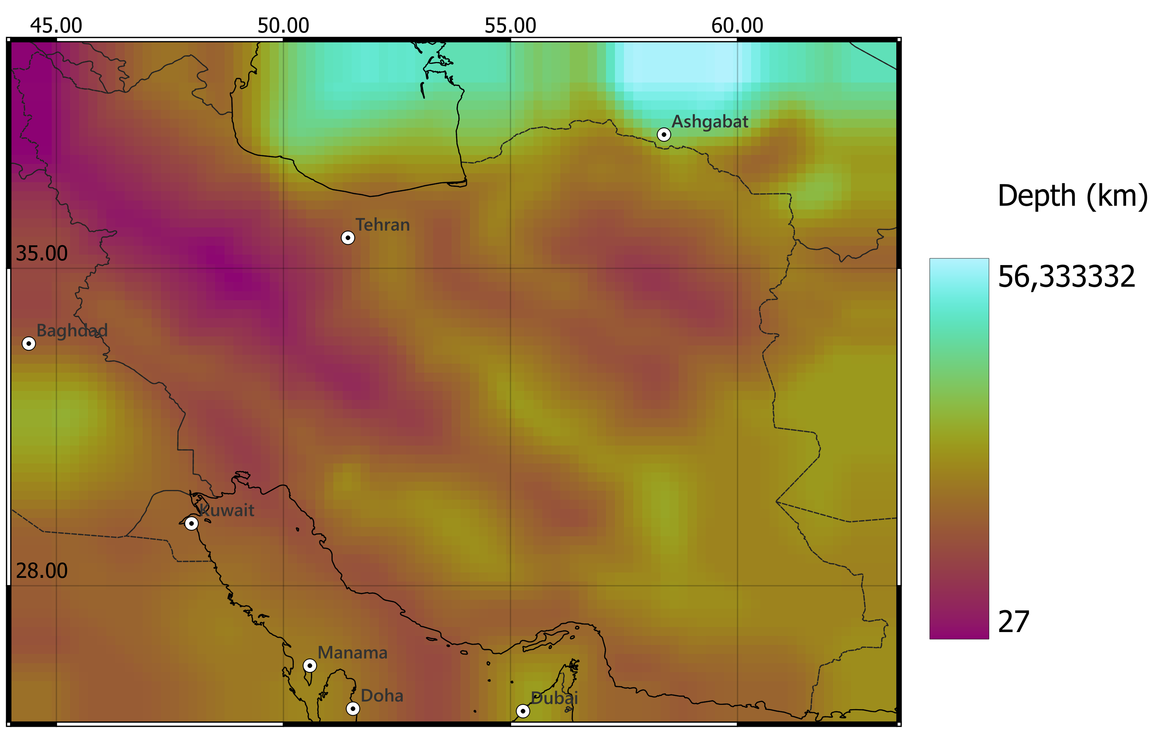
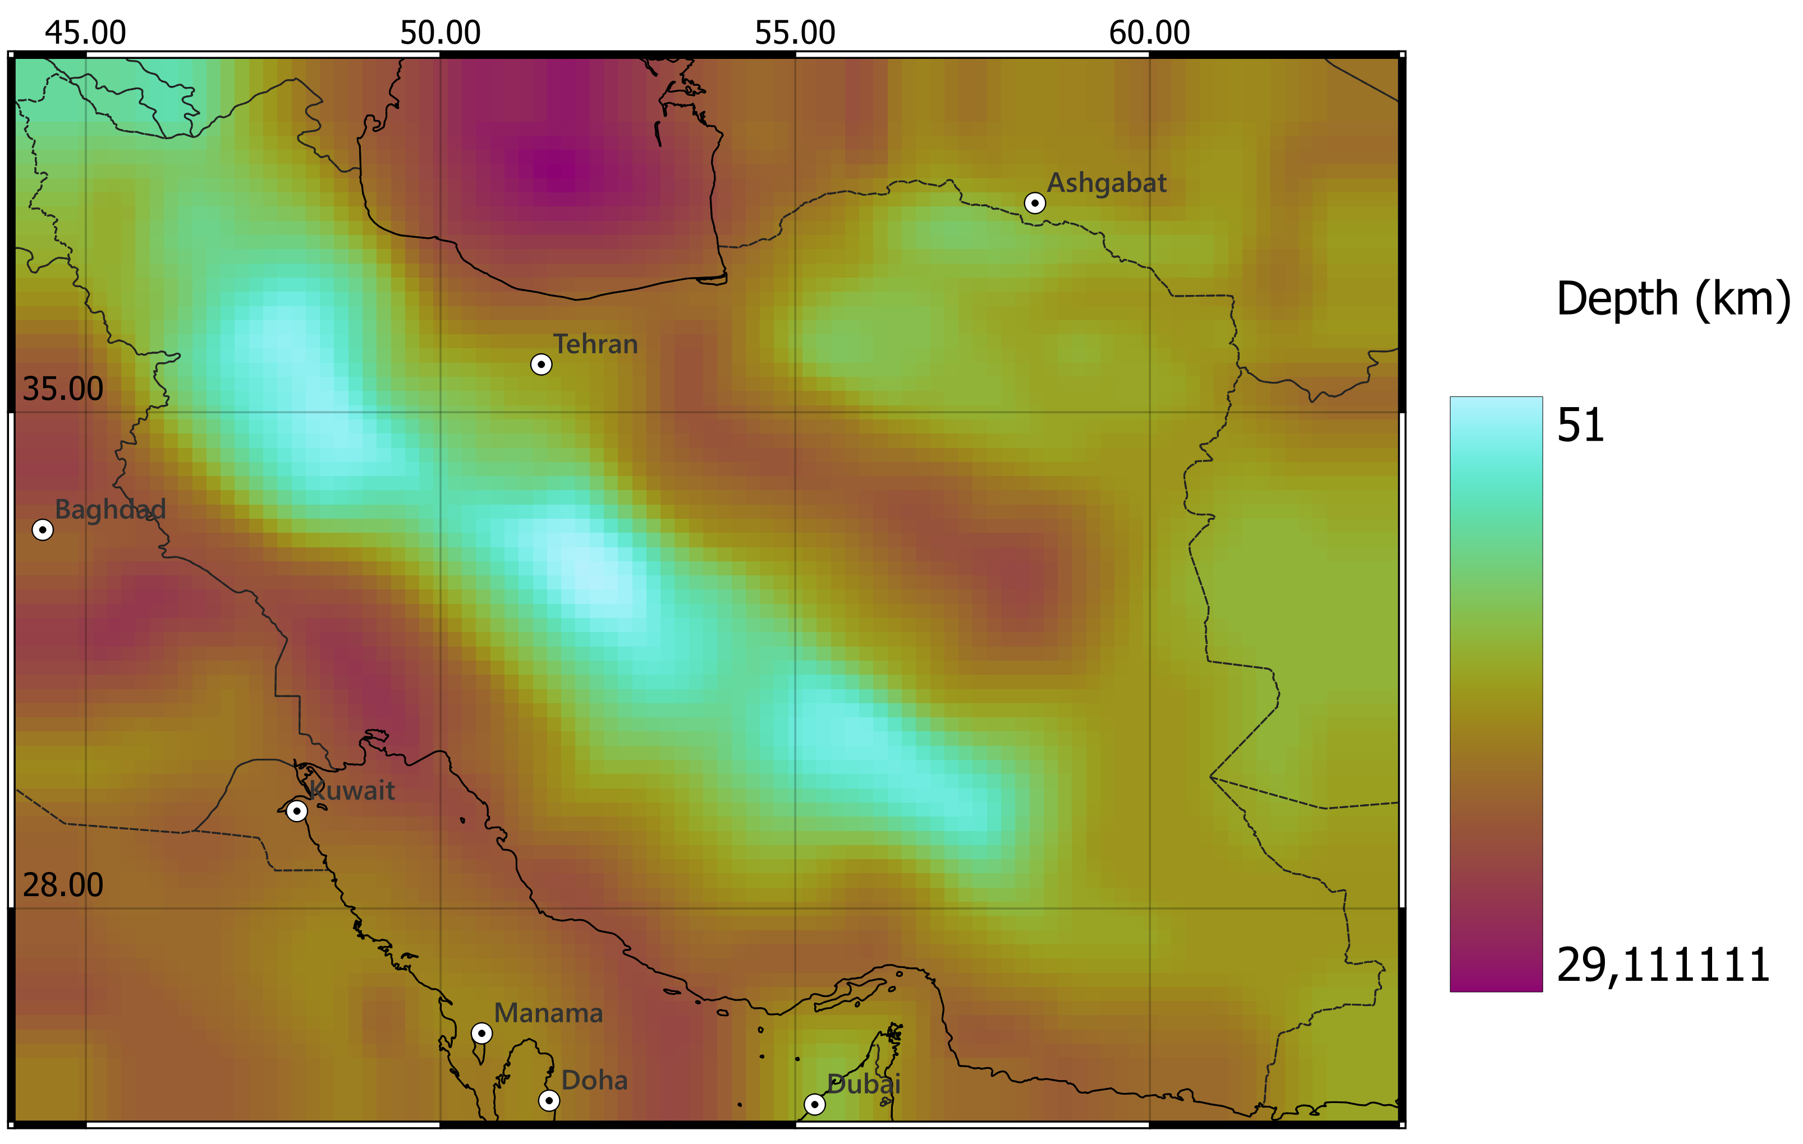
Moho
Sediments
Curie

Slide 4
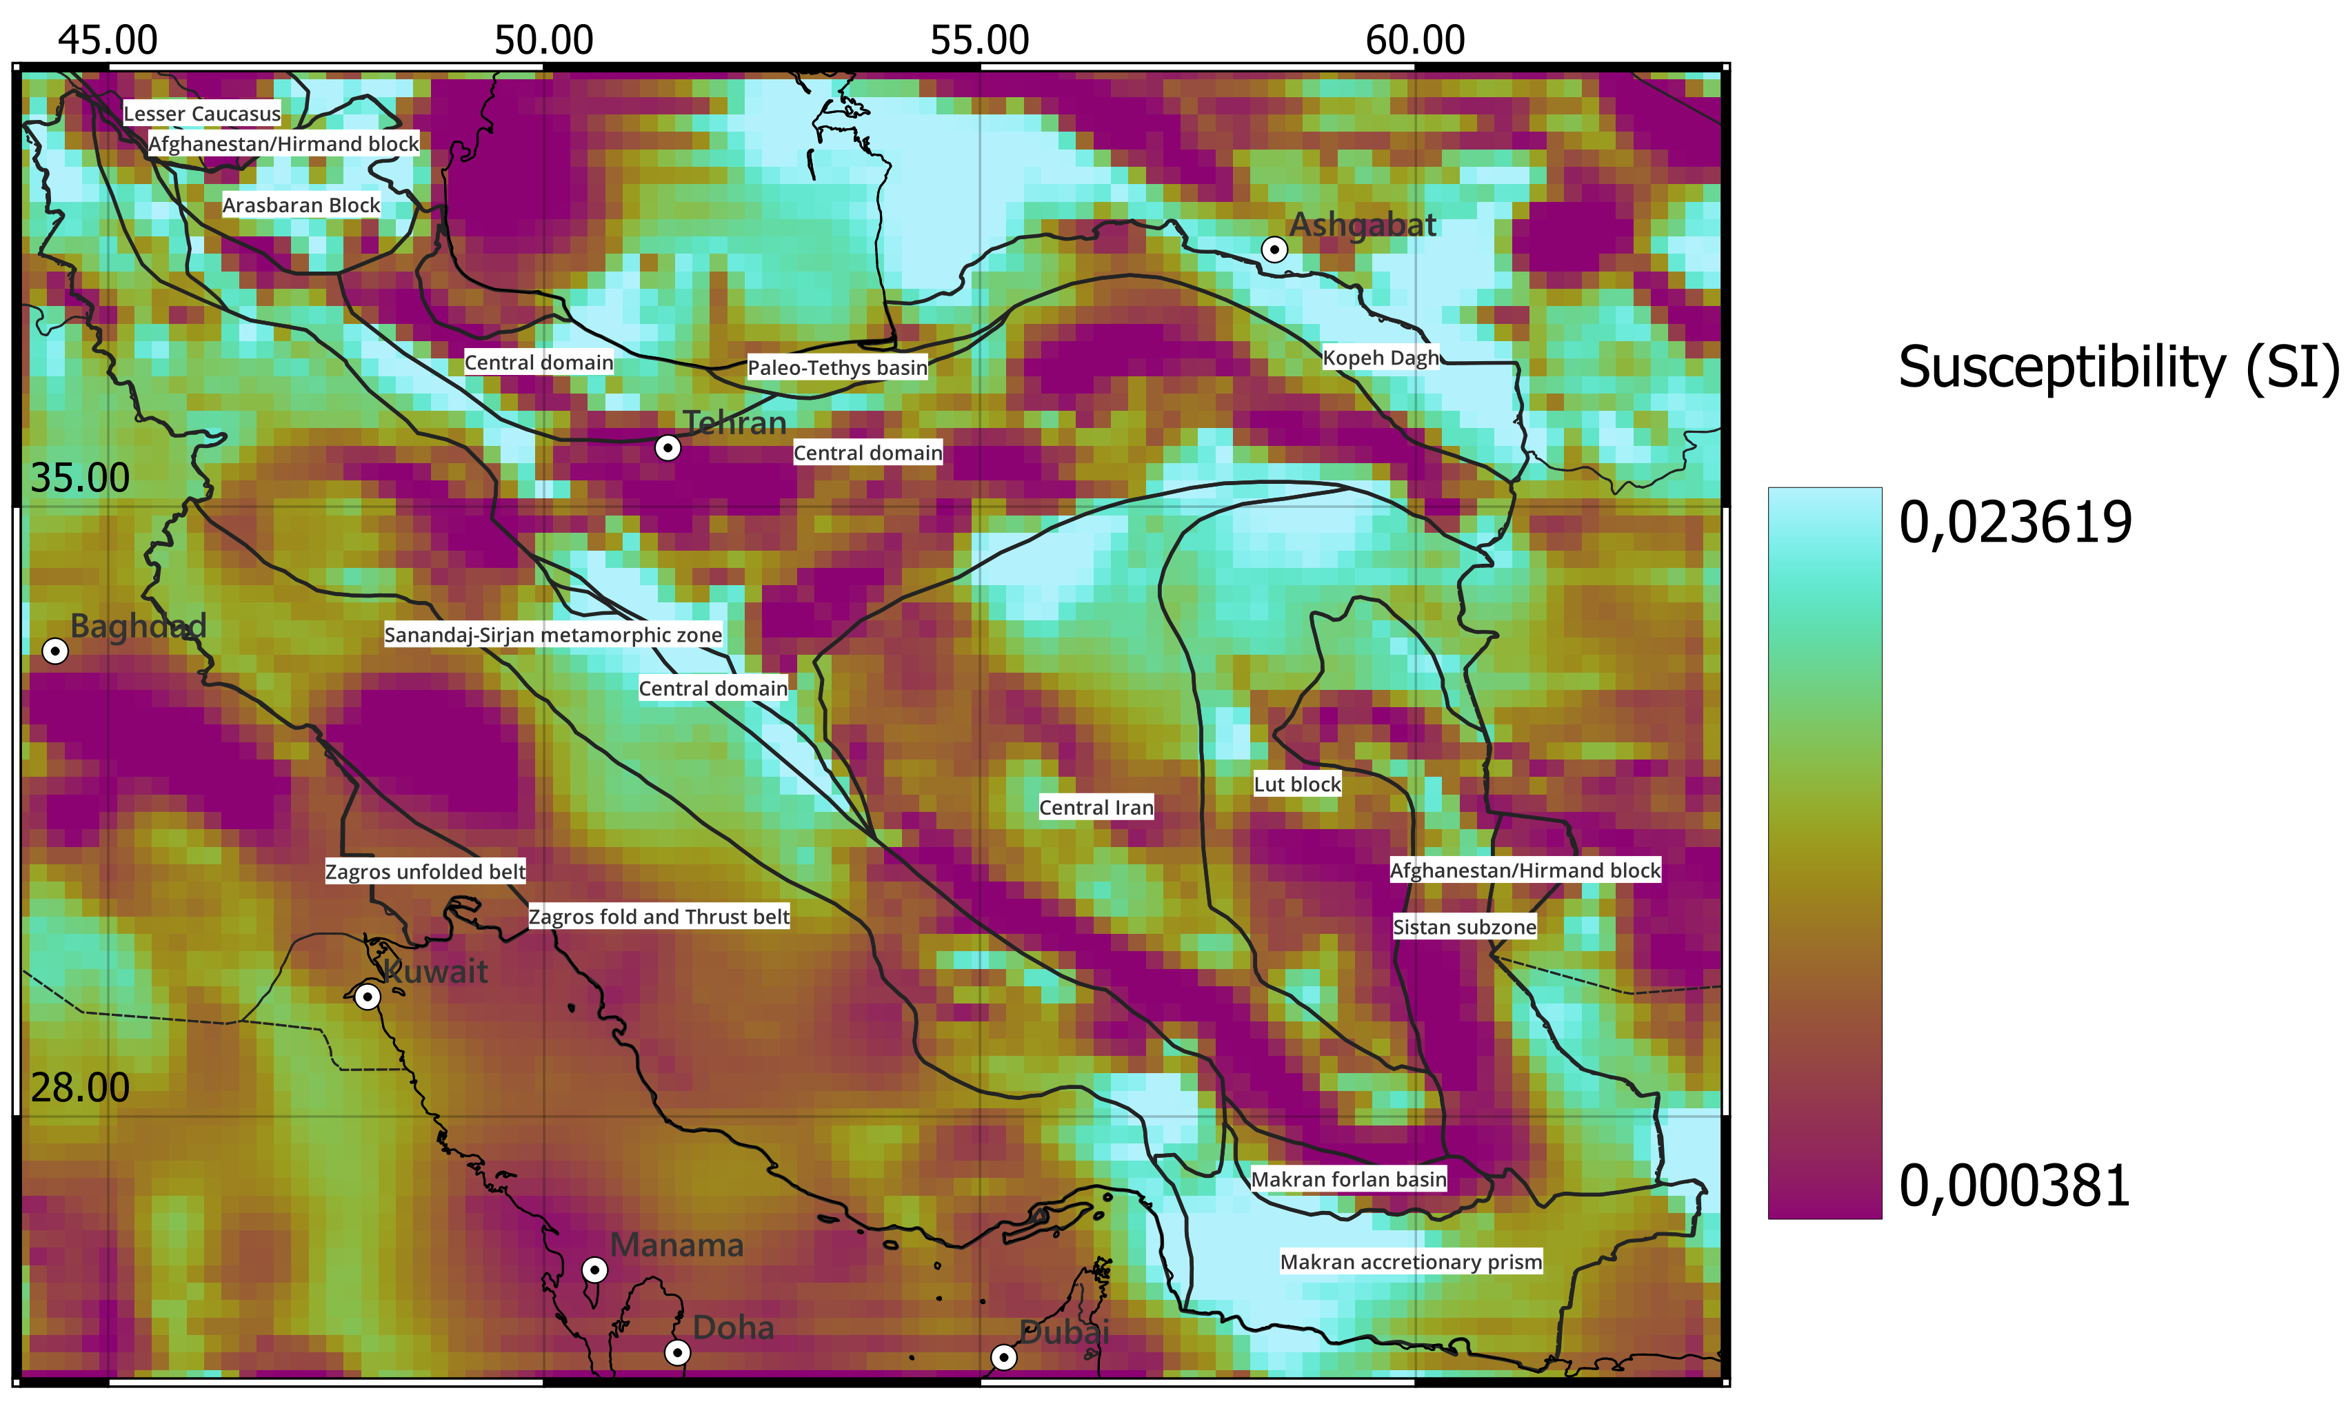
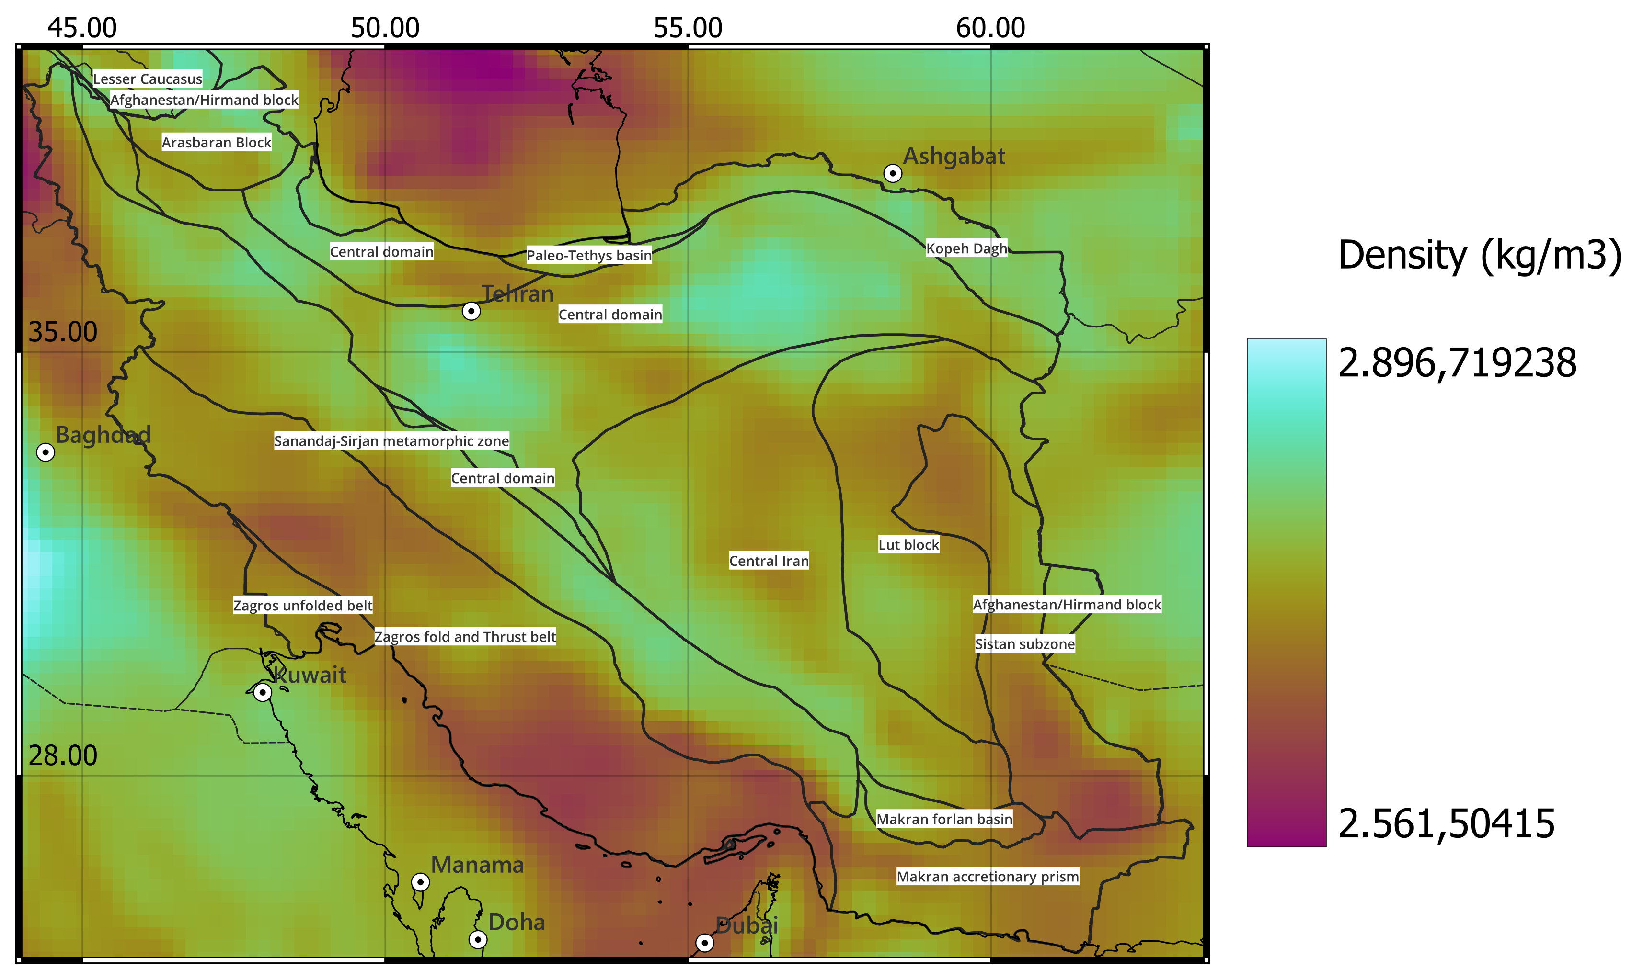
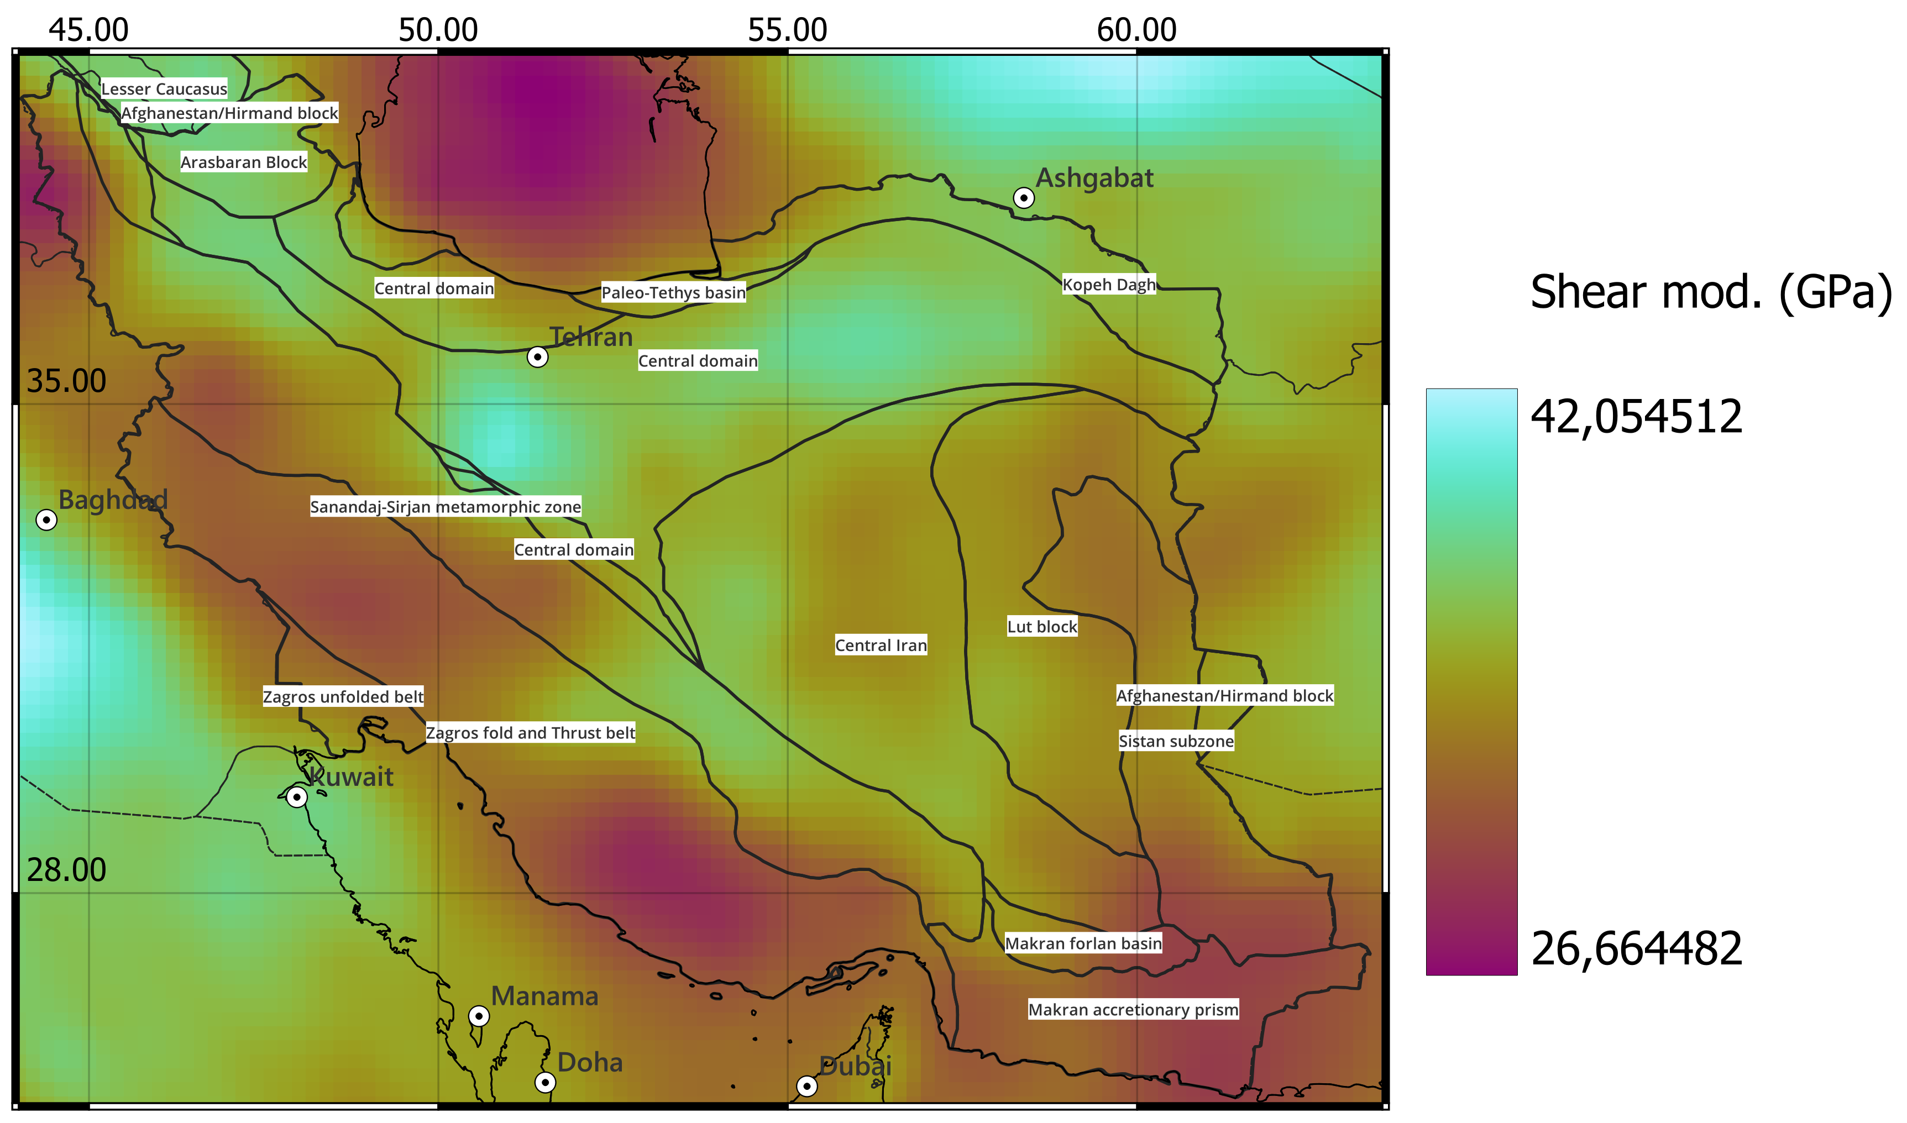
Inverted (density and susceptibility) and calculated (shear modulus) models
(slice at at 20 km depth)
.
.
.
.
.
.

Slide 5
PICO presentation
Interactive outline
1. Geological introduction
3. Conversion formula
2. Datasets used
4. Results & Conclusion

Slide 6
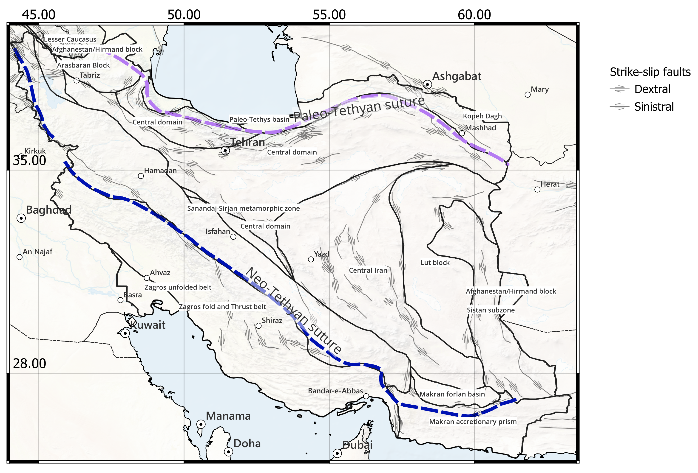
Tectonic setting
Iranian plateau: zone of continental deformation formed by the Arabian-Eurasian collision (25 Ma).
Evolution associated to opening and closure of Paleo- and Neo-Tethys oceans.
Iranian plateau formed with the coalescing of island-arcs and continental fragments of Gondwana.
Closing of Neo-Tethys and Arabian-Eurasian collision began in early Miocene.
Northward motion of Arabian plate formed the Zagros Fold Belt and Iranian Plateau NE of Bitlis-Zagros suture.

Slide 7
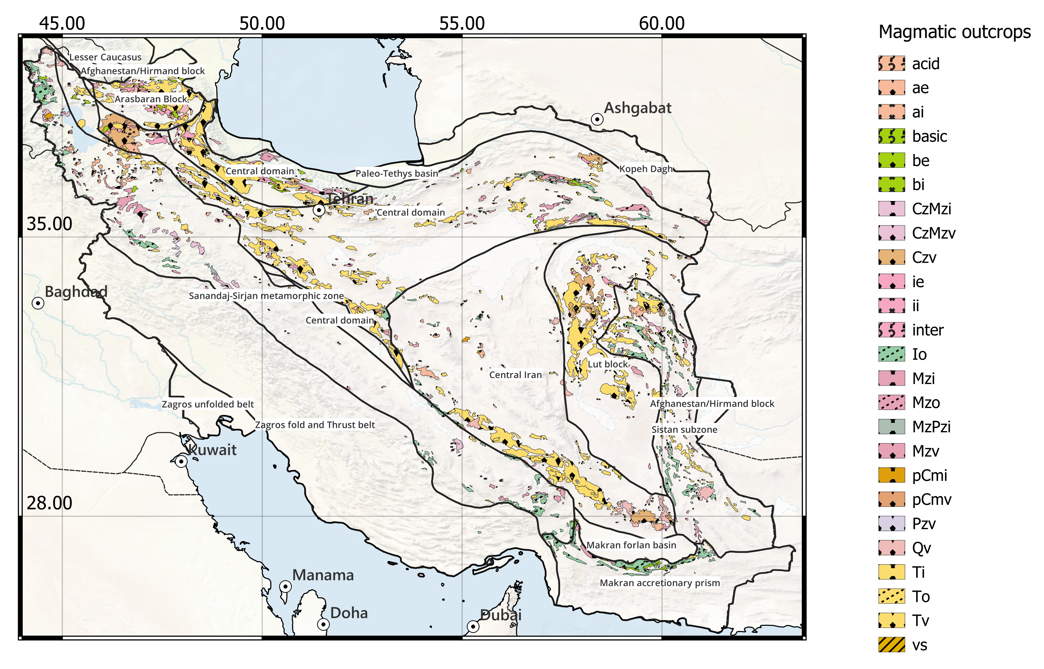
Iranian magmatism
Major volcanism in the area is Tertiary (along UDMA*, in the Lut block, and in the Central Domain following the principal tectonic lineaments).
Mesozoic volcanism is also relevant, mainly in the north-west of the area, close to Urmia lake.
Ophiolites outcrop in the Makran area and in Sistan subzone
*Urumieh Doktar magmatic arc (UDMA) is a magmatic outcrops area across Iran from NW to SE, parallel to Zagros belt

Slide 8
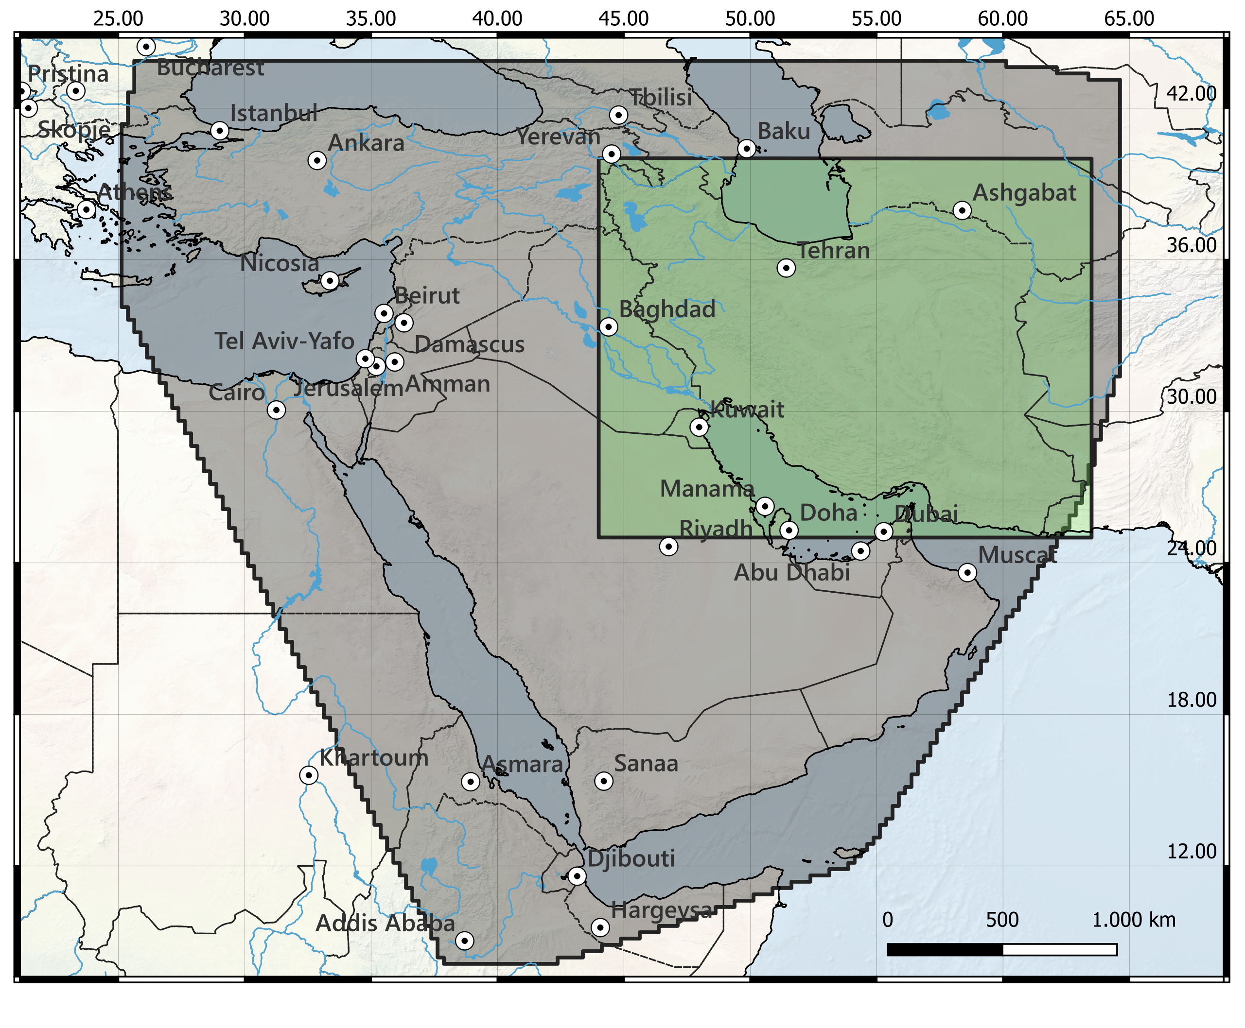
Datasets used
Seismic tomography (Kaviani et al., 2020)
Seismic tomography Resolution:
Spatial Resolution = 0.25° (~27 km)
Vertical Resolution = 1 km to 7 km
Final Cube dimension (76x98x75):
Latitude = 25 ÷ 40 °N;
Longitude = 44 ÷ 63.4 °E;
Depth max = 105 km
We conserve vertical resolution from seismic original model. Final spatial resolution is 0.2° (~22 km)
Area covered by the regional tomography (black area). Green box is the area selected for this work.
- Kaviani et al., 2020, Crustal and uppermost mantle shear wave velocity structure beneath the Middle East from surface wave tomography. Geophysical Journal International, 221(2), 1349-1365.

Slide 9
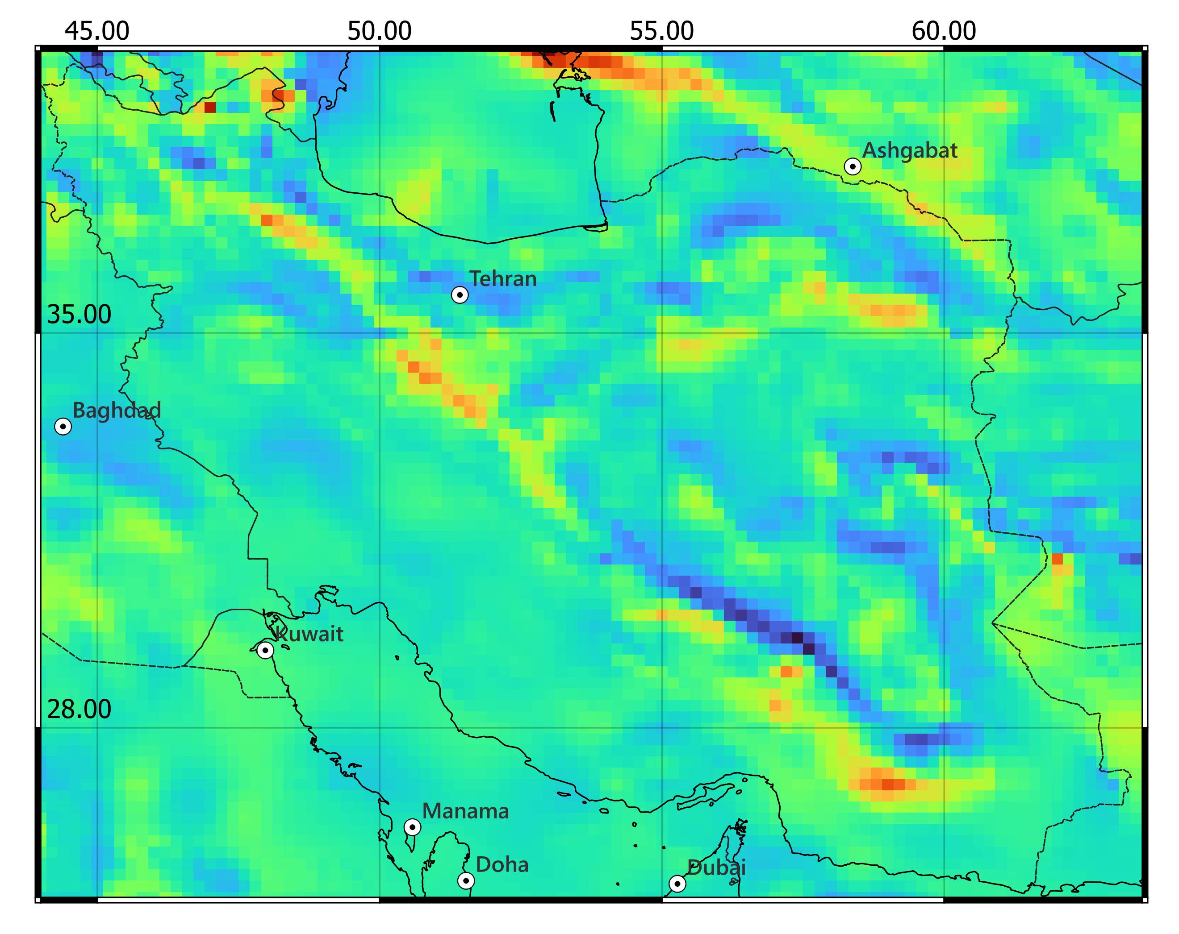
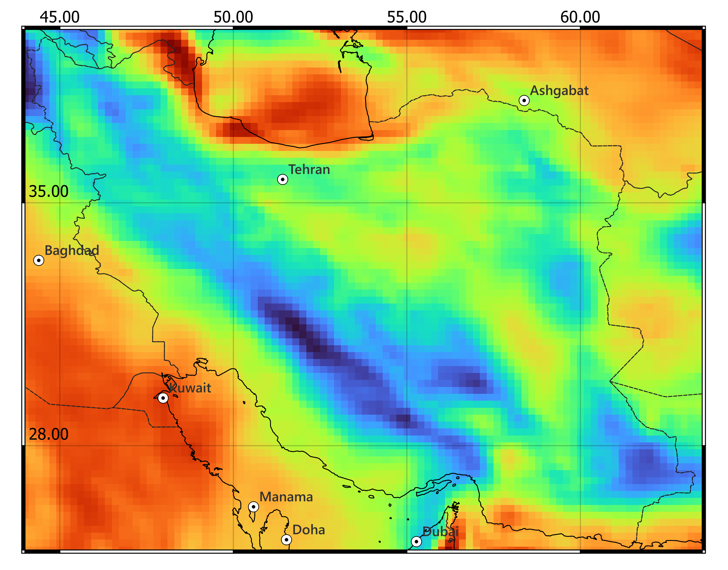
- Zingerle, P., Pail, R., Gruber, T. et al. The combined global gravity field model XGM2019e. J Geod 94, 66 (2020). https://doi.org/10.1007/s00190-020-01398-0
- Brian Meyer; Richard Saltus; and Arnaud Chulliat. 2017: EMAG2v3: Earth Magnetic Anomaly Grid (2-arc-minute resolution). Version 3. NOAA National Centers for Environmental Information. https://doi.org/10.7289/V5H70CVX
Gravity observation (XGM2019e, reduced by lower degree < 12)
Magnetic observation (EMAG2 v3, measured at 4 km continuous altitude upon continents)

Slide 10
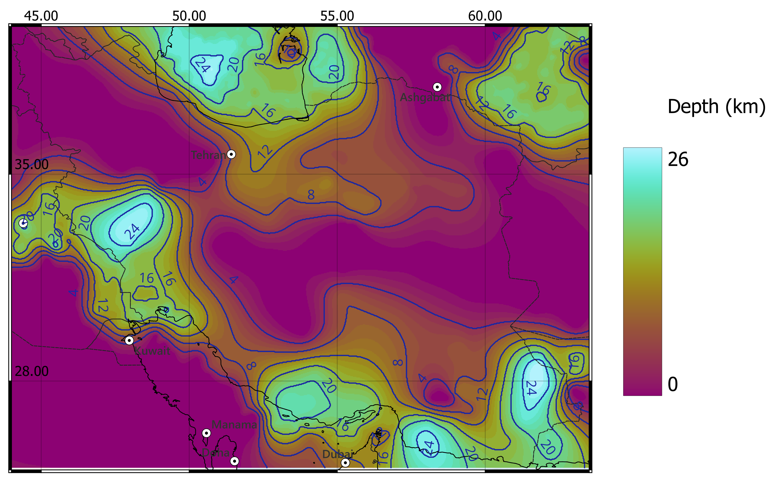
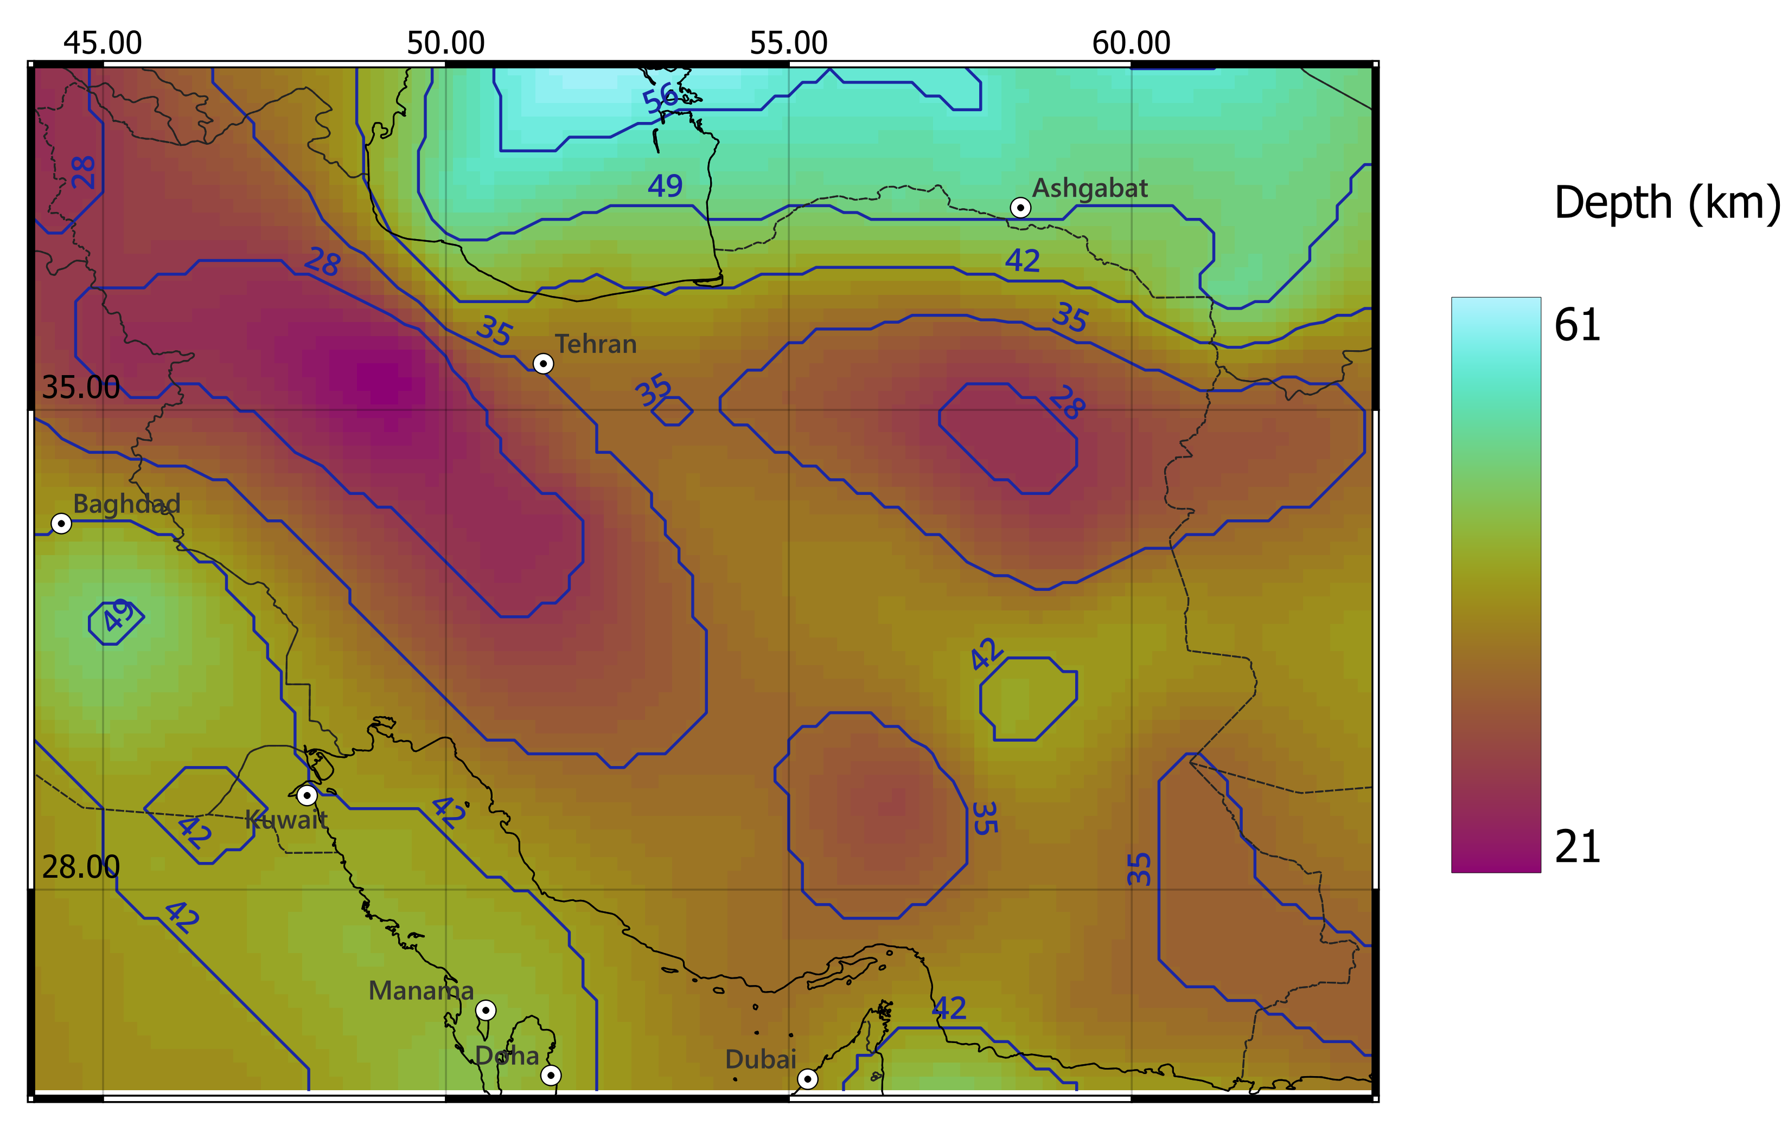
- Irandoust, M. A., Priestley, K., & Sobouti, F. (2022). High-resolution lithospheric structure of the Zagros collision zone and Iranian Plateau. Journal of Geophysical Research: Solid Earth, 127, e2022JB025009. https://doi.org/10.1029/2022JB025009
- Mousavi, N., Ardestani, V.E., 2023, 3D map of surface heat flow, low-temperature basins and Curie point depth of the Iranian plateau: Hydrocarbon reservoirs and iron deposits, Journal of the Earth and Space Physics, 48(4), 137-150. https://doi.org/10.22059/jesphys.2023.348000.1007453
Curie depth (Mousavi & Ardestani, 2023)
Sediment base depth (Irandoust et al., 2022)

Slide 11
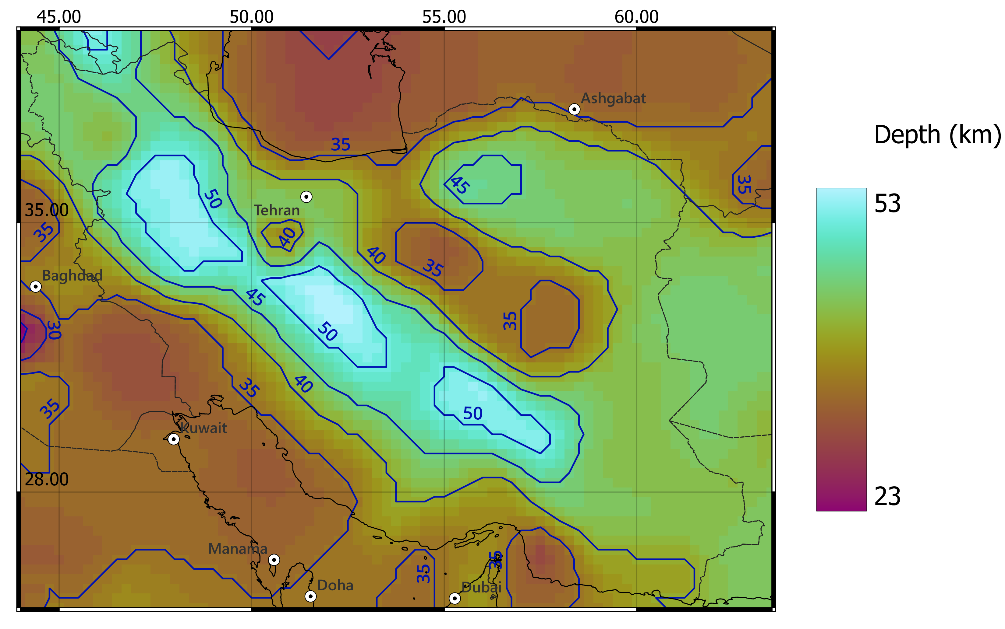
Moho definition
Gradient Method (Tadiello & Braitenberg, 2021)
Determination of the Moho depth studying the vertical velocity variations for each node.
Research of the maximum vertical gradient, within a determined velocity range.
- Tadiello D. and Braitenberg C.; 2021: Gravity modeling of the Alpine lithosphere affected by magmatism based on seismic tomography. Solid Earth, 12(2), 539-561.

Slide 12
Density conversion
crust
mantle
Water: 2670 kg/m³
Sediments
Cont. crust
Perple_X modeling
Na₂O | CaO | FeO | MgO | Al₂O₃ | SiO₂
0.13 | 1.90 | 7.90 | 41.60 | 2.00 | 45.20
Brocher’s relation
(%)
Mantle velocities from tomography compared with synthetic upper mantle velocities and densities
$$V_{p}\left(km/s\right)=0.9409+2.0947V_{s}−0.8206V_{s}^{2}+0.2683V_{s}^{3}−0.0251V_{s}^{4}$$
$$ρ\left(g/{cm}^{3}\right)=1.6612V_{p}−0. 4721V_{p}^{2}+0.0671V_{p}^{3}−0.0043V_{p}^{4}+0.000106V_{p}^{5}$$
- Thomas M. Brocher; Empirical Relations between Elastic Wavespeeds and Density in the Earth's Crust. Bulletin of the Seismological Society of America 2005;; 95 (6): 2081–2092. doi: https://doi.org/10.1785/0120050077
- Connolly, J. A. D. (2009), The geodynamic equation of state: What and how, Geochem. Geophys. Geosyst., 10, Q10014, doi:10.1029/2009GC002540.
Notes:
Perple_X: chemical mantle composition taken from global model of Griffin et al. 2009, used also for similar mantle conversion in the same area by Tunini et al. 2014

Slide 13
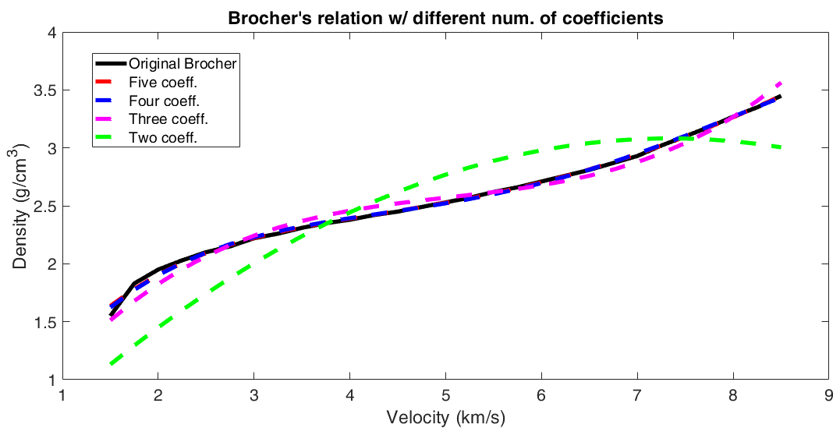
Statistical inference
Before applying Brocher’s Equation, we try to simplify it with statistical inference.
Applying Fischer’s Law, we have demonstrated the possibility to delete the last term of the equation.
We found other parameters and defined a new relation for the V_{p} → density conversion:
Results of the Brocher’s relation (y-axis) with empirical velocity (x-axis) : Black line represent the original relation, dashed lines represent our test, starting from five coefficients and eliminating ones at every iteration.
$ρ=1,6026V_{p}−0,4164V_{p}^{2}+0,0493V_{p}^{3}−0,0020V_{p}^{4}$
Notes:
Classic least square approach to estimate new coefficients of the new relations with 4, 3, 2 order.
Then Fischer’s law to control the grade of incidence of each coefficients in all the new equations

Slide 14
Density inversion with Bayesian approach
A probabilistic Bayesian approach is proposed for the joint gravity-magnetic inversion. It searches, from the a-priori model, the density distribution that minimizes the gravity and magnetic residuals.
- Marchetti, P., Sampietro, D., Capponi, M., Rossi, L., Reguzzoni, M., Porzio, F., Sansò, F. et al. (2019) Lithological constrained gravity inversion. A Bayesian approach. In: 81st EAGE Conference and Exhibition 2019. EAGE Publishing BV, 1–5
- Sansò, Fernando, and Daniele Sampietro. Analysis of the gravity field: Direct and inverse problems. Springer Nature, 2022.
- Sampietro, D., Capponi, M., Maurizio, G. (2022) 3D Bayesian Inversion of Potential Fields: The Quebec Oka Carbonatite Complex Case Study. Geosciences 2022, 12, 382. https://doi.org/10.3390/geosciences12100382

Slide 15
Elastic parameters calculation
- Thomas M. Brocher; Empirical Relations between Elastic Wavespeeds and Density in the Earth's Crust. Bulletin of the Seismological Society of America 2005;; 95 (6): 2081–2092. doi:https://doi.org/10.1785/0120050077
We use the final density model to calculate some elastic parameters.
$$μ= V_{s}^{2}ρ$$
(Shear modulus)
$$λ= ρ(V_{p}^{2}−{2V}_{s}^{2})$$
(1st Lame parameter)
$$P_{t}=g∗Z_{t}∗ρ_{t}$$
$$σ= λ/[2\left(λ+μ\right)]$$
(Poisson’s ratio)
$ρ_{t}$= topo density = 2670 kg/m³
$$∆P_{1}=g∗{(Z}_{1}−Z_{0})∗ρ_{1}$$
$Z_{t}$= topo height
$g$= 9.81 m/s²
$Z$= node depth
$$∆P_{z}=g∗{(Z}_{z}−Z_{z−1})∗ρ_{z}$$
$ρ$= node density
$$P=P_{t}+\sum_{i}^{z}{∆P_{i}}$$

Slide 16
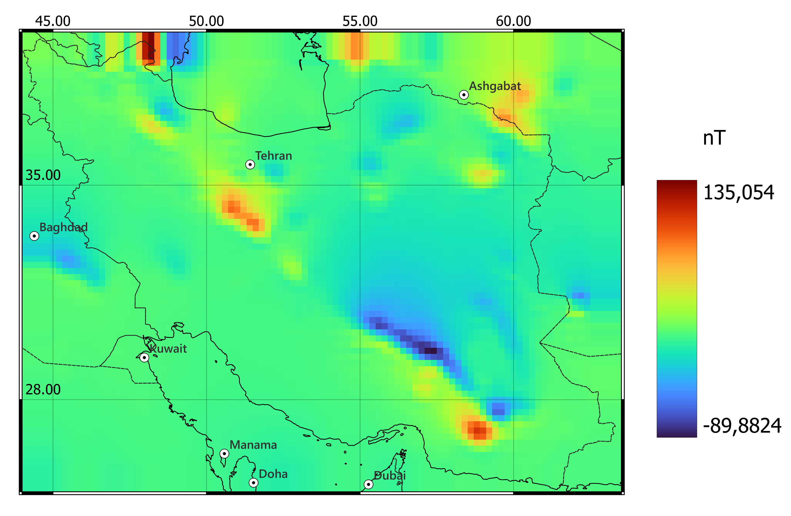
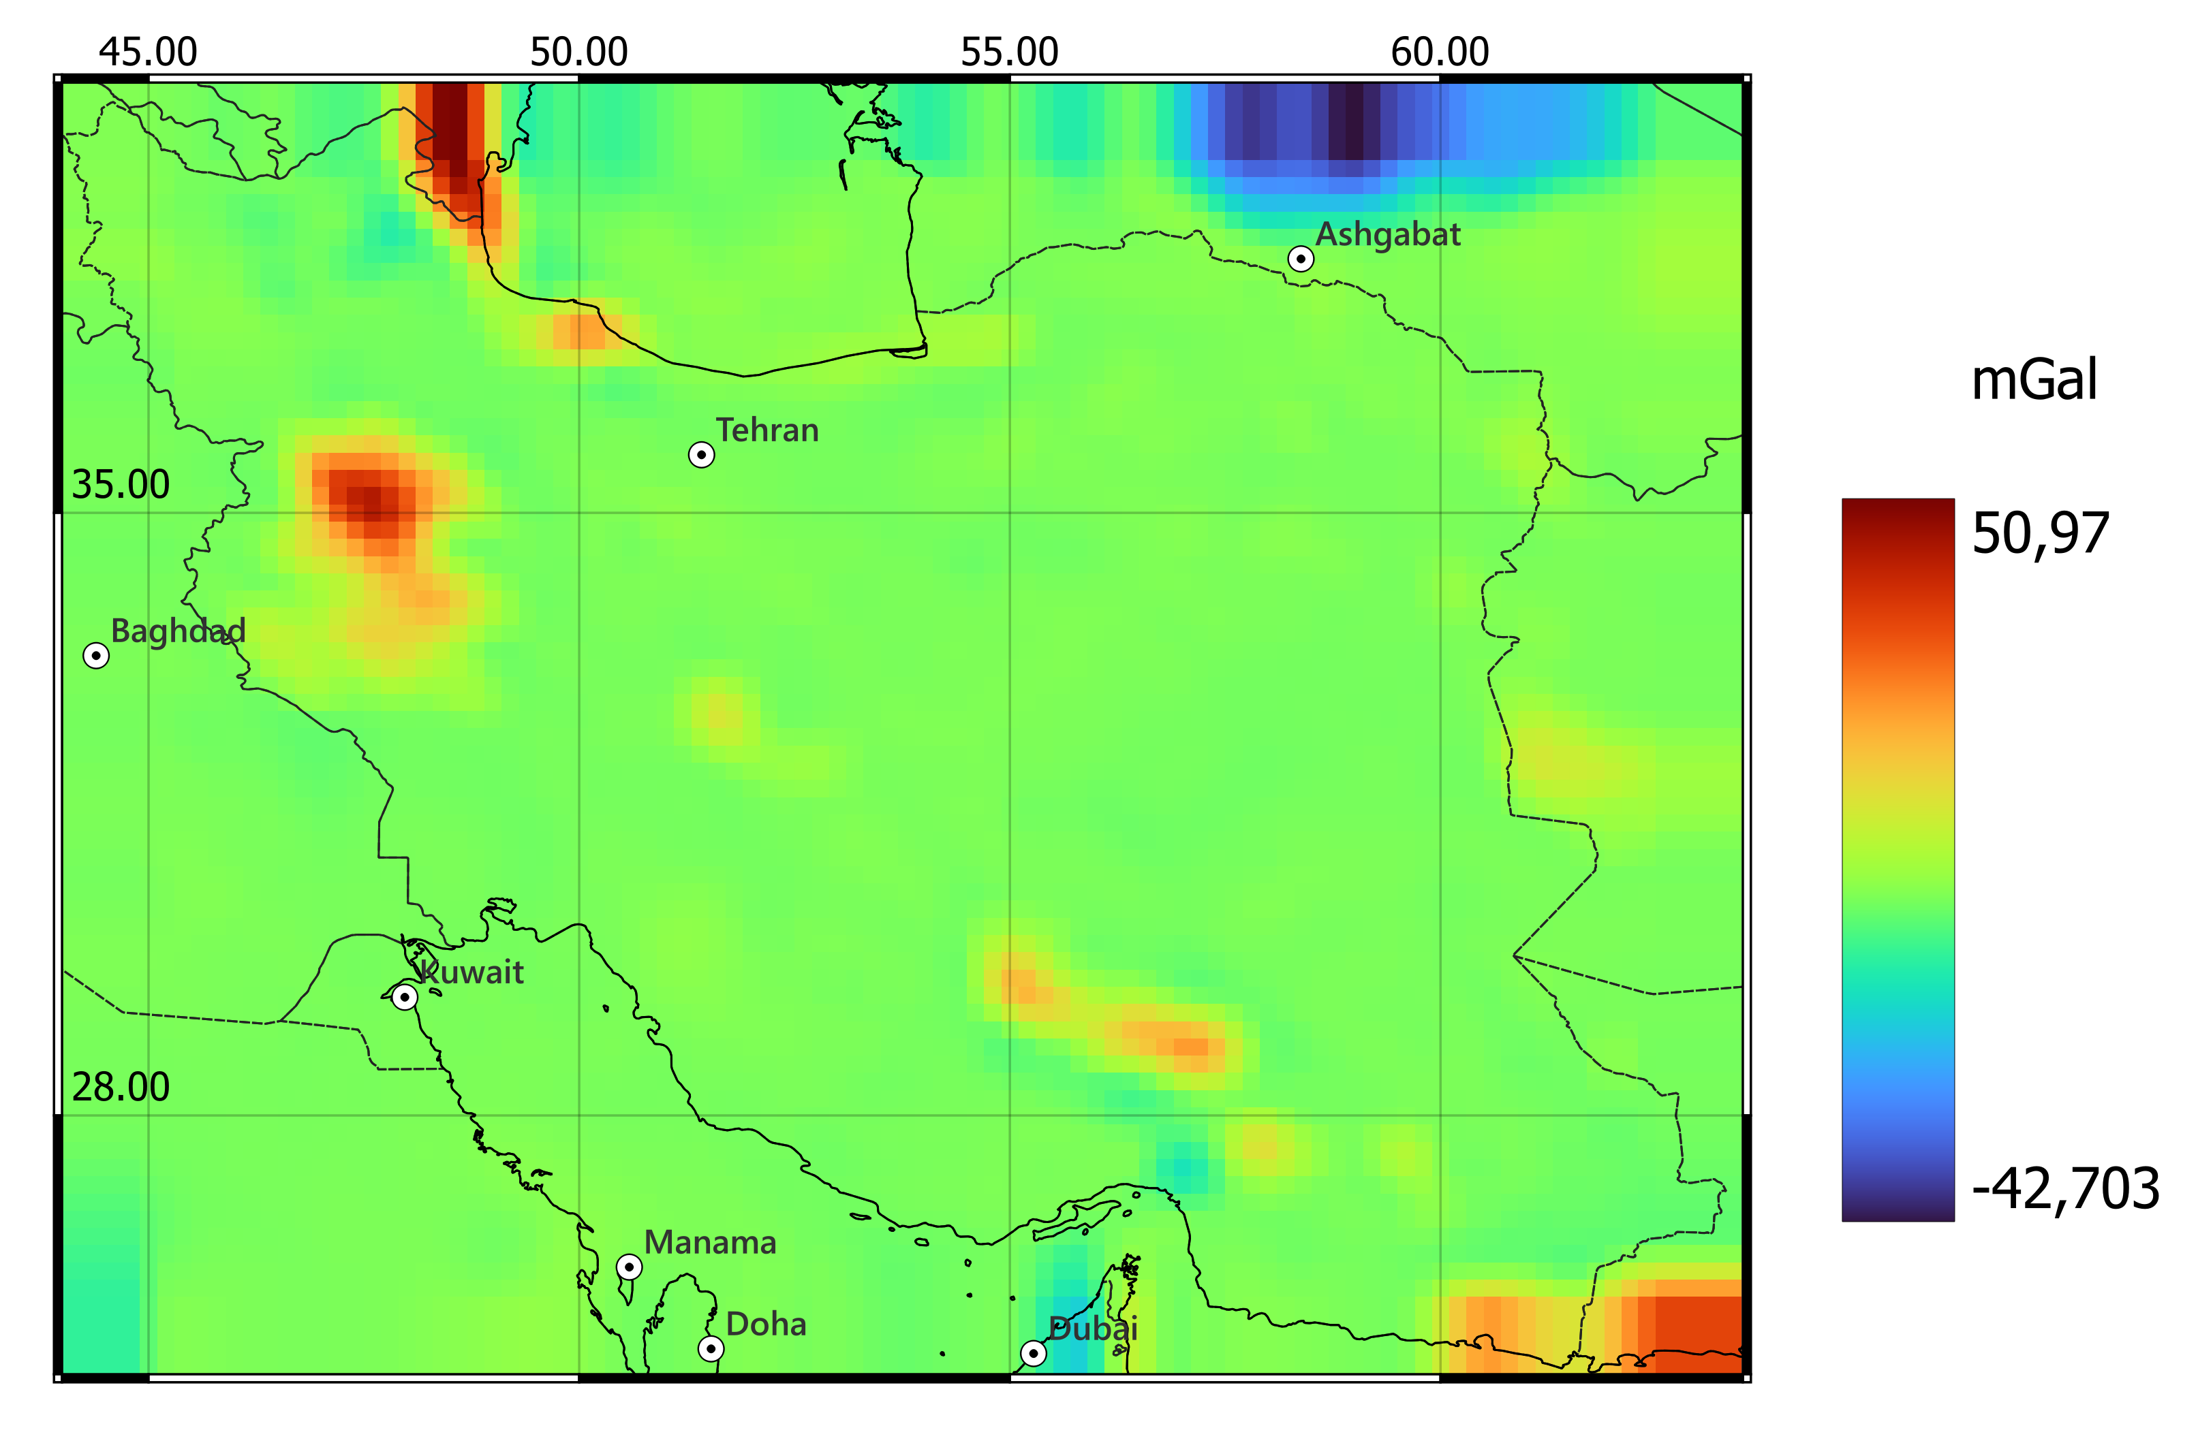
Inversion results
Field residuals
Magnetic
Gravity
.
.
.
.
Std: 15 nT
Std: 7 mGal

Slide 17
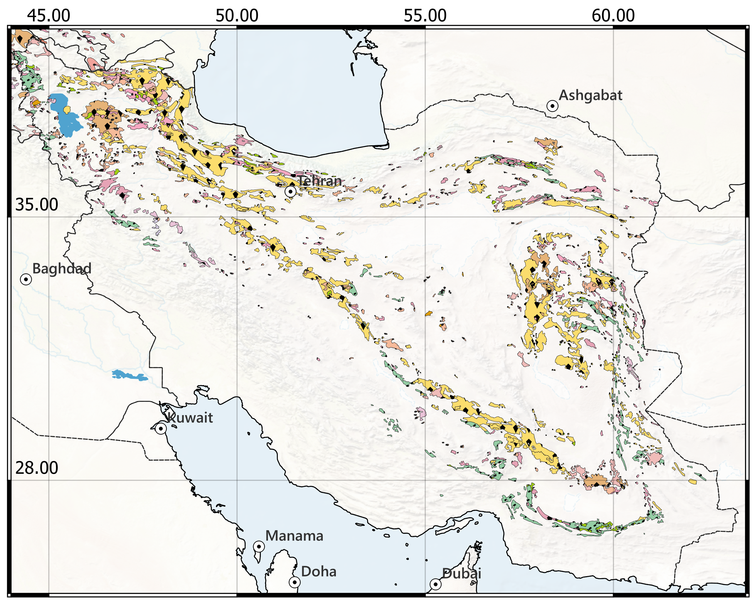
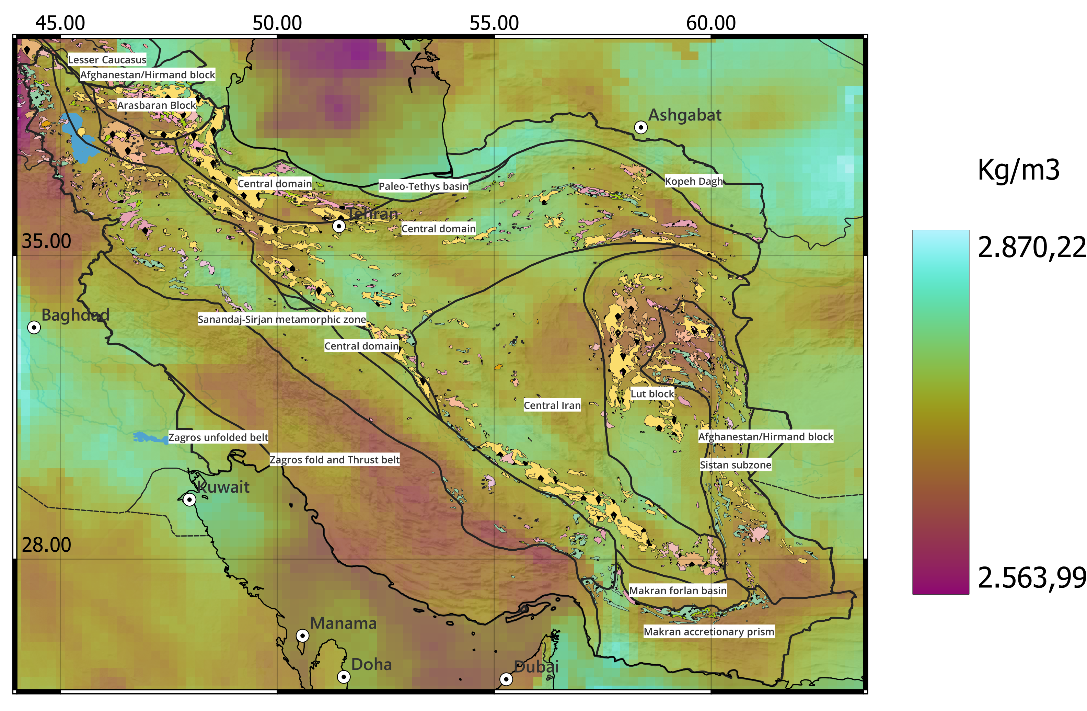
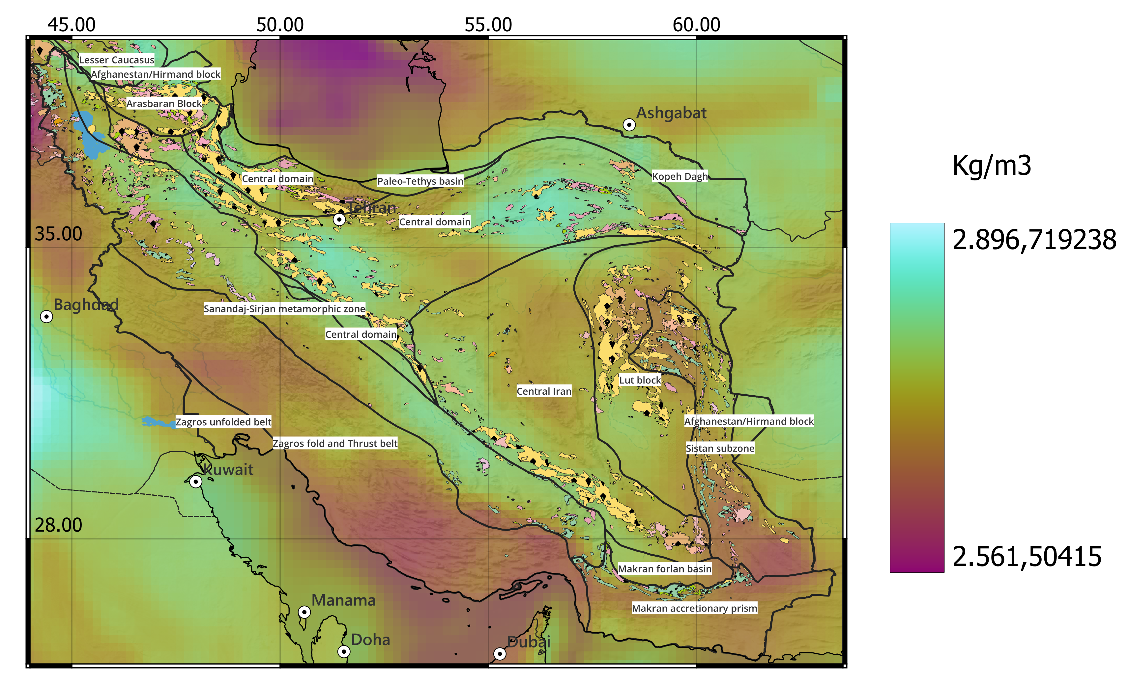
Discussion of inverted density
Upper crustal density partly correlates with magmatic outcrops
.
.
.
.
Crustal average density
Depth: 20 km

Slide 18
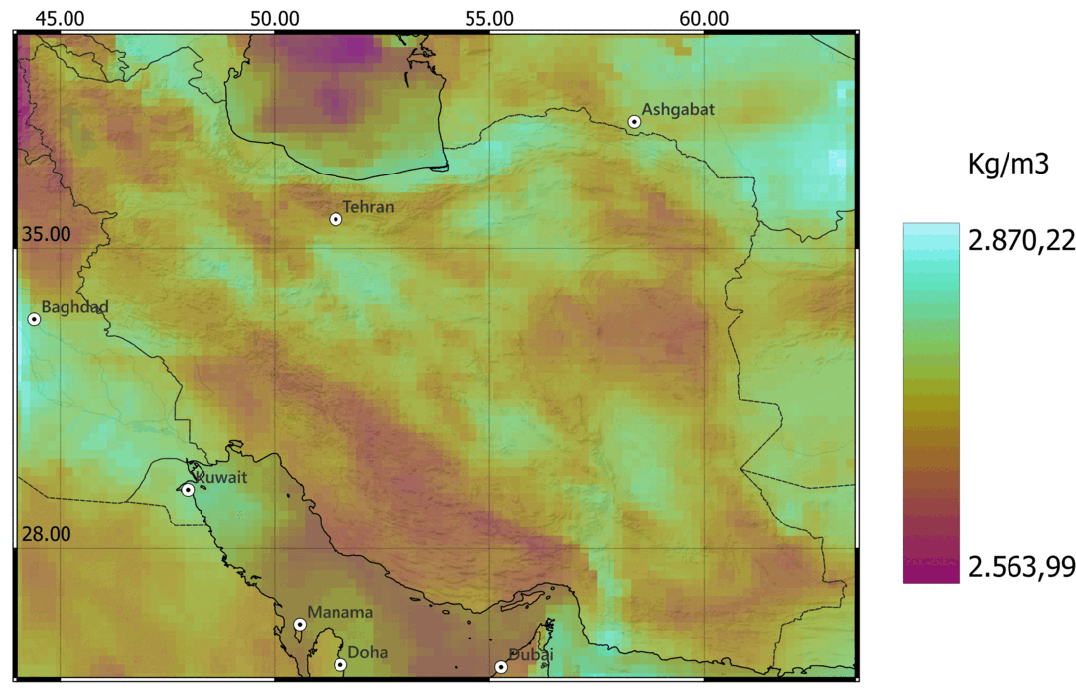
Discussion of inverted density
Lower crustal density vs Tethyan suture:
Paleo-Tethyan suture corresponds to a high-density trend.
Neo-Tethyan suture bounds a low-density area from an higher density zone
.
.
Crustal average density

Slide 19
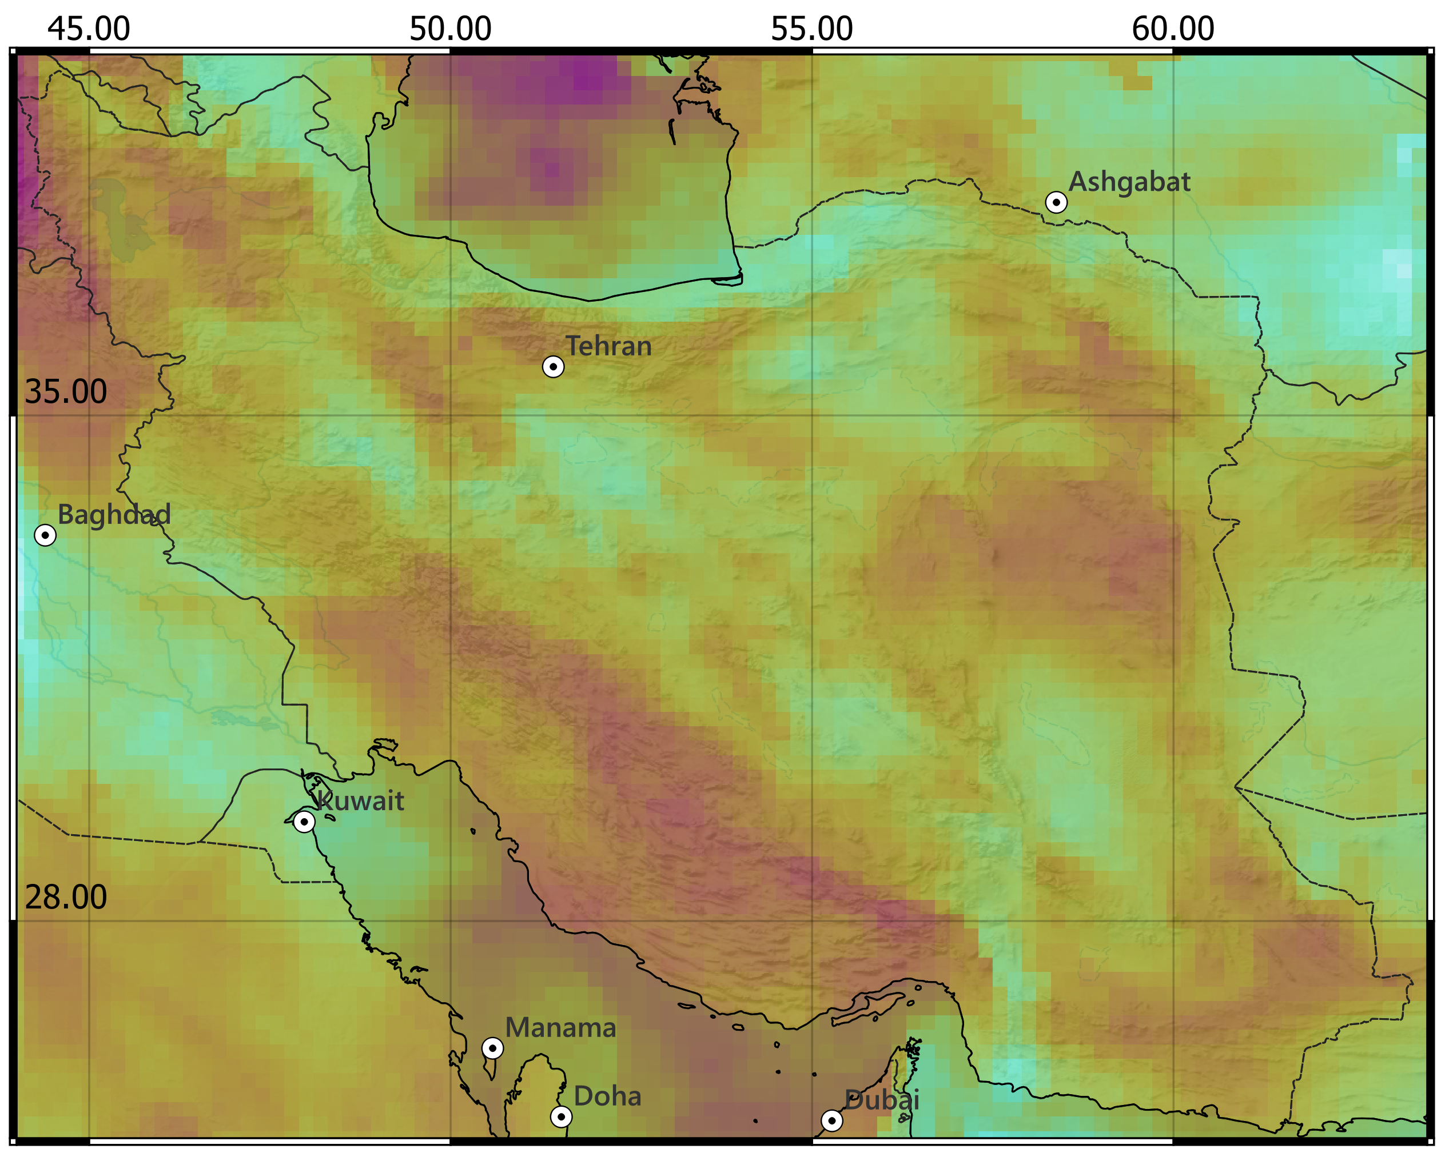
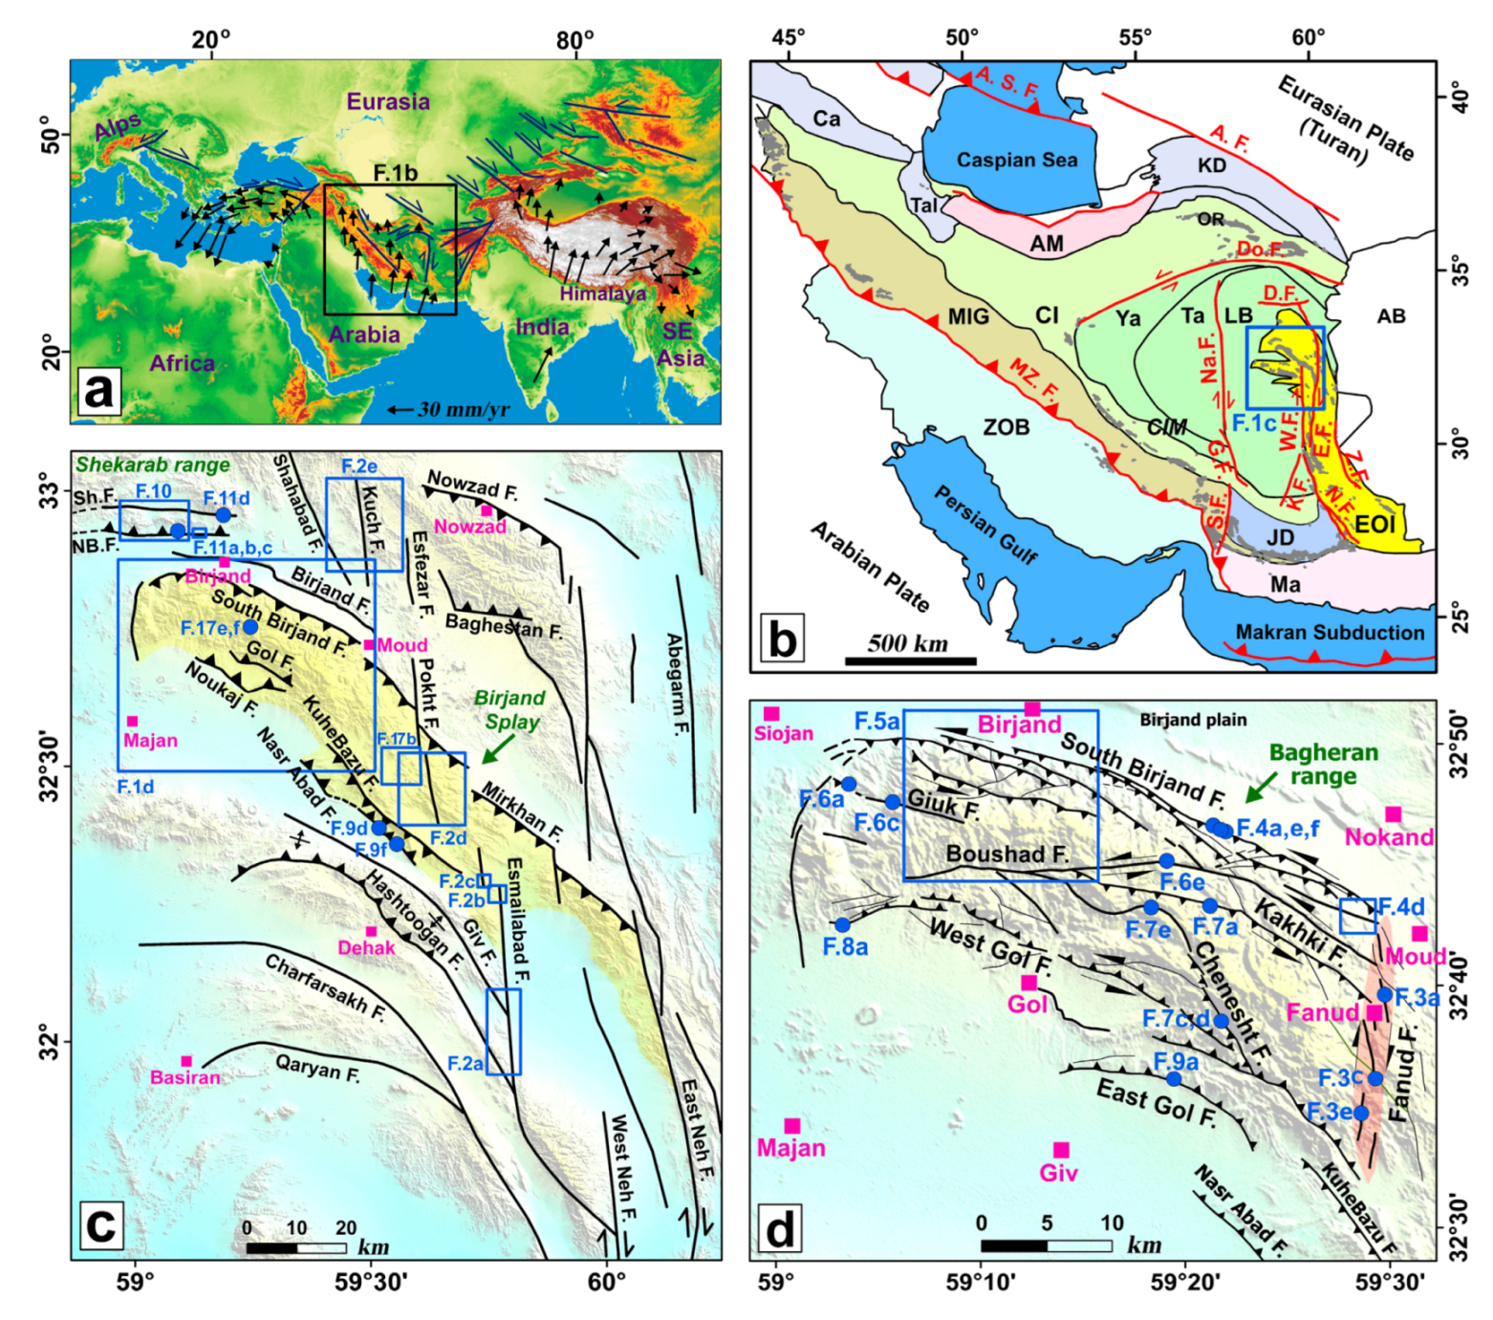
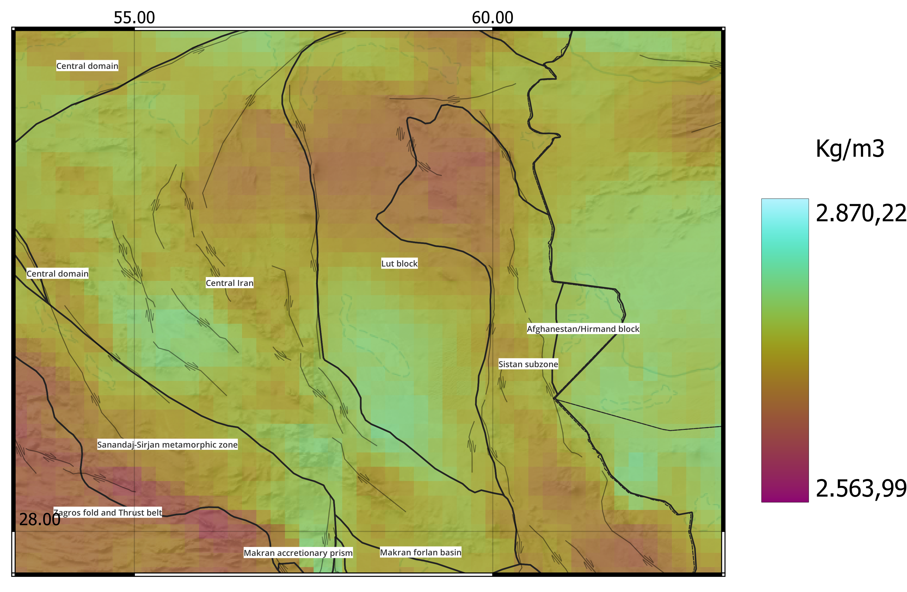
Lut Block focus
Average crustal density
.
Tectonic of the area (from Rashidi et al., 2022)
Density vs strike-slip faulting. Rotation of Birjand block helped by the presence of the high-density body.
.
- Rashidi, A., Shahpasandzadeh, M., Braitenberg, C., Late Cenozoic to Present Kinematic of the North to Eastern Iran Orogen: Accommodating Opposite Sense of Fault Blocks Rotation. Remote Sens. 2022, 14, 4048. https://doi.org/10.3390/rs14164048

Slide 20
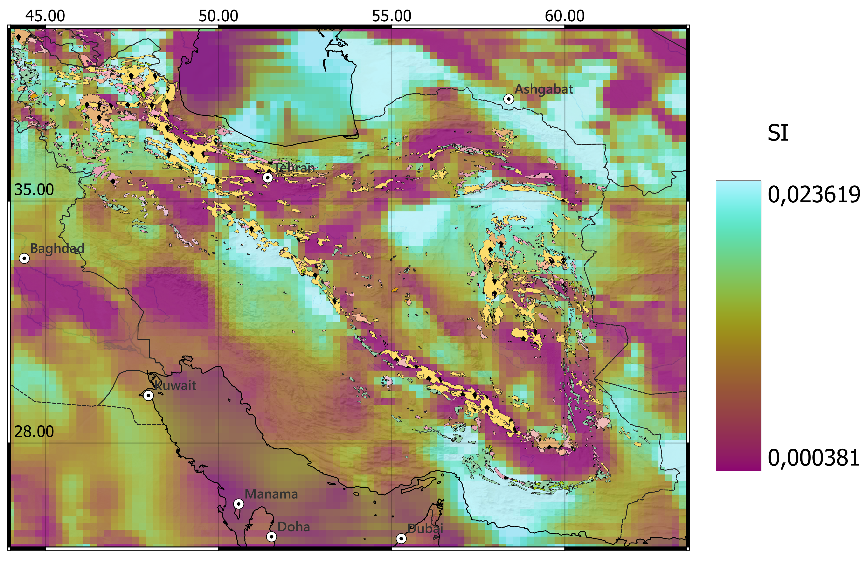
Discussion of inverted susceptibility
.
High magnetization corresponds to west northwest presence of magmatic bodies.
Highly magnetized body is detected in Central Iran and in Makran subduction zone.
.
Crustal average susceptibility

Slide 21
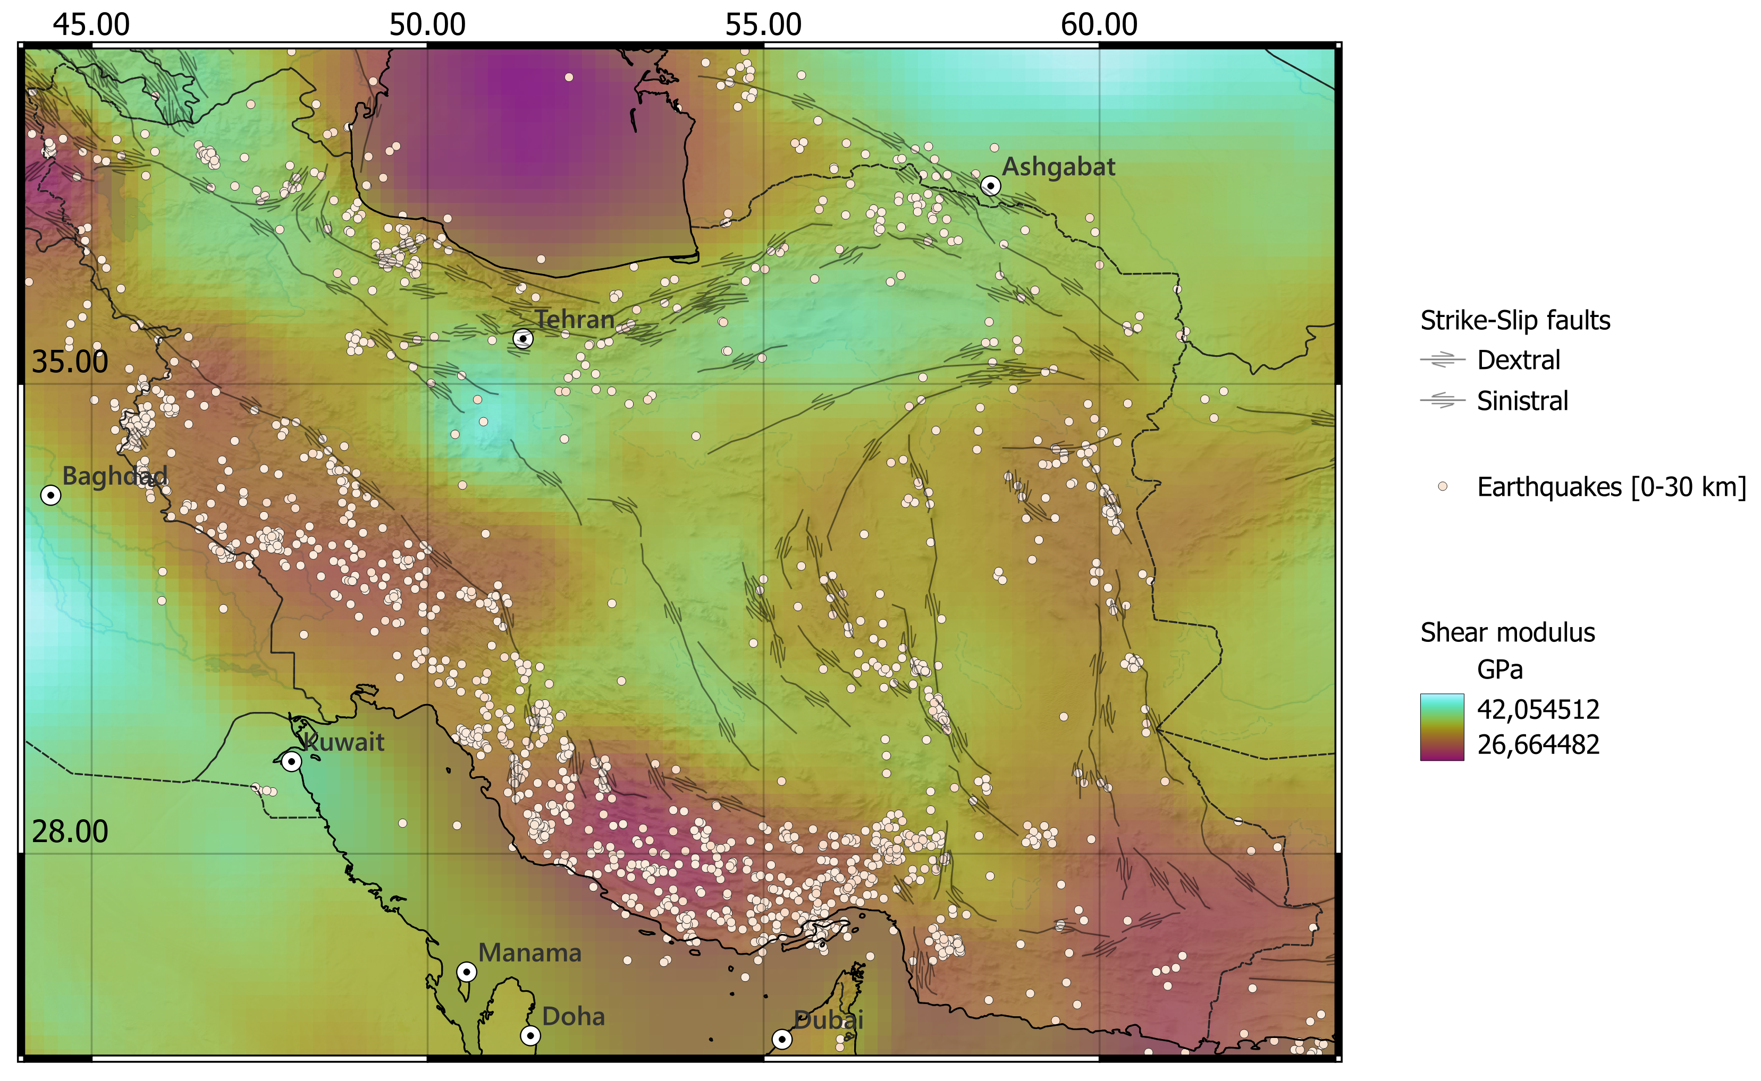
Discussion of calculated shear modulus
Location of superficial earthquakes perfectly matches less rigid superficial areas.
Exception is Caspian Sea. It is close to aseismic but has low rigidity.
.
.
Depth: 20km

Slide 22
Conclusion
Bayesian joint gravity-magnetic inversion has defined a reliable 3D density and magnetic susceptibility model.
The density variations match the geologically expected variations well.
The seismic velocity and density has produced a rigidity model with significant variations. The more deformable areas are those with higher crustal seismicity.

