Slide 1


Summary
Quantifying the uncertainty corresponding to the radar rainfall estimation
process: an inverse model for radar attenuation error
Amy Green, Chris Kilsby, András Bárdossy
amy.green3@newcastle.ac.uk
Newcastle University
Summary
What did we do?
What did we find?
How can you find us?
Simulated realistic space-time rainfall events using clustered spatiotemporal event properties
Inverted radar rainfall estimation process stochastically to generate ensemble of errors
Investigate error behaviour, introducing rainfall shadows – where rainfall information is lost
“At least 3% of significant rainfall rates were completely lost in 50% of simulated radar images”
“Rainfall shadows of over 45km² in 25% of simulated radar images”
“Single largest area of rainfall shadowed over 50km² in 5% of simulated radar images”
Use the QR code below to download this presentation
Summary
Methodology
Results
Introduction
Motivation
Impacts
Aims
Rainfall model
Radar error model
Event errors
Image-based
Rainfall shadows
HS7.1 Precipitation variability from drop scale to catchment scale : measurement, processes and hydrological applications
EGU General Assembly 2023
Notes:
START HERE
Hi, I’m Amy Green and I am a researcher at Newcastle University.

Slide 2
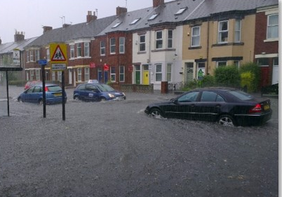
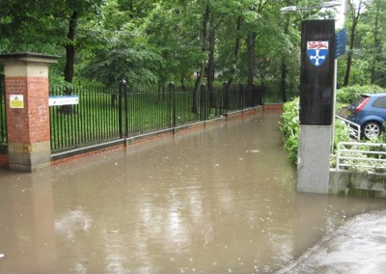
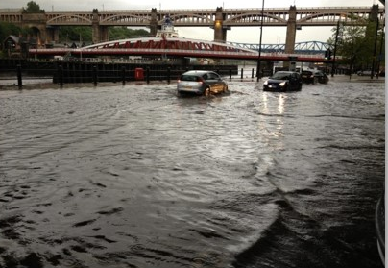
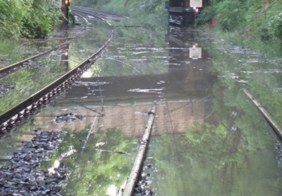
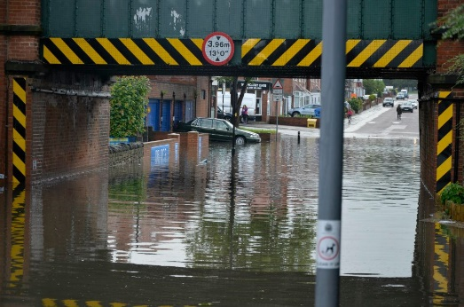
Introduction
Quantifying the uncertainty corresponding to the radar rainfall estimation
process: an inverse model for radar attenuation error
Amy Green, Chris Kilsby, András Bárdossy
amy.green3@newcastle.ac.uk
Newcastle University
Introduction
Flooding is the extreme weather event that causes the biggest economic losses in Europe
High resolution rainfall data in space and time needed (e.g. flood risk, resilience)
Figure 1: Photographs of flooding in Newcastle upon Tyne in June 2012, underestimated in radar rainfall estimates
Summary
Methodology
Results
Introduction
Motivation
Impacts
Aims
Rainfall model
Radar error model
Event errors
Image-based
Rainfall shadows
HS7.1 Precipitation variability from drop scale to catchment scale : measurement, processes and hydrological applications
EGU General Assembly 2023
Notes:
SKIP!

Slide 3
Motivation
Quantifying the uncertainty corresponding to the radar rainfall estimation
process: an inverse model for radar attenuation error
Amy Green, Chris Kilsby, András Bárdossy
amy.green3@newcastle.ac.uk
Newcastle University
Motivation
Radar rainfall estimation introduces a wide range of errors (cumulative) from many different sources
Even with current correction and merging methods, information is often lost.
It is not known where, when or how often this happens, as the true rainfall field is not known.
Rain gauges often assumed ground truth – unrealistic assumption
Figure 2: Diagram of some of the sources introducing errors in radar rainfall estimation
Summary
Methodology
Results
Introduction
Motivation
Impacts
Aims
Rainfall model
Radar error model
Event errors
Image-based
Rainfall shadows
HS7.1 Precipitation variability from drop scale to catchment scale : measurement, processes and hydrological applications
EGU General Assembly 2023
Notes:
SKIP!

Slide 4
Aims
Quantifying the uncertainty corresponding to the radar rainfall estimation
process: an inverse model for radar attenuation error
Amy Green, Chris Kilsby, András Bárdossy
amy.green3@newcastle.ac.uk
Newcastle University
Aims
Explore and exploit space-time properties of radar rainfall errors to improve understanding of the dependence structure between them.
Gain improved understanding of radar rainfall estimation process
Repeat to generate an ensemble
Parametrised using clustered rainfall event properties
Simulated ‘true’ reference rainfall
Weather radar image
Corrected rainfall ensemble
Impose inverted radar rainfall estimation
Process using standard methods
Figure 3: Diagram representing the workflow for the radar error model
Summary
Methodology
Results
Introduction
Motivation
Impacts
Aims
Rainfall model
Radar error model
Event errors
Image-based
Rainfall shadows
HS7.1 Precipitation variability from drop scale to catchment scale : measurement, processes and hydrological applications
EGU General Assembly 2023
Notes:
I will be outlining results, obtained from imposing a radar error model on simulated space-time rainfall events, designed to improve understanding of radar rainfall estimation errors.

Slide 5
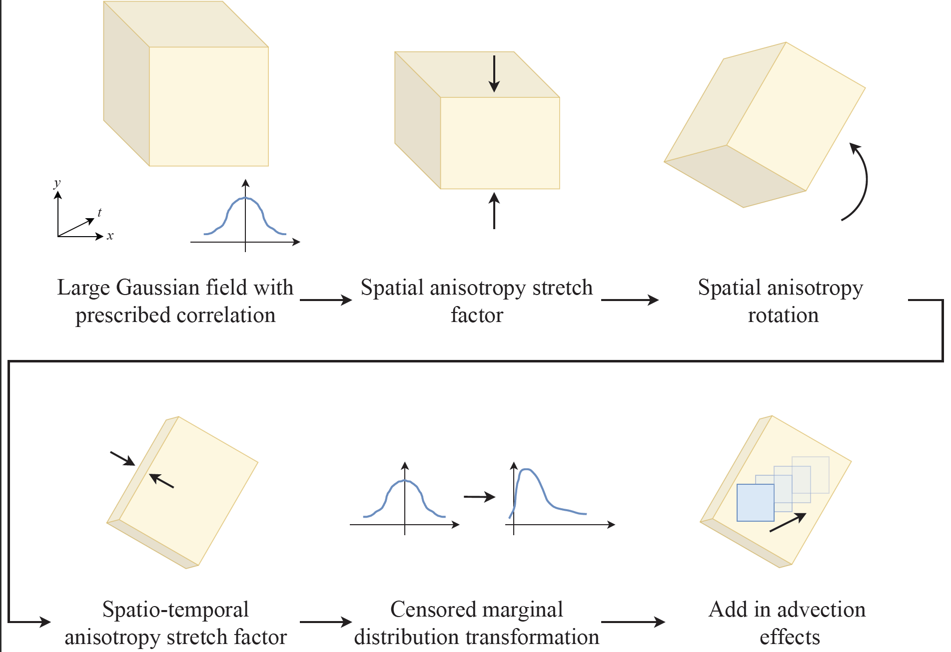
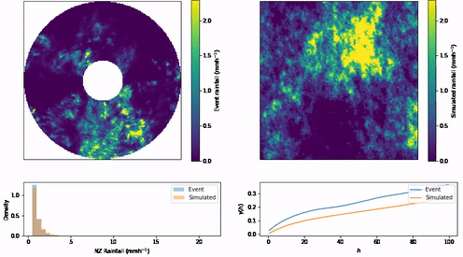
Rainfall model
Quantifying the uncertainty corresponding to the radar rainfall estimation
process: an inverse model for radar attenuation error
Amy Green, Chris Kilsby, András Bárdossy
amy.green3@newcastle.ac.uk
Newcastle University
Rainfall model
Simulated event
Spatial anisotropy stretch factor
Large Gaussian field with prescribed correlation
Spatial anisotropy rotation
Actual event for parametrisation
Spatiotemporal anisotropy stretch factor
Censored marginal distribution transformation
Add in
advection effects
Figure 4: Example simulated rainfall event and actual event used to paramterise simulations, with the marginal non-zero rainfall distribution and covariance structure
Figure 5: Schematic for space-time rainfall model
Summary
Methodology
Results
Introduction
Motivation
Impacts
Aims
Rainfall model
Radar error model
Event errors
Image-based
Rainfall shadows
HS7.1 Precipitation variability from drop scale to catchment scale : measurement, processes and hydrological applications
EGU General Assembly 2023
Notes:
SKIP!

Slide 6
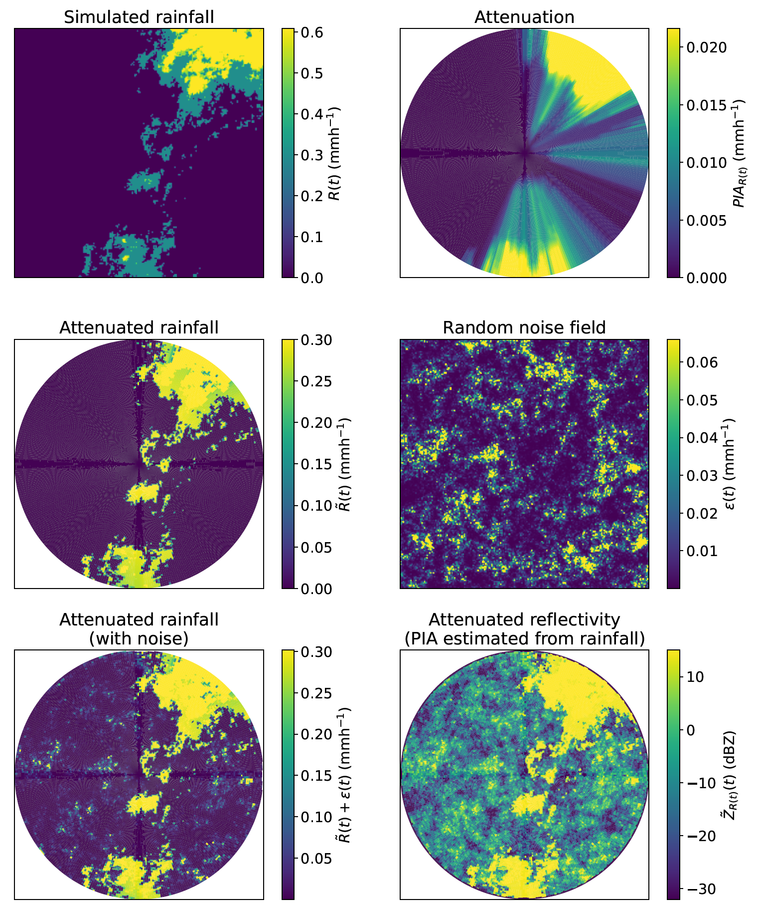
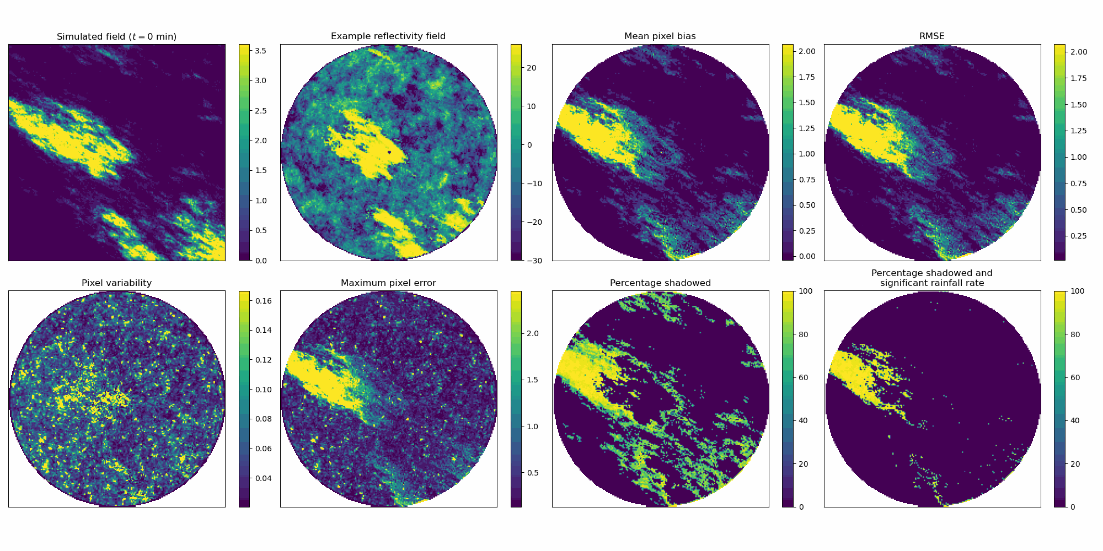
Radar error model
Quantifying the uncertainty corresponding to the radar rainfall estimation
process: an inverse model for radar attenuation error
Amy Green, Chris Kilsby, András Bárdossy
amy.green3@newcastle.ac.uk
Newcastle University
Radar error model
Simulated rainfall event (i.e. ‘true’ rainfall field)
Weather radar image for example single ensemble member
Figure 6: Simulated rainfall field parametrised from clustered spatio-temporal event properties, and corresponding example ensemble member weather radar image
Figure 7: Example for single time step of radar error model steps
Summary
Methodology
Results
Introduction
Motivation
Impacts
Aims
Rainfall model
Radar error model
Event errors
Image-based
Rainfall shadows
HS7.1 Precipitation variability from drop scale to catchment scale : measurement, processes and hydrological applications
EGU General Assembly 2023
Notes:
To do this, standard processing methods were inverted, replacing deterministic parameters with more realistic random fields, accounting for random noise effects, drop-size distribution errors, sampling estimation variance and most importantly, attenuation effects.
For each time step of a simulated space-time rainfall event, we obtained an ensemble of weather radar images.
To allow for direct comparisons, standard radar processing methods are applied to each radar image, to obtain corrected ‘best guess’ rainfall estimates which would be obtained in real world applications.

Slide 7
Event error results
Quantifying the uncertainty corresponding to the radar rainfall estimation
process: an inverse model for radar attenuation error
Amy Green, Chris Kilsby, András Bárdossy
amy.green3@newcastle.ac.uk
Newcastle University
Event error results
Example error structure for simulated event
Variability throughout ensemble
Maximum error throughout ensemble
Average bias
RMSE
Figure 8: Simulated rainfall field, example reflectivity image, average bias, RMSE, pixel ensemble variability and maximum error for an example event (left to right)
Summary
Methodology
Results
Introduction
Motivation
Impacts
Aims
Rainfall model
Radar error model
Event errors
Image-based
Rainfall shadows
HS7.1 Precipitation variability from drop scale to catchment scale : measurement, processes and hydrological applications
EGU General Assembly 2023
Notes:
The difference between the simulated and corrected rainfall, taken to be the error, is considered for each ensemble member.
The variability throughout the ensemble treated as uncertainty in the radar rainfall estimation process.
I am just going to give a quick summary of some of the results from this.

Slide 8
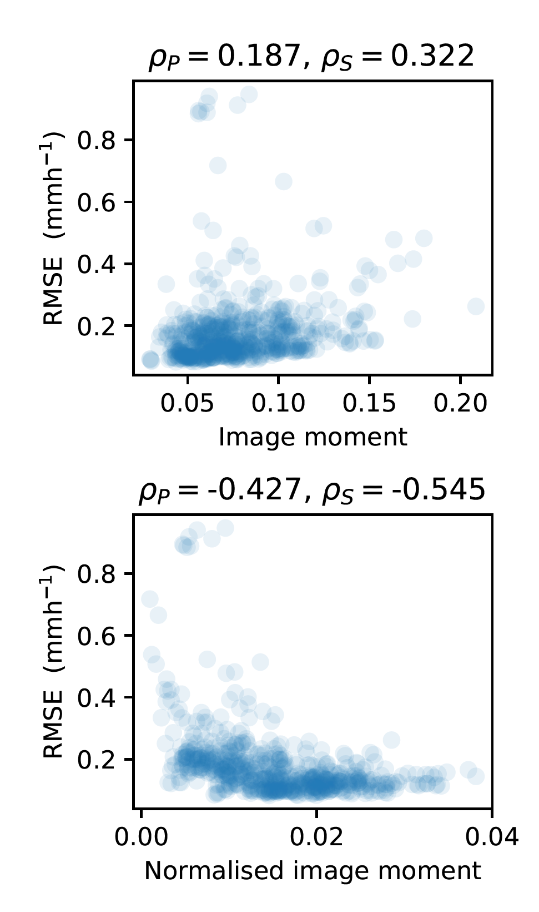
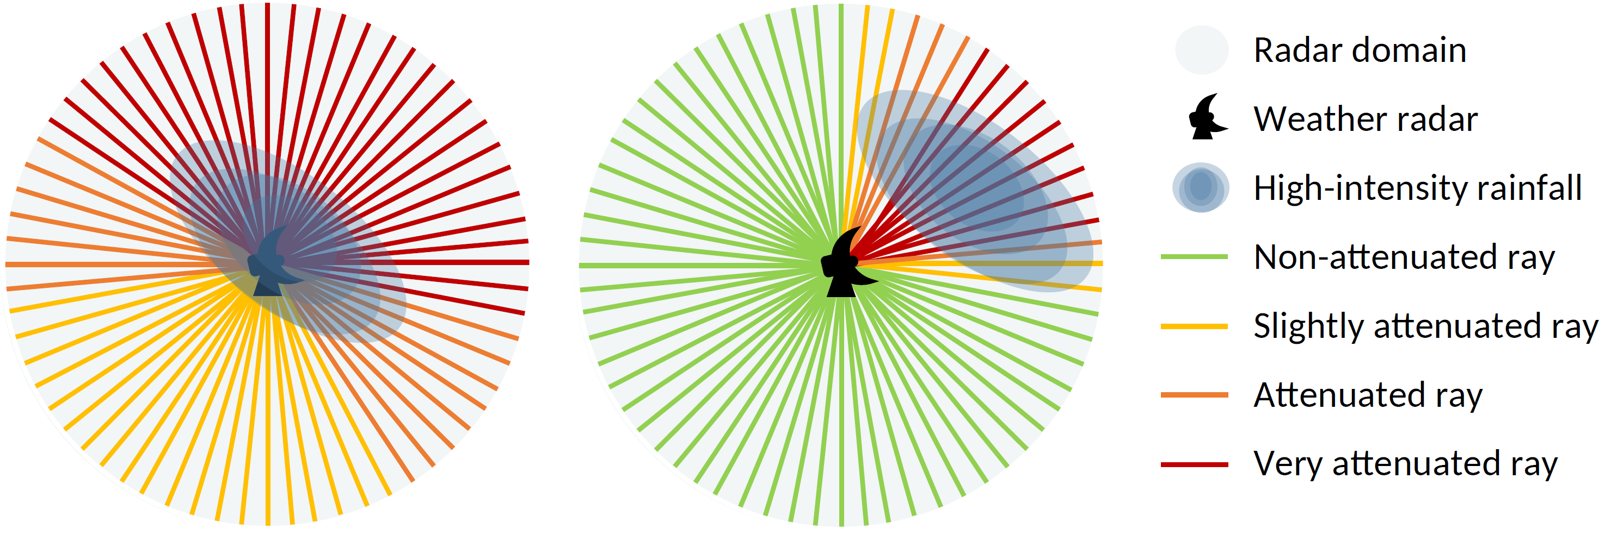
Image-based
Quantifying the uncertainty corresponding to the radar rainfall estimation
process: an inverse model for radar attenuation error
Amy Green, Chris Kilsby, András Bárdossy
amy.green3@newcastle.ac.uk
Newcastle University
Image-based error results
Introduced second moment of area – quantify how central rainfall is in domain, before and after normalising rainfall in image
Figure 9: Diagram of the different effect high-intensity rainfall has on the radar rays based on its location within the domain
Figure 10: Second moment of area of for rainfall images with and without normalisation, and image RMSE
Summary
Methodology
Results
Introduction
Motivation
Impacts
Aims
Rainfall model
Radar error model
Event errors
Image-based
Rainfall shadows
HS7.1 Precipitation variability from drop scale to catchment scale : measurement, processes and hydrological applications
EGU General Assembly 2023
Notes:
SKIP!

Slide 9
Shadows and moments
Quantifying the uncertainty corresponding to the radar rainfall estimation
process: an inverse model for radar attenuation error
Amy Green, Chris Kilsby, András Bárdossy
amy.green3@newcastle.ac.uk
Newcastle University
Rainfall shadows
Rainfall shadows for example event and individual image behaviour for 100 simulated events
Percentile (%) | Proportion shadowed (%) | Largest shadowed area (km²) | Actual shadowed area (km²)
25 | 1 | 0 | 0
50 | 3 | 10.1 | 1.2
75 | 6 | 20.2 | 45.5
90 | 9 | 30.3 | 90.9
95 | 13 | 50.5 | 136.4
Table 1: Minimum frequency percentiles for all simulated rainfall images, of the proportion of significant rainfall shadowed, largest single area shadowed and actual shadowed area
Figure 11: Simulated rainfall field, example reflectivity image and percentage of ensemble members that are shadowed (if pixel is significant rainfall rate)
Summary
Methodology
Results
Introduction
Motivation
Impacts
Aims
Rainfall model
Radar error model
Event errors
Image-based
Rainfall shadows
HS7.1 Precipitation variability from drop scale to catchment scale : measurement, processes and hydrological applications
EGU General Assembly 2023
Notes:
We introduced a simple measure to help understand how often errors result in a rainfall signal completely irretrievable.
Rainfall shadows are defined to be equivalent to where a significant rainfall rate has been completely lost, and would therefore be irretrievable using standard correction methods.
To quantify the frequency of this, we considered the minimum likelihood of occurrence of rainfall shadows throughout the ensemble.
Half of the simulated radar images in events had at least 3% of significant rainfall shadowed and a quarter of images had a shadowed area of over 45km².

Slide 10
Impacts
Quantifying the uncertainty corresponding to the radar rainfall estimation
process: an inverse model for radar attenuation error
Amy Green, Chris Kilsby, András Bárdossy
amy.green3@newcastle.ac.uk
Newcastle University
Impacts
1.
Provides information about radar rainfall that we would otherwise not know
2.
Sets up a framework for a large area of future research, lots of potential uses for radar error model
Allows investigation into radar rainfall errors
Rainfall shadow frequencies
Radar alone cannot be used for rainfall estimation
Highlights the need for conditional simulations of rainfall fields when merging with other sources
Cannot rely on radar field to capture the spatial behaviour of rainfall
Predict where information is lost, allows use other information at these locations
Put gridded rain gauge estimates/forecasts into the model, impose radar errors, compare with radar image for further understanding of error structure
Determine optimal location for weather radars/rain gauges e.g. rain gauges where rainfall shadows likely, not in densely populated areas/cities as too late for warning that radar is missing information, ideally overlapping radars
Assess radar gauge merging techniques
Assess how radar rainfall errors propagate into hydrological and hydrodynamic modelling
Summary
Methodology
Results
Introduction
Motivation
Impacts
Aims
Rainfall model
Radar error model
Event errors
Image-based
Rainfall shadows
HS7.1 Precipitation variability from drop scale to catchment scale : measurement, processes and hydrological applications
EGU General Assembly 2023
Notes:
This gap would result in an underestimation of the impact of potential floods.
To summarise – a model framework for representing the uncertainty in the radar rainfall estimation process has been developed.
This provides methodology for assessing the impacts of radar rainfall errors in many hydrological and meteorological applications.
Thank you for listening, please come and chat to me if you want to know more.

