Slide 1
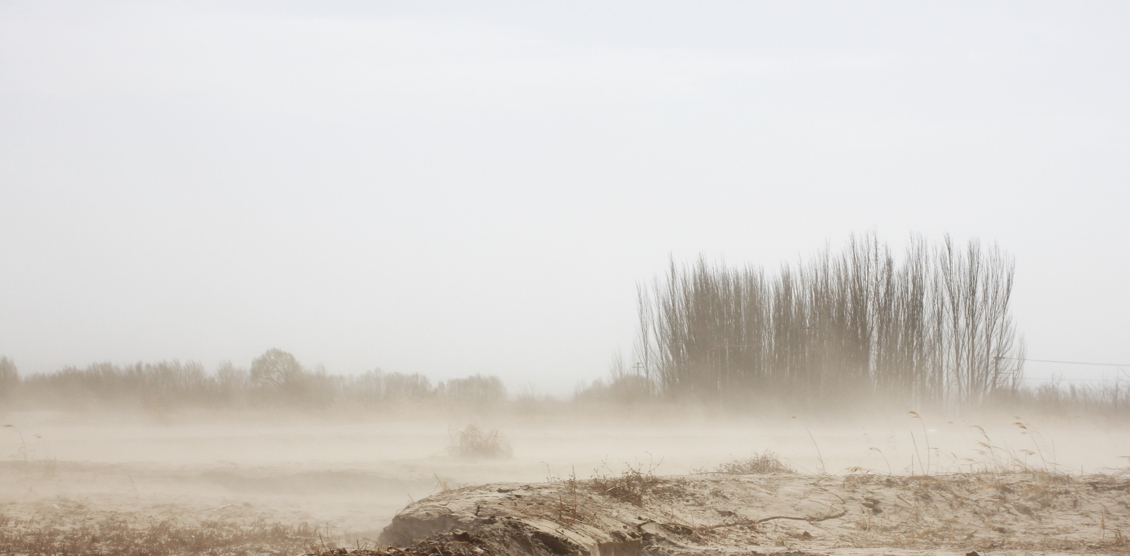
Paleogene to Neogene aeolian dust provenance in the Chinese Loess Plateau region
Katja Bohm^{1,2}, Anu Kaakinen¹, Thomas Stevens², Yann Lahaye³, and Hui Tang^{1,4,5}
¹Department of Geosciences and Geography, University of Helsinki, Helsinki, Finland (katja.bohm@helsinki.fi)
²Department of Earth Sciences, Uppsala University, Uppsala, Sweden
³Geological Survey of Finland, Espoo, Finland.
⁴Finnish Meteorological Institute, Climate System Research, Helsinki, Finland
⁵Department of Geosciences, University of Oslo, Oslo, Norway
1. Background
4. Results
5. Conclusions
Geographic setting
3. Study sites
Late Neogene dust
provenance
Paleogene to Neogene dust provenance
2. Methods
Baode Red Clay (7–2.6 Ma)
Paleoclimatic setting
2.1 zircon
6. Summary
2.2 rutile
Ulantatal loess (34.2–29.3 Ma)
Paleogene dust provenance
Objectives of the study
→ At least c. 34 million years of: Northwesterly winds and Central Asian aridity
Abstract:
Acknowledgements
Photo: A minor dust event on the Yellow River bank

Slide 2
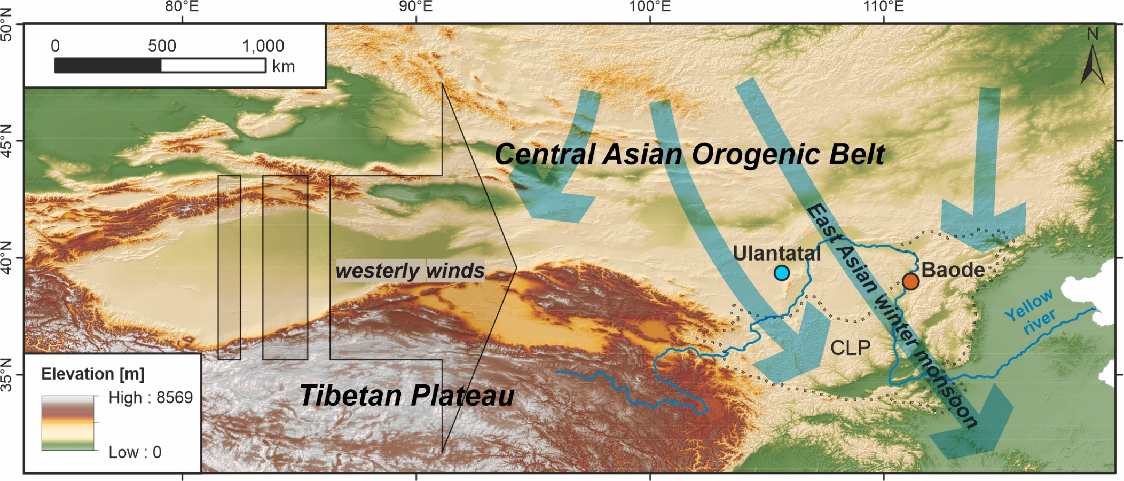
1.1 Geographic setting
Two dust sites (Ulantatal & Baode) at latitude ~40°N: northwest of, or in the northern Chinese Loess Plateau (CLP)
Two dust transporting wind systems: the East Asian winter monsoon and the westerly winds
Two major primary source regions: Central Asian Orogenic Belt (CAOB) and Northern Tibetan Plateau (NTP)
Chinese Loess Plateau (CLP) is an exceptionally large terrestrial dust archive
Abstract:
Geographic setting
Late Neogene dust
provenance
Paleogene to Neogene dust provenance
2. Methods
Paleoclimatic setting
2.1 zircon
Baode Red Clay (7–2.6 Ma)
6. Summary
Objectives of the study
2.2 rutile
Ulantatal loess (34.2–29.3 Ma)
Paleogene dust provenance
Acknowledgements

Slide 3
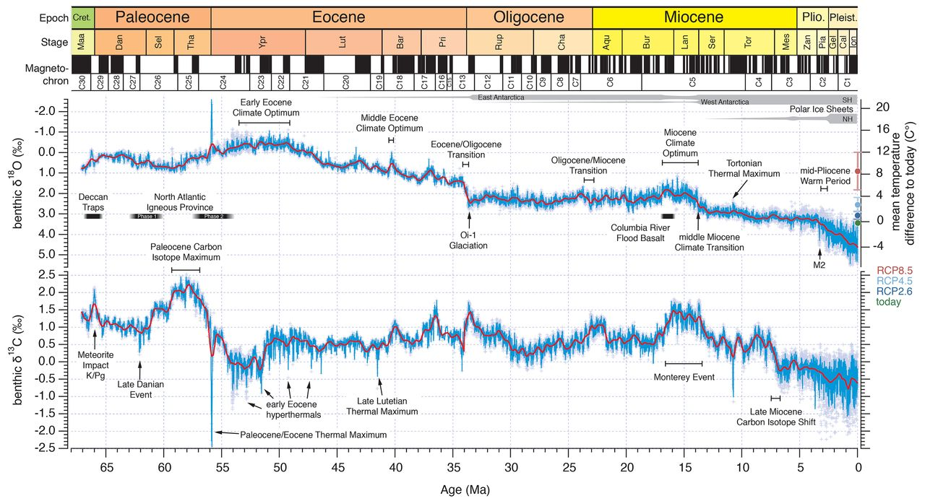
1.2 Paleoclimatic setting
Two time periods of warmer global climates than the pre-industrial → analogous to future climates
Paleogene included the Eocene-Oligocene transition - Central Asia shifted to cooler and drier climates
Late Neogene climate was transitioning towards the Quaternary icehouse conditions
Westerhold et al. (2020), Science, 369(6509): 1383-1387.
Abstract:
Geographic setting
Late Neogene dust
provenance
Paleogene to Neogene dust provenance
2. Methods
Paleoclimatic setting
2.1 zircon
Baode Red Clay (7–2.6 Ma)
6. Summary
Objectives of the study
2.2 rutile
Ulantatal loess (34.2–29.3 Ma)
Paleogene dust provenance
Acknowledgements

Slide 4
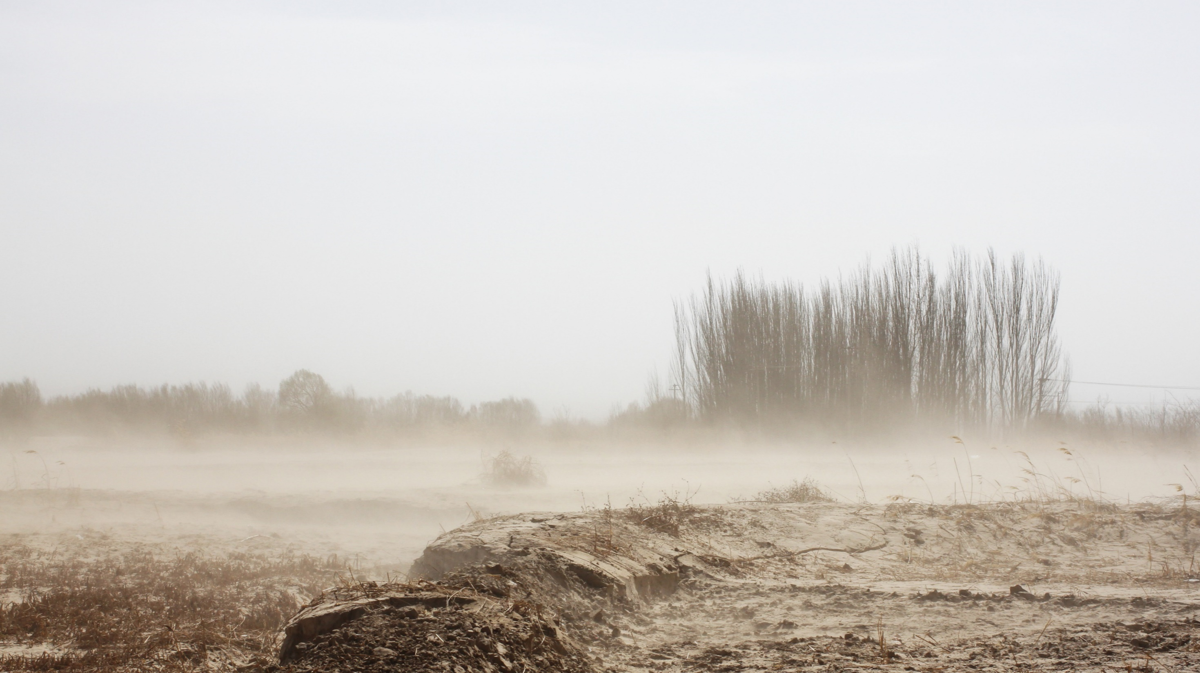
1.3 Objectives of the study
Provenance research:
Backbone for paleoclimatic and -environmental reconstructions (provenance affects grain size and chemical composition of sediments)
Gives crucial information on the evolution of the CLP dust source regions
(e.g. aridification of Central Asia, tectonic uplift of the Tibetan Plateau, Yellow River evolution)
One of the few ways to reconstruct past atmospheric circulation
The objectives of this study:
High-resolution provenance analysis of the two pre-Quaternary dust sequences
Development of a novel single-grain provenance indicator for the CLP region (detrital rutile trace element geochemistry)
Better understanding on the
Central-East Asian paleoenvironments and the interactions of dust, climate and tectonics
Central-East Asian atmospheric circulation during warmer global climates
Abstract:
Geographic setting
Late Neogene dust
provenance
Paleogene to Neogene dust provenance
2. Methods
Paleoclimatic setting
2.1 zircon
Baode Red Clay (7–2.6 Ma)
6. Summary
Objectives of the study
2.2 rutile
Ulantatal loess (34.2–29.3 Ma)
Paleogene dust provenance
Acknowledgements

Slide 5
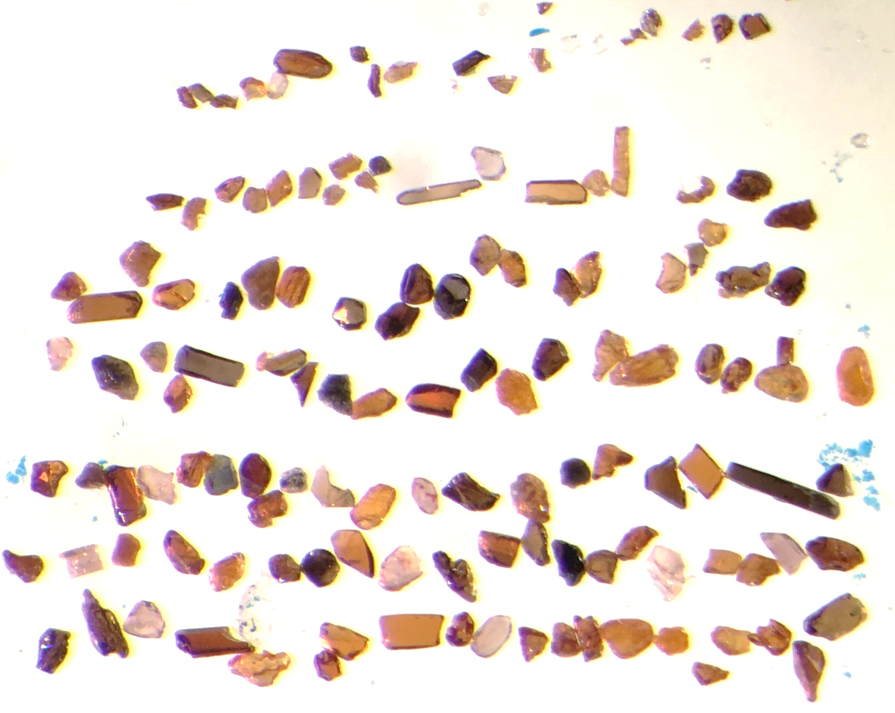
2. Methods
Analyses for both minerals were done at the Geological Survey of Finland (GTK) by using LA-ICP-MS
Figure: Rutiles (with some zircons) from Baode Red Clay
Single-grain analyses allow the distinction of multiple mixed sources in the dust deposits
detrital zircon U-Pb dating +
detrital rutile trace element geochemistry
→ information on different types of source rocks
Hundreds of grains per sample (& per mineral) are analysed
Grain sizes >20 μm
500 μm
Go to:
2.1 zircon
1/2
2/2
2.2 rutile
1/3
2/3
3/3
Abstract:
Geographic setting
1/2
2/2
Late Neogene dust
provenance
Paleogene to Neogene dust provenance
2. Methods
Paleoclimatic setting
2.1 zircon
Baode Red Clay (7–2.6 Ma)
6. Summary
Objectives of the study
2.2 rutile
Ulantatal loess (34.2–29.3 Ma)
Paleogene dust provenance
1/3
2/3
3/3
Acknowledgements

Slide 6
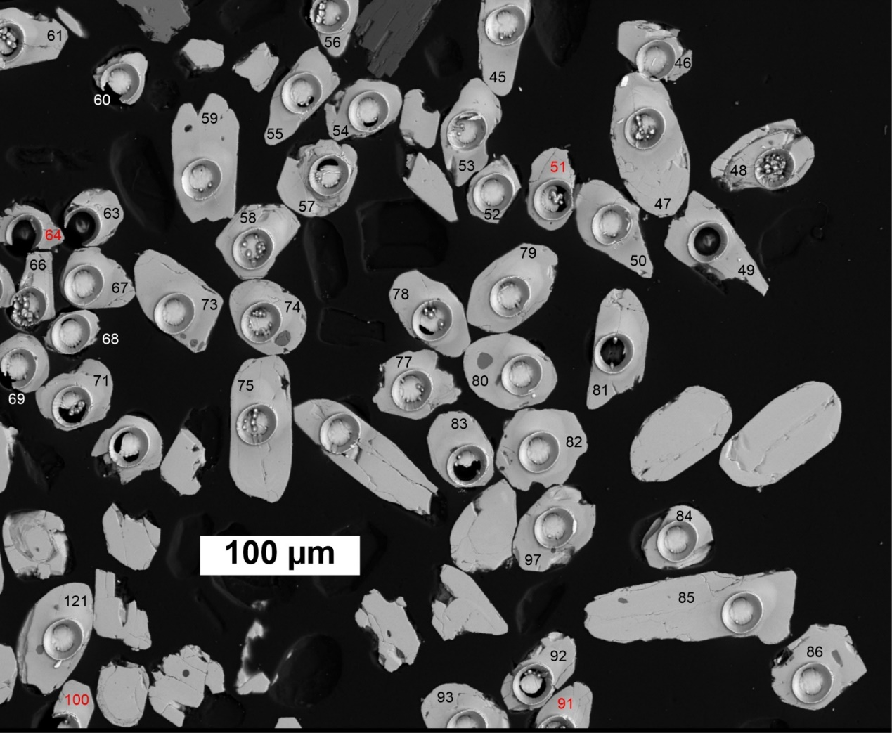
2.1 Methods: zircon (1/2)
Mostly in intermediate-felsic igneous and high-grade metamorphic rocks
U-Pb dating → formation ages of the primary source rocks in which the zircons crystallized
→ Age distributions of the target sediment (loess/Red Clay) are compared to those of the potential source regions (see next slide)
Go to:
2.1 zircon
1/2
2/2
2.2 rutile
1/3
2/3
3/3
Figure: BSE image of zircon grains with laser ablation pits
Abstract:
Geographic setting
1/2
2/2
Late Neogene dust
provenance
Paleogene to Neogene dust provenance
2.1 zircon
Baode Red Clay (7–2.6 Ma)
Paleoclimatic setting
2. Methods
6. Summary
Objectives of the study
2.2 rutile
Ulantatal loess (34.2–29.3 Ma)
Paleogene dust provenance
1/3
2/3
3/3
Acknowledgements

Slide 7
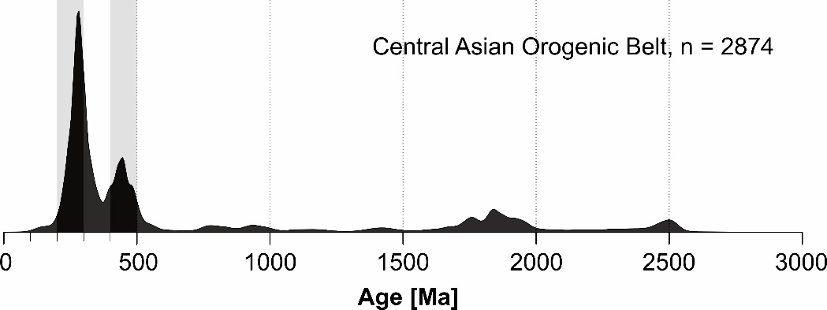
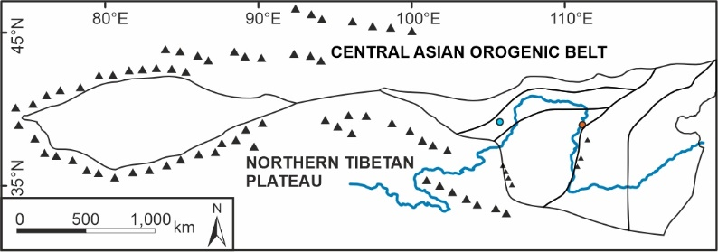
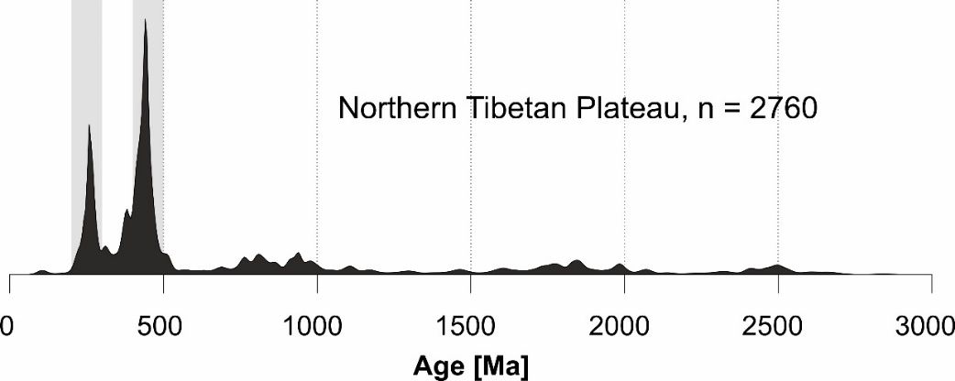
2.1 Methods: zircon (2/2)
Detrital zircon age distributions of two potential primary source regions
Data from numerous published studies
(CAOB)
Go to:
2.1 zircon
1/2
2/2
Note the different heights of the age peaks
2.2 rutile
1/3
2/3
3/3
(NTP)
Abstract:
Geographic setting
1/2
2/2
Late Neogene dust
provenance
Paleogene to Neogene dust provenance
2.1 zircon
Baode Red Clay (7–2.6 Ma)
Paleoclimatic setting
2. Methods
6. Summary
Objectives of the study
2.2 rutile
Ulantatal loess (34.2–29.3 Ma)
Paleogene dust provenance
1/3
2/3
3/3
Acknowledgements

Slide 8
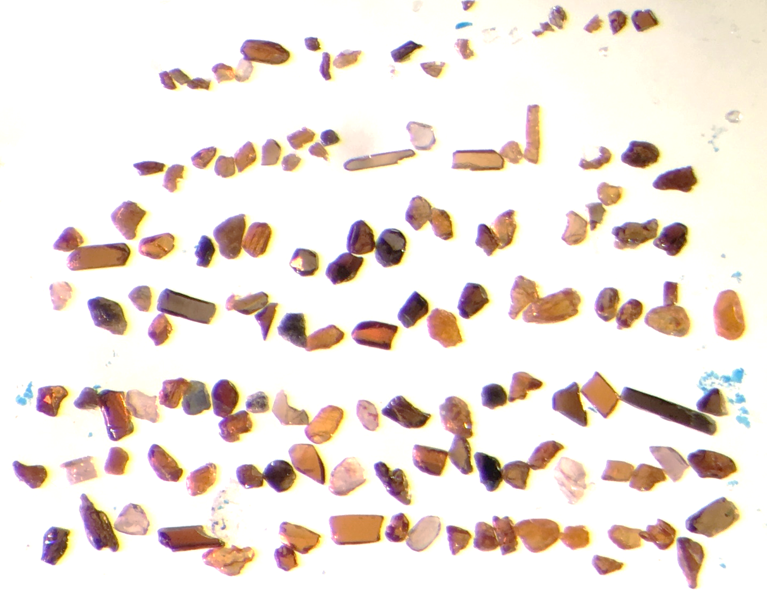
2.2 Methods: rutile (1/3)
Figure: Rutiles with some zircons from Baode Red Clay
Metamorphic mineral
The concentration of Zr is dependent on temperature
→ Zr-in-rutile geothermometer:
the metamorphic temperatures of the primary source rocks
Cr & Nb: primary source rock lithology before metamorphism (metapelitic/-mafic)
500 μm
Go to:
2.1 zircon
1/2
2/2
2.2 rutile
1/3
2/3
3/3
Abstract:
Geographic setting
1/2
2/2
Late Neogene dust
provenance
Paleogene to Neogene dust provenance
2.1 zircon
Baode Red Clay (7–2.6 Ma)
Paleoclimatic setting
2. Methods
6. Summary
Objectives of the study
2.2 rutile
Ulantatal loess (34.2–29.3 Ma)
Paleogene dust provenance
1/3
2/3
3/3
Acknowledgements

Slide 9
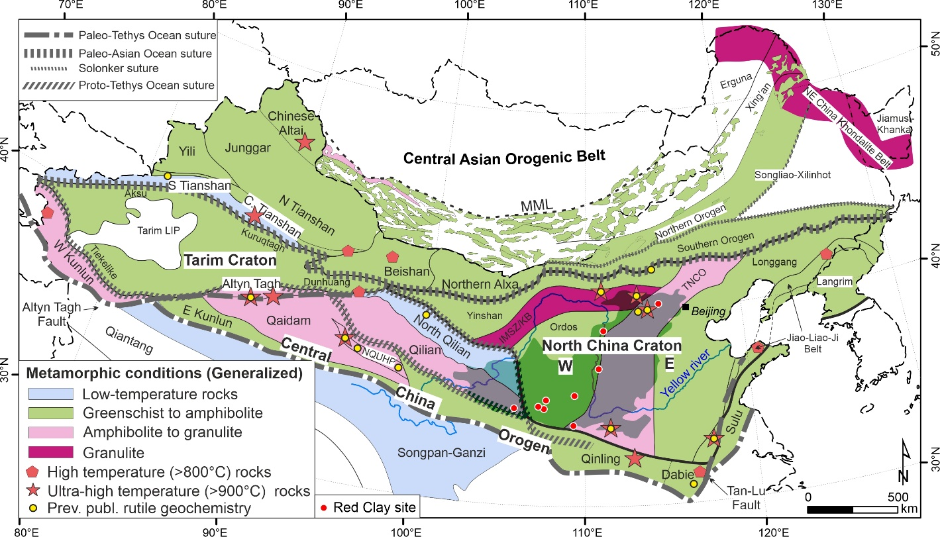
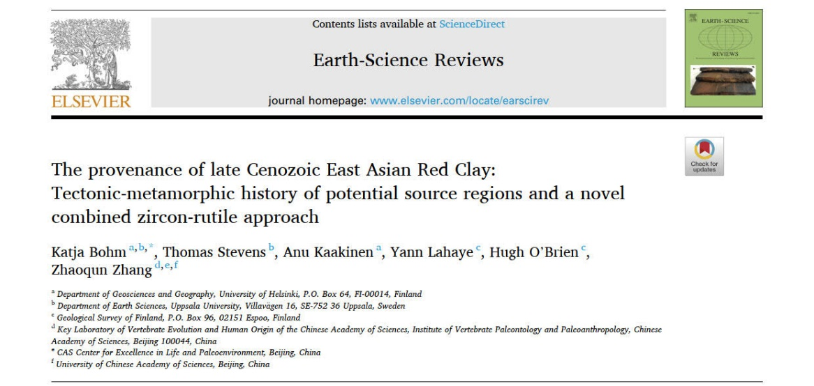
2.2 Methods: rutile (2/3)
The first studies using detrital rutile trace elements in sourcing the Chinese loess
→ Primary source rock information compiled by Bohm et al. (2022):
Go to:
2.1 zircon
1/2
2/2
2.2 rutile
1/3
2/3
3/3
Link to the study
Abstract:
Geographic setting
1/2
2/2
Late Neogene dust
provenance
Paleogene to Neogene dust provenance
2.1 zircon
Baode Red Clay (7–2.6 Ma)
Paleoclimatic setting
2. Methods
6. Summary
Objectives of the study
2.2 rutile
Ulantatal loess (34.2–29.3 Ma)
Paleogene dust provenance
1/3
2/3
3/3
Acknowledgements

Slide 10
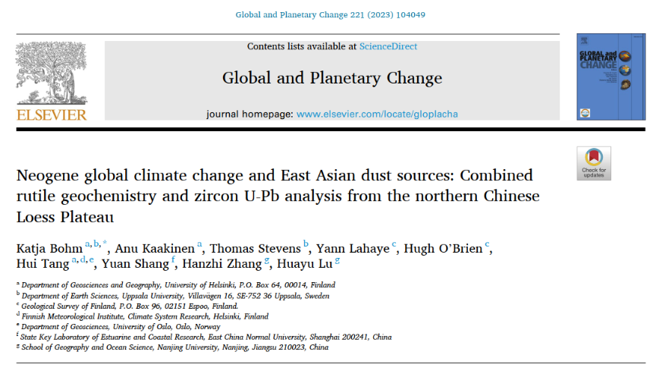
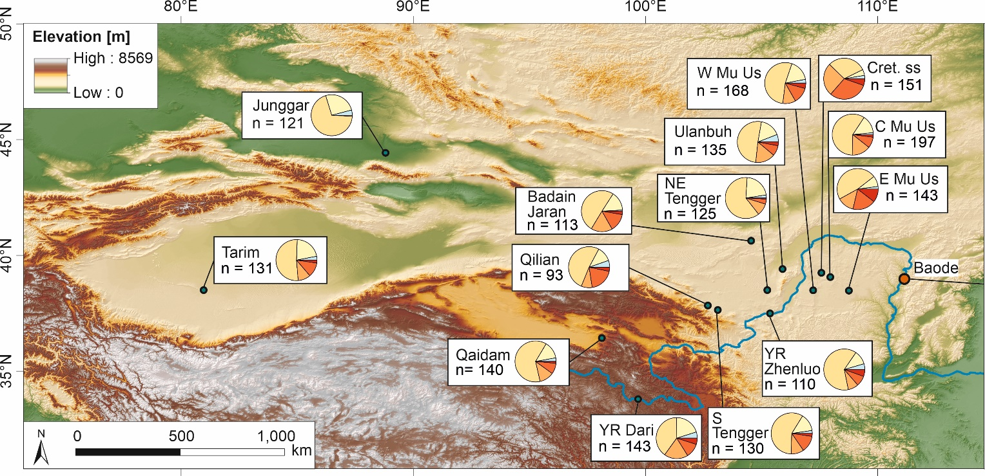
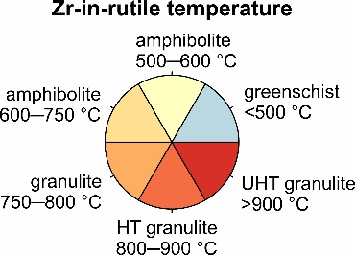
2.2 Methods: rutile (3/3)
Sedimentary source region data by Bohm et al. (2023):
Go to:
2.1 zircon
1/2
2/2
2.2 rutile
1/3
2/3
3/3
Geographic setting
1/2
2/2
Late Neogene dust
provenance
Paleogene to Neogene dust provenance
2.1 zircon
Baode Red Clay (7–2.6 Ma)
Paleoclimatic setting
2. Methods
6. Summary
Objectives of the study
2.2 rutile
Ulantatal loess (34.2–29.3 Ma)
Paleogene dust provenance
1/3
2/3
3/3
Acknowledgements

Slide 11
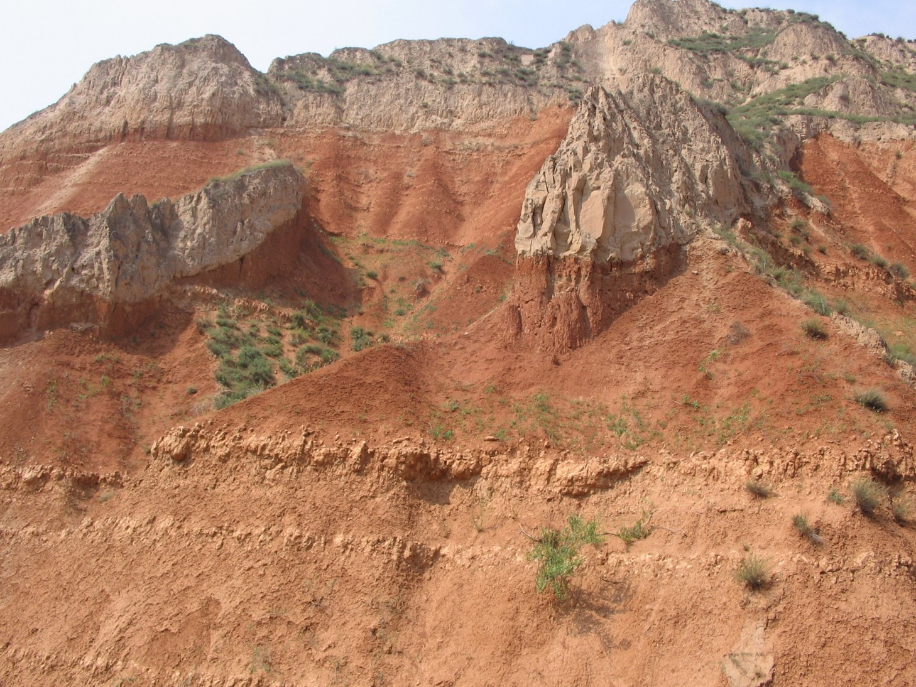
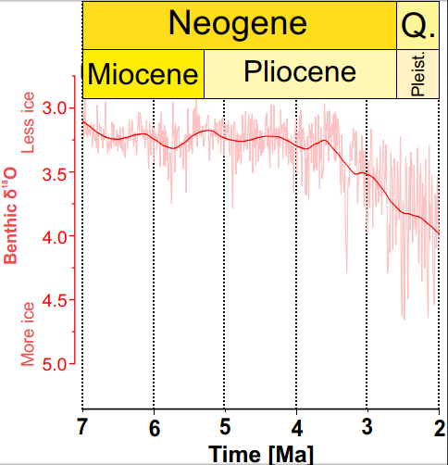
3.1 Baode Red Clay (7–2.6 Ma)
2.7-2.6 Ma: Transitional Unit (TU): 1 sample
(Quaternary
Loess)
-- 2.6 Ma --
Pliocene Jingle Formation (JL):
5 samples
Samples:
BD 5.75 Ma
TU 2.64 Ma
Benthic δ¹⁸O data from Westerhold et al. (2020), Science, 369(6509): 1383-1387.
BD 6.56 Ma
JL 4.04 Ma
JL 3.39 Ma
----- 5.3 Ma -----
BD 6.91 Ma
JL 5.24 Ma
JL 3.67 Ma
JL 2.79 Ma
Miocene Baode Formation (BD):
3 samples
Photo: Anu Kaakinen
BD
JL
TU
Abstract:
Geographic setting
Late Neogene dust
provenance
Paleogene to Neogene dust provenance
2.1 zircon
Baode Red Clay (7–2.6 Ma)
Paleoclimatic setting
2. Methods
6. Summary
Objectives of the study
2.2 rutile
Ulantatal loess (34.2–29.3 Ma)
Paleogene dust provenance
Acknowledgements

Slide 12
4.1 Late Neogene dust provenance (1/3)
A detailed provenance analysis was recently published (Bohm et al. 2023):
Go to:
Late Neogene dust
provenance
Link to the article:
1/3
2/3
3/3
Abstract:
Geographic setting
Late Neogene dust
provenance
Paleogene to Neogene dust provenance
2.1 zircon
Baode Red Clay (7–2.6 Ma)
Paleoclimatic setting
2. Methods
6. Summary
Objectives of the study
2.2 rutile
Ulantatal loess (34.2–29.3 Ma)
Paleogene dust provenance
Acknowledgements

Slide 13
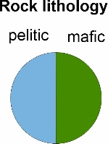
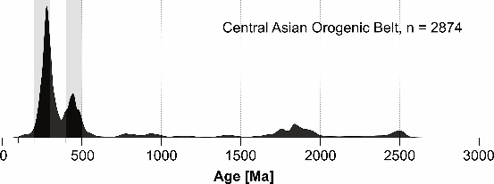
4.1 Late Neogene dust provenance (2/3)
Depositional age:
After the onset of Late Miocene cooling at c. 6.6 Ma, provenance gradually changed to mostly CAOB (NW source) in the Pliocene
→ East Asian winter monsoon dust transport
Go to:
Late Neogene dust
provenance
1/3
2/3
3/3
Source region data, see slide:
zircon 2/2
(CAOB)
The Lower Baode Fm has a dominant source from the NTP
NTP uplift
Onset of dust deposition on the eastern CLP
(NTP)
Baode data include previously published zircon data from Shang et al. (2016), Earth Planet. Sci. Lett. 439: 88-100.
Geographic setting
Late Neogene dust
provenance
Paleogene to Neogene dust provenance
2.1 zircon
Baode Red Clay (7–2.6 Ma)
Paleoclimatic setting
2. Methods
6. Summary
Objectives of the study
2.2 rutile
Ulantatal loess (34.2–29.3 Ma)
Paleogene dust provenance
Acknowledgements

Slide 14
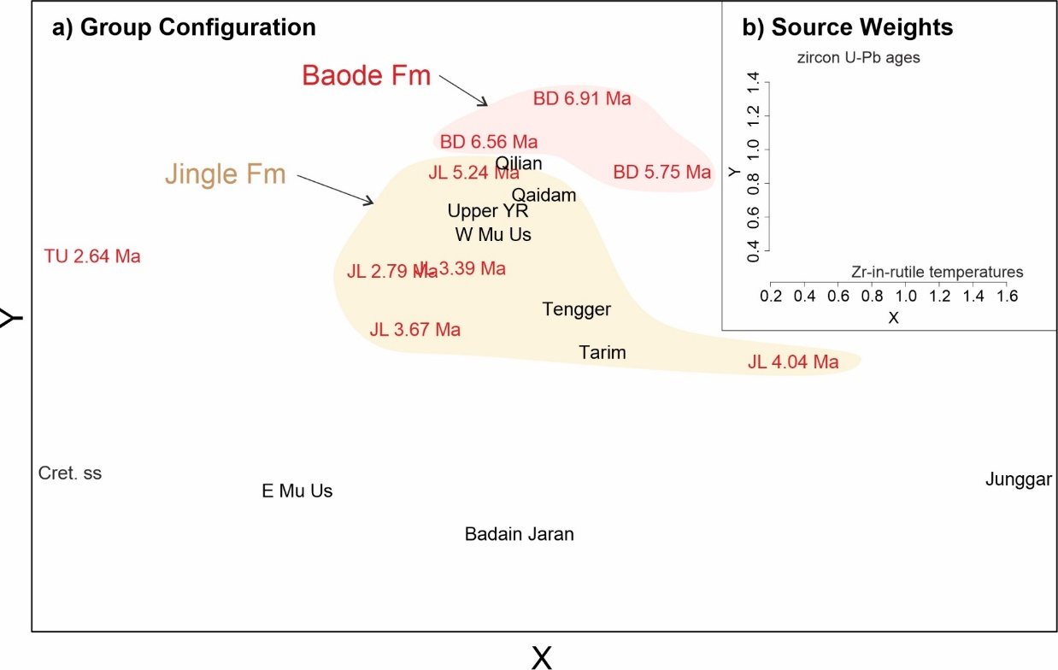
4.1 Late Neogene dust provenance (3/3)
The gradual change from the dominantly NTP/west-sourced Miocene Baode Fm and CAOB/northwest-sourced Pliocene Jingle Fm is seen in both provenance indicator minerals
Go to:
Late Neogene dust
provenance
1/3
2/3
3/3
Locations of the source region samples:
rutile 3/3
Figure: An Individual differences scaling (INDSCAL) map of the combined zircon and rutile data (Baode Red Clay & potential sedimentary source areas). The differences in the X-axis are mostly produced by the rutile data, and those in the Y-axis by the zircon data
Abstract:
Geographic setting
Late Neogene dust
provenance
Paleogene to Neogene dust provenance
2.1 zircon
Baode Red Clay (7–2.6 Ma)
Paleoclimatic setting
2. Methods
6. Summary
Objectives of the study
2.2 rutile
Ulantatal loess (34.2–29.3 Ma)
Paleogene dust provenance
Acknowledgements

Slide 15
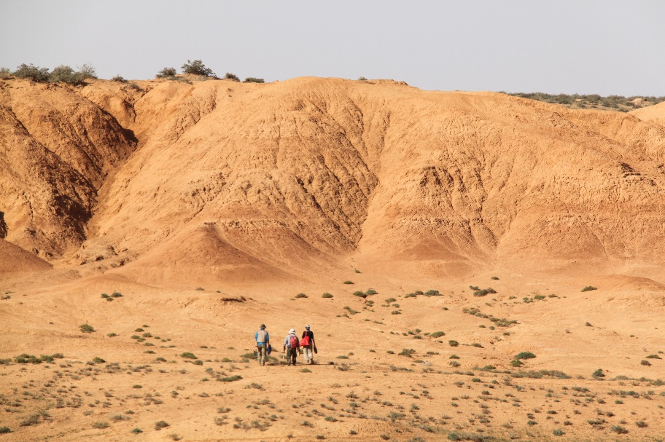
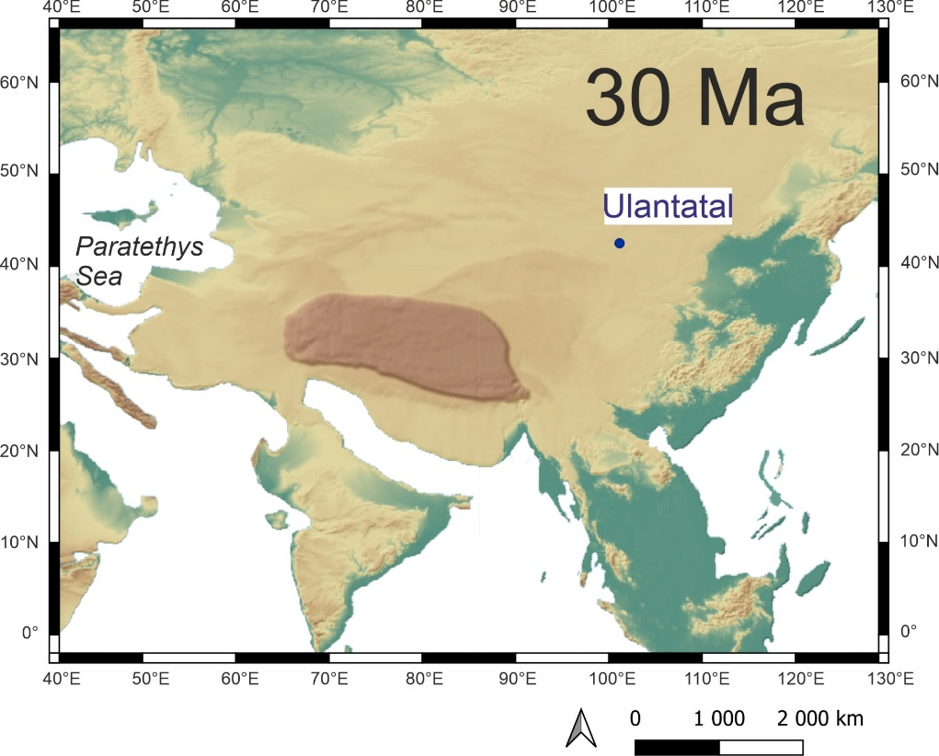
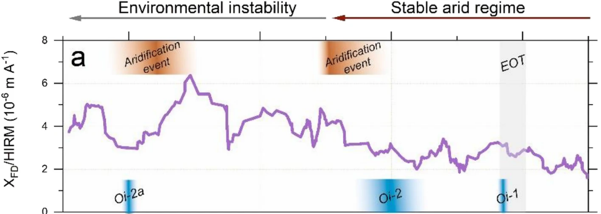
3.2 Ulantatal loess (34.2–29.3 Ma)
In the Paleogene, Paratethys Sea was a moisture source via westerly winds, and the India-Asia collision was not as complete as today.
In Ulantatal, the Eocene-Oligocene transition (EOT) was not observed in precipitation proxies (Wasiljeff et al. 2022). Instead, aridification culminated at 31 Ma.
Central Asian Orogenic Belt
Photo: Anu Kaakinen
proto-Tibetan Plateau
Five provenance samples from 34.2–29.3 Ma:
32.5 Ma
33.1 Ma
34.2 Ma
Samples:
30.9 Ma
29.3 Ma
Paleomap created by QGIS plugin Terra Antiqua (Poblete, F., et al., 2021. Earth Sci. Rev. 214: 103508.;
https://paleoenvironment.eu/terra-antiqua/)
Wasiljeff et al. 2022; Sci. Rep. 12:5597
Geographic setting
Late Neogene dust
provenance
Paleogene to Neogene dust provenance
2.1 zircon
Baode Red Clay (7–2.6 Ma)
Paleoclimatic setting
2. Methods
6. Summary
Objectives of the study
2.2 rutile
Ulantatal loess (34.2–29.3 Ma)
Paleogene dust provenance
Acknowledgements

Slide 16
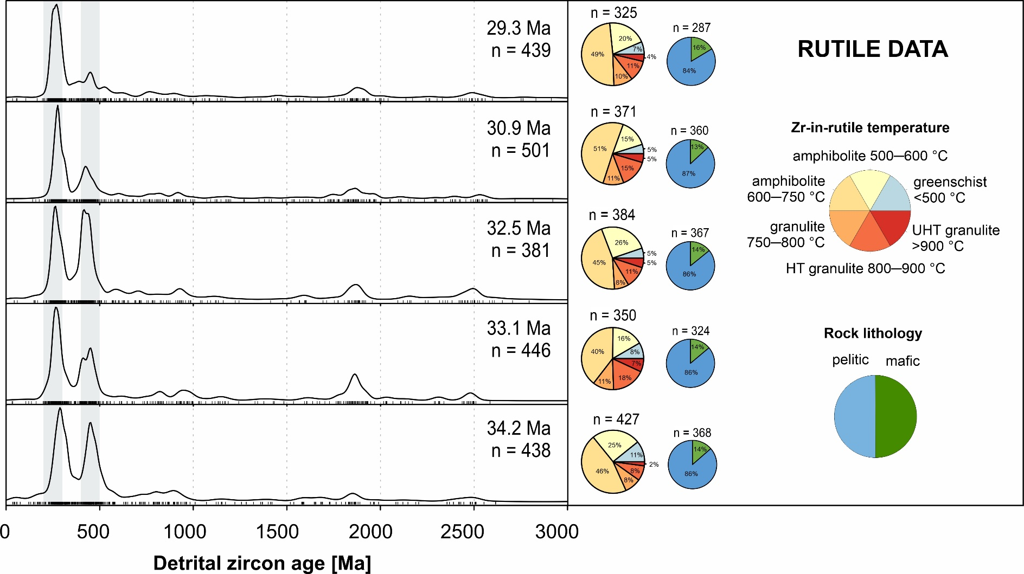
4.2 Paleogene dust provenance (in prep.) (1/2)
Provenance mostly CAOB (to the northwest)
Northwesterly dust transport (East Asian winter monsoon?)
Paleogene dust provenance
1/2
2/2
Only the 32.5 Ma sample has a dominant NTP/west source
Source region data, see slide:
zircon 2/2
Oligocene
(CAOB)
Eocene
Rutile data show small variations
(NTP)
Geographic setting
Late Neogene dust
provenance
Paleogene to Neogene dust provenance
2.1 zircon
Baode Red Clay (7–2.6 Ma)
Paleoclimatic setting
2. Methods
6. Summary
Objectives of the study
2.2 rutile
Ulantatal loess (34.2–29.3 Ma)
Paleogene dust provenance
Acknowledgements

Slide 17
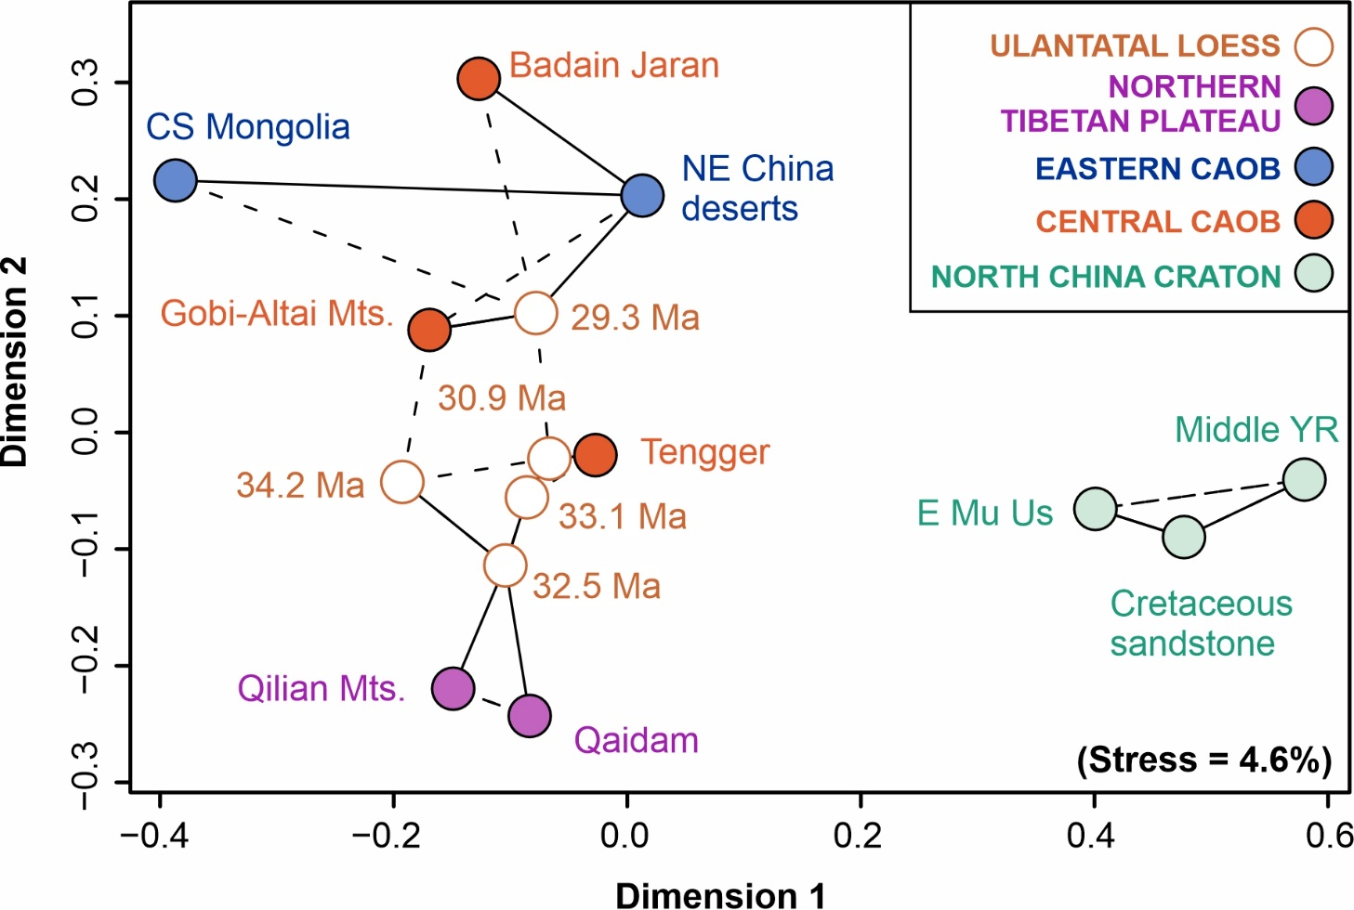
4.2 Paleogene dust provenance (in prep.) (2/2)
Provenance mostly CAOB (to the northwest)
Northwesterly dust transport (East Asian winter monsoon?)
Paleogene dust provenance
1/2
2/2
Only the 32.5 Ma sample has a dominant NTP/west source
Figure: A multidimensional scaling (MDS) map of the Ulantatal and source region zircon age data. Samples with (dis)similar age distributions plot close to (far from) each other.
Geographic setting
Late Neogene dust
provenance
Paleogene to Neogene dust provenance
2.1 zircon
Baode Red Clay (7–2.6 Ma)
Paleoclimatic setting
2. Methods
6. Summary
Objectives of the study
2.2 rutile
Ulantatal loess (34.2–29.3 Ma)
Paleogene dust provenance
Acknowledgements

Slide 18
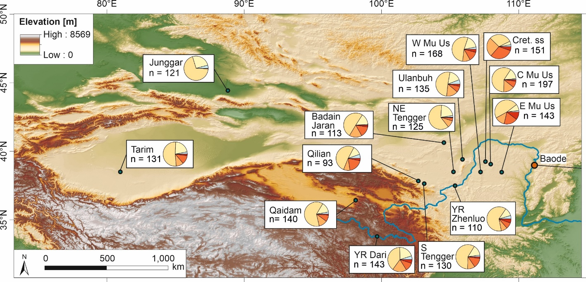
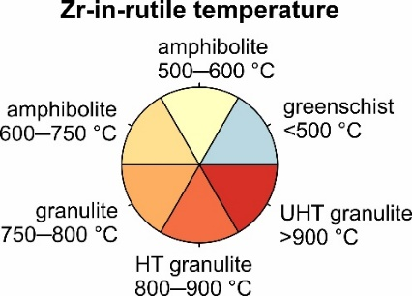
5. Paleogene to Neogene dust provenance (1/5)
Detrital rutiles (Zr-in-rutile temperatures) are more useful at the Baode site than in Ulantatal.
Baode
Very high-temperature metamorphic terranes to the north of Baode
→ easily identified from the rutile data
For Ulantatal, those distinct sources are to the east
→ not on the westerly or northwesterly dust transport path
Paleogene to Neogene dust provenance
1/5
2/5
3/5
4/5
5/5
Ulantatal
Abstract:
Geographic setting
Late Neogene dust
provenance
Paleogene to Neogene dust provenance
2.1 zircon
Baode Red Clay (7–2.6 Ma)
Paleoclimatic setting
2. Methods
6. Summary
Objectives of the study
2.2 rutile
Ulantatal loess (34.2–29.3 Ma)
Paleogene dust provenance
Acknowledgements

Slide 19
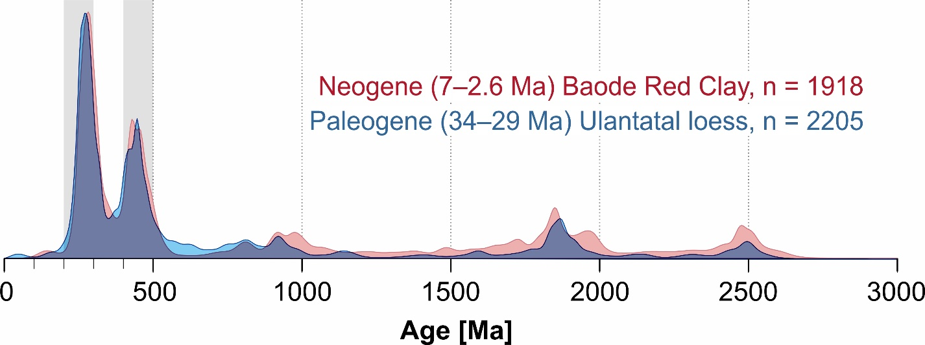
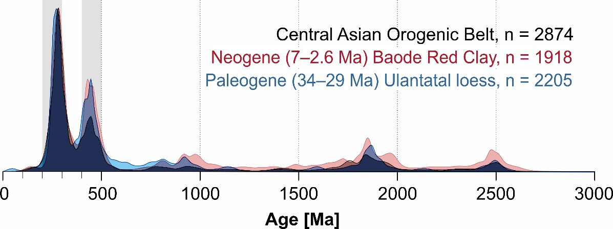
5. Paleogene to Neogene dust provenance (2/5)
The combined late Neogene Baode Red Clay detrital zircon data are very similar to the Paleogene Ulantatal loess data
Paleogene to Neogene dust provenance
The dominant overall provenance signal in Baode and Ulantatal is the Central Asian Orogenic Belt in the northwest/north/northeast
1/5
2/5
3/5
4/5
5/5
Geographic setting
Late Neogene dust
provenance
Paleogene to Neogene dust provenance
2.1 zircon
Baode Red Clay (7–2.6 Ma)
Paleoclimatic setting
2. Methods
6. Summary
Objectives of the study
2.2 rutile
Ulantatal loess (34.2–29.3 Ma)
Paleogene dust provenance
Acknowledgements

Slide 20
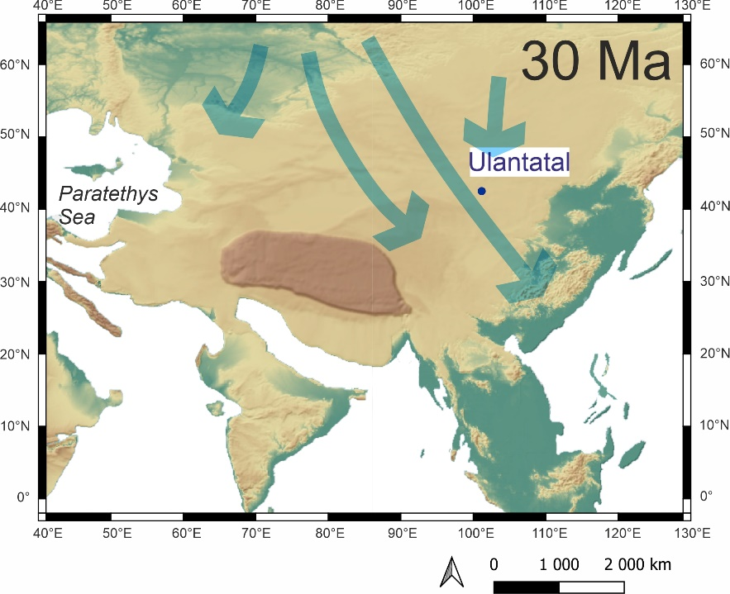
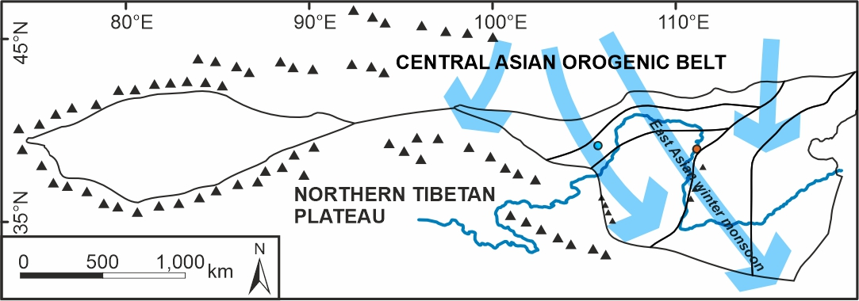
5. Paleogene to Neogene dust provenance (3/5)
At least c. 34 million years of:
Northwesterly winds (East Asian winter monsoon?) despite changes in paleogeography
Central Asian aridity despite Paleogene moisture transport from the Paratethys Sea
Paleogene to Neogene dust provenance
Ulantatal loess is possibly also a source for the Baode Red Clay in the late Miocene. Supported by:
The lack of Miocene dust deposits in Ulantatal
Late Miocene tectonic activity in the Ulantatal region
1/5
2/5
3/5
4/5
5/5
Geographic setting
Late Neogene dust
provenance
Paleogene to Neogene dust provenance
2.1 zircon
Baode Red Clay (7–2.6 Ma)
Paleoclimatic setting
2. Methods
6. Summary
Objectives of the study
2.2 rutile
Ulantatal loess (34.2–29.3 Ma)
Paleogene dust provenance
Acknowledgements

Slide 21
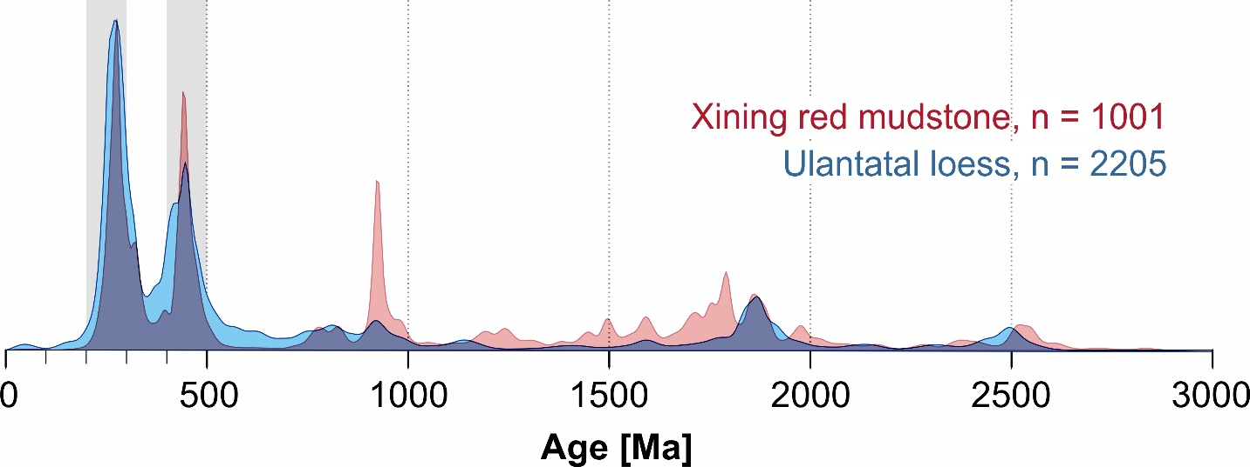
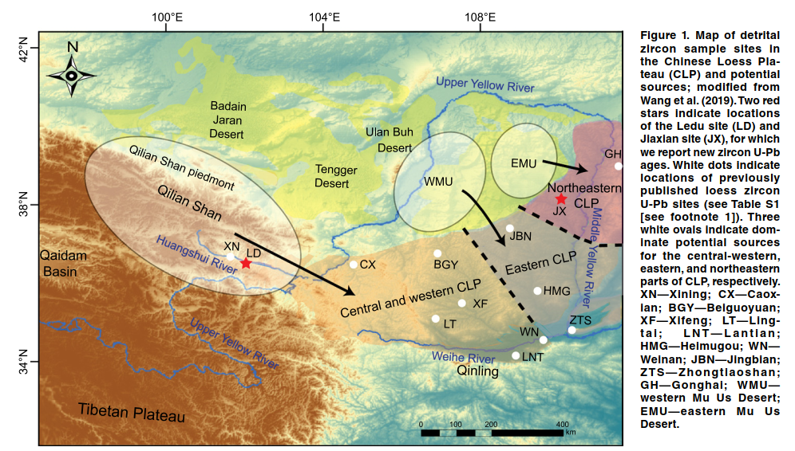
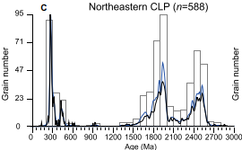
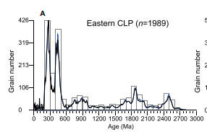
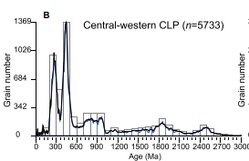
5. Paleogene to Neogene dust provenance (4/5)
Ulantatal loess provenance differs from the 42–33 Ma aeolian Xining red mudstones on the southwestern margin of the CLP
Xining data from Licht et al. 2016. Nat. Comm. 7: 12390
Paleogene to Neogene dust provenance
Quaternary Loess:
1/5
2/5
3/5
Similar spatial source variation in the Neogene Red Clay and Quaternary loess
4/5
5/5
Zhang, H., et al. 2021. Geology, 49 (10): 1155–1159.
Geographic setting
Late Neogene dust
provenance
Paleogene to Neogene dust provenance
2.1 zircon
Baode Red Clay (7–2.6 Ma)
Paleoclimatic setting
2. Methods
6. Summary
Objectives of the study
2.2 rutile
Ulantatal loess (34.2–29.3 Ma)
Paleogene dust provenance
Acknowledgements

Slide 22
5. Paleogene to Neogene dust provenance (5/5)
Fluvial processes (proto-Yellow River), have been argued to explain the spatial variation in the late Neogene-Quaternary CLP dust provenance, but the Paleogene fluvial systems are unknown
Ulantatal loess provenance differs from the 42–33 Ma aeolian Xining red mudstones on the southwestern margin of the CLP
Dust provenance is defined by adjacent sources
and/or
Predominant dust transporting wind directions differ across the CLP region
Paleogene to Neogene dust provenance
1/5
2/5
3/5
Xining
4/5
5/5
Fluvial processes (proto-Yellow River), have been argued to explain the spatial variation in the late Neogene-Quaternary CLP dust provenance, but the Paleogene fluvial systems are unknown.
The paleolocations of the sites were acquired from the Paleoenvironment map website (https://map.paleoenvironment.eu) on 21 April 2023
Geographic setting
Late Neogene dust
provenance
Paleogene to Neogene dust provenance
2.1 zircon
Baode Red Clay (7–2.6 Ma)
Paleoclimatic setting
2. Methods
6. Summary
Objectives of the study
2.2 rutile
Ulantatal loess (34.2–29.3 Ma)
Paleogene dust provenance
Acknowledgements

Slide 23
6. Summary
Central Asian Orogenic Belt
Similar northwesterly provenance of Ulantatal loess and Baode Red Clay
→ At least c. 34 million years of:
Northwesterly winds (East Asian winter monsoon?) despite changes in paleogeography
Central Asian aridity despite Paleogene moisture transport from the Paratethys Sea
proto-Tibetan Plateau
Abstract:
Geographic setting
Late Neogene dust
provenance
Paleogene to Neogene dust provenance
2.1 zircon
Baode Red Clay (7–2.6 Ma)
Paleoclimatic setting
2. Methods
6. Summary
Objectives of the study
2.2 rutile
Ulantatal loess (34.2–29.3 Ma)
Paleogene dust provenance
Acknowledgements

Slide 24
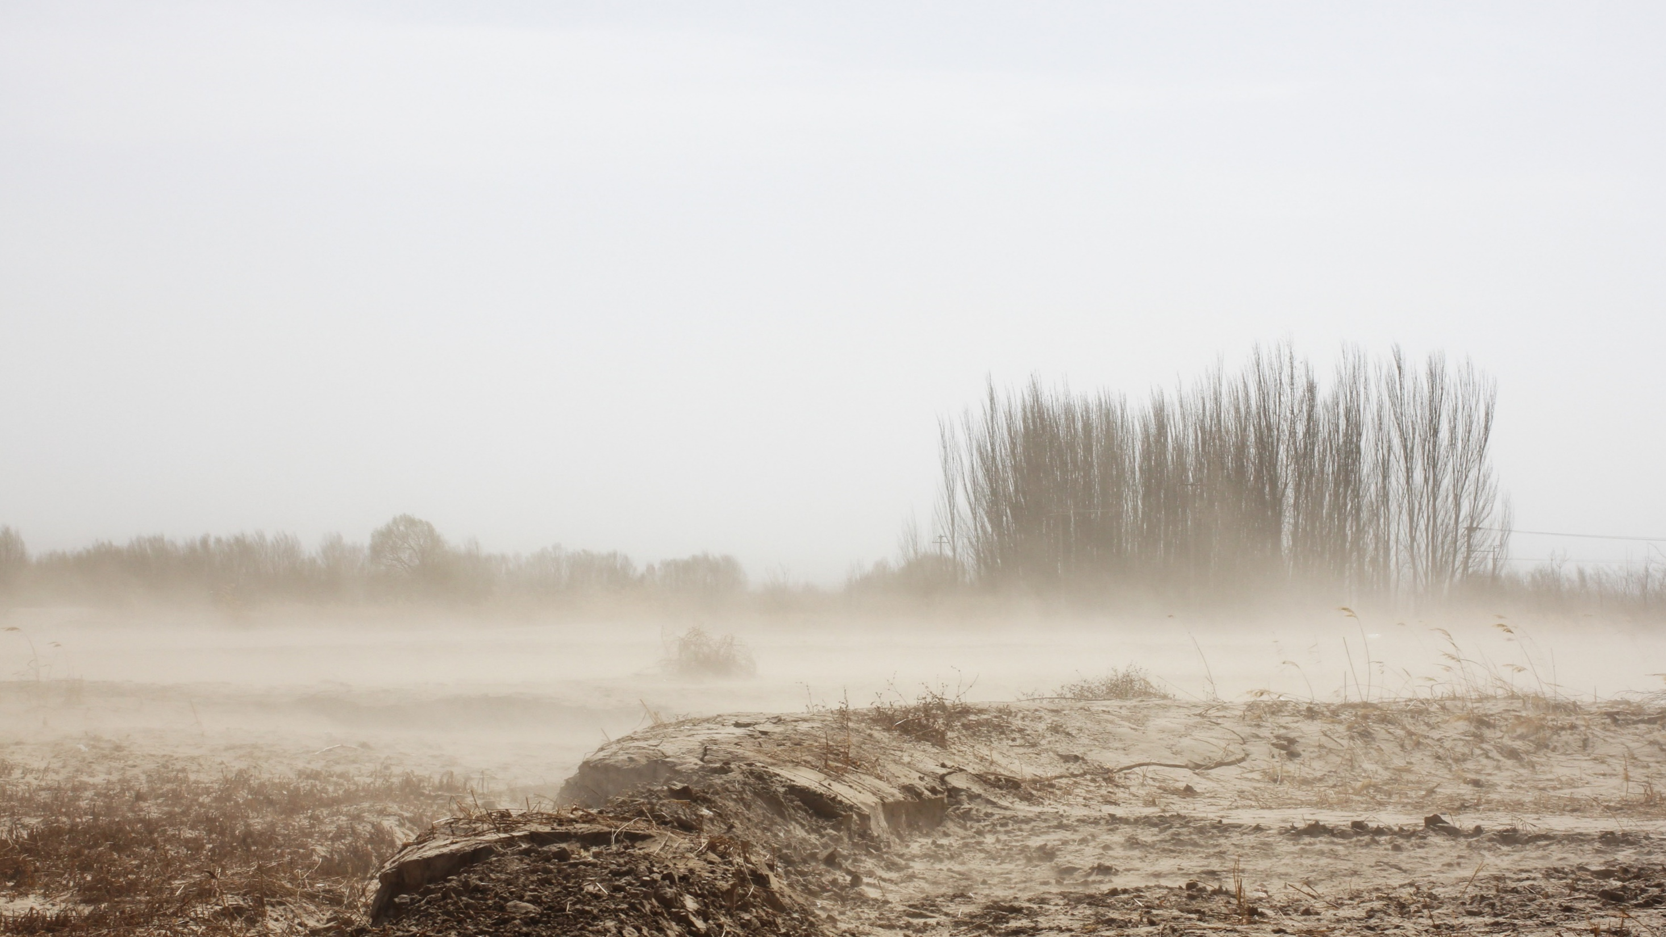
Acknowledgements
Magnus Ehrnrooth Foundation
The Finnish Concordia Fund
Abstract:
Geographic setting
Late Neogene dust
provenance
Paleogene to Neogene dust provenance
2.1 zircon
Baode Red Clay (7–2.6 Ma)
Paleoclimatic setting
2. Methods
6. Summary
Objectives of the study
2.2 rutile
Ulantatal loess (34.2–29.3 Ma)
Paleogene dust provenance

