Slide 1
The composition of asbestos bodies in human lungs
Fabrizio Bardelli, Carlotta Giacobbe, Alessandro Pacella, Francesco Di Benedetto, Giordano Montegrossi, Violetta Borelli, Paolo Ballirano, and Donata Bellis
Geosciences for a sustainable future, September, 19 – 21 - Torino
Notes:
In this presentation I will describe our efforts to reveal the exact composition of the asbestos bodies in human lungs
Besides the authors, I want to mention also prof. Elena Belluso and Dr. Silvana Capella, because I will remind some previous results obtained working with them. And of course I want to mention Dr. Donata Bellis, who gave us the lung tissue samples of former asbestos workers and provided valuable knowledge

Slide 2
Asbestos: still a present danger
Asbestos induces pleural mesothelioma (5-year survival rate: 5%) and other pulmonary diseases
1960s: First modern epidemiological evidences
1980s – 1990s: Worldwide ban on asbestos extraction, production, and commercialization (with some notable exceptions)
5,000 deaths per year only in Western Europe
Peak of mortality predicted in the next 5 years in most countries
Causes:
Long latency time of mesothelioma (20 – 40 years)
Weathering of existing asbestos manufacts
Natural occurring asbestos (NOA)
Notes:
Even if you probably already know, I want to quickly remind the extent of the asbestos danger
Asbestos is known to induce pleural mesothelioma, a cancer of the lung lining with a 5-year survival rate of only 5%, and other seriuous pulmonary diseases
The link between asbestos and mesothelioma has been proven by science since the sixties
Starting from the eighties, asbestos extraction, production, and commercialization has been started to be ban worldwide, with some notable exceptions, as china, india, canada, russia and brazil
One may think that the asbestos problem has been solved with the ban, but the truth is that asbestos remains a major health risk worldwide with about 5000 deaths per year only in western Europe and the peak of mortality predicted in the next five years in most countries
This is due to the long latency time of mesothelioma (from 20 to 40 years), to the weathering of existing asbestos manufacts, and to natural occurring asbestos.

Slide 3
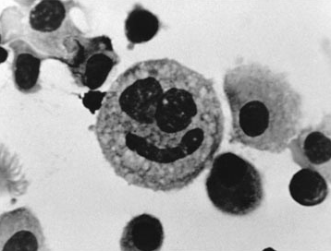
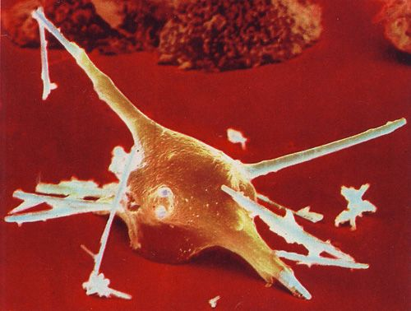
Asbestos in biological tissues
Phagocytosis
TEM
Frustrated
phagocytosis
SEM
Notes:
In the lungs the alveolar macrophages are the ones in charge of removing foreign particles, and they can do a good job when dealing with most common particulate matter, which they remove by phagocytosis and digestion
However, they have problems when dealing with high aspect ratio materials, such as asbestos, because they cannot engulf it, giving rise to frustrated phagocytosis

Slide 4
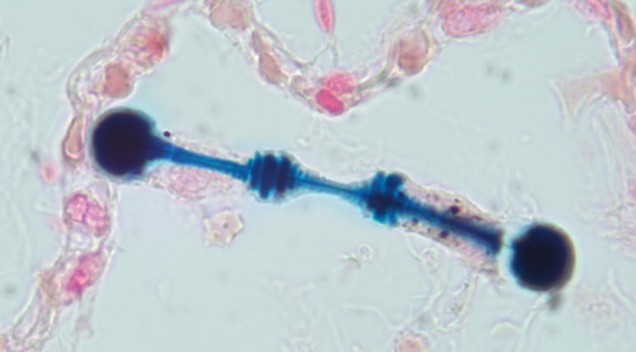
The Asbestos Bodies
OM
400x
1 - 4 µm
OM
1000x
Asbestos fiber
(d = 0.2 - 0.3 µm)
+
Fe-coating
(biomineraliziation)
=
asbestos body
10-100 µm
SEM
50 μm
Notes:
During this process, organic and inorganic material cluster around asbestos, starting an in vivo in biomineralization process
The ensemble of the fiber and the coating is refererred to as an asbestos body, and can have a diameter of up to 6 microns, while the lenght is determined by that of the underlying asbestos fiber.
They grow in very peculiar structures, often with segmented units along the longitudinal axis, and with knobbed extremities

Slide 5
Why it is worth studying the asbestos bodies
Long believed to be a protective mechanism (asbestos tombstone)
Shown to be catalitycally active, to induce ROS production, and DNA damage
Form in weeks/months after inhalation (mesothelioma in decades)
Become the actual interface between fibers and tissues
-> It is reasonable to believe that they have a role in the carcinogenic mechanism
Notes:
The AB where long believed to be a protective mechanism of the host organism aimed at isolating the foreign fibers.
In particular, they were believed to be inert and, therefore, they were also called the asbestos tombstone.
However, more recently, they were shown to be catalitycally active, to induce the production of reactive oxygen species, and DNA damage, suggesting that they might instead enhance the cytotoxic properties of asbestos.
It has to be noted that the Asbestos bodies start to form week to months after inhalation, while mesothelioma takes decades to set in, and that during all this time they become the actual interface between the fibers and the biological tissues.
Therefore, it is reasonable to believe that they may have a role in the pathogenetic mechanisms

Slide 6
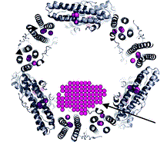
The ferritin protein and its Fe-core
12 nm
8 nm
Fe³⁺
Fe²⁺
hollow space
Ferrihydrite
Protein
shell
Up to 30% Fe
Notes:
They are mainly made of Fe and they are long believed to be composed of ferritin, which is an Fe-storage protein made of a spherical protein shell surrounding a hollow space. Its role is to transfer Fe2+ cations in the hollow sphere, oxide them to Fe3+, and store Fe in the form of ferrihydrite, a poorly crystalline Fe-oxyhydroxide.
However, direct proof of the Fe form in the AB were still lacking.

Slide 7
Asbestos bodies
Long believed to be a protective mechanism (asbestos tombstone)
Become the actual interface between fibers and tissues
Catalitycally active
Reactive Oxygen Species
-> Probable role in Asbestos-Related Diseases
(e.g. mesothelioma)
DNA damage
Conventional analyses can alter the composition of the AB
-> their exact composition remained uncertain
Notes:
The AB where long believed to be a protective mechanism of the host organism with the aim of isolating the foreign fibers.
For this reasons, they were also called the asbestos tombstone.
However, more recently, they were shown to be catalytically active,
to induce the production of reactive oxygen species,
and DNA damage.
The AB start to form weeks after inhalation, while mesothelioma takes decades to set in.
During this time, the AB become the actual interface between the fibers and the biological tissues.
These observations suggest that the AB might enhance the cytotoxic properties of asbestos and thus play a role in the mechanisms leading to asbestos-related diseases.
However, as conventional analysis can alter their composition, their exact composition remained uncertain, which prevented to determine their role in the pathogenesis.

Slide 8
The sample preparation problem
Pioneer TEM studies (e.g. Pooley, 1972):
structure of digested AB compatible with animal and human ferritin references
The structure of alkali digested and ashed AB is different
Borelli et al., 2008:
AB obtained in more biologically representative form (magnetic-based method)
Peptide Mass Fingerprint analysis suggested the presence of ferritin and albumin
AB obtained from chemical digestion have different reactivity
Recent SAED-TEM study: Di Giuseppe et al. 2019
d-spacings compatible with the presence of ferrihydrite, goethite, and apatite
The lung tissue was removed by ashing
Notes:
As AB are too small to be analyzed individually by conventional chemical techniques they have been historically studied by electron microscopies.
In the 70’ by electron diffraction Pooley discovered that the structure of the AB were close to the animal and human ferritin references. He prepared the AB by digesting the biological tissue with alkali or by removing it by ashing, and discovered that the structure changes depending on the sample preparation approach, indicating that invasive sample preparation can alter the nature of the asbestos bodies.
After this pioneer studies, no great advances were made in the characterization of the asbestos bodies, until, in 2008 Borelli and collaborator developed a procedure to obtain asbestos bodies in a more biologically representative form by exploiting their magnetic properties. They were able to apply peptide mass fingerprint analysis, obtaining results that are compatible with the presence of ferritin or albumin. And they discovered that AB obtained by magnetic separation or by common digestion in sodium hypochlorite have different reactivity properties, suggesting that chemical digestion alters their chemical from as well.
The results of a recent electron microscopy and electron diffraction study suggested the presence of ferrihydrite, goethite, and apatite. However, the AB were obtained by the ashing approach and therefore, they may have been altered during sample preparation

Slide 9
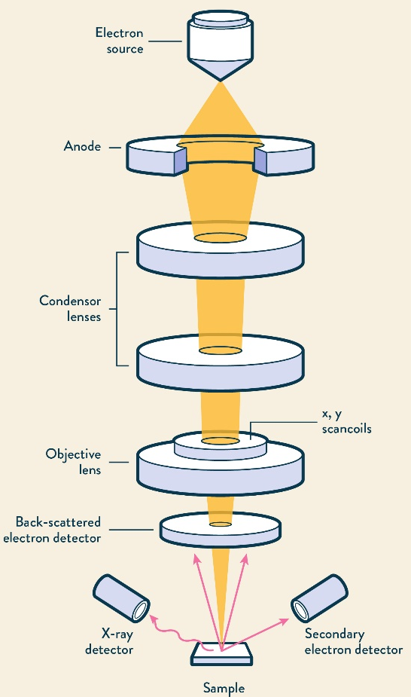
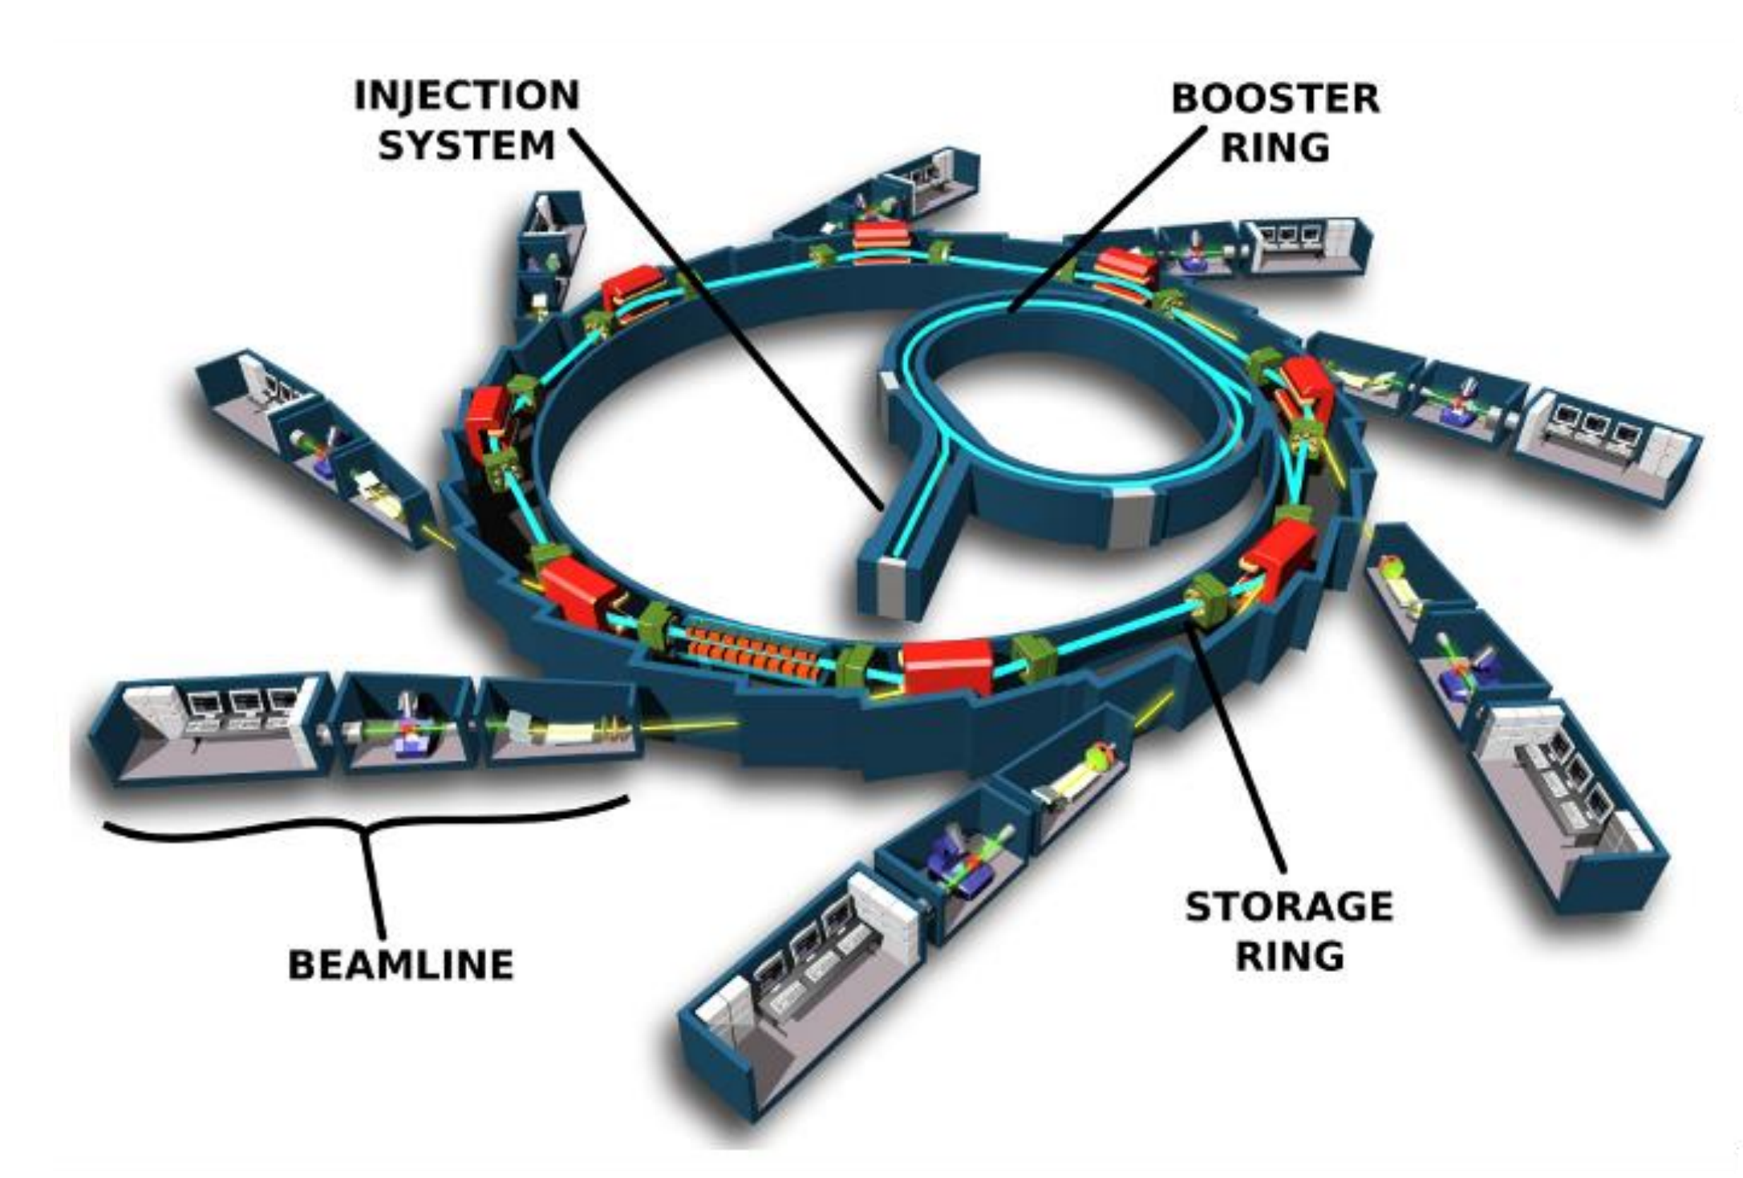
Electrons vs. X-rays (synchrotron radiation)
SEM or TEM
Invasive sample preparation
X-rays techniques (XRD, XAS, XPF, XCT, XPS…)
Non-invasive sample preparation
vs.
High spatial resolution (50 nm)
Very intense and focused x-ray beam
Thicker samples (10 – 30 µm)
Little or no beam damage
Limited beamtime available
Very high resolution (atomic scale)
Very thin samples (50 – 100 nm)
Possible beam damage
Notes:
Electron microscopies require invasive sample preparation methods, such as the removal of the lung tissue to obtain good images and electron diffraction data. In addition, beam damage due to the strong interaction of electrons with the sample is also probable.
On the other hand, x-ray techniques do not require invasive sample preparation and it is possible to work with much thicker samples (10 microns or more compared to the 50 to 100 nm of TEM). In addition, beam damage is usually negligible.
This strongly limits altering the samples.
Synchrotron radiation, in particular, can provide very intense and focused x-ray beams that allow to reach resolutions comparable to electron microscopies and to detect the signal of microscopic samples.

Slide 10
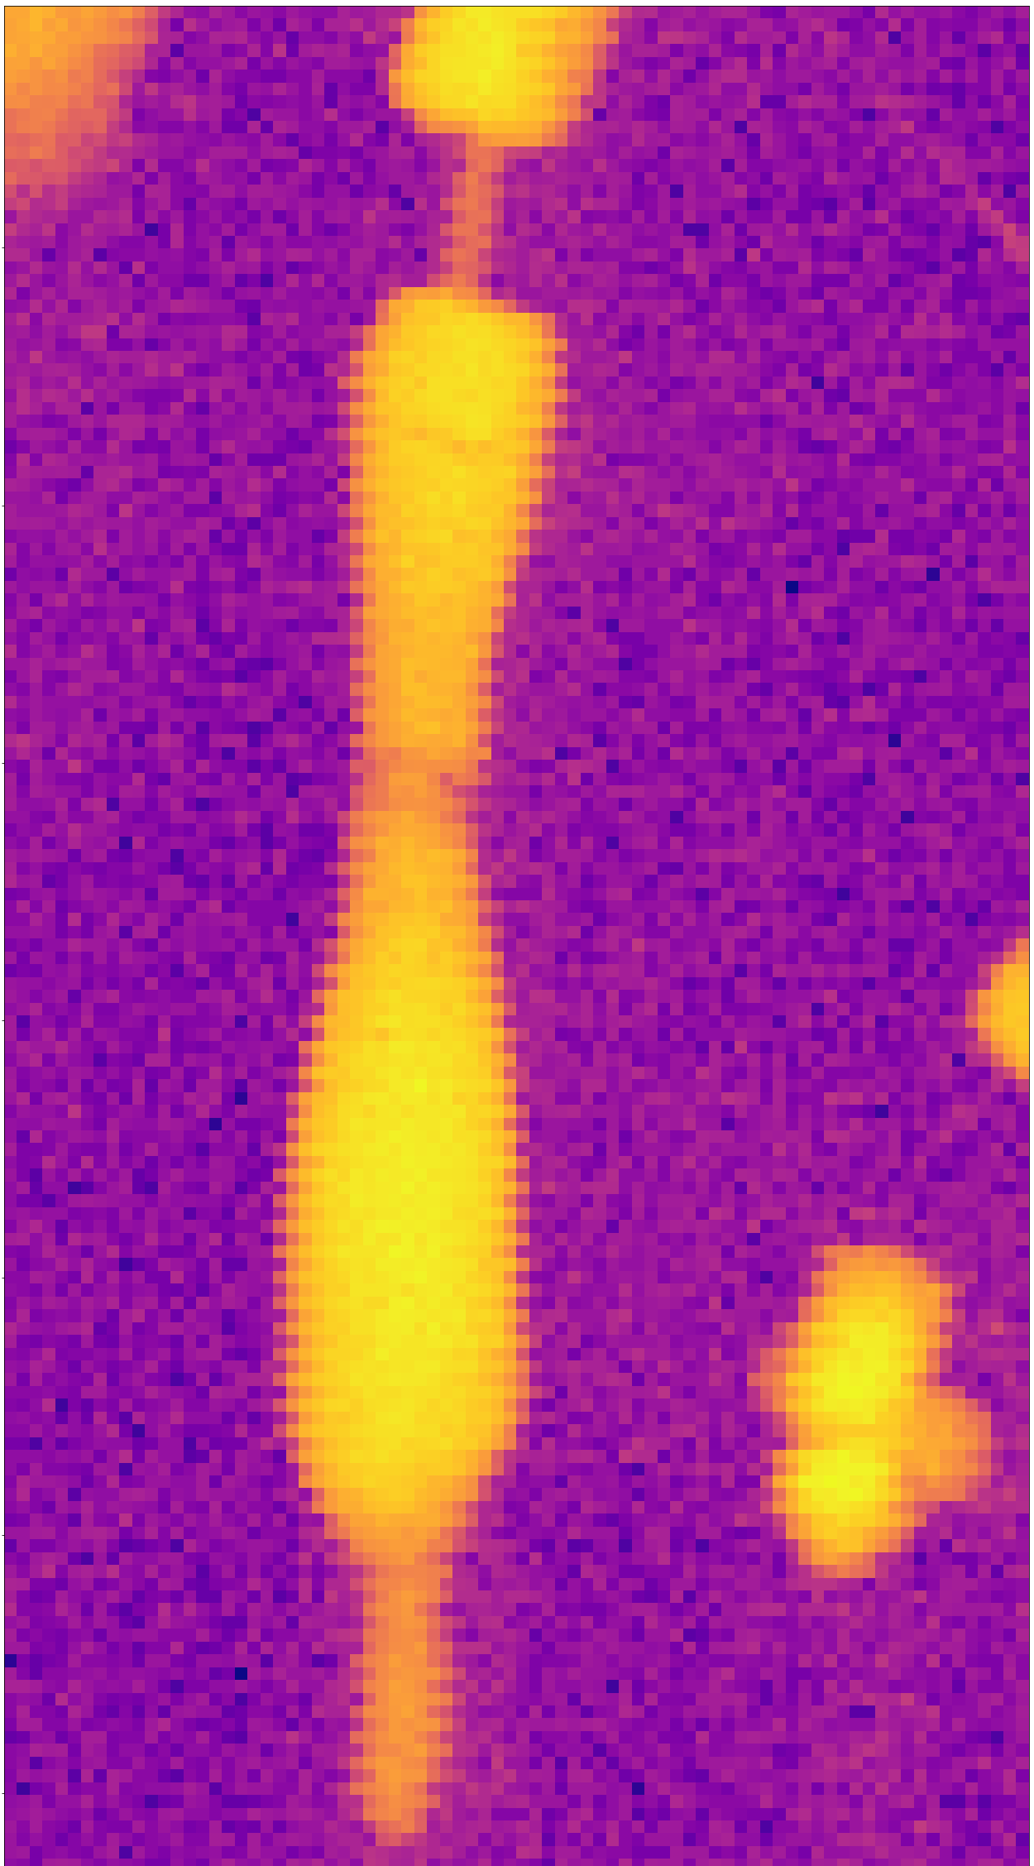
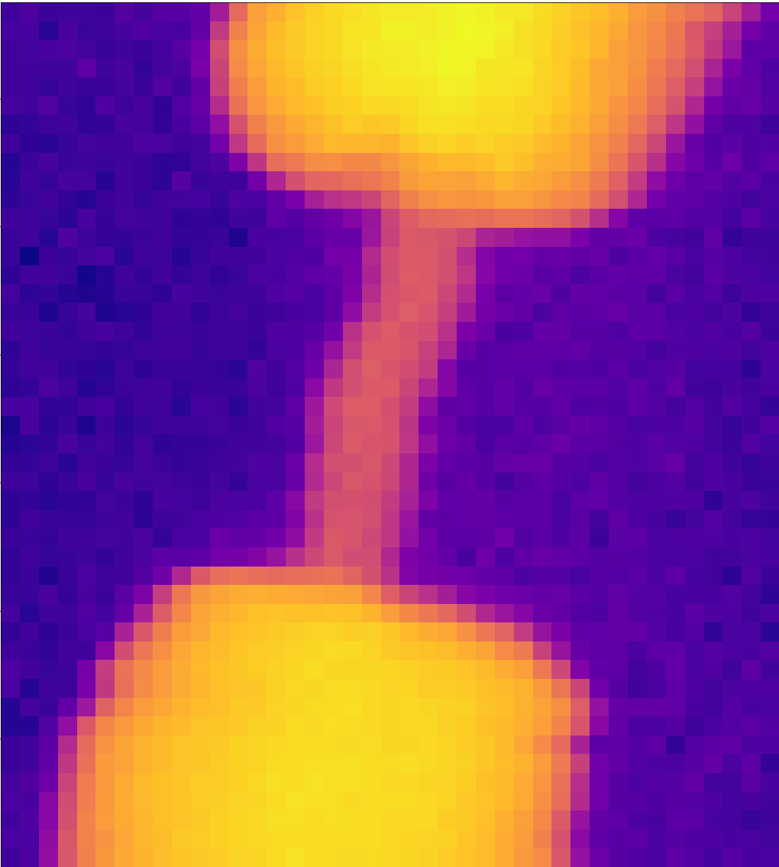
X-ray diffraction (XRD) + X-ray Absorption Spectroscopy (XAS)
XRD
XAS
ROI 2
20 μm
ROI 1
XRD
XRF
Notes:
To reveal the composition of the AB, and in particular the chemical form of Fe, which is by far their main constituent, we combined two x-ray techniques: x-ray diffraction and x-ray absorption spectroscopy to study single AB embedded in the lung tissue without the risk of altering them with invasive sample preparation methods
A beam spot size of 0.15 microns allowed us to measure single AB embedded in the lung tissues and to perform point acquisitions on the inner fiber or on the Fe-coating.
The data on the fibers revealed that the inner fiber is crocidolite, which maintained a good level of cristallinity.
Unexpectedly, diffraction data revealed the presence of goethite in the Fe-rich coating.
Absorption data confirmed the presence of goethite, but indicated that ferrihydrite is the major Fe-phase in the AB.
These results are compatible with the metastable and nano-crystalline nature of ferrihydrite, which shall convert to goethite at acidic pH, as the ones produced by the macrophages during phagocytosis.
Goethite is also much more cytotoxic than ferrihydrite, which supports the enhanced cytotoxicity of the AB.

Slide 11
Ferrihydrite, goethite, and hematite
Ferrihydrite
Fe(OH)₃
(metastable)
Goethite
FeO(OH)
Hematite
Fe₂O₃
At pH = 7 and T = 25°C -> full trasformation to goethite/hematite in ~ 1y
Transformation can be slowed down or blocked in the presence of Si
(Schwertmann et al. Clay Miner. 2004, 39, 433–438)
Notes:
This result is in line with the research on ferrihydrite, which is known to be metastable, and to transform in time, and in a wide range of pH and temperatures, to goethite and finally hematite, wich are more more stable and crystalline Fe species.
Schwertmann observed that at the quasi-phisiological pH of 7 and 25C, full transformation to goethite and hematite takes about 1 year. He also observed that the transformation can be slowed down or blocked if Silicon or silica units are present in the system.

Slide 12
Conclusions
Ferrihydrite is metastable and transforms to goethite at acidic pH
(e.g. during frustrated phagocitosis)
Goethite is much more cytotoxic than ferrihyidrite
Notes:
More experimental work is needed to understand why ferrihydrite, which, as said, is metastable, is still present in the AB after decades
We don’t know if the transformation of ferrihydrite into goethite occurred in vivo or ex vivo.
A simple test we have in mind is to subject ferrihydrite to the same treatment used for the preparation of biological samples.
More complex experiments we would like to perform include in vitro experiments to induce the formation of AB in cell coltures with asbestos, and then perform new XAS/XRD analyses

Slide 13
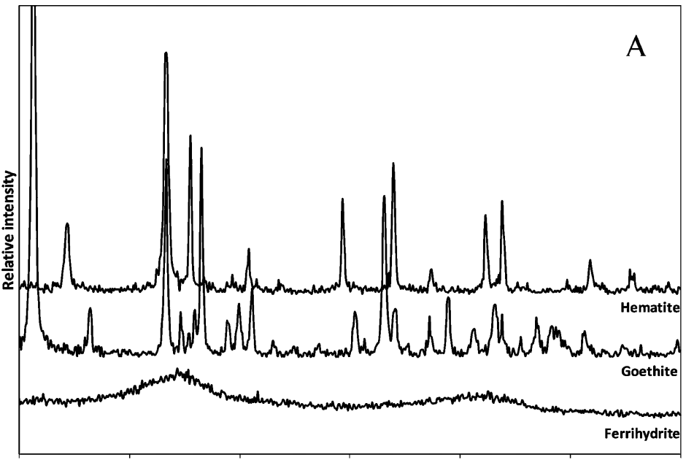
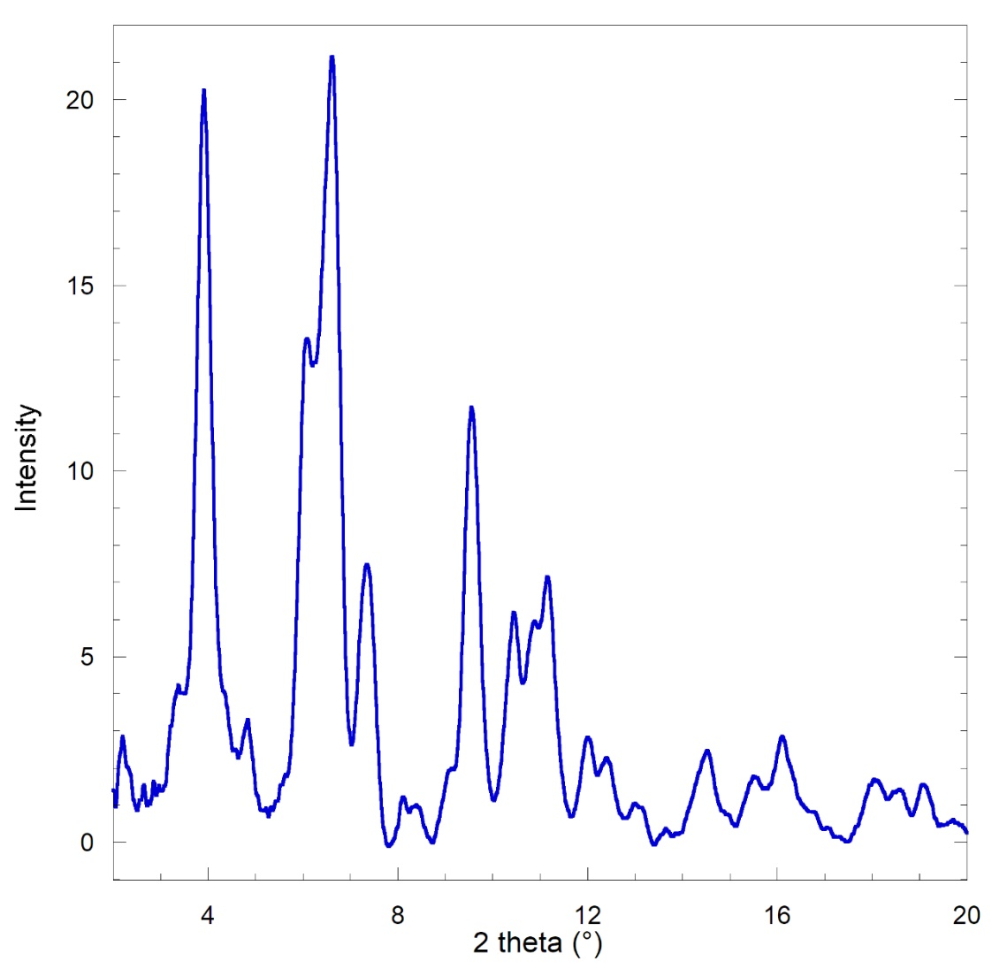
X-ray diffraction (XRD) inserire mappa XRF e pattern crocidolite
OM 400x
80 μm
goethite
X-ray beam spot size: 0.15um x 0.15um
X-ray energy: 43.3 keV
(ID11@ESRF)
Notes:
Later we tried to confirm this result with XRD. We succeeded by using a very intense and focused x-ray beam with a spot size smaller than the diameter of the AB, that is 0.15 um. Only with such a focused beam we were able to measure separately the inner fiber (which was crocidolite) and the Fe-coating, which resulted to be goethite.
So, the question now is why we detected ferrihydrite with XAS and goethite with XRD?
The reason is that ferrihydrite is poorly cristalline. As you can see, in the less crystalline form, only two broad peaks appear in the XRD pattern, and they can easily be at the background level.

Slide 14
Lung tissue samples
Case | Age | Sex | Occupation | Exposure period | Exposure nature | Disease | AB count (/g_{dw})
A | 81 | M | Fiber-cement plant | 27 years | Crocidolite asbestos | AS (grade 3) PP and MM | ~ 0.36·10⁶
B | 80 | F | Fiber-cement plant | > 10 years | Crocidolite asbestos | AS (grade 4) PP and LC | ~ 12·10⁶
AS: asbestosis; PP: pleural plaques; MM: malignant (pleural) mesothelioma; LC: lung cancer
Asbestos Bodies were prepared in two ways:
Removing the lung tissue by chemical digestion with sodium hypochlorite (NaClO)
Left embedded in the original lung tissue (formalin-fixed and paraffin embedded)
Notes:
Campioni di tessuto polmonare sono stati raccolti durante le autopsie forensi da due ex lavoratori della Eternit di Cavagnolo (Piemonte).
I lavoratori sono stati esposti per decenni ad alte concentrazioni di polvere d'amianto. Entrambi avevano asbestosi e placche pleuriche, uno aveva anche il mesotelioma e uno anche il cancro ai polmoni.
Il conteggio dei corpuscoli era di 360.000 in un caso 12 milioni nell’altro per grammo di peso secco di tessuto.
I corpuscoli sono poi stati preparati estraendoli dal tessuto mediante digestione chimica con ipoclorito di sodio oppure lasciati nel tessuto originale che è stato fissato in formalina e inglobato in paraffina.

