Slide 1
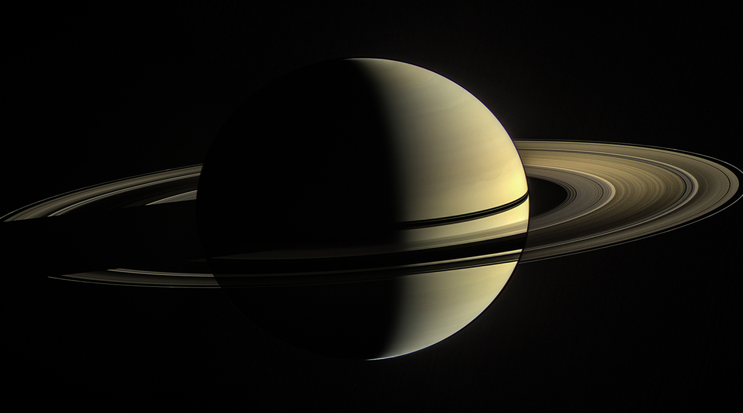
Deriving mixing ratios of heavier neutral species in Saturn's ionosphere from light ion measurements and helium chemistry
Helium ion chemistry and measurements of light ions and neutrals can be used to constrain the mixing ratios of heavier species in Saturn’s ionosphere.
Joshua Dreyer^{1,2}, Erik Vigren¹ , Fredrik L. Johansson³, J. Hunter Waite⁴ joshua.dreyer@irfu.se
[1] Swedish Institute of Space Physics (IRF), [2] Uppsala University, [3] ESA ESTEC, [4] Waite Science LLC
Image credit: NASA/JPL-Caltech/Space Science Institute
Manuscript currently undergoing minor revisions, likely to be published soon

Slide 2
Navigation
TITLE
INTRODUCTION
METHODS
RESULTS

Slide 3
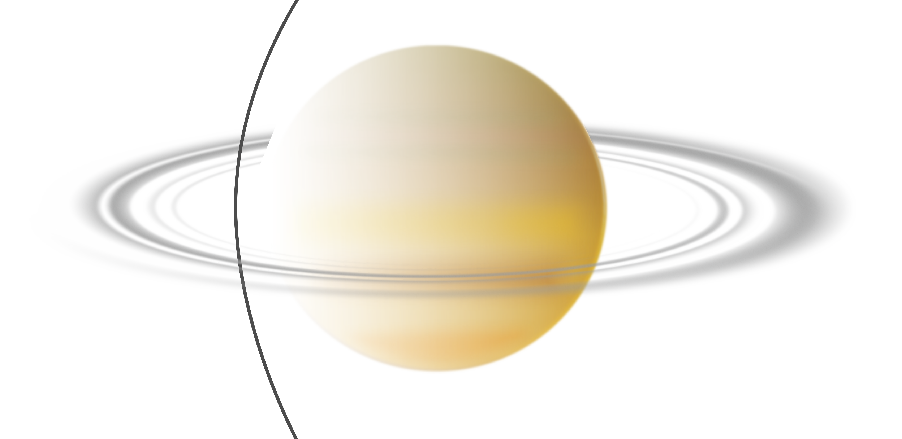
Introduction: Helium ion chemistry
We are studying Cassini’s Grand Finale data from the ion and neutral mass spectrometer (INMS) from Saturn’s equatorial ionosphere, specifically orbits 288 and 292 (for which we have all required data).
He⁺ reacts very slowly with H₂ and H. Hypothesis: He⁺ ions are mainly lost through charge exchange reactions with other species.
We group all these species: H₂O, CH₄, NH₃, N₂, CO ∈ X

Slide 4
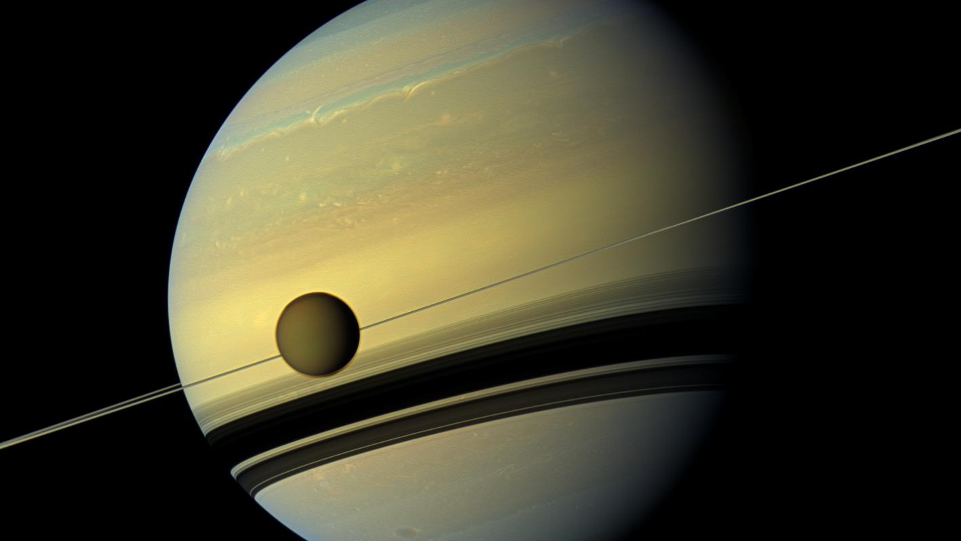
Image credit: NASA/JPL-Caltech
Main neutrals:
H
H₂
He
CH₄
NH₃
H₂0
CO₂
CO/N₂/ C₂H₄
INMS-measured light ion species available, measurements of heavier species limited!
Main ions:
H⁺
H₃⁺
He⁺
H₂⁺
H_{x}O⁺
C_{x}H_{y}⁺
HCO⁺
HCO₂⁺
Methods
Directly to RESULTS

Slide 5
METHODS: Basic atmospheric modelling
EUV fluxes from LISIRD (LASP) for dates of orbits 288 and 292
INMS-measured $H_{2}$-densities
$H_{2}$ photoabsorption cross sections (phidrates database)
attenuated EUV flux
${×H}_{2}$ and He photoionisation cross sections (phidrates database)
ionisation frequencies $ν_{ion, H_{2}}$ and $ν_{ion, He}$
$r_{ν}=\frac{ν_{ion, H_{2}}}{ν_{ion,He }}$

Slide 6
METHODS: Hydrogen ion chemistry
The production rate of H₂⁺ equals its loss rate in photochemical equilibrium (altitudes below ~2500 km).
Main production channel: $H_{2}+hν→H_{2}^{+}+e^{−}$
Main loss channel: $H_{2}^{+}+H_{2}→H_{3}^{+}+H$ (rate constant $k_{2}=2.1×{10}^{−9}$ cm³ s⁻¹)
$→ P\left(H_{2}^{+}\right)=k_{2}\left[H_{2}^{+}\right][H_{2}]$
$$ν_{ion, H_{2}}$$

Slide 7
METHODS: Helium ion chemistry
Goal: Utilize the measured $H_{2}^{+}$densities as a proxy for the solar EUV flux.
Didn’t we just model that? -> yes, but… modelled EUV results requires correction of up to +70% for orbit 292 (known problem, see, e.g., Moore et al., 2018)
$P\left(He^{+}\right)=ν_{ion,He}\left[He\right]=\frac{ν_{ion,H_{2}}}{r_{ν}}\left[He\right]=\frac{k_{2}}{r_{ν}}\left[H_{2}^{+}\right]\left[He\right]$
In photochemical equilibrium $P\left(He^{+}\right)=L\left(He^{+}\right)$. Assuming only loss via ion-neutral and charge-exchange reactions with $H_{2}$:
$P\left(He^{+}\right)=k_{2}\left[H_{2}^{+}\right][He]$ $L\left(He^{+}\right)=k_{3}\left[{He}^{+}\right]\left[H_{2}\right] k_{3} = \left(3.7 × {10}^{−14}+ 7.2 × {10}^{−15}\right){ cm}^{3} s^{−1}$
$$\left[He^{+}\right]=\frac{k_{2}\left[H_{2}^{+}\right][He]}{k_{3}r_{ν}[H_{2}]}$$

Slide 8
METHODS: He⁺ Loss channels?
If we assume He⁺ loss only via H₂, the estimated upper limits exceed the measured densities by an order of magnitude or more.
Strong indication that the main loss channel is via reactions with other species.
Interesting: For altitudes from 1850–2000 km during orbit 288 inbound, this discrepancy is sharply reduced.

Slide 9
METHODS: Mixing ratio equation for X
$P\left(He^{+}\right)=k_{2}\left[H_{2}^{+}\right][He]$ $L\left(He^{+}\right)=k_{x}\left[He^{+}\right]\left[X\right]+k_{3}\left[{He}^{+}\right]\left[H_{2}\right]$
$$P=L and \left[X\right]=f_{x}[H_{2}]$$
$$f_{X}=\frac{k_{2}\left[H_{2}^{+}\right]\left[He\right]}{r_{ν}k_{x}\left[He^{+}\right][H_{2}]}−\frac{k_{3}}{k_{X}}$$
Reaction | Rate constant k_{x} (10⁻⁹ cm³s⁻¹)
$$He^{+}+H_{2}O →He+other species$$ | 0.55
$$He^{+}+CH_{4}→He+other species$$ | 1.8
$$He^{+}+NH_{3}→He+other species$$ | 2.2
$$He^{+}+{CO}_{2}→He+other species$$ | 1.14
$$He^{+}+N_{2}→He+other species$$ | 1.6
$$He^{+}+CO→He+other species$$ | 1.6
Rate constants from UMIST database, see astrochemistry.net
M-type
R-type

Slide 10
RESULTS: Orbit 288
Large variability; especially for orbit 288 inbound, mainly due to very high He⁺ densities (see also figure two slides back). This is a potential indication of a variable influx of the species $∈$ X.
Major differences (and potential anticorrelation) compared to mixing ratio profiles derived from H₃⁺ (red dashed lines), suggesting different chemistry for He⁺ and H₃⁺.

Slide 11
RESULTS: Orbit 292
Our results fall below those derived from direct INMS measurements and from H₃⁺ chemistry for orbit 292.
Large inter- and intraorbital variability suggests temporal and/or spatial changes in ring influx.
A constructed geometric mean between our He⁺-based values and those derived from hydrogen ion chemistry shows less variations.

Slide 12
RESULTS: Conclusions & Summary
The dominant loss process for He⁺ ions in Saturn’s equatorial ionosphere is with species $∈$ X. We can estimate the mixing ratio of heavy volatiles in Saturn’s ionosphere from light ion and neutral measurements, using helium ion chemistry ($2×{10}^{−4}$ at closest approach, varying by an order of magnitude in either direction over the analysed altitudes/orbits).
Notable discrepancies to other methods/studies and large inter- and intraorbital variability suggests differences in helium and hydrogen ion chemistry and temporal/spatial variability of ring influx. There is something about the hydrogen ion chemistry in Saturn’s ionosphere that as of yet eludes our understanding (see further the mixing ratio conundrum described in, e.g., Vigren et al., 2022).
A comparison with recent modelling efforts by Moses et al. (2023) potentially suggests that only the most volatile species (CO, N₂ and CH₄) enter the atmosphere as vapour, whereas the other species $∈$ X may be bound to grains.

Slide 13
References
Cravens, T. E., Moore, L., Waite, J. H. et al., 2019 GRL 46 12 6315-6321
Johansson, F. L., Vigren, E., Waite, J. H. et al., 2022 MNRAS 515 2 2340-2350
Miller, K.E., Waite, J.H., Perryman, R.S. et al., 2020 Icarus 339 113595
Moses, J. I., Brown, Z. L., Koskinen, T. T. et al., 2023 Icarus 391 115328
Serigano, J., Hörst, S. M., He, C. Et al., 2022 JGR Planets, 127(6) e2022JE007238
Vigren, E., Dreyer, J., Eriksson, A. I. et al., 2022 PSJ 3 2 49

