Slide 1
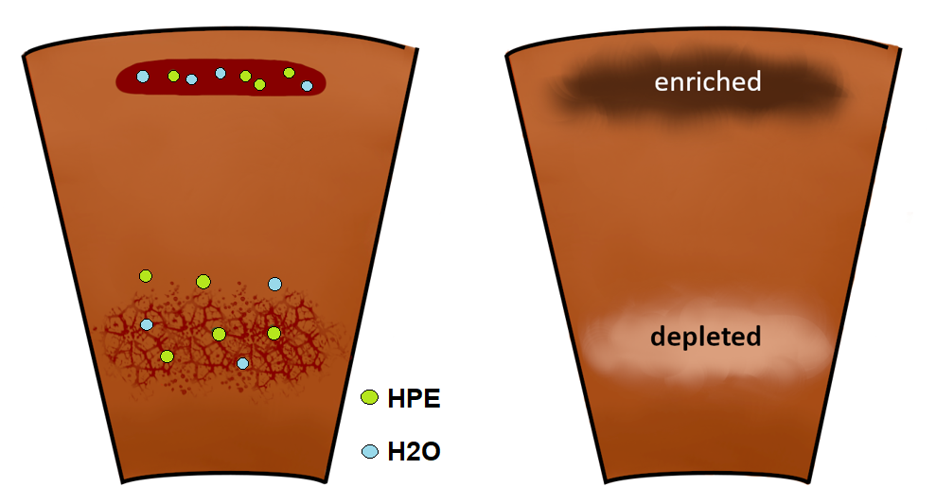
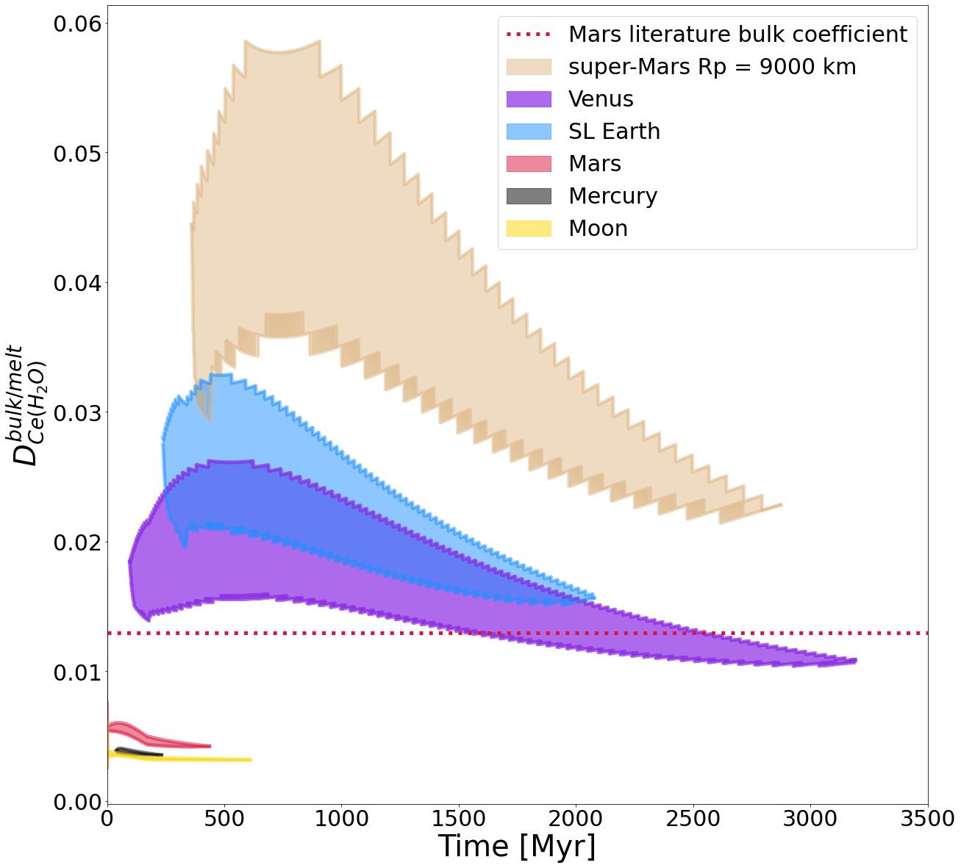
Planet size controls the redistribution of heat producing elements and volatiles from mantle to crust
Julia Schmidt and Lena Noack, Freie Universität Berlin
EGU conference 2023, Vienna
Investigating the effects
Redistribution from mantle to crust
Quantifying the amount of redistribution
depending on planet size
Upper mantle melting

Slide 2
Planet size controls the redistribution of heat producing elements and volatiles from mantle to crust
1. Introduction
Start
1. Introduction
2. Methods
3. Results
4. Discussion & Conclusion
End

Slide 3
1.1. Redistribution of trace elements from mantle to crust
HPE = heat producing elements
When melting occurs inside the upper mantle, the melt accumulates trace elements and volatiles which are incompatible inside the solid rock.
Up to a certain pressure (the density crossover), the melt is lighter than the surrounding rock and rises towards the surface.
This causes the crust to get enriched with incompatible trace elements and volatiles and the mantle to be depleted.
With partition coefficients you can determine the compatibility of an element and therefore determine the amount of the redistributed trace elements.
Start
1. Introduction
2. Methods
3. Results
4. Discussion & Conclusion
End

Slide 4
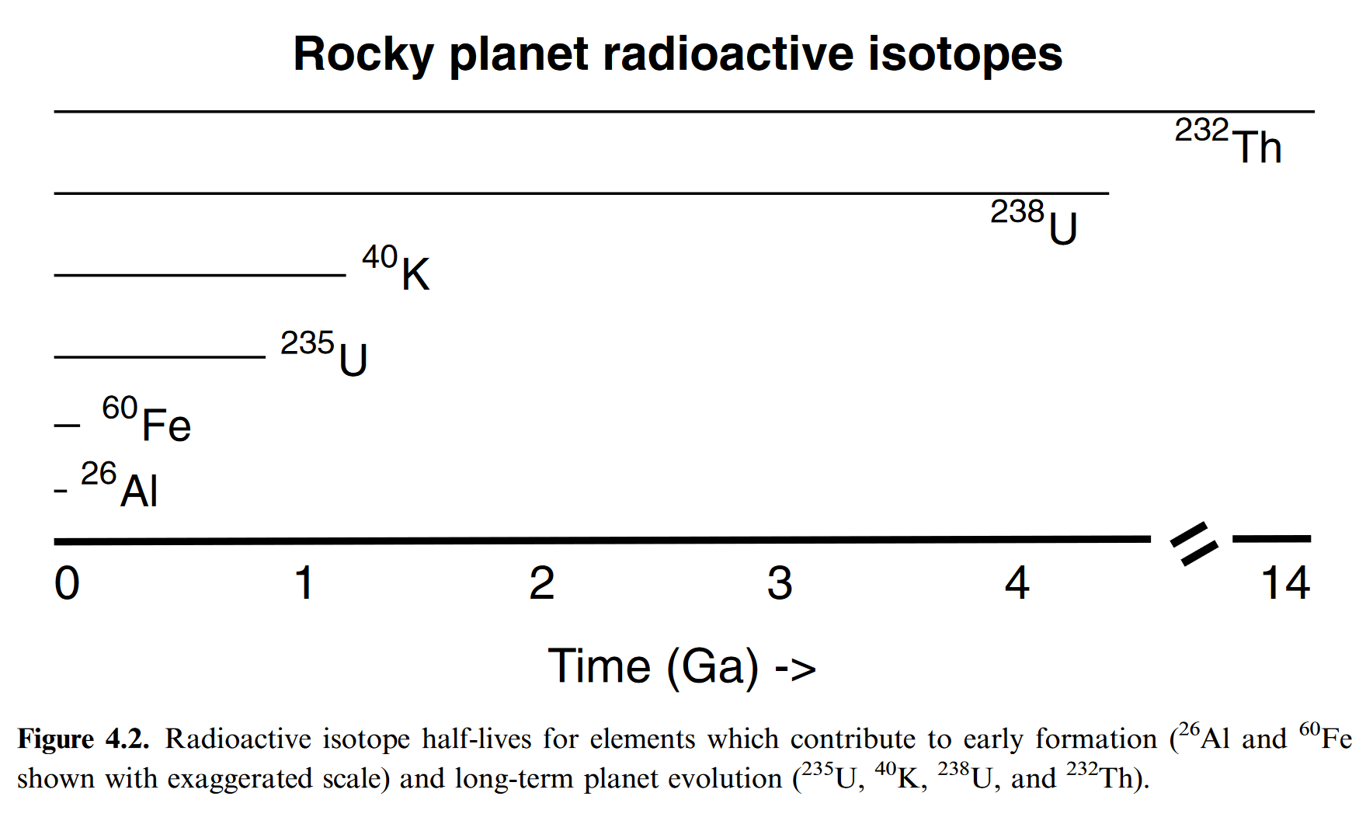
1.2. Heat Producing Elements (HPEs) and their implications for the evolution of rocky planets
Three main types of internal heating in rocky planets:
Accretional heating
Tidal deformation
Radioactive decay
Foley et al. (2020)
We focus on the elements Uranium, Thorium and Potassium, as their isotopes survived for longer time spans. Our models starts after the magma ocean phase of a planet.
A higher amount of HPEs can increase the temperature and faciliate melting.
Start
1. Introduction
2. Methods
3. Results
4. Discussion & Conclusion
End

Slide 5
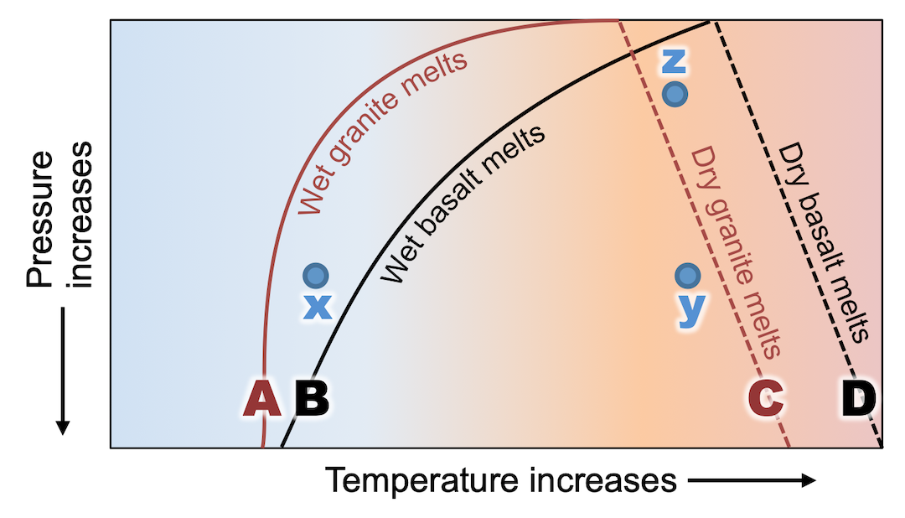
1.3. Volatiles and their implications for the evolutio of rocky planets
H2O lowers the melting temperature of rocks.
Volatiles which are redistributed from the mantle to the crust are outgassing and contributing to the atmosphere and potential oceans.
https://opentextbc.ca/
Start
1. Introduction
2. Methods
3. Results
4. Discussion & Conclusion
End

Slide 6
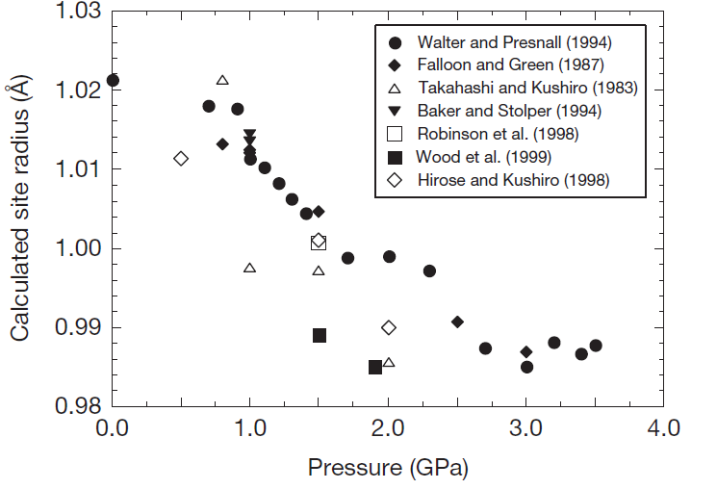
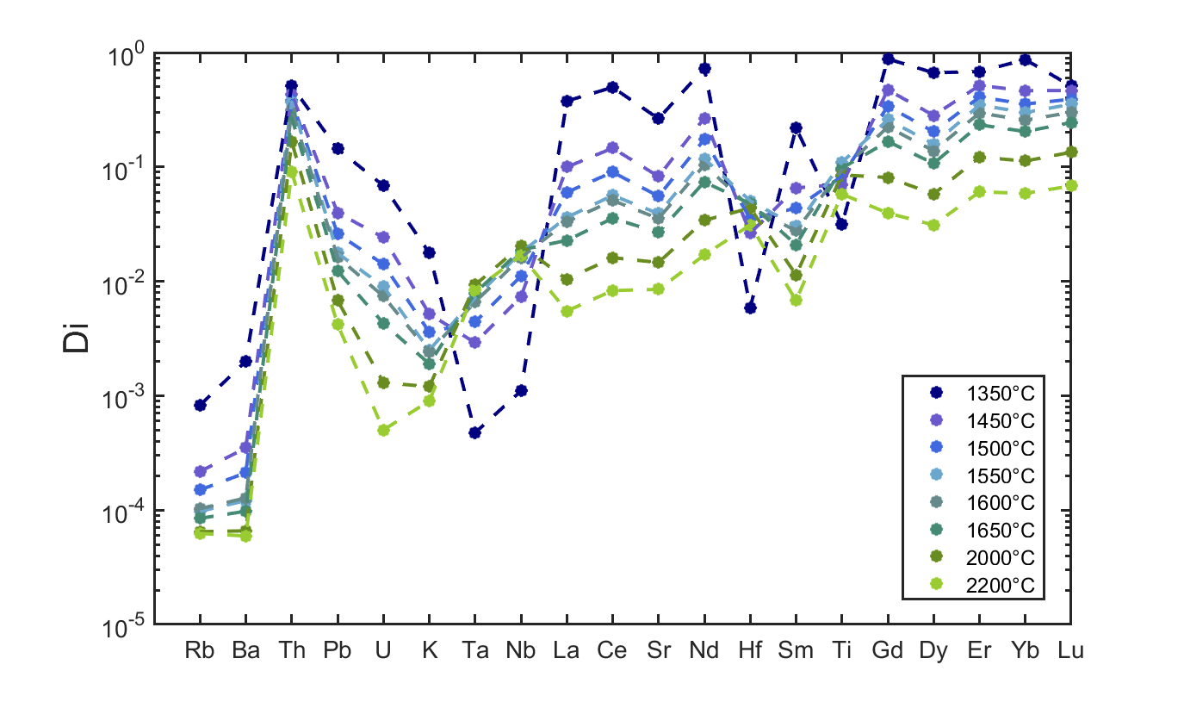
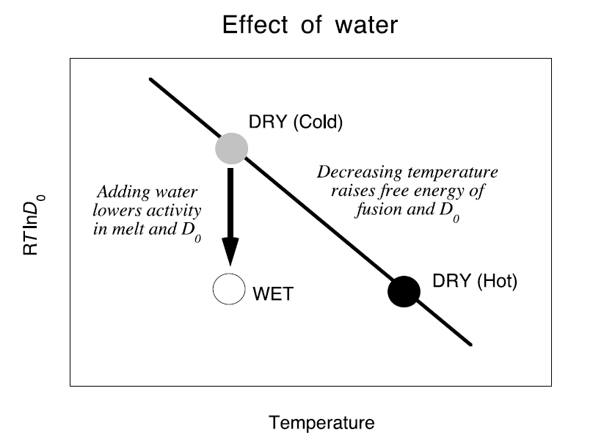
1.4. Using Partition coefficients to determine redistribution
Partition coefficients describe how easily an element gets incorporated into a certain mineral crystal lattice:
0 to <1: incompatible in solid material
>1 : compatible in solid material
Sensitive to pressure, temperature, and compositional changes!
Effect of pressure
Effect of temperature
Effect of water
Wood (2014)
Composition after Salters and Stracke (2004)
Blundy and Wood (2003)
Start
1. Introduction
2. Methods
3. Results
4. Discussion & Conclusion
End

Slide 7
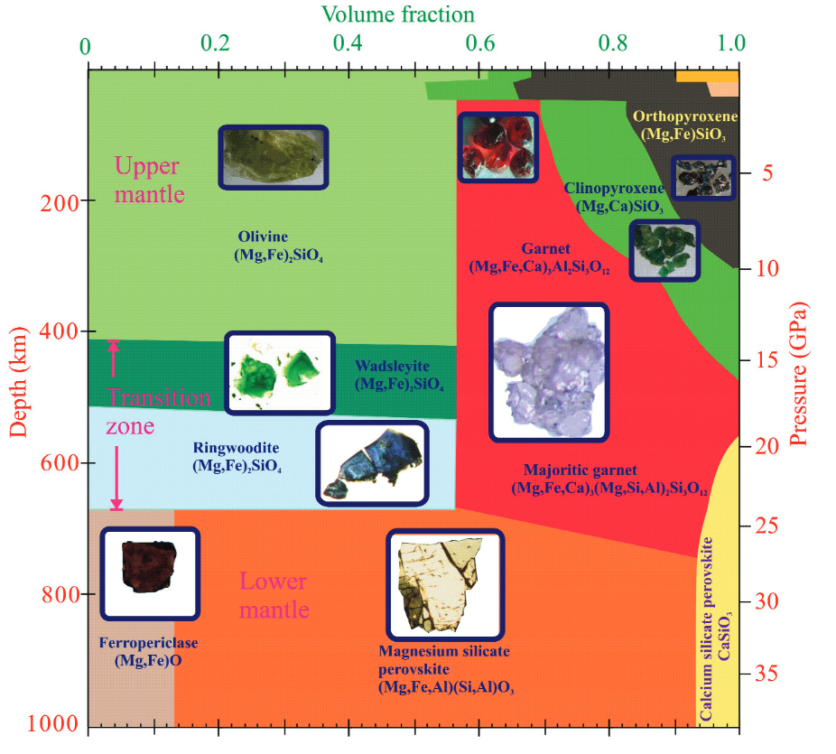
1.5. Why we model clinopyroxene/melt partiton coefficents
Earth mantle composition
While olivine dominates in the upper mantle, clinopyroxene is the mineral which incorporates most trace elements in the upper mantle.
Olivine‘s partition coefficients are rather stable with pressure, temperature, and compositional changes, so we can use literature values.
Phase propotions change with depth. However, we have taken constant values for our 1D interior evolution code.
Frost (2008)
Start
1. Introduction
2. Methods
3. Results
4. Discussion & Conclusion
End

Slide 8
Planet size controls the redistribution of heat producing elements and volatiles from mantle to crust
2. Methods
Start
1. Introduction
2. Methods
3. Results
4. Discussion & Conclusion
End

Slide 9
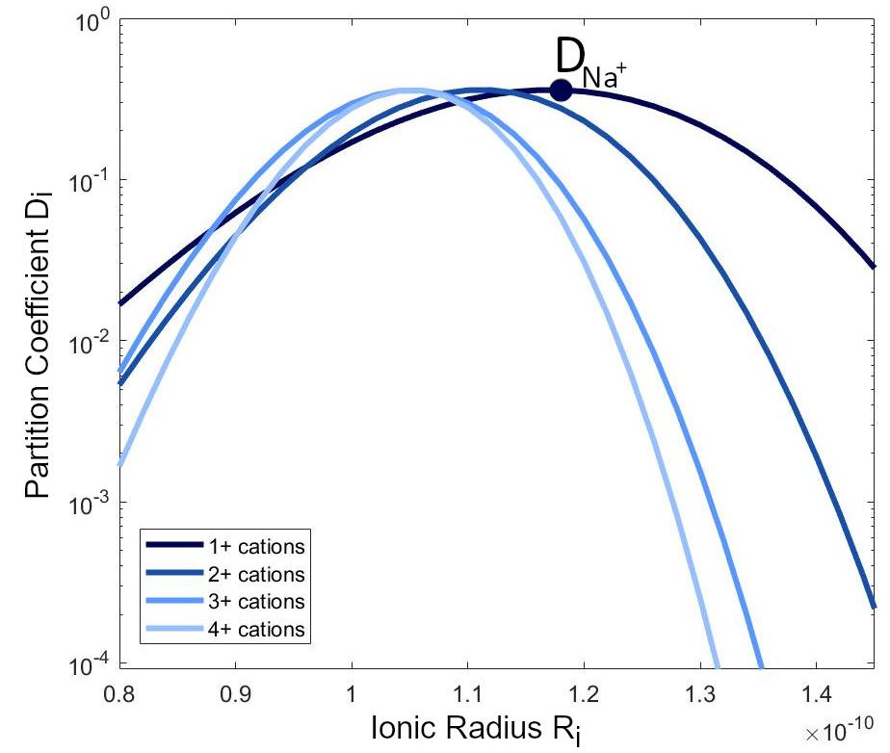
2.1. Clinopyroxene/melt partition coefficient modelling
With the „lattice strain model“ you can determine the strain needed to fit an element into a mineral lattice. The higher the strain, the less the element fits into a mineral lattice site and the more incompatible the element is with the mineral of interest.
Clinopyroxene/melt partition coefficients
Model by Blundy et al. (1997):
log(D_{Na})
$$D_{i}= D_{0}∗exp\left[\frac{−4πE_{M2}N_{A}\left[\frac{r_{0}}{2}{\left(r_{0} −r_{i}\right)}^{2}+\frac{1}{3}{\left(r_{0} −r_{i}\right)}^{3}\right]}{RT}\right]$$
E
$D_{0}$ = Used as a reference to model other elements‘ partition coefficients. Here: $D_{0}$ = $D_{Na}$
R
The logarithmic relationship between partition coefficients of one charge and their dependence on the bulk modulus E and the lattice site radius R₀ allows us to calculate Ds for all trace elements.
Schmidt and Noack (2021)
Start
1. Introduction
2. Methods
3. Results
4. Discussion & Conclusion
End

Slide 10
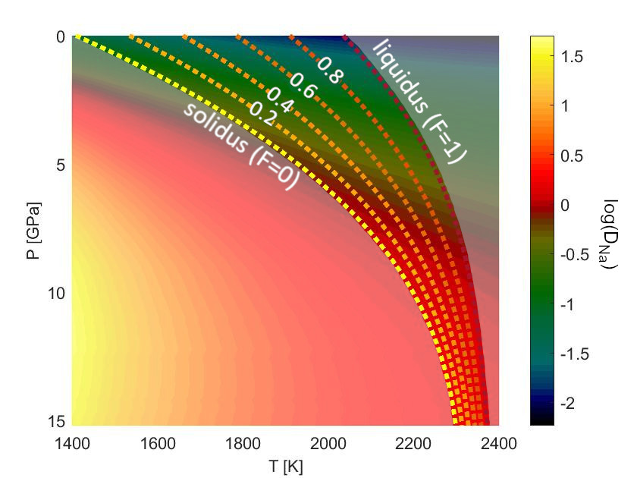
2.2. Thermodynamic model for cpx/melt of sodium
Sodium in clinopyroxene/melt partition coefficients
Na⁺ is the ion which fits best into jadeite and therefore has the highest partition coefficient. This is why it serves us as a „reference“ coefficient $D_{0}$.
From 0-15 GPa along the peridotite solidus, D_{Na} changes up to 2 orders of magnitude!
Schmidt and Noack (2021)
Start
1. Introduction
2. Methods
3. Results
4. Discussion & Conclusion
End

Slide 11
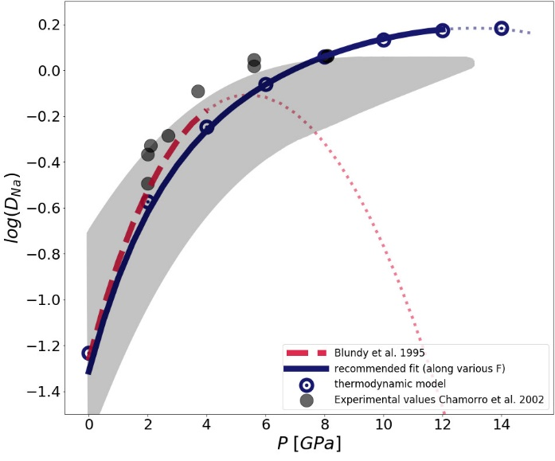
2.3. New D₀ scaling law for higher pressures
New scaling law which is suitable for interior evolution models
The older scaling law by Blundy and Wood (1995) is only suitable for pressures < 4 Gpa.
This is a problem because most mantle evolution codes need a model that is also suitable for higher pressures.
Based on a thermodynamic model (link), we parameterized a new scaling law which is valid for higher pressures.
New scaling law:
$$D_{Na}=$$
$$exp\left(\frac{2183+2517P−157P^{2}}{T}−4.575−0.5149P+0.0475P^{2}\right)$$
Schmidt and Noack (2021)
The new scaling law fits very well to the thermodynamic model and the experimental literature data (gray shaded area).
It is suitable for P < 12 GPa.
Start
1. Introduction
2. Methods
3. Results
4. Discussion & Conclusion
End

Slide 12
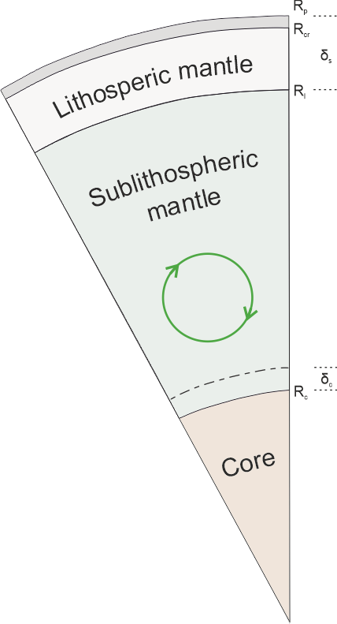
2.4. 1D interior evolution model
Our 1D interior evolution code calculates the thermal development based on energy conservation of a planet over 4.5 Ga.
Among others, the code computes: The thermal evolution the layers of a planet, thickness of crust and lithosphere, melting, heating rates, simplistic outassing of H₂O and CO₂, evolution of mantle viscosity, …
The starting point of the model is after the magma ocean phase of a planet.
Stamencović (2012)
Schmidt, Vulpius & Noack (in prep)
Start
1. Introduction
2. Methods
3. Results
4. Discussion & Conclusion
End

Slide 13
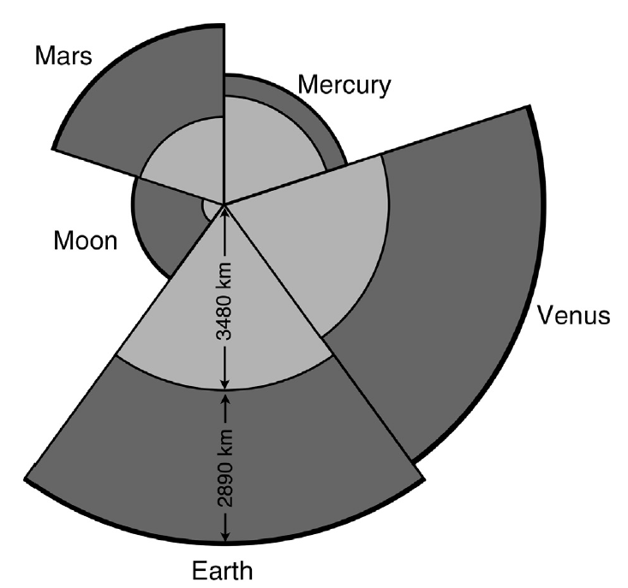
2.5. Parameter choices
We chose two different model parameter-sets:
Solar system bodies with their respective radii, thermal parameters, and compositions.
Solar system bodies with a Mars-composition (to exclude compositional effects) + one super-Mars with R_{p} = 9000 km.
Tosi et al. (2014)
Mineralogy table and bulk mineral/melt composition calculation.
Start
1. Introduction
2. Methods
3. Results
4. Discussion & Conclusion
End

Slide 14
Mantle compositions and bulk mineral/melt partitioning
Fixed literature mantle mineralogy for each planet in wt%
Planet | Olivine | Cpx | Opx | Garnet | Ref.
Earth/Moon/Venus | 61 | 10 | 15 | 14 | Pyrolite by Duffy and Anderson (1989)
Mars | 60 | 11 | 19.2 | 9.8 | Waenke and Dreibus (1988)
Mercury | 27.2 | 8.9 | 47.8 | 16 | Padovan et al 2014
Bulk mineral/melt partition coefficient $D_{i}^{bulk}:$
$D_{i}^{bulk}= \frac{{Ol}^{wt\%}}{100}D_{i}^{Ol}$ + $\frac{{Cpx}^{wt\%}}{100}D_{i}^{Cpx}$+ $\frac{{Opx}^{wt\%}}{100}D_{i}^{Opx}$+ $\frac{{Grt}^{wt\%}}{100}D_{i}^{Grt}$
Start
1. Introduction
2. Methods
3. Results
4. Discussion & Conclusion

Slide 15
Planet size controls the redistribution of heat producing elements and volatiles from mantle to crust
3. Results
Start
1. Introduction
2. Methods
3. Results
4. Discussion & Conclusion
End

Slide 16
4.1. Melt zones of rocky planets
Stagnant lid Earth
Venus
Mars
Mercury
Moon
Profile depths: 400 km
Melt zone areas between black solid lines
Start
1. Introduction
2. Methods
3. Results
4. Discussion & Conclusion
End

Slide 17
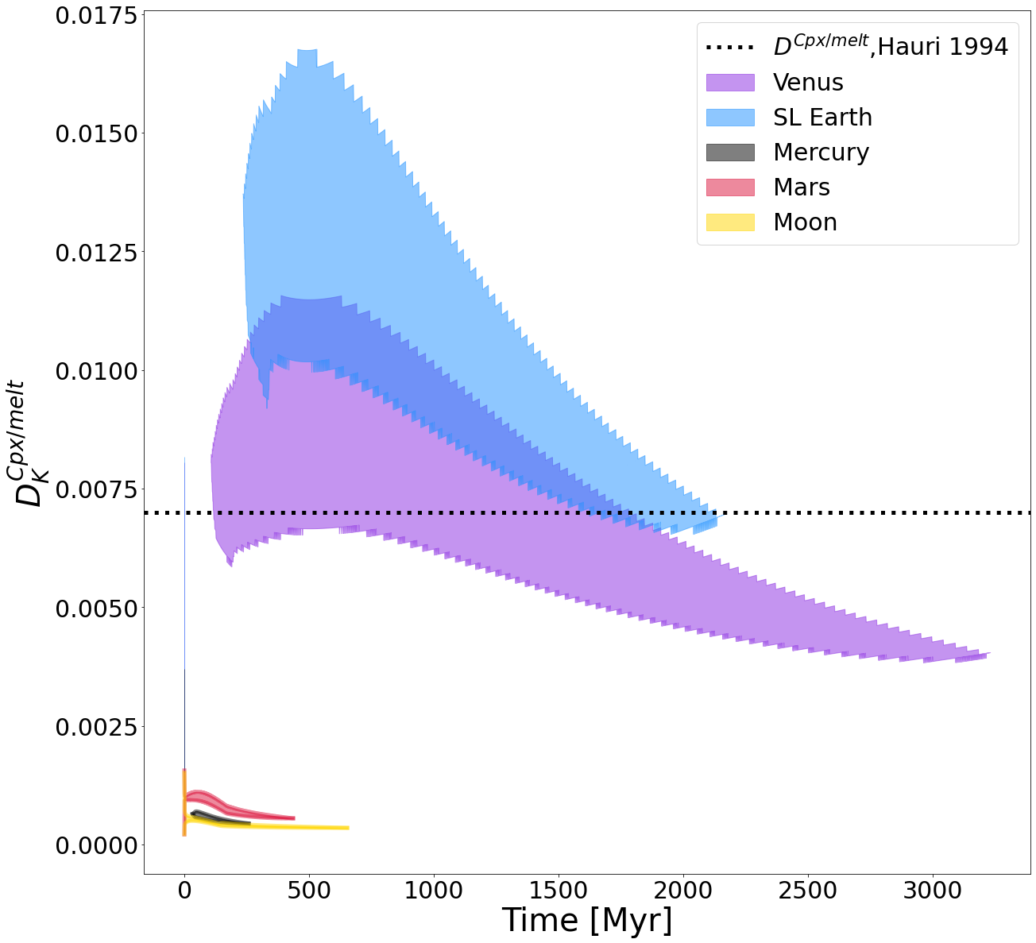
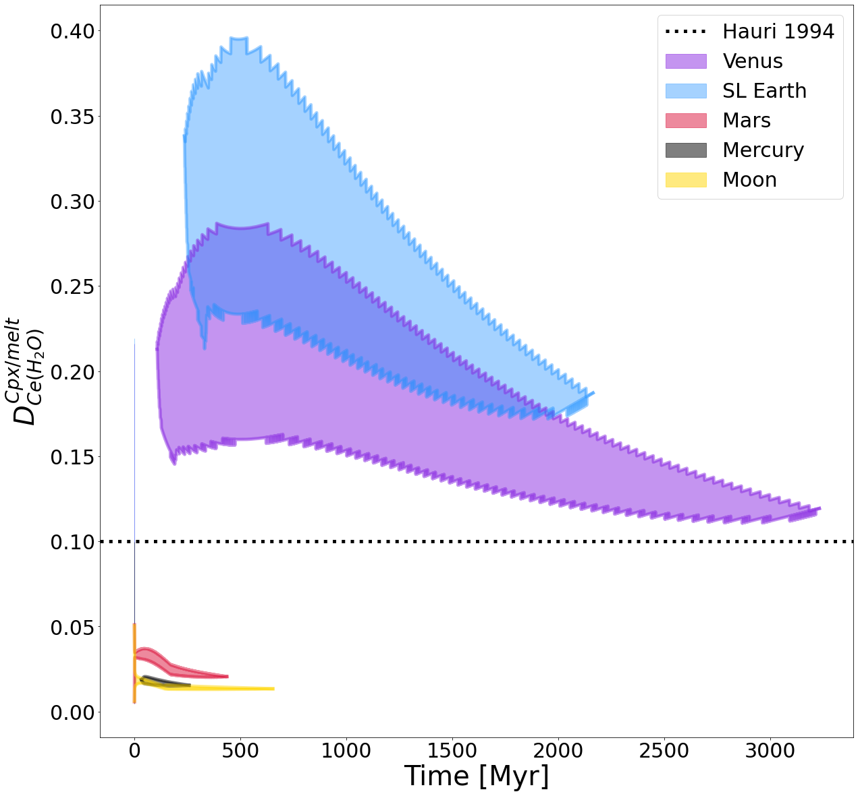
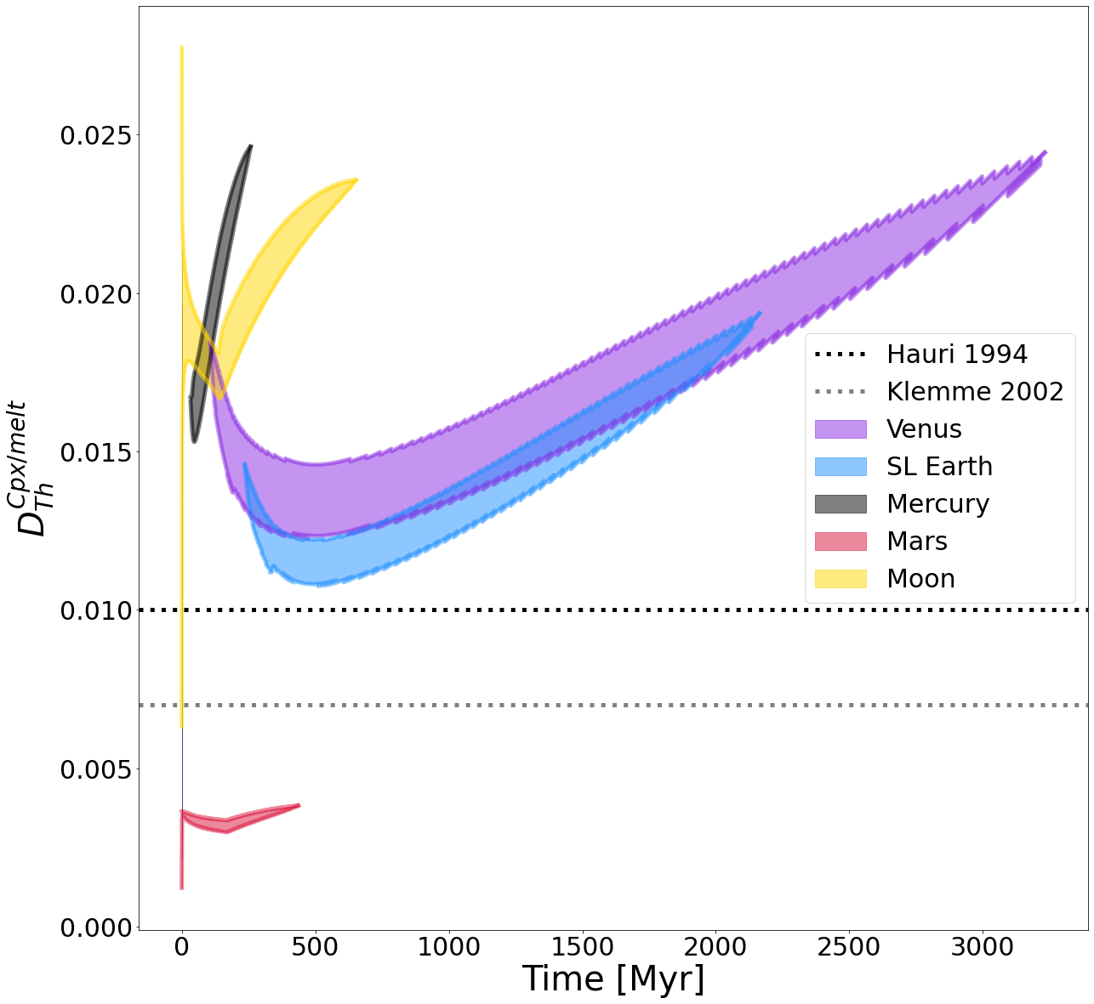
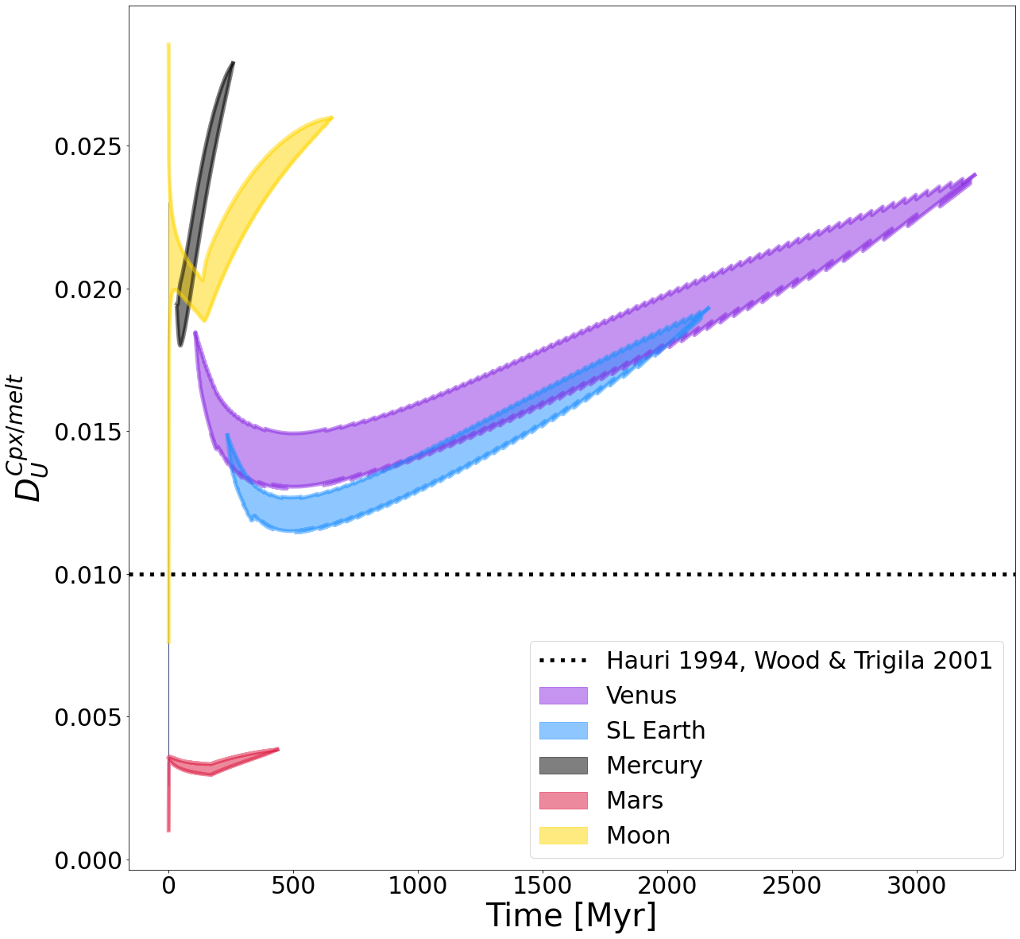
4.2. Cpx mineral/melt partitioning in rocky solar system bodies
Potassium
H₂O
The cpx/melt partition coefficients depend largely on the depth and temperature of a melt zone.
For larger planets, the partition coefficients are generella higher for K and H₂O.
For Thorium and Uranium, the effect seems to be inversed.
Thorium
Uranium
Start
1. Introduction
2. Methods
3. Results
4. Discussion & Conclusion
End

Slide 18
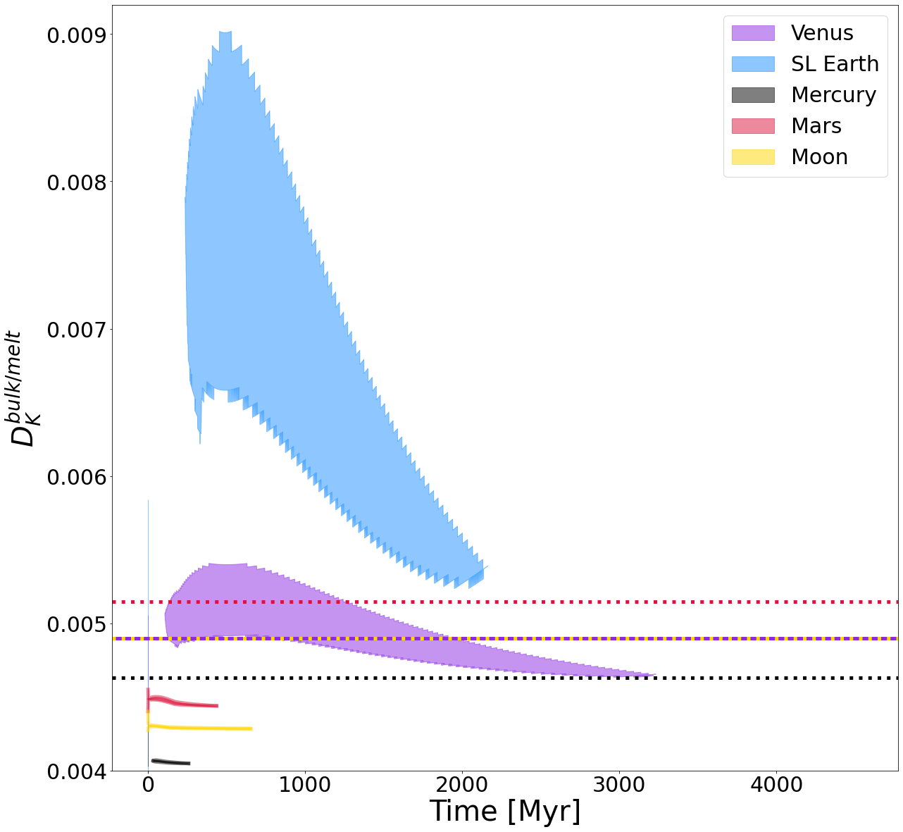
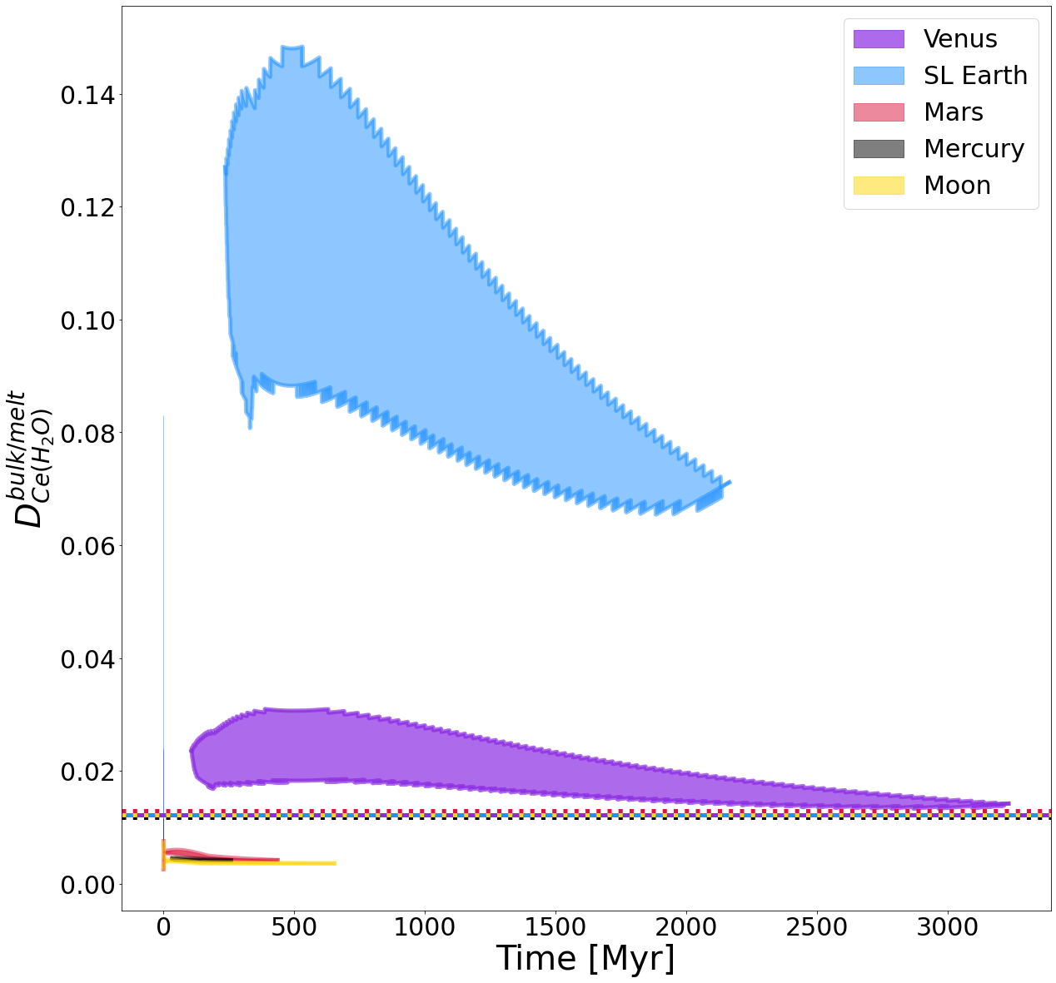
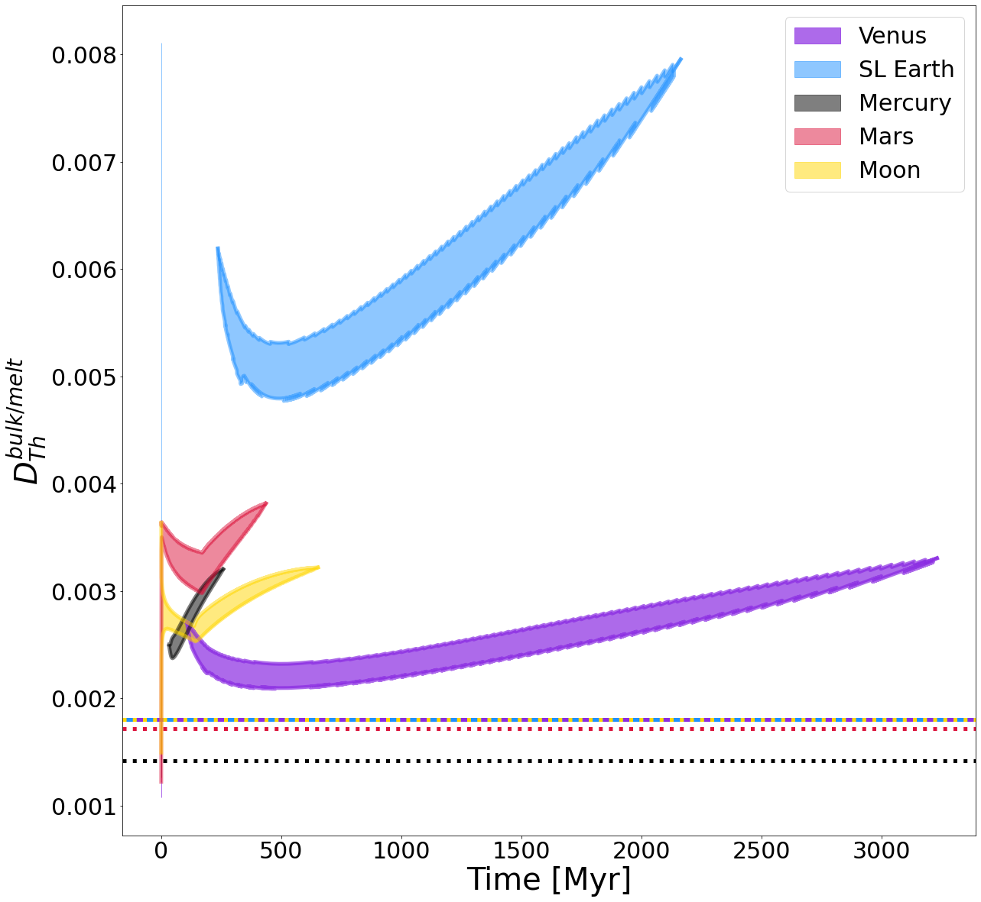
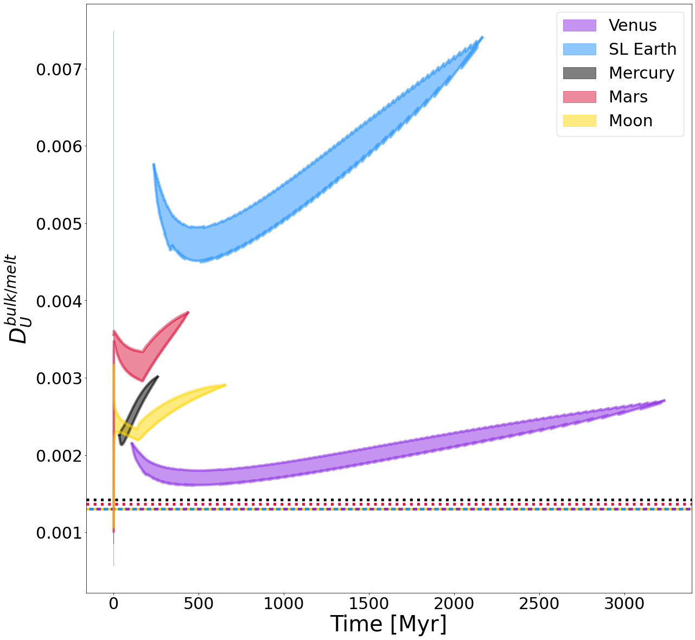
4.3. Bulk mineral/melt partitioning in rocky solar system bodies
Potassium
H₂O
As the olivine, garnet, and orthopyroxene partitioning data are taken from the literature, the D variations between planets and inside a melt zone decrease.
For H₂O, the Ds still change one order of magnitude depending on planet size.
Thorium
Uranium
Start
1. Introduction
2. Methods
3. Results
4. Discussion & Conclusion
End

Slide 19
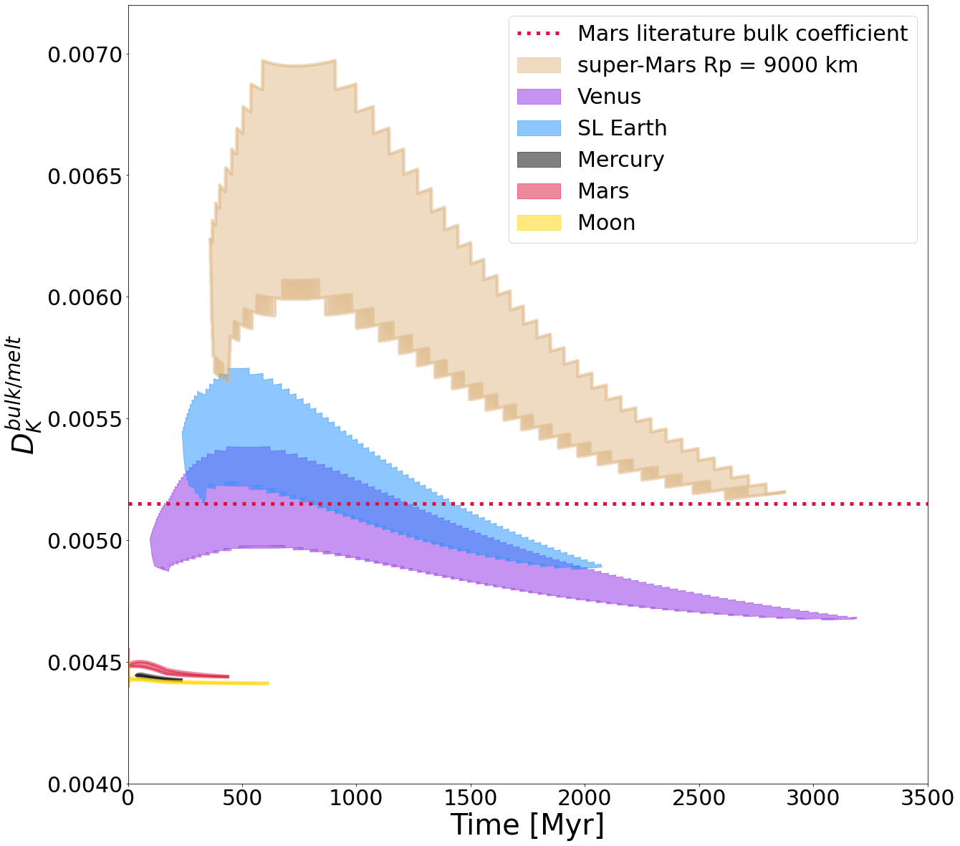
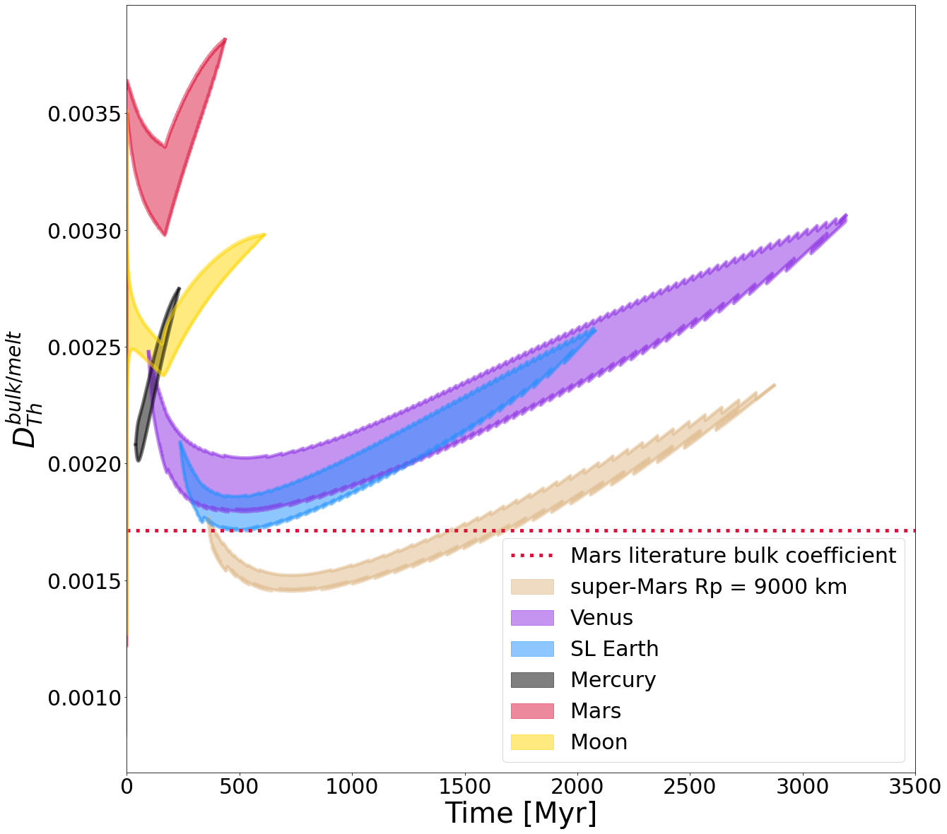
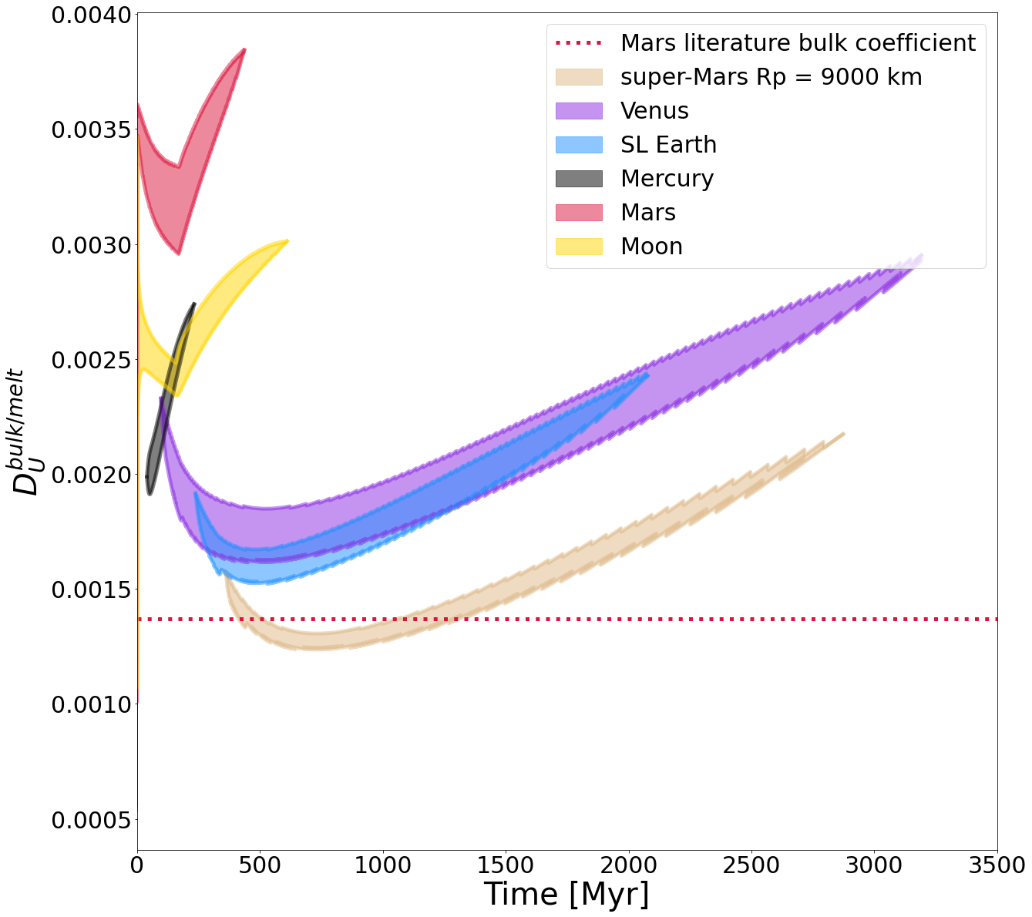
4.4. Bulk mineral/melt partitioning with Mars-like mantle composition
Potassium
H₂O
If we take away compositional effects, the results show the same correlation:
Higher K and H₂O Ds for larger planets.
Lower Th and U Ds for larger planets.
Thorium
Uranium
Start
1. Introduction
2. Methods
3. Results
4. Discussion & Conclusion
End

Slide 20
4.5. Mars – crustal thickness with varying staring parameters
Results are at the upper end of the crustal thickness from the mission data.
A mantle with lower viscosities leads to the most fitting results.
For lower mantle viscosities, the crustal delamination increases.
HPE Partition Coefficient calculations have a negligible impact on crust thickness for Mars-size planets, but can have an impact on element ratios and REE patterns.
Crust thickness from InSight mission:
24- to 72 km
(Knapmeyer-Endrun et al. 2021)
Start
1. Introduction
2. Methods
3. Results
4. Discussion & Conclusion
End

Slide 21
4.6. Mars – Element redistribution with varying starting parameters
Total amout of redistributed potassium
Taylor et al. (2006): 2000-6000 ppm K on Martian surface
Data collected by Mars Odyssey spacecraft
All model results fit very well to the mission data.
Because the calculated Ds have only a slight variation from the experimental results (link), the effect on the total redistribution is negligible.
Start
1. Introduction
2. Methods
3. Results
4. Discussion & Conclusion
End

Slide 22
4.7. Mars – Equivalent global layer thickness with varying starting parameters
EGL = Equivalent Global Layer thickness; The thickness of an water ocean on Mars if all outgassed H₂O built up the ocean.
With the calculated Ds, EGL changes up to ~20 m. This is because the partitioning of water is highly sensitive to temperature and pressure changes. The calculated P-T-X dependent bulk mineral/melt partition coefficients are lower than the literature values. Therefore, they are less incompatible with the solid mantle and more water is redistributed from mantle to crust. With larger planets, this effect is reverted (link).
Start
1. Introduction
2. Methods
3. Results
4. Discussion & Conclusion
End

Slide 23
4.8. Stagnant lid Earth – Equivalent global layer thickness with varying starting parameters
With the calculated Ds, EGL changes up up to several hundrets of meters.
The calculated P-T-X dependent bulk mineral/melt partition coefficients are higher than the literature values. Therefore, they are more incompatible and therefore less water is redistributed from mantle to crust. With smaller planets, this effect is reverted (link).

Slide 24
Planet size controls the redistribution of heat producing elements and volatiles from mantle to crust
Discussion
& Conclusions
Start
1. Introduction
2. Methods
3. Results
4. Discussion & Conclusion
End

Slide 25
5. Discussion & Conclusions
Locally calculated partition coefficients vary between planets with different sizes.
For K and H2O, Ds increase with planet size/melt zone depth.
For Th and U, the effect is inversed.
The impact of the D calculations is largest for H₂O
For a Mars-size planet, literature values were overestimated for planetary melting depth. Therefore, the resulting EGL is slightly larger than estimated with the literature Ds.
For larger, Earth-sized planets, the effect is inversed since the literature Ds are underestimated. Thus, more H2O will stay inside the mantle than expeceted, which reduces the EGL thickness significantly.
In one planet, locally calculated partition coefficients can vary significantly inside the developing melt zone
The starting parameter choice has very large consequences on the model evolution
Locally calculated D‘s can improve your mantle evolution code, especially with respect to water partitioning.
Start
1. Introduction
2. Methods
3. Results
4. Discussion & Conclusion
End

Slide 26
References
Blundy, J., & Wood, B. (2003). Partitioning of trace elements between crystals and melts. Earth and Planetary Science Letters, 210(3-4), 383-397.
Foley, B. J., Houser, C., Noack, L., & Tosi, N. (2020). The heat budget of rocky planets. In Planetary Diversity: Rocky planet processes and their observational signatures. IOP Publishing.
Frost, D. J. (2008). The upper mantle and transition zone. Elements, 4(3), 171-176.
Wood, B. J., & Blundy, J. D. (2014). 3.11-Trace Element Partitioning: The Influences of Ionic Radius, Cation Charge, Pressure, and Temperature. Treatise on Geochemistry (Second Edition). Elsevier, Oxford, 421-448.
Salters, V. J., & Stracke, A. (2004). Composition of the depleted mantle. Geochemistry, Geophysics, Geosystems, 5(5).
Schmidt, J.M. and Noack, L. (2021). Clinopyroxene/Melt Partitioning: Models for Higher Upper Mantle Pressures Applied to Sodium and Potassium, SysMea, 13(3&4), 125-136.
Stamenković, V., Noack, L., Breuer, D., & Spohn, T. (2012). The influence of pressure-dependent viscosity on the thermal evolution of super-Earths. The Astrophysical Journal, 748(1), 41.
Tosi, N., Breuer, D., & Spohn, T. (2014). Evolution of planetary interiors. In Encyclopedia of the Solar System (pp. 185-208). Elsevier.

