Slide 1
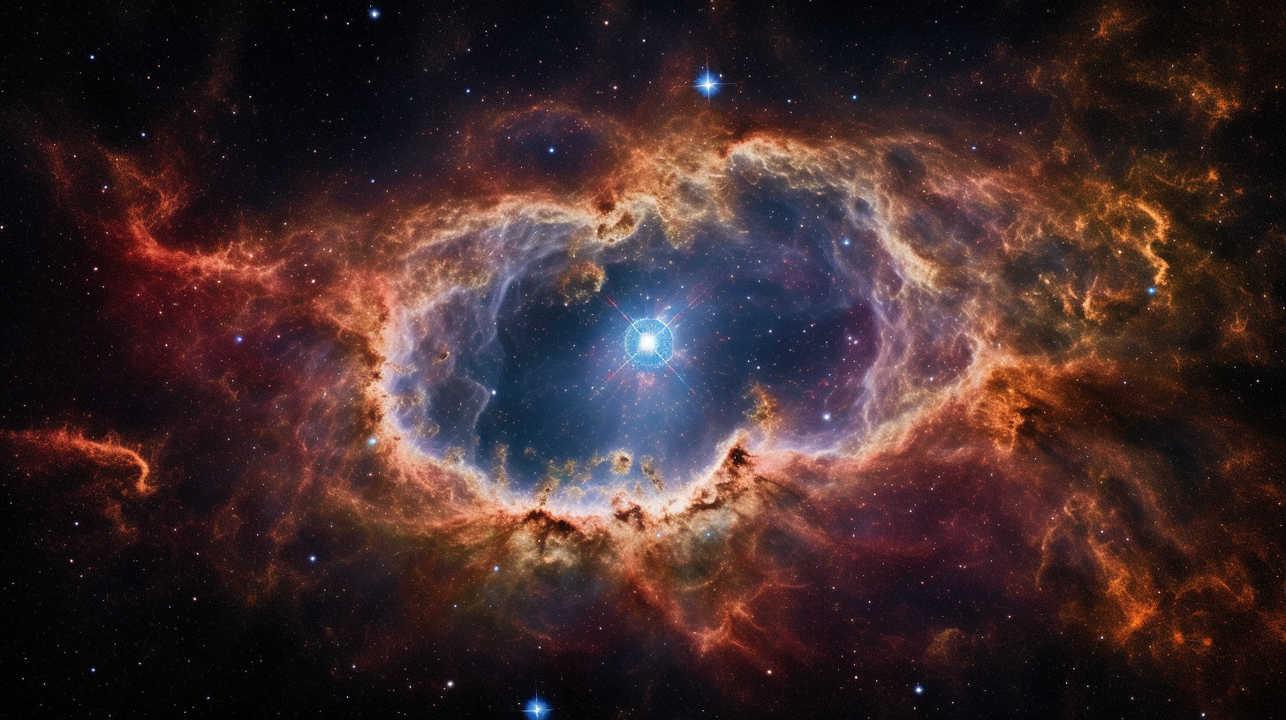
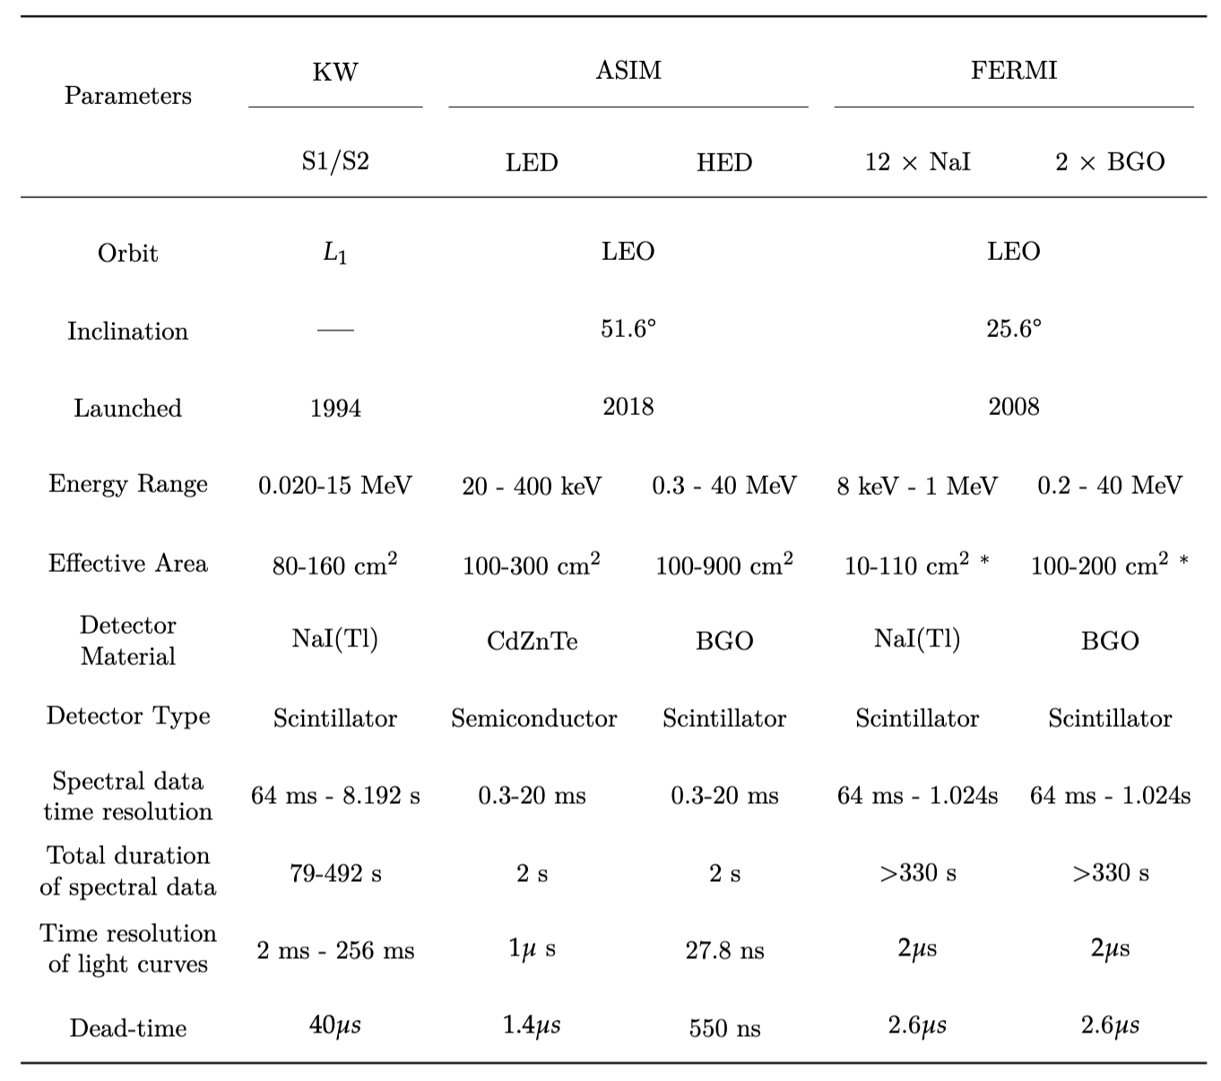
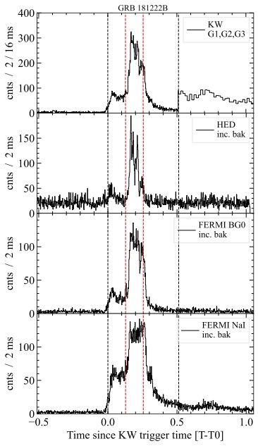
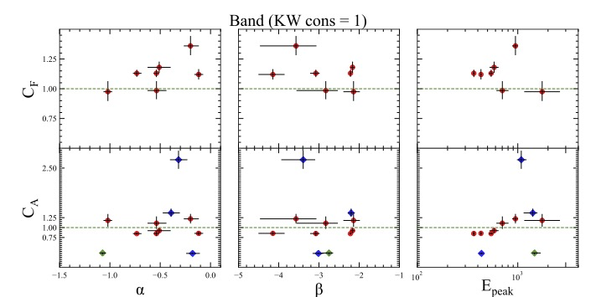
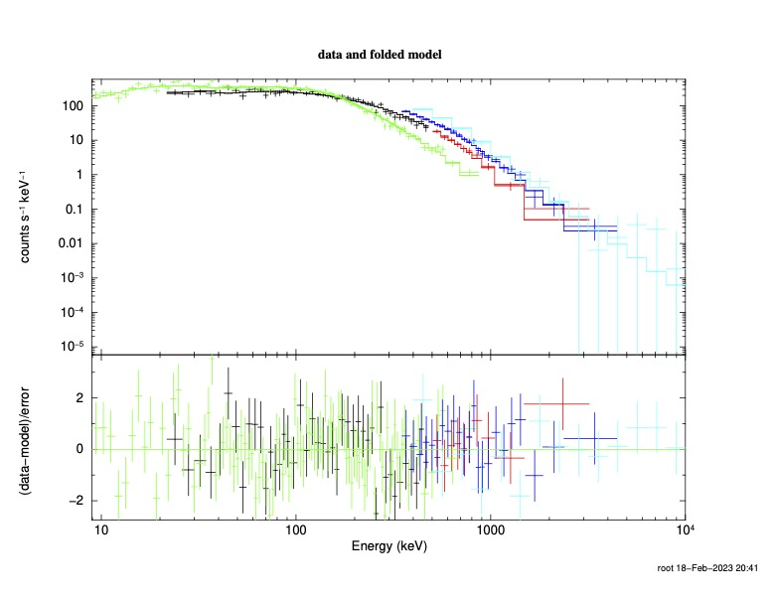
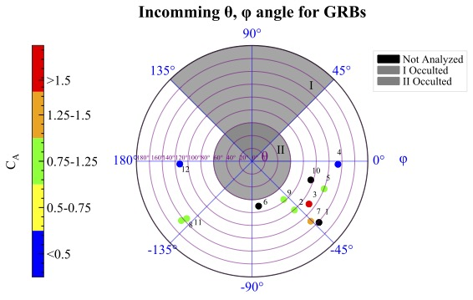
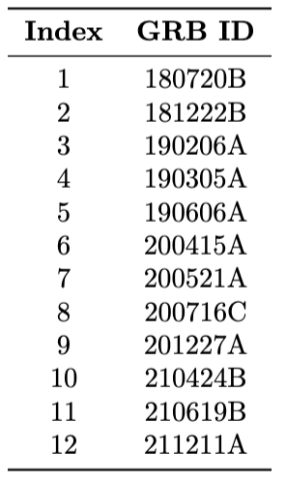
Validation of the ASIM MXGS performance using cosmic Gamma-Ray Bursts
Andreas Ramsli¹, Martino Marisaldi¹, Anastasia Tsvetkova^{2,3}, Cristiano Guidorzi⁴, David Sarria¹, Andrey Mezentsev¹, Anders Lindanger¹,
Nikolai Østgaard¹, Torsten Neubert⁵, Victor Reglero⁶, Dmitry Svinkin³, Alexandra Lysenko³, and Dmitry Frederiks³
¹Birkeland Centre for Space Science, University of Bergen, Norway, ²Dipartimento di Fisica, Università degli Studi di Cagliari, I-09042 Monserrato, Italy, ³Ioffe Institute, Politekhnicheskaya 26, 194021 St. Petersburg, Russia,
⁴Department of Physics and Earth Science, University of Ferrara, via Saragat 1, I–44122, Ferrara, Italy, ⁵National Space Institute, Technical University of Denmark, Kgs. Lyngby, Denmark, ⁶University of Valencia, Valencia, Spain
EGU 2023
14736
INSTRUMENTS AND DATASETS
The three stacked scatter plots display the cross-correlation normalization constants for ASIM (C_{A}) and Fermi (C_{F}) across each parameter in the Band model during joint fits
Red dots show KW-ASIM-Fermi data, blue points represent KW-ASIM data, and green points indicate ASIM-Fermi-GBM data for GRB 211211A. The green dashed line in each subplot signifies the expected cross-calibration coefficient of 1
Data from all three instruments were not concurrently available for every burst
The figure below features the spectra in the top section, while the residuals from the fit are displayed in the bottom section of the same figure.
Color-coded as follows: black and red represent the low and high energy spectra of KW, green and blue indicate the Fermi/GBM NaI and BGO, while cyan corresponds to ASIM/HED.
Spectra is fitted with the Band model
DISCUSSION
Polar plot below illustrating the cross-calibration coefficient C_{A} for incoming GRBs as data points, based on their angle of incidence (theta, phi) as observed by MXGS. The color-coded points represent the C_{A} values. Outliers are indicated by arrows
GRB artistic view - A. Ramsli
ABSTRACT
The Atmosphere-Space Interactions Monitor (ASIM) is an ESA mission on the ISS that studies Transient Luminous Events (TLEs) and Terrestrial Gamma-ray Flashes (TGFs). Validating the performance of the TGF-detecting MXGS sensor is challenging due to TGFs' local nature. This study suggests using cosmic Gamma-ray Bursts (GRBs) for calibration. From June 2018 to December 2021, 12 GRBs were detected by ASIM and other spacecraft, like Konus-WIND and Fermi GBM. Cross-correlation and spectral analysis were conducted, with some cases showing good consistency between detectors, validating MXGS performance, while others revealed discrepancies possibly due to absorption from masses not included in the ASIM mass model
ASIM is the first mission specifically dedicated to the observation of TGFs and Transient Luminous Events (TLEs).
Fermi is a space low-earth orbit satellite dedicated to gamma-ray astrophysics.
Fermi Gamma-ray Burst Monitor (GBM) is accurate and consistent in GRB detection and analysis, verified through cross-calibration efforts, joint spectral fits, and extensive GRB cataloging
WIND is a satellite orbiting the Lagrange point L1 dedicated to solar wind studies.
Konus-WIND (KW) has consistent GRB detection capabilities with other monitors; spectrum normalization differences < 20% in joint fits.
KW and Fermi-GBM are two of the current benchmarks in GRB observations, therefore are optimal candidates for cross-calibration studies
Utilized the Interplanetary Network (IPN), GRBweb database, and Gamma-ray Coordinate Network (GCN) archive to gather information on detected GRBs and their coordinates.
Acquired ASIM data from a local database, while obtaining data from KW and Fermi through collaboration and public databases.
Approach outlined in T. Sakamoto et al. Publications of the Astronomical Soci- ety of Japan, 63(1):215–277 (2011) followed to investigate any systematic trends in model parameters obtained from joint spectral analysis and the KW fit alone; scatter plots used to depict correlation between Band parameters.
METHOD
Identified GRBs by finding correspondence between ASIM trigger list and GRBs identified by the IPN or GRBweb collaboration
Prepared ASIM data for spectral analysis, extracting metrics such as time of arrival, energy channel calibration to keV etc.
Prepared Fermi-GBM data, selecting detectors with the lowest angle of incidence and the most illumination.
Cross-correlated light curves from different instruments to align them in the correct reference frame
Utilized Xspec for spectral fitting, calculating goodness-of-fit, cross-calibration coefficients, and confidence intervals.
Performed ASIM data consistency check to investigate significant deviations in cross calibration coefficients
Time intervals for accumulating spectra determined using Konus-WIND;
KW spectra provided by KW-team with specified start and stop times.
Outliers in C_{A} are not outliers in spectral parameters, meaning that while flux might be incorrect for some directions, spectral parameters remain reliable.
Cross-calibration coefficient deviations prompted a data consistency check for ASIM, investigating potential data preparation pipeline errors.
Outliers at phi ~0 and ~180 degrees may result from absorption by payload masses not included in the ASIM mass model. This highlights the importance of considering angle of incidence constraints for ASIM.
ASIM/HED calibration performance is generally verified
ASIM is shown to be an effective GRB detector, especially for short bursts, expected to be associated to gravitational wave events. This opens space for scientific exploitation of the ASIM mission also in the field of high-energy astrophysics
RESULTS:
Model parameters obtained from joint spectral fits using normalization constant factor and Band function (broken power law, typical for GRB spectra); primary focus on cross-calibration coefficient for HED
Majority of sample composed of short GRBs; ASIM's trigger logic focused on extremely short time scales (300 µs to 20 ms) due to main focus on detecting TGFs.
Three scatter plots above show correlations between Band parameters α, β, and E_{peak} for KW-ASIM and KW-only spectral fit. Each subplot has KW-only parameter values on the x-axis and corresponding KW-ASIM values on the y-axis.
The correlation among Band parameters is consistent between the ASIM-KW and KW-only fits; an outlier in the E_{peak} plot corresponds to GRB 190606
ACKNOWLEDGMENTS
The research presented in this study has been supported by funding from the European Union’s Horizon 2020 Programme, specifically through the AHEAD2020 project (grant agreement no. 871158)

