Slide 1
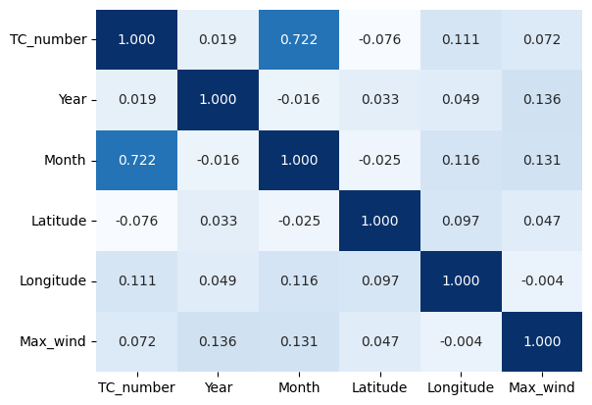
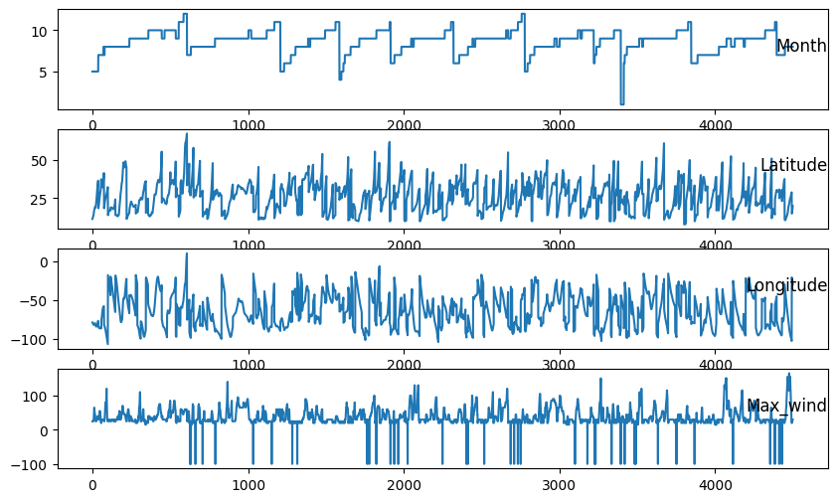
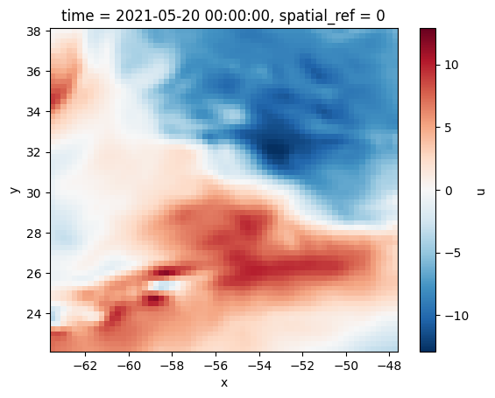
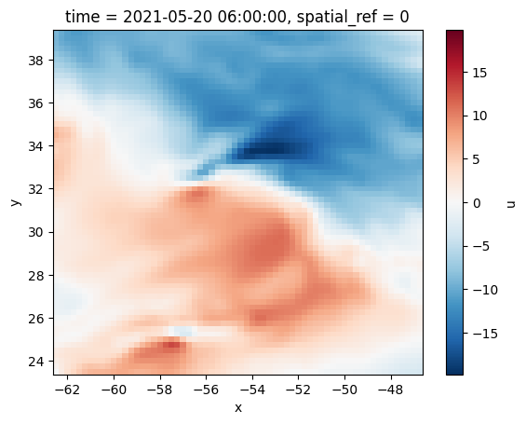
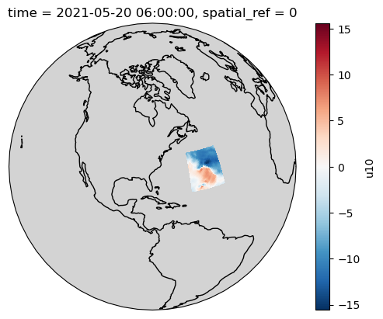
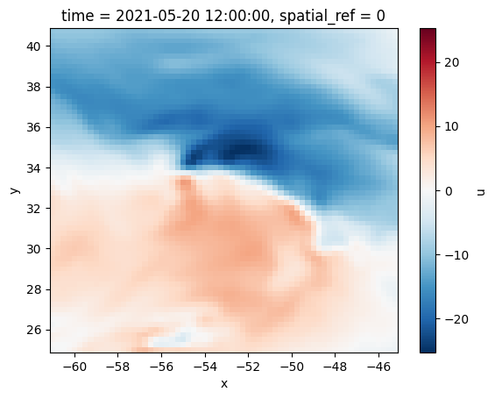
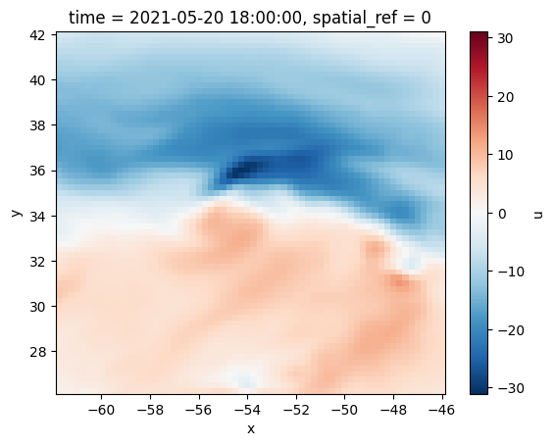
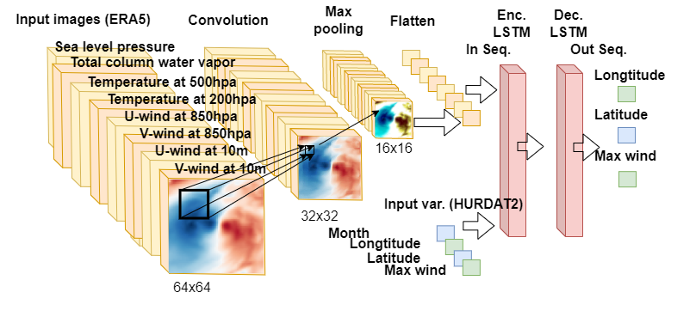
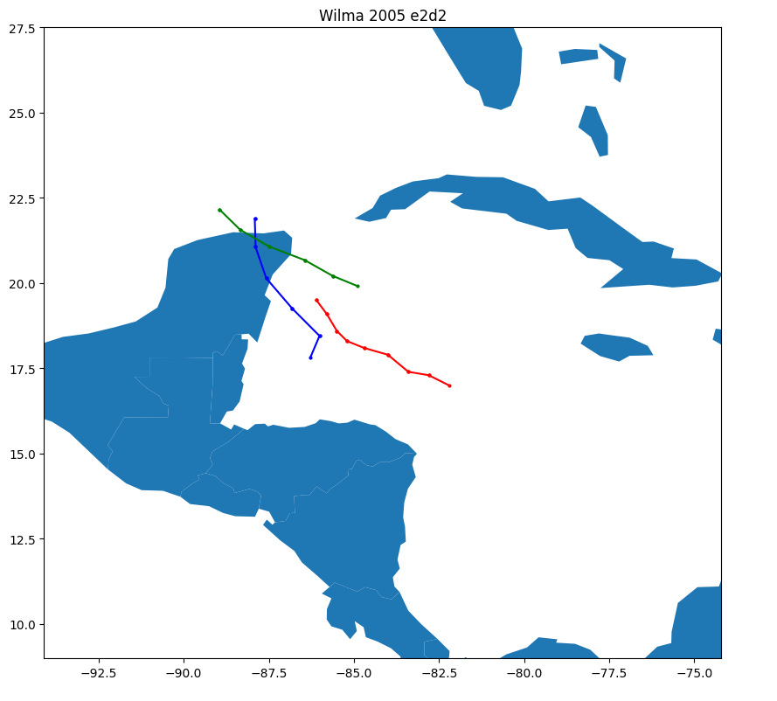
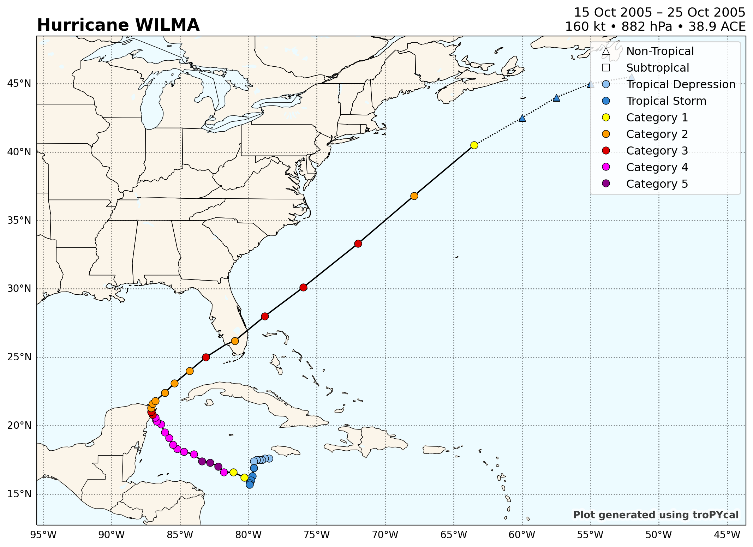
Yegor Hudozhnik¹ and Andreas Windisch
Multivariate forecasting of tropical cyclones using combined neural networks
Author: Yegor Hudozhnik Supervisor: Ing. Mag. Dr. Andreas Windisch
Yegor Hudozhnik and Andreas Windisch
00 Problem Statement
02 Data and Methods
Problem Statement
Tropical Cyclones (TCs) development depends on environmental features with non-linear behaviour.
Deep Learning (DL) methods are designed to facilitate the prediction process, as well as automatically detect and adapt to possible trends that may emerge over time.
DL methods can adjust themselves to climate changes and provide additional level of insights.
TC prediction is still perceived as a complicated DL task.
HURDAT2 provides documents spatial and temporal development of TCs. Weak correlations between variables hint that additional data is essential for forecasting.
ERA5 meteorological reanalysis provides advanced data in an image-like format.
Research Questions
Correlations heatmap.
Values seasonality.
U component of a wind at 850 hpa. First 24 hours of a TC development.
Data is divided to sequences of past and future observations for supervised learning.
LSTM encoder + decoder models, with single and double LSTM layers are examined.
As next point we are going to incorporate the 2D data into the models.
Use of autoencoder to dimensionality reduction.
01 Objective
Forecast trajectory and intensity using sequence to sequence pipeline.
Compare different NN architecture approaches.
Estimate ability to detect trends in the context of climate change.
04 Outline
03 Results
We will bring additional methods to test, such as Gaussian process regression and Bayesian linear regression. These methods can then refine the prediction with every data point that is observed, as well as provide uncertainty quantification.
Investigating hyper parameter space such as batch size or complexity of the NN to improve the results. Second LSTM layer improves long term predictions.
Red line - input observations, blue – Model 1, green – Model 2.
Actual trajectory.

