Slide 1
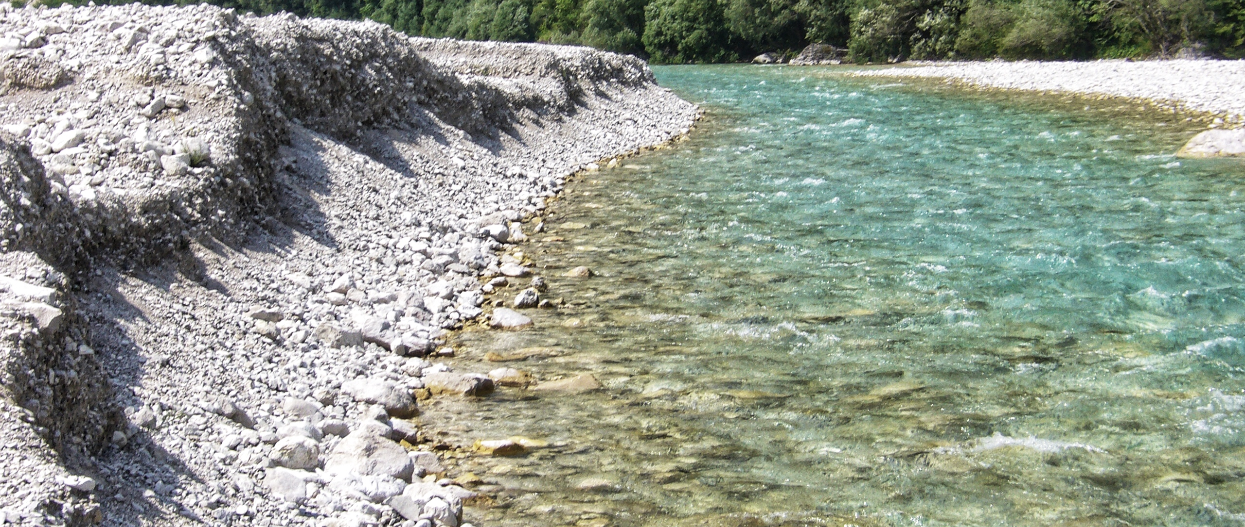
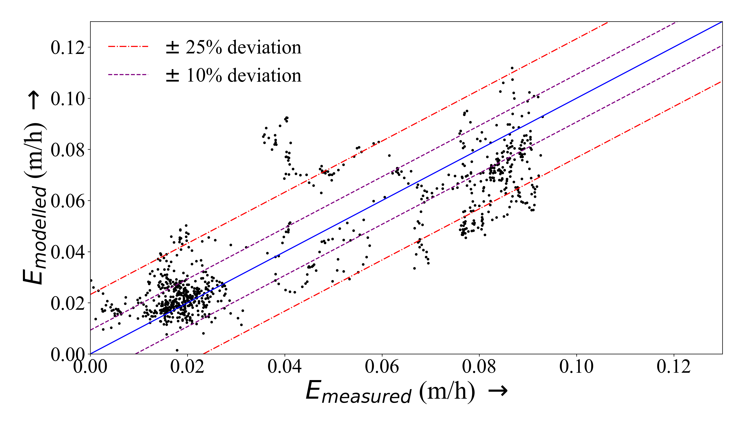
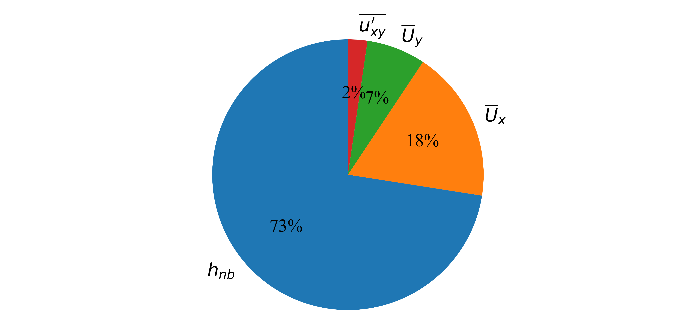
Correlating flow field with river bank erosion opposite to an accreting bank: A Large-Eddy Simulation approach Pratik Chakrabortyª, Daniel Valero^{a,b}, Andrés Vargas-Luna^{c}, Francesco Bregoli^{a,d}, Alessandra Crosato^{a,e} ªDepartment of Water Resources and Ecosystems, IHE Delft Institute for Water Education, Delft, The Netherlands ^{b}Institute for Water and River Basin Development, Karlsruhe Institute of Technology, Karlsruhe, Germany ^{c}Department of Civil Engineering, Pontificia Universidad Javeriana, Bogotá, Colombia ^{d}Department of Environmental Science, Radboud University, Nijmegen, The Netherlands ^{e}Faculty of Civil Engineering and Geosciences, Delft University of Technology, Delft, The Netherlands
Introduction
Results
Experimental flumes are studied to infer real river processes. However, flumes are often characterised by loose bank material, localised scour near banks and have scale issues.
Is bank erosion in experimental channels representative of bank erosion in rivers?
Fig. 2 High turbulent kinetic energy flow structures interacting with eroding bank
Eq. 1: Erosion rate as a function of mean flow variables and turbulence quantity
$$E=\frac{1}{3600}\left(0.453 \overline{U_{x}}+0.0815 \overline{U_{y}}−0.023 \frac{h_{nb}g}{{\overline{U}}_{b}}−2.24\frac{\overline{u_{xy}^{′^{2}}}}{{\overline{U}}_{b}}+0.1076\right)$$
Fig. 3 Comparison of modelled v/s measured (experimental) erosion rates
Fig. 1: (above) Bank erosion observed in the Cellina River (Italy). (below) Bank erosion in the experiments of Vargas-Luna et. al. (2019)
Goal
Establish the factors governing bank erosion in a well-monitored flume experiment and compare the results against literature on real rivers.
Methods
Fig. 4 Percentage contribution of flow variables to predicted bank erosion rates
Extending flume scale studies to real rivers requires examination of the equivalence of conditions since certain flow cases may show opposite trends (such as effect of water depth in this case). A linear regression model may not sufficiently capture the effects of turbulence.
Analyse the bank and bed evolution of a well-monitored experiment Describe the flow-field using a high-fidelity modelling technique viz., fully three-dimensional Large-Eddy Simulations (in OpenFOAM) Statistical identification of most influential variables and turbulent quantities using Correlation Analysis and Principal Component Analysis (PCA)
References:
Vargas‐Luna A, Duró G, Crosato A, Uijttewaal W (2019) Morphological Adaptation of River Channels to Vegetation Establishment: A Laboratory Study. Journal of Geophysical Research: Earth Surface 124: 1981-1995

