Slide 1
LOCATE: Prediction of plastic hotspots in coastal regions using numerical simulations in a coupled system
Ivan Hernandez ¹, Leidy Maricela Castro Rosero ¹, Manuel Espino Infantes ¹, José María Alsina Torrent ^{1,2}
1. Laboratorio de Ingeniería Marítima. Departamento de Ingeniería Civil y Ambiental (DECA), Universitat Politécnica de Catalunya 2. Departament d'Enginyeria Gràfica i de Disseny, Universitat Politécnica de Catalunya

Slide 2
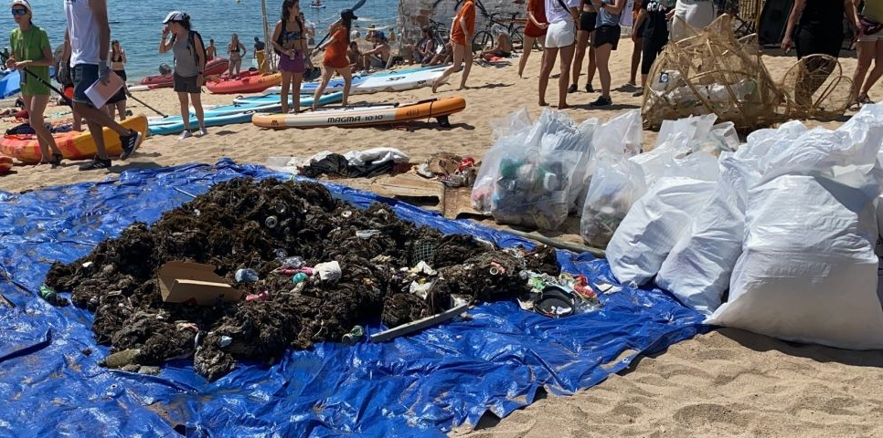
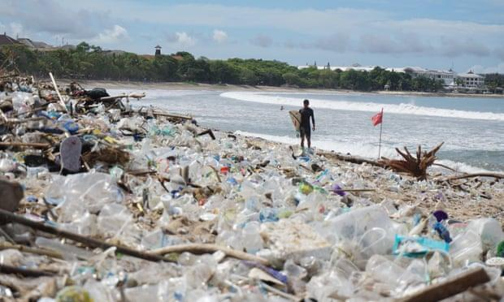
Marine litter in coastal zones
Coastal regions are heavily impacted by the accumulation of marine litter
Rivers can act as vectors of transport of litter into the sea
Once in the sea marine litter can travel great distances and accumulate, sink to the seafloor or return to land.
Marine litter collected by volunteers at Badalona beach)
Presence of marine litter on Kuta beach (Bali) (The Guardian

Slide 3
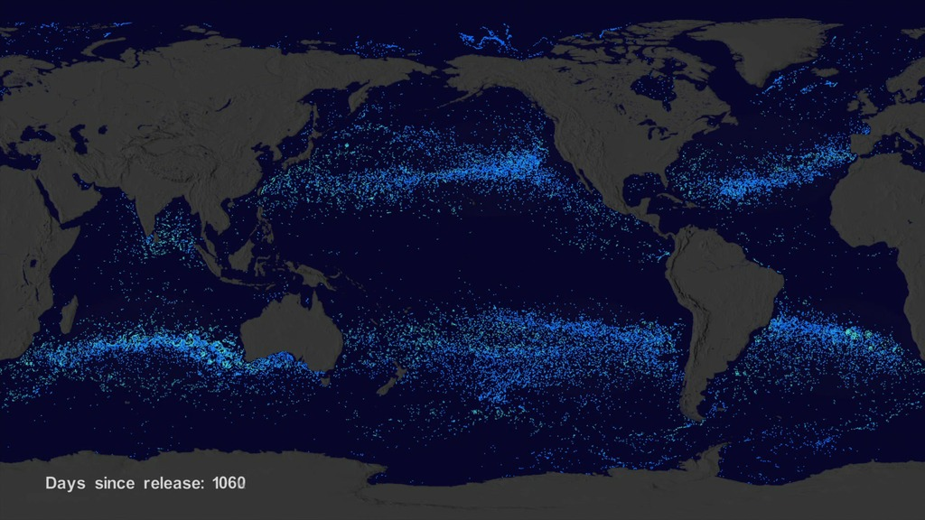
Lagrangian numerical models
OceanParcels (Probably A Really Computationally Efficient Lagrangian Simulator) - highly customisable model using Python

Slide 4
The Barcelona coastline is one of the litter hotspots in the Mediterranean Sea ^{1, 2}
Accumulation and transport mechanisms are largely unknown in coastal waters.
Occur close to the shoreline
Can be very energetic, wave action transports material
Challenging to include in models due to high resolution required and high spatial requirements.
﻿Averaged 2013–2017 map of plastic debris concentration (g km⁻²) at the sea surface, Liubartseva, et al., 2018
1, Liubartseva, S. et al. (2018) ‘Tracking plastics in the Mediterranean: 2D Lagrangian model’, Marine Pollution Bulletin, 129(1), pp. 151–162. doi: 10.1016/j.marpolbul.2018.02.019.
2. Sanchez-Vidal, A. et al (2021) Paddle surfing for science on microplastic pollution: a successful citizen science initiative, in: EGU21-10579. Presented at EGU21.

Slide 5
Coastal processes
Occur close to the shoreline
Can be very energetic, wave action transports material
Challenging to include in models due to high resolution required and high spatial requirements.

Slide 6
LOCATE working flow diagram
Couples Eulerian hydrodynamic information and the Lagrangian simulation of virtual particles using the hydrodynamic information
OceanParcels (Probably A Really Computationally Efficient Lagrangian Simulator) - highly customisable model using Python
CMEMS server
Direct numerical Eulerian simulations
Circulation information at three nested grids and wave information
Circulation model
Regional (IBI)
Precomputed data
Lagrangian Particle Solver (Ocean Parcels)
Opendap server (Puertos del Estado)
Circulation model
Coastal
Harbour
Wave propagation model
Regional
Coastal simulation Current and wave advection and turbulent dispersion

Slide 7
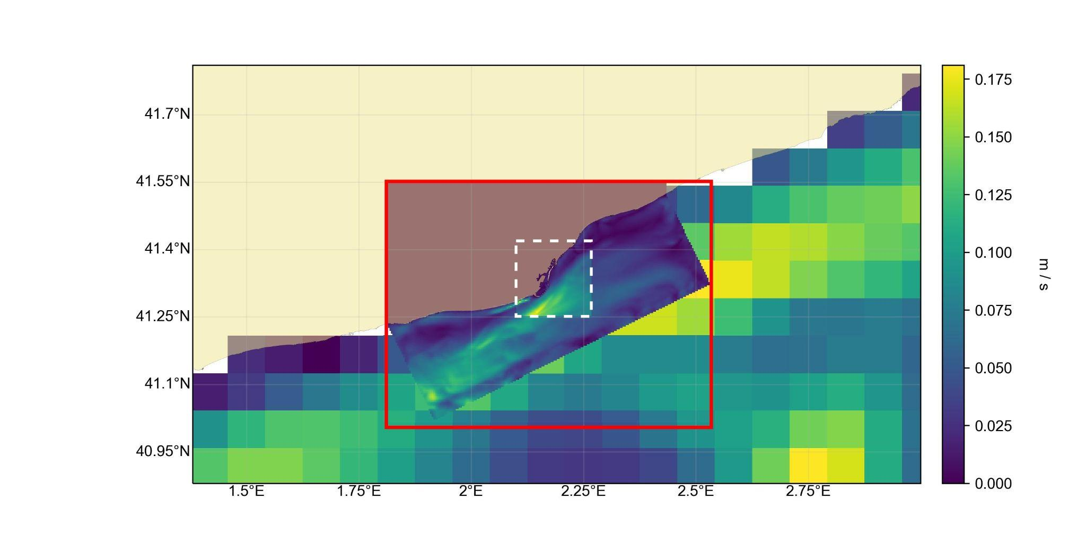
Nested hydrodynamic grids
— 0.175
— 0.150
— 0.125
— 0.100
— 0.075
— 0.050
— 0.025
— 0
Regional grid, resolution 2500 m
Current velocity m/s
Coastal grid, resolution 350 m
Harbour grid, resolution 70 m

Slide 8
Beaching sensitivity analysis
Beached particles are deleted from the simulation - counted and registered
Current velocity ≈ 0 m s⁻¹ (< 1-16e)
Distance to shore <= 0 km
25
20
15
10
5
0
-5
0
0
-1
-2
-3
-4
-5

Slide 9
Simulation of marine litter
Simulation period was of 260 days (01-02-2017 to 19-10-2017)
552,480 particles released in total from the Llobregat and Besòs river mouths
Interpolated observational data from Schirinzi, et al., 2020

Slide 10
Simulation of marine litter
Observational data from Schirinzi, et al., 2020
Simulation period was of 260 days (01-02-2017 to 19-10-2017)
552,480 particles released in total from the Llobregat and Besòs river mouths

Slide 11
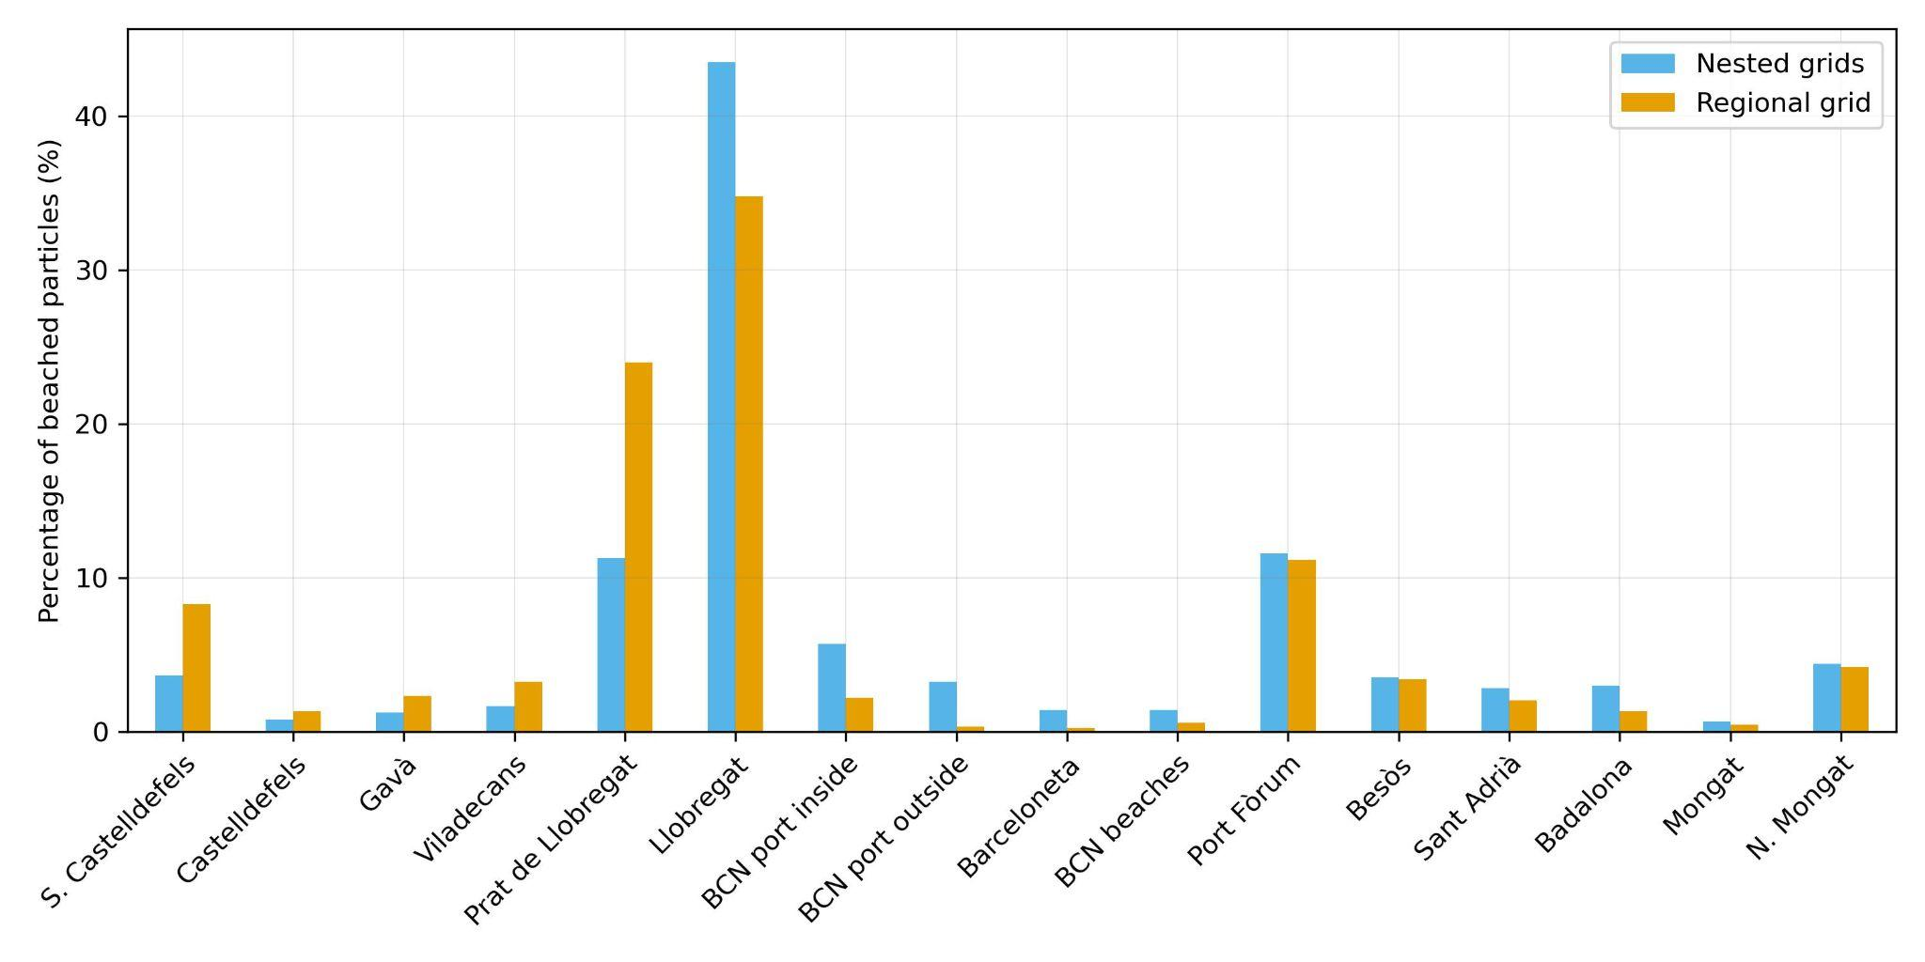
Nested versus single grid
Nested grid 91.5% beaching. Single regional grid 95.8% beaching

Slide 12
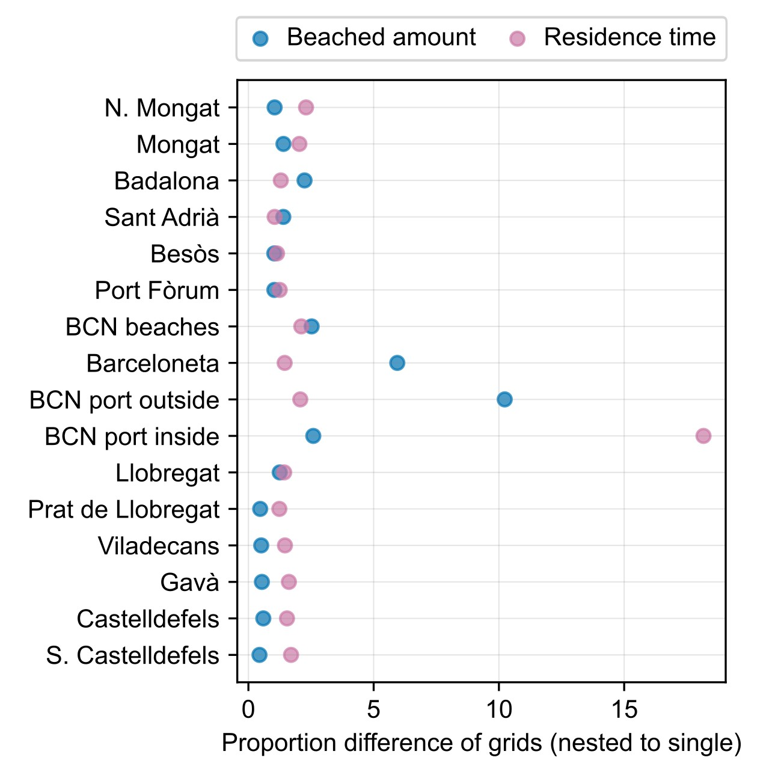
Overall beaching amounts similar for both cases:
91.5% nested grids
95.8% single grid
Higher amounts in beaching and residence time in zones where the highest resolution applies
Inside the port area the harbour grid resolves the processes in an area where there is a natural barrier

Slide 13
Conclusion
LOCATE can be used to efficiently simulate dispersion of marine litter at coastal scales.
Coastal processes are taken into account
Distance to shore for beaching
Localised differences between nested and single grids

Slide 14
Thank you!
ACKNOWLEDGEMENT
The present study has been carried out in the framework of the TRACE (Tools for a better management of marine litter in coastal environments to accelerate the tRAnsition to a Circular plastic Economy) project. TRACE, TED2021-130515B-I00 funded by the MCIN/AEI/10.13039/501100011033 and the European Union within the “NextGenerationEU”/PRTR.

