Slide 1
Correcting biases toward large and severe fires in the SPITFIRE model
Luke Oberhagemann, Maik Billing, Werner von Bloh, Markus Drüke, Boris Sakschewski, and Kirsten Thonicke

Slide 2
The SPITFIRE Model
Designed for use with dynamic global vegetation models (DGVMs)
Calculates average fire behavior within coarse grid cells (usually 0.5° by 0.5°)
Rothermel-based wind-driven fire spread
Vegetation Model
Mortality
Ignitions
Fire Danger
Fire Spread
Fuel Consumption
Number of fires
Area burnt
1

Slide 3
The SPITFIRE Model
Established model in the field of global fire modelling
Created in 2010
Basis paper cited 393 times (Google Scholar)
Implemented in several DGVMs
SPITFIRE-based models form a substantial part of the fire model intercomparison project (FireMIP) – 5 out of 11 models
Some unexplained tendencies have been observed
Too much, severe fire on grasslands
Too little fire in forests
2

Slide 4
Sources of bias in the SPITFIRE Model

Slide 5
Bias due to application of the Rothermel Equation
Rate of energy release towards next section of fuel
Energy required for ignition
$$R=f(σ, w_{n},….)$$
Surface area to volume ratio
Net fuel load
Straightforward if fuels are uniform
3

Slide 6
Bias due to application of the Rothermel Equation – nonuniform fuels case
$$R=f(σ_{ij}, w_{n,ij},….)$$
$$i= 1 2$$
$$j= 1 2 3$$
Weighted combination of parameters from different fuel classes
$$σ_{i}=\sum_{j}{f_{ij}σ_{ij}}$$
$$w_{n,i}=\sum_{j}{g_{ij}w_{n,ij}}$$
Surface area-based weighting
4

Slide 7
Difference to implementation in SPITFIRE
Rothermel 1972, Albini 1976
SPITFIRE
$$σ_{i}=\sum_{j}{f_{ij}σ_{ij}}$$
$$σ_{i}=\sum_{j}{\frac{w_{n,ij}}{w_{n,i}}σ_{ij}}$$
$$w_{n,i}=\sum_{j}{g_{ij}w_{n,ij}}$$
$$w_{n,i}=\sum_{j}{w_{n,ij}}$$
Missing Weighting Factor
5

Slide 8
Impact on Model Results: TL3
TL3
Moisture contents
Vlow
Low
Moderate
High
1h (%) | 3 | 6 | 9 | 12
10h (%) | 4 | 7 | 10 | 13
100h (%) | 5 | 8 | 11 | 14
Scott and Burgan 2005
6

Slide 9
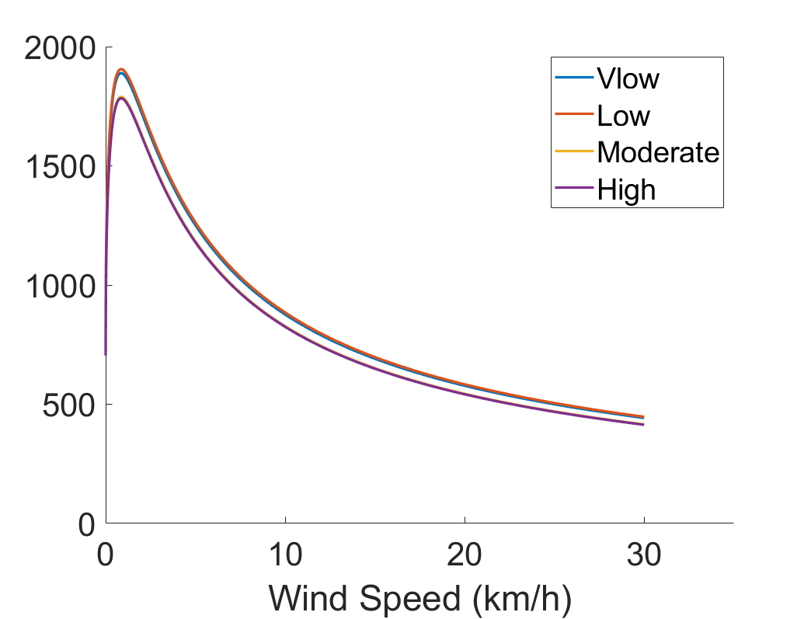
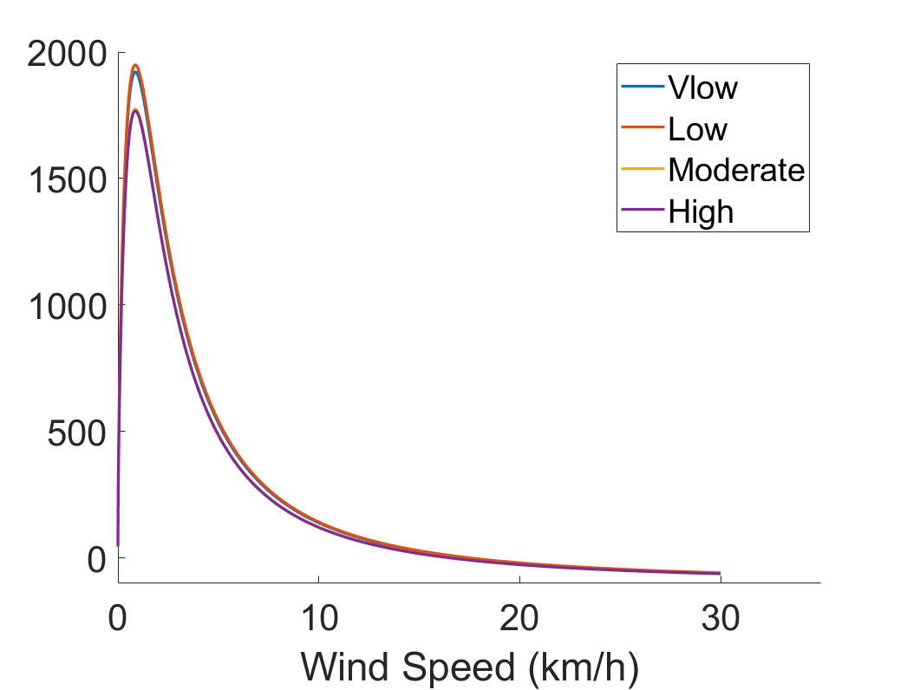
Impact on Model Results: Quantifying error in SPITFIRE
% Difference in Fire Size
% Difference in Scorch Height
Too Large and Severe Fires
% Difference
% Difference
7

Slide 10
Bias due to calculation of live fuel moisture
Rothermel 1972, Albini 1976
SPITFIRE
Dead and live fuel moistures treated separately
$$ω_{combined}=ω_{dead}^{\frac{w_{dead}}{w_{total}}}∗ω_{lg}^{\frac{w_{lg}}{w_{total}}}$$
e.g. Scott and Burgan 2005, NFDRS
SPITFIRE
Live fuel moistures can be greater than 100% (up to 250% in NFDRS 2016)
Maximum = 1
8

Slide 11
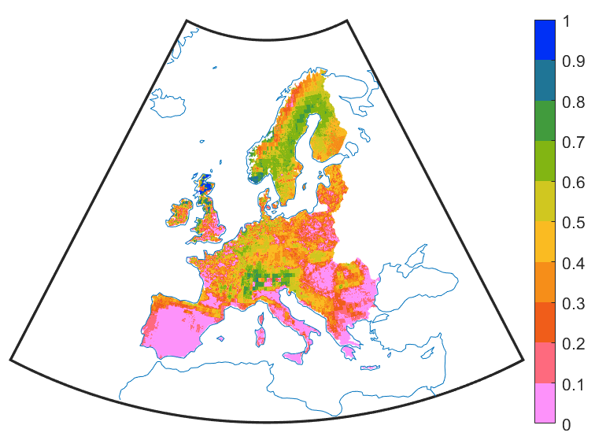
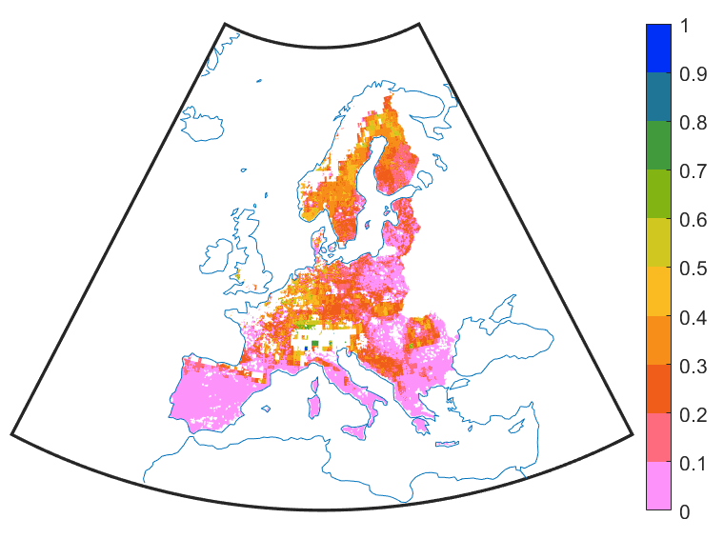
Impact on Model Results: Livegrass Moisture
Mean live grass moisture 2003-2016 (dry mass basis)
Live grass moisture when there is fire
Fire Excluded from High Soil Moisture Areas
(Often Forests)
9

Slide 12
Additional sources of bias requiring parametrization
Dead fuels
Errors in fuel bulk density calculation
Some missing distinctions between fuel types and size classes
Moisture of extinction
Too low live fuel moisture of extinction (20%)
Universal dead fuel moisture of extinction (30%)
Compensating errors in other model components
Bug leading to exclusion of cured grass from fire spread
Very low fire duration
10

Slide 13
Current Corrections

Slide 14
Corrected Weighting Factors
Implemented and tested a corrected rate of spread calculation
Hard-coded Scott-Burgan fuel models into SPITFIRE for testing
Results shown at very low fuel moisture scenario, 8km/h wind speed
Fuel Model | Rate of Spread (m/min)
 | Code Verified Using Scott and Burgan 2005 | Previous version of SPITFIRE | SPITFIRE with corrections
TL3 | 0.782 | 1.42 | 0.768
GR6 | 28.17 | 0 | 28.24
11

Slide 15
Live Grass Moisture Parametrization
Adopted and currently testing the live fuel moisture parametrization from the 2016 NFDRS
Based on Growing Season Index (GSI)
GSI = f(VPD,Photoperiod,Temperature)
Values of herbaceous LFM between 30-250%
More realistic values and seasonality
12

Slide 16
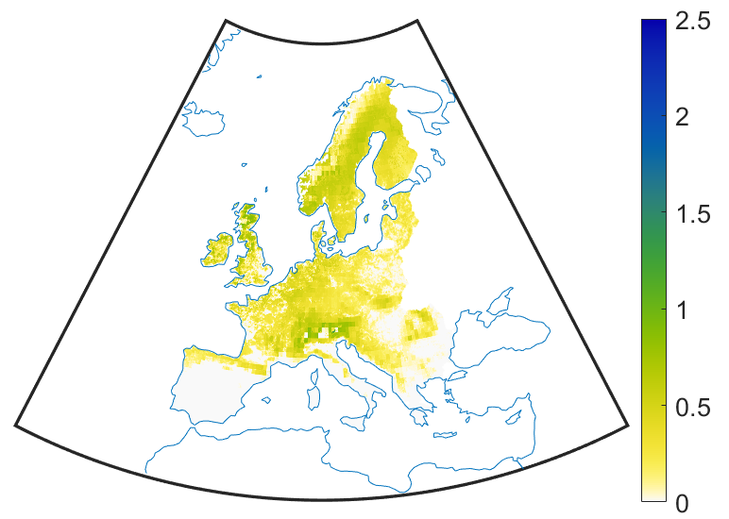
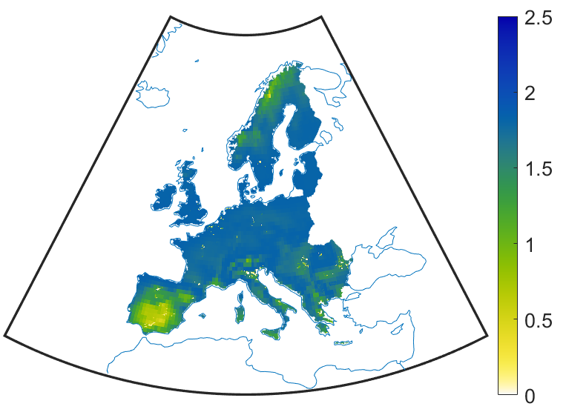
Live Grass Moisture Parametrization
Previous Mean August live grass moisture 2003-2016
Mean August live grass moisture using NFDRS2016
13

Slide 17
Conclusions
Inaccurate weighting of fuel components results in significant upward biases in fire size and fire severity in the SPITFIRE model
Bias corrected with corrected weighting factors
Inaccurate live grass moistures and combination with fuel moistures results in too sharp divisions between forest and grassland fires
Currently testing a new parametrization
Some issues have been corrected, however additional parametrizations and tests are required
Knowledge of these issues can help explain previous results and allow for future model improvements
oberhagemann@uni-potsdam.de
14

