Slide 1
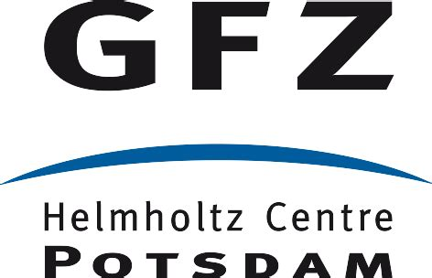
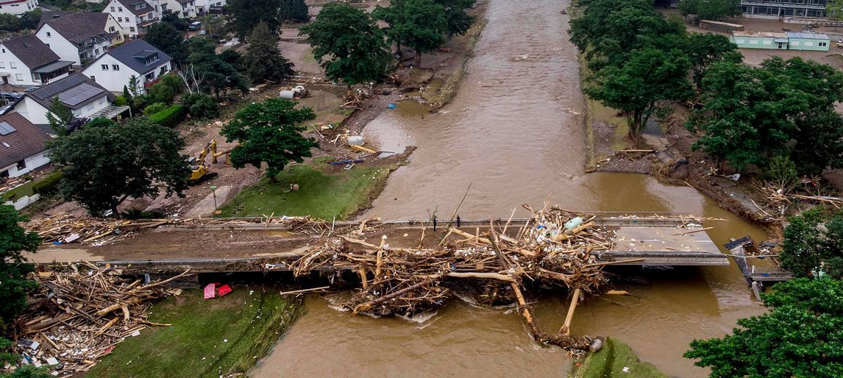
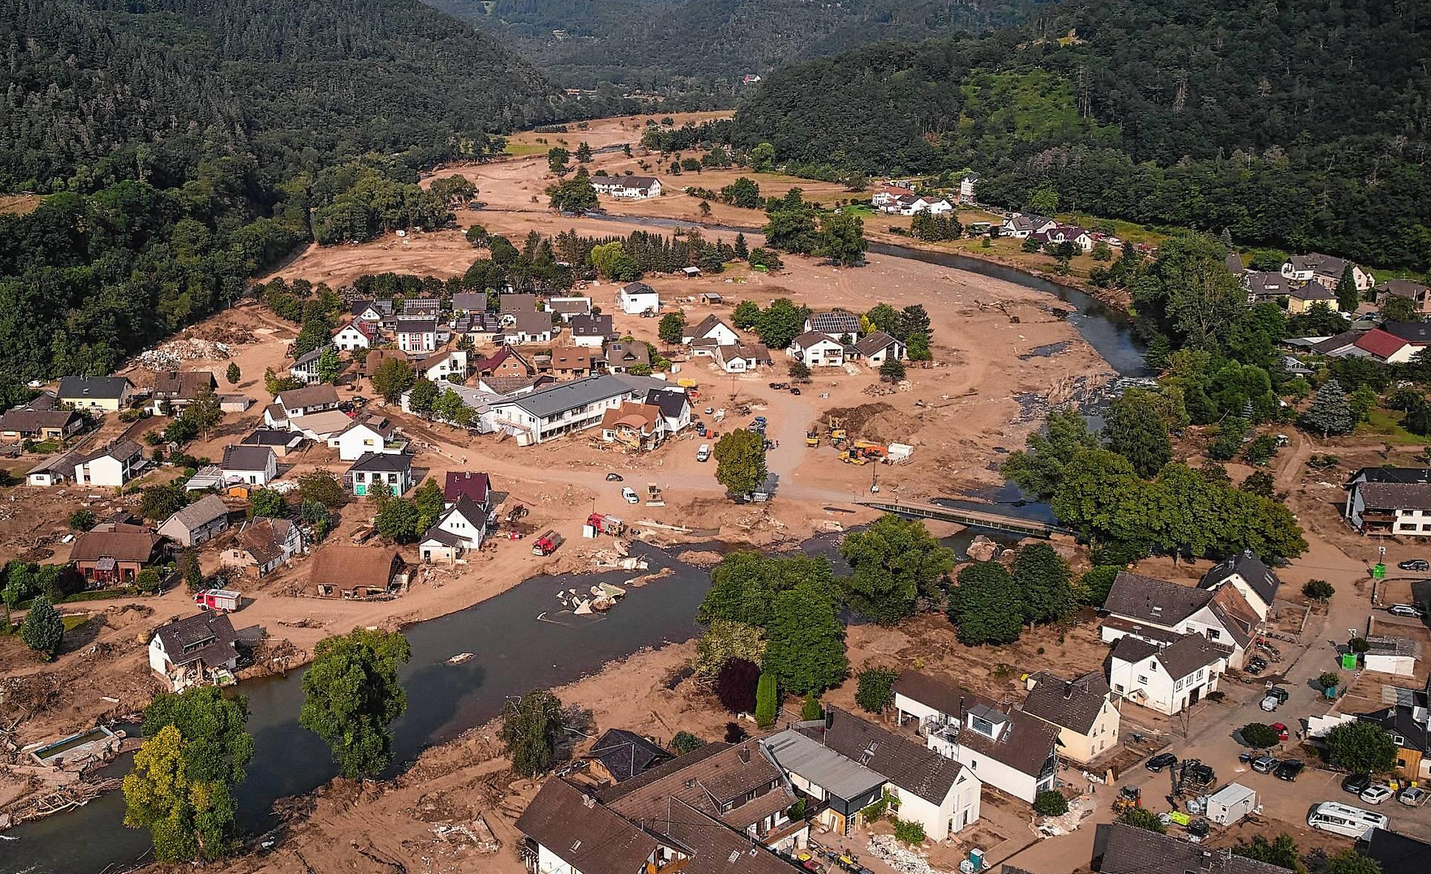
Extreme flood impact on riparian vegetation dynamics in the Ahr river catchment, Germany
Center of Applied Geosciences
Faculty of Science
Authors: C. Hauser¹, A. R. Beer¹, C. Gacmenga¹, U. Ozturk^{2,3}, M. Dietze^{4,5}, R. Bell⁶, A. Lucía⁷
¹Department of Geosciences, University of Tübingen, Germany; ²Institute of Environmental Science and Geogaphy, Univesity of Potsdam, Germany; ³Section 2.6 Seismic Hazard and Risk Dynamics, GFZ Potsdam, Germany; ⁴Faculty of Geosciences and Geography, University of Göttingen, Gemany; ⁵Section 4.6 Geomorphology, GFZ Potsdam, Germany; ⁶Department of Geography, University of Bonn, Germany; ⁷Department of Geohazards and Climate Change, IGME-CSIS,Spain
Introduction & Background
Material & Methods
Results
Discussion & Conclusion
The Ahr river in western Germany is 86 km long and drains ≈ 900 km² of the Rhenish Massif (Fig. 1).
56.3% of the Ahr river catchment are forested and only 5.7% belong
We detected NDVI (normalized differential vegetation index) changes using Landsat/ Sentinel satellite data (Google Earth Engine based HazMapper²) to identify flood affected areas (Fig. 4b).
A CORINE land cover map (CLC5 2018) was used for identifying forested areas (Fig. 4a). The type and amount of affected vegetation was quantified with data from the German national forest inventory³.
We expect most changes to happen near the stream network. Therefore, we used buffers of 100-500m around streams according to their stream order (Fig.1, 4c).
Field visits and mapping of some designated reaches were used to validate the remotely obtained data (Fig. 4c).
All processing was done with QGIS 3.28⁴.
Field mapping showed: trees are mainly uprooted in areas of NDVI decrease ≥ 20% compared to pre-event times.
Vegetation loss of ≥ 20% was detected on ≈ 1565 ha (≙ 1.7%) of the Ahr catchment.
210 ha are located within forested areas (≙ 13.4% of all affected areas) (Fig. 5). Around 435 ha (≙ 27,8% of all affected areas) are arable land.
Forests in the Ahr catchment have a mean wood volume of 270.5 m³/ha. Different forest types are not significantly different regarding biomass volumes³.
Total loss of large wood for the Ahr catchment is nearly 23’000 m³. This refers to a mean large wood recruitment of 267.4 m³/km and a specific large wood transport volume of 25.5 m³/km².
76.8 % (≈ 17’667 m³) happened in the main valley. Areas of more than 80% vegetation loss are restricted to the main valley only.
20’700 t of CO₂ were stored in all the recruited wood⁵.
We could prove that most of the recruited wood (76.8%) origins from the fluvial corridor in the main valley.
In total, the Ahr flood led to nearly 23’000 m³ of large wood recruitment (≙ 267.4 m³/km). Burning and rotting of this wood releases as much CO₂ emissions as 13’800 cars in one year.
In relation to catchment size, the specific large wood transport volume is comparable to other flood events, e. g., the Kander Basin flood in Switzerland in 2005⁶.
Artificial structures in or at the river, such as bridges and weirs, are main deposition areas for large wood during floods⁶. This should be kept in mind for the (re)construction of critical infrastructure.
Further steps:
Identify control factors for large wood recruitment at reach scale (e.g., discharge)
Identify deposition areas via ortho photo analysis to investigate a wood balance
to urban regions and infrastructure.
Fig. 1: Study area with stream buffers (≙ areas used for analysis). The little map of Germany shows the location of the study area.
Severe floodings happened on 14th & 15th July 2021 due to heavy rainfall with a return period of >500 years¹.
Large wood caused clogging of bridges and damage of houses and infrastructure (Fig. 2 and 3).
https://www.wsws.org/asset/89d8d504-f1a1-4091-81c0-72d3f09d26a2?rendition=image1280
https://www.suedkurier.de/storage/image/4/2/1/6/13226124_shift-644x0-2560w_1A8_NU_D9A6ql.jpg
References
Fig. 5: NDVI change respectively vegetation loss of ≥ 20% within forested areas in the stream buffers. Calculated values of large wood recruitment are based on these areas only.
Dietze, M., Bell, R., Ozturk, U., Cook, K. L., Andermann, C., Beer, A. R., Damm, B., Lucia, A., Fauer, F. S., Nissen, K. M., Sieg, T., & Thieken, A. H. (2022). More than heavy rain turning into fast-flowing water – a landscape perspective on the 2021 Eifel floods. Nat. Hazards Earth Syst. Sci., 22(6), 1845-1856. https://doi.org/10.5194/nhess-22-1845-2022
Scheip, C. M. and Wegmann, K. W.: HazMapper: a global open-source natural hazard mapping application in Google Earth Engine. Nat. Hazards Earth Syst. Sci., 21, 1495–1511, https://doi.org/10.5194/nhess-21-1495-2021, 2021
Thünen-Institut, Dritte Bundeswaldinventur - Ergebnisdatenbank, https://bwi.info, Aufruf am: 23.11.2022
QGIS.org, QGIS 3.28 Geographic Information System. QGIS Association. http://www.qgis.org
Holzforschung München, & Technische Universität München. (2010). Bauen mit Holz = aktiver Klimaschutz. Zweite Auflage. https://www.cluster-forstholzbayern.de/images/stories/downloads/broschuere/broschuere-bauen-mit-holz-klimaschutz.pdf
Comiti, F., Lucía, A., & Rickenmann, D. (2016). Large wood recruitment and transport during large floods: A review. Geomorphology, 269, 23-39. https://doi.org/https://doi.org/10.1016/j.geomorph.2016.06.016
Fig. 2: Clogging and damage of a bridge in Ahrweiler
Fig. 3: Damage of houses and infrastructure
Research questions:
How much wood was recruited and from which areas?
Which impact do large wood have on channel dynamics?
(a)
(b)
(c)
Fig. 4: The same reach of the Ahr river near Altenahr is shown in different map views. For comparison, the stream network is included in all maps. (a) shows a map of land cover. Only forested areas are included in the wood recruitment analyses. (b) shows a satellite image that was taken a few days after the flood. (c) shows the output of the HazMapper analysis (NDVI change) which was cut to the streamnet buffers. Results of post-event tree mapping are included as points in blue (uprooted trees) or green (still standing trees).
Acknowledgements
For further information please contact:
chiara.hauser@student.uni-tuebingen.de
This research is partially funded by the HART (Hazard and Risk Team) action of Eifel Flood Event 2021 funded by the Helmholtz Centre Potsdam – GFZ German Research Centre for Geosciences and University of Potsdam.

