Slide 1
Identifying the convective and stratiform rainfall regimes using stable isotopic measurement
Atmospheric Science (AS) Division
Abstract ID: EGU23-14988
https://doi.org/10.5194/egusphere-egu23-14988
Pramit Kumar Deb Burman*^{1,2}, Supriyo Chakraboty², Amey Datye¹,
B. Abida Choudhury³, Milind Mujumdar¹, PM Mohan⁴, Nirmali Gogoi⁵, Rajendra Trivedi⁶,
Dipankar Sarma⁵, Abhijit Bora⁵, Neha Trivedi⁶
* pramit.cat@tropmet.res.in
¹Centre for Climate Change Research, Indian Institute of Tropical Meteorology,
Ministry of Earth Sciences, Pune – 411008, India
²Department of Atmospheric and Space Sciences, Savitribai Phule Pune University,
Pune – 411007, India
³Indian Institute of Tropical Meteorology, Ministry of Earth Sciences, Pune – 411008, India
⁴Department of Ocean Studies and Marine Biology, Pondicherry University,
Port Blair – 744112, India
⁵Department of Environmental Science, Tezpur University, Tezpur – 784028, India
⁶Department of Applied Geology, Dr. Harisingh Gour Vishwavidyalaya, Sagar – 470003, India

Slide 2
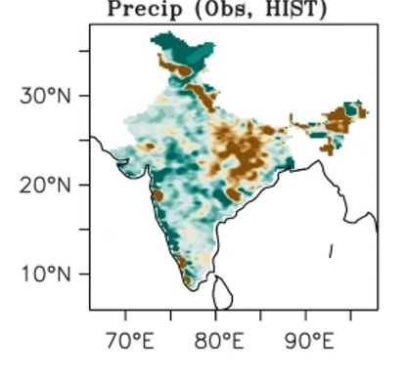
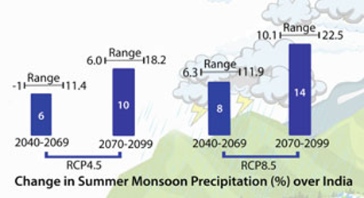
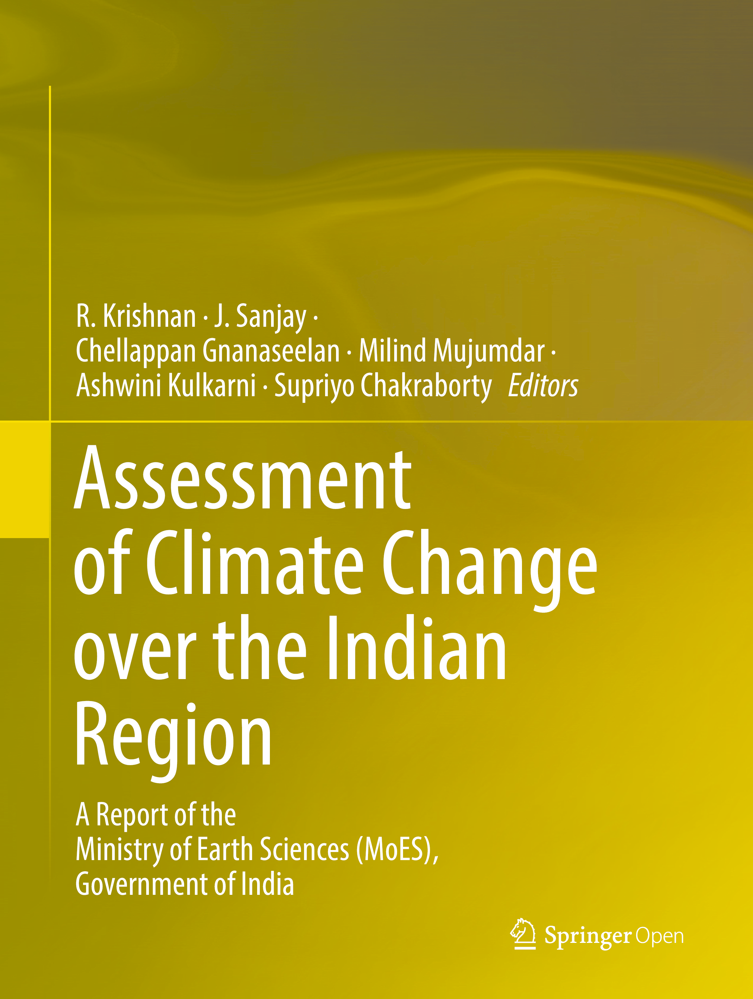
Why is it important?
Notes:
The summer monsoon (June to September) rainfall has decreased approximately by 6% over India. The changes are most prominent over the Indo-Gangetic Plain and Western Ghat regions.
More frequent dry spells and more intense wet spells.
More seasonal and sub-seasonal variabilities in in future with an overall increase in daily precipitation extreme and frequency of extreme events such as floods and droughts.
Largest contributor to the Indian GDP is agriculture, which are directly or indirectly driven by monsoon rainfall. Refer to the schematic.
Multiple cropping seasons in India. Changes in rainfall pattern will affect the agricultural practice, irrigation planning and scheduling etc. Overall, it will affect the productivity.

Slide 3
Existing observational approaches
Method | Recipe | Reference
Radar-based or texture methods | Background exceedance technique (BET): based on the rainfall rate | Austin and Houze, 1972
 | Objective classification based on 38 dBZ radar reflectivity and vertical wind | Gamache and Houze, 1982
 | Based on vertical wind or precipitation velocity threshold from wind profiler | Balsley et al., 1988; Williams et al., 1995
 | Based on bright band reflectivity | Rosenfeld et al., 1995; Steiner et al., 1995; Biggerstaff and Listemaa, 2000
 | Using microwave radiance measurement | Hong et al., 1999
 | Polarisation based | Olson et al., 1999; Olson et al., 2001
Satellite-based | Griffith-Woodley Technique (GWT): empirical classification | Griffith et al., 1976; Griffith et al., 1980
 | Based on the cloud top temperature (CTT) or IR brightness temperature | Arkin, 1979; Richards and Arkin, 1981; Delbeato and Barrell, 1985; Spencer et al., 1989; Heymsfield and Fulton, 1994a
 | Convective-Stratiform Technique (CST) | Adler and Negri, 1987; Simpson et al., 1988;
 | Equivalent blackbody temperature (EBBT) based | Arkin and Meissner, 1987
Notes:
Three major types of approaches: Radar, Satellite and Rainfall parameter based

Slide 4
Existing observational approaches (continued)
Method | Recipe | Reference
Combination of radar, satellite, aircraft and atmospheric soundings | Few of these techniques modified the Adler and Negri, 1987 method to match with the classification by Churchill and Houze, 1984 | Gamache and Houze, 1983; Churchill and Houze, 1984; Houze and Rappaport, 1984; Goldenberg et al., 1990; Heymsfield and Fulton, 1994b; Gourley et al., 2002
Rainfall parameter based | Looks at rainfall parameter distribution to identify the rainfall regimes; predecessor of drop size distribution (DSD) based methods | Ulbirch and Atlas, 1978; Tokay and Short, 1996
 | DSD based | Tokay et al., 1999; Atlas et al., 1999
 | Liquid and ice water paths in clouds | Sui et al., 2007; Xin-Yong et al., 2016; Lazri and Ameur, 2016
Other methods | Based on rainfall sound spectra on ocean surface | Black et al., 1997
 | Based on exponential relation between accumulated rainfall and rain rate | Tremblay, 2005; Ruiz-Leo et al., 2013
 | Using vertical wind and potential vorticity | Poujol et al., 2019

Slide 5
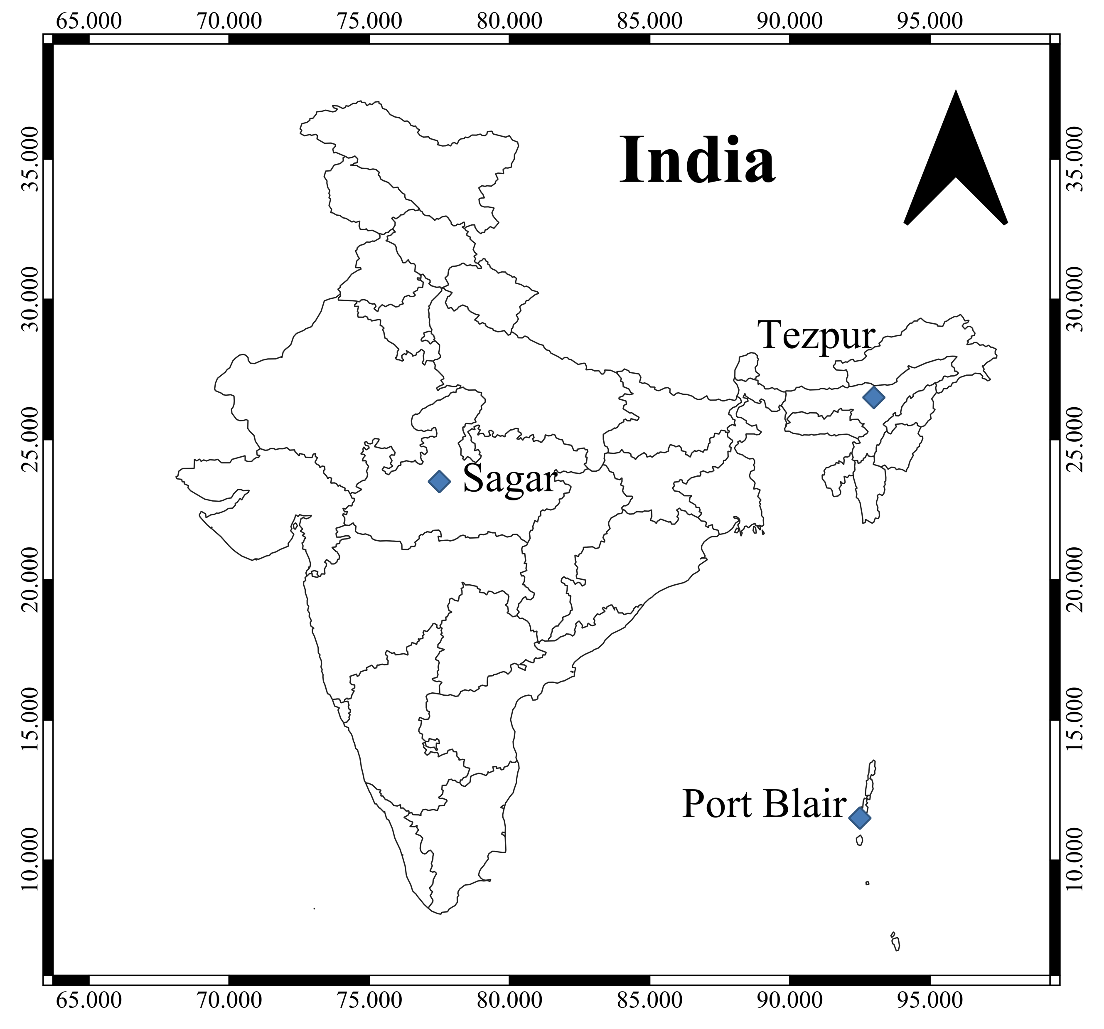
Study sites
Rainwater samples are collected daily since 2013
Analysed for oxygen isotopic concentration at IITM, Pune
Site | Latitude (°N) | Altitude (m AMSL) | Site feature | Mean annual temperature (°C) | Mean annual precipitation (mm y⁻¹)
Tezpur | 26.5 | 80 | Forested (semi-urban) | 23.82 ± 3.76 (Deb Burman et al., 2021) | 1725 ± 121.47 (Deb Burman et al., 2021)
Sagar | 23.5 | 427 | Semi-arid | 25 | 1148 ± 301.11 Som and Dey, (2022)
Port Blair | 11.5 | 16 | Oceanic (island) | 28 (Equbal et al., 2017) | 3079.1 ± 487.3 Adamala and Velmurugan, (2020)
Notes:
Rainwater collected daily between 0830 to 0900 IST; accumulated over the last 24 hours; care is taken to restrict evapotranspiration. IMD (custodian of meteorological measurements over India, a WMO constituent)

Slide 6
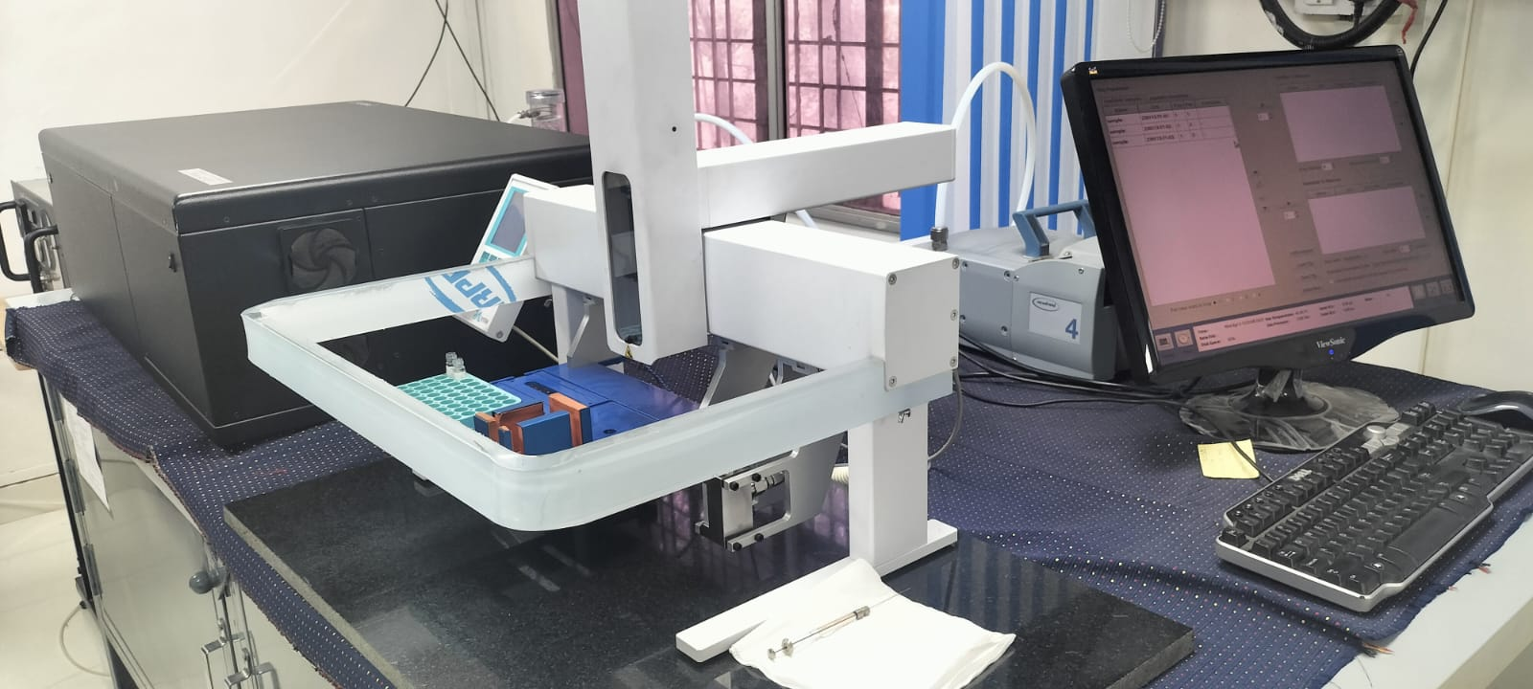
Rainwater isotopic analysis
Instrument name: Triple Isotopic Water Analyzer (TIWA)
Make: ABB Los Gatos Research, USA
Model: TIWA 45EP, Off-axis integrated cavity output spectroscopy
Throughput: 700 injections per day (~ 10 dummies + 40 samples + 4 laboratory standards)
Source Type: Tunable diode laser
Sample input: 1 ml
Sample injection volume : 1 μL per injection
Reported Precision: 0.8 ‰ for δ²H, 0.08 ‰ for δ¹⁸O (Chakraborty et al. 2016)

Slide 7
Methodology
Stratiform Rainfall Area Fraction (F_{st}) is defined as the average percent of rainfall area covered by stratiform rainfall over a particular zone.
Area-averaged Rainfall Amount (P_{area}) is defined as the average rain intensity over this particular zone.
In our analysis we have kept this zone confined within a 5° by 5° area surrounding the location of our rainwater sample collection, following Munksgaard et al., (2019).
We have used the Global Precipitation Measurement (GPM) Dual-frequency Precipitation Radar (DPR) Ku Precipitation Profile data (GPM_2AKu).
Dataset resolution: 1.5-hourly (temporal) and 5 km (spatial).
typePrecip flag in the GPM data is used to identify the stratiform and convective rainfall types. Missing values (NaN) are omitted from the calculation.
Code developed in MATLAB. We plan to translate it to open-access tools, preferably R or Python, in future.

Slide 8
Relation between F_{st} and P_{area}
Logarithmic regression weakens with latitude
F_{st} = a + b*P_{area}
Site | Latitude | a | b | R² | p-value
Port Blair | 11.5°N | 0.83 | 0.07 | 0.36 | 0.001
Sagar | 23.5°N | 0.84 | 0.05 | 0.20 | 0.020
Tezpur | 26.5°N | 0.82 | 0.01 | 0.02 | 0.007
Deb Burman et al., Under preparation

Slide 9
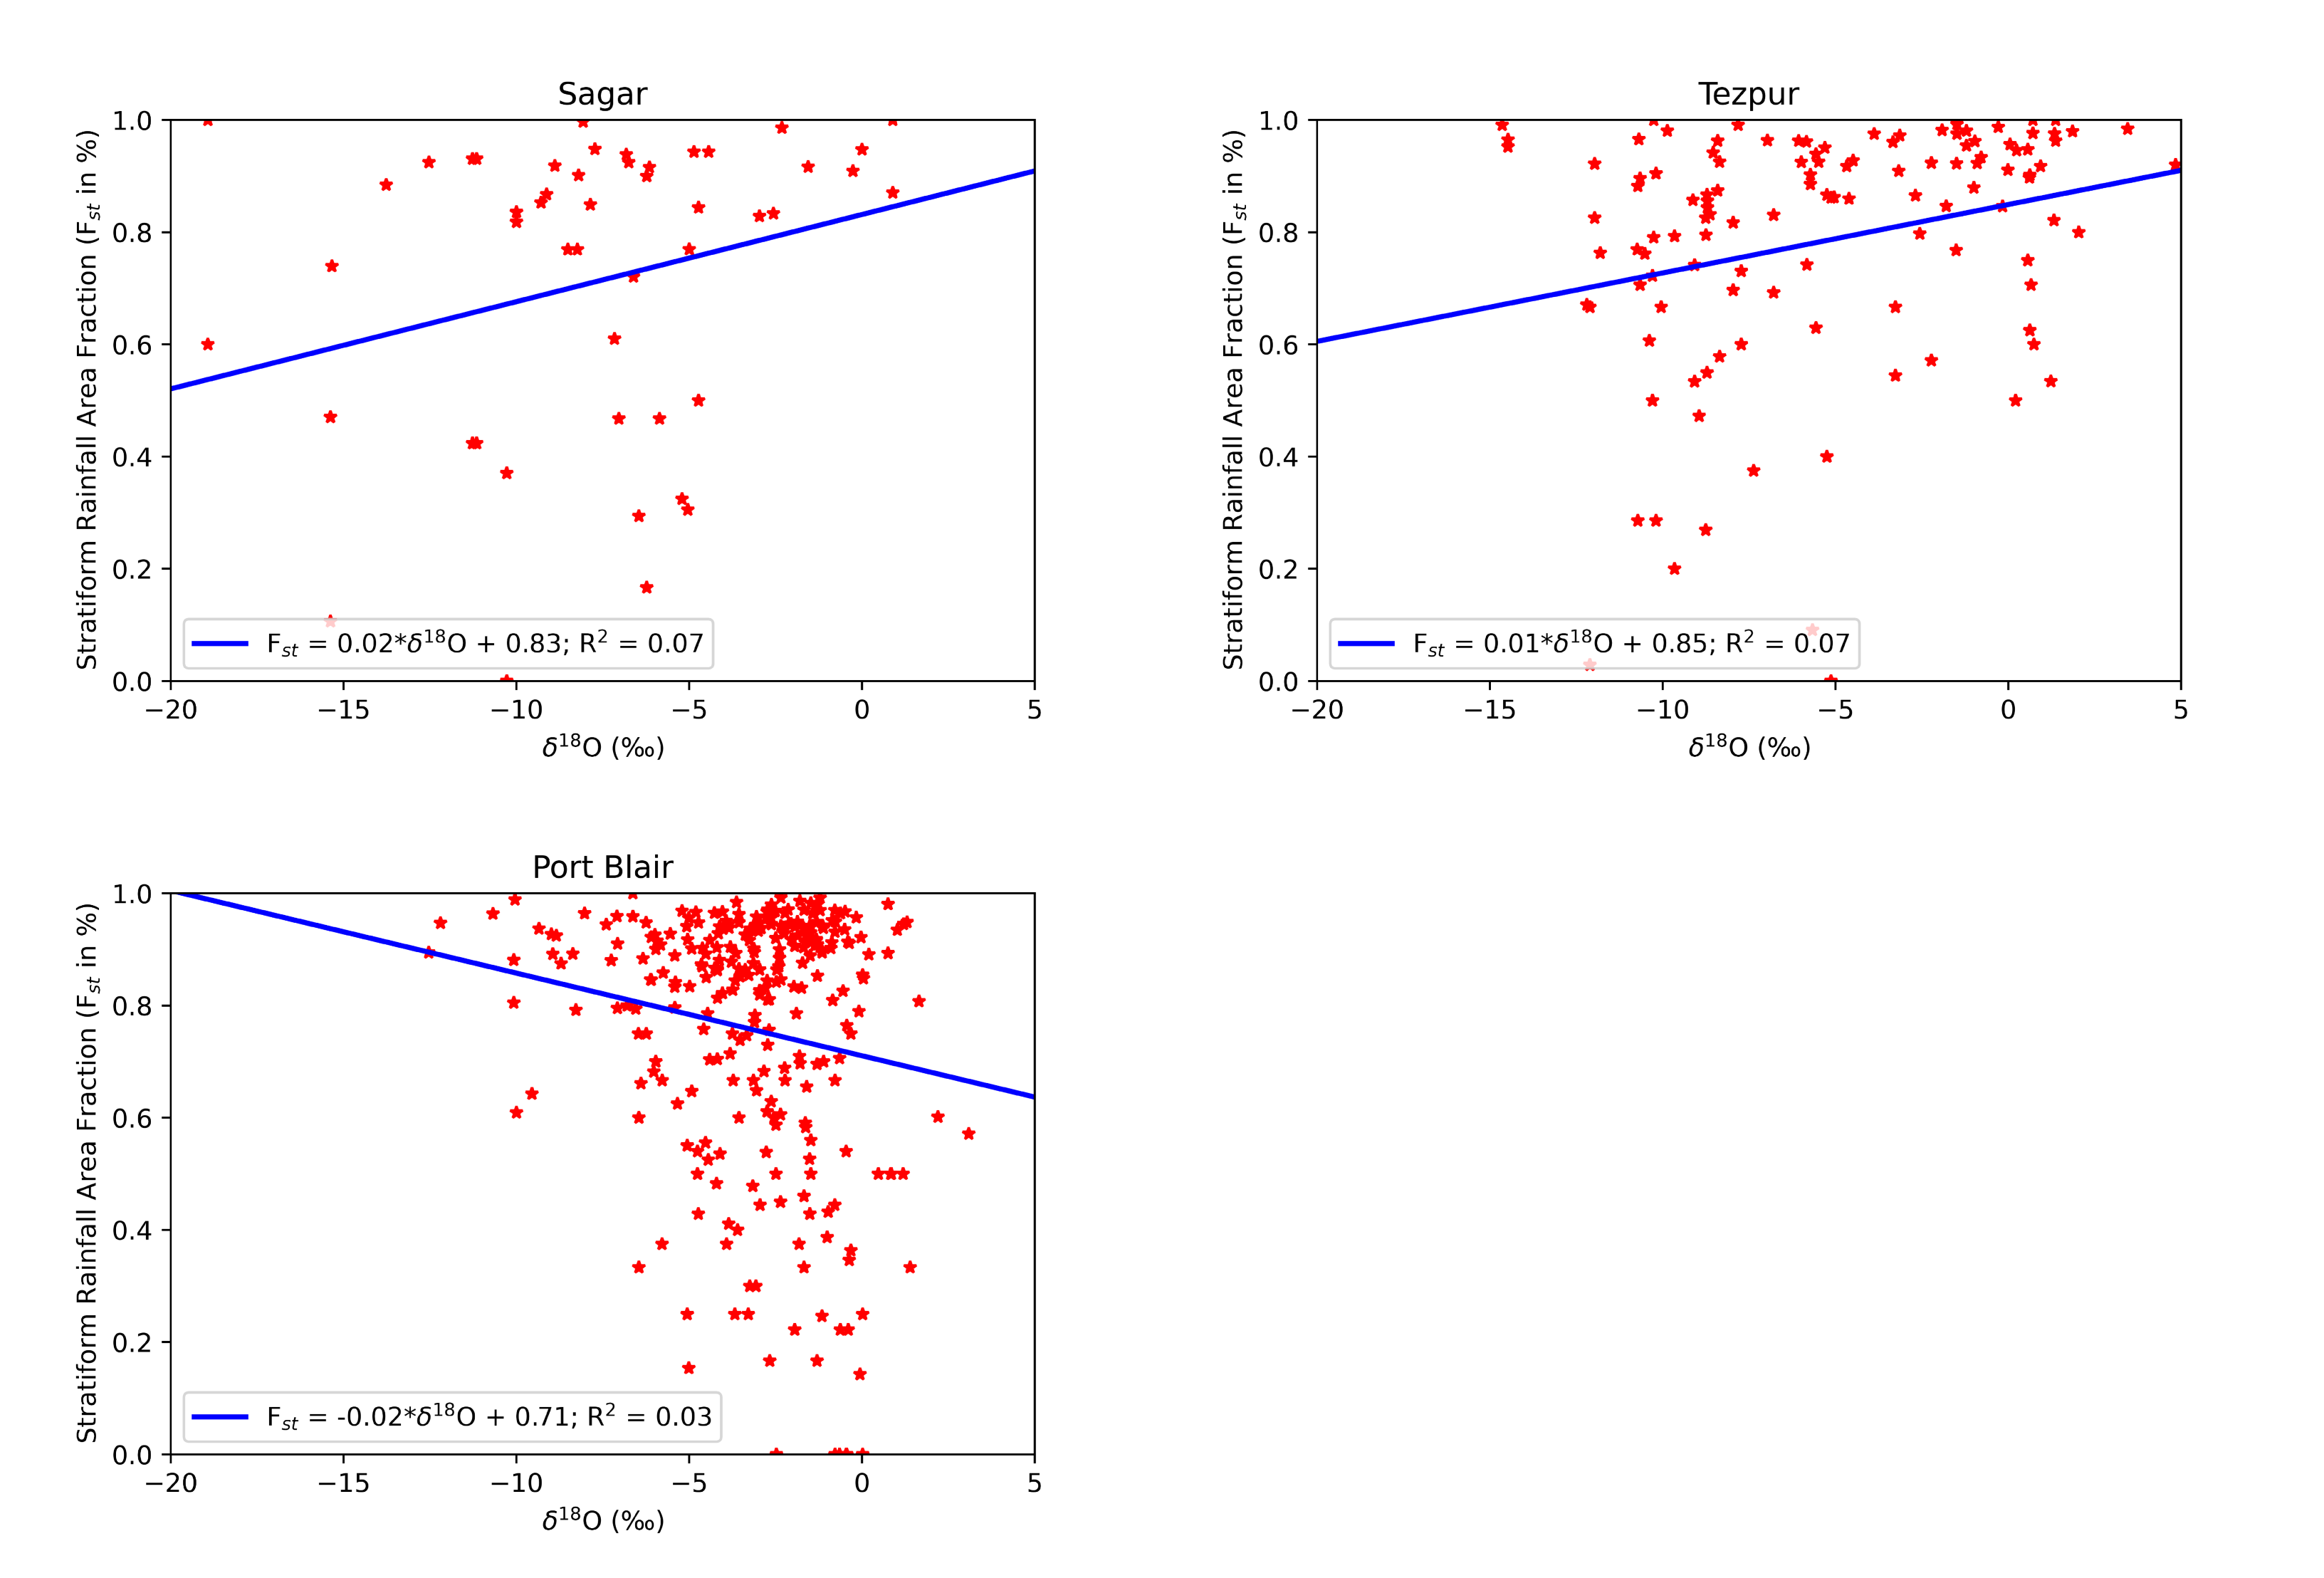
Relation between F_{st} and δ¹⁸O
Negative relation over oceanic regions, but positive over continental regions.
F_{st} = c + m*δ¹⁸O
Site | Type | c | m | R² | p-value
Port Blair | Oceanic (island) | 0.71 | -0.02 | 0.03 | 0.004
Sagar | Semi-arid | 0.83 | 0.02 | 0.07 | 0.048
Tezpur | Forested | 0.85 | 0.01 | 0.07 | 0.001
Deb Burman et al., Under preparation
Notes:
Positive relation between Fst and delta18O has been reported earlier at the tropical site in Kuching, Malaysia by the NUS (National University of Singapore) group in Munksgaard et al., 2019.

Slide 10
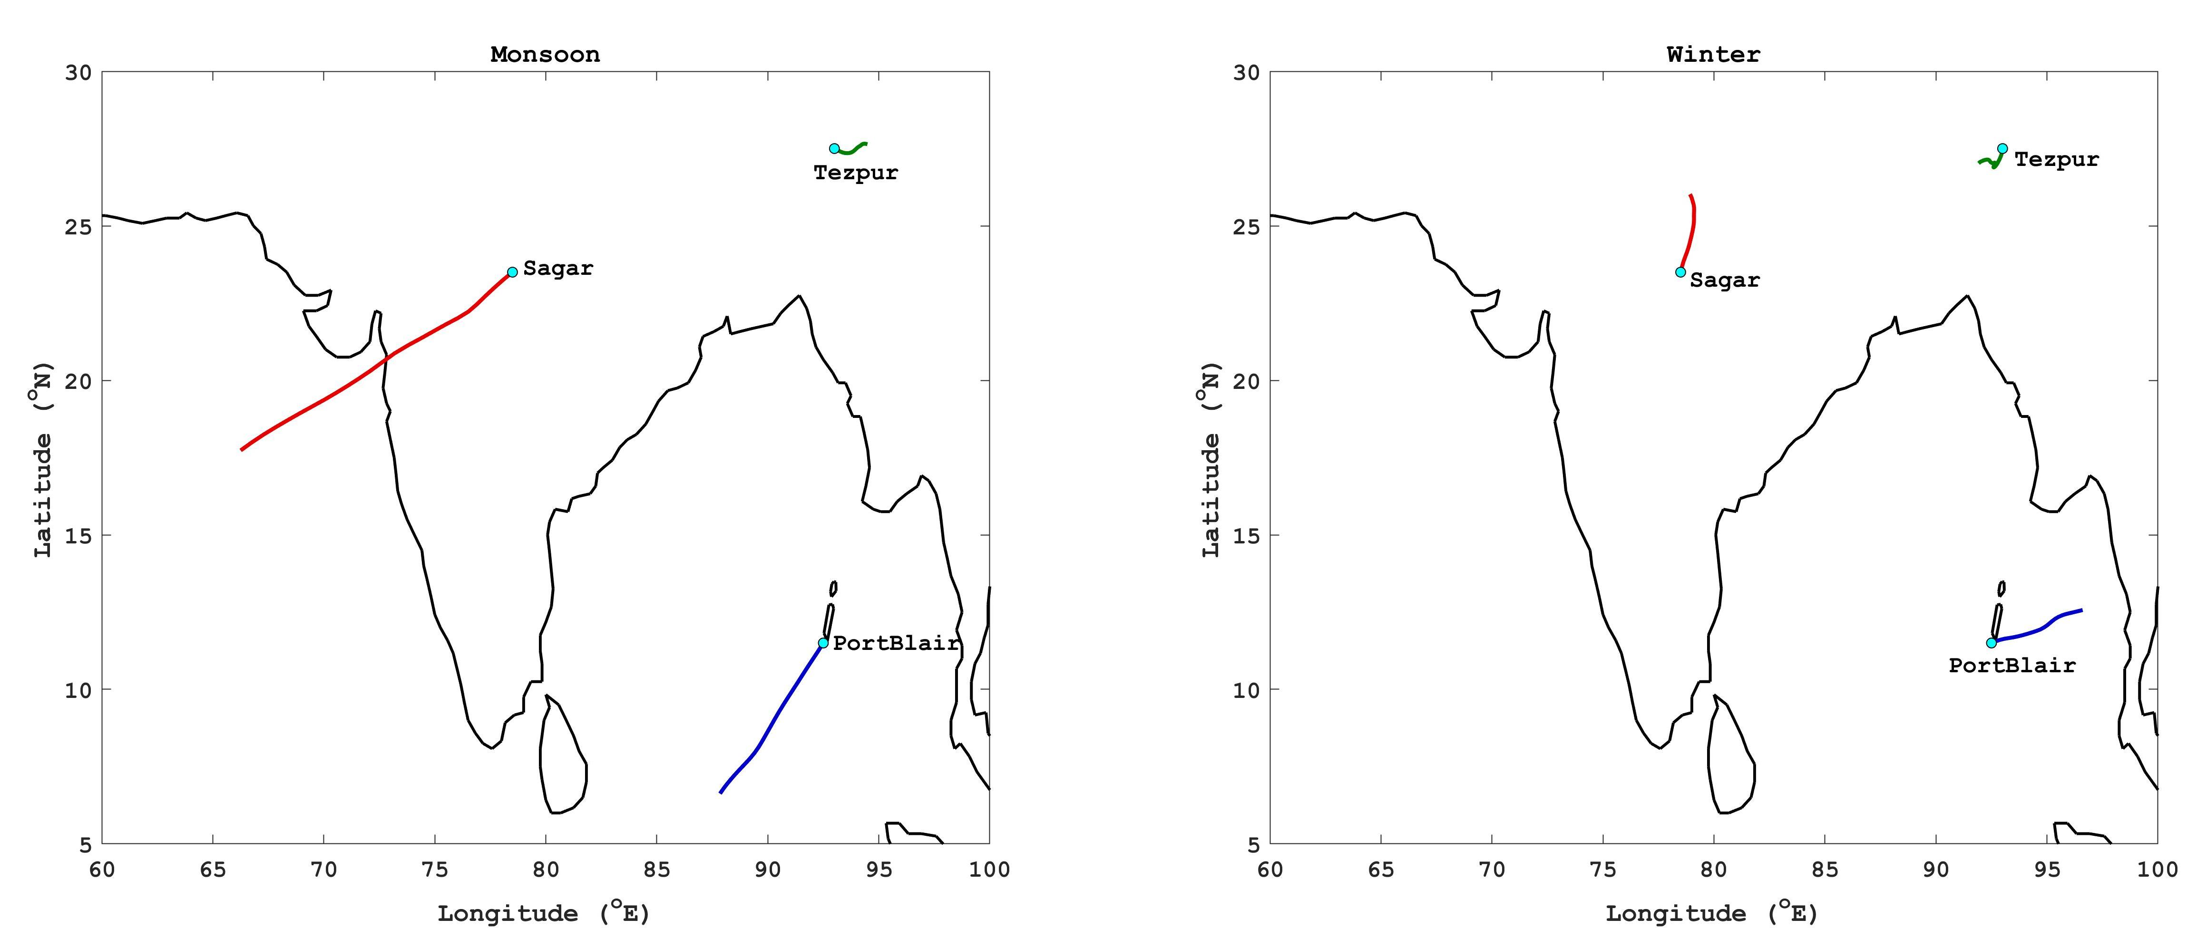
Our hypothesis …
Backward trajectory source: NOAA HYSPLIT MODEL
In the island site most of the moisture are generated from the ocean basin, throughout year, both in the wet (monsoon) and dry (winter) seasons. With more rain, the rainwater gets more isotopically depleted manifesting the amount effect (Dansgaard, 1964).
In the inland sites, a significant part of the moisture is generated locally (Chakraborty et al., 2021), also known as the recycled rainfall.
Transpiration, which is highly isotopically enriched, is a major contributor to this recycled moisture at Tezpur (Deb Burman et al., 2022).
An interplay between these two sources of moisture primarily governs the overall relation between F_{st} and δ¹⁸O.
Notes:
Need further refinement. Need to explore the effects of meteorology and other factors such as, altitude etc.

Slide 12
References
Austin, Pauline M., and Robert A. Houze Jr. "Analysis of the structure of precipitation patterns in New England." Journal of Applied Meteorology and Climatology 11.6 (1972): 926-935. https://doi.org/10.1175/1520-0450(1972)011<0926:AOTSOP>2.0.CO;2
Gamache, John F., and Robert A. Houze Jr. "Mesoscale air motions associated with a tropical squall line." Monthly Weather Review 110.2 (1982): 118-135. https://doi.org/10.1175/1520-0493(1982)110<0118:MAMAWA>2.0.CO;2
Balsley, B. B., et al. "Average vertical motions in the tropical atmosphere observed by a radar wind profiler on Pohnpei (7 N latitude, 157 E longitude)." Journal of Atmospheric Sciences45.3 (1988): 396-405. https://doi.org/10.1175/1520-0469(1988)045<0396:AVMITT>2.0.CO;2
Williams, Christopher R., Warner L. Ecklund, and Kenneth S. Gage. "Classification of precipitating clouds in the tropics using 915-MHz wind profilers." Journal of Atmospheric and Oceanic Technology 12.5 (1995): 996-1012. https://doi.org/10.1175/1520-0426(1995)012<0996:COPCIT>2.0.CO;2
Rosenfeld, Daniel, Eyal Amitai, and David B. Wolff. "Classification of rain regimes by the three-dimensional properties of reflectivity fields." Journal of Applied Meteorology and Climatology 34.1 (1995): 198-211. https://doi.org/10.1175/1520-0450(1995)034<0198:CORRBT>2.0.CO;2
Steiner, Matthias, Robert A. Houze Jr, and Sandra E. Yuter. "Climatological characterization of three-dimensional storm structure from operational radar and rain gauge data." Journal of Applied Meteorology and Climatology 34.9 (1995): 1978-2007. https://doi.org/10.1175/1520-0450(1995)034<1978:CCOTDS>2.0.CO;2
Biggerstaff, Michael I., and Steven A. Listemaa. "An improved scheme for convective/stratiform echo classification using radar reflectivity." Journal of applied meteorology 39.12 (2000): 2129-2150. https://doi.org/10.1175/1520-0450(2001)040<2129:AISFCS>2.0.CO;2
Hong, Ye, Christian D. Kummerow, and William S. Olson. "Separation of convective and stratiform precipitation using microwave brightness temperature." Journal of Applied Meteorology and Climatology 38.8 (1999): 1195-1213. https://doi.org/10.1175/1520-0450(1999)038<1195:SOCASP>2.0.CO;2
Olson, William S., et al. "Atmospheric latent heating distributions in the tropics derived from satellite passive microwave radiometer measurements." Journal of Applied Meteorology and Climatology 38.6 (1999): 633-664. https://doi.org/10.1175/1520-0450(1999)038<0633:ALHDIT>2.0.CO;2
Olson, William S., et al. "A texture-polarization method for estimating convective–stratiform precipitation area coverage from passive microwave radiometer data." Journal of Applied Meteorology and Climatology 40.9 (2001): 1577-1591. https://doi.org/10.1175/1520-0450(2001)040<1577:ATPMFE>2.0.CO;2
Griffith, Cecilia G., et al. ”Rainfall estimation from geosynchronous satellite imagery during daylight hours.” NOAA Technical Report ERL 356-WMPO 7
Griffith, C. G., W. L. Woodley, and J. A. Augustine. "Estimation of convective, summertime rainfall in the US high plains for thermal infrared, geostationary satellite data." Final Report to the Water and Power Resources Service (1980).
Arkin, Phillip A. "The relationship between fractional coverage of high cloud and rainfall accumulations during GATE over the B-scale array." Monthly weather review 107.10 (1979): 1382-1387. https://doi.org/10.1175/1520-0493(1979)107<1382:TRBFCO>2.0.CO;2
Richards, Frank, and Phil Arkin. "On the relationship between satellite-observed cloud cover and precipitation." Monthly Weather Review 109.5 (1981): 1081-1093. https://doi.org/10.1175/1520-0493(1981)109<1081:OTRBSO>2.0.CO;2
DelBeato, R., and S. L. Barrell. "Rain estimation in extratropical cyclones using GMS imagery." Monthly weather review 113.5 (1985): 747-755. https://doi.org/10.1175/1520-0493(1985)113<0747:REIECU>2.0.CO;2
Spencer, Roy W., H. Michael Goodman, and Robbie E. Hood. "Precipitation retrieval over land and ocean with the SSM/I: Identification and characteristics of the scattering signal." Journal of Atmospheric and Oceanic Technology 6.2 (1989): 254-273. https://doi.org/10.1175/1520-0426(1989)006<0254:PROLAO>2.0.CO;2
Heymsfield, G. M., and R. Fulton. "Passive microwave and infrared structure of mesoscale convective systems." Meteorology and Atmospheric Physics 54.1-4 (1994): 123-139. https://doi.org/10.1007/BF01030055

Slide 13
References (continued)
Adler, Robert F., and Andrew J. Negri. "A satellite infrared technique to estimate tropical convective and stratiform rainfall." Journal of Applied Meteorology and Climatology 27.1 (1988): 30-51. https://doi.org/10.1175/1520-0450(1988)027<0030:ASITTE>2.0.CO;2
Simpson, Joanne, Robert F. Adler, and Gerald R. North. "A proposed tropical rainfall measuring mission (TRMM) satellite." Bulletin of the American meteorological Society 69.3 (1988): 278-295. https://doi.org/10.1175/1520-0477(1988)069<0278:APTRMM>2.0.CO;2
Arkin, Phillip A., and Bernard N. Meisner. "The relationship between large-scale convective rainfall and cold cloud over the western hemisphere during 1982-84." Monthly Weather Review 115.1 (1987): 51-74. https://doi.org/10.1175/1520-0493(1987)115<0051:TRBLSC>2.0.CO;2
Gamache, John F., and Robert A. Houze Jr. "Water budget of a mesoscale convective system in the tropics." Journal of Atmospheric Sciences 40.7 (1983): 1835-1850. https://doi.org/10.1175/1520-0469(1983)040<1835:WBOAMC>2.0.CO;2
Churchill, Dean D., and Robert A. Houze Jr. "Development and structure of winter monsoon cloud clusters on 10 December 1978." Journal of Atmospheric Sciences 41.6 (1984): 933-960. https://doi.org/10.1175/1520-0469(1984)041<0933:DASOWM>2.0.CO;2
Houze, Robert A., and Edward N. Rappaport. "Air motions and precipitation structure of an early summer squall line over the eastern tropical Atlantic." Journal of the Atmospheric Sciences41.4 (1984): 553-574. https://doi.org/10.1175/1520-0469(1984)041<0553:AMAPSO>2.0.CO;2
Goldenbergl, Stanley B., Robert A. Houze Jr, and Dean D. Churchill. "Convective and stratiform components of a winter monsoon cloud cluster determined from geosynchronous infrared satellite data." Journal of the Meteorological Society of Japan. Ser. II 68.1 (1990): 37-63. https://doi.org/10.2151/jmsj1965.68.1_37
Heymsfield, Gerald M., and Richard Fulton. "Passive microwave structure of severe tornadic storms on 16 November 1987." Monthly weather review 122.11 (1994): 2587-2595. https://doi.org/10.1175/1520-0493(1994)122<2587:PMSOST>2.0.CO;2
Gourley, Jonathan J., et al. "An exploratory multisensor technique for quantitative estimation of stratiform rainfall." Journal of Hydrometeorology 3.2 (2002): 166-180. https://doi.org/10.1175/1525-7541(2002)003<0166:AEMTFQ>2.0.CO;2
Ulbrich, Carlton W., and David Atlas. "The rain parameter diagram: Methods and applications." Journal of Geophysical Research: Oceans 83.C3 (1978): 1319-1325. https://doi.org/10.1029/JC083iC03p01319
Richards, Frank, and Phil Arkin. "On the relationship between satellite-observed cloud cover and precipitation." Monthly Weather Review 109.5 (1981): 1081-1093. https://doi.org/10.1175/1520-0493(1981)109<1081:OTRBSO>2.0.CO;2
Tokay, Ali, and David A. Short. "Evidence from tropical raindrop spectra of the origin of rain from stratiform versus convective clouds." Journal of Applied Meteorology and Climatology 35.3 (1996): 355-371. https://doi.org/10.1175/1520-0450(1996)035<0355:EFTRSO>2.0.CO;2
Tokay, Ali, et al. "Tropical rainfall associated with convective and stratiform clouds: Intercomparison of disdrometer and profiler measurements." Journal of Applied Meteorology 38.3 (1999): 302-320. https://doi.org/10.1175/1520-0450(1999)038<0302:TRAWCA>2.0.CO;2
Atlas, David, et al. "Systematic variation of drop size and radar‐rainfall relations." Journal of Geophysical Research: Atmospheres 104.D6 (1999): 6155-6169. https://doi.org/10.1029/1998JD200098
Sui, Chung‐Hsiung, Ching‐Tung Tsay, and Xiaofan Li. "Convective–stratiform rainfall separation by cloud content." Journal of Geophysical Research: Atmospheres 112.D14 (2007). https://doi.org/10.1029/2006JD008082
Shen, Xin-Yong, et al. "CONVECTIVE-STRATIFORM RAINFALL PARTITION BY RADIANCE-DERIVED CLOUD CONTENT: A MODELING STUDY." Journal of Tropical Meteorology (2016).
Lazri, Mourad, and Soltane Ameur. "Using cloud water path and cloud top temperature for estimating convective and stratiform rainfall from SEVIRI daytime data." Arabian Journal of Geosciences 9.11 (2016): 577. https://doi.org/10.1007/s12517-016-2610-8

Slide 14
References (continued)
Black, Peter G., et al. "Oceanic rainfall detection and classification in tropical and subtropical mesoscale convective systems using underwater acoustic methods." Monthly weather review 125.9 (1997): 2014-2042. https://doi.org/10.1175/1520-0493(1997)125<2014:ORDACI>2.0.CO;2
Tremblay, André. "The stratiform and convective components of surface precipitation." Journal of the atmospheric sciences62.5 (2005): 1513-1528. https://doi.org/10.1175/JAS3411.1
Ruiz-Leo, Ana M., et al. "Convective and stratiform precipitation trends in the Spanish Mediterranean coast." Atmospheric Research 119 (2013): 46-55. https://doi.org/10.1016/j.atmosres.2011.07.019
Poujol, B., et al. "A physically based precipitation separation algorithm for convection‐permitting models over complex topography." Quarterly Journal of the Royal Meteorological Society 146.727 (2020): 748-761. https://doi.org/10.1002/qj.3706
Deb Burman, Pramit Kumar, et al. "Ecosystem-atmosphere carbon and water exchanges of subtropical evergreen and deciduous forests in India." Forest Ecology and Management495 (2021): 119371. https://doi.org/10.1016/j.foreco.2021.119371
Som, Kalyan Sundar, and Mousumi Dey. "Analysis and forecasting of rainfall trends in semi-arid Bundelkhand region of Madhya Pradesh, India: using statistical methods." Environmental Earth Sciences 81.3 (2022): 98. https://doi.org/10.1007/s12665-021-10159-x
Equbal, Jawed, et al. "Assessing the ecological quality of the Port Blair coast (South Andaman, India) using different suites of benthic biotic indices." Journal of the Marine Biological Association of the United Kingdom 97.5 (2017): 1007-1021. https://doi.org/10.1017/S0025315417000753
ADAMALA, SIRISHA, and A. Velmurugan. "Trend analysis of rainfall and air temperature in Andaman & Nicobar Islands, India." J. Indian Soc. Coastal Agric. Res 38.2 (2020): 95-103.
Chakraborty, S., et al. "Atmospheric controls on the precipitation isotopes over the Andaman Islands, Bay of Bengal." Scientific reports 6.1 (2016): 19555. https://doi.org/10.1038/srep19555
Munksgaard, Niels C., et al. "Data descriptor: daily observations of stable isotope ratios of rainfall in the tropics." Scientific reports 9.1 (2019): 14419. https://doi.org/10.1038/s41598-019-50973-9
Dansgaard, Willi. "Stable isotopes in precipitation." tellus 16.4 (1964): 436-468. https://doi.org/10.3402/tellusa.v16i4.8993
Chakraborty, Supriyo, et al. "Linkage between precipitation isotopes and biosphere-atmosphere interaction observed in northeast India." npj Climate and Atmospheric Science 5.1 (2022): 10. https://doi.org/10.1038/s41612-022-00231-z
Deb Burman, Pramit Kumar, et al. "A comparative study of ecohydrologies of a tropical mangrove and a broadleaf deciduous forest using eddy covariance measurement." Meteorology and Atmospheric Physics 134 (2022): 1-22. https://doi.org/10.1007/s00703-021-00840-y
Rolph, G., Stein, A., and Stunder, B., (2017). Real-time Environmental Applications and Display sYstem: READY. Environmental Modelling & Software, 95, 210-228,https://doi.org/10.1016/j.envsoft.2017.06.025

Slide 15
Acknowledgement
The Director, IITM
Executive Director, Centre for Climate Change Research
International Atomic Energy Agency (IAEA)
NOAA Air Resources Laboratory for HYSPLIT model
Science and Engineering Research Board (SERB), the Government of India for providing the International Travel Support (ITS) grant

