Slide 1
Ensemble machine learning improves pedotransfer functions for predicting soil mineral associated organic carbon.
Yi Xiao^{1,2}, Jie Xue¹, Xianglin Zhang¹, Nan Wang¹, Emanuele Lugato³,
Dominique Arrouays⁴, Zhou Shi¹, Songchao Chen^{1,2}
¹Institute of Applied Remote Sensing and Information Technology, College of Environmental & Resource Sciences, Zhejiang University(China)
²ZJU-Hangzhou Global Scientific and Technological Innovation Center(China) ³European Commission, JRC(Italy) ⁴INRAE, Unité InfoSol(France)
1
Background
4
Discussion
2
Materials & Methods
5
Conclusion
3
Results
6
Reference
Contact:
xiaoyi111@zju.edu.cn
researchgate.net/profile/Yi-Xiao-79

Slide 2
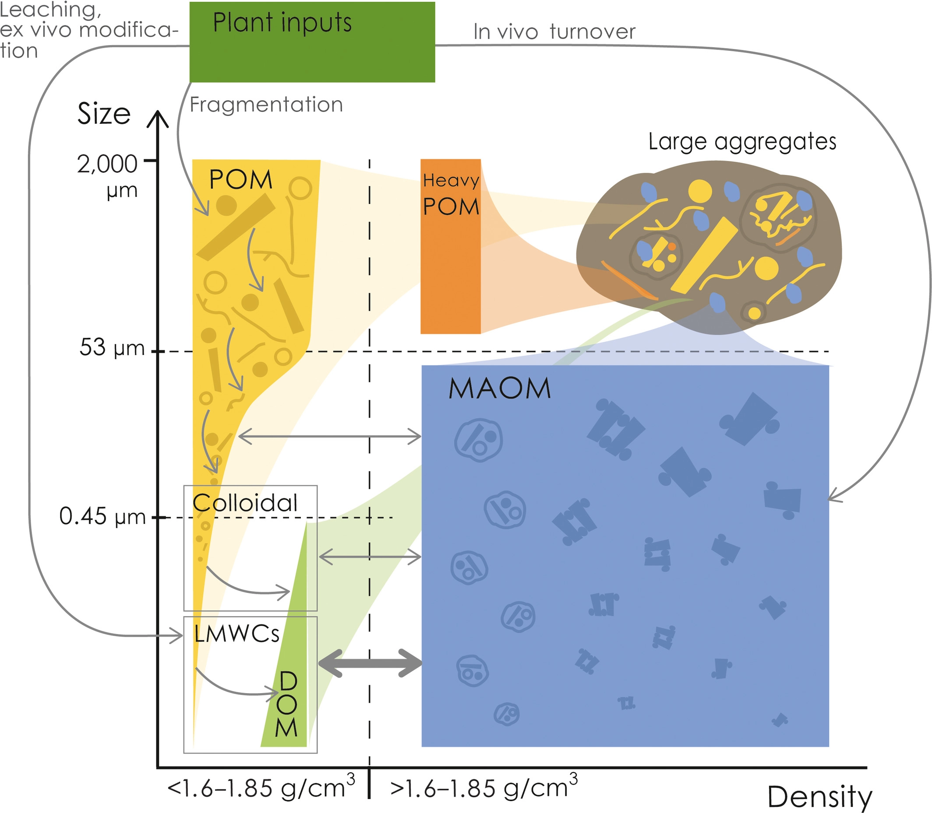
2 Minute Madness - Motivation & Objectives PICO Spot 3b.7
Motivation
Soil carbon fraction, such as particulate organic carbon (POC) and mineral associated organic carbon (MAOC), facilitates a deeper exploration of the complexity of SOC.
POC and MAOC information is still scarce in the soil databases, particularly on a broad scale.
Pedotransfer function (PTF) is a good strategy to estimate missing soil properties.
Objectives
Comparing the predictive ability of multiple predictor selections and machine learning based PTFs in MAOC prediction.
(Lavallee et al, 2019)
Taking the study of Lugato et al. (2021) as a benchmark, we expect to develop a more accurate and robust modelling strategy for predicting MAOC using PTF.
Evaluating the potential of improving MAOC prediction by ensemble modelling.
(Lugato et al, 2021)

Slide 3
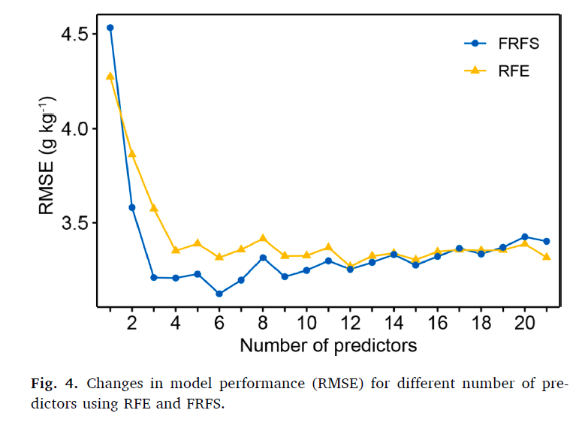
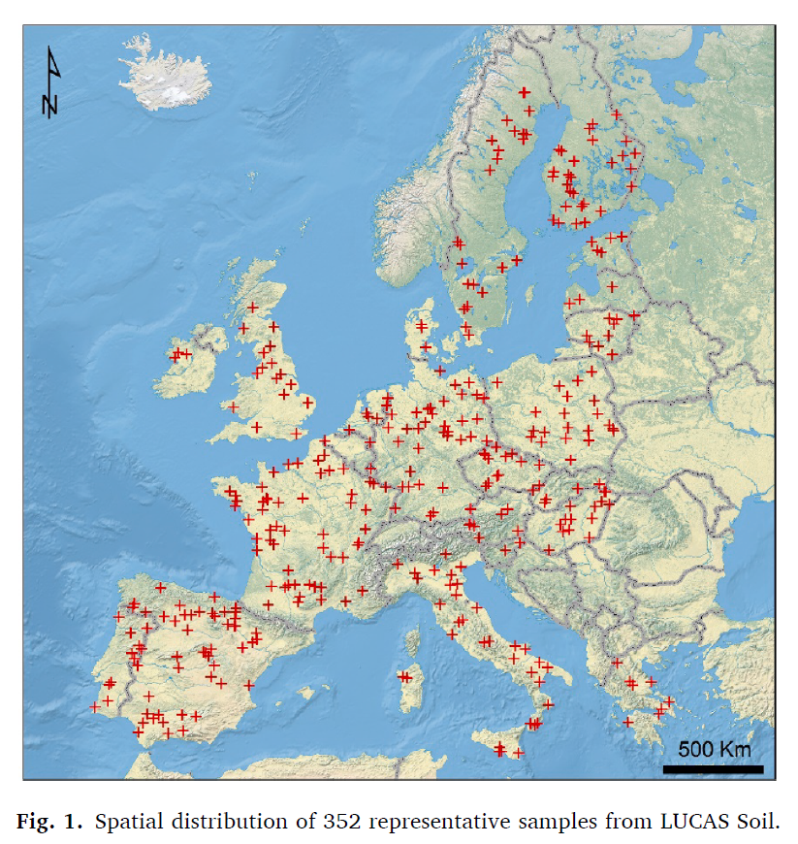
2 Minute Madness - Data & Results PICO Spot 3b.7
Data
A new predictor selection algorithm - “forward recursive feature selection” (FRFS)
352 representative samples from LUCAS(2019) Soil.
FRFS:
fewer predictors, better model performance.
RFE:
more predictors, higher RMSE.

Slide 4
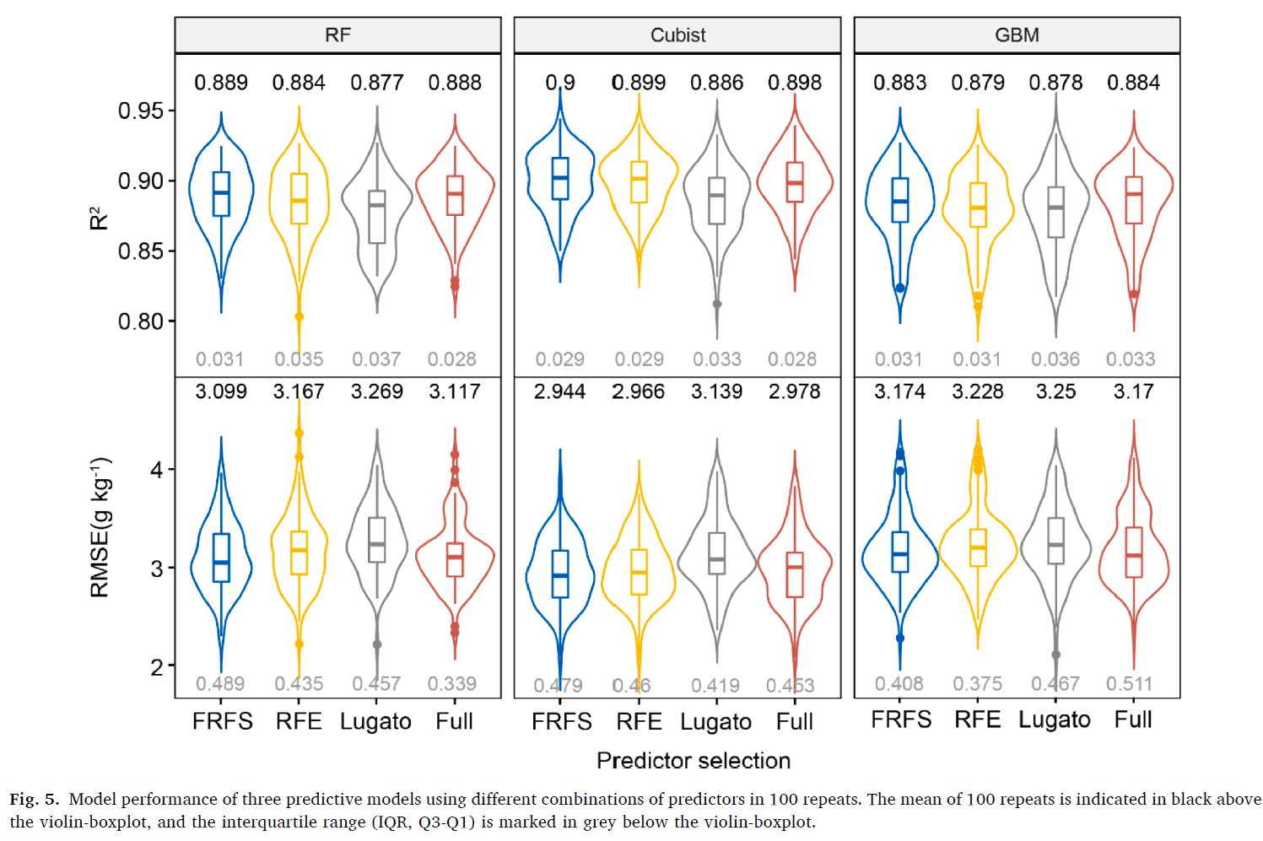
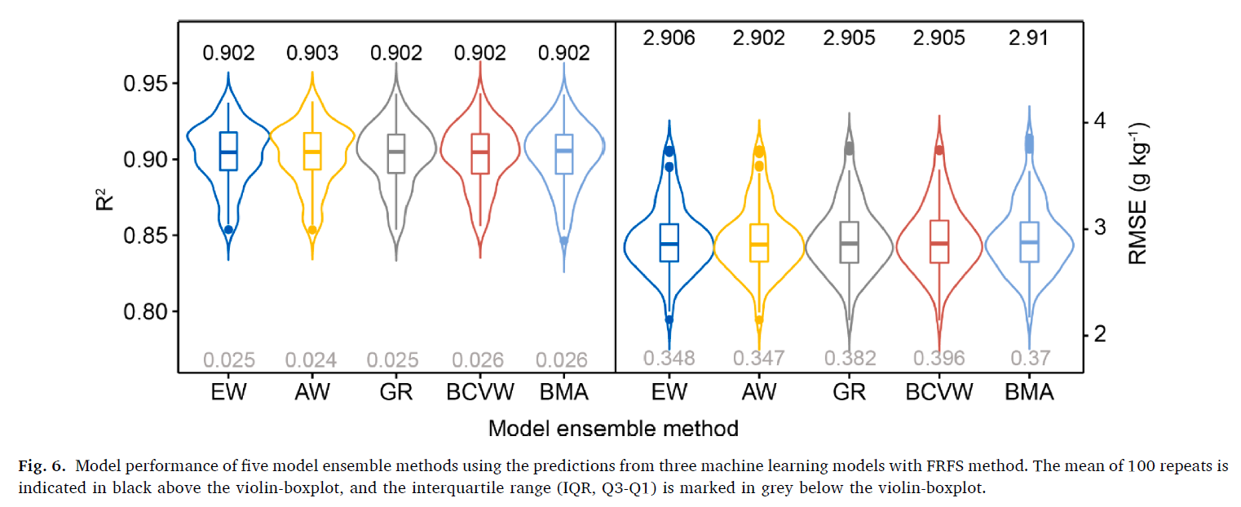
2 Minute Madness - Main Results PICO Spot 3b.7
Model performance under different predictors and machine learning
Model performance of model ensemble methods
best
Comparison of 5 ensemble methods: All these methods had quite similar model performances.
Comparison of ensemble methods and single model: All model ensemble methods performed better than the single machine learning model.
Comparison of 3 machine learning models: Cubist performed the best when combined with FRFS.
Robustness:
IQR_{model ensemble methods} < IQRthe single machine learning model

Slide 5
Ensemble machine learning improves pedotransfer functions for predicting soil mineral associated organic carbon. Yi Xiao
Thank you for your attention!
Get more information about our work at
the PICO screen 3b.7
Contact information:
Email: xiaoyi111@zju.edu.cn; yixiao.cn.zju@gmail.com
Researchgate: researchgate.net/profile/Yi-Xiao-79

Slide 6
Background PICO Spot 3b.7
1.1 Soil organic carbon (SOC) accounts for two-thirds of the terrestrial carbon (C) pool
Soil stores more carbon than the atmosphere and vegetation combined.
Sequestrating carbon in the soil is considered as a natural climate solution for atmospheric CO₂ capture.
(Jobbágy et al, 2000)
(Batjes, 1996; Chabbi et al., 2017; Chenu et al., 2019; Bossio et al., 2020; Jobbágy et al, 2000)

Slide 7
Background PICO Spot 3b.7
1.2 Soil carbon fraction facilitates a deeper exploration of the complexity of SOC
Particulate organic carbon
Mineral associated organic carbon
Combination with mineral surface
Physical occlusion by aggregates
Mean Residence Time: Decades to centuries(Kleber et al., 2015)
Mean Residence Time: Years to decades
soil saturates
(Lavallee et al, 2019)
Vulnerability to climate and land use managemnt: POM > MAOM；
POC and MAOC information is still scarce in the soil databases, particularly on a broad scale.
(Von Lützow et al, 2007; Cotrufo et al, 2019; Lugato et al., 2021; Lavallee et al, 2019)

Slide 8
Background PICO Spot 3b.7
1.3 Pedotransfer function (PTF) is a good strategy to estimate missing soil properties
Several studies of methods to estimate POC and MAOC
A fixed proportion of SOC under different land
low accuracy, only applicable without POC and MAOC measurement for calibrating a predictive model either by soil spectra or using relevant soil propertiesuses
Soil spectroscopy
Soil spectroscopy predicted POC and MAOC from field to national scale successfully.
Pedotransfer function
In the absence of soil spectra, building a PTF using relevant soil properties is the best solution to estimate POC and MAOC from regional to continental scale, especially for the legacy soil databases with relatively complete soil information.
(Chen et al., 2018; Zimmermann et al., 2007; Baldock et al., 2013; Viscarra Rossel et al., 2019; Ramírez et al., 2021; Sanderman et al., 2021; Viscarra Rossel et al., 2020; Lugato et al., 2021)

Slide 9
Background PICO Spot 3b.7
Problems
Limited studies on the use of PTF for POC or MOAC.
Which predictors are helpful for the estimation?
How are the prediction performance with optimal machine learning methods?
Objectives
Comparing the predictive ability of multiple predictor selections and machine learning based PTFs in MAOC prediction.
Taking the study of Lugato et al. (2021) as a benchmark, we expect to develop a more accurate and robust modelling strategy for predicting MAOC using PTF.
Evaluating the potential of improving MAOC prediction by ensemble modelling.

Slide 10
Materials & Methods PICO Spot 3b.7
2.1Predictors for MAOC modelling
Predictor | Abbreviation | Category | Reference/Source
Soil organic carbon | SOC | Soil | Ballabio et al. (2016), Orgiazzi et al. (2018)
Calcium Carbonate | CaCO₃ | Soil | Ballabio et al. (2016) , Orgiazzi et al. (2018)
Nitrogen | N | Soil | Ballabio et al. (2016) , Orgiazzi et al. (2018)
Phosphorus | P | Soil | Ballabio et al. (2016) , Orgiazzi et al. (2018)
Potassium | K | Soil | Ballabio et al. (2016) , Orgiazzi et al. (2018)
pH (measured in H₂O) | pH | Soil | Ballabio et al. (2016) , Orgiazzi et al. (2018)
Clay | - | Soil | Ballabio et al. (2016) , Orgiazzi et al. (2018)
Silt | - | Soil | Ballabio et al. (2016) , Orgiazzi et al. (2018)
Sand | - | Soil | Ballabio et al. (2016) , Orgiazzi et al. (2018)
Silt+clay | SC | Soil | Ballabio et al. (2016) , Orgiazzi et al. (2018)
Cation exchange capacity | CEC | Soil | Ballabio et al. (2016) , Orgiazzi et al. (2018)
Soil erosion | SR | Soil | Panagos et al. (2015)
Groundwater table depth | WT | Hydrology | Fan et al. (2017)
Mean annual temperature | MAT | Climate | Fick and Hijmans (2017)
Mean annual precipitation | MAP | Climate | Fick and Hijmans (2017)
Potential evapotranspiration | PET | Climate | Zomer et al. (2008)
Nitrogen deposition | ND | Climate | Simpson et al. (2012)
Normalised difference vegetation index | NDVI | Organism | USGS
Enhanced vegetation index | EVI | Organism | USGS
Net primary productivity | NPP | Organism | LP DAAC
Elevation | ELE | Relief | Tadono et al. (2014)

Slide 11
Materials & Methods PICO Spot 3b.7
2.2 Soil data
Resource: LUCAS 2019
Study area: across European Union and the United Kingdom
Feature: air-dried, sieved to < 2 mm
2.3 Soil organic carbon fractions
Resoure: the SOM fractions of a subset of the LUCAS 2009 topsoil dataset.
Content: 352 samples for all land uses and 186 samples only for grassland and forest used to derived maps on POM(>53 mm) and MAOM(<53 mm).
352 representative samples from LUCAS(2019) Soil.
(Orgiazzi et al., 2018; Lugato et al., 2021)

Slide 12
Materials & Methods PICO Spot 3b.7
2.4 Predictive models
5 model ensemble methods
3 machine learning algorithms
Equal Weighted (EW)
Train set
Random forest（RF)
Test set
Accuracy Weighted (AW)
Train set
Cubist
Test set
Granger-Ramanathan (GR)
Train set
Gradient Boosted Machine (GBM)
Test set
internal 5-fold cross-validation
Bias Corrected Variance Weighted (BCVW)
Bayesian Model Averaging (BMA)
Model ensemble is a method to merge the predictions from different models, which can take each models’ advantages and thus improve the model performance and robustness.
(Farina et al., 2021; Sylvain et al., 2021)

Slide 13
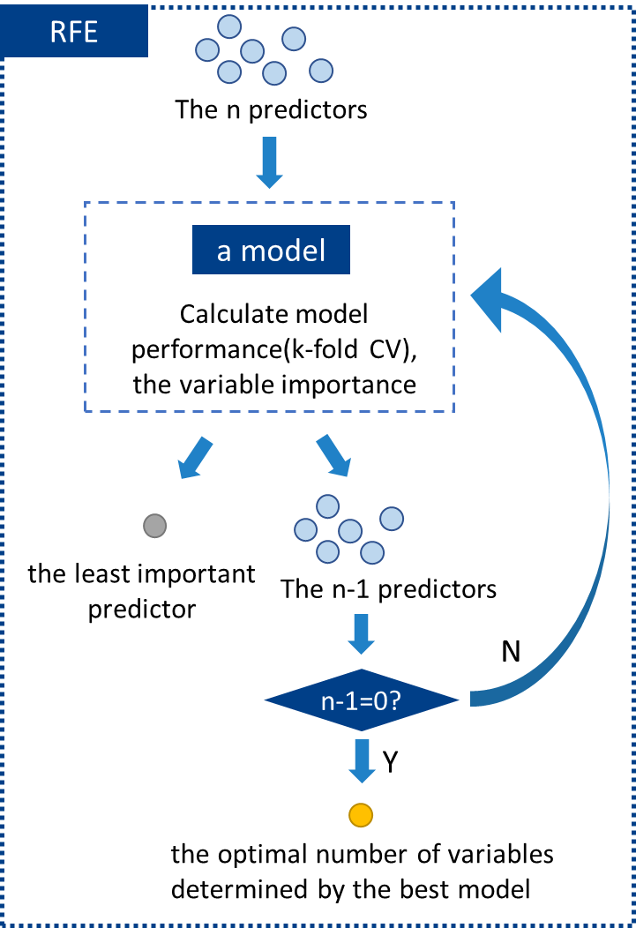
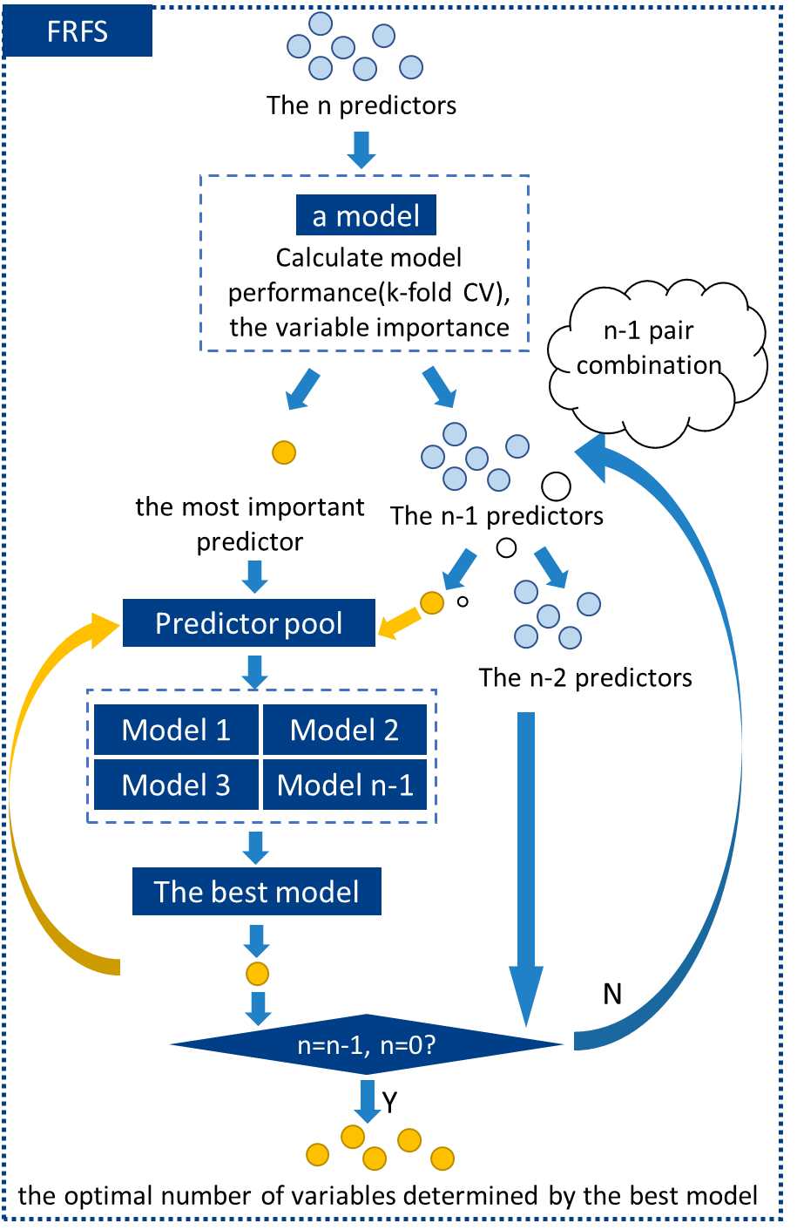
Materials & Methods PICO Spot 3b.7
2.5 A new predictor selection algorithm - “forward recursive feature selection” (FRFS)
RFE may remove some weak but informative predictors during the selection as their importance can be masked by the complex interactions among other so-called dominant predictors.
We used random forest as an internal model in FRFS for a fair comparison with RFE.

Slide 14
Materials & Methods PICO Spot 3b.7
2.6 Model evaluation
Calibration set（70%）
Model
Tuning parameters
352 samples
Repeated random split（100 times）
Validation set（30%）
Final model
Evaluation
R²
RMSE
P.S. for the different predictive models and model ensemble methods, the same validation data was used to evaluate the model within each repeat to ensure that all the results were comparable.

Slide 15
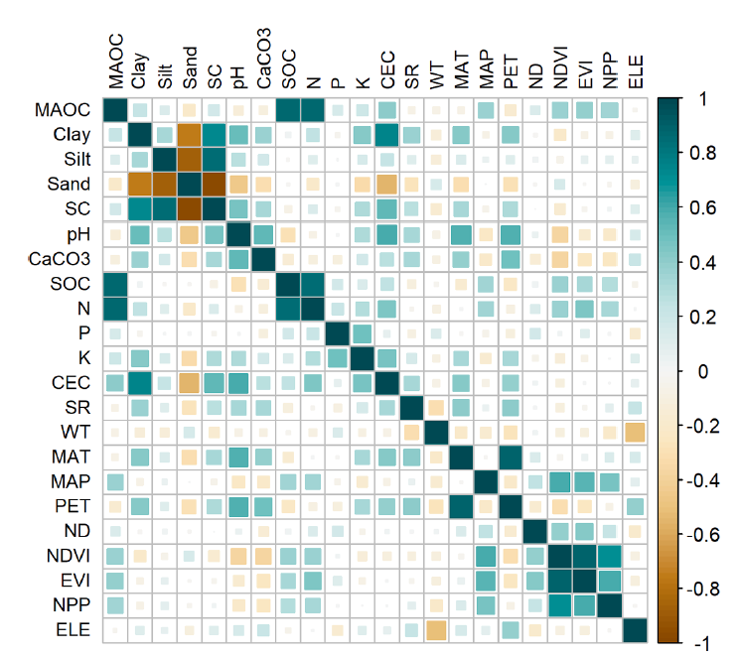
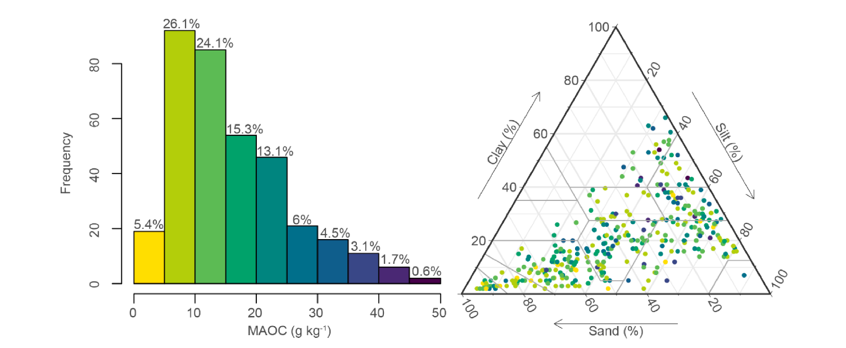
Results PICO Spot 3b.7
3.1 Description of MAOC in the LUCAS soil and its correlation with predictors
Half: 5 - 15 g kg⁻¹
<10 %: over 30 g kg⁻¹
Histogram of MAOC and USDA soil texture triangle.
Correlation plot among MAOC and predictors.

Slide 16
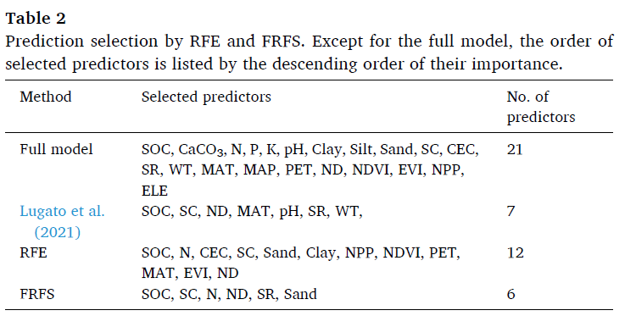
Results PICO Spot 3b.7
3.2 The selected predictors by RFE and FRFS
FRFS: fewer predictors, better model performance.
RFE: more predictors, higher RMSE.

Slide 17
Results PICO Spot 3b.7
3.3 Model performance under different predictors and machine learning（in 100 repeats）
100 repeats’ impact: R² ranged from 0.803 to 0.941, RMSE ranged from 2.054 to 4.171 g kg⁻¹ .
RF: FRFS performed slightly better than RFE and Full
Cubist: showed a similar performance ranking as RF, but it had better model performance
GBM: had the lowest overall performance among the three machine learning models.

Slide 18
Results PICO Spot 3b.7
3.4 Model performance of model ensemble methods
best
Comparison of 5 ensemble methods: All these methods had quite similar model performances
(R²: 0.902 - 0.903, mean RMSE: 2.902 - 2.91 g kg⁻¹).
Comparison of ensemble methods and single model: All model ensemble methods performed better than the single machine learning model. (R²: 0.854 - 0.943, RMSE: 2.145 - 3.859 g kg⁻¹ ）.
Robustness: IQR_{model ensemble methods} < IQRthe single machine learning model

Slide 19
Discussion PICO Spot 3b.7
4.1 The comparison o f FRFS and RFE
 | FRFS | RFE
No. of predictors | 6 | 12
Selected predictors | SOC, SC, N, ND, SR, Sand | SOC, N, CEC, SC, Sand, Clay, NPP, NDVI, PET, MAT, EVI, ND
Strength | performed similar or even better than RFE and Full among three machine learning models. can select the most relevant predictors more efficiently The final optimal model is more parsimonious. | Compared with Full and Lugato’s predictors collection, simplified the model while not losing model accuracy. High calculation efficiency.
Weakness | more computing-intensive | potentially lose some weak but informative predictors in the optimal solution
Boost the computing efficiency of map prediction: fewer covariate layers;
Reduce the uncertainty propagation from covariates which are not uncertainty-free.
FRFS

Slide 20
Discussion PICO Spot 3b.7
4.2 the predictors selection and ensemble model
The necessity of finding the optimal predictors and predictive models when fitting a PTF for MAOC prediction.
RF model: RMSE_{Lugato}>RMSE_{FRFS}（5.2%↓）
Cubist model: RMSE_{Lugato}>RMSE_{FRFS}（9.9%↓）
The ensemble model improved model accuracy and robustness.
Accuracy: RMSE_{single}> RMSE_{ensemble}(1.4-8.6% ↓） RMSE_{Lugato}>RMSE_{ensemble}（11.2%↓）
Robustness(the IQR of RMSE): IQR_{single}>IQR_{AW}(12.5-29%↓）
P.S. AW is the best ensemble model in our study.
The extrapolation ability of the proposed PTF on other regions needs further evaluation for our PTF for MAOC prediction was built on LUCAS Soil.

Slide 21
Discussion PICO Spot 3b.7
4.3 the application of PTFs in predicting MAOC by “digging” the legacy soil database
Representative soil samples
The remaining samples
Measure MAOC by soil spectroscopy
Predicting MAOC by models
SOC
-
MAOC
=
POC
Climate Change measures
Soil carbon sequestration
Landuse management
Farm production management
…
Simulate SOC dynamics

Slide 22
Conclusion PICO Spot 3b.7
MAOC could be successfully predicted by machine learning based PTFs with a mean R² of 0.877–0.9 and mean RMSE of 2.994–3.269 g kg⁻¹.
Comprision of 2 predictor selection algorithms
RFE: reduced the number of predictors, kept comparable accuracy obtained by the Full model.
FRFS: improved model parsimony, performing similar to or even better than RFE.
The best performed model with FRFS: Cubist
The performances of 5 ensemble methods
All performed similarly, slightly improving model accuracy and model robustness.
In our study, EW and AW were optimal for their easy implementation with equivalent accuracy, while this can be case-specific so that comparison is necessary for other studies .

Slide 23
Reference PICO Spot 3b.7
Adhikari, K., Hartemink, A.E., 2016. Linking soils to ecosystem services—A global review. Geoderma, 262, 101-111.
Baldock, J.A., Hawke, B., Sanderman, J., Macdonald, L.M., 2013. Predicting contents of carbon and its component fractions in Australian soils from diffuse reflectance mid-infrared spectra. Soil Research, 51(8), 577-595.
Ballabio, C., Panagos, P., Montanarella, L., 2016. Mapping topsoil physical properties at European scale using the LUCAS database. Geoderma, 261, 110-123.
Batjes, N.H., 1996. Total carbon and nitrogen in the soils of the world. European journal of soil science, 47(2), 151-163.
Benbi, D.K., Boparai, A.K., Brar, K., 2014. Decomposition of particulate organic matter is more sensitive to temperature than the mineral associated organic matter. Soil Biology and Biochemistry, 70, 183-192.
Bossio, D.A., Cook-Patton, S.C., Ellis, P.W., Fargione, J., Sanderman, J., Smith, P., Wood, S., Zomer, R.J., Von Unger, M., Emmer, I.M., Griscom, B.W., 2020. The role of soil carbon in natural climate solutions. Nature Sustainability, 3(5), 391-398.
Brungard, C.W., Boettinger, J.L., Duniway, M.C., Wills, S.A., Edwards Jr, T.C., 2015. Machine learning for predicting soil classes in three semi-arid landscapes. Geoderma, 239, 68-83.
Cambardella, C.A., Elliott, E.T., 1992. Particulate soil organic‐matter changes across a grassland cultivation sequence. Soil Science Society of America Journal, 56(3), 777-783.
Chabbi, A., Lehmann, J., Ciais, P., Loescher, H.W., Cotrufo, M.F., Don, A., SanClements, M., Schipper, L., Six, J., Smith, P., Rumpel, C., 2017. Aligning agriculture and climate policy. Nature climate change, 7(5), 307-309.
Chen, S., Arrouays, D., Mulder, V.L., Poggio, L., Minasny, B., Roudier, P., Libohova, Z., Lagacherie, P., Shi, Z., Hannam, J., Meersmans, J., Richer-de-Forges, A.C., Walter, C., 2022. Digital mapping of GlobalSoilMap soil properties at a broad scale: A review. Geoderma, 409, 115567.
Chen, S., Liang, Z., Webster, R., Zhang, G., Zhou, Y., Teng, H., Hu, B., Arrouays, D., Shi, Z., 2019. A high-resolution map of soil pH in China made by hybrid modelling of sparse soil data and environmental covariates and its implications for pollution. Science of the Total Environment, 655, 273-283.

Slide 24
Ensemble machine learning improves pedotransfer functions for predicting soil mineral associated organic carbon. Yi Xiao
THANKS FOR YOUR ATTENTION!
Contact information:
Email: xiaoyi111@zju.edu.cn; yixiao.cn.zju@gmail.com
Researchgate: researchgate.net/profile/Yi-Xiao-79

