Slide 1
Carbonate sediment production, redistribution and accumulation in ongoing climate warming - The case of Lakshadweep Archipelago
Supplementary File
Shradha Menon, Pankaj Khanna
Discipline of Earth Sciences, IIT Gandhinagar, Gujarat, India - 382355
shradha.menon@iitgn.ac.in
pankaj.Khanna@iitgn.ac.in

Slide 2
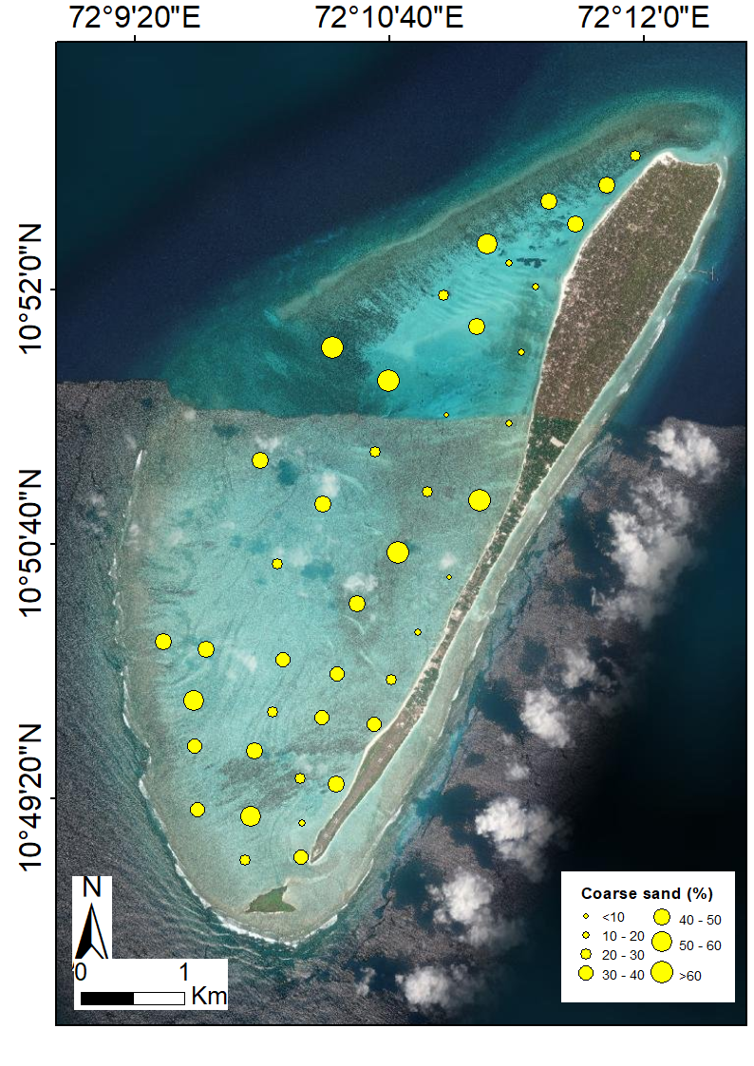
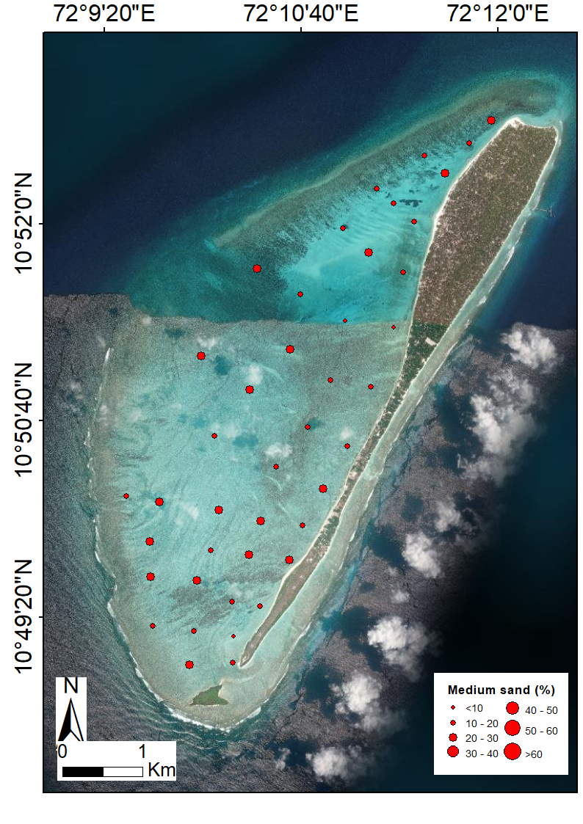
Grain Size Distribution - Agatti
Grain size distribution of Agatti A) Coarse (2 – 0.5mm), B) Medium sand (0.5 – 0.25mm). C)Fine sand (0.25 – 0.125mm)

Slide 3
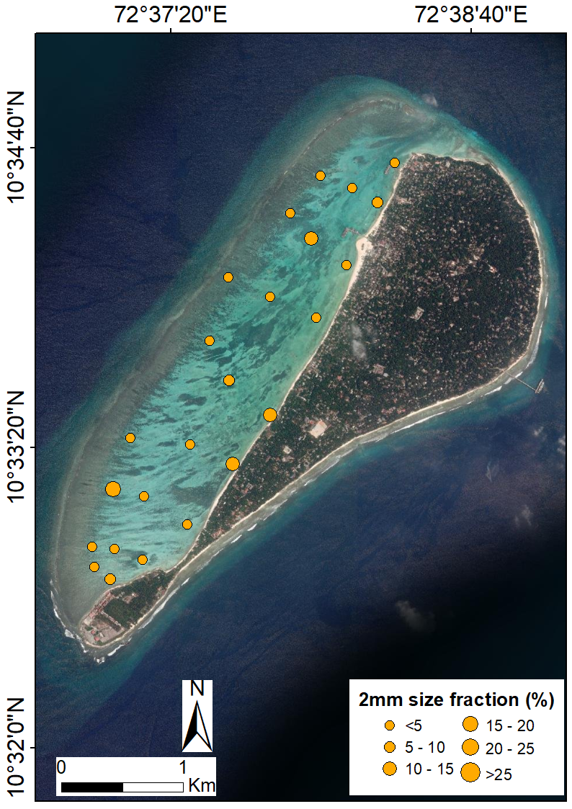
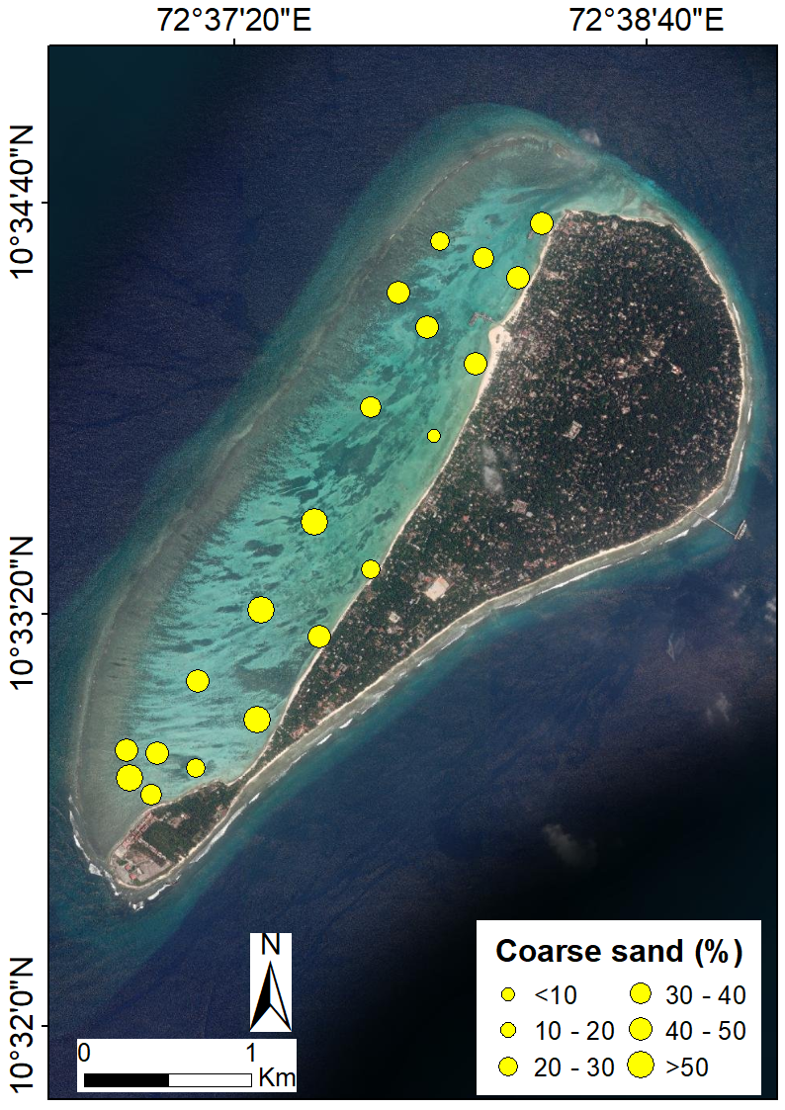
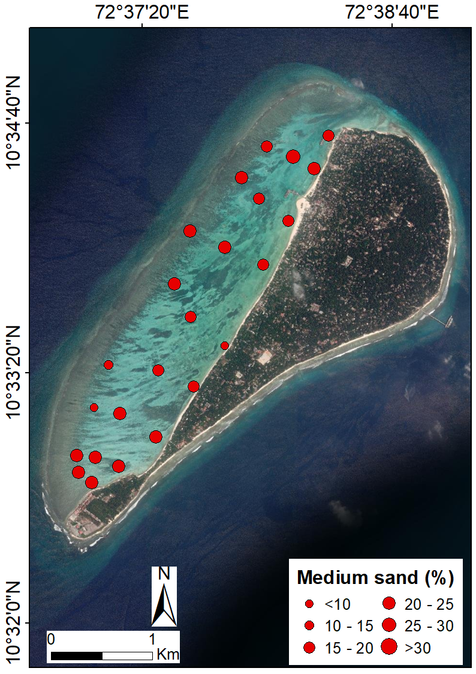
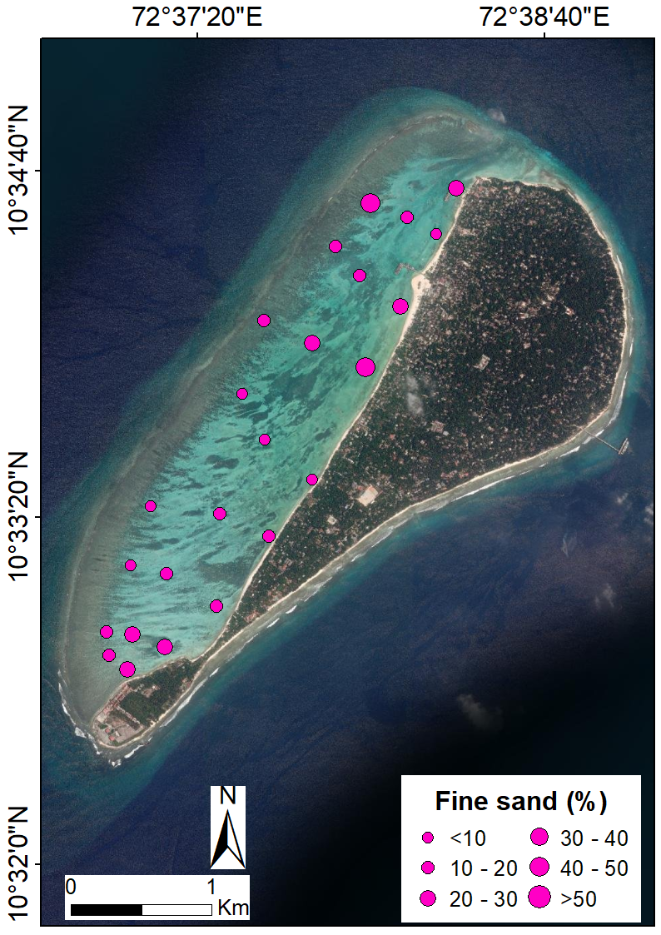
Grain Size Distribution - Kavaratti
Grain size distribution of Kavaratti . A) 4 – 2mm size fraction. B) Coarse (2 – 0.5mm), C) Medium sand (0.5 – 0.25mm). D)Fine sand (0.25 – 0.125mm).

