Slide 1







Simulating the Hydrological Impacts of Intensive Soil and Water Conservation Measures in the Yellow River Basin Using a Distributed Physically-based Model
(Supplementary Material)
Zihan Yan¹, Huimin Lei¹, Haidong Gao², Teng Ma¹, Haiyan Yang¹and Dawen Yang^{1,*}
1 State Key Laboratory of Hydroscience and Engineering, Department of Hydraulic Engineering, Tsinghua University, Beijing, China
2 State Key Laboratory of Eco-Hydraulics in Northwest Arid Region of China, Xi'an University of Technology, Xi'an 710048, Shaanxi, China.

Slide 2
Data used in this Study
Data category | Variables | Original Spatial resolution | Original Temporal resolution | Sequence Length | Date Source
Meteorological forcing data | Air temperature (mean, maxima and minima), average relative humidity, wind velocity， sunshine duration | 113 meteorological stations | Daily | 1982-2019 | China Meteorological Administration (http://data.cma.cn)
 | precipitation | 0.25° | Daily | 1982-2019 | (Shen and Xiong, 2016)
Underlying surface parameters | Digital Elevation Model (DEM) | 90 m | - | - | SRTM DEM (Jarvis, 2008)
 | Soil texture（soil sand content, soil clay content and soil organic carbon content） | 1 km | - | - | (Shangguan et al., 2014)
 | Soil hydraulic parameters（parameters for in the van Genuchten Function） | 1 km | - | - | (Dai et al., 2013)
 | Vegetation parameters, including Leaf Area Index (LAI) and Fraction of Photosynthetically Active Radiation (FPAR） | 8 km | 16 days | 1982-2016 | GIMMS LAI3g, GIMMS FPAR3g (Zhu et al., 2013)
 | Land use map | 30m | 5 years | 1985-2020 | Global Land Cover dataset (Zhang et al., 2020; Zhang et al., 2021)
 | The area ratio of terracing, afforestation, and grass planting in each subbasin | - | 5 years | 1980-2010 | Chinese National Water Resources Census; Investigation on Soil and Water Conservation Measures conducted by Yellow River Water Conservancy Commission
 | Census of key check dams consisting of construction time, dam position, dam storage capacity, dam height, and the silted volume | - | One time | 2012 | Chinese First National Census for Water records
Model validation data | Natural discharge | Station | Monthly | 1982-2000 at16 stations 1982-2015 at 22 stations | Annual Hydrological Report by the Ministry of Water Resources of China; the Third National Water Resources Census
 | evapotranspiration | 0.25° | daily | 1982-2018 | GLEAM (Miralles et al., 2011; Martens et al., 2017)
Notes:
Dai, Y.J. et al., 2013. Development of a China Dataset of Soil Hydraulic Parameters Using Pedotransfer Functions for Land Surface Modeling. J Hydrometeorol, 14(3): 869-887. DOI:10.1175/Jhm-D-12-0149.1
Jarvis, A., 2008. Hole-filed seamless SRTM data. http://srtm. csi. cgiar. org.
Martens, B. et al., 2017. GLEAM v3: satellite-based land evaporation and root-zone soil moisture. Geosci Model Dev, 10(5): 1903-1925. DOI:10.5194/gmd-10-1903-2017
Miralles, D.G. et al., 2011. Global land-surface evaporation estimated from satellite-based observations. Hydrol Earth Syst Sc, 15(2): 453-469. DOI:10.5194/hess-15-453-2011
Shen, Y., Xiong, A.Y., 2016. Validation and comparison of a new gauge-based precipitation analysis over mainland China. Int J Climatol, 36(1): 252-265. DOI:10.1002/joc.4341
Shangguan, W., Dai, Y.J., Duan, Q.Y., Liu, B.Y., Yuan, H., 2014. A global soil data set for earth system modeling. J Adv Model Earth Sy, 6(1): 249-263. DOI:10.1002/2013ms000293
Zhang, X. et al., 2020. Development of a global 30&thinsp;m impervious surface map using multisource and multitemporal remote sensing datasets with the Google Earth Engine platform. Earth Syst. Sci. Data, 12(3): 1625-1648. DOI:10.5194/essd-12-1625-2020
Zhang, X. et al., 2021. GLC_FCS30: global land-cover product with fine classification system at 30m using
Zhu, Z.C. et al., 2013. Global Data Sets of Vegetation Leaf Area Index (LAI)3g and Fraction of Photosynthetically Active Radiation (FPAR)3g Derived from Global Inventory Modeling and Mapping Studies (GIMMS) Normalized Difference Vegetation Index (NDVI3g) for the Period 1981 to 2011. Remote Sens-Basel, 5(2): 927-948. DOI:10.3390/rs5020927

Slide 3
Definition of the natural runoff/streamflow in this study
The natural streamflow was collected from the third national water resources survey and evaluation work conducted by the Ministry of Water Resources, PRC.
This survey employed the sub-item investigation method to generate the dataset based on the gauge observations. It only restored the surface water consumption, the regulation processes of the reservoir, and the leakage and evaporation amount caused by the reservoirs.
The impacts of SWC measures, the part of direct intake that returns to groundwater, and groundwater extraction were not considered (Jia et al., 2022).
Therefore, it can be used for calibrating and validating our model, which simulates the natural processes with consideration of the SWC measures.
Jia, S., Liang, Y., Zhang, S., 2022. Discussion on evaluation of natural runoff in the Yellow River Basin. Water Resources Protection, 38: 33-3855.

Slide 4
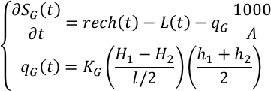

Introduction of the GBEHM
This study developed the SWC parametrization scheme based on the Geomorphology-Based Eco-Hydrological Model (GBEHM), which stems from a geomorphology-based hydrological model (GBHM). The details can be seen in (Gao et al., 2016; Gao et al., 2018; Yang et al., 2015).
Hydrological Modules
Physical processes
Main Equations
  Simulating glacier ablation, snow accumulation and snowmelt, and soil freeze-thaw processes based on hydrothermal coupling and exchange;
  Simulating vegetation growth process and vegetation transpiration process based on photosynthesis;
  The runoff process is simulated based on soil hydrodynamics, and the confluence process is simulated based on channel hydraulics.
(1) Radiation transfer
(2) Glaciers melting
(3) Snow accumulation and snowmelt
(4) Soil freeze-thaw
(5) Vegetation dynamics
(6) Canopy interception
(7) Rainfall infiltration
(8) Soil water movement
(9) Hillslope surface runoff
(10) Hillslope interflow
(11) Groundwater-river exchange
(12) River network confluence
Code and case for the GBEHM： https://github.com/gb03/GBEHM
Notes:
Gao, B., Qin, Y., Wang, Y.H., Yang, D.W., Zheng, Y.R., 2016. Modeling Ecohydrological Processes and Spatial Patterns in the Upper Heihe Basin in China. Forests, 7(1). DOI:ARTN 10
Gao, B. et al., 2018. Change in frozen soils and its effect on regional hydrology, upper Heihe basin, northeastern Qinghai-Tibetan Plateau. Cryosphere, 12(2): 657-673. DOI:10.5194/tc-12-657-2018
Yang, D.W. et al., 2015. A distributed scheme developed for eco-hydrological modeling in the upper Heihe River. Sci China Earth Sci, 58(1): 36-45. DOI:10.1007/s11430-014-5029-7

Slide 5
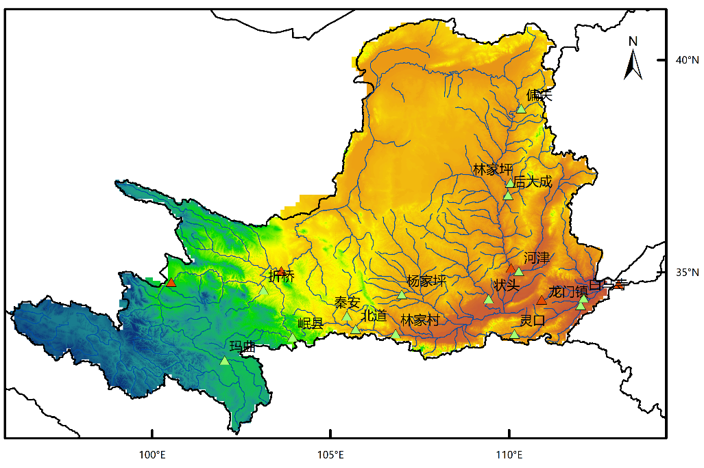
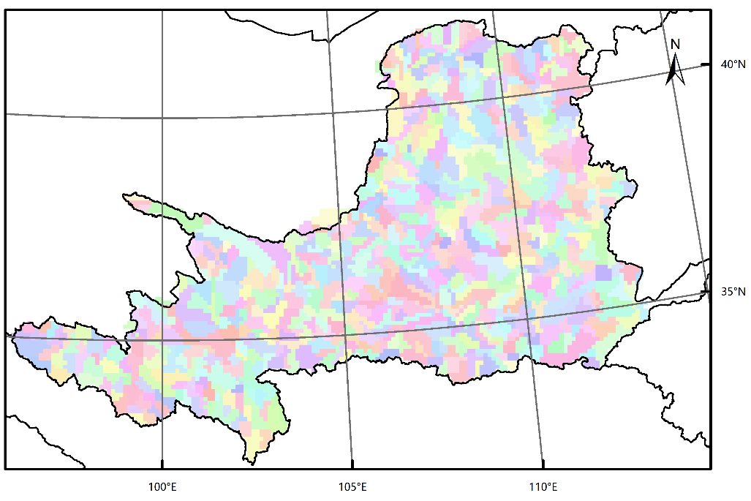
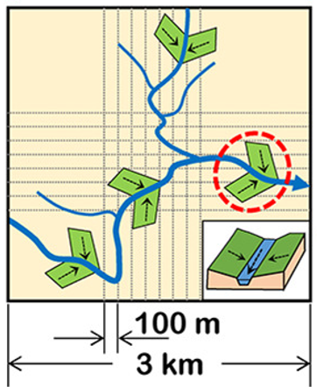
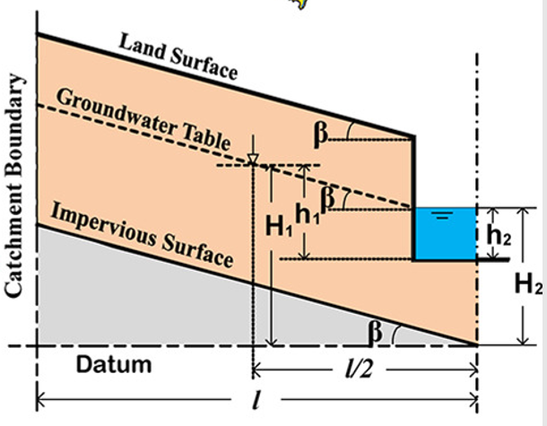
Establishment of the GBEHM in the YRB
The simulated watershed covers an area of ​​about 750,000 km². A 10km×10km grid was used to
discretize this area, and the parameters of one 10km grid were estimated based on resolution geographic data in sub-grids.
The study area was divided into 718 sub-basins with an average area of ​​1044km²; the river network topology and confluence order are defined based on the Horton-Strahler river network classification system.
Flow interval
10 km
Sub-basin
One 10 km gird and its sub-grids
Hillslope unit

Slide 6
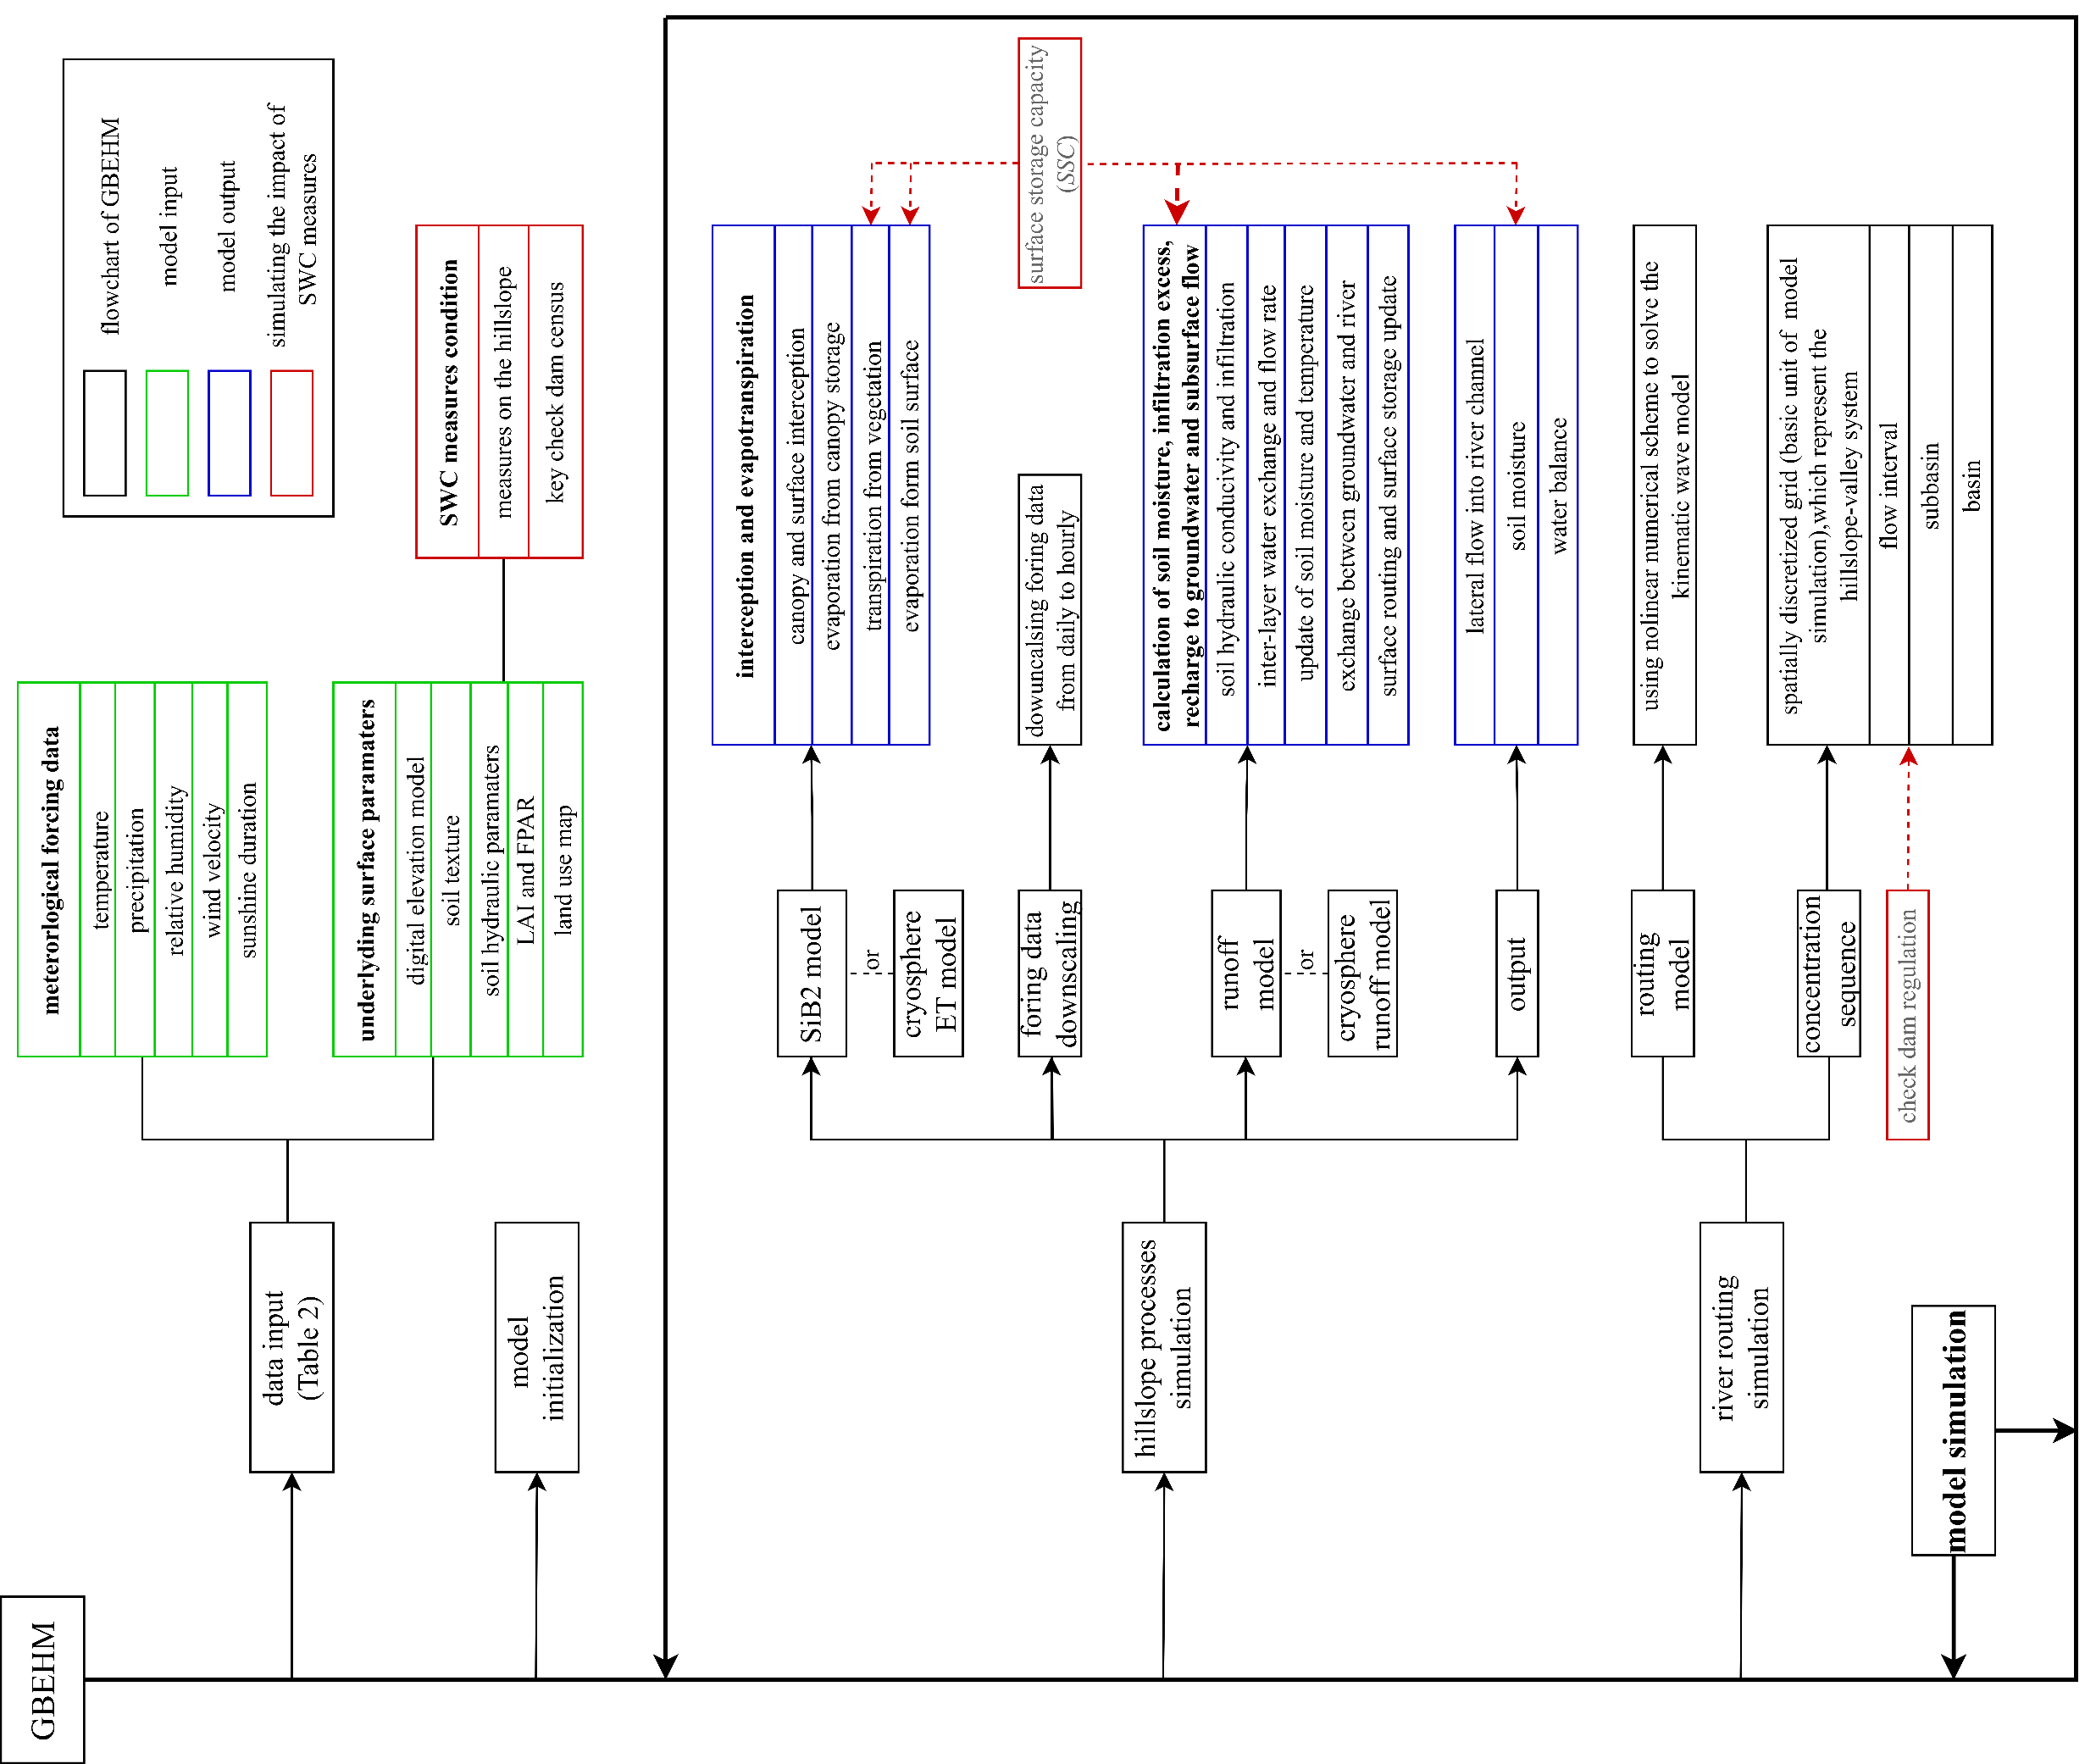
The SWC parameterization based on the GBEHM
The flowchart of hydrological simulation with SWC impacts based on the GBEHM model

Slide 7

Parameterization of HSWC Measures
The HSWC was parameterized to change surface storage capacity (SSC) as:
where r₁, r₂ and r₃ are the area ratio of terracing, afforestation, and grass planting in a specific simulation grid, respectively; SSC₀, SSC₁, SSC₂ and SSC₃ stand for the surface storage capacity of original hillslope, terraces, afforestation fields and grass planting fields, respectively.
The SSC will influence the hydrological simulation in these ways:
Surface evaporation
In each 10km grid:
potential evaporation (on x)
where L_{t}, L_{s}, H_{s}, β_{t}, and H_{t} are the construction parameters. ratio_{e} is the horizontal engineering section projection ratio on the horizontal plane. SSC_{i} is the surface storage capacity of the terrace, afforestation field or grass planting field. K_{lateral} and K_{damage} are the coefficient to reflect the incomplete water retention capacity of HSWC and the damage situation, respectively.
surface soil evaporation (on 1-x)
Surface runoff:

Slide 8
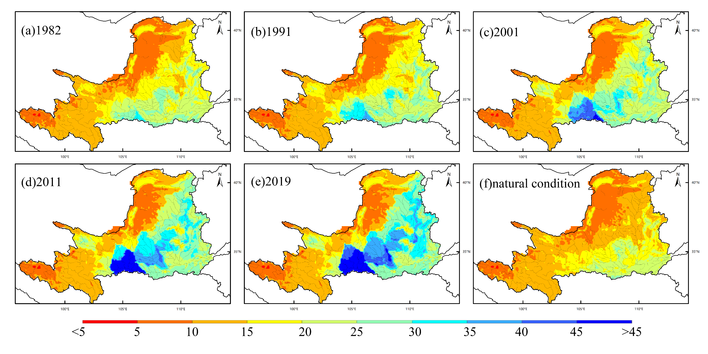
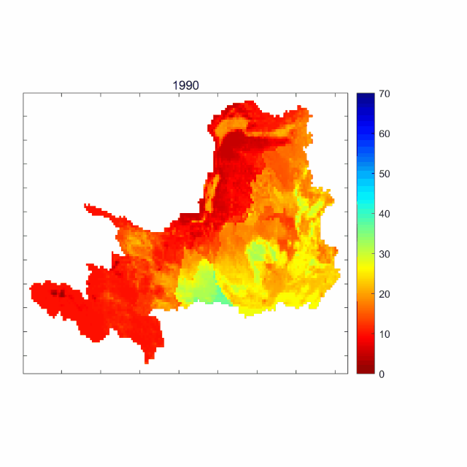
Parameterization of HSWC Measures
The SSC distribution after the HSWC parameterization
1982
1991
2001
2011
2019
natural condition
Inter-annual variation of SSC distribution in the YRB
Spatial distribution the SSC after SWC implementation and the comparison with SSC of the natural condition

Slide 9
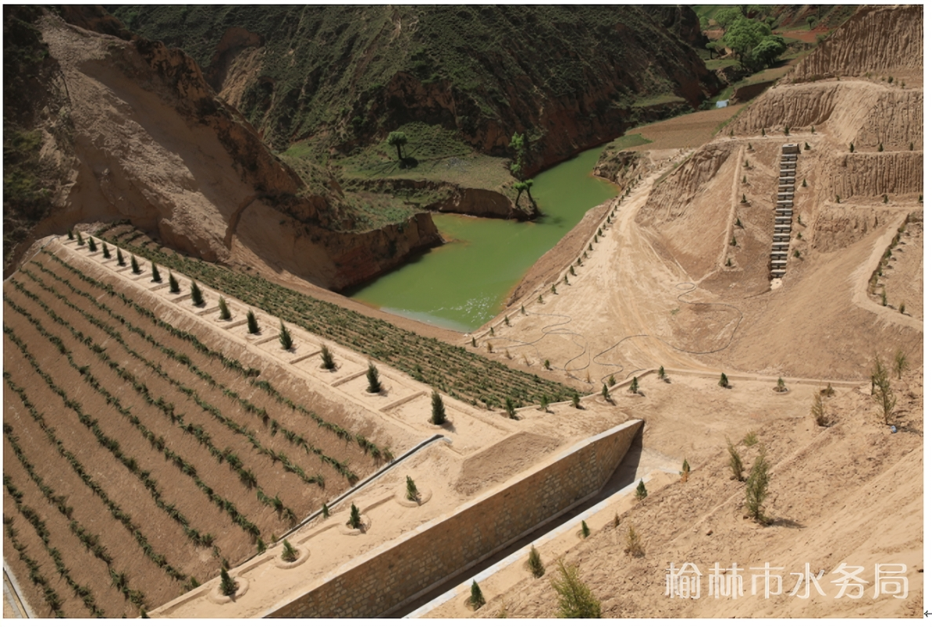
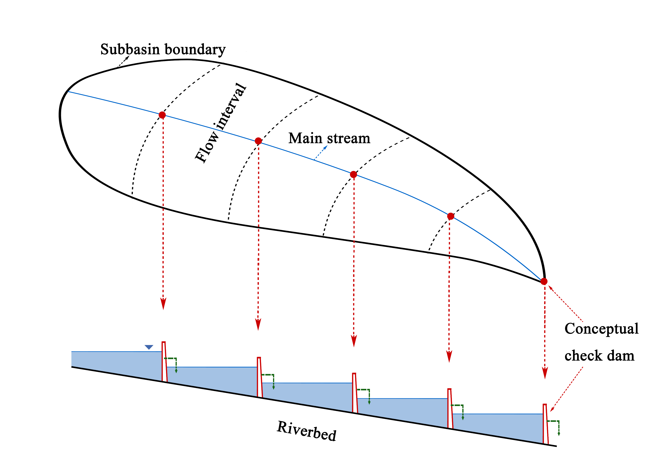
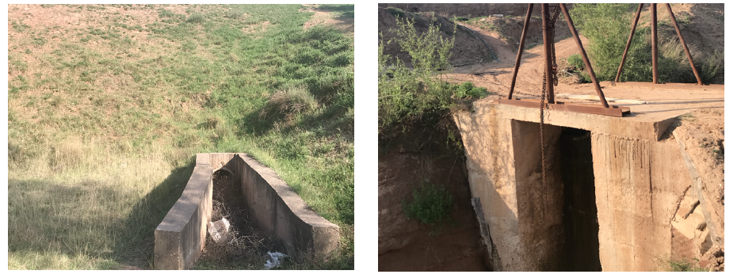
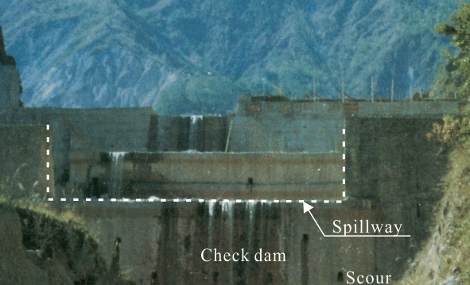
Conceptualization and Operation of Check Dam along the River Network
The RSWC was conceptualized as conceptual check dams and operated as unregulated reservoirs:
A check dam is a small, sometimes temporary, dam constructed across a swale, drainage ditch, or waterway to counteract erosion by reducing water flow velocity.——by Wikipedia
The regulation of check dams can be taken as a non- regulated reservoir, the water is released downstream through discharge facilities such as drainage canels and spillways.
Drainage canal outlet
Spillway
The check dams in each flow interval were taken as on conceptual check dam located at the interval outlet

Slide 10
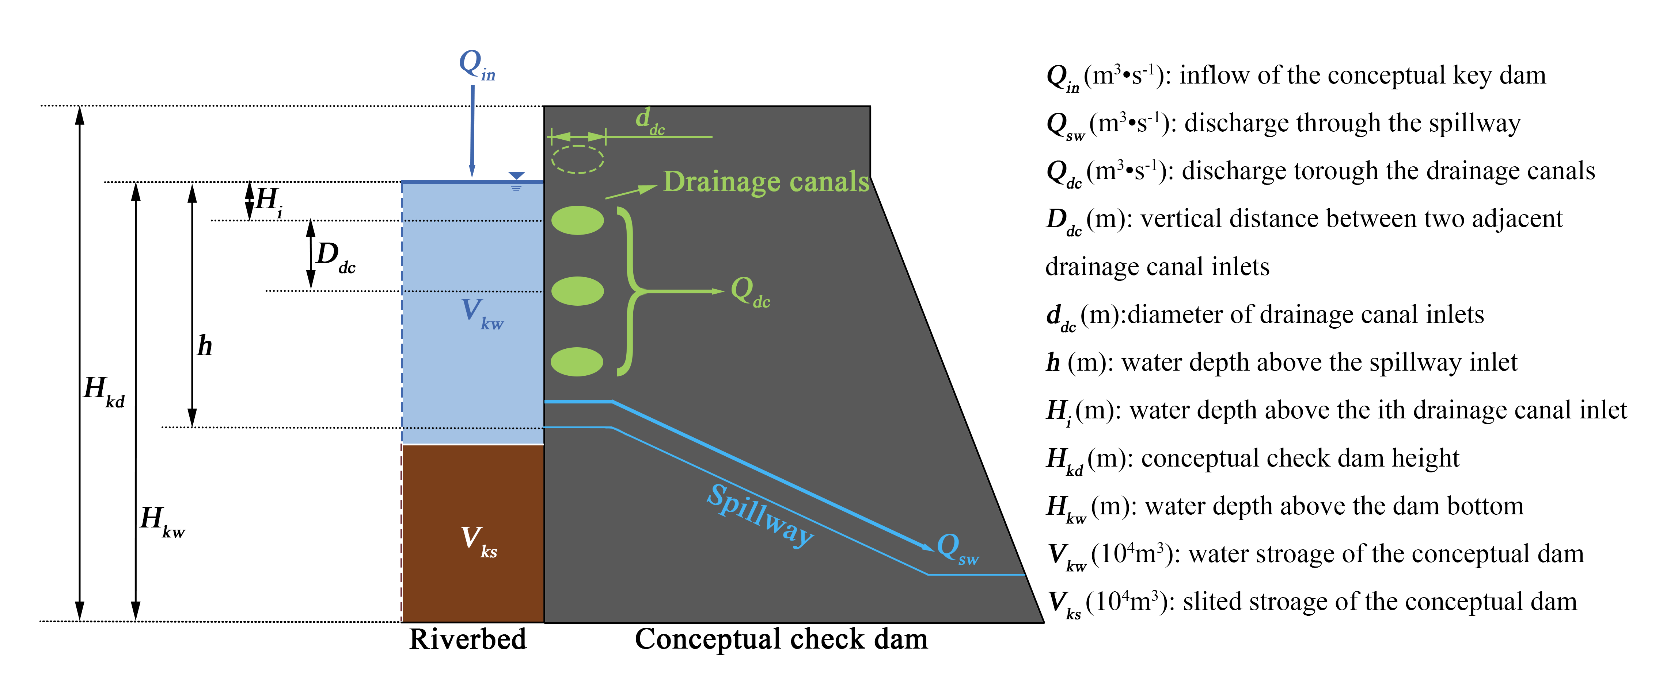
Conceptualization and Operation of Check Dam along the River Network
At the start of each year, the storage capacity and the silted volume of each conceptual key check dam were imported. In each hourly time step, the conceptual check dam regulates the discharge at the interval outlet (Qin) as following steps: (a) The inflow is added to the conceptual check dam storage of the last time step. (b) According to Chinese Technical Specifications for Soil and Water Conservation Ditch Management Backbone Project (SL 289-2003), the dam outflow through spillway (Qsw) and drainage canals (Q_{dc}) are calculated using the following equations. (c) The dam water storage is updated, and the dam overflow situation is checked.
where Q_{sw} and Q_{dc} is the water discharge (m³/s) through spillway and drainage canals in each time step (hr), respectively; K_{gsw} and K_{qdc} are two artificial coefficients added by (Lu et al., 2020) for correcting the spillway and drainage canals outflow discharge designed by SL 289-2003 in the LP; B_{sw} is the width of spillway inlets (m); M is the discharge coefficient ranging from 1.42 to 4.62, and was given 1.5 in this study; H₀ is the water head in the moving flow (m); h is the water depth over the spillway (m); V₀ is the flow velocity before spillway inlet (m/s), which is assumed to be 0 in this study (Aydin, 2016); g is the gravitational acceleration; H_{w}, H_{d} and D_{sw} are the water depth above the dam bottom, the dam height and the vertical distance from the top of the conceptual dam to the spillway (m), respectively; d_{dc} is the diameter of drainage canals (m); N_{dc} is the number of opened drainage canals which are above the spillway height; D_{dc} is the vertical distance between two drainage canals (m); H_{i} is the water head above corresponding drainage canal inlet (m).
Sketch of the check dam operation adapted from (Lu et al., 2020)
Notes:
Lu, B.J., Lei, H.M., Yang, D.W., Fu, X.D., 2020. Separating the effects of revegetation and sediment-trapping dams construction on runoff and its application to a semi-arid watershed of the Loess Plateau. Ecol Eng, 158. DOI:ARTN 106043

Slide 11
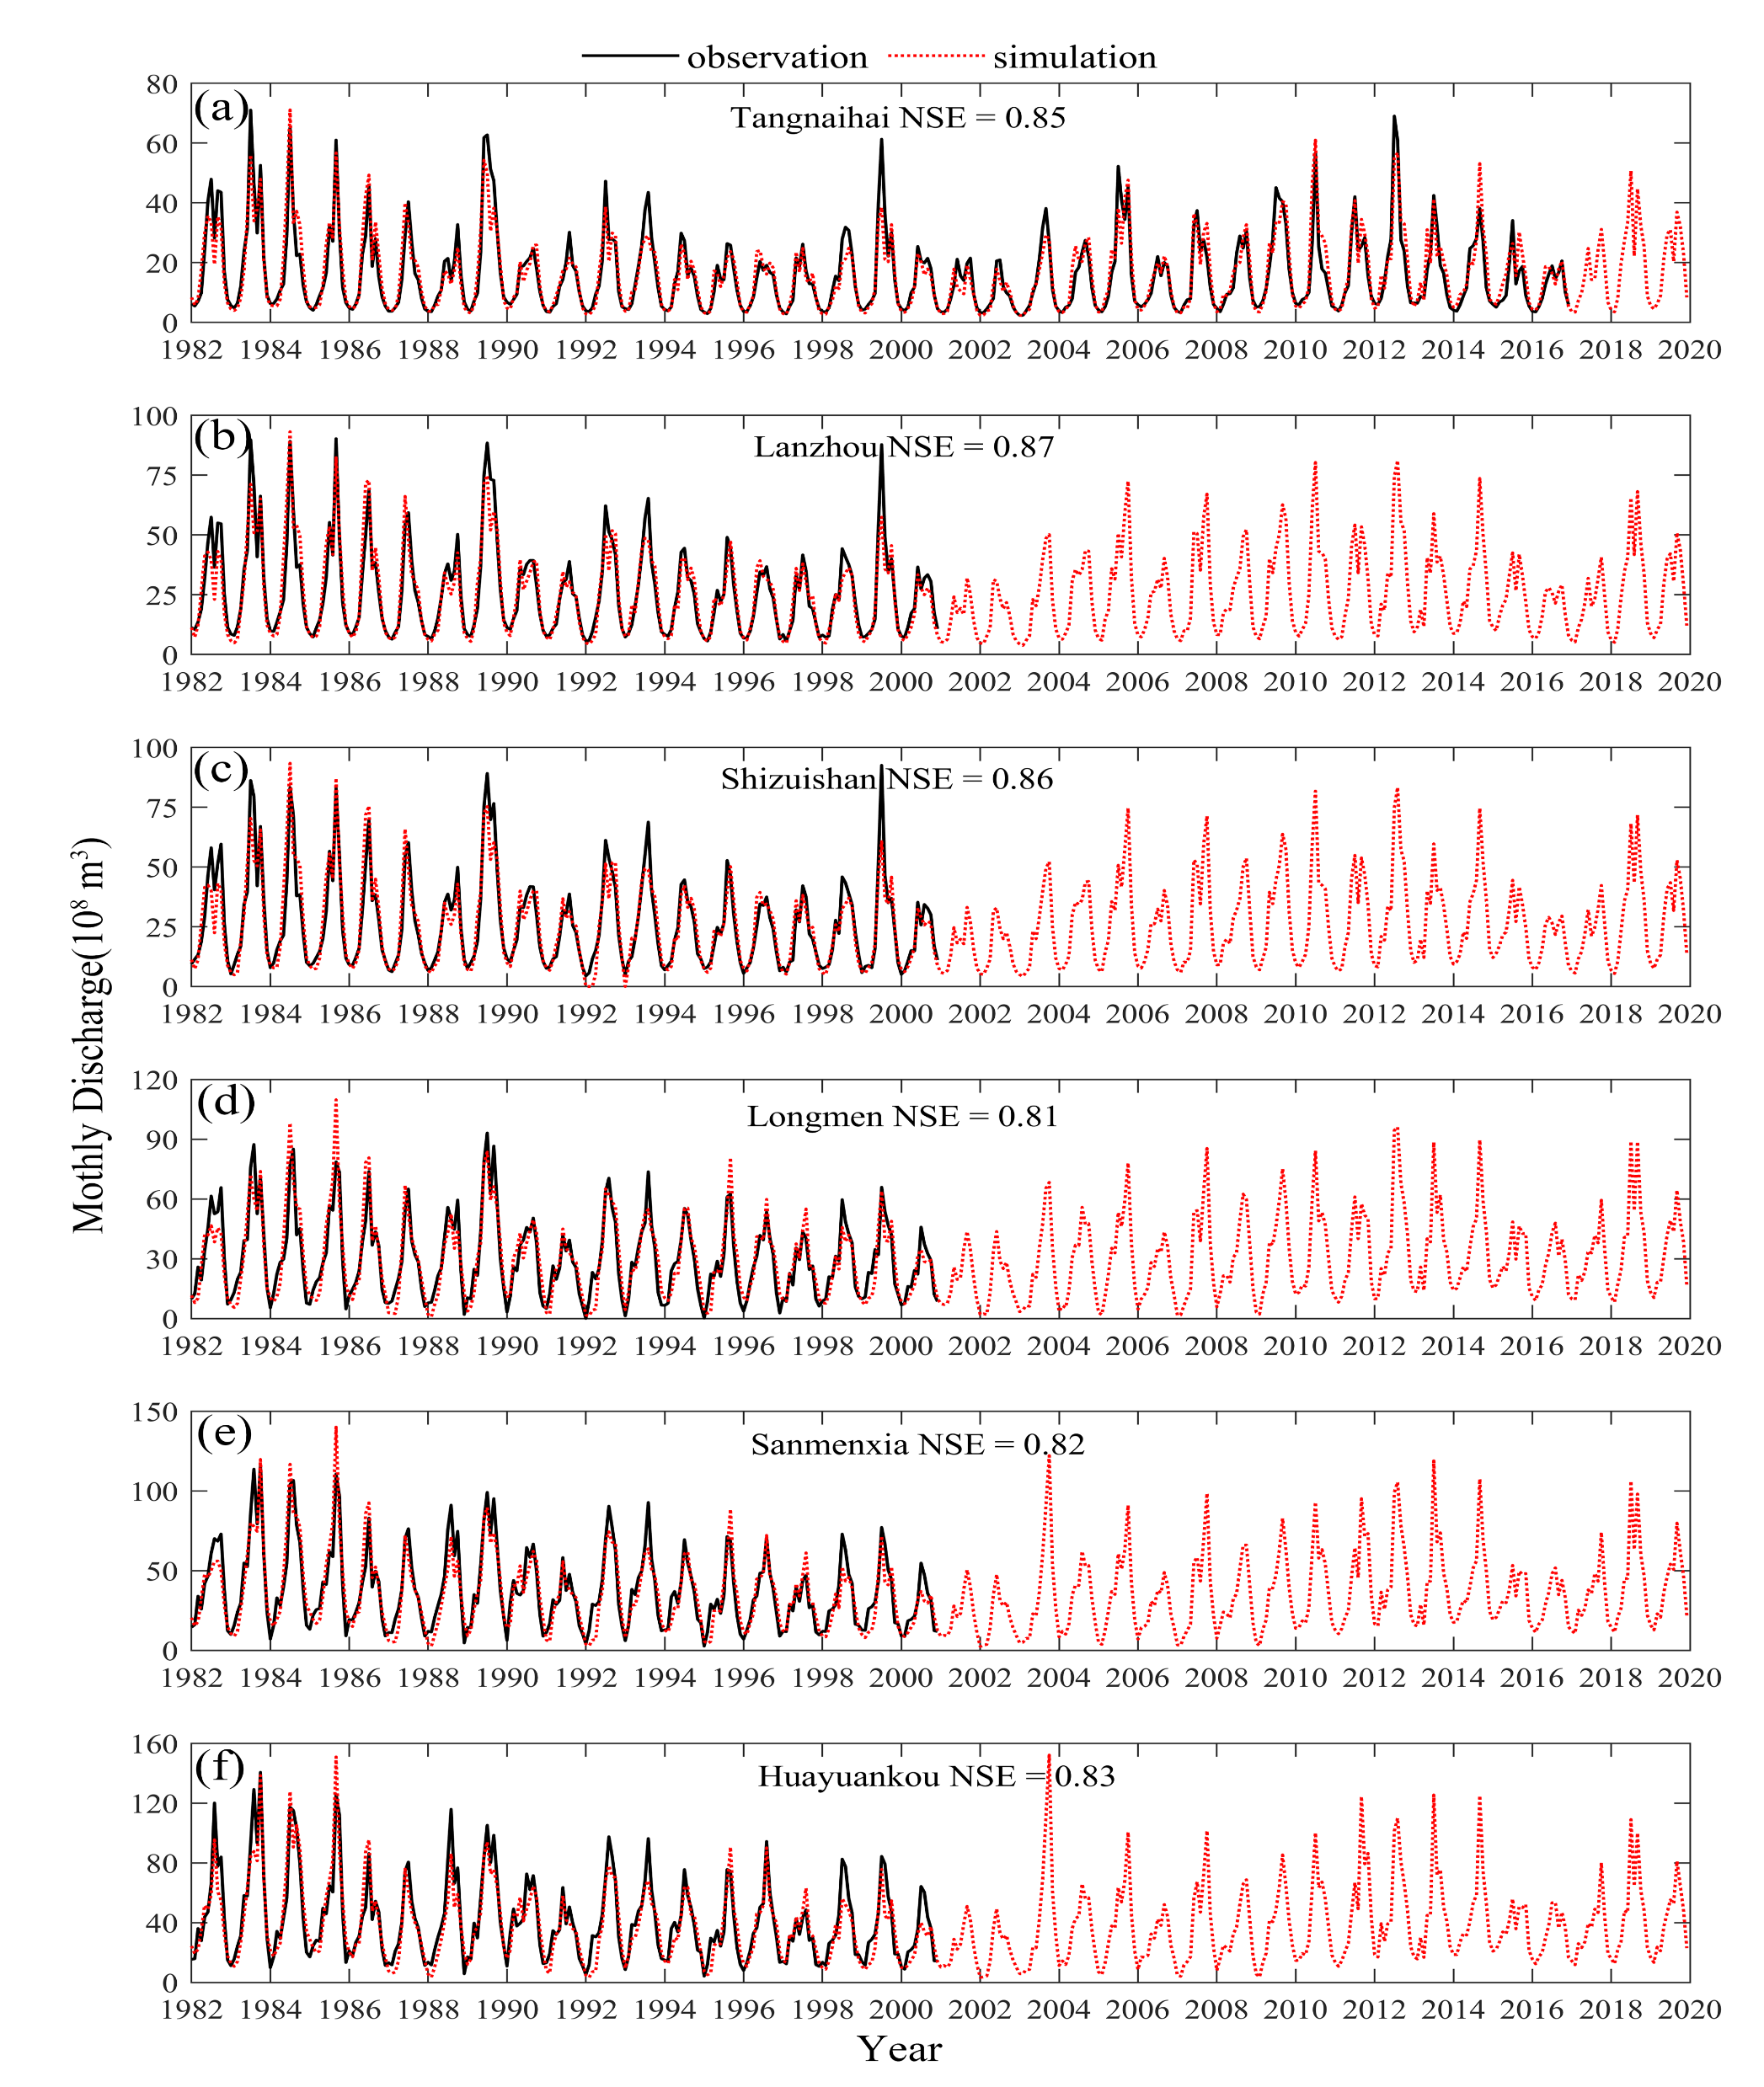
Model Performance after the SWC parameterization
After the SWC parameterization, the enhanced model (GBEHM-SWC) was comprehensively calibrated and validated during 1982-2000. It showed a strong capability to simulate natural runoff.
The NSE value of monthly natural runoff for evaluating model performance
station location | subordinate subbasin | station name | model calibration period 1982- 1990 | model validation period 1991-2000 | period with intensive SWC 2001-2015
main-stream | - | Tangnaihai | 0.86 | 0.81 | 0.84
 | - | Lanzhou | 0.87 | 0.88 | -
 | - | Shizuishan | 0.85 | 0.88 | -
 | - | Longmen | 0.81 | 0.79 | -
 | - | Sanmenxia | 0.83 | 0.82 | -
 | - | Huayuankou | 0.85 | 0.83 | -
tributaries | Yellow River Source Region | Maqu | 0.88 | 0.92 | 0.82
 | Taohe River basin | Hongqi | 0.73 | 0.68 | 0.65
 | Huangshui River basin | Minhe | 0.53 | 0.59 | -
 | Kuyehe River basin | Wenjiachuan | 0.61 | 0.45 | -
 | Jinghe River basin | Zhangjiashan | 0.63 | 0.60 | -
 | Weihe River basin | Linjiacun | 0.70 | 0.64 | 0.68
 | Fenhe River basin | Hejin | 0.39 | 0.38 | 0.30
 | Yiluohe River basin | Heishiguan | 0.93 | 0.85 | 0.87
 | Qinhe River basin | Wuzhi | 0.57 | 0.53 | 0.51
Comparison of the simulated and observed monthly natural river discharge at six main-stream hydrological stations.

Slide 12
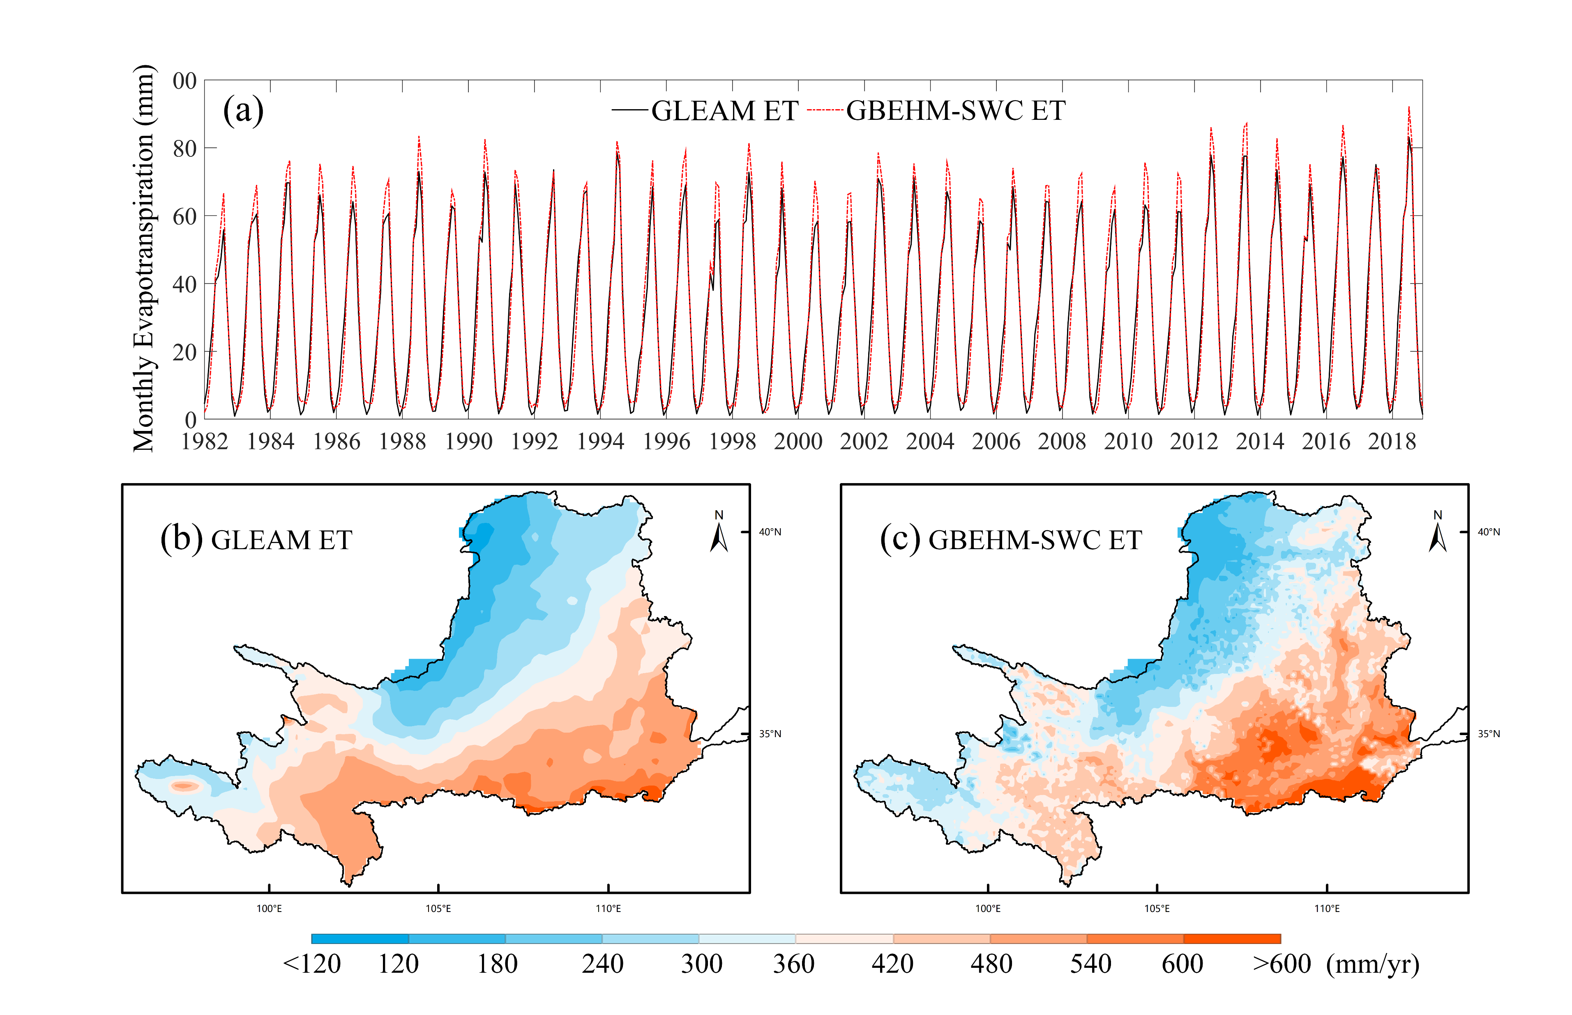
Model Performance after the SWC parameterization
The enhance model also showed a strong capability to simulate the actual evapotranspiration (ET).
Comparison of the ET simulated by GBEHM-SWC and remote sensing estimation (GLEAM ET) during 1982-2018.

Slide 13
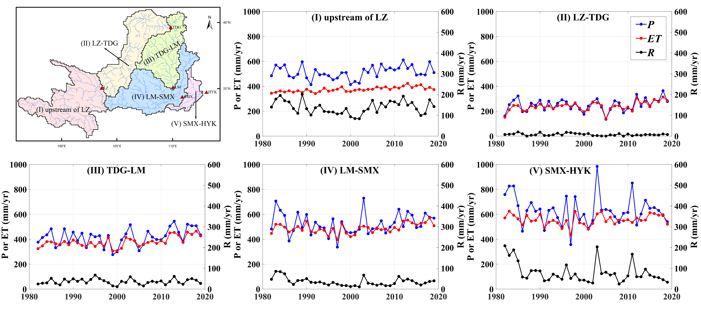
Hydrological changes along the main-stream sections
The upstream of LZ and SMX-HYK sections have relatively plentiful precipitation and higher runoff generation. In the other sections, the ET is close to the P, and the hydrological variation in most sections shows similar characteristics to that of the whole basin. During the study period, a decreasing trend of runoff coefficient was found in all the sections.
P =251
ET=240
R =10
P =417
ET=383
R =34
P =512
ET=373
R =140
P =631
ET=554
R =77
P =524
ET=489
R =35
Temporal variations of annual precipitation (P), actual evapotranspiration (ET) and natural runoff (R) during 1982-2019 in the five sub-regions as shown in the upper left figure.

Slide 14
Designed Scenarios to separate the CC and SWC impacts
Scenarios designed to differentiate the impacts of climate change (CC), HSWC and RSWC on the streamflow.
Scenarios | CC | HSWC | RSWC | Output | Quantitative Method
 | Precipitation, temperature, radiation, wind velocity, relative humidity, and cloud | Vegetation and hillslope surface storage capacity | Storage capacity and silted storage of conceptual check dams | Annual natural streamflow (Q) | The annual hydrological component change caused by different factors
S_{control1} | 1982-2000 | 1982-2000 | 1982-2000 | Q_{control1}
S1 | 2001-2019 | 1982-2000 | 1982-2000 | Q_{S1} | ΔQ_{CC} = Q_{S1} - Q_{control1}
S2 | 1982-2000 | 2001-2019 | 1982-2000 | Q_{S2} | ΔQ_{HSWC} = Q_{S2} - Q_{control1}
S3 | 1982-2000 | 1982-2000 | 2001-2019 | Q_{S3} | ΔQ_{RSWC} = Q_{S3} - Q_{control1}
S_{control2} | 2001-2019 | 2001-2019 | 2001-2019 | Q_{control2} | ΔQ_{total} = Q _{control2} - Q_{control1}

