Slide 1
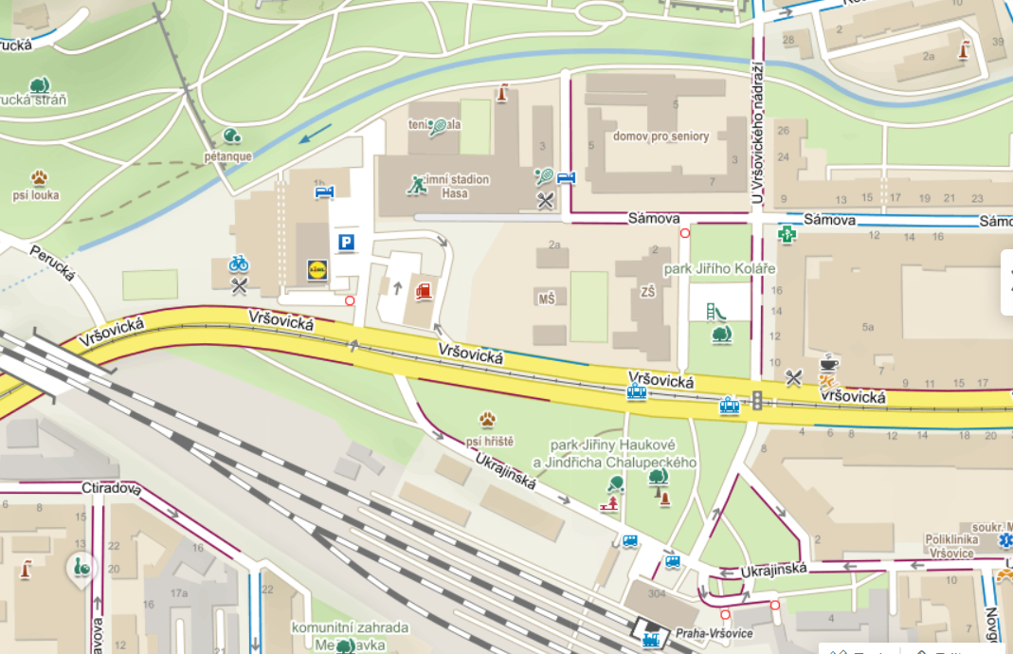
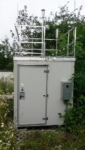
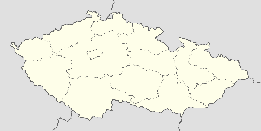
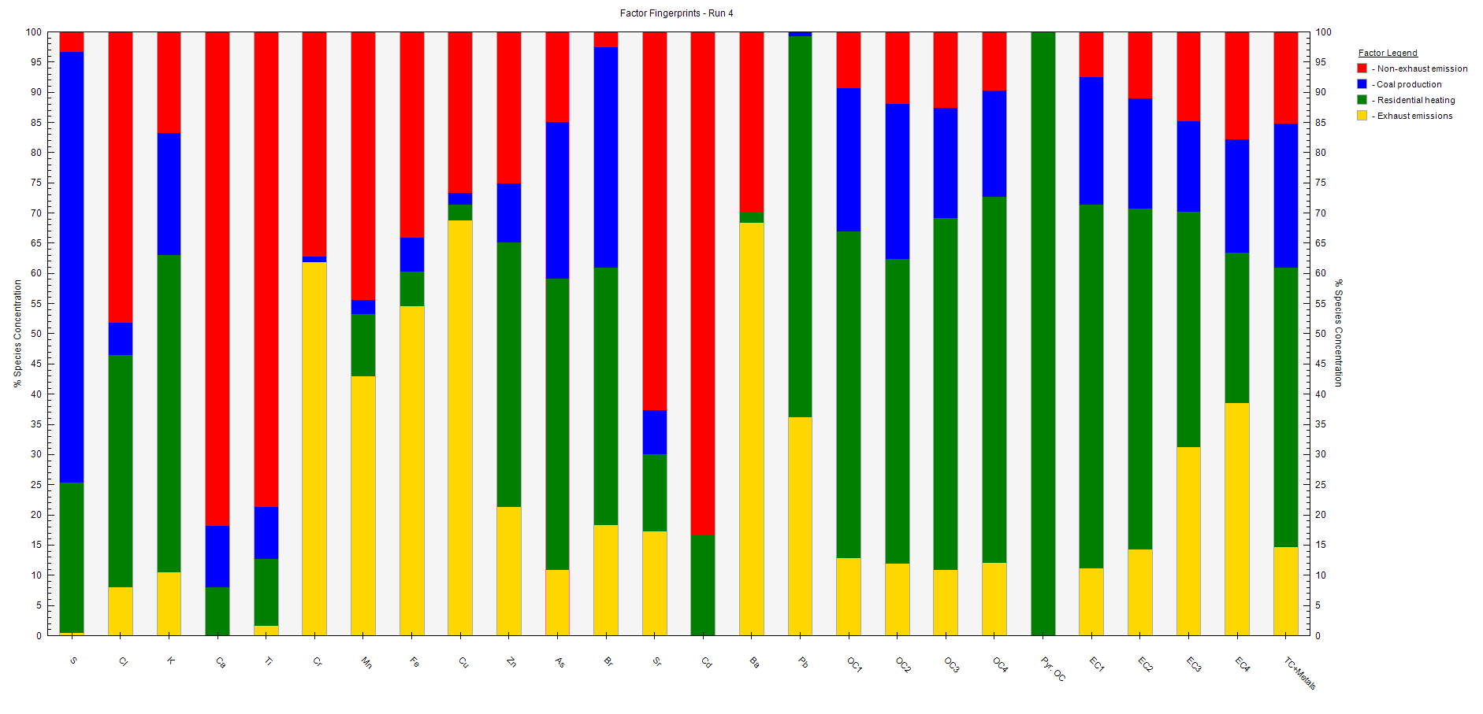
Elemental characterization of PM₂.₅ at an urban traffic site in Central Europe
Laurence Windell, Jaroslav Schwarz, Petr Vodička, Radek Lhotka, Petra Pokorná, Naděžda Zíkova, Vladimír Ždímal
Aerosol Chemistry and Physics Research Group, ICPF of the CAS, Prague, 165 00, Czech Republic
Background and aims: Metal content in traffic emissions are not currently regulated in Europe. Emissions from exhaust and non-exhaust (e.g. tire and brake wear) sources contribute greatly to particulate matter and pose significant health risks in urban settings. This project signifies the first high-time resolution metal analysis in Prague (CZ). It aims to i) quantify metal emissions from traffic and ii) identify and analyse source fingerprints.
Factor 1: Non-exhaust emissions/dust resuspension (traffic)
Factor 2: Coal power plants (industry)
High concentrations of dust-related elements (Ca, Ti), resuspended by the movement of traffic
Indicators of tire/brake wear (Zn, Ba)
Correlation with EC4 (fuel emissions)
Clear emission peaks during morning and afternoon traffic
Emissions from coal power plants located north-west of the city
Indicators of S, As and OC/EC fractions
Source of highest S emissions (80% total S)
Methods: The Vršovice urban site is located near a street (~16,500 vehicles/day), tram railway (~700 trams/day) and a train station, located just south-west of Prague centre.
Sampling was carried out in the winter season of 2020. Chemical PM₂․₅ (particulate matter <2.5μm) analysis using i) Xact625i Online Ambient Metals Monitor (ED-XRF) and ii) semi-online Elemental Carbon/Organic Carbon Analyzer (EC/OC) at two-hour time resolution. Source apportionment using EPA PMF software.
Mo
Tu
We
Th
Fr
Sa
Su
Mo
Tu
We
Th
Fr
Sa
Su
Factor 3: Residential heating (coal/wood)
Factor 4: Exhaust emissions (traffic)
Local residential heating
Key indicator of K (wood) and S/As (coal)
High concentrations of OC and pyrolyzed OC
Highest total emissions across all factors, due to abundant heating emissions during winter
Direct emissions from exhaust fumes
Emission peaks during morning and afternoon traffic are visible
High concentrations of traffic markers (Cu, Fe, Cr)
Strong correlation with EC fractions (fuel emissions)
Mo
Tu
We
Th
Fr
Sa
Su
Mo
Tu
We
Th
Fr
Sa
Su
Results
Conclusions
Factor Name
Factor 1: Non-exhaust emissions/dust resuspension (traffic)
Factor 2: Coal power plants (industry)
Factor 3: Residential heating (coal/wood)
Factor 4: Exhaust emissions (traffic)
4 factor fingerprints were identified using PMF software
Each factor displayed key elemental markers
The use of high-time resolution metal analysis, alongside EC/OC measurements, allowed for the identification of different emission sources found at the urban site
Factor 1: Non-exhaust emissions, although usually found in PM₁₀, were detected at PM₂․₅ and were correlated with resuspended dust
Factor 2: The influence of coal production was found in the urban site, accounting for ca. 25% of total emissions, highlighting the environmental impacts of this type of energy production
Factor 3: The use of coal and wood for domestic heating accounted for almost 50% of total emissions.
Factor 4: Direct exhaust emissions high in elemental carbon and trace metals were identified, aligning with daily trends of traffic activity
This conference contribution was supported by the Ministry of Education, Youth and Sports of the Czech Republic under grants ACTRIS-CZ LM2018122, ACTRIS-CZ RI (CZ.02.1 .01 / 0.0 / 0.0 / 16_013 / 0001315) and LTAUSA19006.

