Slide 1



Spectroscopic and Imaging Observations of Spatially Extended Magnetic Reconnection in the Splitting of a Solar Filament Structure
Huidong HU¹,
Ying D. LIU¹, Lakshmi Pradeep CHITTA², Hardi PETER², Mingde DING³
¹National Space Science Center, CAS, China;
²Max Planck Institute for Solar System Research, Germany;
³Nanjing University, China.
2023-04-24T08:45
EGU23-1508@Vienna, Austria & Online
EGU23-1508

Slide 2
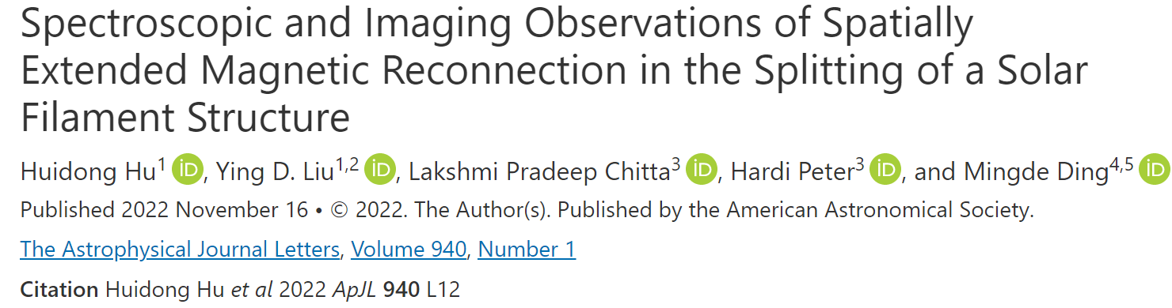

Outline
Introduction
Observations and Overview
Reconnection Region and Outflows
Temperature and Energy Partition
Conclusions and Discussions

Slide 3
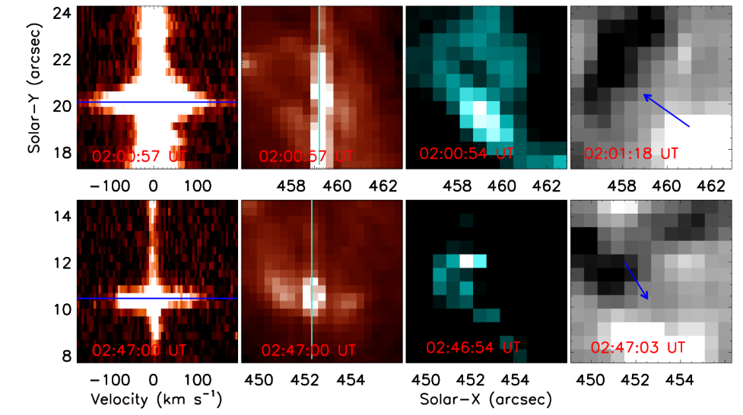
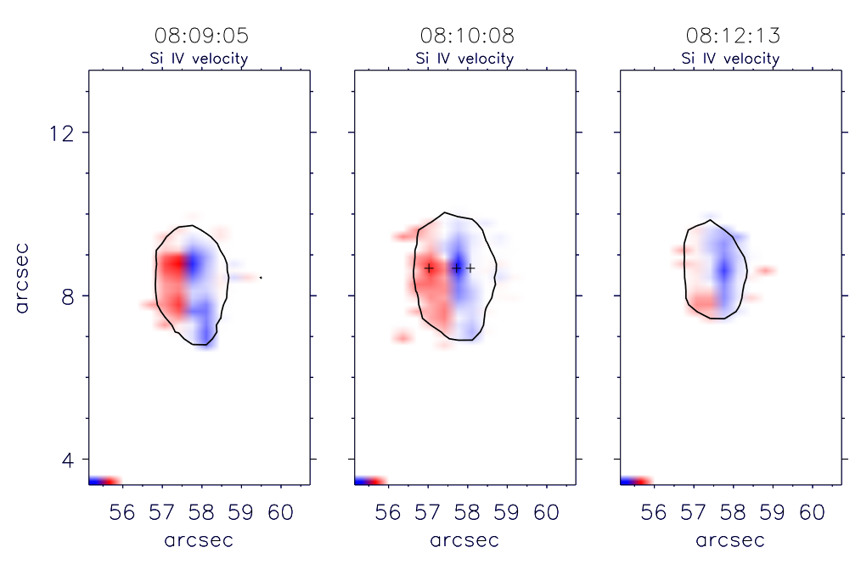
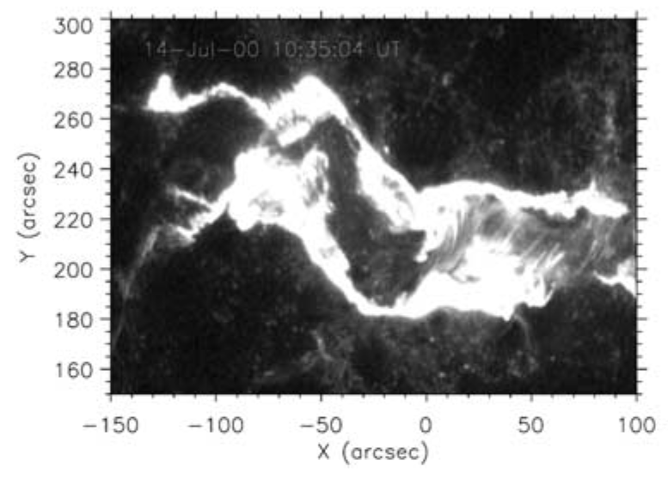
1. Introduction
Spectroscopic observations of extended regions on the Sun are rare, the distribution of reconnection and its outflows is unclear.
Hot Fe XXI line Doppler shifts. (Tian+2014)
Small-scale EUV/X-ray jets. (Chifor+2008)
Spatially resolved outflows. (Tian+2018)
(Fletcher+2001)
Heating cool material. (Peter+2014)
Small-scale jet. (Li+2018)
Ellerman bombs and UV bursts. (Ortiz+2020)

Slide 4
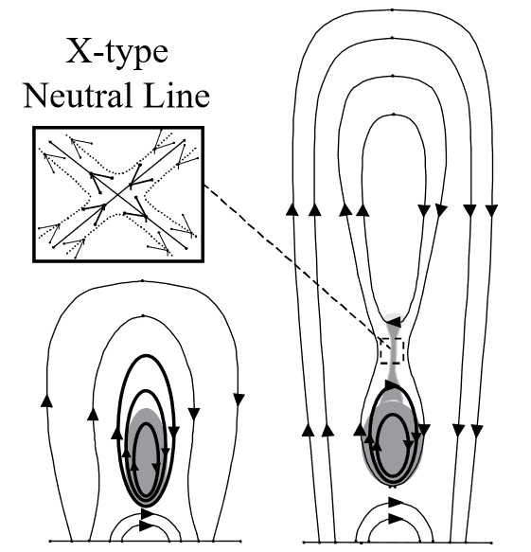
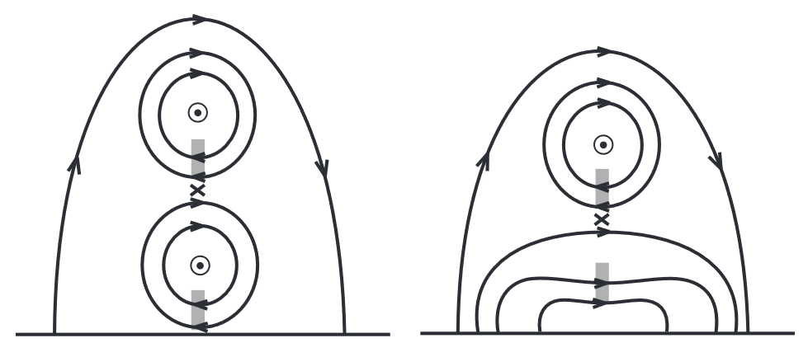
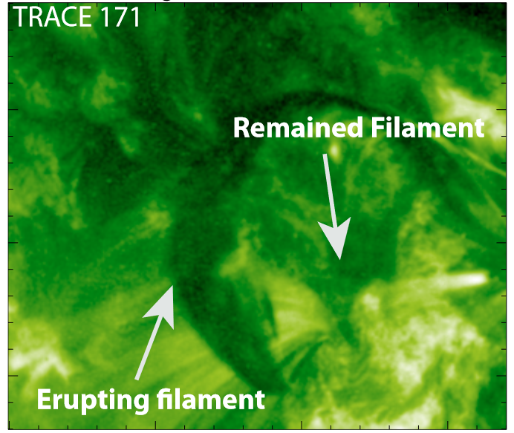
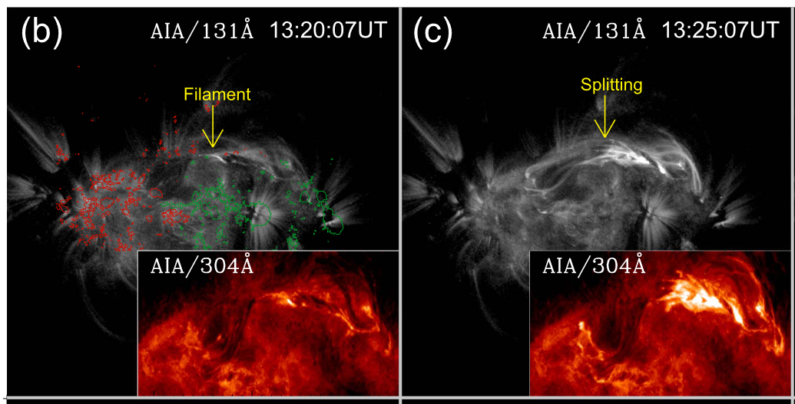
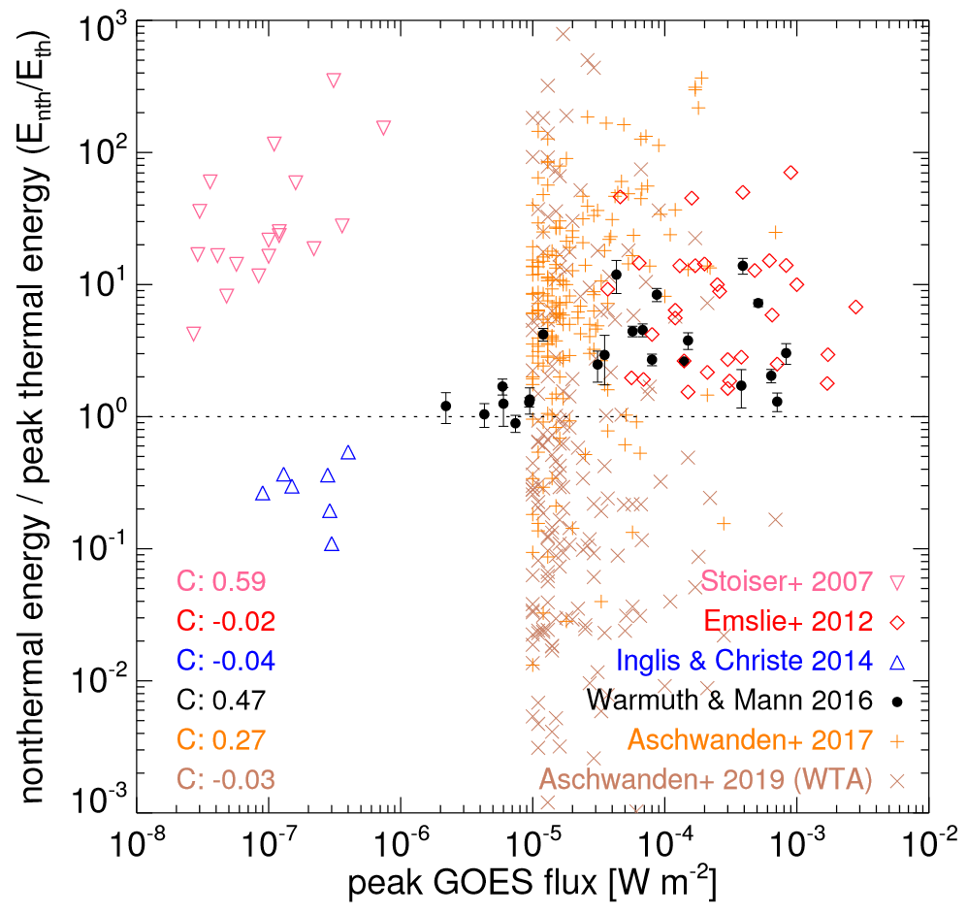
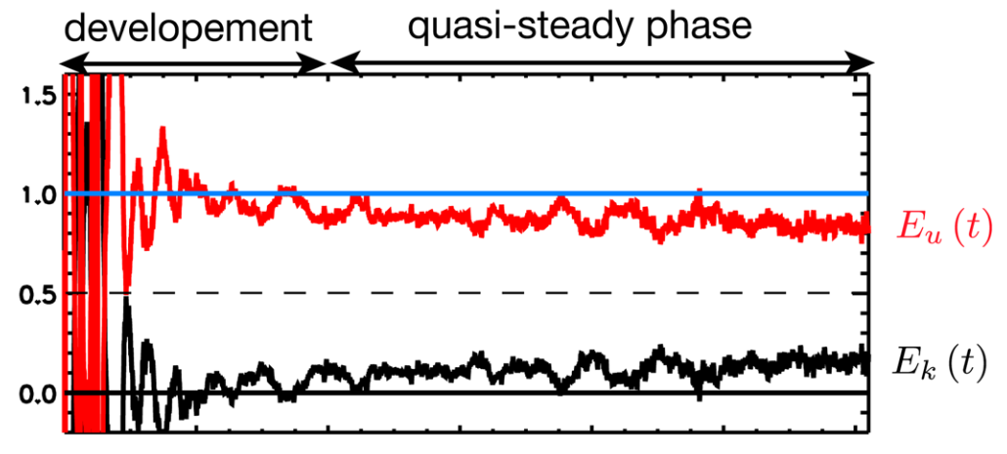
1. Introduction
Gilbert+2001
double decker, Liu+2012
Evidence for reconnection in filament splitting?
  Models and imaging suggest that reconnection can occur inside a filament and cause splitting.
  Lacking definite spectroscopic evidence.
Energy partition in reconnection is in debate.
  Thermal energy is dominant. (Inglis+2014; Shu+2021)
Tripathi+2009
Splitting, Cheng+2018
Aunai+2011
Warmuth+2020

Slide 5
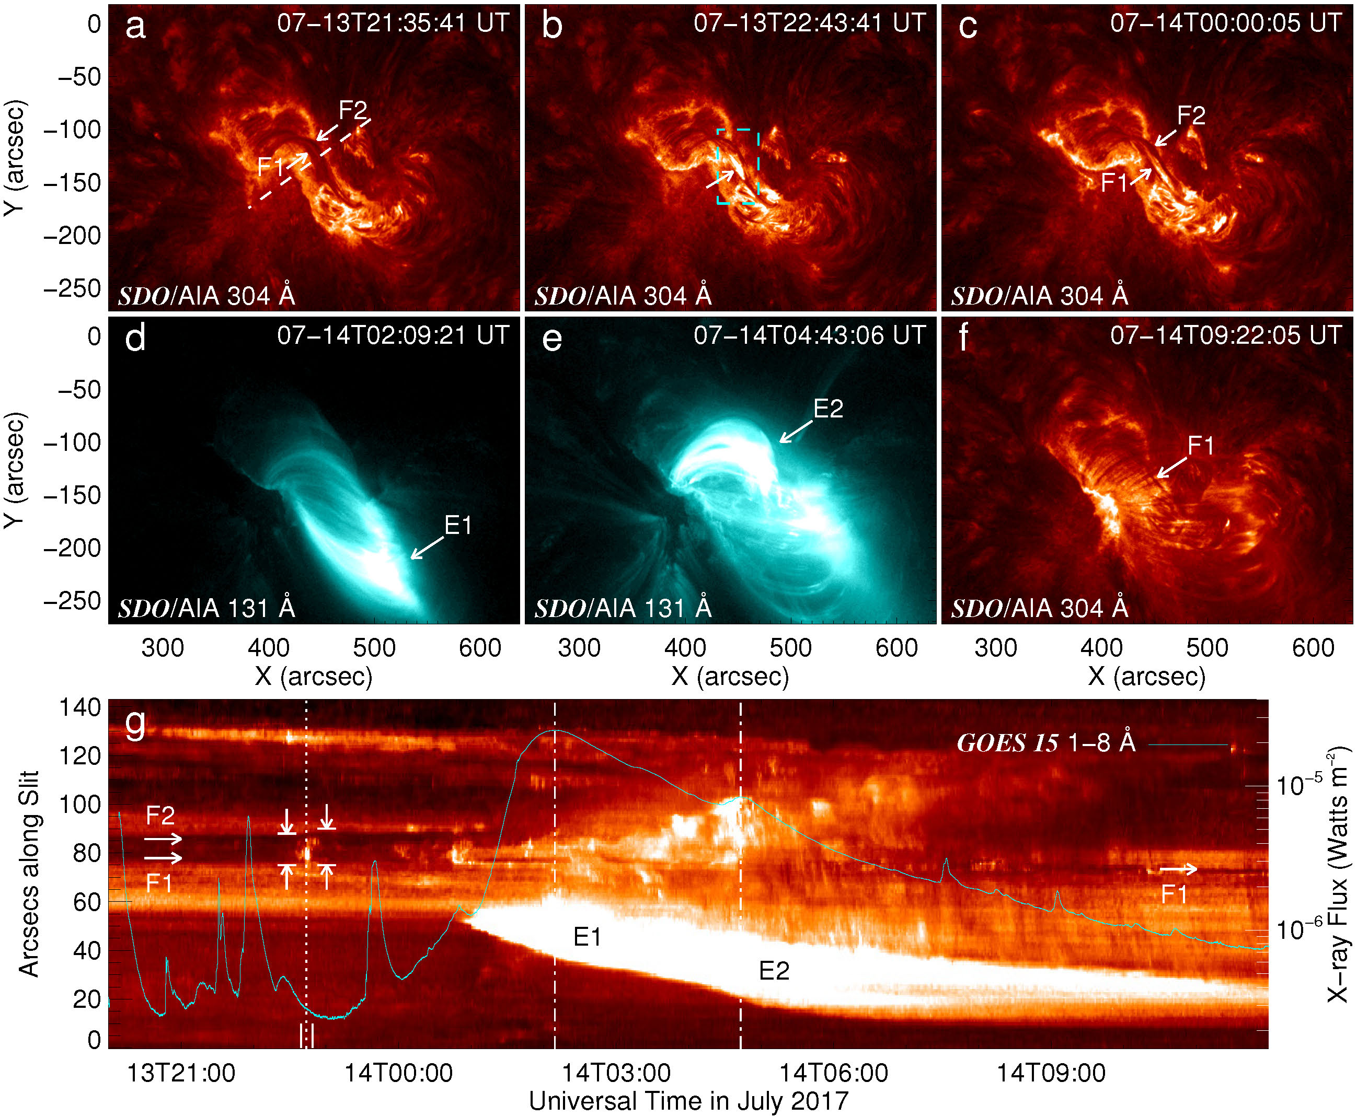
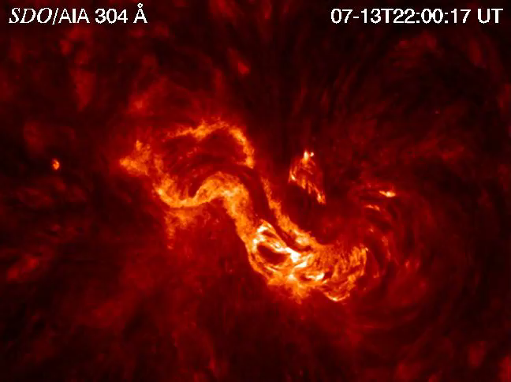
2. Observations and Overview
A filament structure is split into two upper and lower branches (F1&F2) in AR 12665;
The filament undergoes a partial eruption by ejecting the upper filament branch (F2).
The lower branch (F1), as part of the filament structure, survives the eruptions.
The splitting is captured by IRIS spectroscopic observations on a rare occasion.

Slide 6
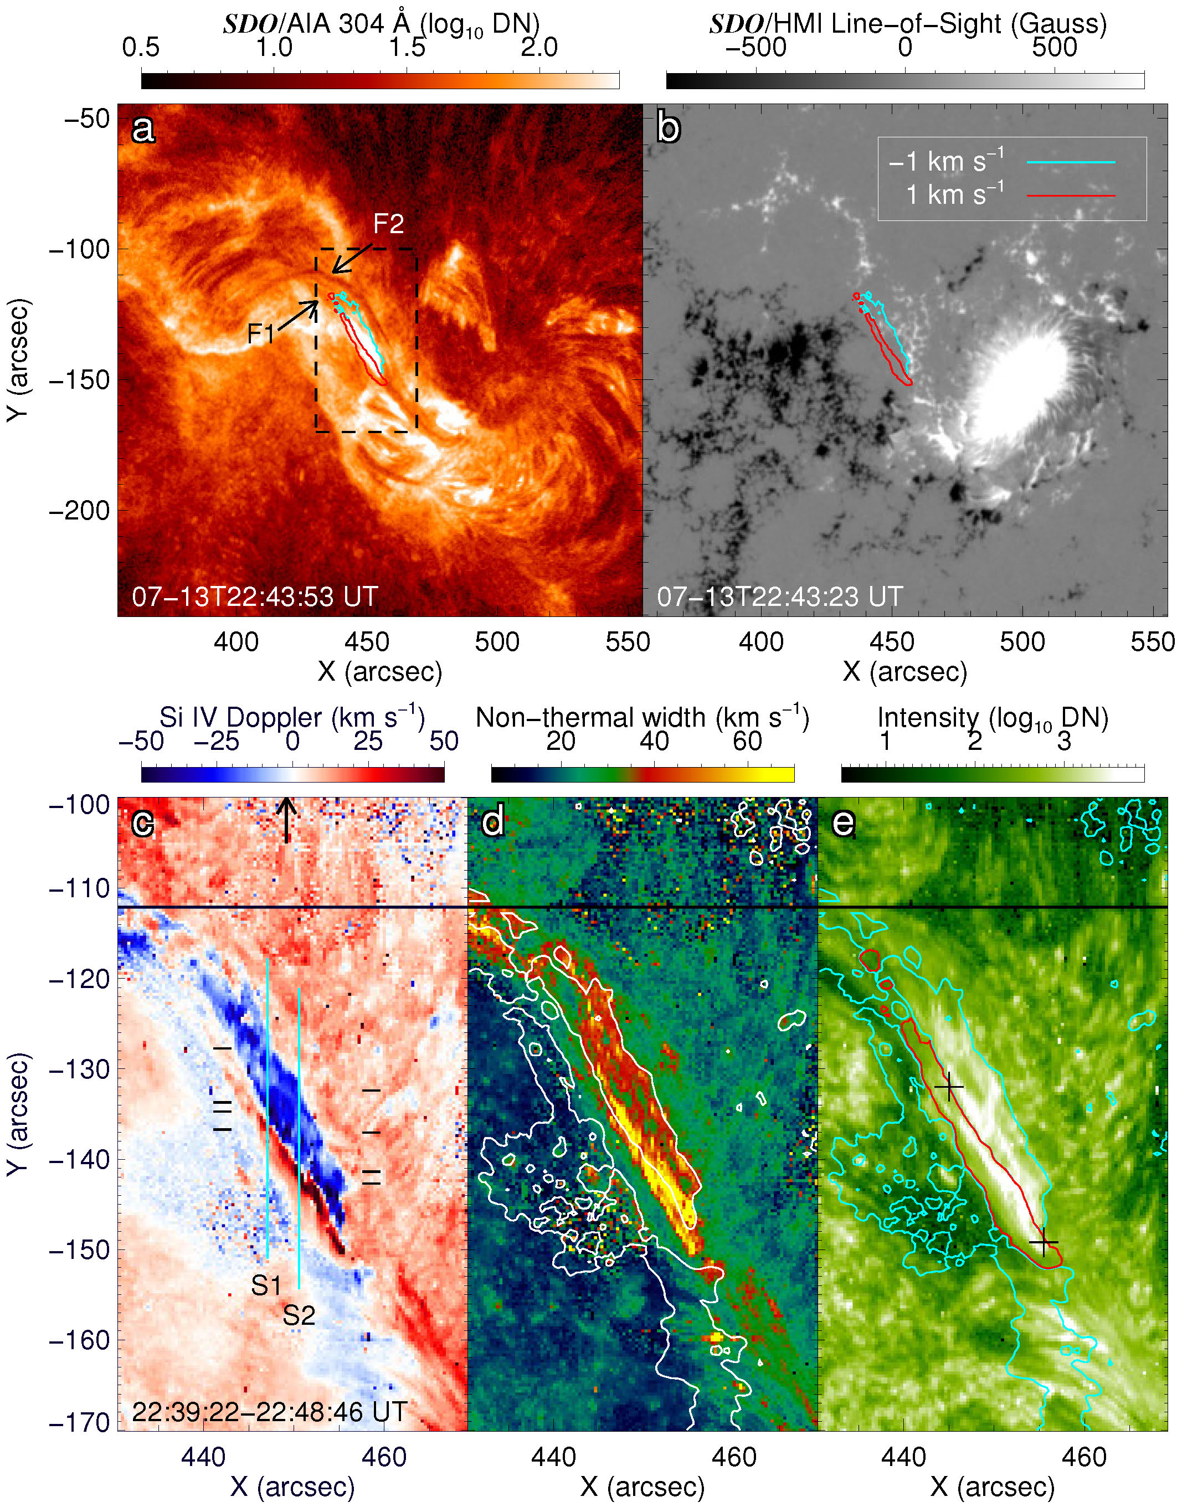
3. Reconnection Region and Outflows
Si IV 1393.755 Å line data reveal magnetic reconnection that splits the filament structure into two branches.
  Neighboring large blue- and redshifts of ≥50 km/s between the two filament branches, which spatially correspond to large nonthermal widths and enhanced intensities.
The length of the reconnection region is unprecedentedly ∼20′′ (∼14 Mm).

Slide 7
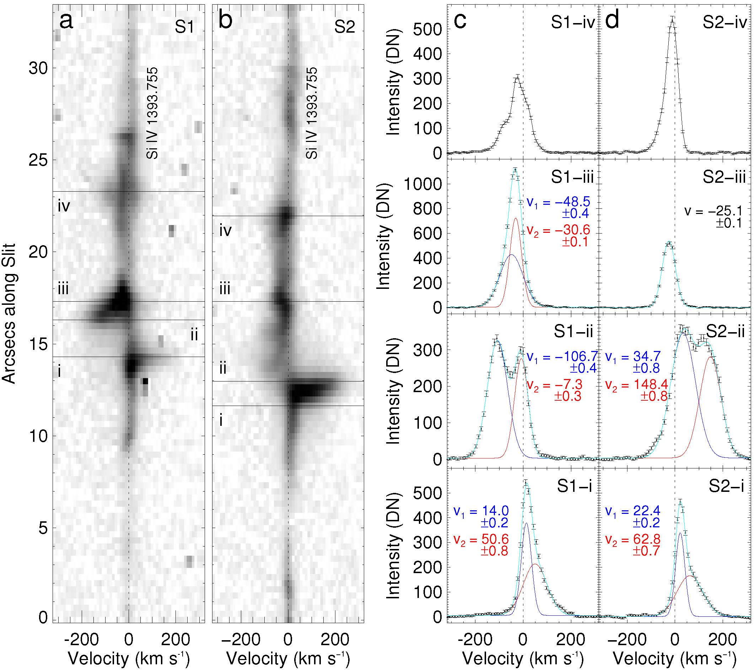
3. Reconnection Region and Outflows
Both the upward and downward outflows decelerate remarkably after they have left the reconnection site.
  ~150 km/s → ~50 km/s.
The upward outflow may interact with the upper filament branch.
  line broadening on the blueshift side.

Slide 8
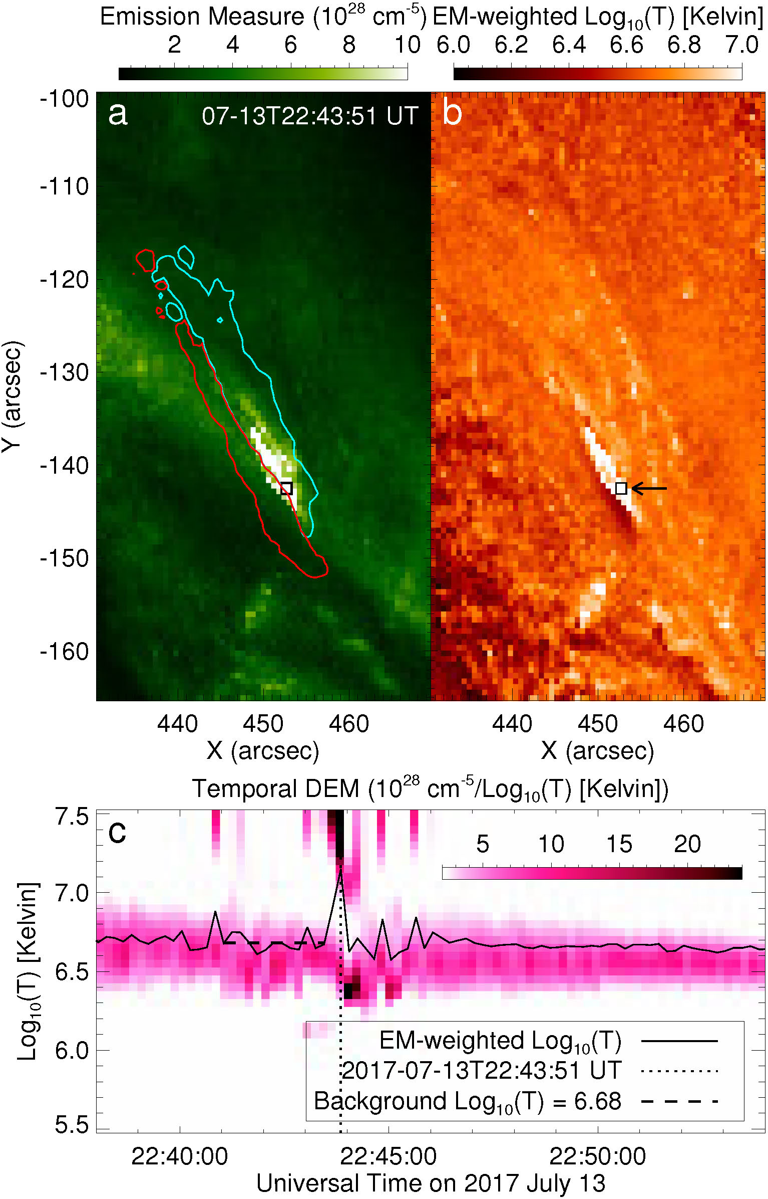
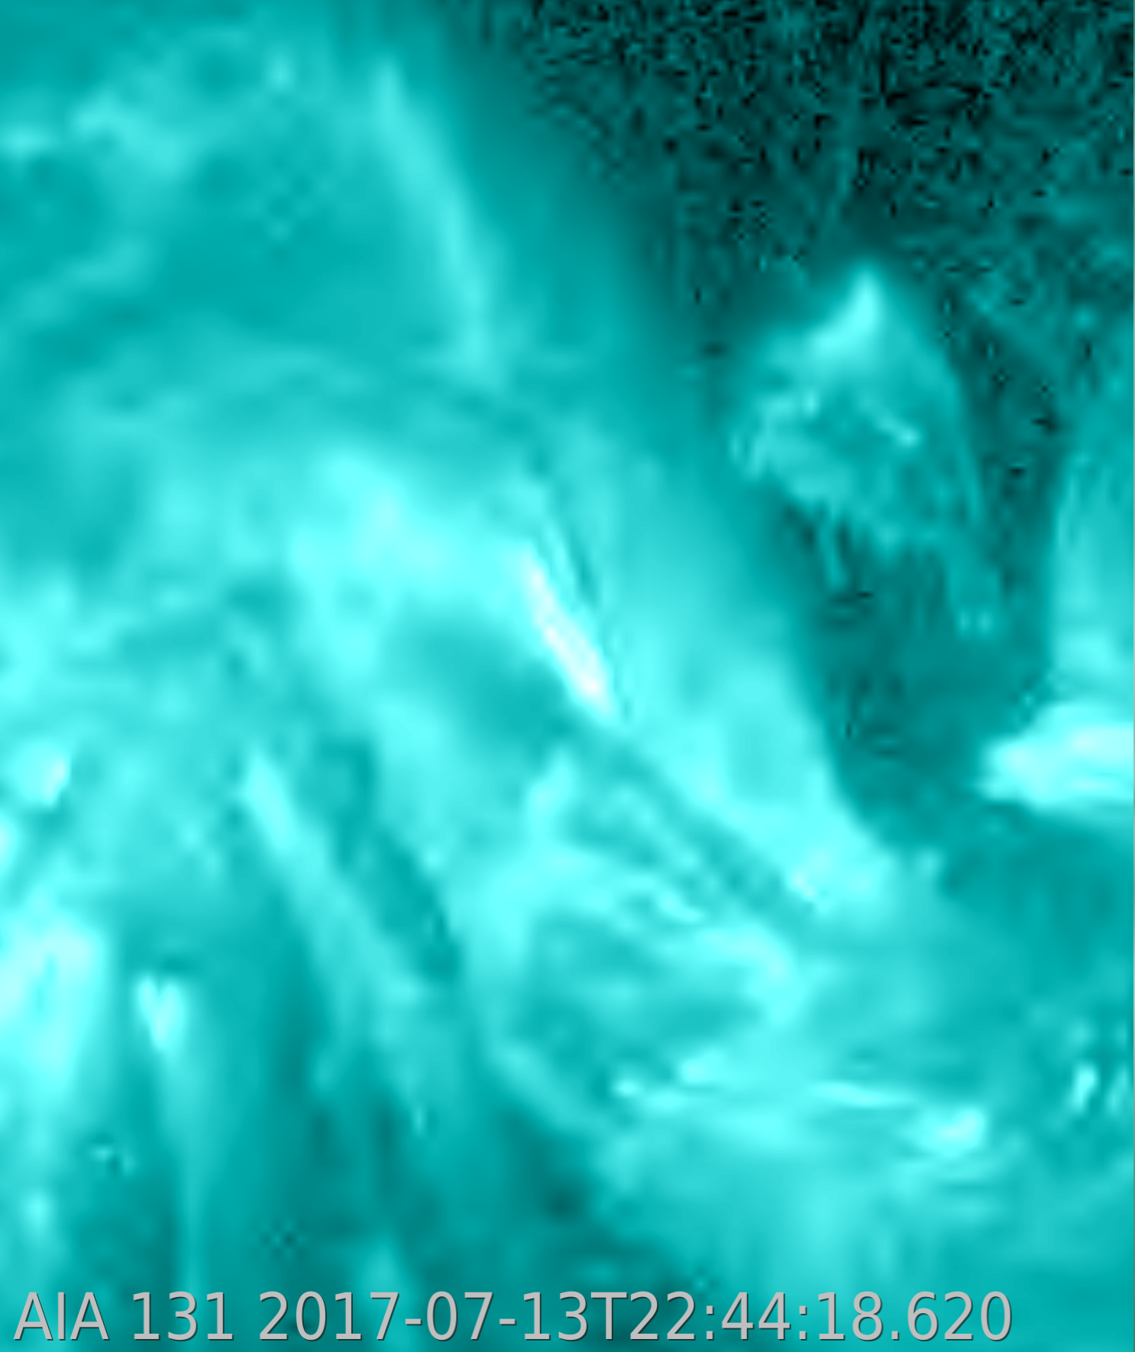
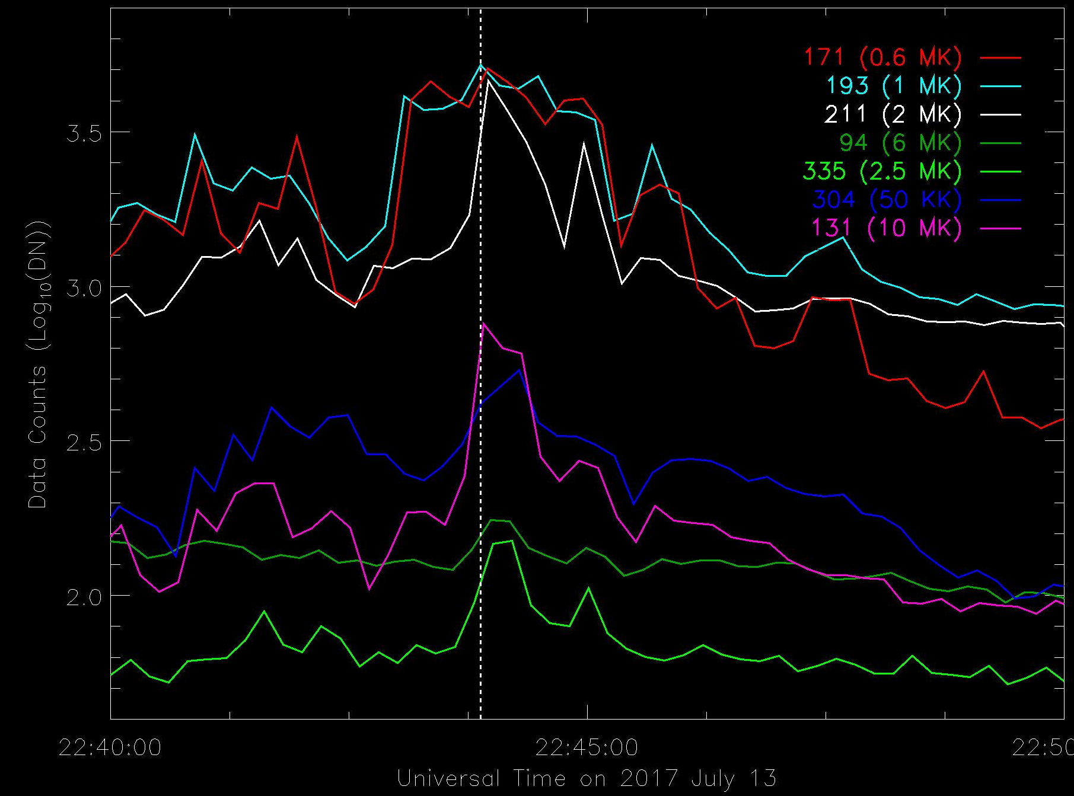
4. Temperature and Energy Partition
Analysis of Differential Emission Measure
  Temperature increased by ~9.2 MK from ∼10^{6.68} K (4.8 MK) to ∼10^{7.15} K (14 MK);
  Electron density n_{e} ≈ 1.94 × 10¹⁰ cm⁻³ before the reconnection, and n_{e} ≈ 3.94 × 10¹⁰ cm⁻³ during the reconnection;
  The thermal energy density is E_{th} ≈ 74.7 ergs cm⁻³, and E_{k} ≈ 2.06 ergs cm⁻³ (v_{i}=100 km/s);
  E_{th}/E_{k} ≈ 36 (v_{i}=100 km/s) or ≈ 9 (v_{i}=200 km/s);
  Total thermal energy W_{th} ≈ 1.3 × 10²⁷ ergs.

Slide 9
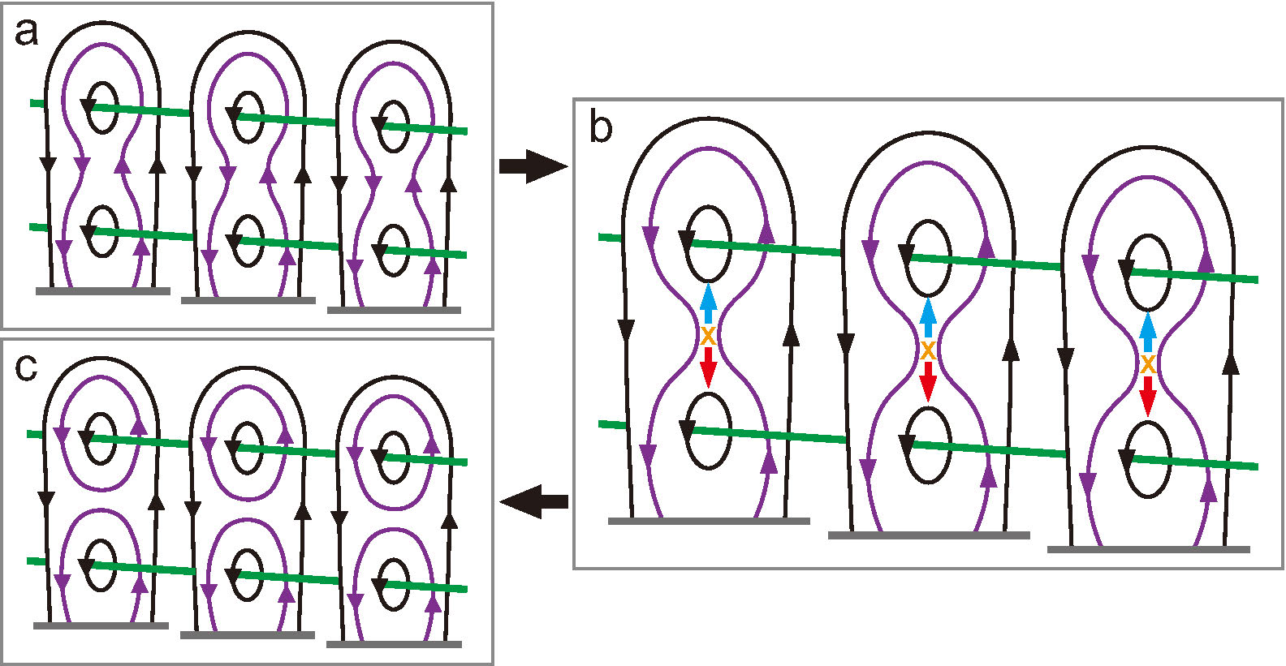
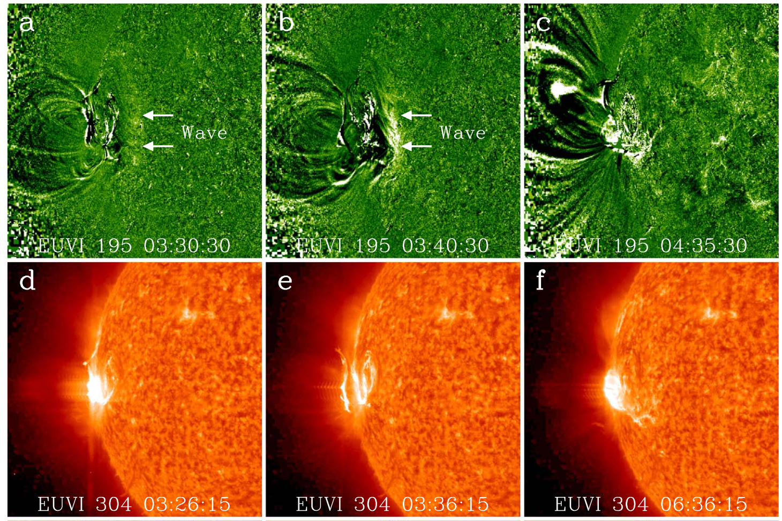
5. Conclusions and Discussions
Definite spectroscopic evidence for the splitting of a solar filament by magnetic reconnection in an extended region.
  reconnection region extends to an unprecedented length of ~14,000 km;
  bidirectional outflows are of ∼100 km/s; the upward flow may interact with the upper filament branch;
  reconnection splits the filament structure into two branches; the upper branch erupts eventually and the lower branch remained.
Temperature is up to 14 MK, and the thermal energy dominates the kinetic energy.
Implications in successive filament eruptions from the same AR.
Hu+2022 ApJL 940 L12
9 days later; Liu+2019

Slide 10
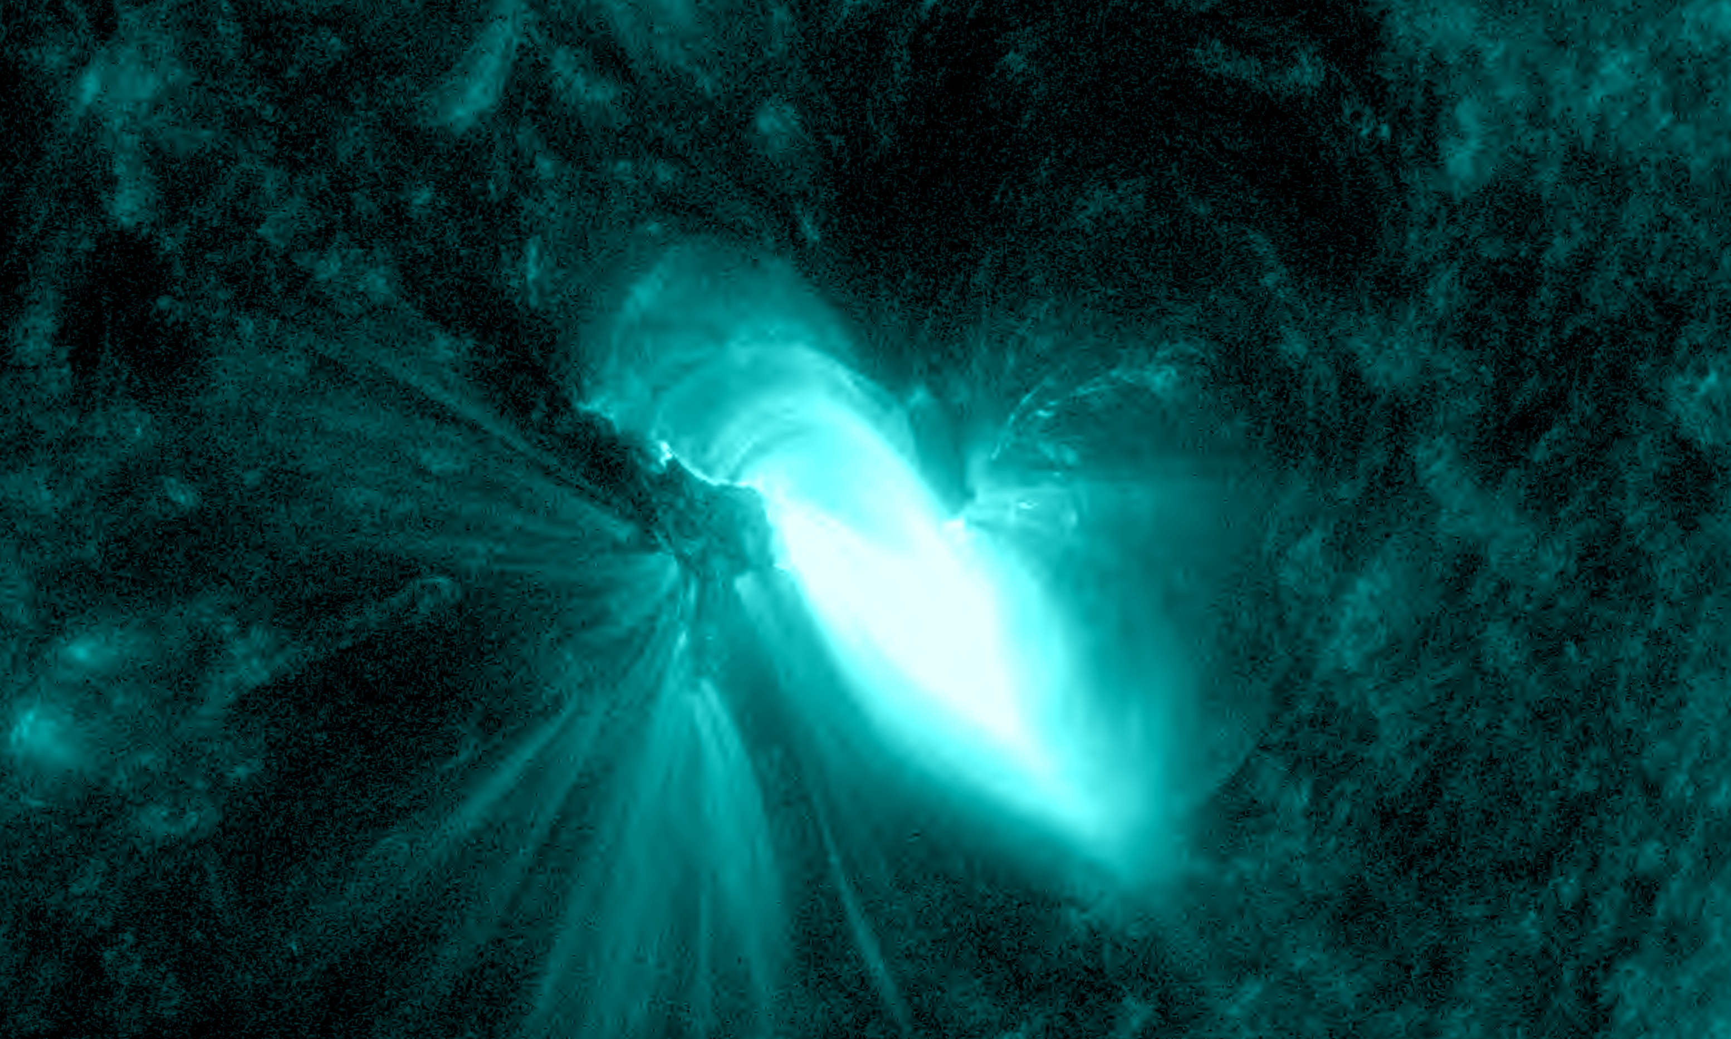
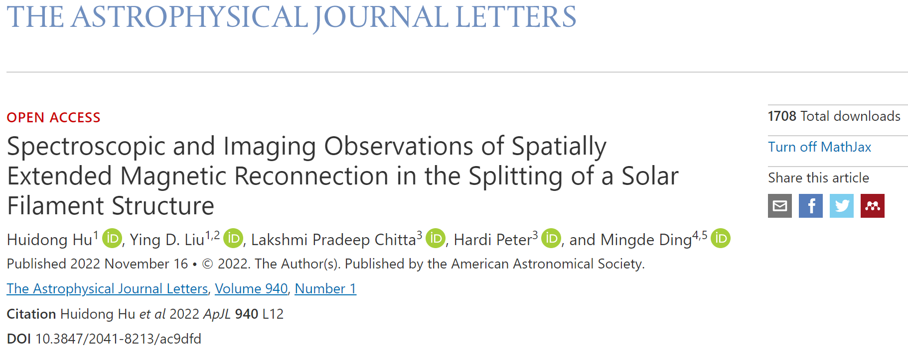
Thank you!
EGU23-1508

