Slide 1
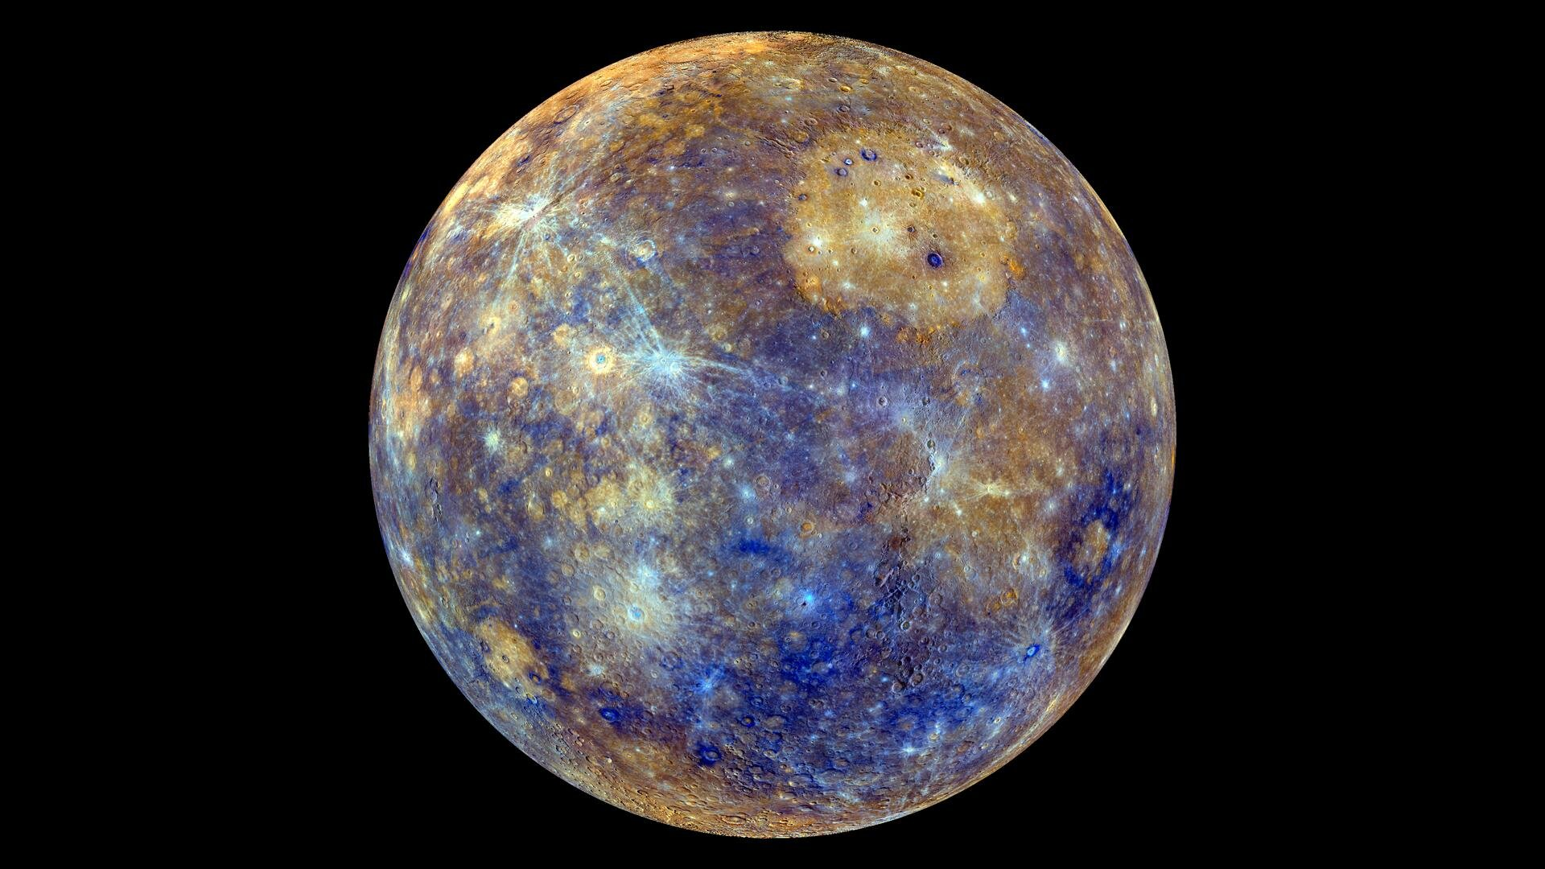
The behaviour of sulfur in reduced systems and its application to Mercury
EGU General Assembly 2023
By: Stefan Pitsch Supervisors: M. Schmidt, P. Sossi and C. Liebske
contact: stefan.pitsch@erdw.ethz.ch

Slide 2
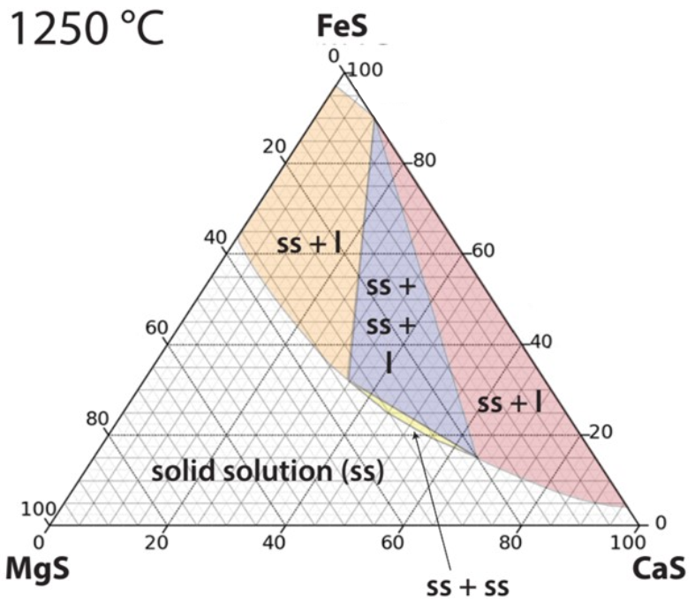
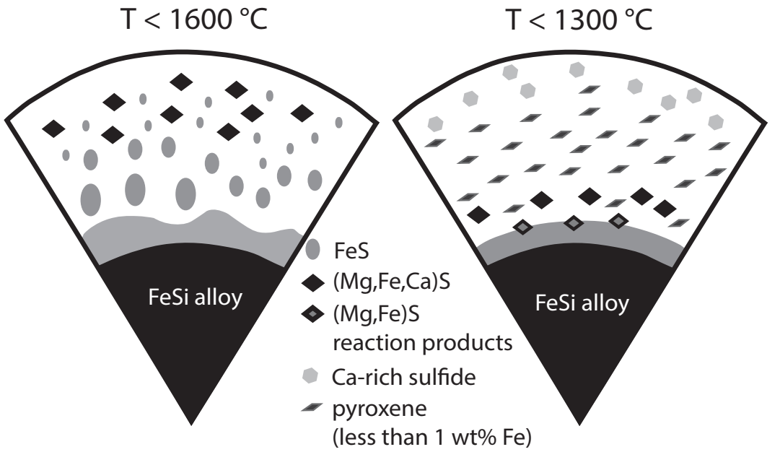
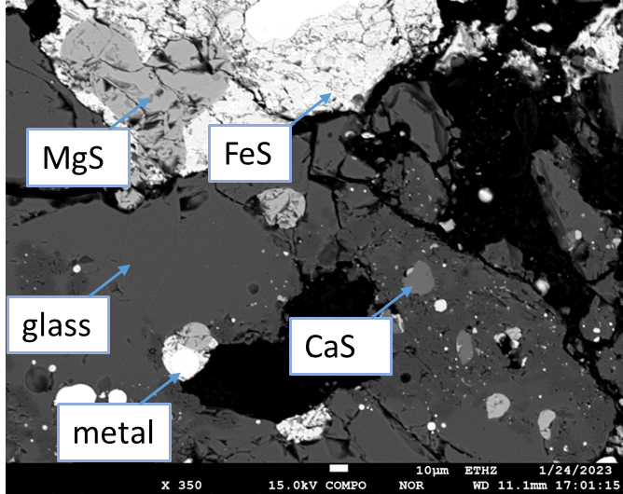
01/21
Contents:
General introduction
Experimental setup and Methodology
Results
Sulfide phase studies
Sulfides and their density relative to Hermean magmas
The sulfide-metal-silicate system (experimental study)
1250 °C
adapted from: Malavergne et al., 2014
1100
1300
1200
1200
1100
T [°C]
MgS as an indirect fO2 buffer in very reduced systems
1300
T [°C]
Conclusions
References
contact: stefan.pitsch@erdw.ethz.ch

Slide 3
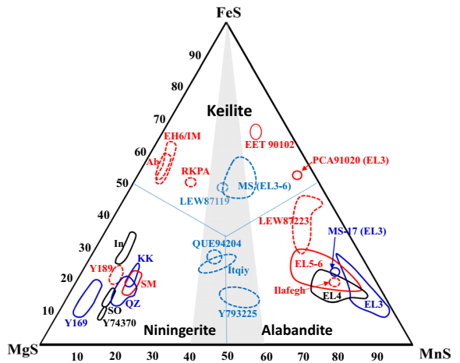
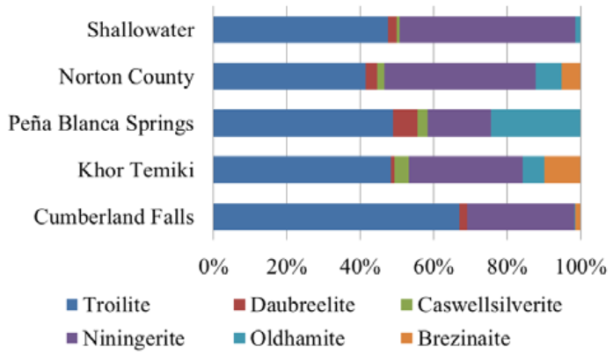
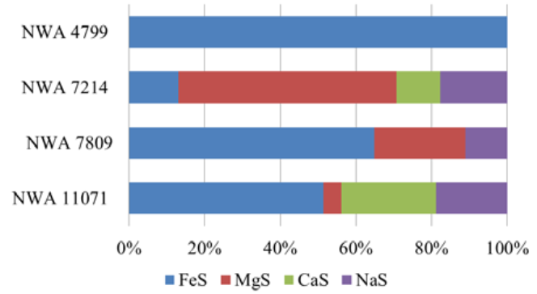
Introduction: The (Fe,Mg,Mn,Ca)S system:
02/21
EH-En
EL-En
Wilbur et al., 2018
Lin, 2022
Wilbur et al., 2018
(Fe,Mg,Mn,Ca)S solutions are abundant on very reduced bodies such as En-chondrites
Heavily recrystallized En-chondrites bear FeS dominated keilite (FeS-rich solid solutions), primary ones alabandite and niningerite.
(1) What are the equilibrium conditions of the monosulfide phases at high temperatures? So far, high-T data is either missing or flawed due to hard and instable experimental conditions at T > 1000 °C.
contact: stefan.pitsch@erdw.ethz.ch

Slide 4
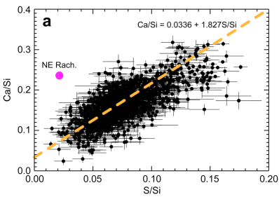
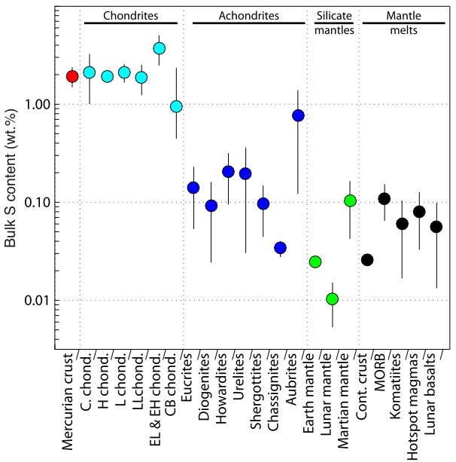
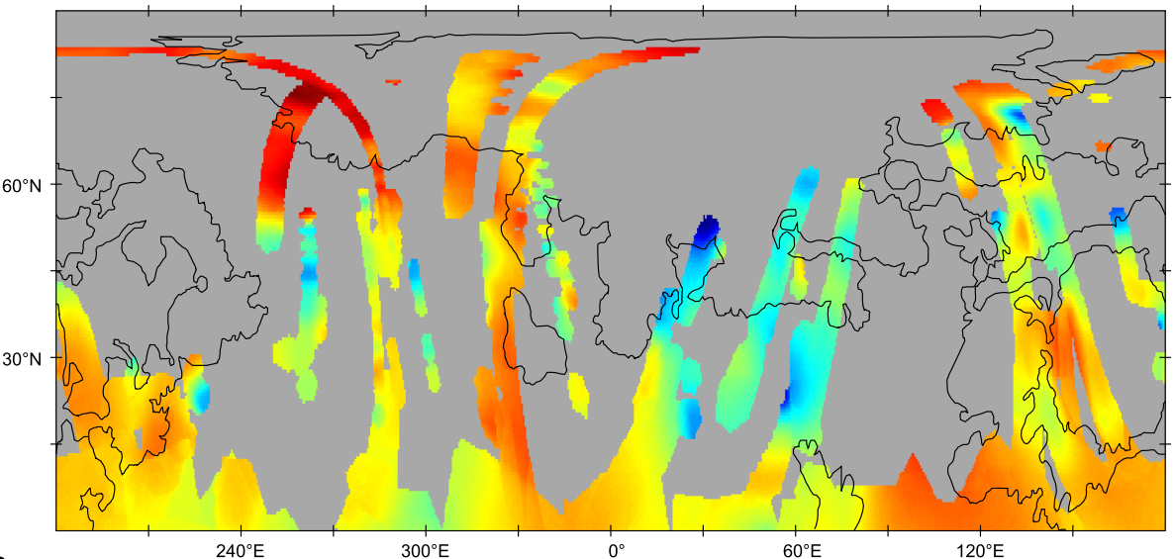
Introduction: The (Fe,Mg,Mn,Ca)S system and its relevance to Mercury:
03/21
Weider et al., 2016
Namur et al., 2016
Namur et al., 2016
On Mercury, a strong correlation of both Mg and Ca with S has been observed in MESSENGER data, possibly indicating the existence of (Fe,Mg,Mn,Ca)S phases
Mercury also shows very low f(O2) (<-3 ΔIW) and very low FeO contents (X-ray, γ and neutron spectroscopy) indicating that Fe is either present in metallic or sulfidic phases.
Mercury is connected to exeptionally high S-surface contents (~3 wt%) for a differenciated planetary body.
contact: stefan.pitsch@erdw.ethz.ch

Slide 5
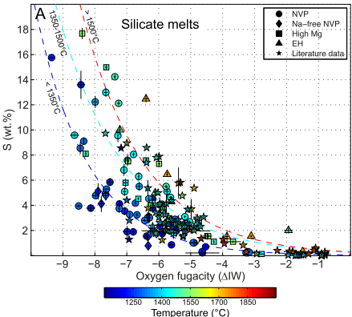
Introduction: monosulfides and their interaction with silicate (metal-bearing) melts on Mercury
04/21
Controlling factors of S-solubility limits in silicate melt (SCSS):
f(O2)
T
FeO content
Controlling factors of sulfide formation:
silicate melt composition
f(S2)
Namur et al., 2016
adapted from: Malavergne et al., 2014
maturation of magma ocean
(2) Are low-density phases (MgS and CaS) responsible for the S-accumulation on the surface? What happens to the monosulfide system during the magma ocean stage?
(3) How does the formation of (Fe,Mg,Mn,Ca)S change with differing parameters in silicate melts and what is their influence on the whole system?
contact: stefan.pitsch@erdw.ethz.ch

Slide 6
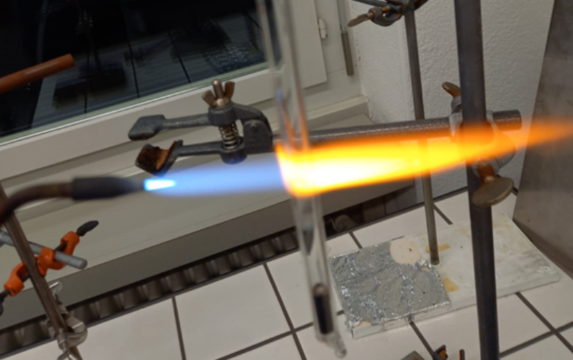
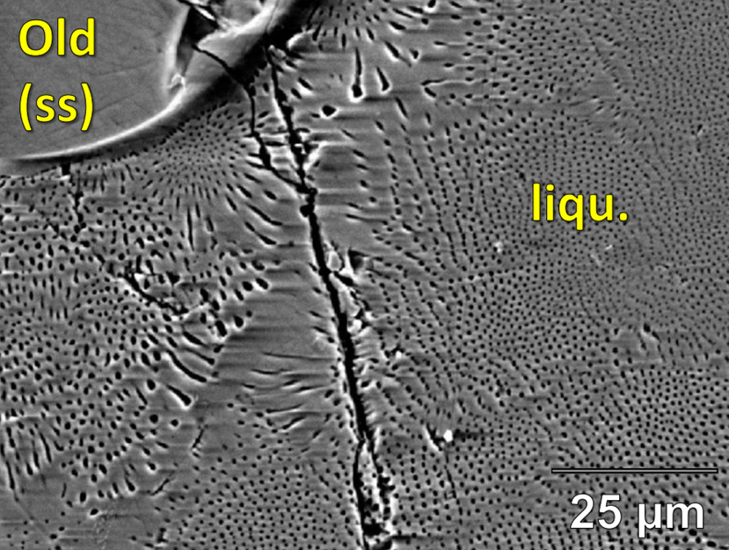
Experimental setup
05/21
C-capsule to mimick low f($O_{2}$)
Charges are dryed, evacuated (${10}^{−5}$ atm) and sealed in silica glass tubes
Samples are heated in box furnace and drop-quenched into water
Sample-polishing using oil-based polishing solution due to extreme hygroscopic behaviour of (Mg,Ca)S
Still high material loss of especially CaS exolutions in the liquid
Texture and composition determined via EDS (SEM) (binary sulfide systems)
Phase diagrams are constructed by using mainly textural bracketing
EPMA analysis for mixed-phase experiments (metal, sulfide, silicate)
contact: stefan.pitsch@erdw.ethz.ch

Slide 7
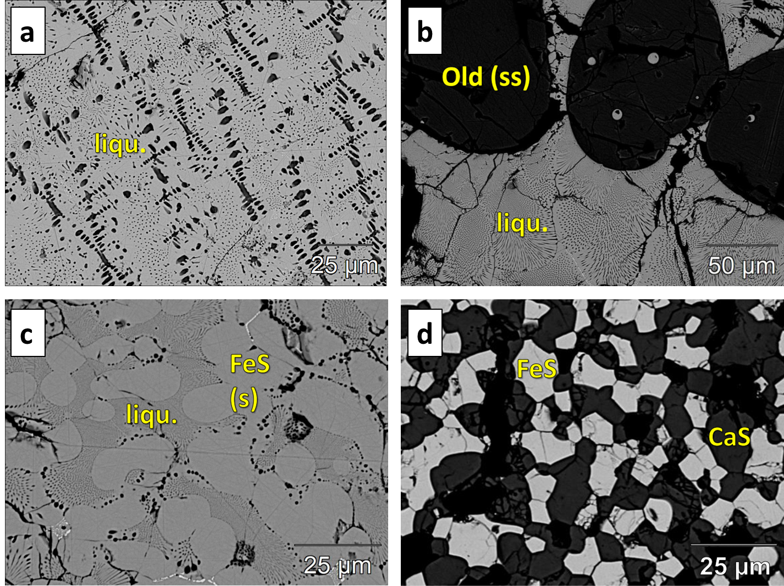
(1) CaS-FeS phase relations
06/21
Textural bracketing and phase relation analysis combined with EDS analysis
Eutectic at 1063 °C ± 3 °C at 7.5 ± 1 mol% CaS
Older study (Heumann (1942)) determined eutectic at 1100°C at 15 mol% CaS with significant experimental problems (interaction with $O_{2}$, S-loss etc.)
liquid
solid solution + liquid
solid + liquid
solid + solid
contact: stefan.pitsch@erdw.ethz.ch

Slide 8
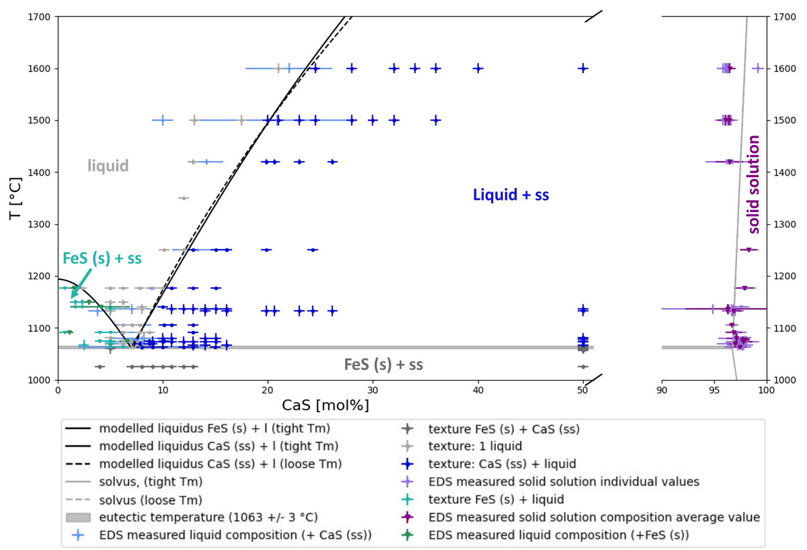
(1) CaS-FeS phase diagram
07/21
Textural bracketing and phase relation analysis combined with EDS analysis
Eutectic at 1063 °C ± 3 °C at 7.5 ± 1 mol% CaS
Older study (Heumann (1942)) determined eutectic at 1100°C at 15 mol% CaS with significant experimental problems (interaction with $O_{2}$, S-loss etc.)
2 models (fixed melting T and open melting T) for verification purposes yield generally good fit
contact: stefan.pitsch@erdw.ethz.ch

Slide 9
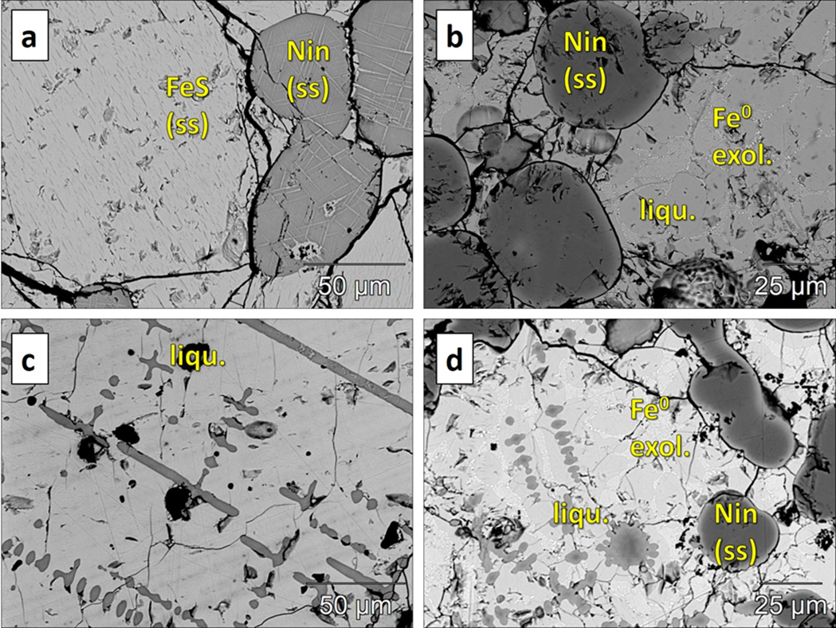
(1) MgS-FeS phase relations
08/21
Textural bracketing and phase relation analysis combined with EDS analysis
Eutectic at 1180 °C ± 10 °C at 0.75 ± 0.5 mol% MgS
Older study (Andreev (2006)) determined eutectic at 1197 °C at 2 mol% MgS but does not specify on FeS stoichiometry or crystal structure (troilite/pyrrhotite). They used a slight S-excess rel. to FeS stoichiometry
2 solid solutions
ss + l
liquid
ss + liquid
How to explain the difference to Andreev et al. (2006)?
contact: stefan.pitsch@erdw.ethz.ch

Slide 10
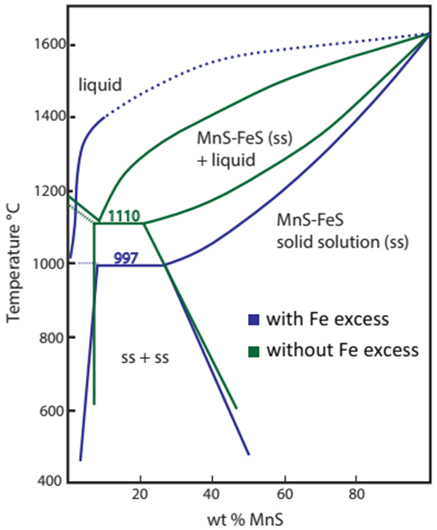
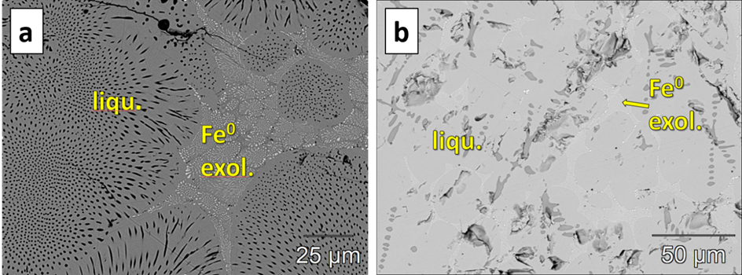
(1) Troilite vs. pyrrhotite
09/21
liquid
solid solution + liquid
Phase studies in the MnS-FeS system indicate a stabilization of troilite in systems with Fe excess) in favour of Fe-deficient pyrrhotite
Metallic Fe forms as quench globules in both CaS and MgS saturated melt.
Metallic Fe precludes CaS to dissolve in FeS liquid associated with Fe globules
adapted from: Mann and Van Vlack., (1976)
Pyrrhotite causes dramatically different solubilities of MnS and structurally similar CaS and MgS and melting behaviour. Troilite was studied in this study.
contact: stefan.pitsch@erdw.ethz.ch

Slide 11
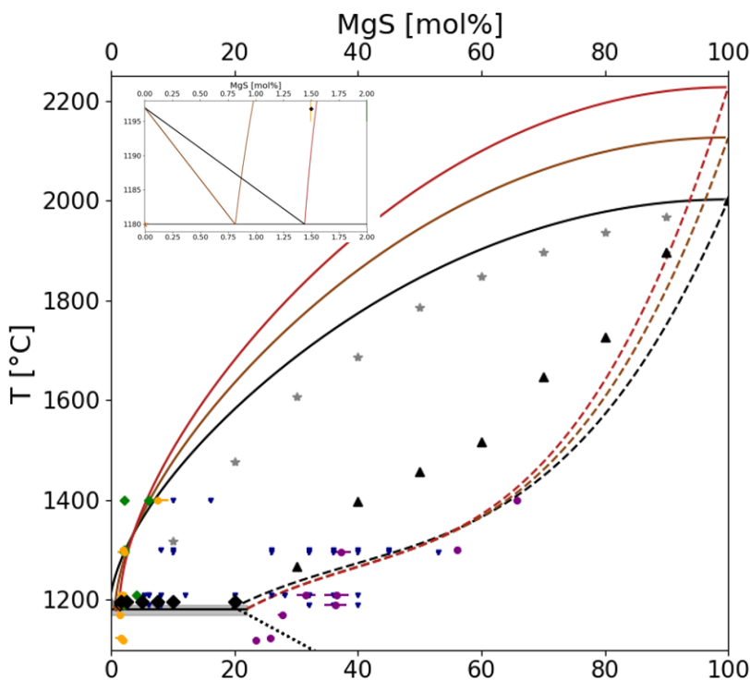
(1) MgS-FeS phase diagram
10/21
Textural bracketing and phase relation analysis combined with EDS analysis
Eutectic at 1180 °C ± 10 °C at 0.75 ± 0.5 mol% MgS
Older study (Andreev (2006)) determined eutectic at 1197 °C at 2 mol% MgS but does not specify on FeS stoichiometry or crystal structure (troilite/pyrrhotite) but used a slight S-excess rel. to FeS stoichiometry
liquid
ss + liquid
The difference between the two studies of the binaries can be explained by MgS-troilite phase relations for this, and MgS-pyrrhotite phase relations for Andreev et al. (2006).
solid solution
ss + ss
contact: stefan.pitsch@erdw.ethz.ch
Andreev, 2006

Slide 12
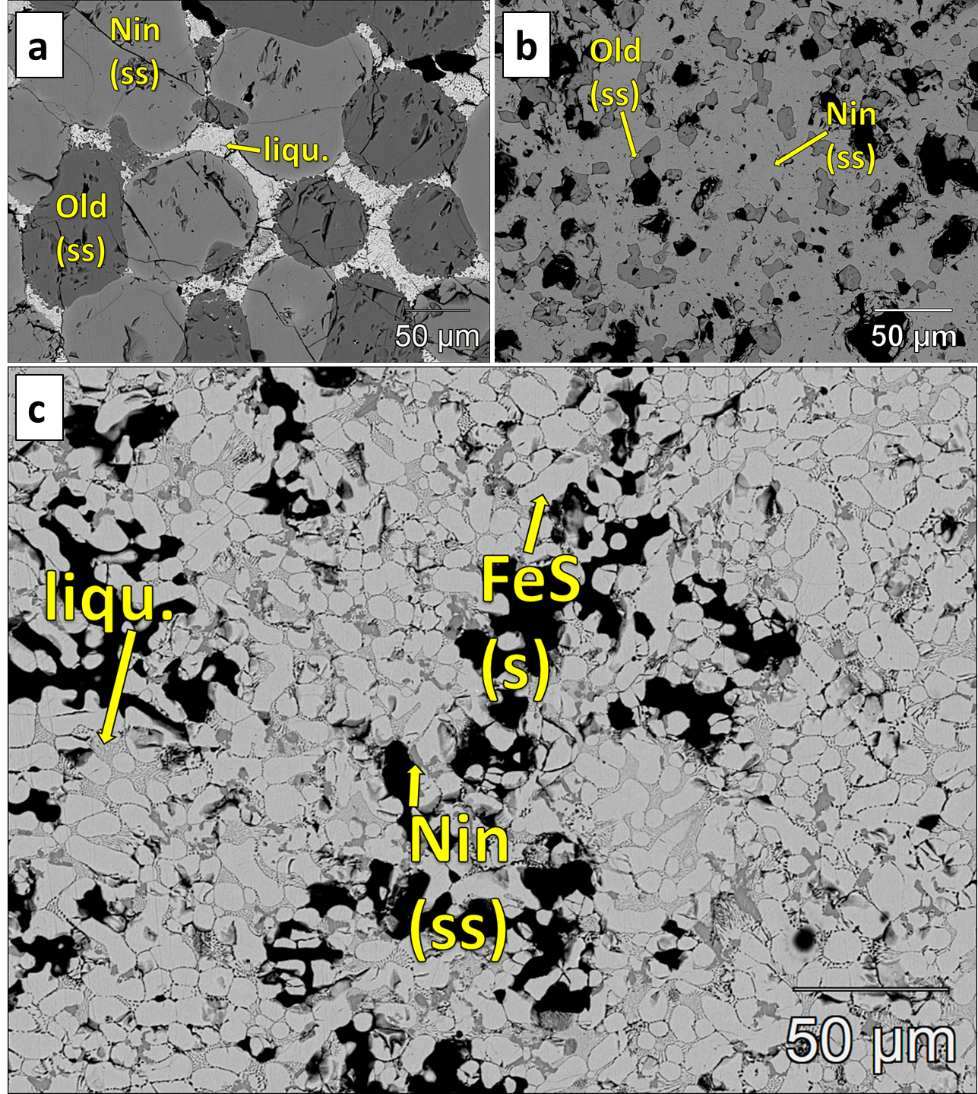
(1) The ternary phase relations
11/21
05/13
Ternary data for the MgS-FeS-CaS system is unavaillable at T > 1000°C
T range covered: 1050 – 1360 °C
Pressure: 1 atm
First liquid appearing at < 1100 °C (pre-determined eutectic of CaS-FeS system: 1063°C)
3 phase field up to 1300 °C present (ss + ss + liquid)
Very pure oldhamite phases (CaS ss)
Very variable niningerite compositions (MgS ss)
contact: stefan.pitsch@erdw.ethz.ch

Slide 13
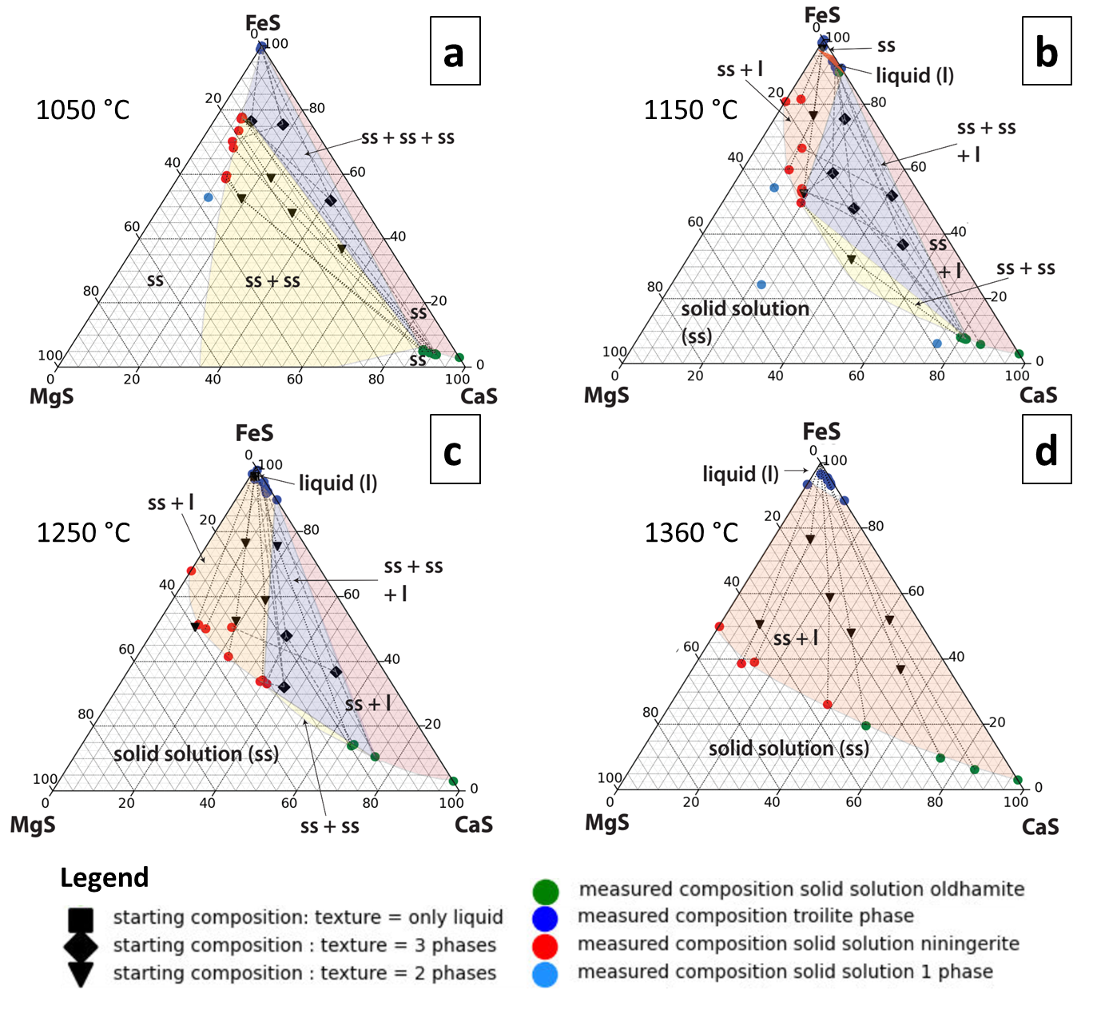
(1) The ternary phase relations
12/21
1050 °C
1150 °C
1250 °C
1360 °C
ss + ss + l
ss + ss
s + ss + l
contact: stefan.pitsch@erdw.ethz.ch

Slide 14
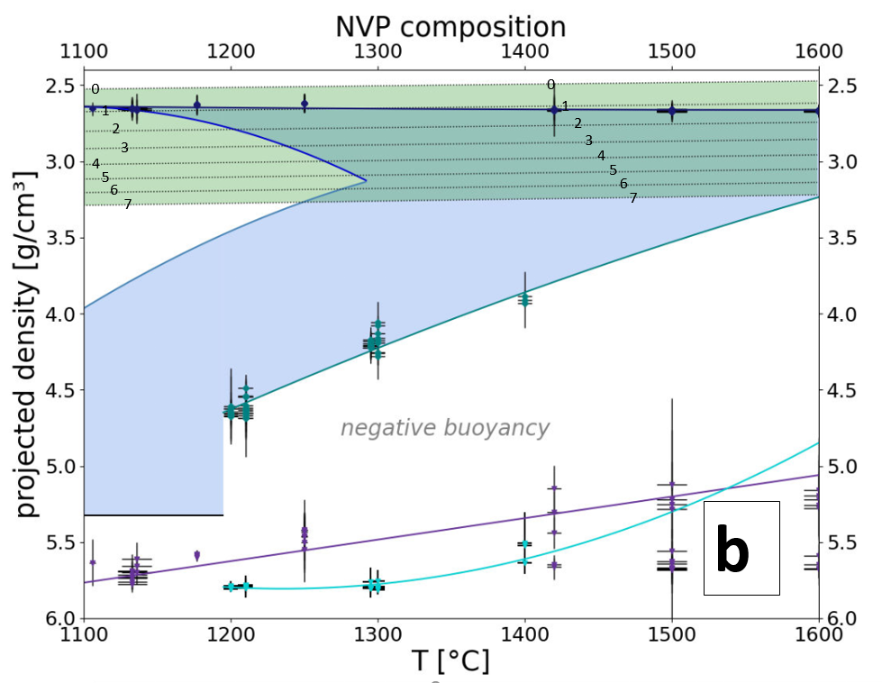
(2) Density implications - NVP
13/21
NVP $≈$ trachy-andecitic comp.
CaS (ss) stable close to surface
MgS (ss) and liquids too dense → sink to core
2 possible CaS (ss) crystallization phases
1050 °C
1250 °C
contact: stefan.pitsch@erdw.ethz.ch

Slide 15
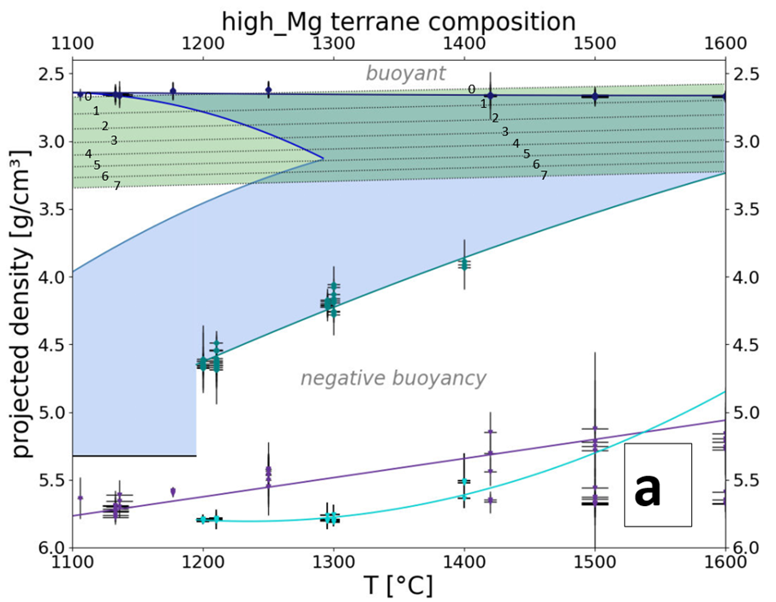
(2) Density implications – high-Mg terrane
14/21
High-Mg $≈$ komatiitic basalt comp.
CaS (ss) stable close to surface
MgS (ss) and liquids too dense → sink to core
2 possible CaS (ss) crystallization phases
1050 °C
1250 °C
contact: stefan.pitsch@erdw.ethz.ch

Slide 16
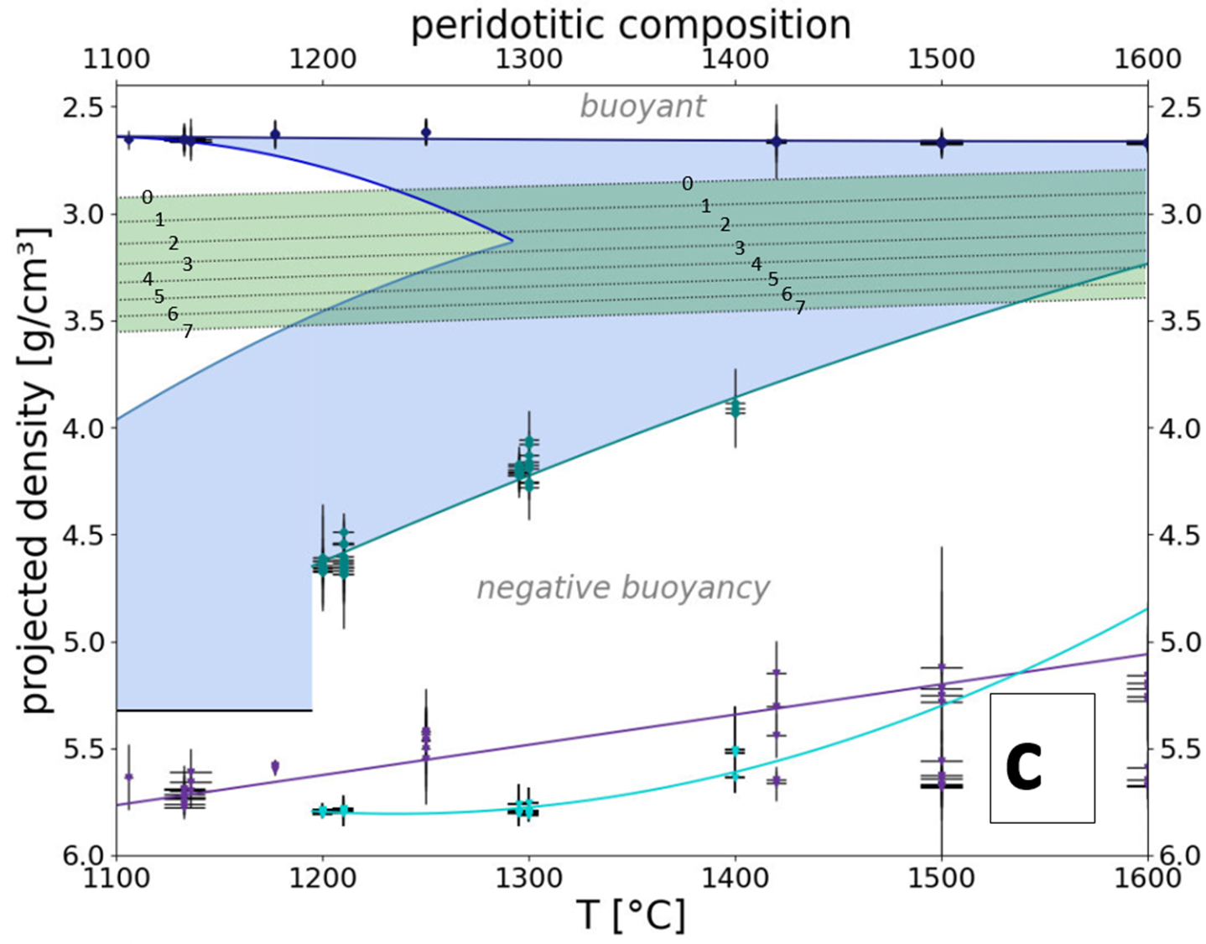
(2) Density implications – KLB1
15/21
KLB1 $≈$ peridotitic comp.
CaS (ss) stable close to surface
MgS (ss) and liquids too dense → sink to core
2 possible CaS (ss) crystallization phases
1050 °C
1250 °C
contact: stefan.pitsch@erdw.ethz.ch

Slide 17
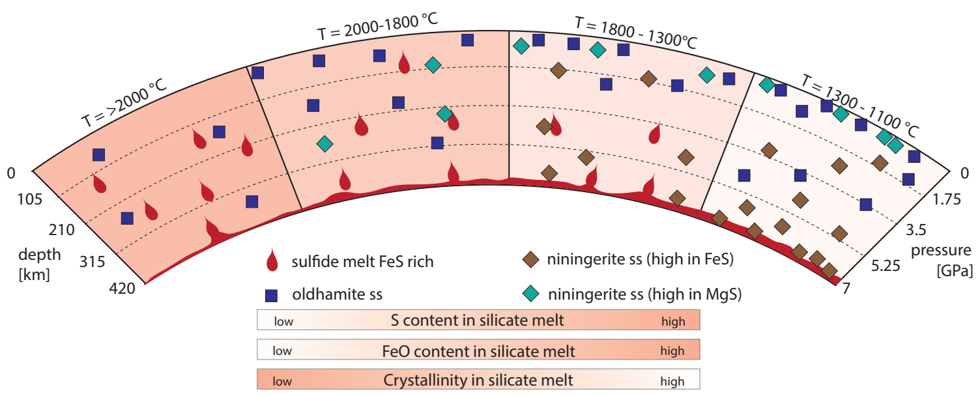
(2) Density – implications for Hermean magma ocean dynamics
16/21
CaS (ss) stable close to surface
Decreasing S content with cooling magma ocean
MgS (ss) and liquids are dense → sink to core
Decreasing FeO content with cooling magma ocean
2 possible CaS (ss) crystallization phases due to 3-phase field in ternary phase diagram at T<1300°C
Remnants of very high T niningerite solid solutrions at the surface might be possible
contact: stefan.pitsch@erdw.ethz.ch

Slide 18
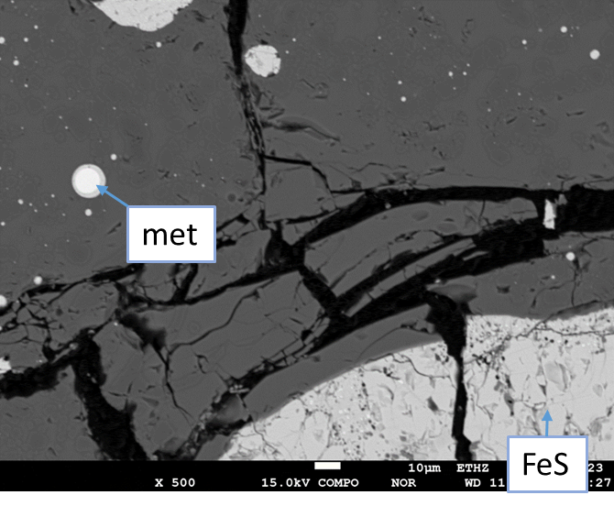
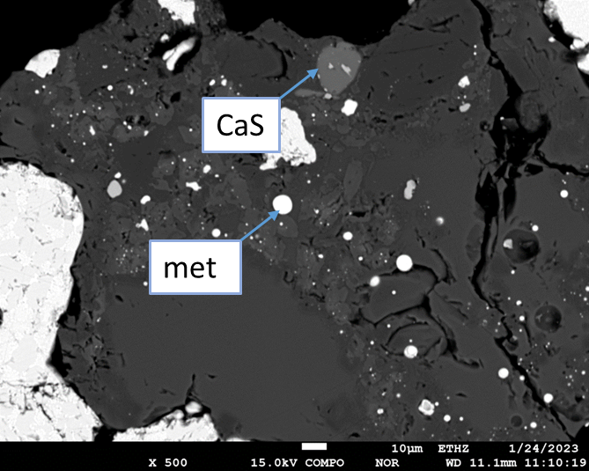
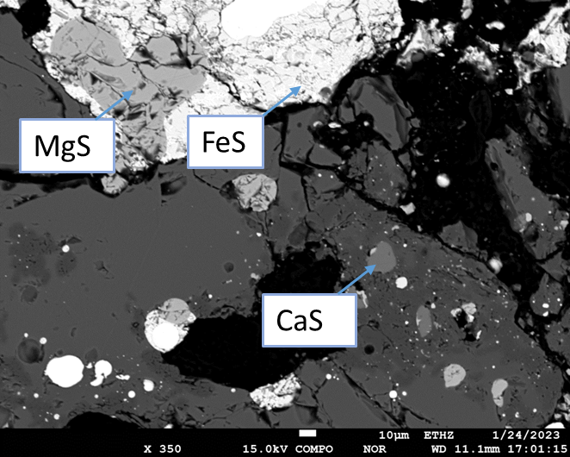
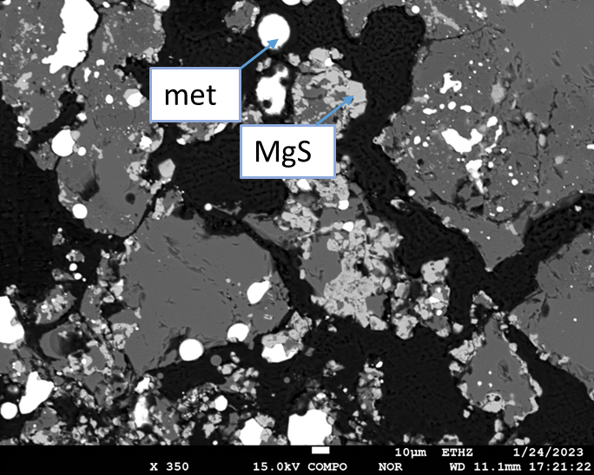
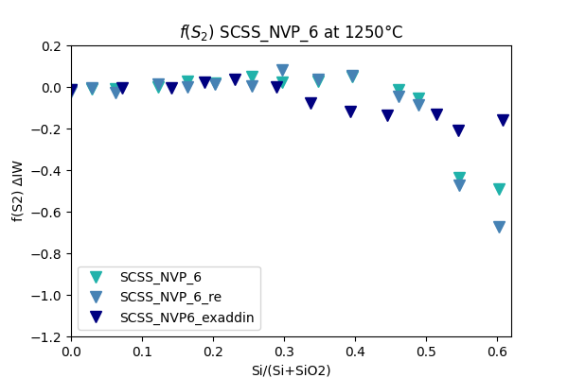
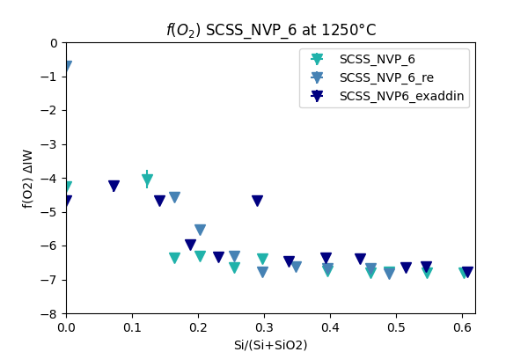
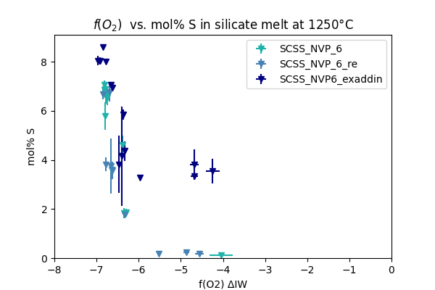
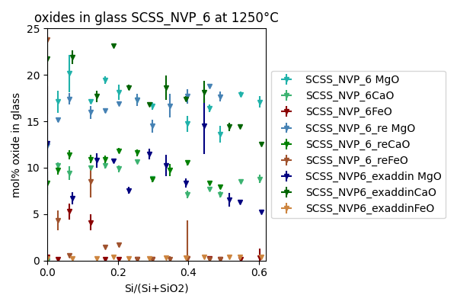
(3) MgS (ss) and CaS (ss) within silicate melt – NVP
17/21
f(O2): -4 $∆$IW f(S2): 0 $∆$ITr
More reducing conditions (higher Si/SiO2 ratio in otherwise constant starting mixture)
f(O2):-7 $∆$IW f(S2) : -1 $∆$ITr
FeS
MgS
+
FeS
MgS + FeS
FeS
MgS
+
FeS
FeS
contact: stefan.pitsch@erdw.ethz.ch

Slide 19
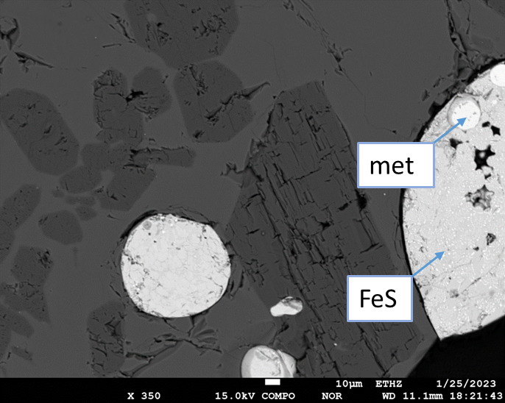
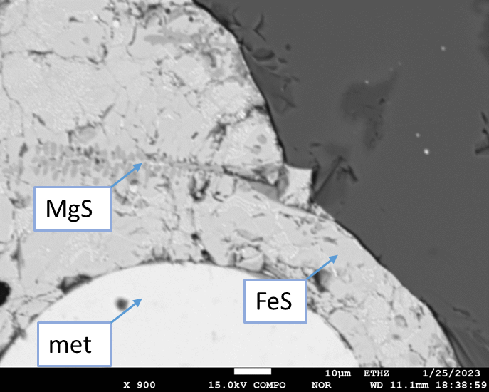
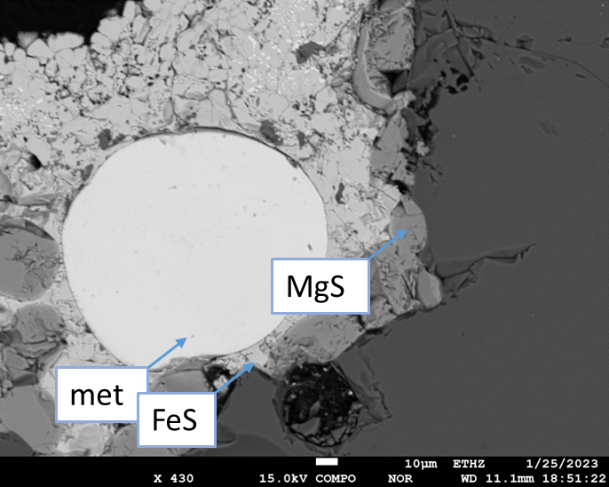
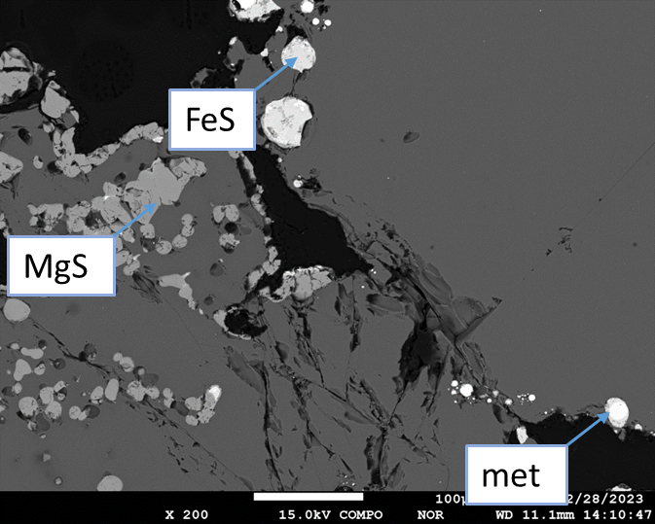
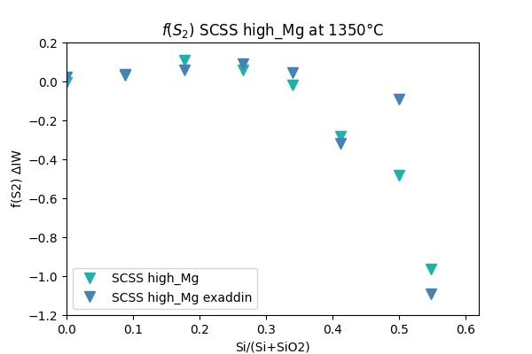
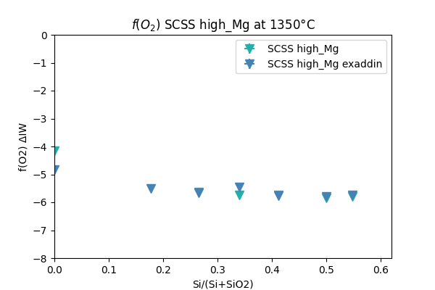
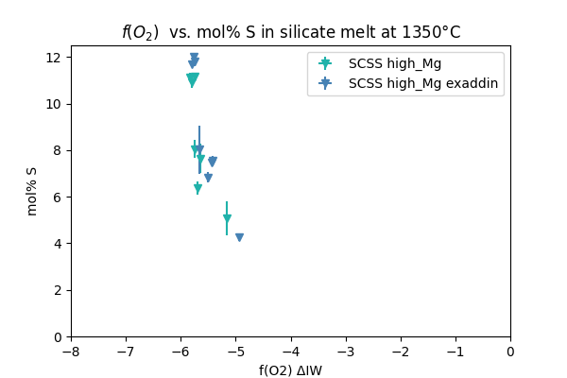
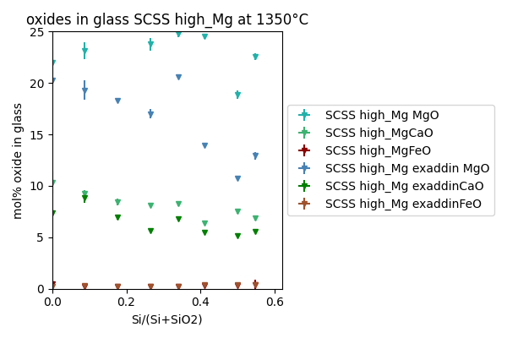
(3) MgS (ss) and CaS (ss) within silicate melt – high-Mg
18/21
f(O2): -4 $∆$IW f(S2): 0 $∆$ITr
More reducing conditions (higher Si/SiO2 ratio in otherwise constant starting mixture)
f(O2):-7 $∆$IW f(S2) : -1 $∆$ITr
MgS
MgS
+
FeS
MgS + FeS
FeS
MgS
+
FeS
MgS
FeS
MgS
FeS
contact: stefan.pitsch@erdw.ethz.ch

Slide 20
(3) MgS as an indirect f($O_{2}$) buffer?
19/21
First observations indicate that especially MgS is the controlling component for the interplay f($O_{2}$) and f($S_{2}$).
Niningerite solid solution starts to appear at f($O_{2}$) < -5 ΔIW.
MgS formation seems to me positively affected by higher T, less mature magmas and low concentrations of ${Na}_{2}O and K_{2}O$.
$$S_{2}+MgO+CaO+2FeS \underset{→}{↑T, ↓{Na}_{2}O,{↓K}_{2}O,{↓SiO}_{2}}O_{2}+MgS+CaS+2{Fe}^{0}$$
contact: stefan.pitsch@erdw.ethz.ch

Slide 21
Conclusions:
20/21
The ternary system MgS-CaS-FeS has been determined up to 1360°C.
The system produces one stable solid solution above 1300 °C and shows an expanding 3-phase field with lower temperatures, where two solid solutions are coexisting: one CaS dominated and one that is high in MgS and FeS
CaS ss are prone to accumulate on the surface due to their low density.
At highly reducing conditions, predominantly MgS solid solutions form in S-oversaturated silicate melts. CaS may form earlier but does not reach high quantities.
f(O2) is indirectly buffered by MgS replacing FeS and stabilizing metallic iron. f(S2) is relatively constant as long as FeS is not completely replaced by MgS.
contact: stefan.pitsch@erdw.ethz.ch

Slide 22
References:
21/21
Andreev, O., Solov’eva, A., and Burkhanova, T., 2006, MgS-FeS phase diagram: Russian journal of inorganic chemistry, v. 51, no. 11, p. 1826-1828.
Heumann, T., 1942, Die Löslichkeit von Eisensulfid in Kalziumsulfid bei der eutektischen Temperatur: Archiv für das Eisenhüttenwesen, v. 15, no. 12, p. 557-558.
Lin, Y., 2022, Enstatite chondrites: condensation and metamorphism under extremely reducing conditions and contributions to the Earth: Progress in Earth and Planetary Science, v. 9, no. 1, p. 1-16.
Malavergne, V., Cordier, P., Righter, K., Brunet, F., Zanda, B., Addad, A., Smith, T., Bureau, H., Surblé, S., and Raepsaet, C., 2014, How Mercury can be the most reduced terrestrial planet and still store iron in its mantle: Earth and Planetary Science Letters, v. 394, p. 186-197.
Mann, G., and Van Vlack, L., 1976, FeS-MnS phase relationships in the presence of excess iron: Metallurgical transactions B, v. 7, no. 3, p. 469-475.
Namur, O., Charlier, B., Holtz, F., Cartier, C., and McCammon, C., 2016, Sulfur solubility in reduced mafic silicate melts: Implications for the speciation and distribution of sulfur on Mercury: Earth and Planetary Science Letters, v. 448, p. 102-114.
Skinner, B. J., and Luce, F. D., 1971, Solid solutions of the type (Ca, Mg, Mn, Fe) S and their use as geothermometers for the enstatite chondrites: American Mineralogist: Journal of Earth and Planetary Materials, v. 56, no. 7-8, p. 1269-1296.
Weider, S. Z., Nittler, L. R., Murchie, S. L., Peplowski, P. N., McCoy, T. J., Kerber, L., Klimczak, C., Ernst, C. M., Goudge, T. A., and Starr, R. D., 2016, Evidence from MESSENGER for sulfur‐and carbon‐driven explosive volcanism on Mercury: Geophysical Research Letters, v. 43, no. 8, p. 3653-3661.
Wilbur, Z., Udry, A., Mccubbin, F. M., McCubbin, F., Combs, L., Rahib, R., McCoy, C., and McCoy, T., Aubrite and Impact Melt Enstatite Chondrite Meteorites as Potential Analogs to Mercury, in Proceedings Annual Lunar and Planetary Science Conference (LPSC) 20182018.
contact: stefan.pitsch@erdw.ethz.ch

Slide 23
Thank you very much!
contact: stefan.pitsch@erdw.ethz.ch

