Slide 1
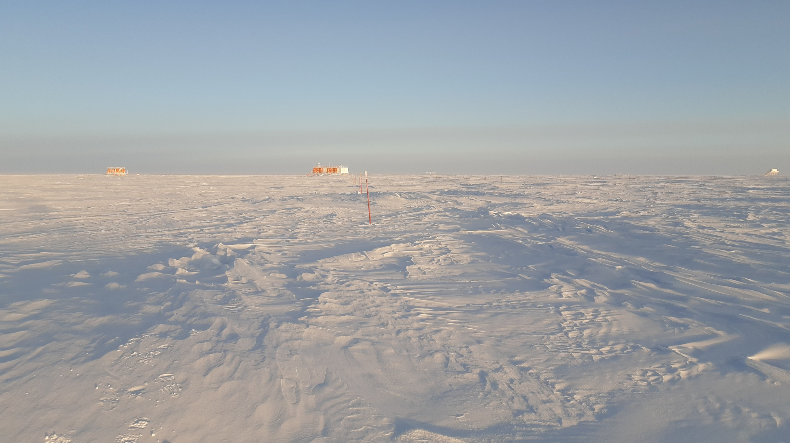
Estimation of moisture fluxes in East Antarctica and their impact on the isotopic composition of the snow surface
Inès Ollivier
with H.C. Steen-Larsen, B. Stenni, M. Casado and A. Landais
University of Bergen, Bjerknes Center for Climate Research & LSCE Paris-Saclay
Ines.ollivier@uib.no
EGU General Assembly – Vienna, April 2023
Session AS2.2 – Surface Exchange Processes in the Polar Regions

Slide 2
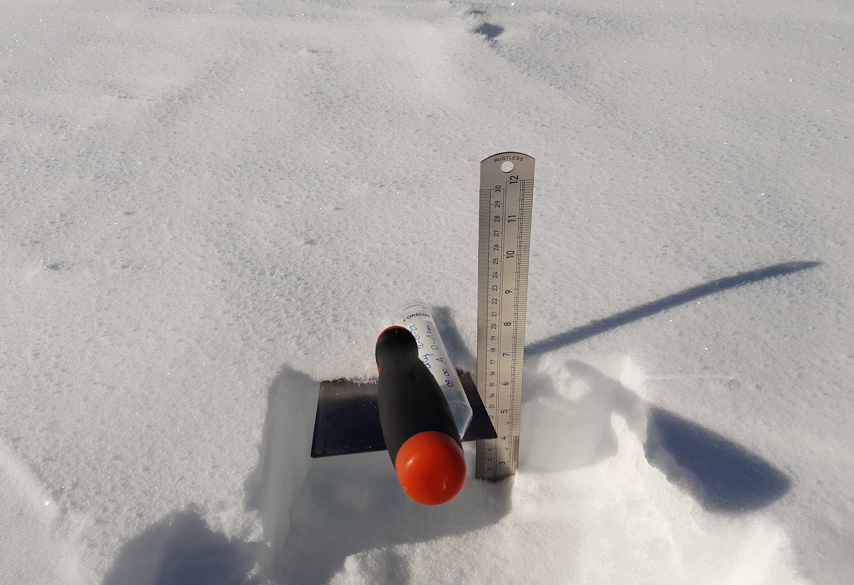
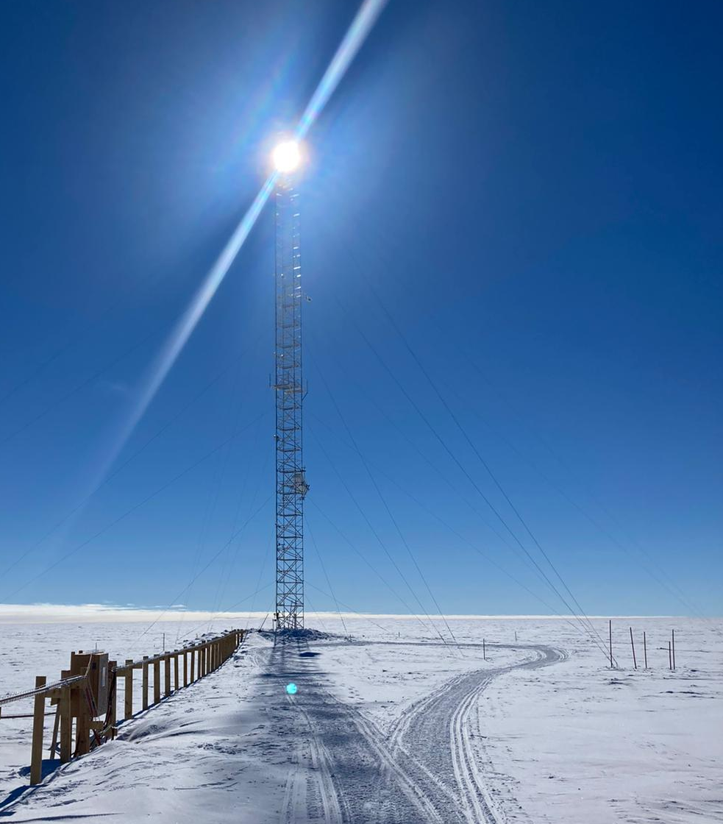
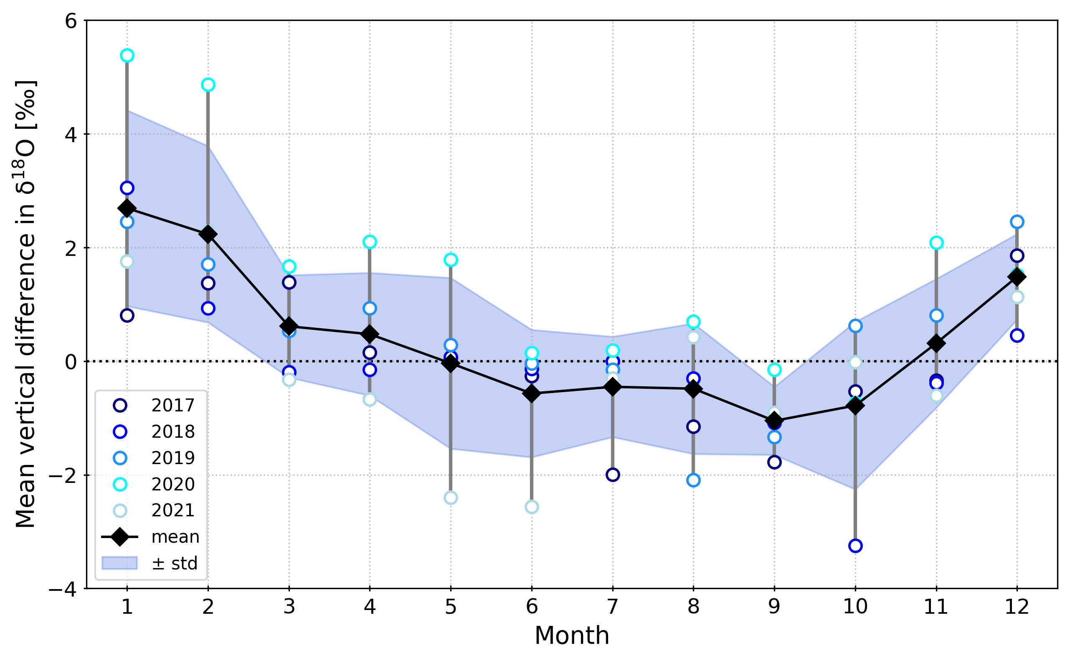
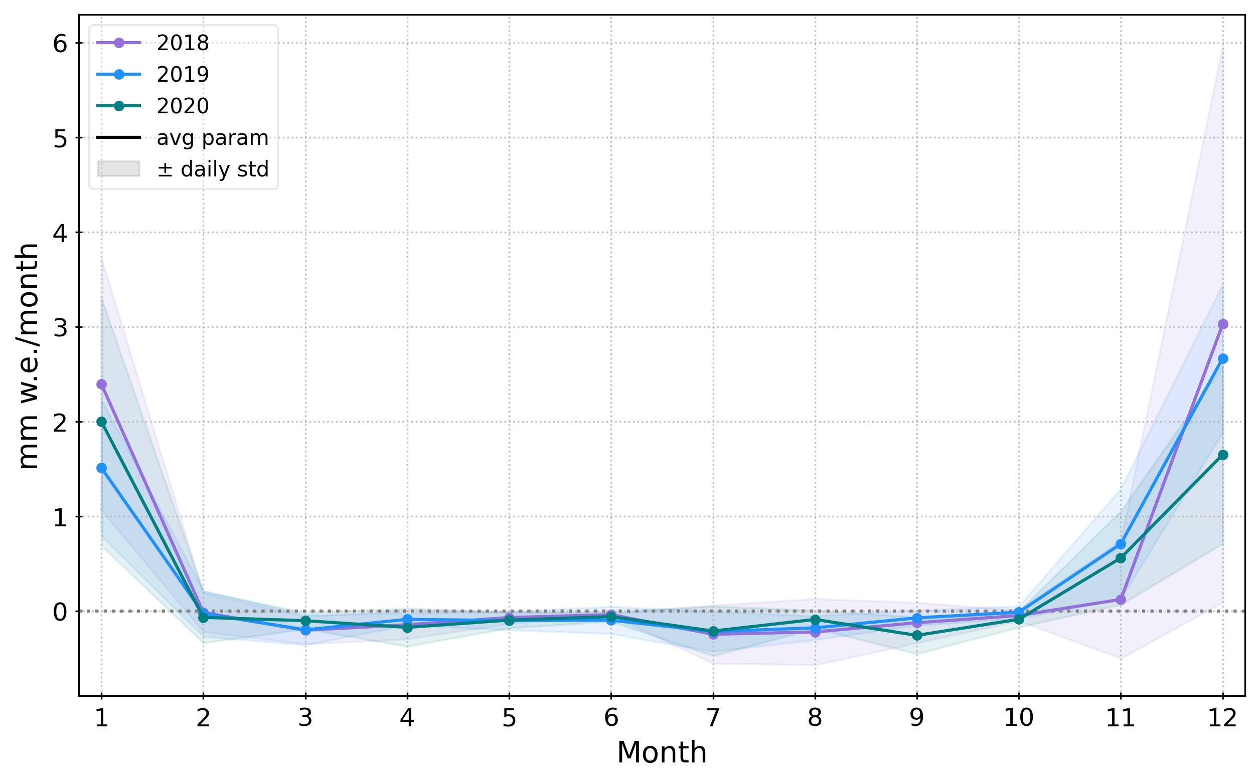
Investigating the role of vapor fluxes on the isotopic composition of the surface snow at Dome C, East Antarctica
0-2 cm
2-5 cm
Bi-weekly snow samples = seasonal variability of isotopic composition
In situ measurements & estimation method =
3 years of latent heat flux
Summer 𝛿¹⁸O enrichment of the snow surface
Sublimation = summer signal
Vapor fluxes contribution to summer snow isotopic composition at Dome C?
To the abstract

Slide 3
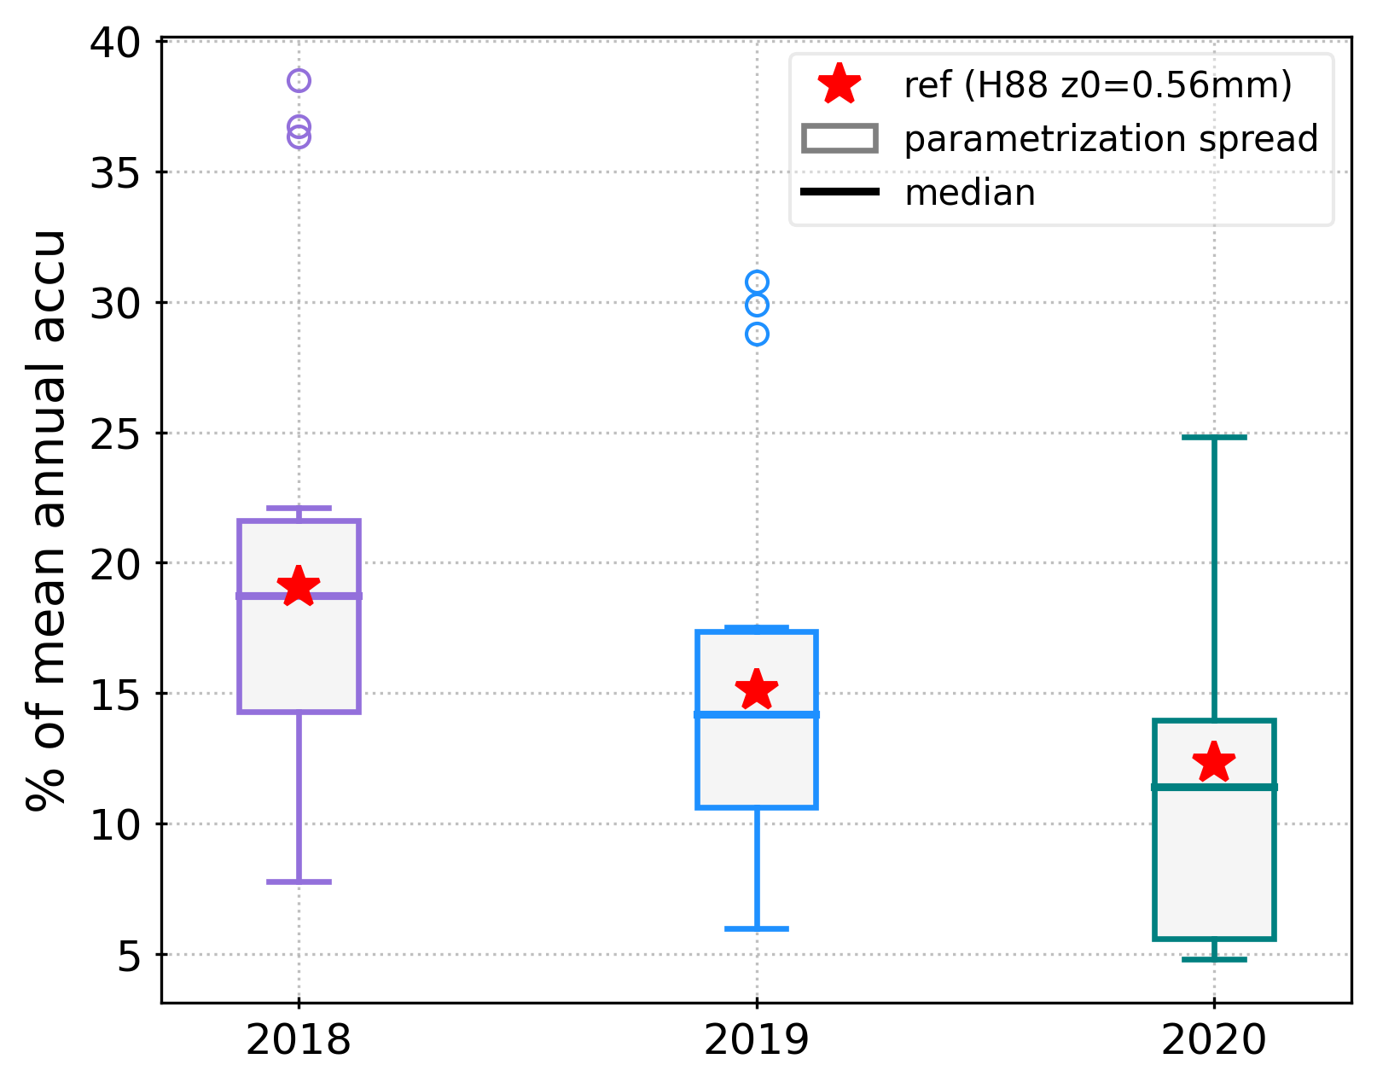
Outline
Three years of surface latent heat flux at Dome C, estimated from meteorological parameters
Summer signal of the latent heat flux
Compared to mean annual accumulation = up to 20%
Five years of snow sampling at Dome C, surface & sub-surface
Summer enrichment in d18O of the surface compared to the sub-surface, by up to 6‰
Summer depletion in d-excess, up to -6‰
0-2 cm
2-5 cm
Implications for the interpretation of the isotopic climate record in ice cores

Slide 4
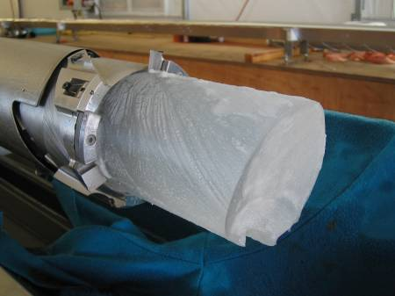
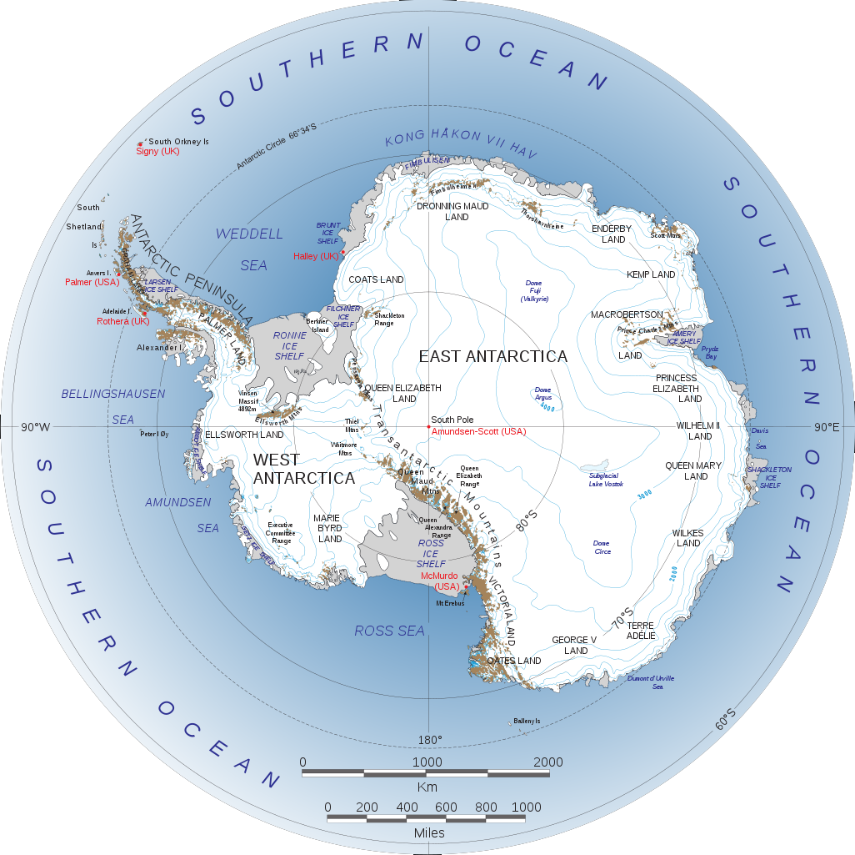
Context
Isotopic measurements
Moisture fluxes
Take-home message & future work
Accurate interpretation of the isotopic record in ice cores
Jouzel & Masson-Delmotte 2010
DOME C
¹⁶O, ¹⁷O, ¹⁸O
¹H, ²H
¹H, ²H
Little Dome C – Beyond EPICA ice core drilling project: aim at 1.5million years back in time

Slide 5
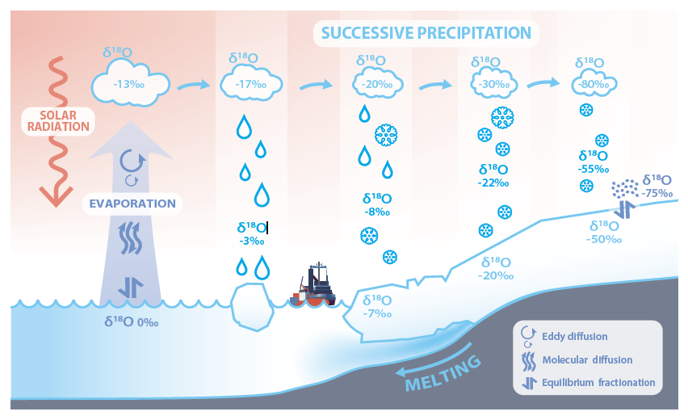
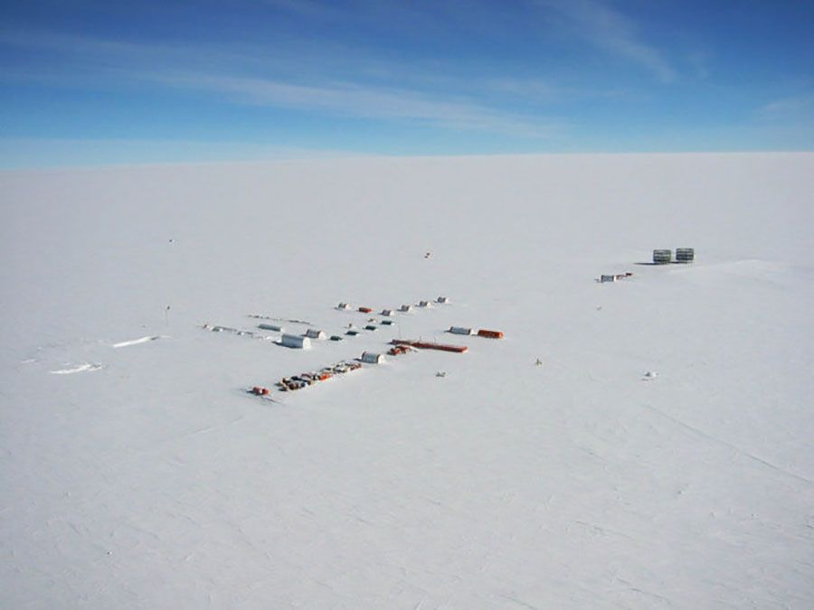
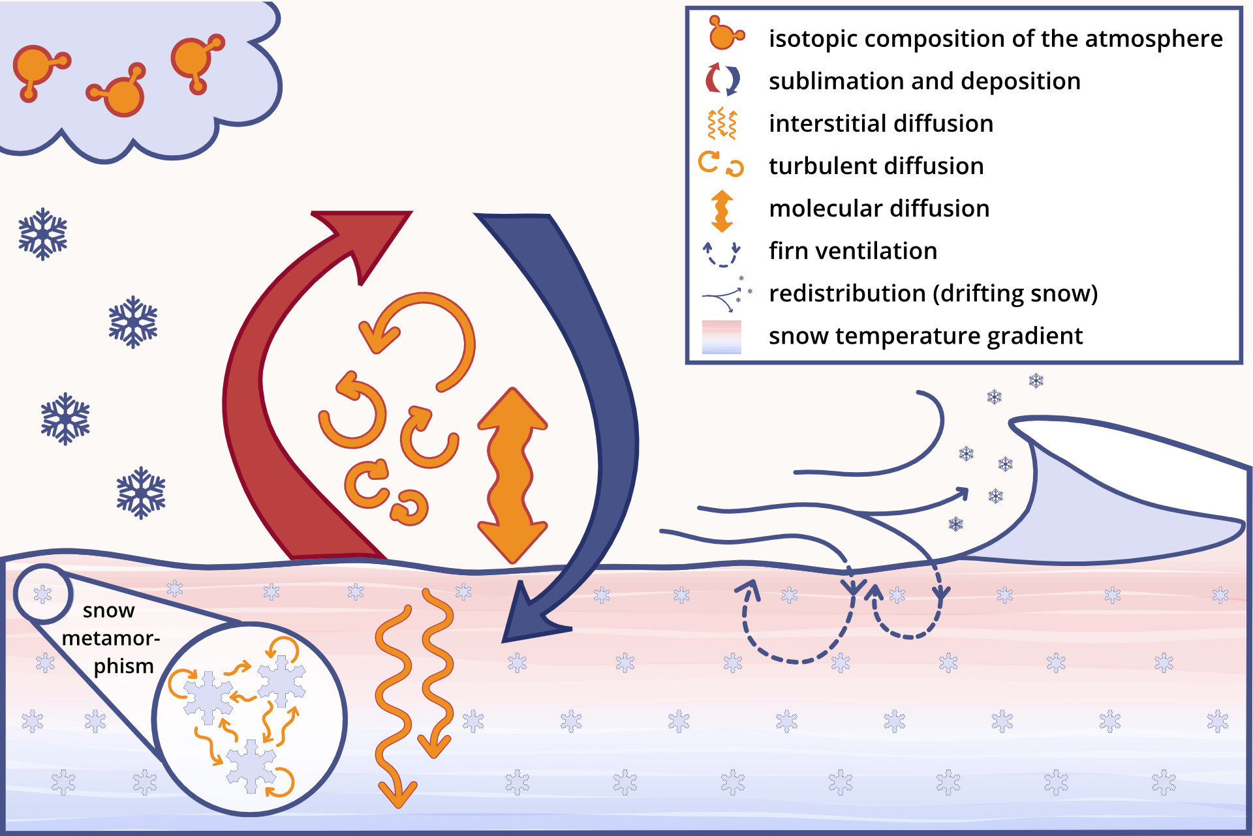
Context
Isotopic measurements
Moisture fluxes
Take-home message & future work
Effect of post-depositional processes on the isotopic climate record?
Casado 2017
Water stable isotopes proxy for past local temperatures
BUT variations in the snow isotopic composition in-between precipitation events
= post-depositional processes
courtesy of Laura DIETRICH

Slide 6
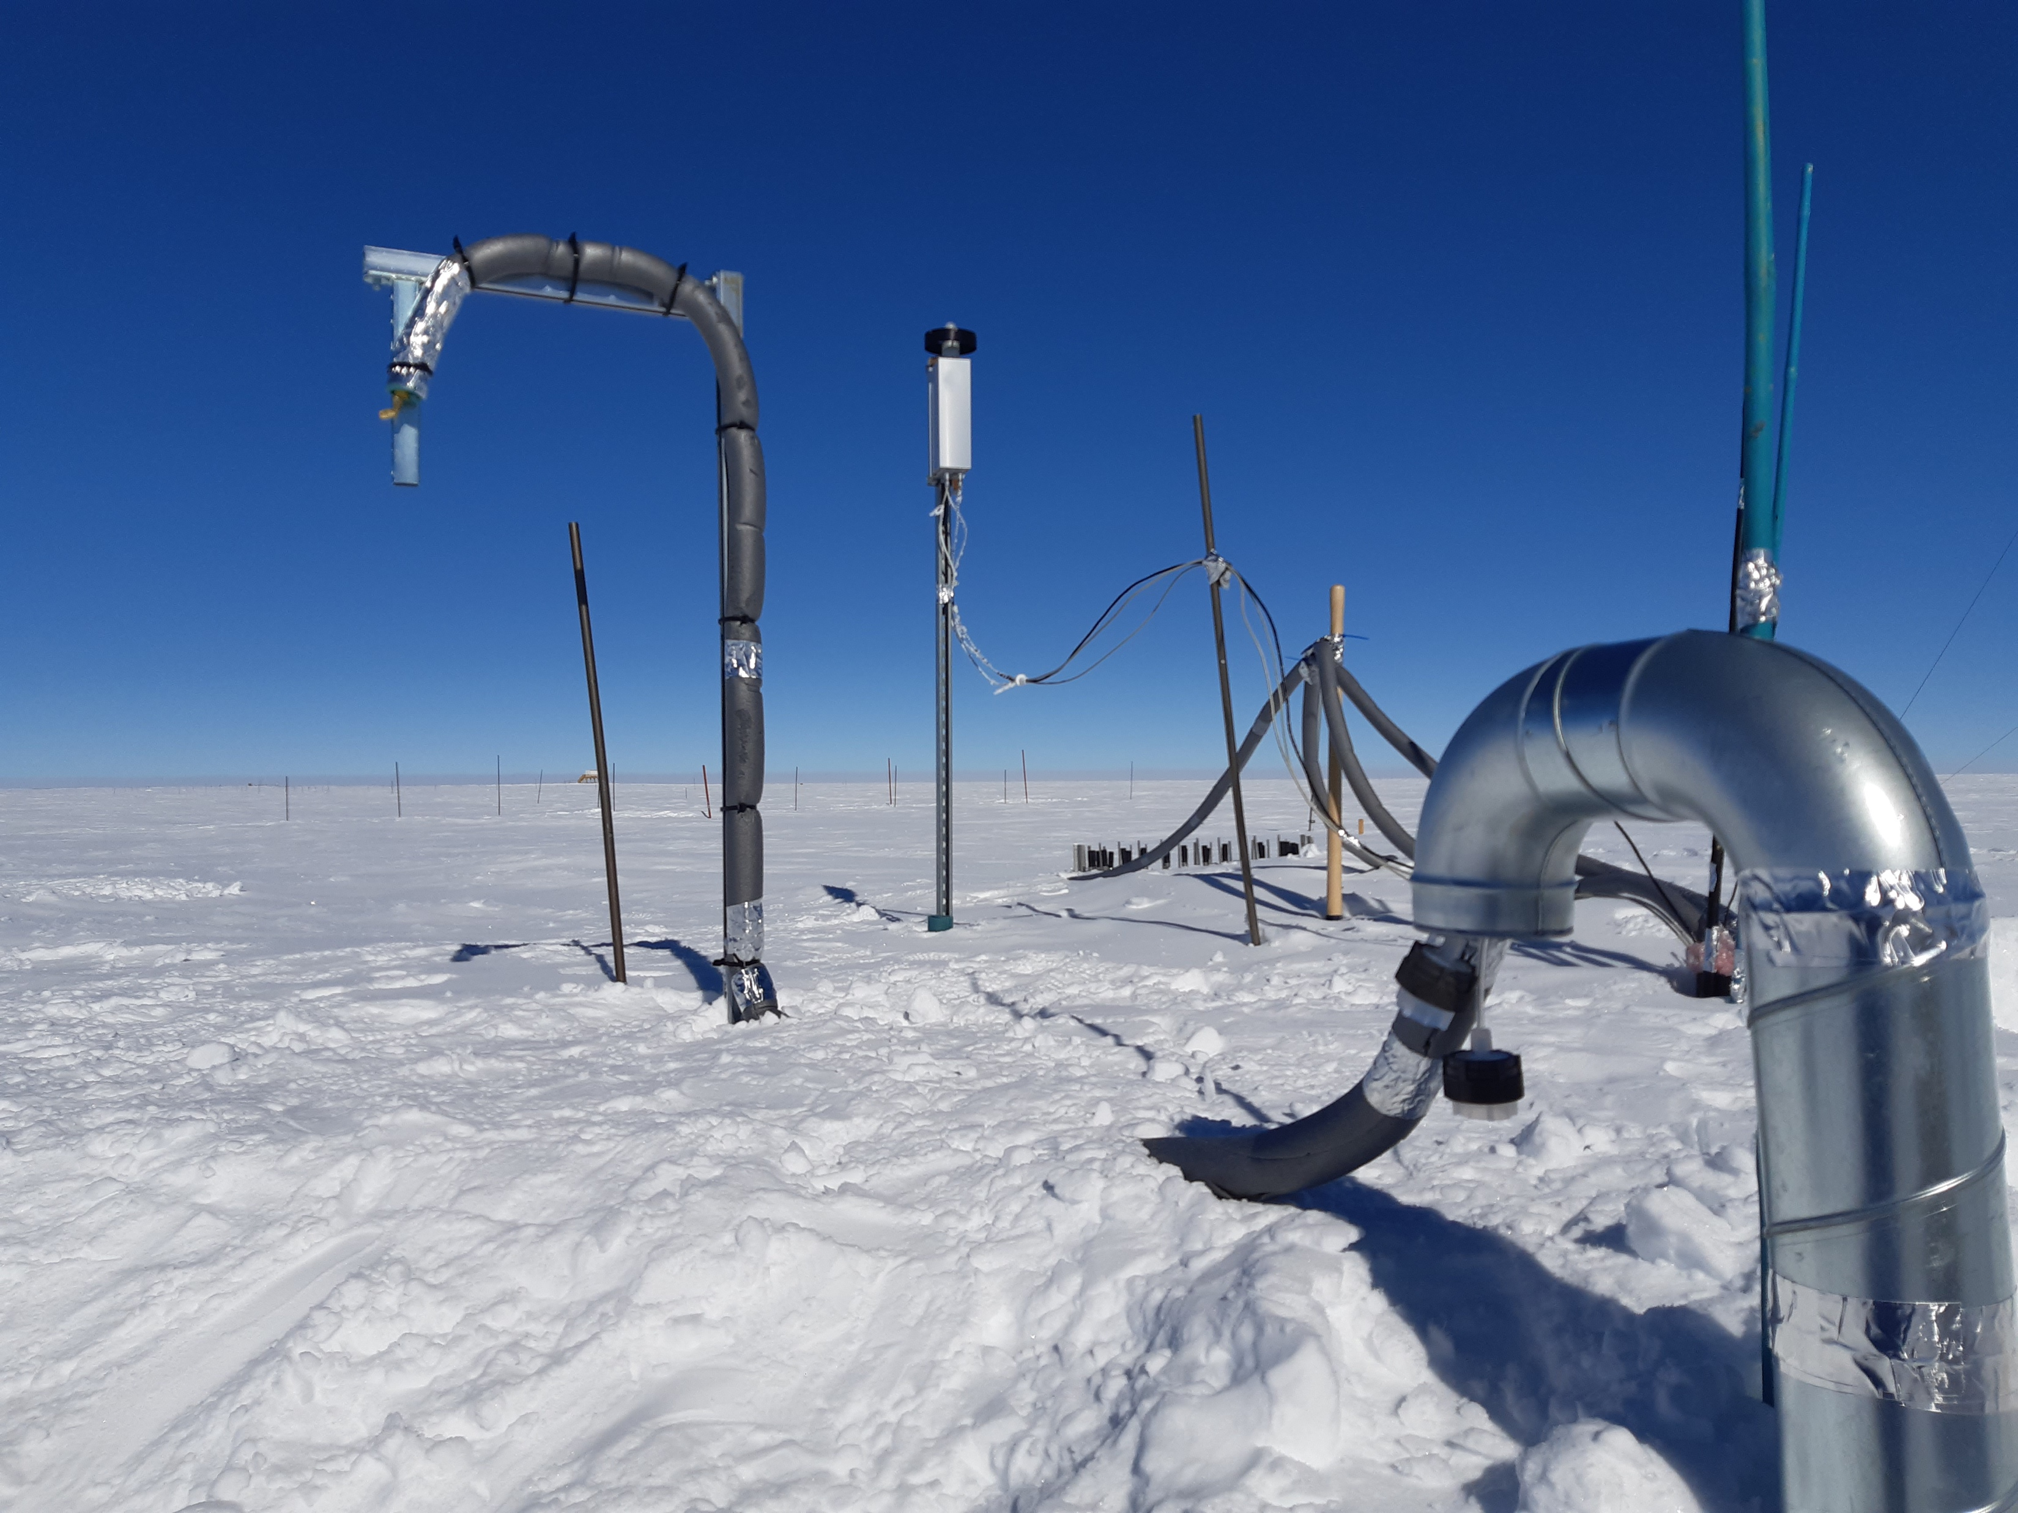
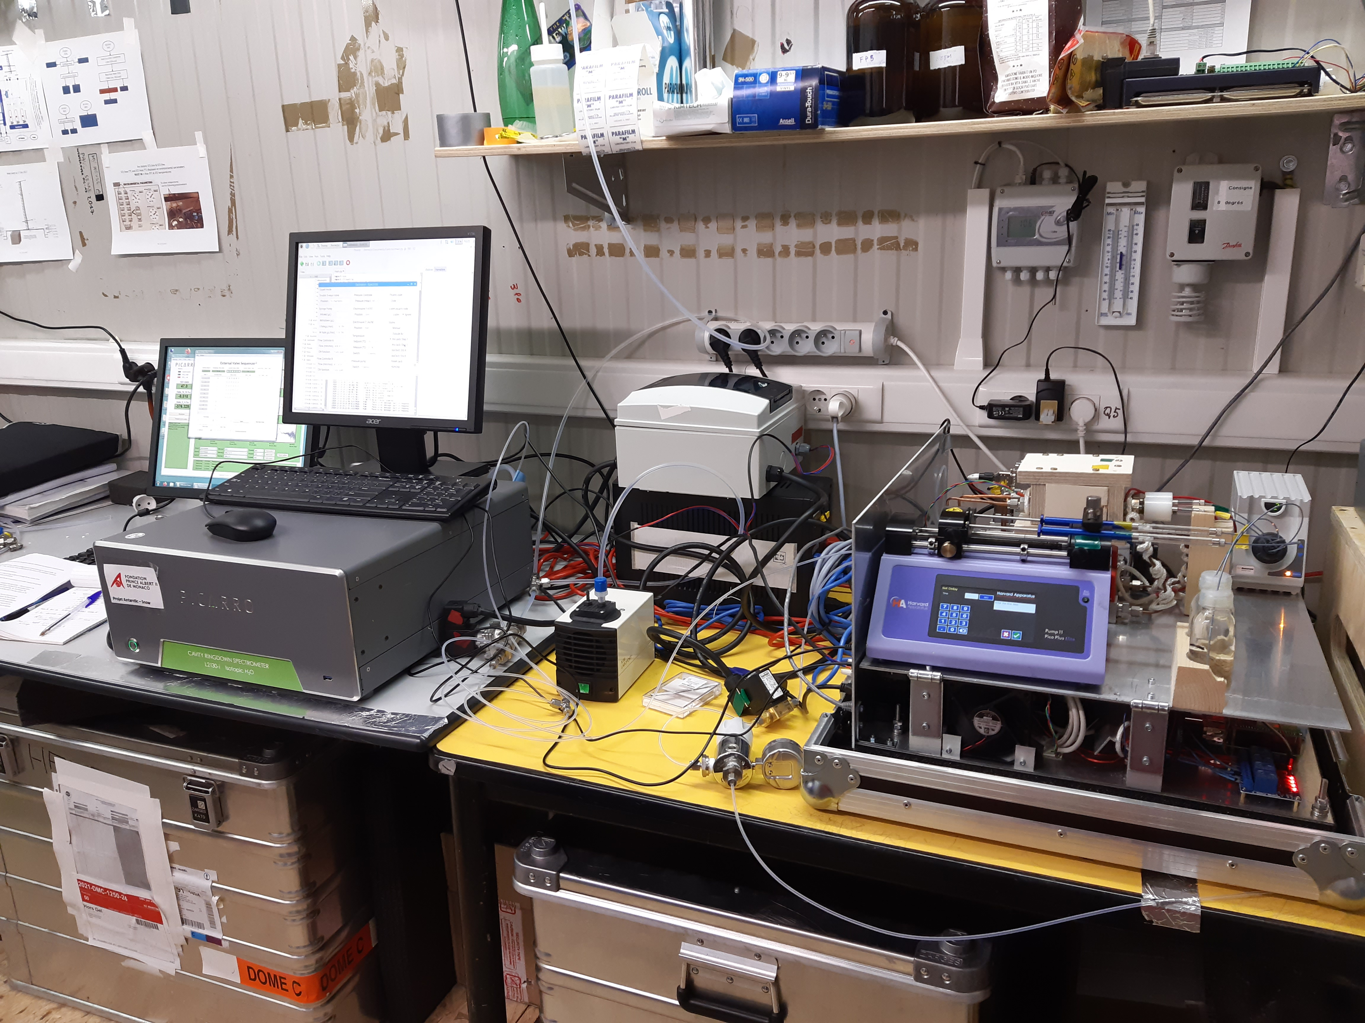
Context
Isotopic measurements
Moisture fluxes
Take-home message & future work
How is formed the isotopic climate record at the surface?
monitoring of the isotopic composition in the atmosphere, precipitation and snow
SNOW
VAPOR
Atmosphere | Precipitation | Snow surface & sub-surface
Continuously | Daily samples | Bi-weekly samples
Summer time (instrumental limitations) | All-year-round | All-year-round
Since summer 2018 (+2015-2016) | Since 2008 | Since 2017
?
PRECIP
0-2 cm
PICARRO laser spectrometer
2-5 cm
Stijn Thoolen

Slide 7
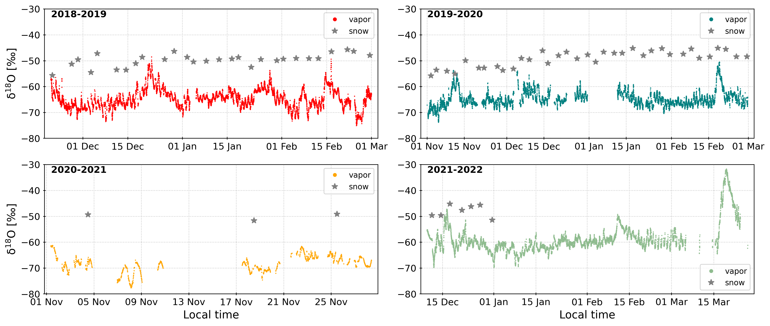
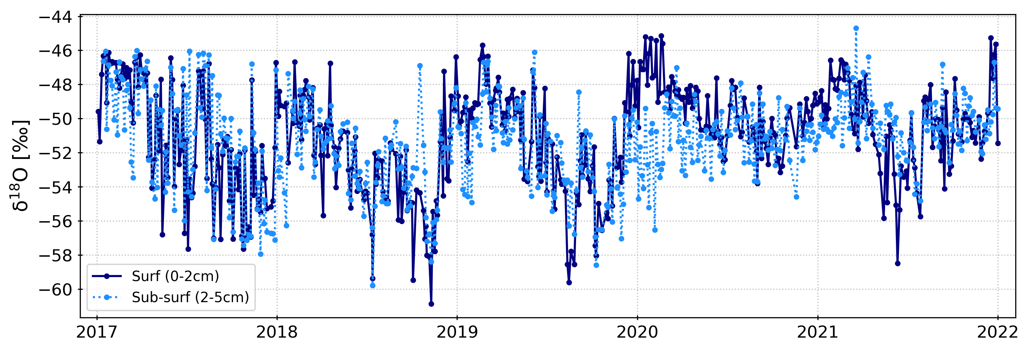
Context
Isotopic measurements
Moisture fluxes
Take-home message & future work
How is formed the isotopic climate record at the surface?
Vapor isotopic composition:
Atmospheric river events signature
Moisture origin
Weather patterns
Exchanges with snow
Wille and the EAHP 2023
Snow isotopic composition:
Seasonal cycle related to atmospheric temperature
Periods of strong difference between surface and sub-surface

Slide 8
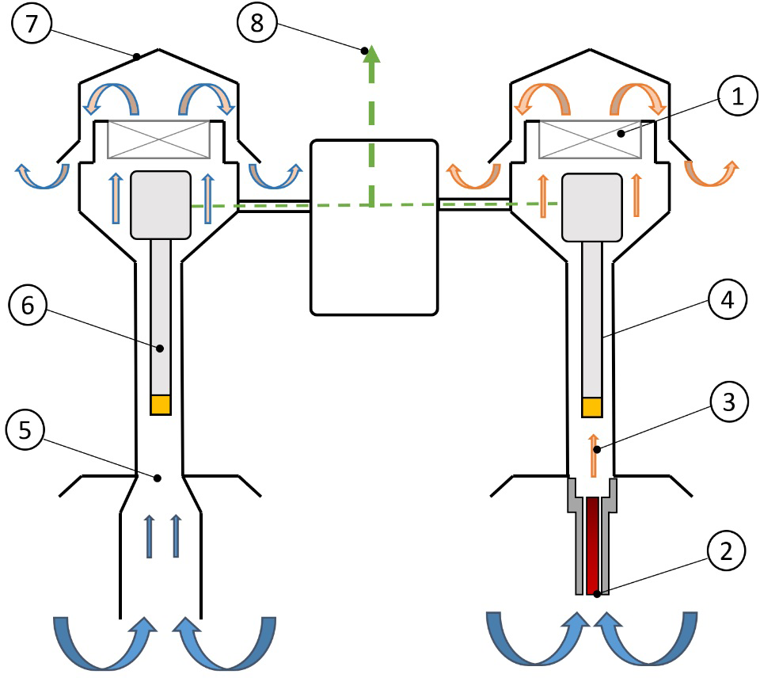
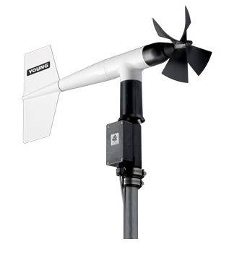
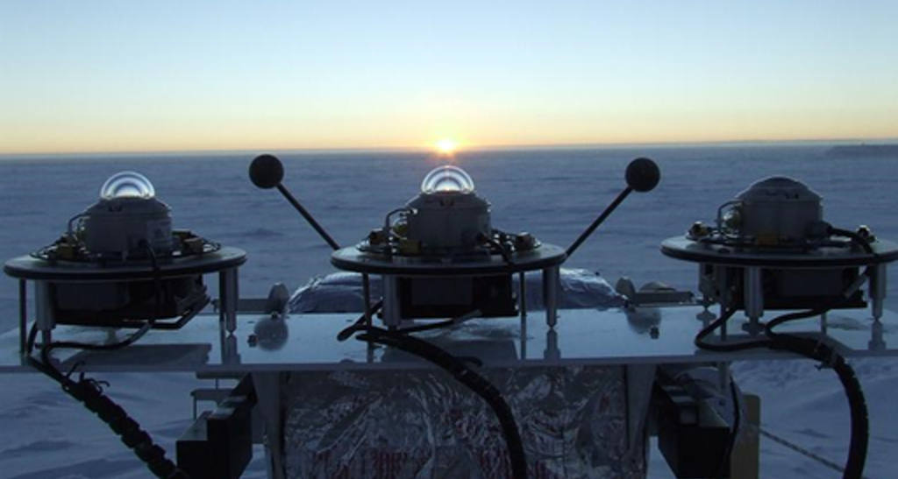
Context
Isotopic measurements
Moisture fluxes
Take-home message & future work
How much sublimation there is at Dome C?
no direct EC measurements -> estimation method from meteorological parameters
Temperature, RH, wind speed
Pressure
SNOW
VAPOR
?
3m atmospheric level
PRECIP
Surface temperature
AMRC - AWS
Scan me for real-time conditions at Dome C!
Instituto di Scienze Polari
bulk method
Surface latent heat flux
[W/m²]

Slide 9
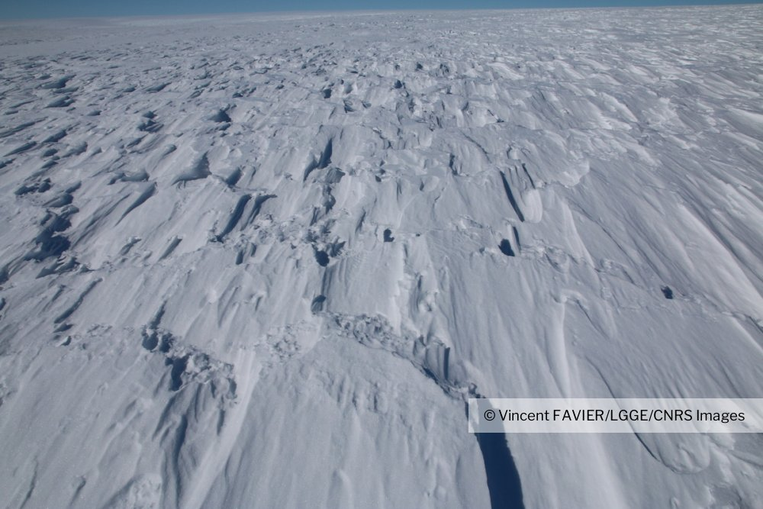
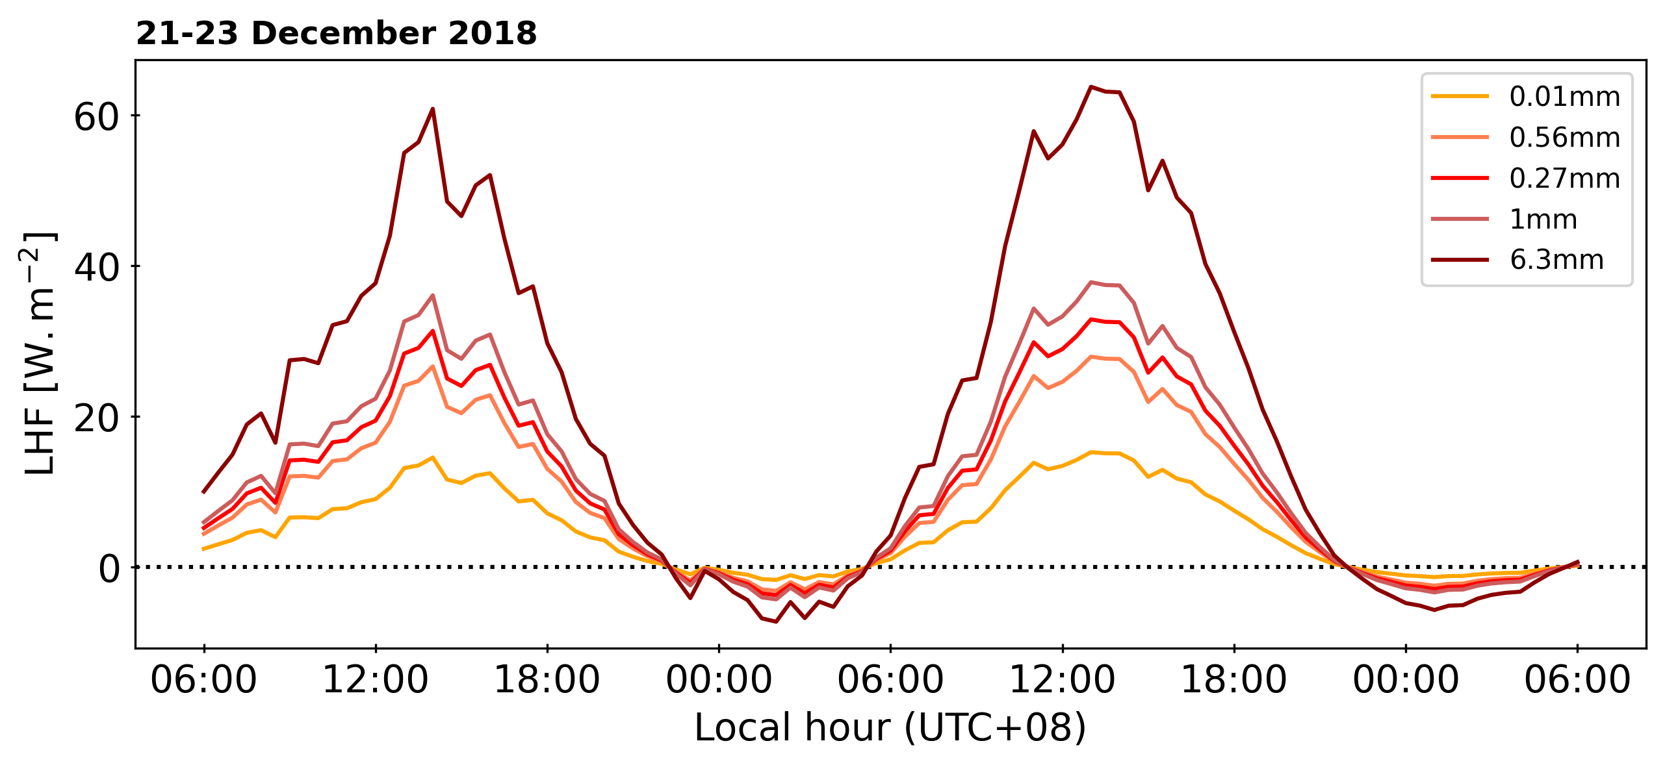
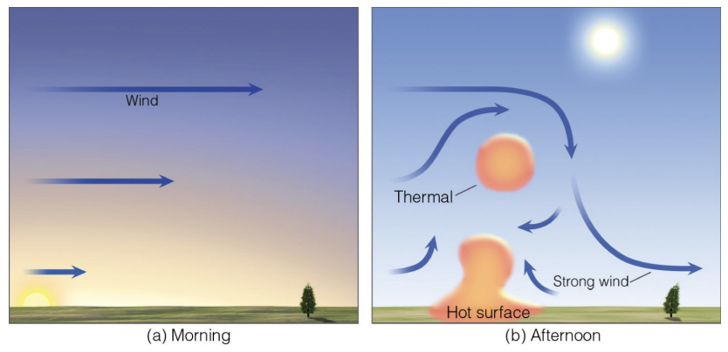
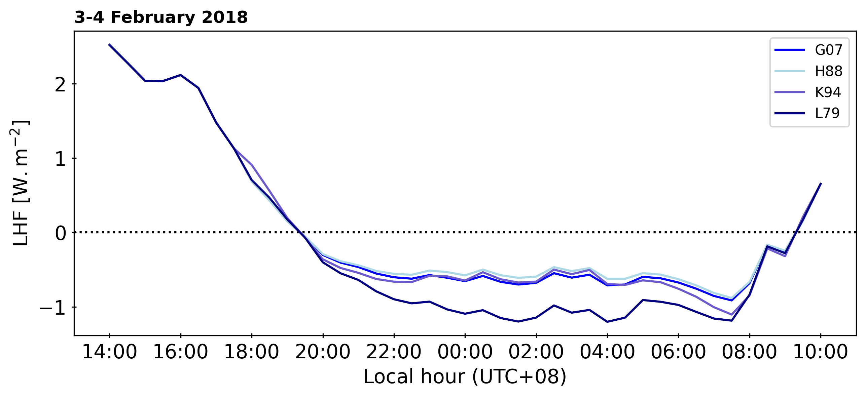
Context
Isotopic measurements
Moisture fluxes
Take-home message & future work
How much sublimation there is at Dome C?
parametrization of the bulk method: roughness length and stability function
Based on Vignon et al. (2016) & Genthon et al. (2017)
z₀ | stability f^{n}
0.01 mm | H88
0.56 mm | H88
1 mm | H88
6.3 mm | H88
Cengage 2012
z₀ | stability f^{n}
0.56 mm | H88
0.56 mm | G07
0.56 mm | K94
0.56 mm | L79

Slide 10
Context
Isotopic measurements
Moisture fluxes
Take-home message & future work
How much sublimation there is at Dome C?
Three years of latent heat flux: comparison to mean annual accumulation
With respect to mean annual accumulation of 2.5 cm w.e./year (Genthon et al. 2015)
AR event

Slide 11
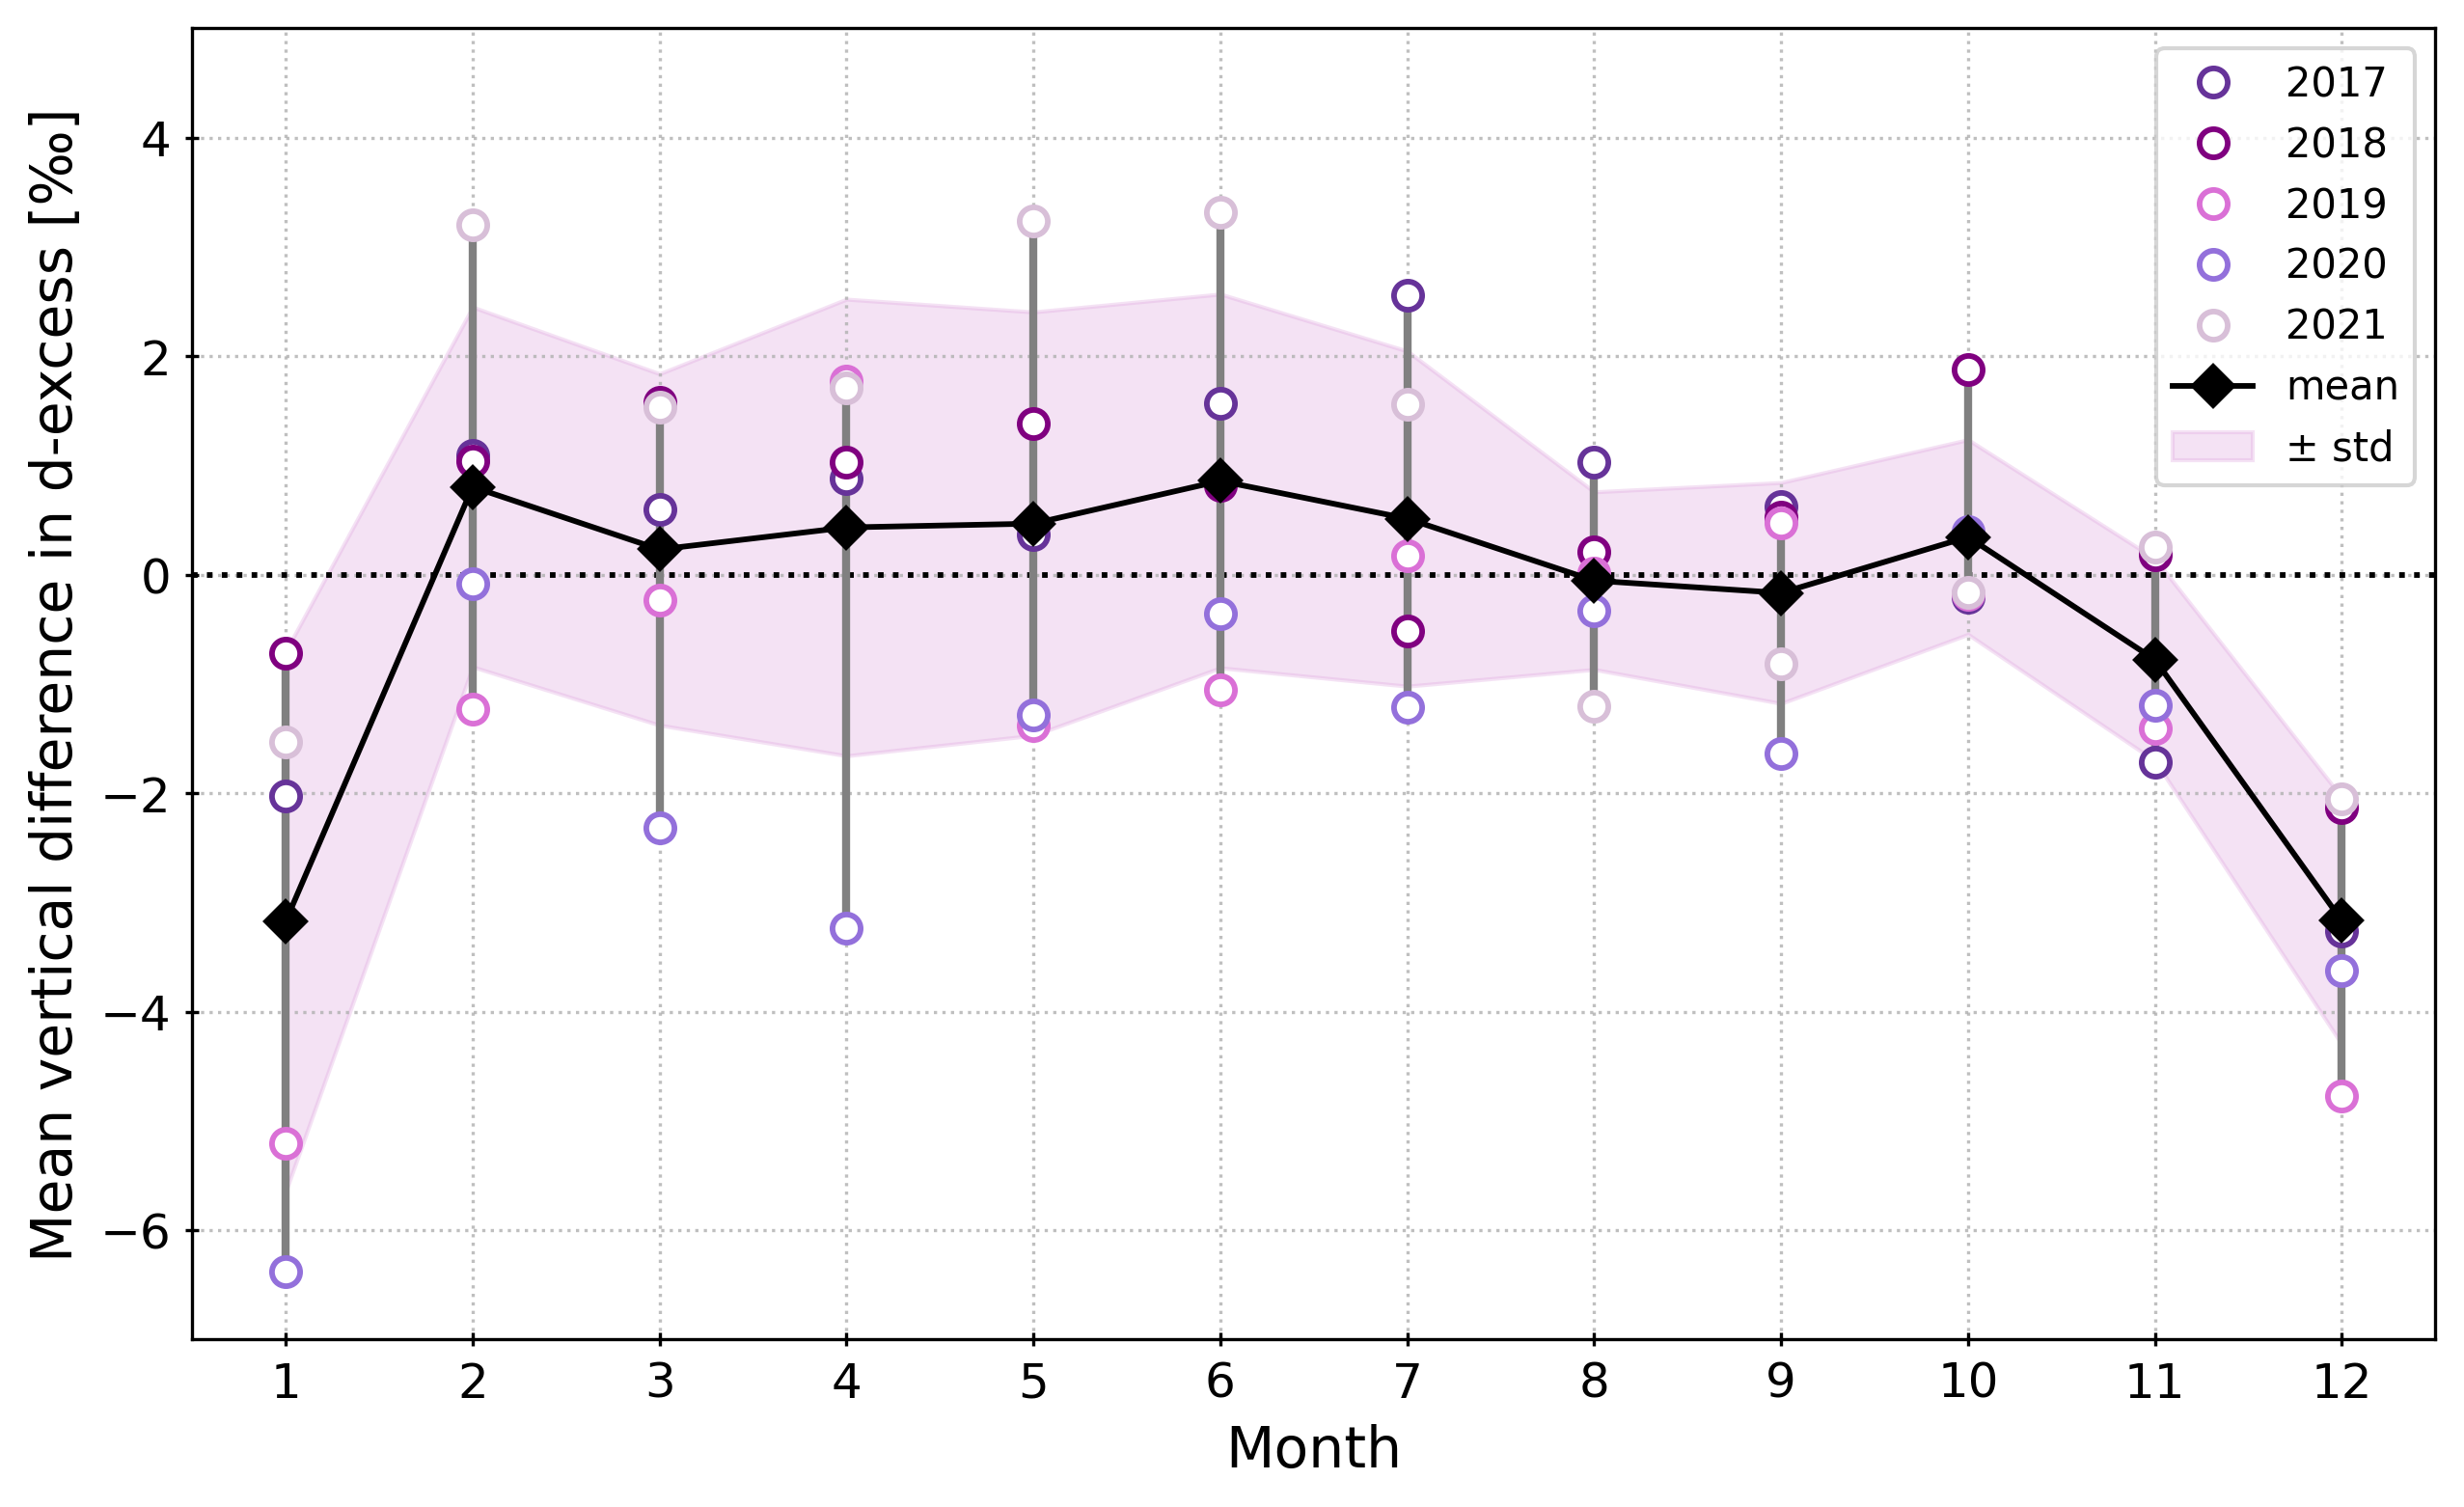
Context
Isotopic measurements
Moisture fluxes
Take-home message & future work
Water vapor fluxes impact on the snow isotopic composition?
Sublimation is a fractionating process = preferential sublimation of light isotopes
Summer 𝛿¹⁸O enrichment of the snow surface
Snow surface & sub-surface
vertical diff
Sublimation = summer signal
Summer d-excess depletion of the snow surface

Slide 12
Context
Isotopic measurements
Moisture fluxes
Take-home message & future work
How much does it matter for the isotopic climate records in ice cores?
SNOW
VAPOR
?
transfer function
PRECIP
NEXT STEP = modelling
Include vapor fluxes (+ other post-depositional processes) in snow-atmosphere coupled model to represent the isotopic climate signal formation at the surface of the ice sheet: SNOWISO (ERC project led by HC Steen-Larsen)
Disentangle the effects and contributions of precipitation inputs, vapor above the snow and post-depositional modifications
= accurate interpretation of isotopic record from ice cores
Casado et al. 2021, Wahl et al. 2022, Dietrich et al. (submitted to GRL), …

Slide 14
Flux estimation method workflow
Based on Vignon et al. (2016) and Genthon et al. (2017)
Input data
RHi (recalculated from RHl given by sensor) at 3m
Air temperature (non-heated sensor) at 3m
Atmospheric pressure
Surface temperature (calculated from LWd and LWu)
Wind speed at 3m
Assumptions
RH at surface = 100% with respect to Ts
MO relations holds (some winds)
Known stability correction functions (test several)
$$p_{sat}$$
$$ρ$$
$$ρ=\frac{\left(p−p_{v}\right)M_{d}+p_{v}M_{v}}{RT}$$
$$p_{v}=RHp_{sat}$$
$$dθ= θ−θ_{s}$$
$$θ={\frac{Tp_{ref}}{p}}^{0.286}$$
Initial guess of L = +/-1000
Update L
$$ζ=\frac{z}{L}$$
L > 0
L < 0
$$φ_{m}, φ_{h}$$
$$u_{∗}$$
$$Re= u_{∗}z/v$$
$$Re$$
$$z_{0q}$$
$$C_{q}$$
$$LHF=E∗Ls$$
$$Sr=E∗3600$$
$$θ_{∗}$$
$$W/m^{2}$$
$$mm/h$$
$$dq= q_{s}−q$$

Slide 15
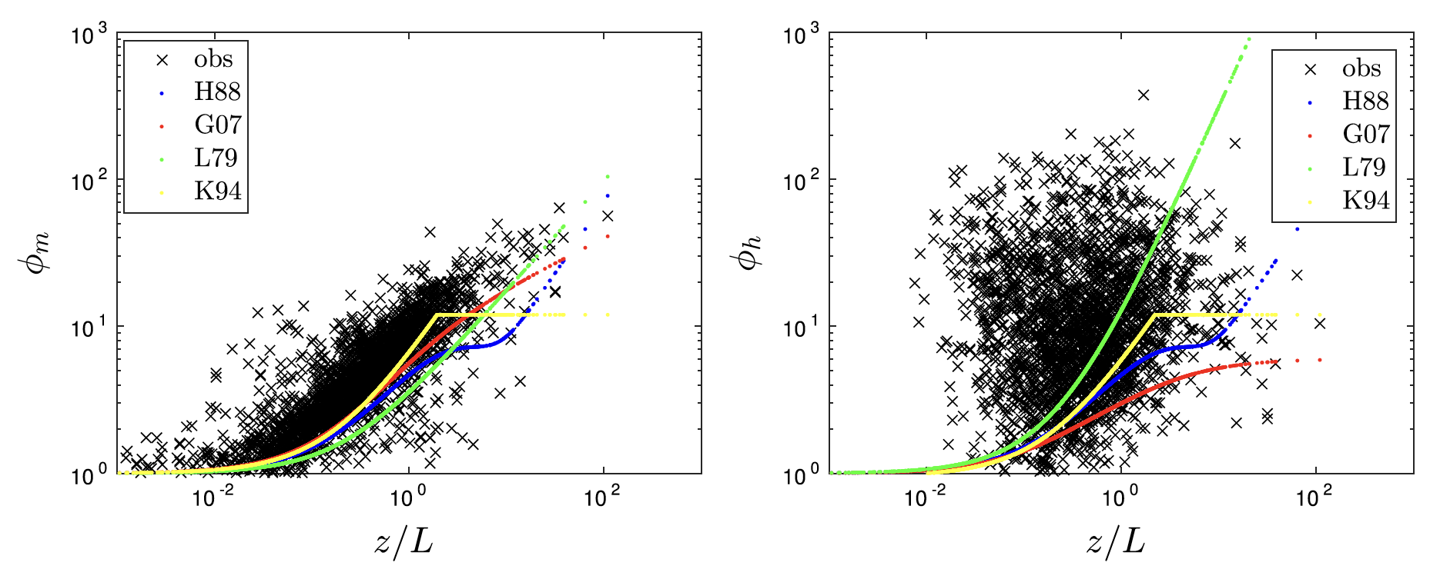
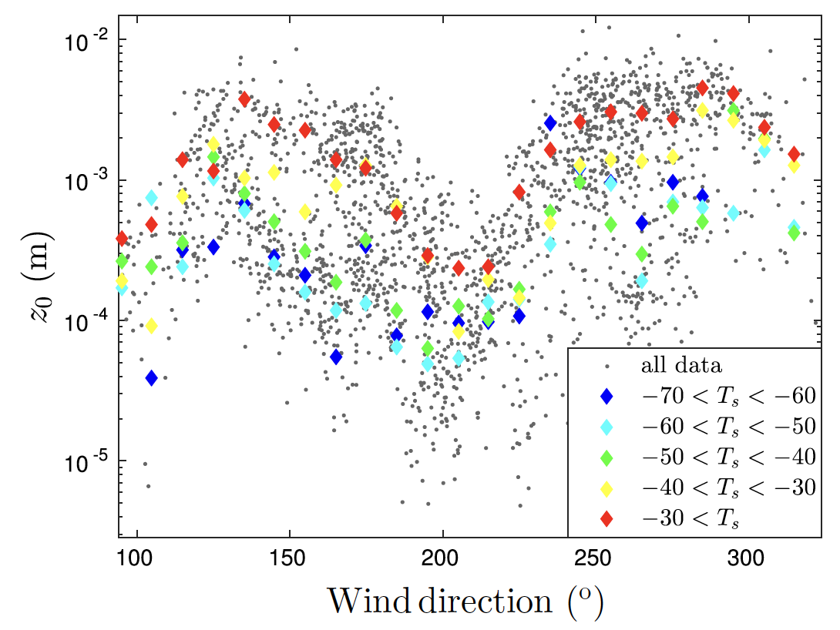
Stability functions and z0
Figures from Vignon et al. 2016

Slide 16
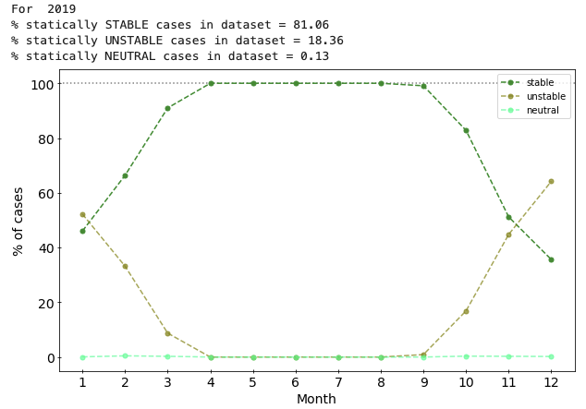
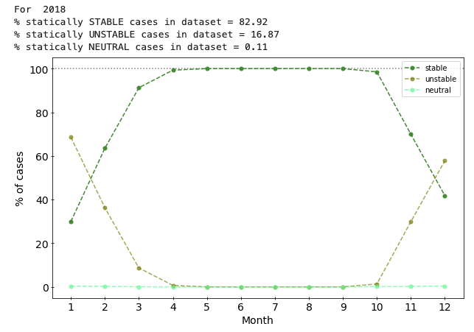
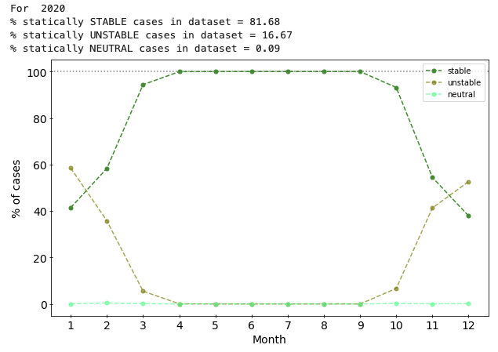
Stability conditions at Dome C

Slide 17
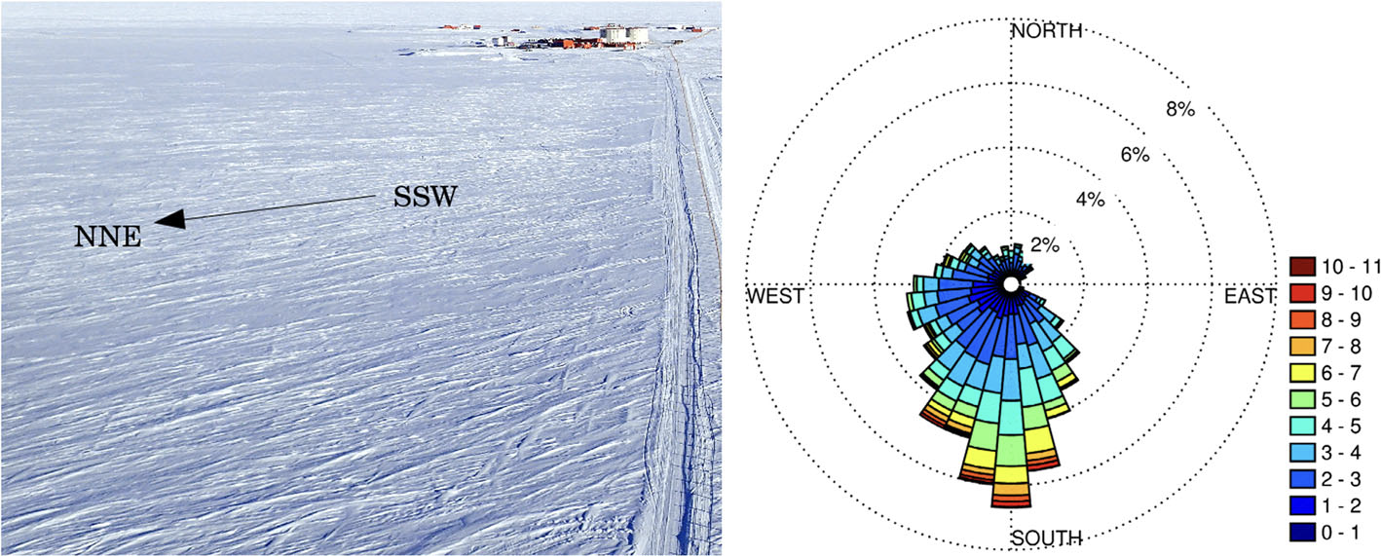
Wind at Dome C
Vignon et al. 2016

Slide 18
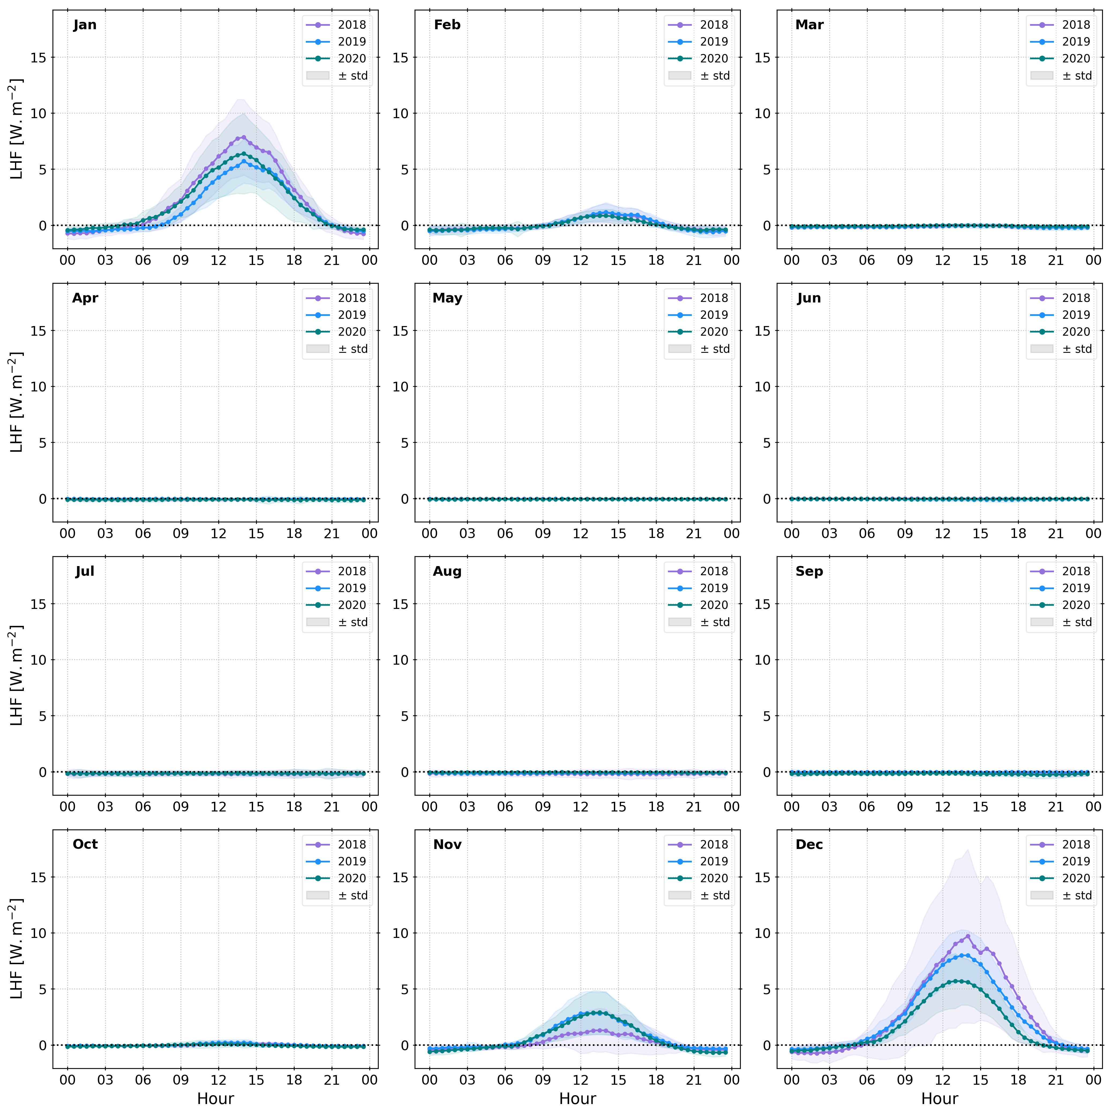
Diurnal cycle of LHF

Slide 19
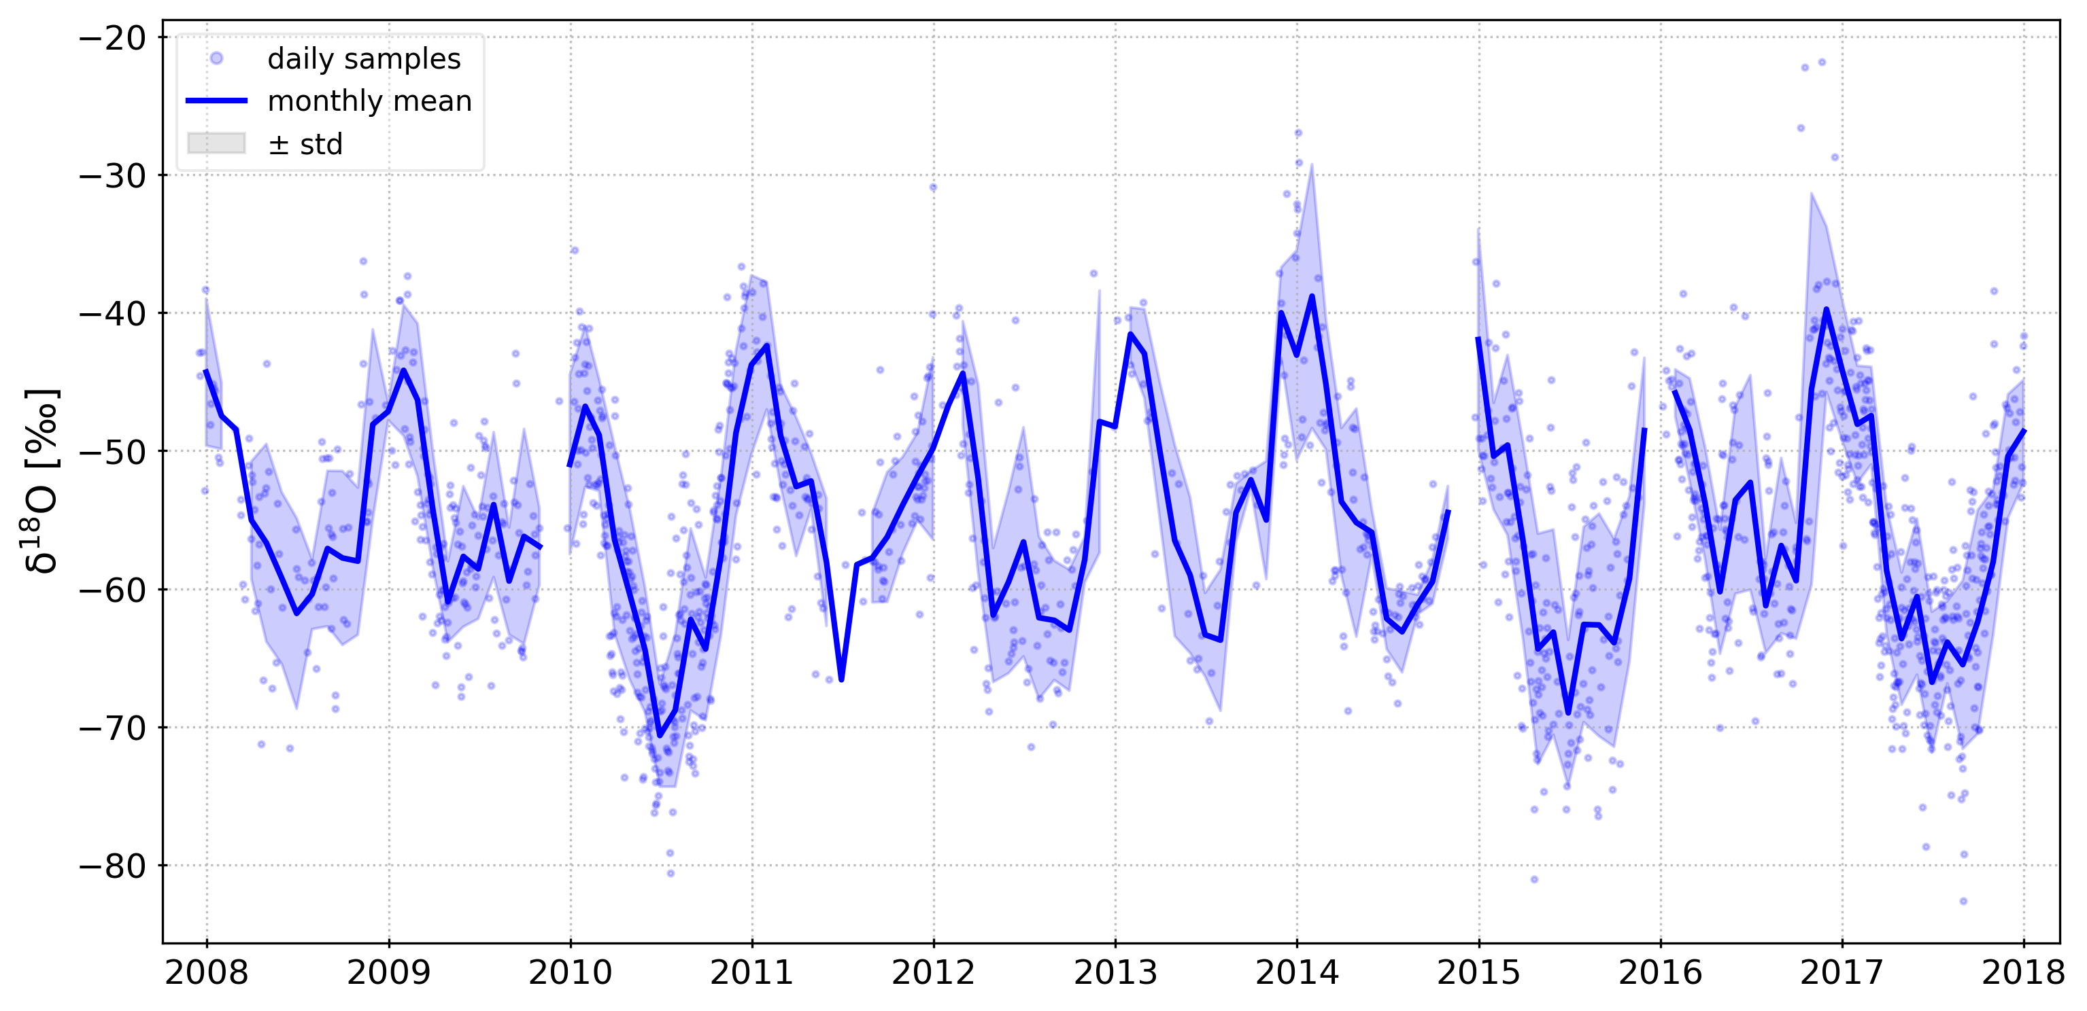
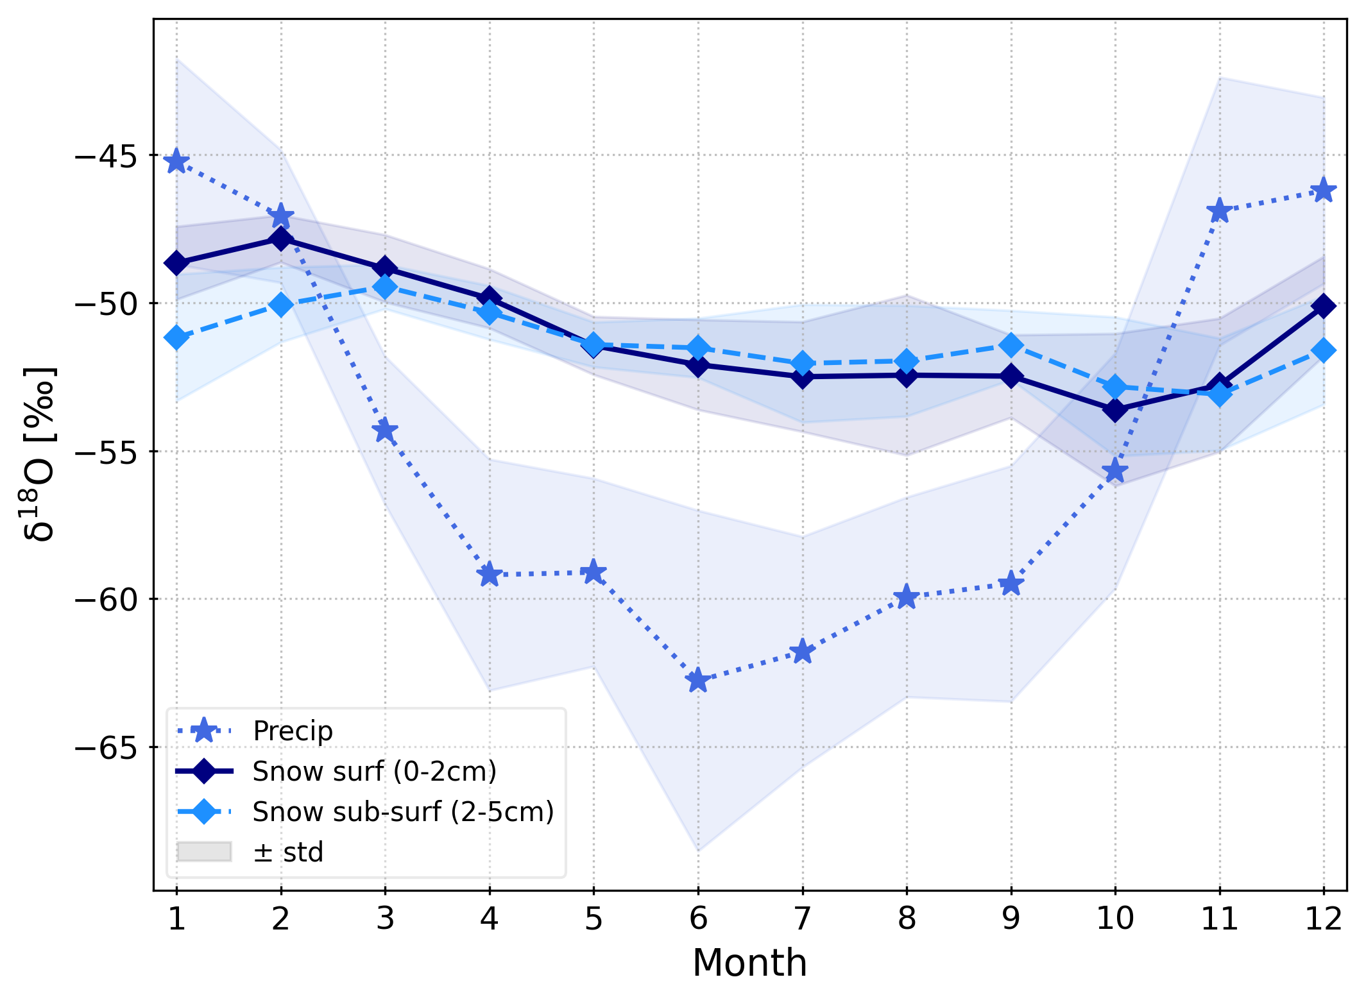
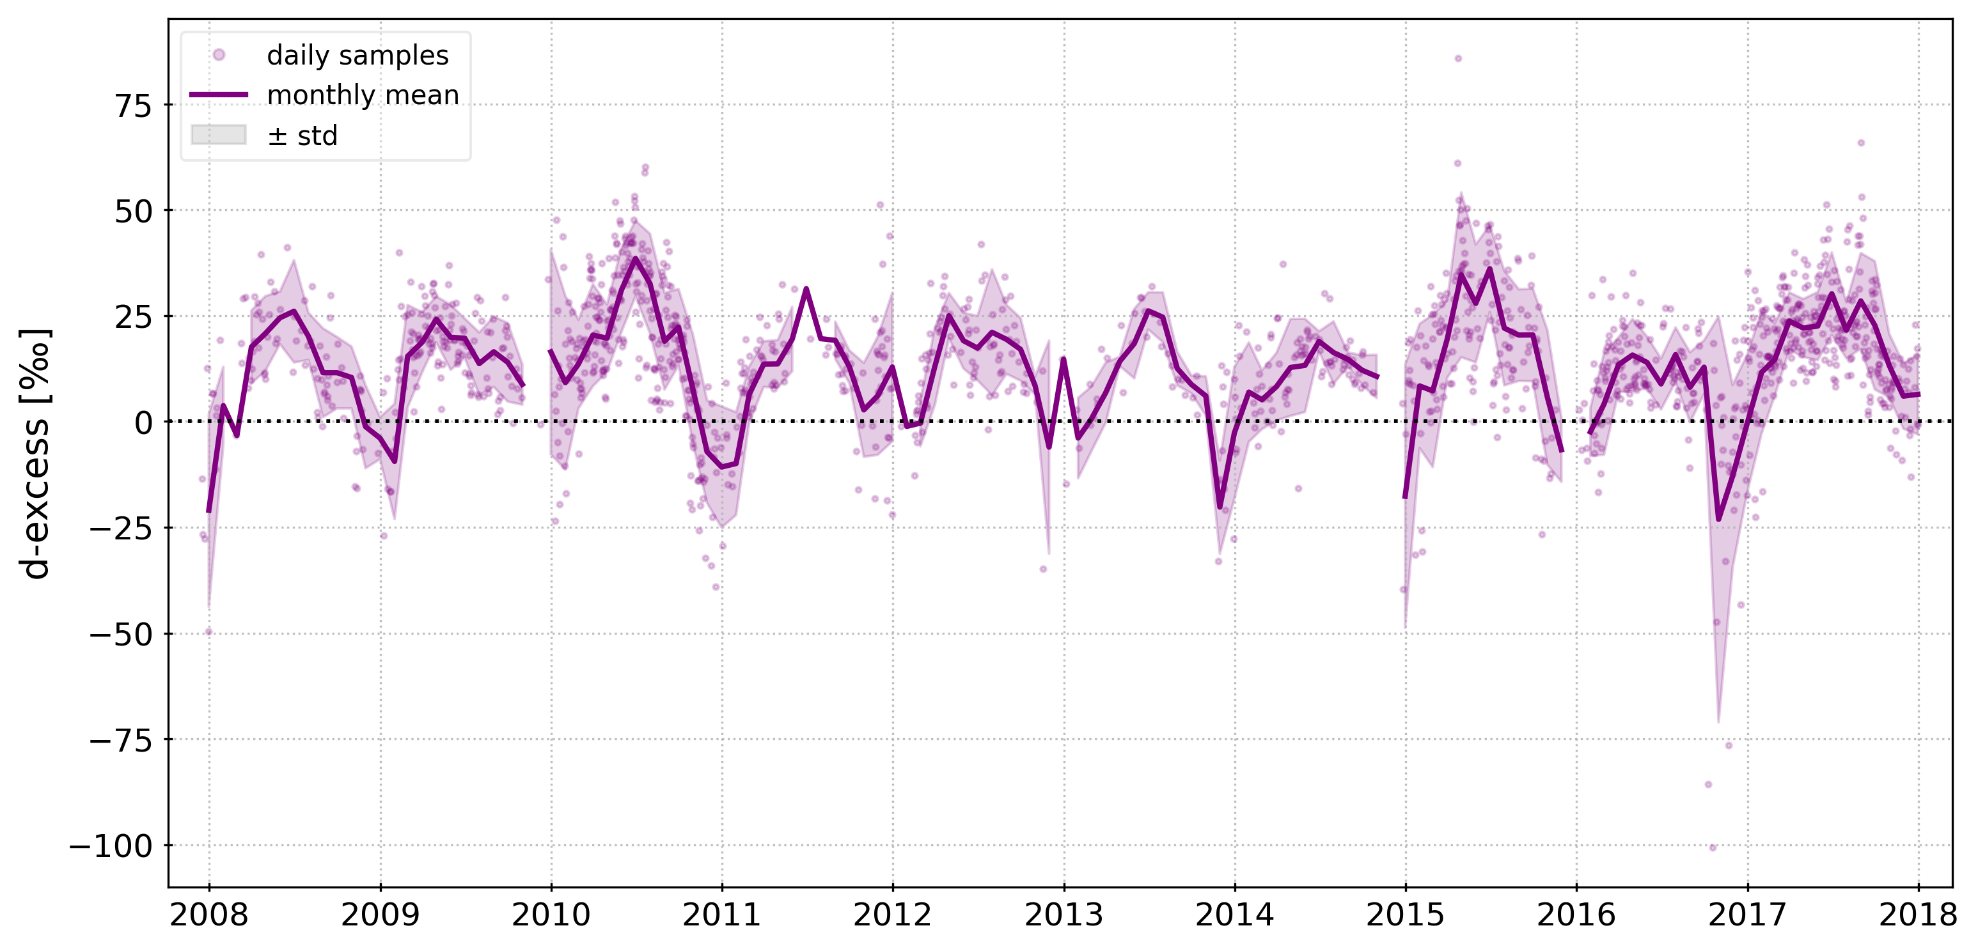
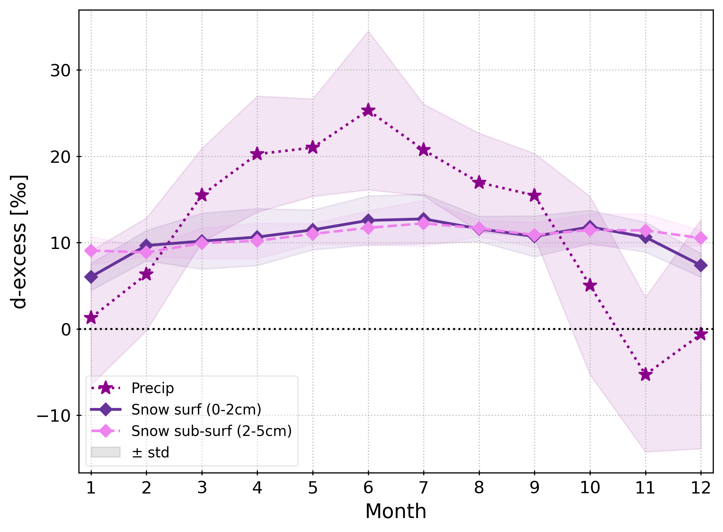
Precipitation isotopic composition
Data from Stenni et al. (2016), Dreossi et al. (in prep)

