Slide 1
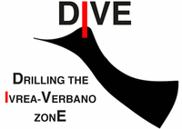
3D Tomography across the Balmuccia Peridotite, Ivrea Zone, Italy - Project DIVE phase two Supplementary material
${\text{D}\text{. }\text{Pasiecznik}}^{1}$, ${\text{A}\text{. }\text{Greenwood}}^{1,2}$, ${\text{G}\text{. }\text{Het}\text{é}\text{nyi}}^{2}$, ${\text{F}\text{. }\text{Bleibinhaus}}^{1}$
${}_{}^{1}{Montanuniversität Leoben}$ ${}_{}^{2}{Université de Lausanne}$

Slide 2
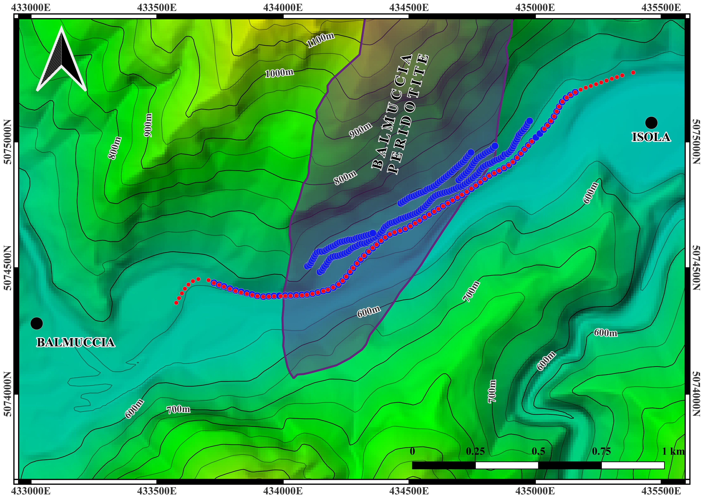
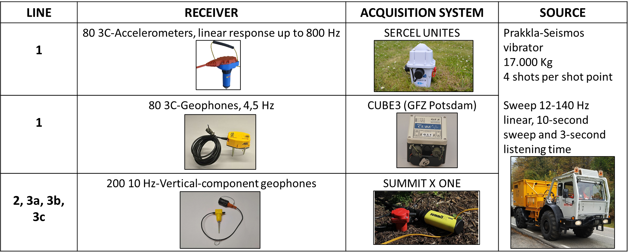
Acquisition
HiSEIZE
1
3c
2
3b
3a
Sources spacing: ca. 22m
Line 1 receivers spacing: ca. 11m
Lines 2 and 3 receivers spacing: ca. 10m
Sources
Receivers
Digital Elevation Model of the study area, with source, receiver positions and proposed drill site.
Notes:
FOUR SHOTS PER SHOT POINT
3C ACCELEROMETERS AND GEOPHONES INTERLEAVED EVERY 11 m IN LINE 1

Slide 3
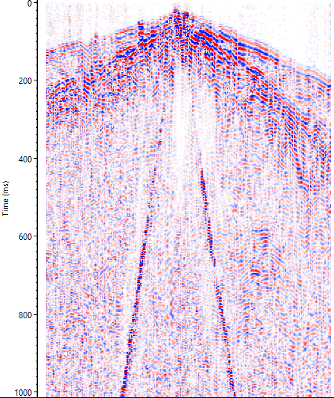
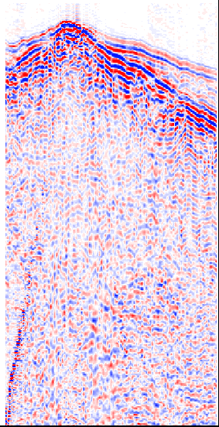
Acquisition: Data examples
W
LINE 1 (Vertical)
LINE 2
LINE 3
E
3a
3b
3c
P-wave
S-wave
500m
Example of a single shot record for lines 1 (vertical component), 2 and 3.
AGC applied for better visualization.

Slide 4
Processing
FULL PROCESSING WORKFLOW
Input data and definition of the survey's geometry
Line 1 tomography
Refraction tomography for velocity model building
1
Diversity stacking (stack of 4 shots per source point)
3D tomography
(Lines 1+2+3)
Spherical divergence correction
4
Vibroseis correlation
Band pass filter (40-50-140-150)
Refraction statics
Accelerometer to geophone conversion (integration), and instrument simulation (frequency and phase response homogenized)
2
Filtering of P-wave direct arrivals
5
Merging of data from both types of 3C-sensors
Filtering of S-wave direct arrivals
Line 1 PSDM from topography
Kirchhoff pre-stack depth migration (PSDM)
6
Trace editing
3D PSDM from topography
(Lines 1+2+3)
3
Air wave mute
Phases 1, 2, 3, 4 and 5 finished
Phase 6 in process
First break picking
Notes:
Only applied to line 1
Say why not CMP processing

Slide 5
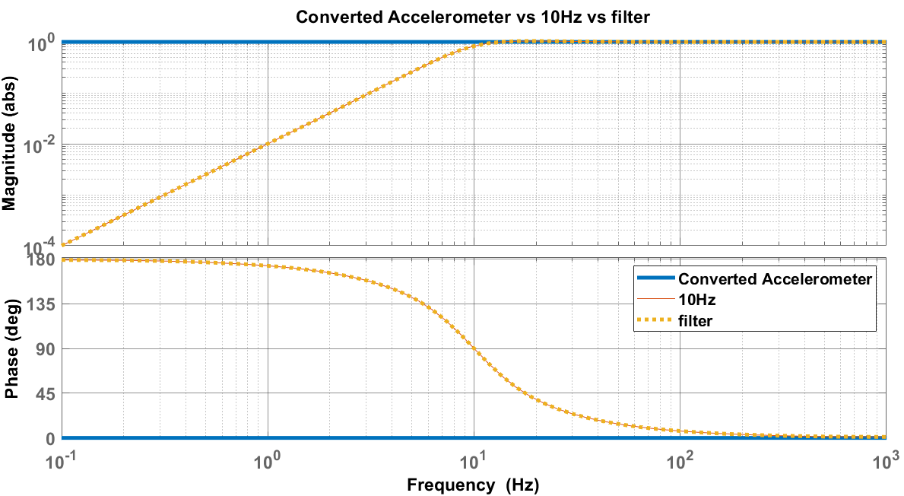
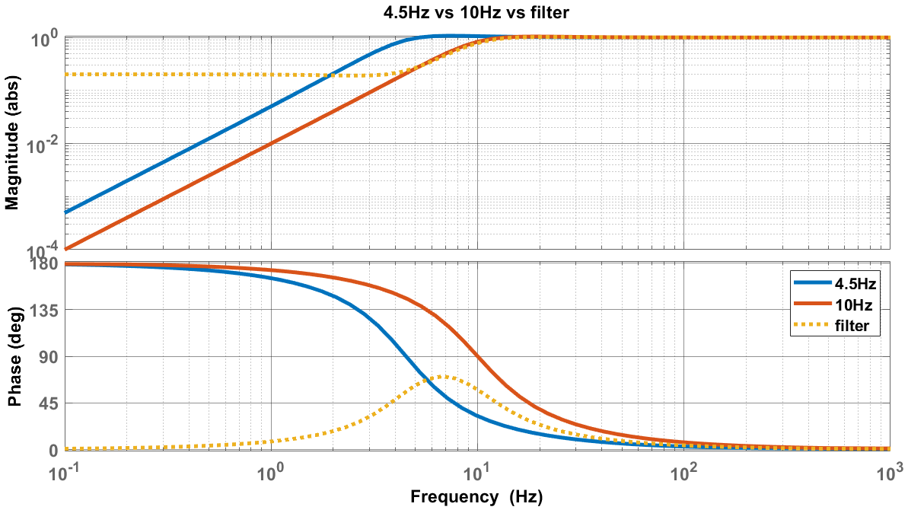
Processing: Instrument Simulation
Filter is built as:
$${FT}^{−1}({S_{a}}/{S_{b}})$$
${FT}^{−1}$: Inverse Fourier Transform.
${S_{a}}/{S_{b}}:$ Ratio of the transfer functions of the instrument to mimic, with eigenfrequency a ($S_{a}$), and the instrument deployed on the field, with eigenfrequency b ($S_{b}$).
A
To obtain $S_{a}$ and $S_{b}$, one must consider the complex-valued frequency response function of the sensor:
$\frac{Z}{U}\left(ω\right)$ = $\frac{ω^{2}}{ω_{0}^{2}−ω^{2}+i2Dωω_{0}}$= $S\left(ω\right)$ = $S_{ω_{0}}$
$Z$: Measured ground motion.
$U:$ True ground motions.
$ω_{0}$: Eigenfrequency of the sensor.
D: Damping coefficient.
B
Figures A and B: Comparison between amplitude and frequency response of the instrument to be simulated (blue), the current instrument (orange) and the filter to be applied (yellow).
Notes:
Instrument simulation

Slide 6
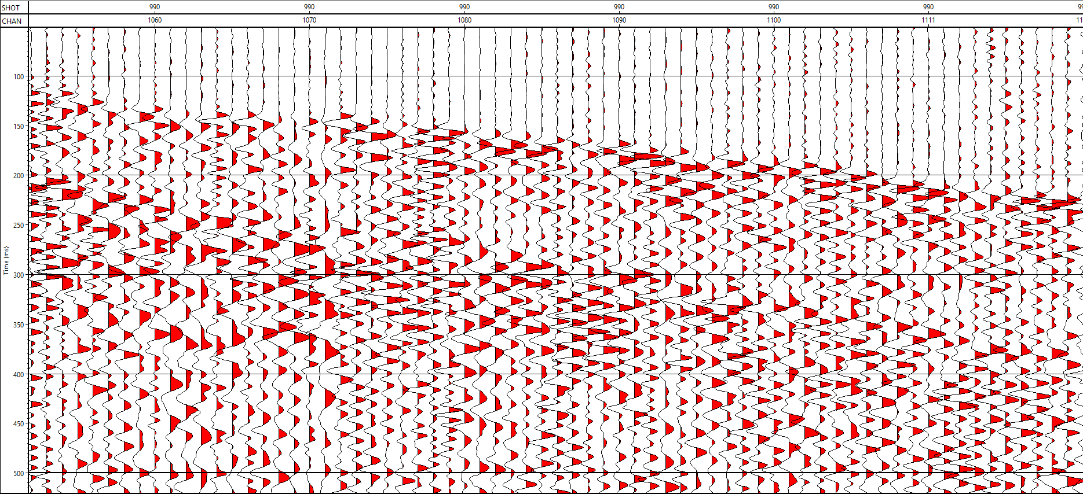
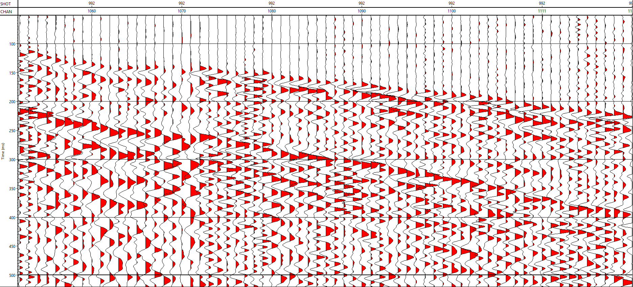
Processing: Instrument simulation results
Direct P-Wave
Direct P-Wave
Direct S-wave
Direct S-wave
Raw data from Line 1 with before accelerometer to geophone conversion and instrument simulation .
Raw data from Line 1 with after accelerometer to geophone conversion and instrument simulation .
Notes:
In figure 11, it is clearly visible that the alternating geophone and accelerometer traces do not match and there is no continuity of the first breaks or S-wave arrivals.
Figure 12 shows the results after the conversion from accelerometer to geophone, and the application of the instrument simulation technique. As can be seen, the first breaks and S-wave arrivals are aligned.

Slide 7
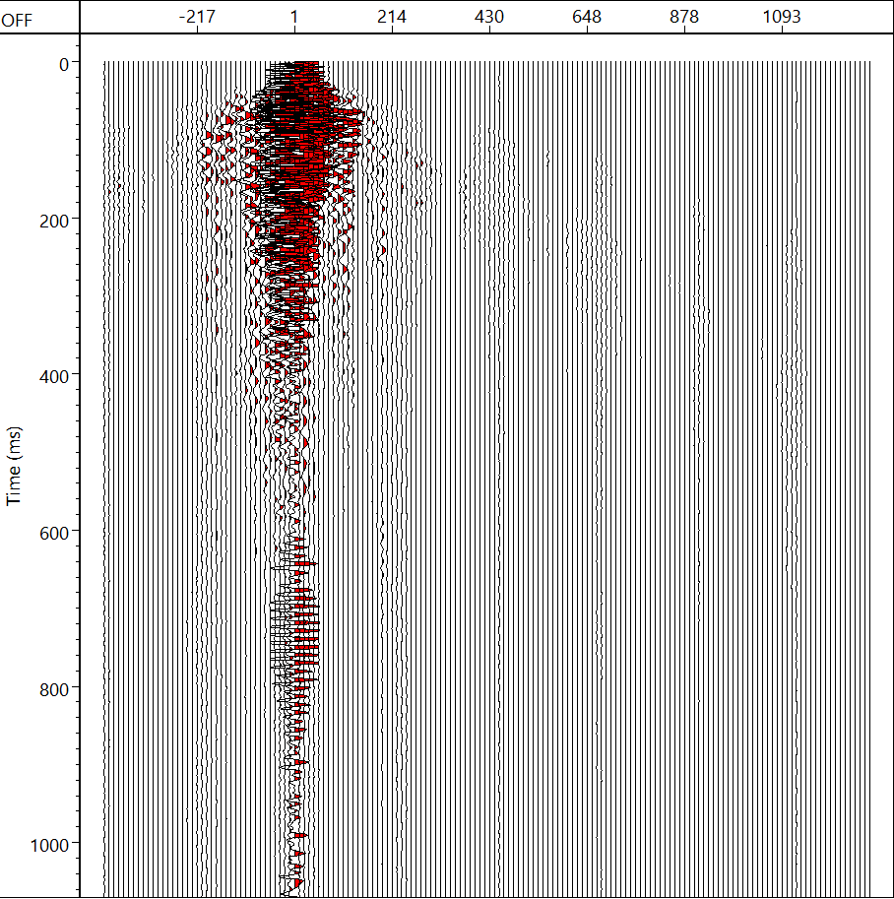
Processing: Phase 3 -5
(m)
Raw data
Spherical div. corr. and band pass filter
Direct P-wave filtered
Direct S-Wave filtered

Slide 8
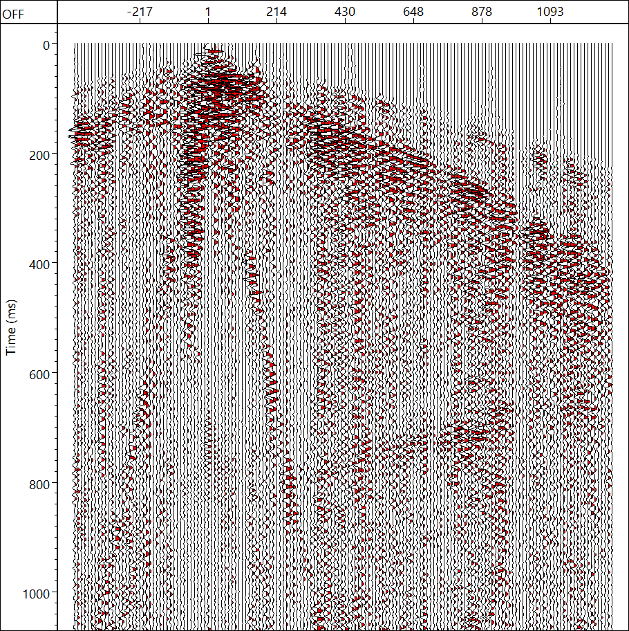
Processing: Phase 3 -5
(m)
Raw data
Spherical div. corr. and band pass filter
Direct P-wave filtered
Direct S-Wave filtered

Slide 9
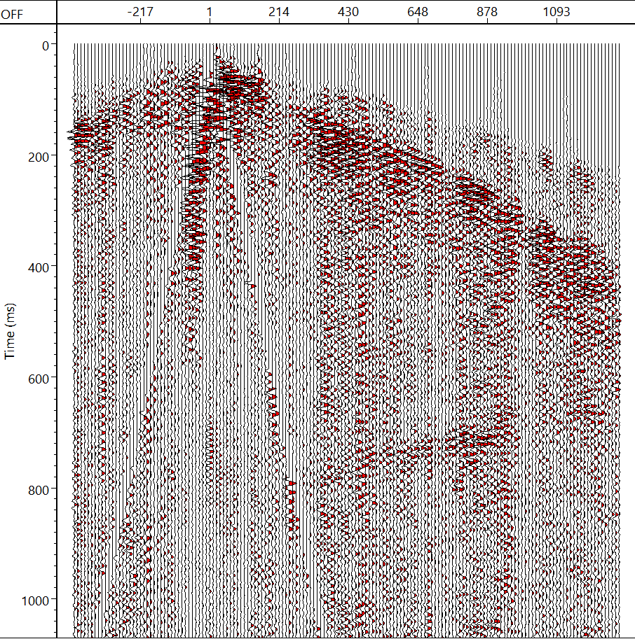
Processing: Phase 3 -5
(m)
Raw data
Spherical div. corr. and band pass filter
Direct P-wave filtered
Direct S-Wave filtered

Slide 10
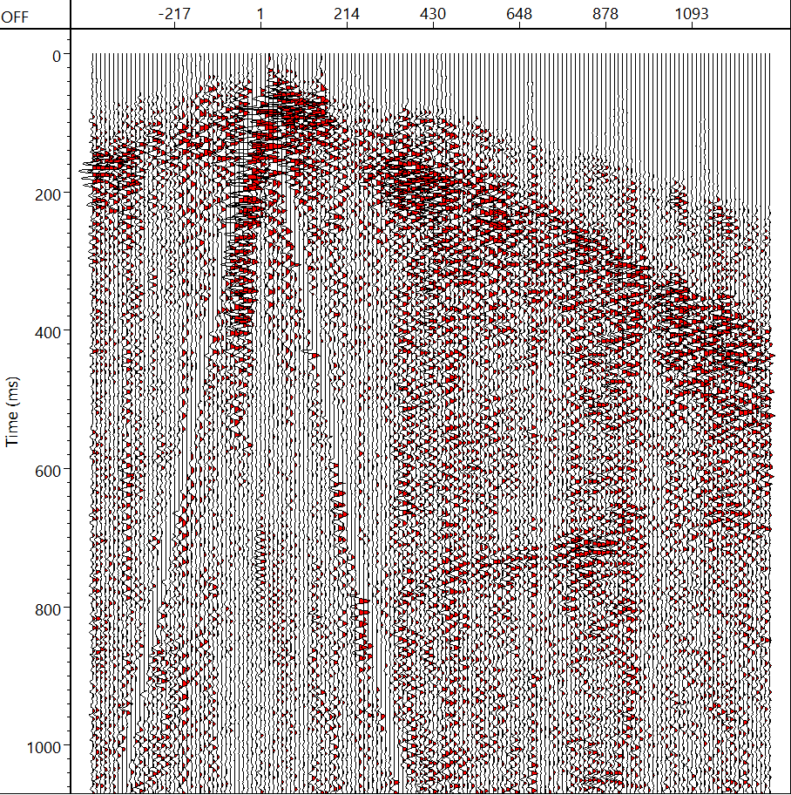
Processing: Phase 3 -5
(m)
Raw data
Spherical div. corr. and band pass filter
Direct P-wave filtered
Direct S-Wave filtered

Slide 11
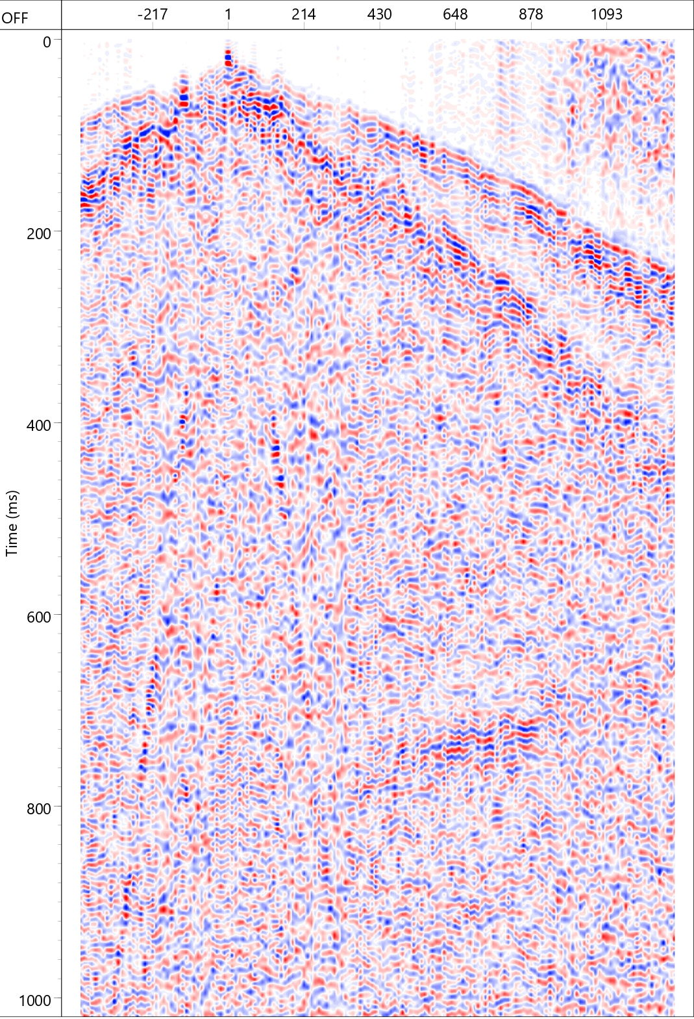
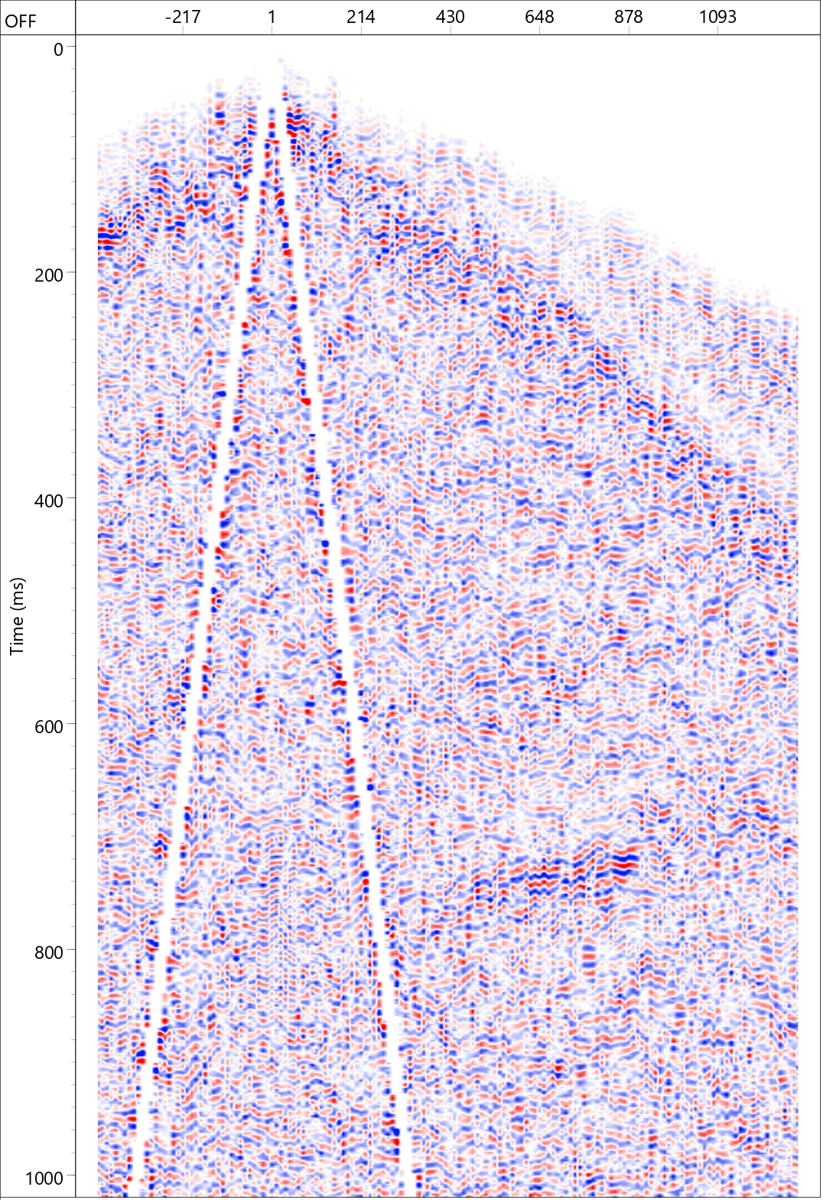
Results: Processed data Line 1
Raw data
Processed data
(m)
(m)
Direct P-wave
After direct P and S-wave filtering
Direct S-wave
Example of a single shot record for line1 (vertical component) before (left) and after (right) processing. AGC applied for better visualization.
Notes:
Better work can be done for the S wave picking and for the airwave mute maybe

