Slide 1
Oxygen balance analysis in the water column of the Black Sea based on a mathematical model
Matvei Novikov¹, Anfisa Berezina² , Svetlana Pakhomova², Evgeniy Yakushev²
¹ Shirshov Institute оf Oceanology. ² Norwegian Institute for Water Research (NIVA).

Slide 2
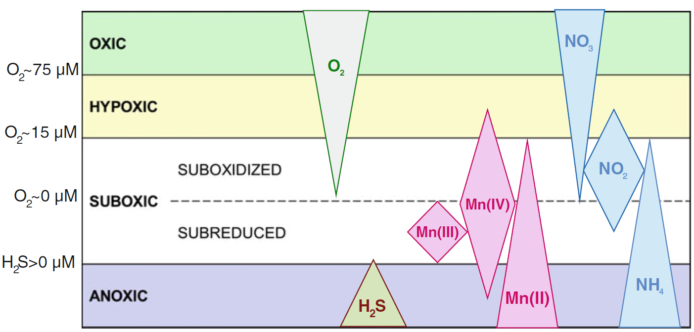
The object of the study
A structure of the oxygen conditions in water column with respect to the distributions of DO, H₂S and indicative speciation of Mn and N (Yakushev,Newton;2012)

Slide 3
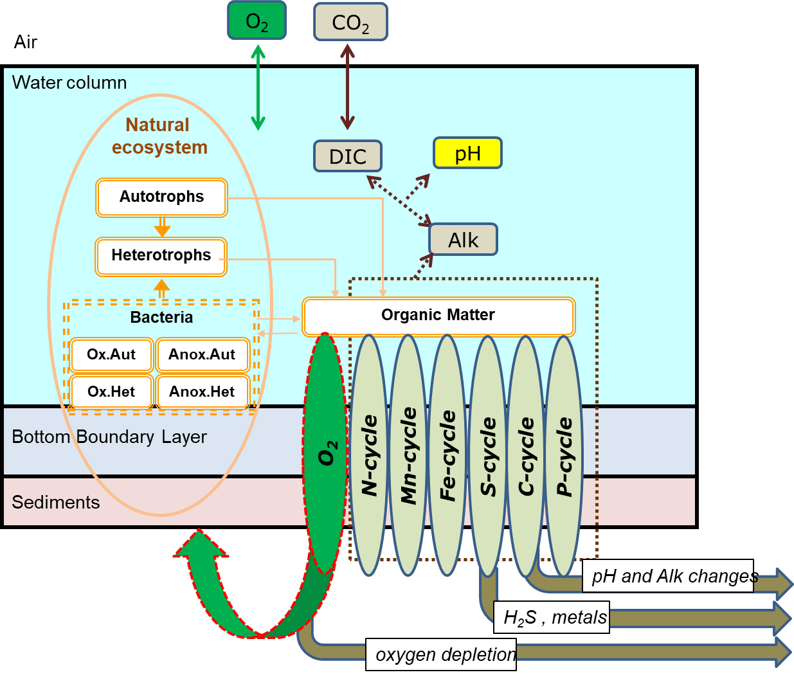
The Bottom RedOx Model (BROM)
Interconnected transfomation of several elements
Case options:
No sediments
Additional vertical velocity term via Mn(IV) aggregation for particulate matter (PM)
doi:10.5194/gmd-10-453-2017
https://github.com/BottomRedoxModel

Slide 4
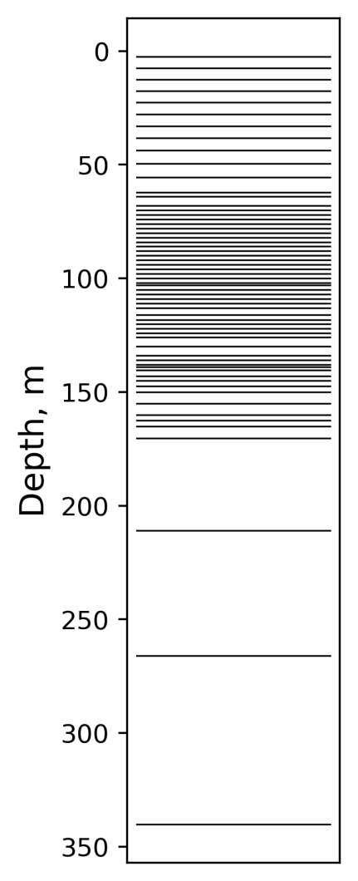
Calculation setup and hydrophysical forcing
Domain type | Vertical column (1D)
Spin up period | 50 years
Max depth | 350 m
Min layer thickness | 1.2 m
Reference year | 2010
Hydrophysics parameters | T, S
Data source | “Copernicus” reanalysis BLKSEA_MULTIYEAR_PHY_007_004
Hydrochemical data | RV “Knorr”, 2003
Vertical transport includes:
vertical viscosity (Gargett, 1997)
sinking

Slide 5
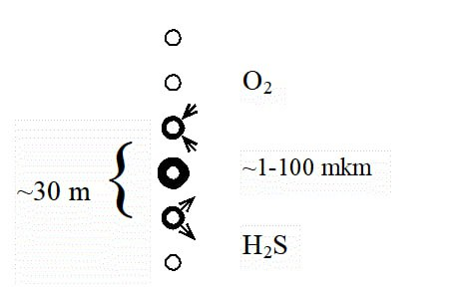
Additional velocity via Mn(IV) aggregation
W_{Ci}=W_{Ci0}+W_{Me} *Mn(IV)/(Mn(IV)+Mnt)
where:
W_{Ci} – total vertical velocity,
W_{Ci0} – the intrinsic vertical velocity of the suspended matter,
W_{Me} – additional vertical velocity,
Mn(IV) – Mn(IV) oxide concentration,
Mnt = 0.1 µМ (empirical coefficient)
PM types: S₀, Mn species, Fe species, CaCO3, POM and plankton species

Slide 6
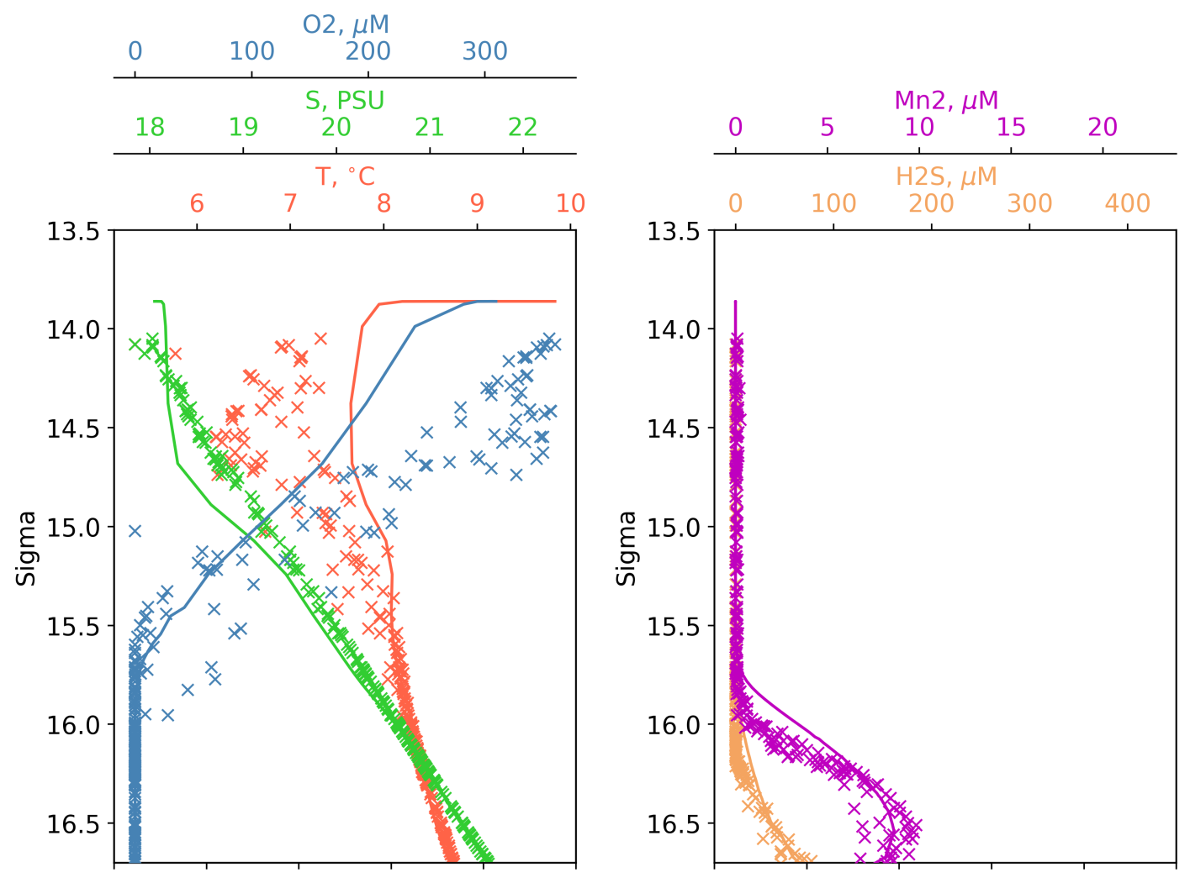
Hydrochemical state consistency
Legend:
‘x’ – Knorr 2003 data
Lines – model data

Slide 7
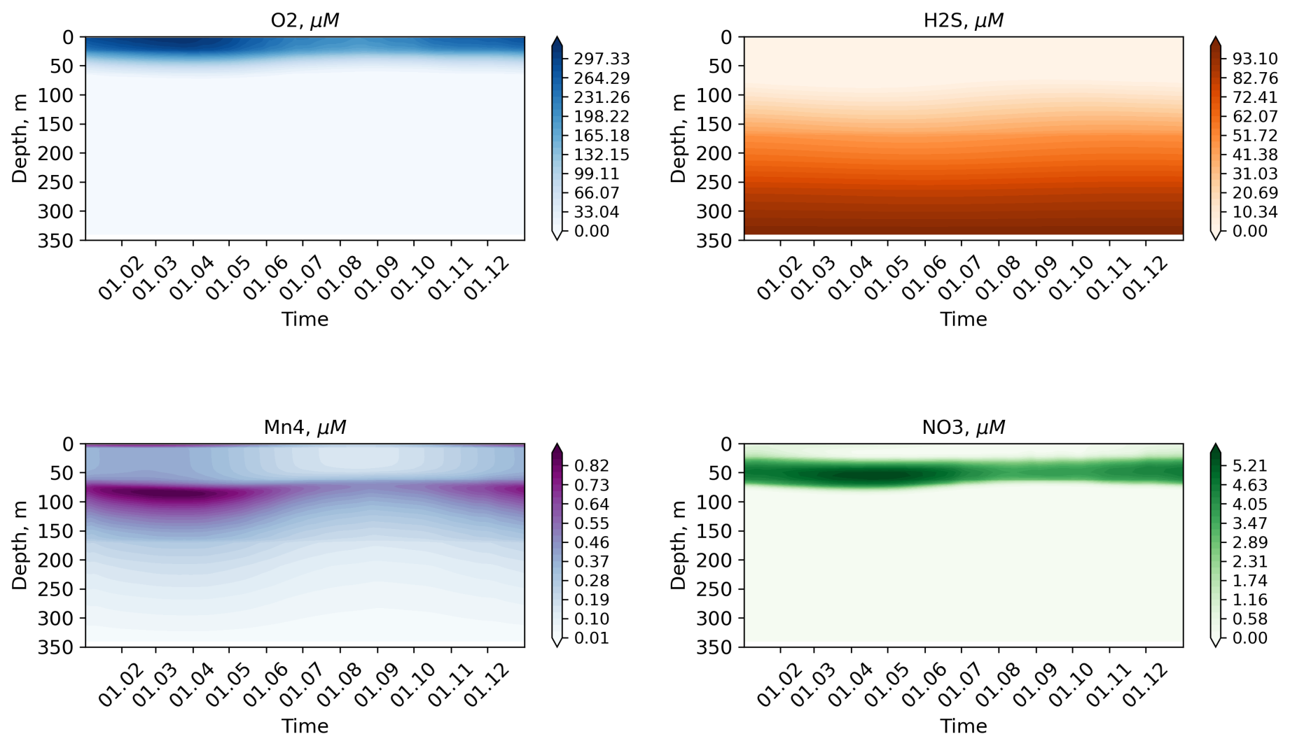
Calculated seasonal variability

Slide 8
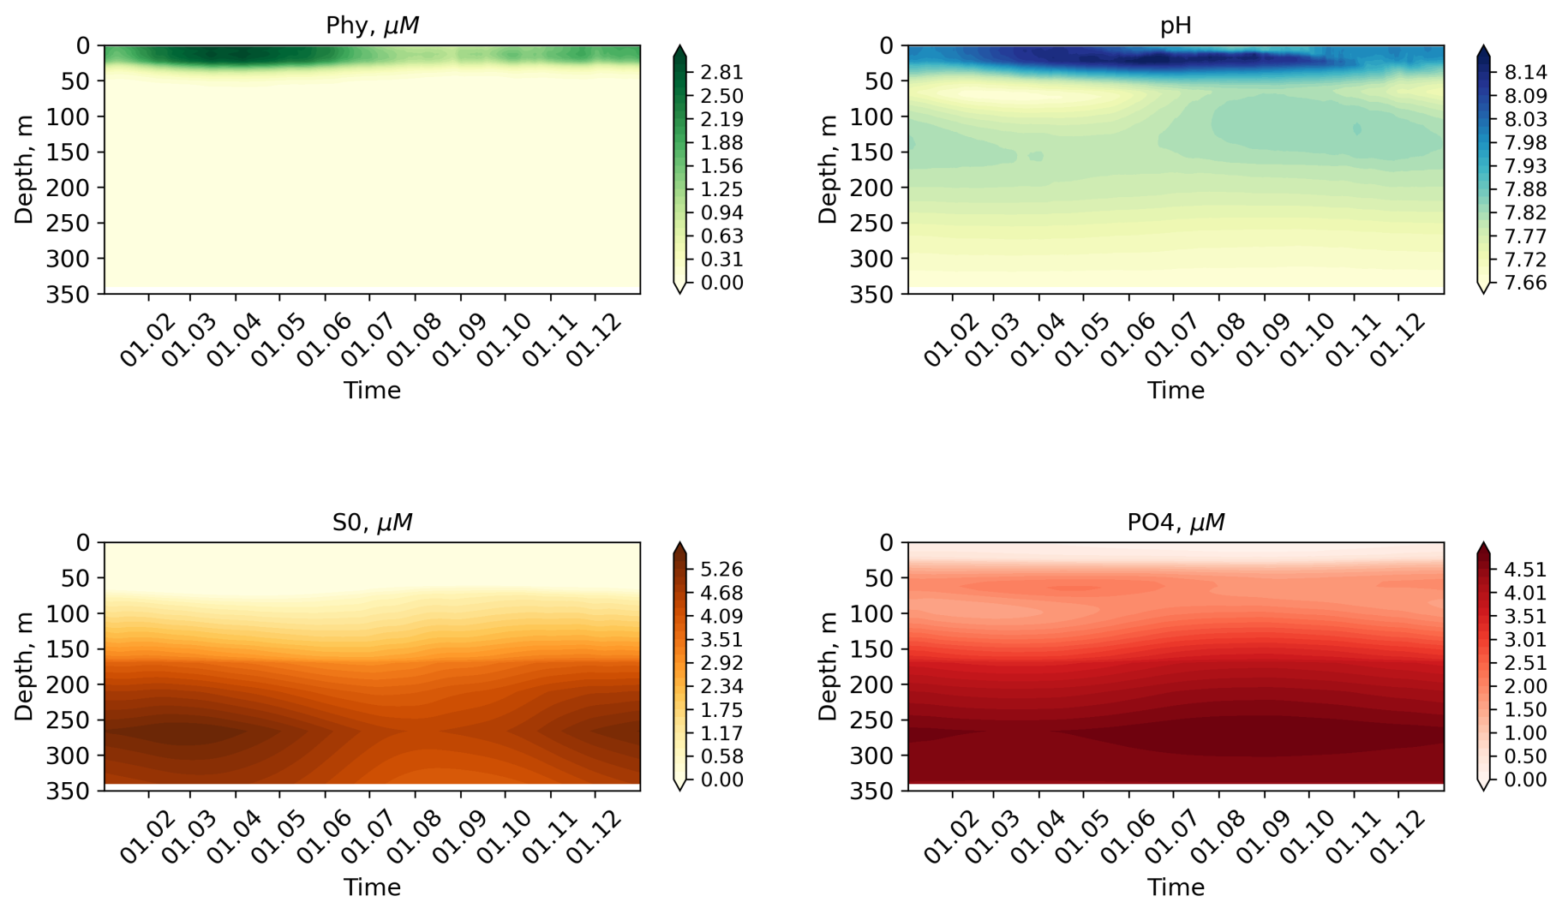
Calculated seasonal variability

Slide 9
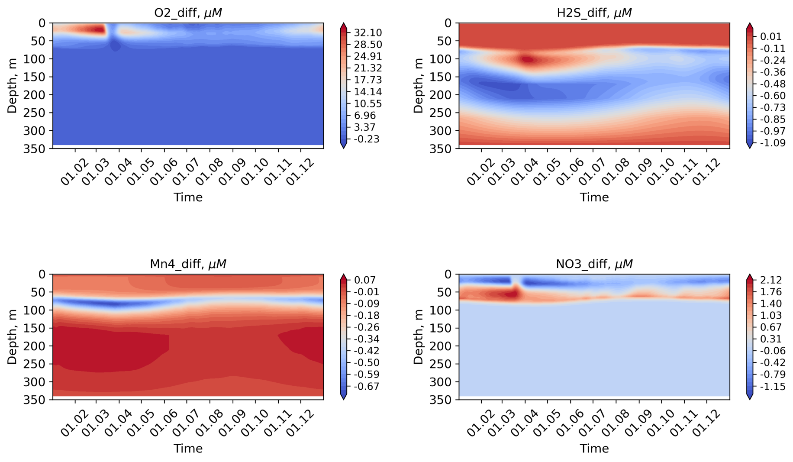
Additional velocity contribution (experiment-base)

Slide 10
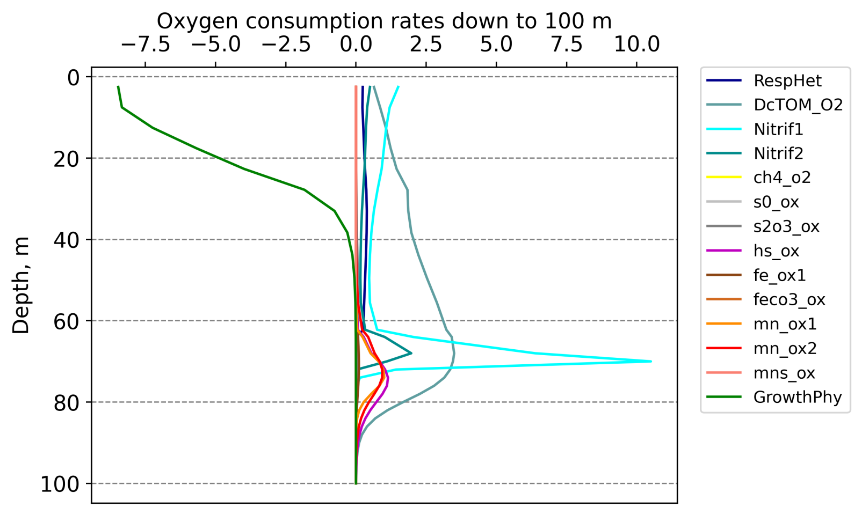
Oxygen consumption in the water column
Photosynthetic O₂ production in upper 50m layer
The most consumption under 60 m

Slide 11
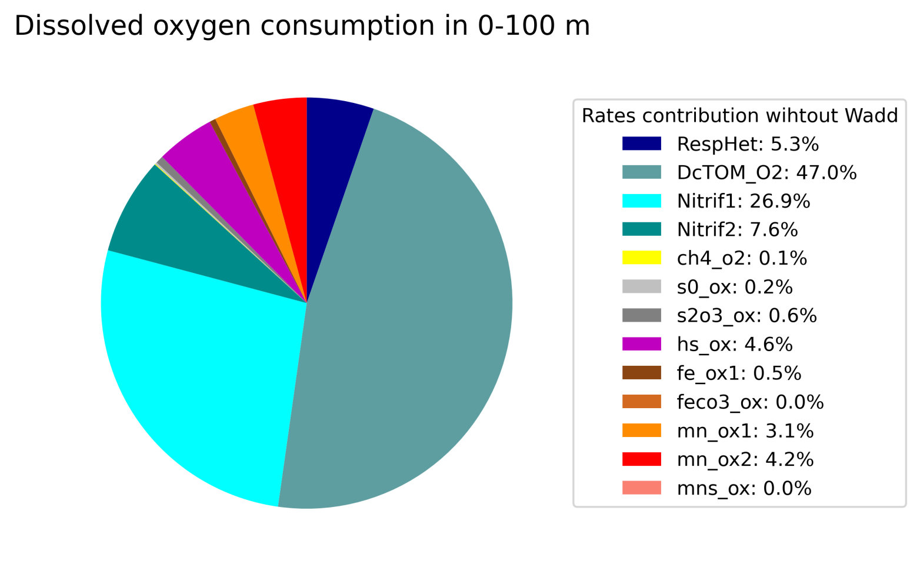
Oxygen consumption
Organic matter (OM) mineralization with 47%
Nitrification (NH₄->NO₂->NO₃) with ~ 35%
Living organisms respiration (5.3%)

Slide 12
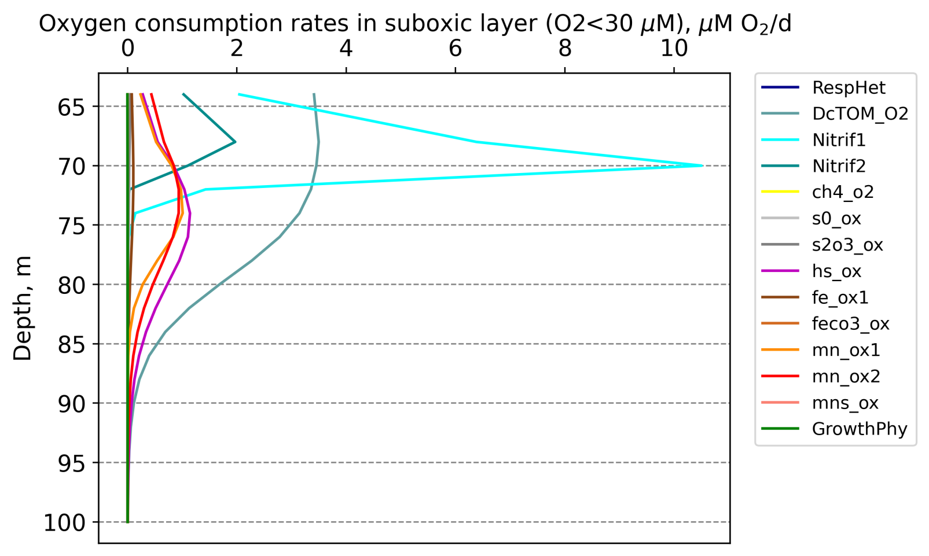
Oxygen consumption in suboxic zone
No photosynthesis and respiration
Increased share for reduced species oxidation

Slide 13
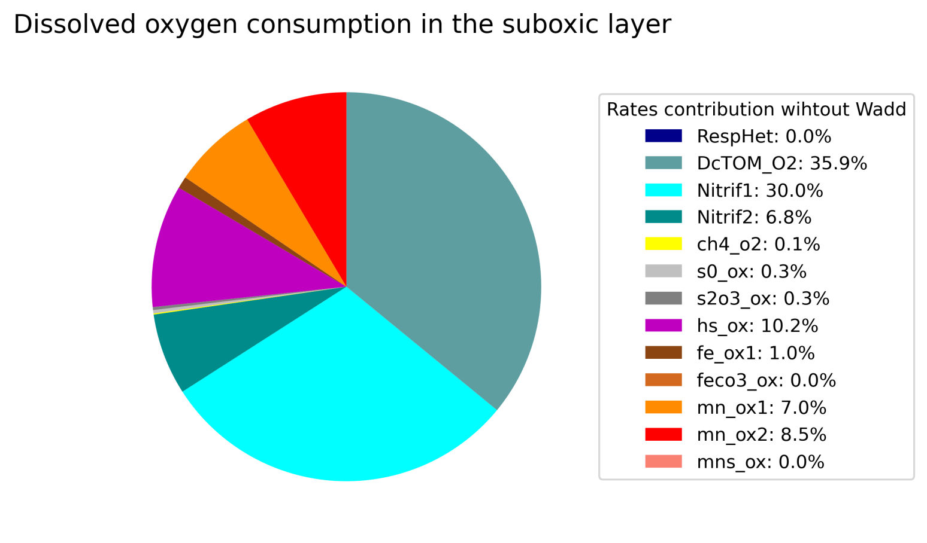
Oxygen consumption balance
OM mineralization ~ 36%
Nitrification ~ 36%
Oxidation of reduced Mn, Fe, S ~ 28%

Slide 14
Conclusions
Parameterization of increased sinking of Mn(IV) covered particles lead to deepening of the redox interface by an average of 2 m.
The main sink of O2 in the Black Sea water column is OM mineralization is about 50%, followed by nitrification – 35% and living organisms respiration . The share of O2 consumption for the reduced species of S, Mn, Fe is 13%.
The main sink of O2 in In suboxic layer (O2>30 µM) is nitrification – 36%, OM mineralization – 36%, and reduced S, Mn, Fe species oxidation– 28 %

Slide 15
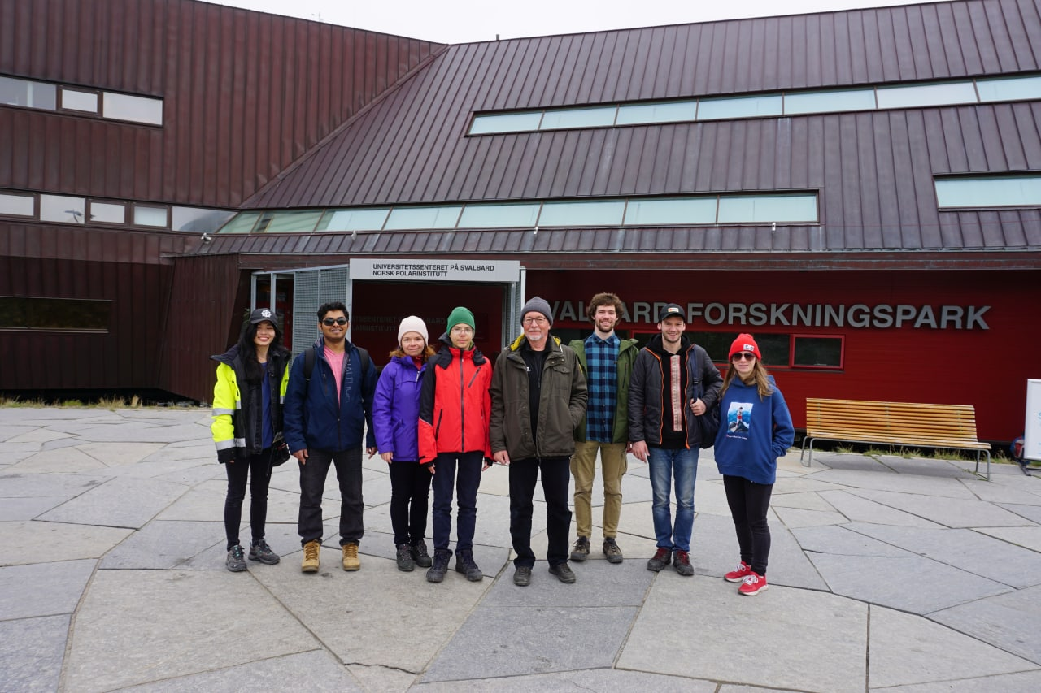
Thank you for your attention!
ma.nowikov@gmail.com
evgeniy.yakushev@niva.no

Slide 16
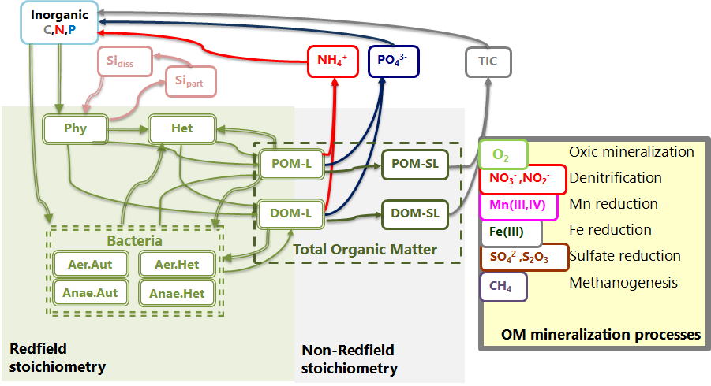
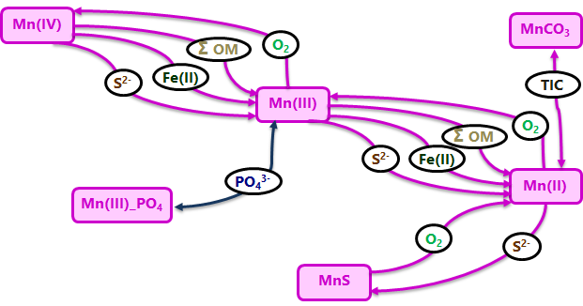
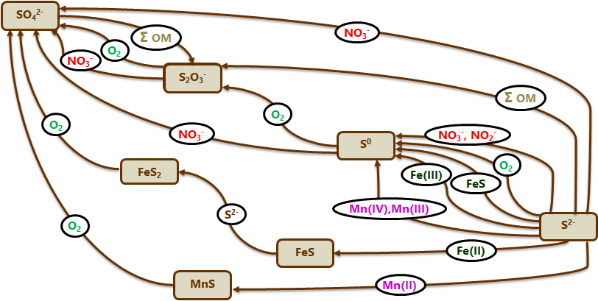
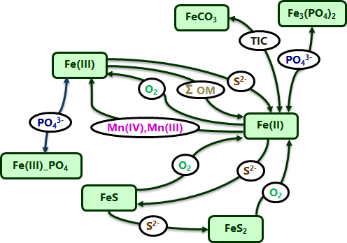
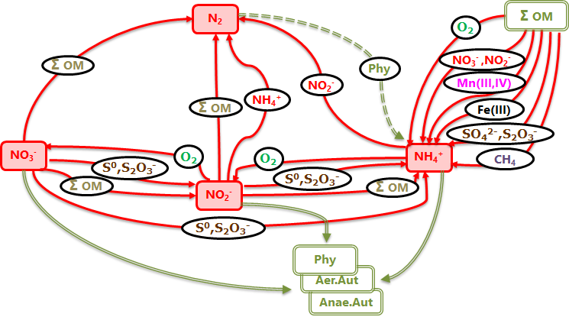
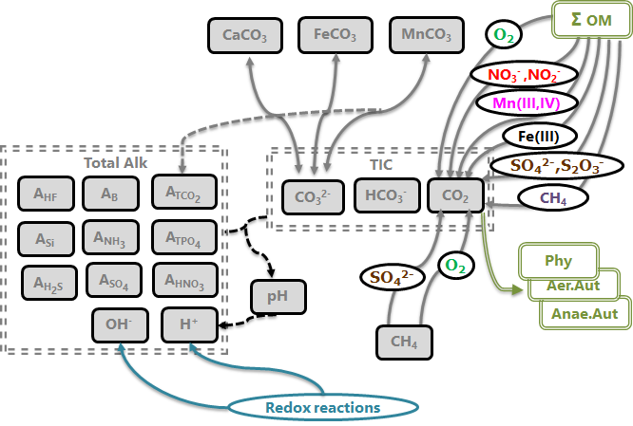
For those, who want more
Mn
S
N
Fe
C

Slide 17
For those, who want more

