Slide 1
Spatio-temporal downscaling of precipitation data
using a
conditional generative adversarial network

Slide 2
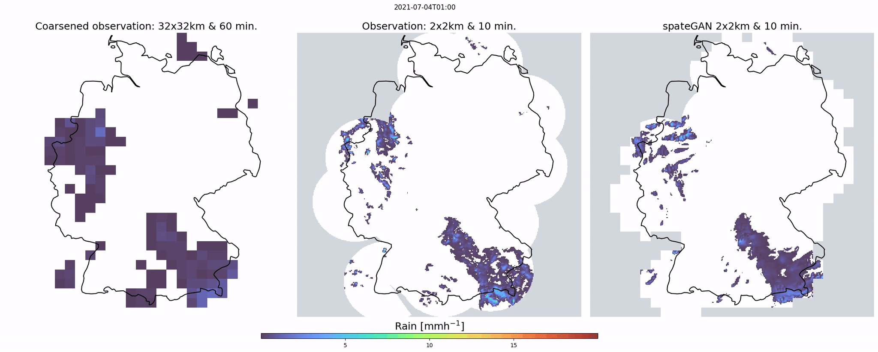
spatio-temporal average
[1]
spateGAN - reconstruction

Slide 3
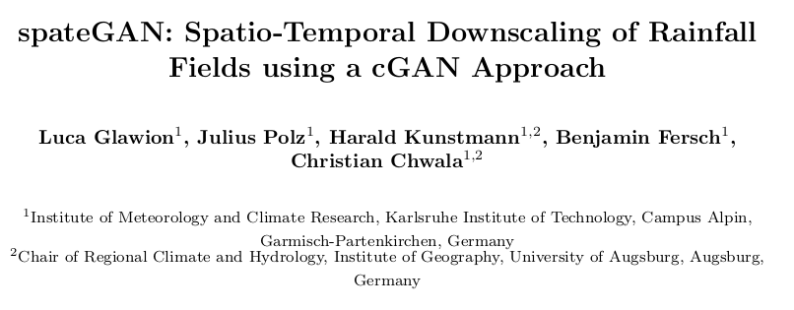
More information: Preprint under review
DOI: 10.22541/essoar.167690003.33629126/v1
Open source model:
DOI: 10.5281/zenodo.7636929
Questions/suggestions:
Ask me via luca.glawion@kit.edu
[1] Glawion, L., Polz, J., Kunstmann, H., Fersch, B. and Chwala, C. (2023): spateGAN: Spatio-Temporal Downscaling of Rainfall Fields using a cGAN Approach - Showcase downscaling and animations (0.1). Zenodo. DOI: 10.5281/zenodo.7636929

