Slide 1
Changes to the IFS atmospheric composition model in support to the CAMS update for CY49R1
Samuel Remy (HYGEOS), Vincent Huijnen (KNMI), Simon Chabrillat (BIRA), Swen Metzger (RC), Jason Williams (KNMI), Daniele Minganti (BIRA), Christine Bingen (BIRA), Mihai Alexe and Johannes Flemming (ECMWF)

Slide 2
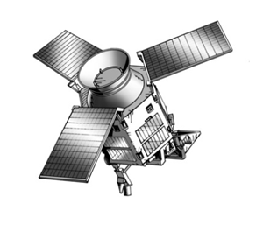
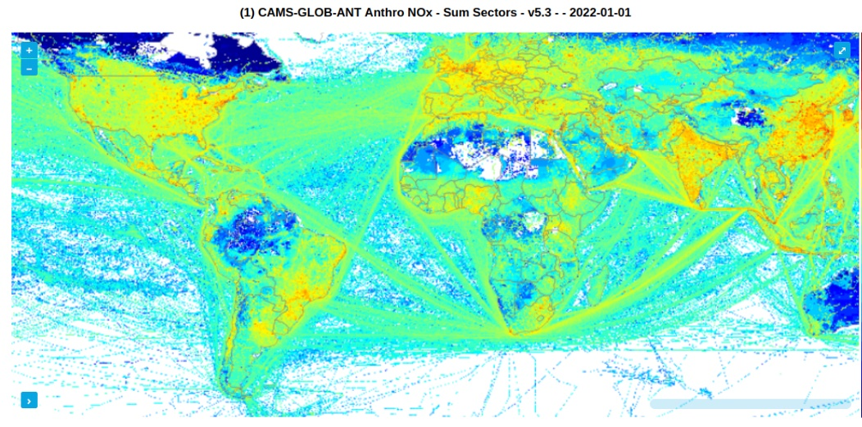
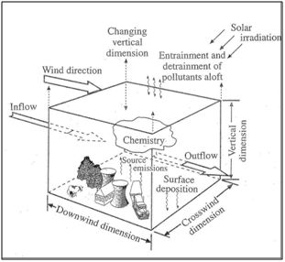
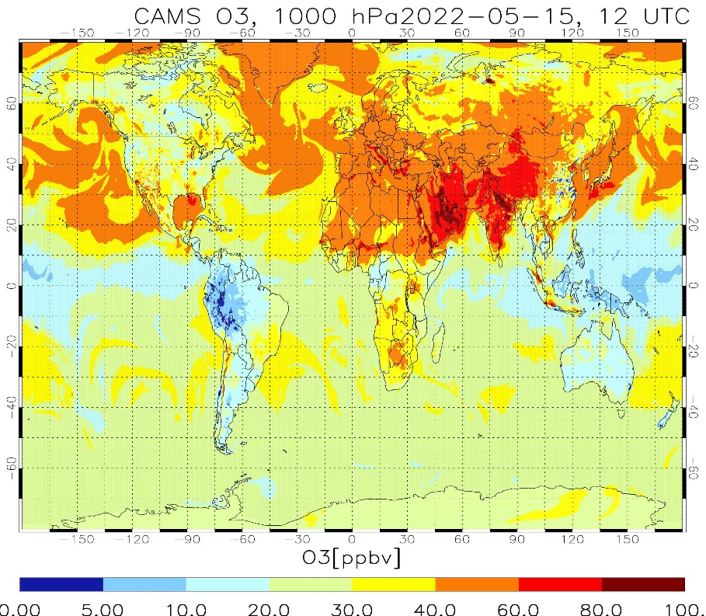
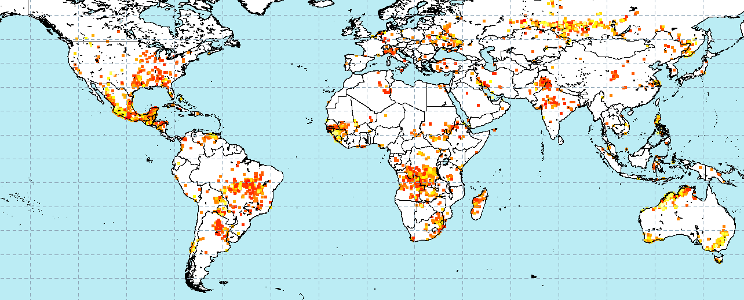
The CAMS global system
IASI, MOPITT,
MODIS, VIIRS, Sentinel, …, missions
CAMS Global atmospheric composition forecasts
Static emissions
data assimilation
and modeling
Daily GFAS fire emissions

Slide 3
Evolution of CAMS operational system
May 2021
Oct. 2021
June 2023
Q? 2024
CY46R1
CY47R1
CY47R2
CY47R3
CY48R1
CY49R1
CY47R3: IFS(CB05-AER); Assimilation of TROPOMI NO₂; Single Precision; TL511L137; …
CY48R1: IFS(CB05-BASCOE-AER);
Stratospheric O₃ chemistry based on BASCOE (see also Huijnen et al., GMD 2016)
Full overhaul of tropospheric VOC and NOy chemistry and solver (Williams et al., GMD 2022)
Revision of dry deposition scheme based on GEOS-Chem module
Updates to inorganic and organic aerosol – new secondary organic aerosol species
Dust updates – optics and emissions, rebound parameterization
Updates to input emissions

Slide 4
Evolution of CAMS operational system
May 2021
Oct. 2021
Q2 2023
Q? 2024
CY46R1
CY47R1
CY47R2
CY47R3
CY48R1
CY49R1
CY49R1: IFS(CB05-BASCOE-AER);
Review of the representation of polar stratospheric clouds and of their impact on stratospheric ozone,
Extension of IFS-AER to represent stratospheric sulfate aerosols, coupled with CB05 and BASCOE precursor gases (see Christine Bingen’s presentation),
Upgrade of gas-particle partitioning through the implementation of EQSAM4Clim in the IFS,
Computation of aerosol, cloud and rain pH, and use of the update pH values in aqueous chemistry (see Swen Metzger’s presentation),
A unified parameterization of aerosols and chemistry deposition processes (wet and dry),
Update of aerosol optics, including a simple representation of dust asphericity and hygroscopic growth,
Update of PM diagnostic output

Slide 5
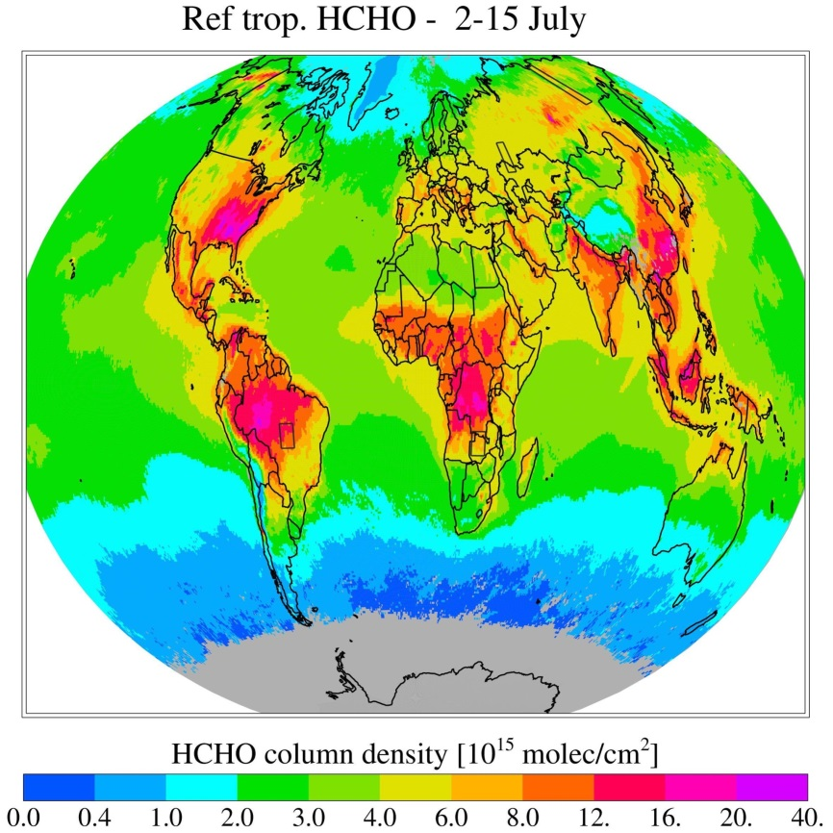
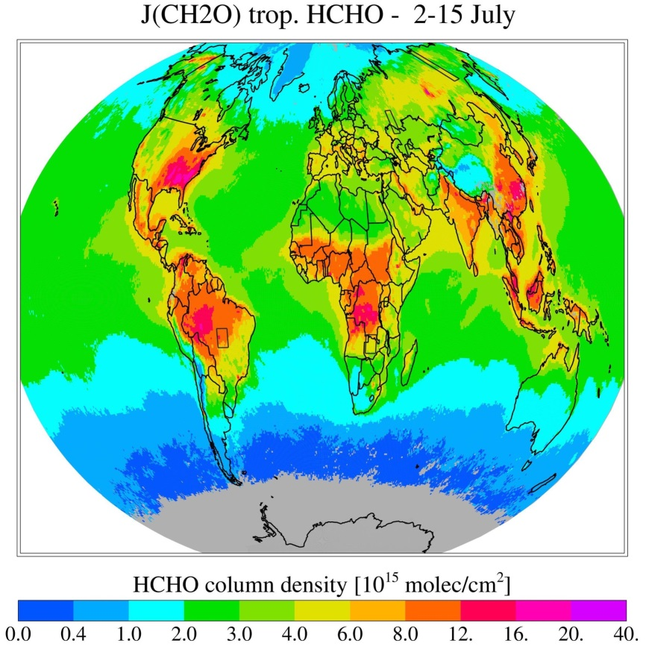
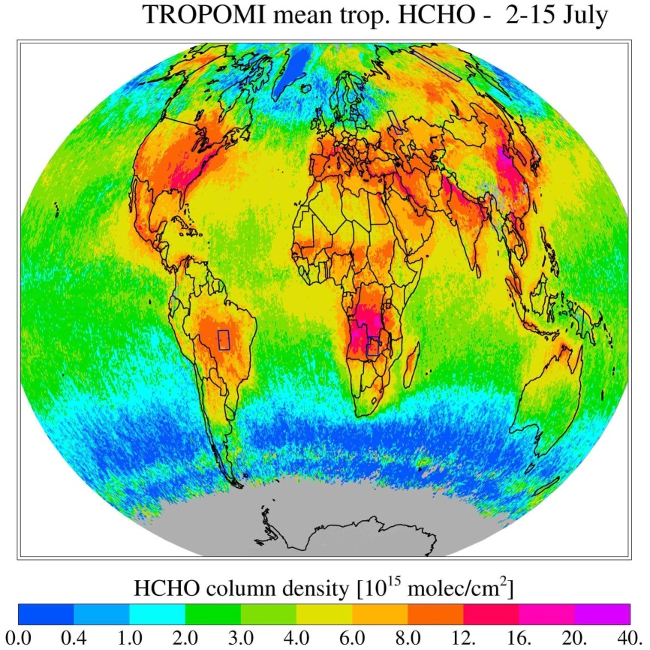
49R1 Tropospheric chemistry updates
.
Updated photolysis for HNO₃, PAN and CH₂O
Impact on simulated HCHO total columns: reduced positive bias over source regions
CY48R1
Pre-CY49R1
TROPOMI

Slide 6
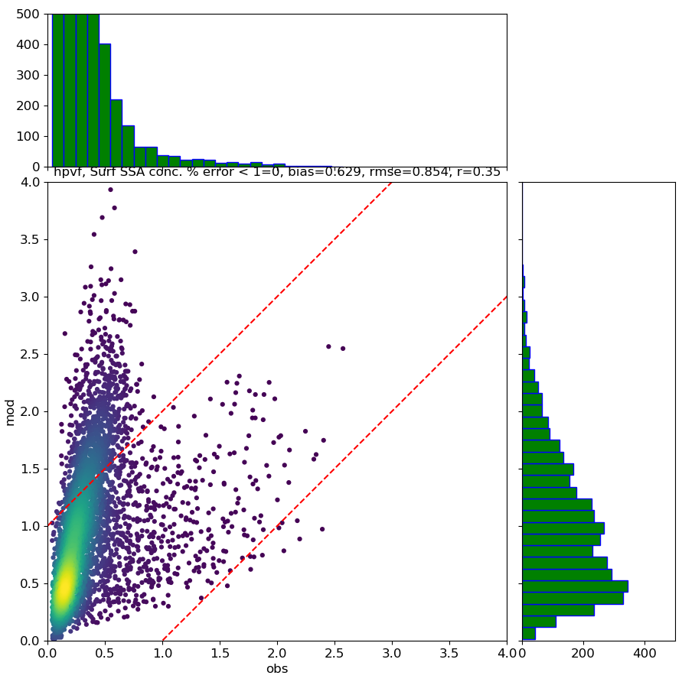
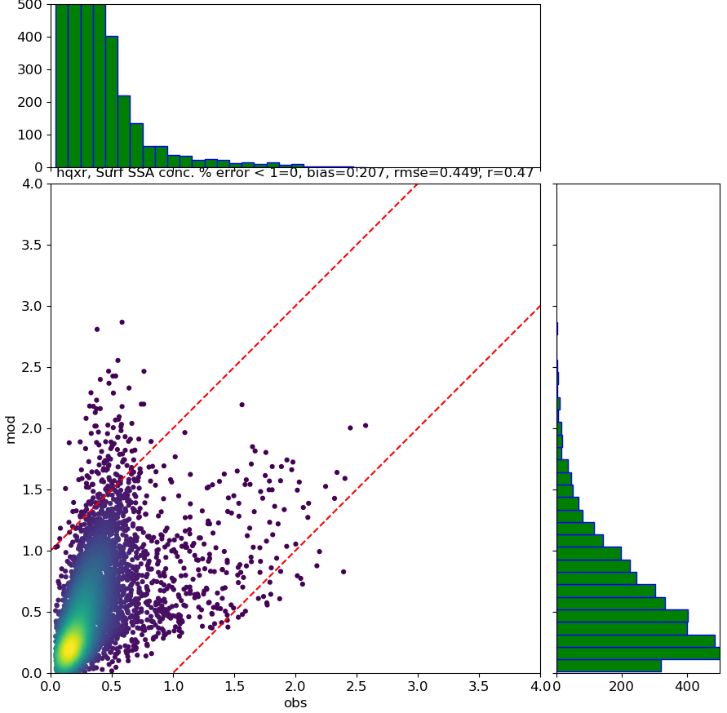
49R1 Tropospheric chemistry updates
.
Use of EQSAM4Clim to compute gas/particle partitioning and estimate aerosol/cloud/rain pH (see Swen Metzger’s talk)
Use of EQSAM4Clim pH in relevant tropospheric chemistry processes: aqueous chemistry and wet deposition
Significant improvement of simulated surface concentration of NH₄/NO₃
B=0.63
RMSE=0.85
R=0.35
B=0.21
RMSE=0.45
R=0.47
CY48R1
Pre-CY49R1
IFS NH₄⁺
IFS NH₄⁺
Obs NH₄⁺
Obs NH₄⁺
Density scatterplots of simulated vs observed weekly NH₄⁺ surface concentrations in ug/m³ during 2019 over the CASTNET network. Without (left) and with (right) the use of EQSAM4Clim in the IFS

Slide 7
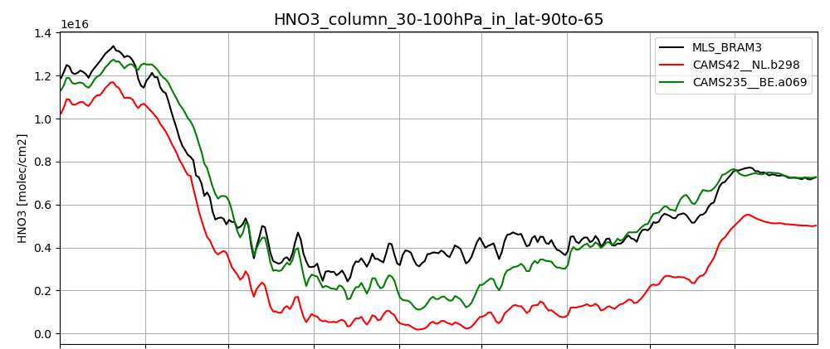
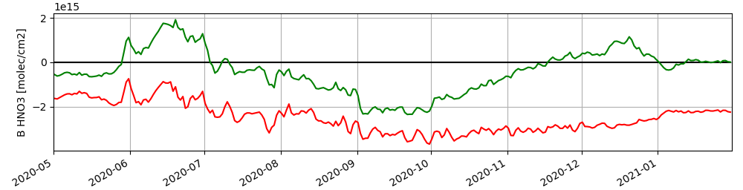
49R1 Stratospheric chemistry updates
Update to the Surface Area Density (SAD) of stratospheric sulfate aerosols, from a multi-annual mean of the output by the model IFS-CB05-BASCOE-GLOMAP (ICBG developed in CAMS_43), to the monthly CMIP6 v4 aerosol SAD dataset;
Update to the calculation of the uptake coefficients, which determine the rates of heterogeneous reactions, following JPL (2015);
The parameterization of the Polar Stratospheric Clouds (PSC) was adjusted in order to minimize the biases between model output and a reanalysis of Aura-MLS observations.
More evaluation in Christine Bingen’s presentation
Comparison between IFS(CBA) in a version similar to 48R1 (red) and similar to pre 49R1 (green) with the BASCOE Reanalysis of Aura-MLS (BRAM3): 2020 partial columns between 30 and 100hPa averaged for the Antarctic region (90°S-65°S) for nitric acid and corresponding biases.

Slide 8
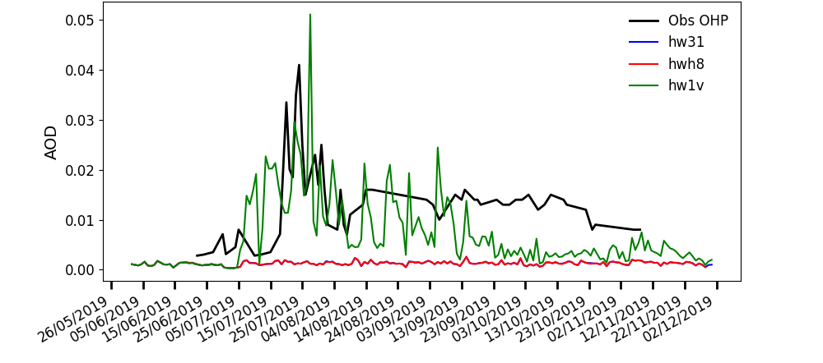
49R1 Stratospheric aerosol updates
Implementation of a stratospheric extension of IFS-AER (please see Christine Bingen’s presentation) in order to represent the impact of large volcanic eruptions
Evaluation against GloSSAC, GOMOS and ground LIDARs
Comparison of observed stratospheric AOD at 532 nm at the Observatoire de Hautes Provence (OHP, SE France) and simulated stratospheric AOD at 550nm from experiment without (red) and with volcanic emissions from the Raikoke eruption (green) of June 2019.
Theoretical pathway of simulating a stratospheric eruption and assimilating the corresponding observations of SO₂ and AOD.

Slide 9
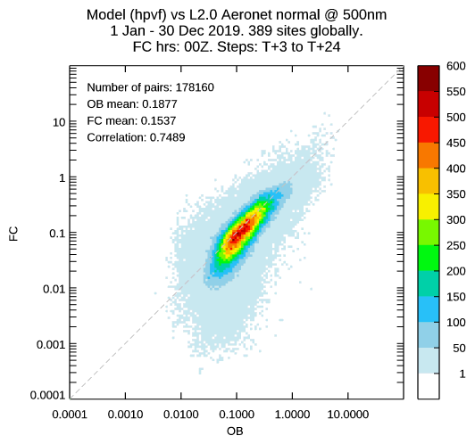
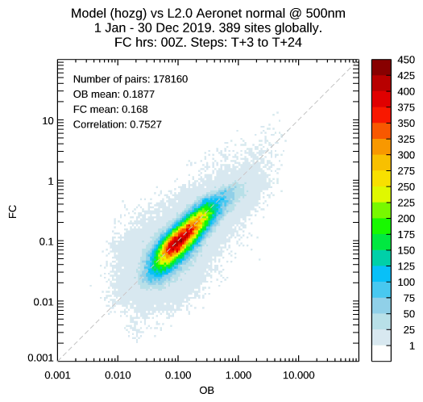
49R1 Dry and wet deposition updates
Aerosol and chemistry dry and wet deposition are now treated in the same routines
Use of a temperature dependent aerosol activation fraction for in-cloud wet deposition from Verheggen et al. (2007)
Review of aerosol below-cloud wet deposition coefficients – dependent on precipitation intensity.
Significantly improves simulated AOD in cold regions
CY48R1
Pre-CY49R1
Density scatter plots of 3 hourly AOD at 500nm against global AERONET data for the year 2019. Left, reference run, right, with updated wet deposition.

Slide 10
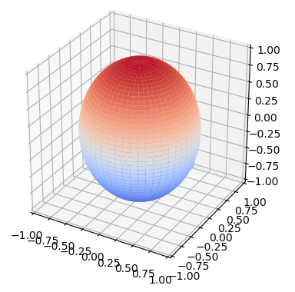
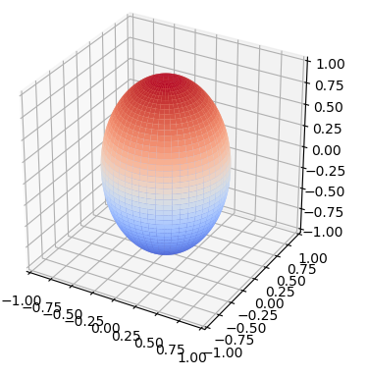
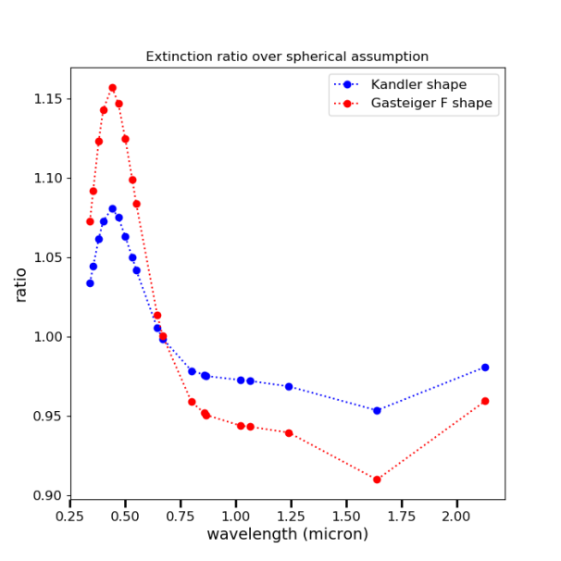
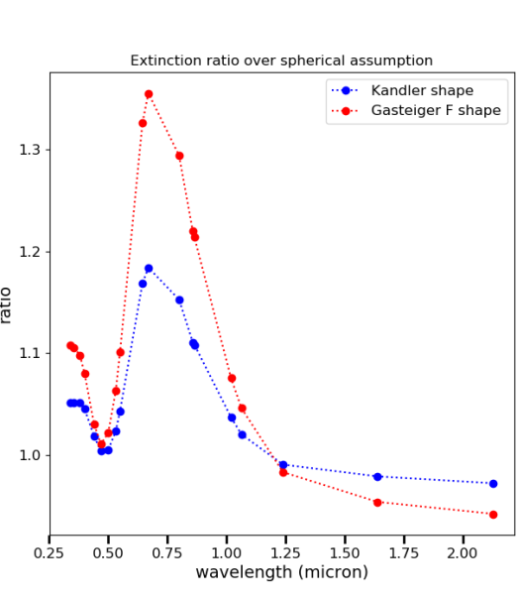
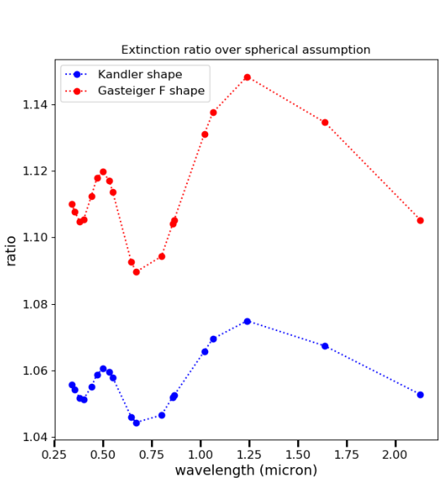
49R1 Tropospheric aerosol updates
Simple representation of dust asphericity and hydrophilic growth,
Update of the aerosol optics,
New aging parameterization of carbonaceous aerosols, using input from chemistry,
Updated PM diagnostic
K09 shape
G11 shape
Dust bin 1
Dust bin 2
Dust bin 3
scaling factor for mass extinction for the two K09 and G11 shapes, as compared to the spherical assumption, as a function of wavelength and for the three dust bins computed with MOP-SMAP.

Slide 11
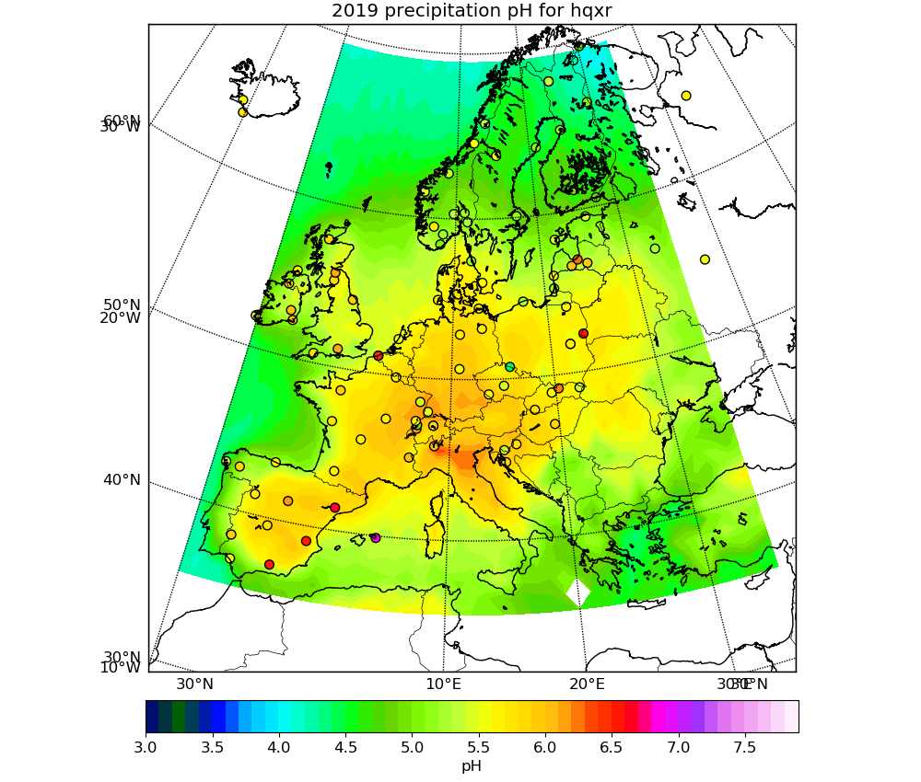
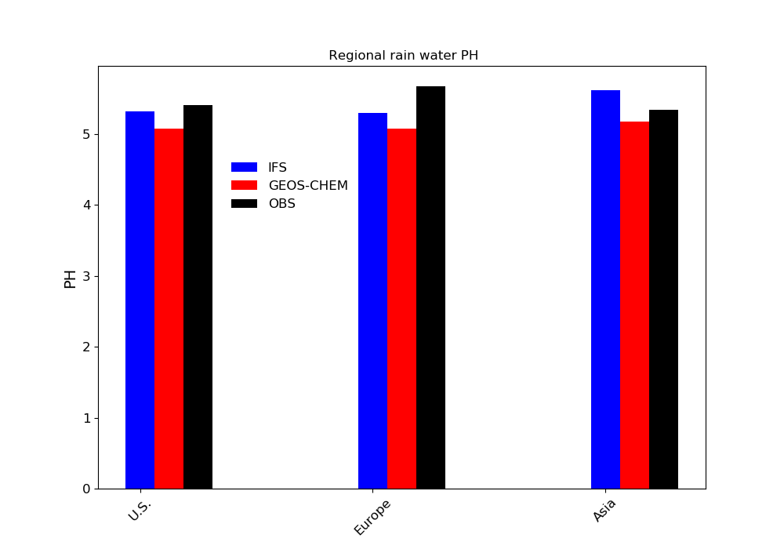
49R1 new experimental products
Thanks to the implementation of EQSAM4Clim and its coupling with chemistry, cloud and rain pH are computed
Aerosol Surface Area Density in the stratosphere
Simulated rain water pH of IFS (REFpH) over Europe as compared against EMEP observations, averaged between surface and the top of the model column for 2019.
Regionally averaged 2019 (2013 for GEOS-Chem) simulated and observed rain water pH. Black: Observations, blue: IFS,
red: GEOS-Chem from Shah et al. (2020, ACP).

Slide 12
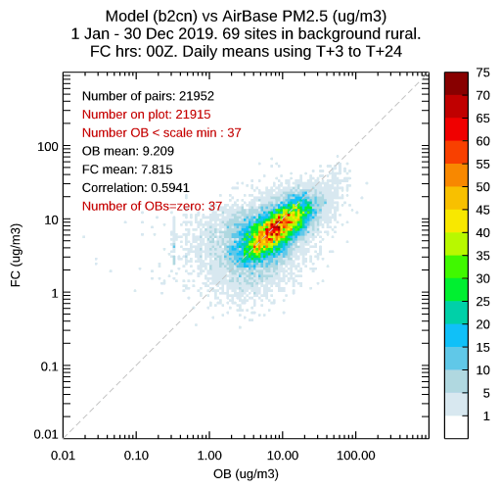

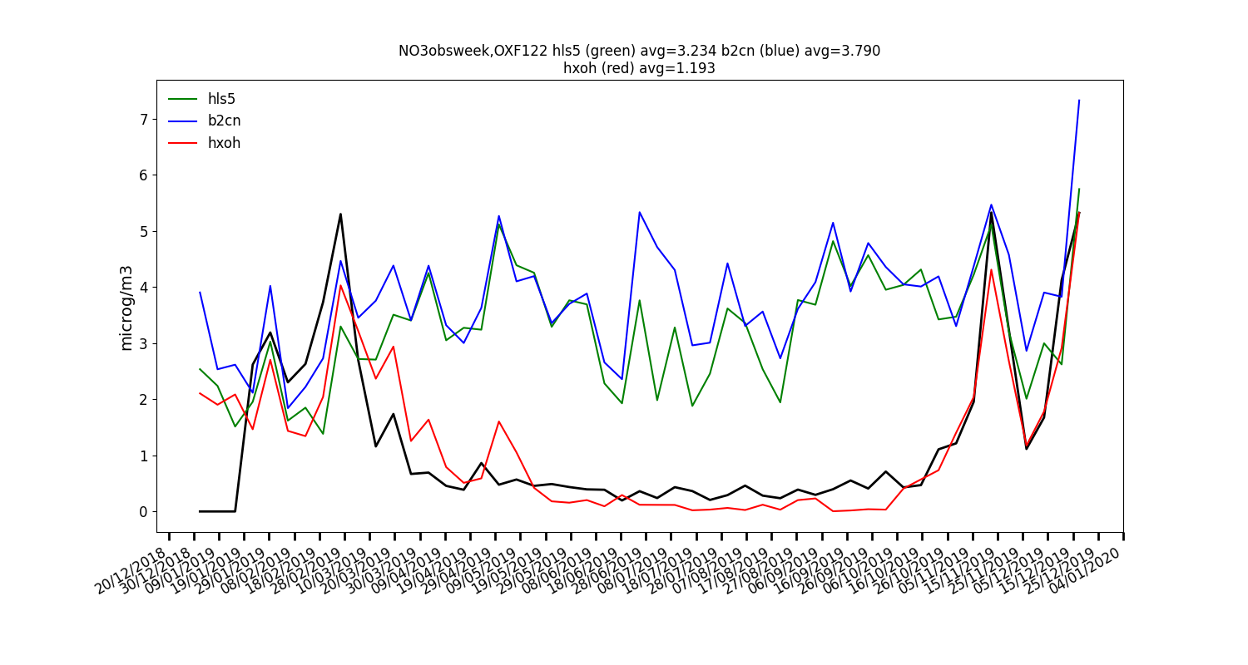
49R1 Evaluation and ongoing tests
Forecast only and data assimilation runs are ongoing, with evaluation against many ground and remote sensing observational datasets.
Results shown here don’t use data assimilation
Simulated weekly surface nitrate vs obs (black) at the CASTNET OXF22 station: forecast only 47R3 (green), 48R1 (blue) and
pre 49R1 (red).
2019 Density scatterplot of daily simulated vs observed PM2.5 over background rural stations in Europe, forecast only 48R1 (left) and pre 49R1 (right).

Slide 13
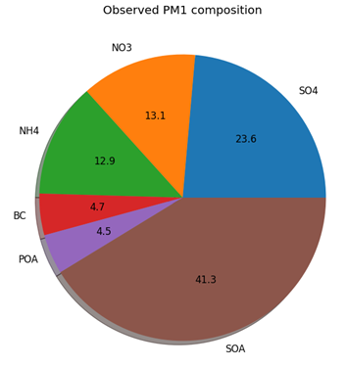
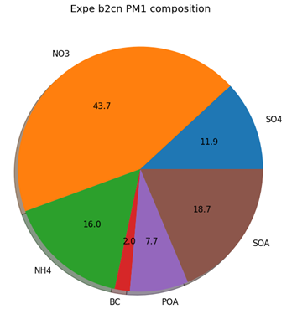
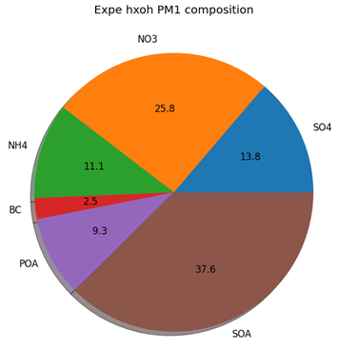
49R1 Evaluation and ongoing tests
Forecast only and data assimilation runs are ongoing, with evaluation against many ground and remote sensing observational datasets.
Results shown here don’t use data assimilation
Fc only 48R1
Fc only pre 49R1
Observed
CY48R1 FC-only
Pre-CY49R1 FC-only
2019, simulated PM1 composition over the HohenPeissenberg station in Germany:
Improved aerosol distribution with Pre-CY49R1

Slide 14
Summary
CY49R1: IFS(CB05-BASCOE-AER) CAMS model system update:
A strong update compared to its predecessor, integrating developments across topics, and harvesting multiple years of developments
A clear improvement on numerous metrics as compared to CY48R1.
Cycle will form basis for use in next CAMS Reanalysis
Outlook
Further dust developments (more dust bins – emissions)
Extension of tropospheric chemistry to include halogens
Continued efforts towards improving comparison vs surface air quality observations

