Slide 1
28 April 2023 14:14 – 14:16 CET
Overview
Summary
Tagging O₃ with its precursor sources
Attribution of Tropospheric Ozone to
Sources of NOx and VOC Precursor Emissions in a Global Chemistry-Climate Model
(CESM1.2.2-CAM4-Chem)
for the 2000-2018 Period
O
O
O
Adi Nalam^{1,2}, Aura Lupascu¹, Tim Butler^{1,2}
1. Research Institute for Sustainability, Potsdam, Germany
2. Freie Universitaet Berlin, Berlin, Germany
Prec. NOx:
European
Prec. VOC:
Biogenic
Results
adinalam@zedat.fu-berlin.de

Slide 2
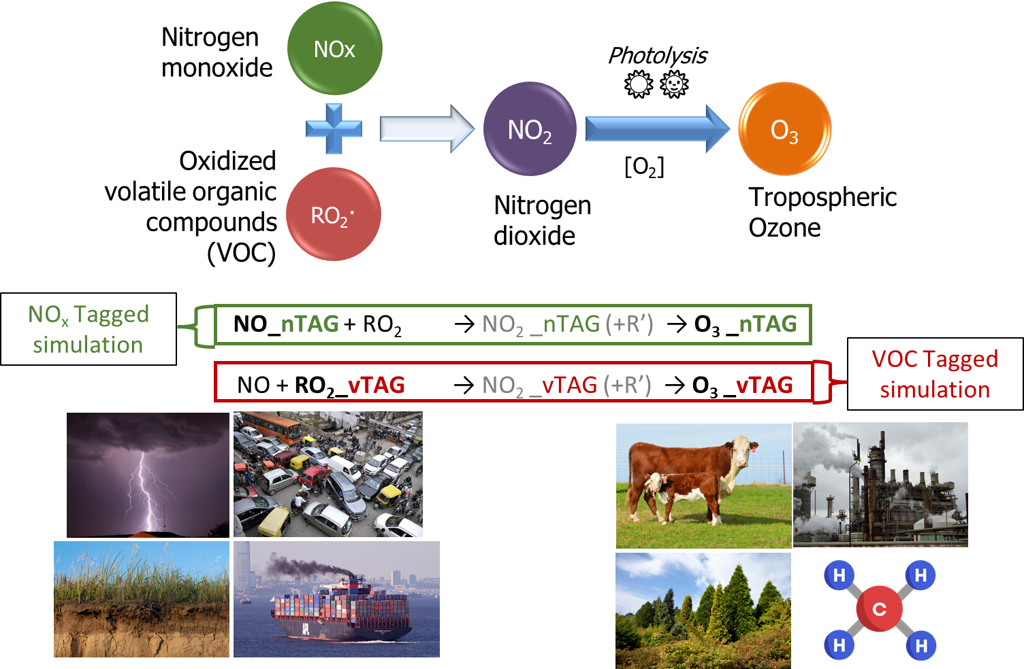
Overview
Background
Tropospheric ozone is a major air pollutant and an important greenhouse gas
Labelling (or Tagging) ozone molecules with their precursor sources in chemistry-climate models can help us understand the contributions of precursor emissions from various regions/sectors.
Separate simulations for NOx and VOC tagging
Next: Simulation setup
adinalam@zedat.fu-berlin.de

Slide 3
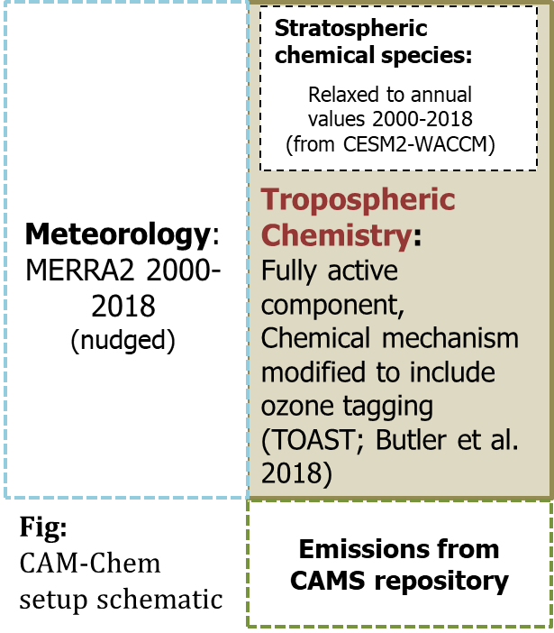
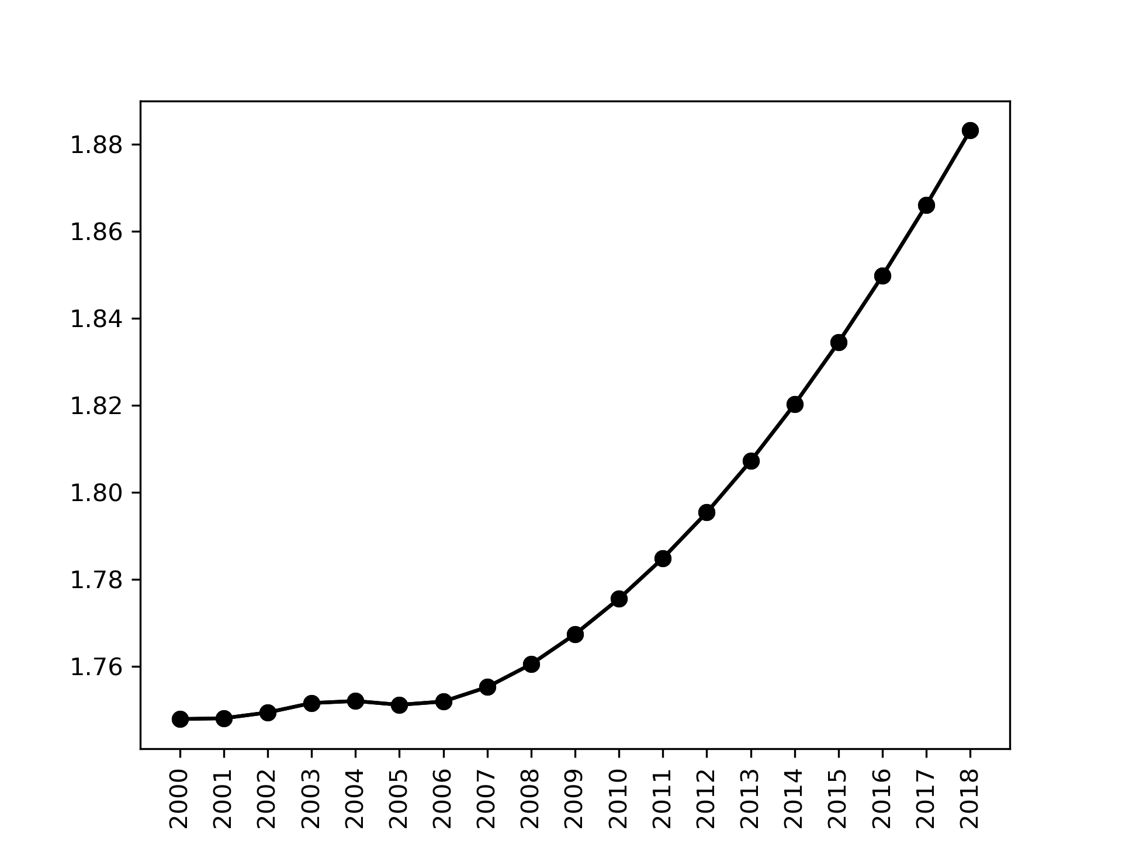
Overview
Simulations
List of tags in our NOx-tagged simulation:
Stratospheric influx
Biogenic
Biomass Burning (GFED)
Aircraft (from CAMS-GLOB-AIR)
Lightning
Anthropogenic ↓
List of tags in our VOC-tagged simulation:
Stratospheric influx
Biogenic (CAMS-GLOB-BIO)
Biomass Burning
Aircraft
Methane
Anthropogenic ↓
1.9x2.5⁰ horizontal resolution, 56 vertical levels
Annually varying prescribed CH4 concentration , years 2000-2018
Anthropogenic tags (from CAMS-GLOB-ANT):
North America
Europe
East Asia
South Asia
Middle-East
Russia-Belarus-Ukraine
Shipping (from CAMS-GLOB-SHIP)
Rest of the world
Next: Questions
adinalam@zedat.fu-berlin.de

Slide 4
Overview
Questions
Contribution
What is the typical contribution of precursor emissions from various regions/sectors to tropospheric O₃ burden?
Efficiency
How does the ozone production efficiency respond to changing precursor emissions during the 2000-2018 period?
Contrast
How do contributions to burden contrast with contribution to surface O₃ and population weighted O₃?
Precursor Emission
Trop. O₃ burden
Links to results
Ozone production efficiency
Surface Ozone and exposure
Link to this questions slide
Q
adinalam@zedat.fu-berlin.de

Slide 5
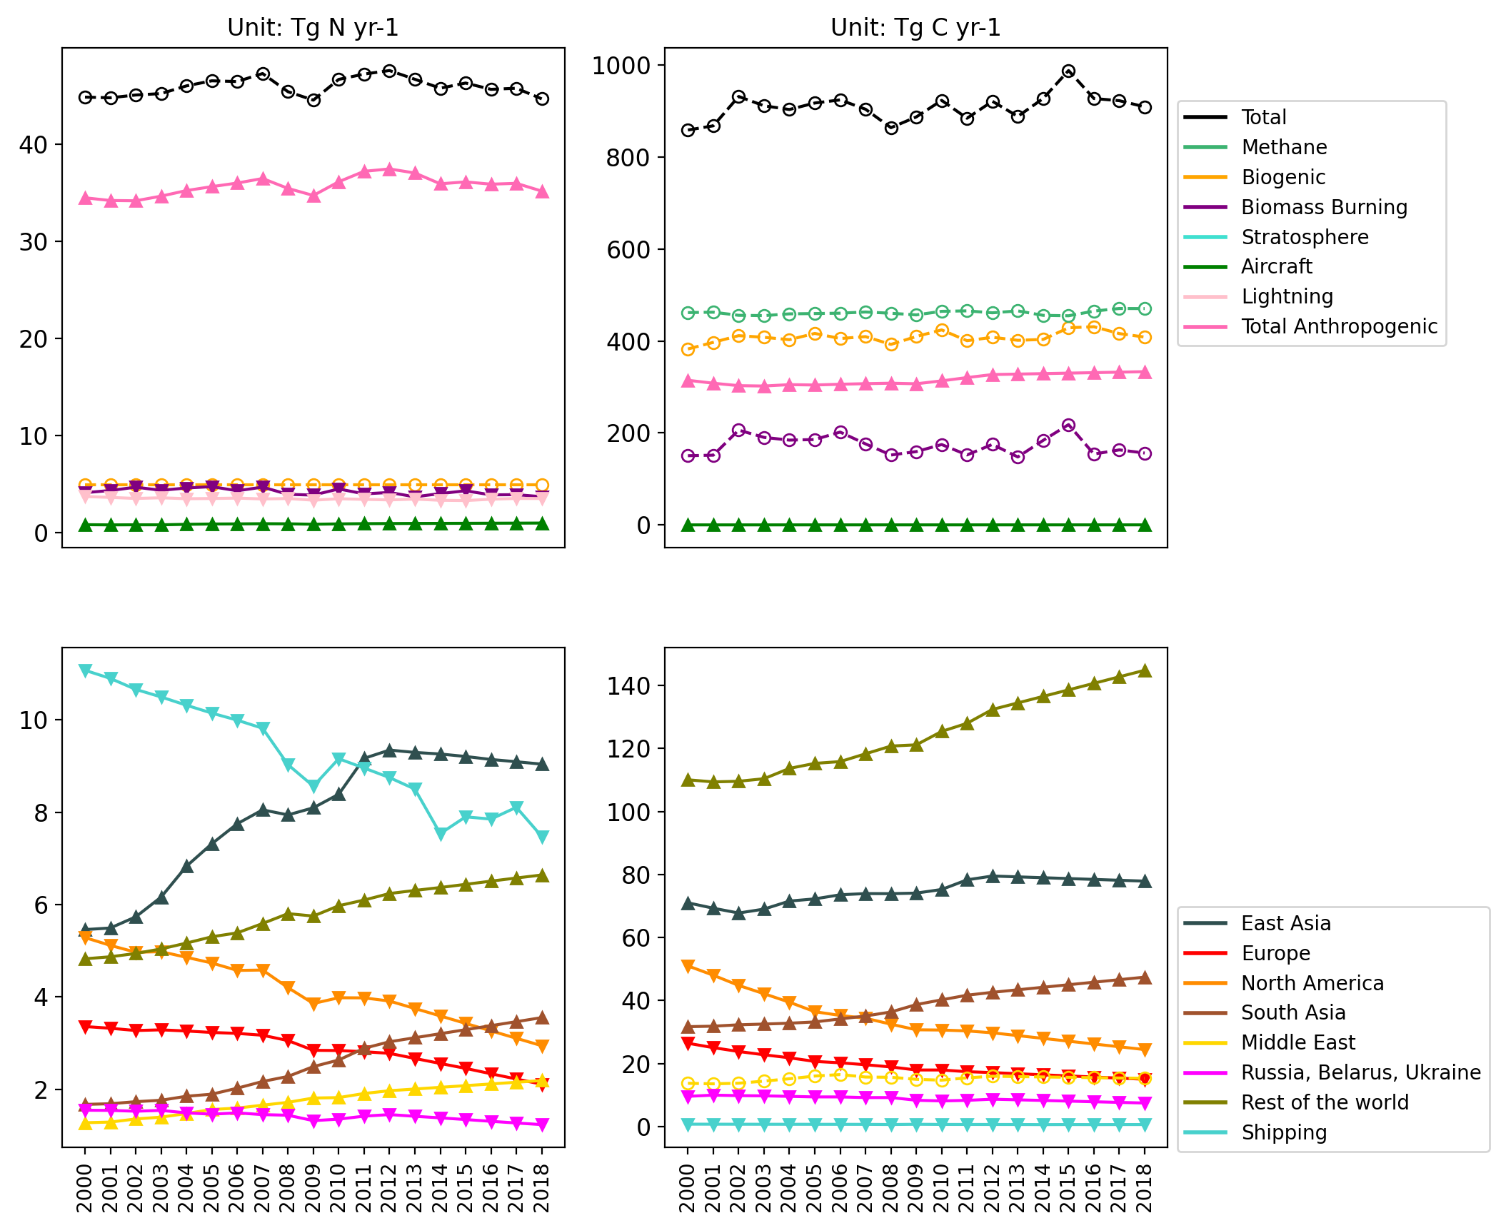
Results
Precursor Emissions
NOx emissions (TgN yr ⁻¹)
VOC emissions (TgC yr ⁻¹)
Anthropogenic NOx emissions are much larger than natural sources
Methane and Biogenic VOCs are the largest source of VOCs (more than anthropogenic VOCs)
East Asian emissions peak at 2012 and start declining after that
South Asian and Rest of the world emissions increase throughout the period
North American, Russian and European decrease throughout the period
1
CH4
2
▲ Increasing trend
▼Decreasing trend
Օ No trend
Regional Contribution to Total Anthropogenic emissions
SHIP
Click on the colored buttons for elaboration
4
SHIP
Why are ship NOx emissions so large?
3
3
Why don’t we see plateau followed by increase ?
4
4
CH4
5
4
5
Q
adinalam@zedat.fu-berlin.de

Slide 6
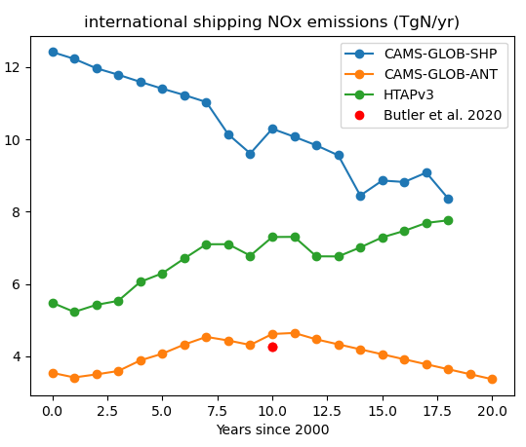
Results
SHIP
NOx emissions (TgN yr ⁻¹)
VOC emissions (TgC yr ⁻¹)
Click here to go back to previous
SHIP
Why are ship NOx emissions so large?
▲ Increasing trend
▼Decreasing trend
Օ No trend
Regional Contribution to Total Anthropogenic emissions
SHIP
We use CAMS-GLOB-SHIP dataset, which have the largest ship NOx emissions compared to other datasets
If we use other emission datasets, we can expect major changes in ship contribution to trop O3 burden
Q
adinalam@zedat.fu-berlin.de

Slide 7
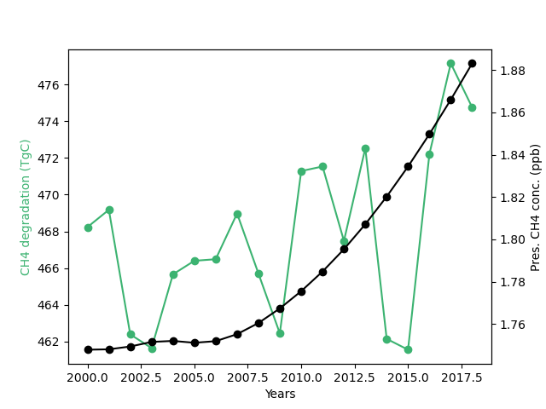
Results
CH4
NOx emissions (TgN yr ⁻¹)
VOC emissions (TgC yr ⁻¹)
Click here to go back to previous
CH4
Why don’t we see plateau followed by increase ?
CH4
▲ Increasing trend
▼Decreasing trend
Օ No trend
Regional Contribution to Total Anthropogenic emissions
Methane degradation from OH radical is the mass of methane that is chemically active
Large interannual variability seen in CH4 degradation, as opposed to prescribed concentration
Q
adinalam@zedat.fu-berlin.de

Slide 8
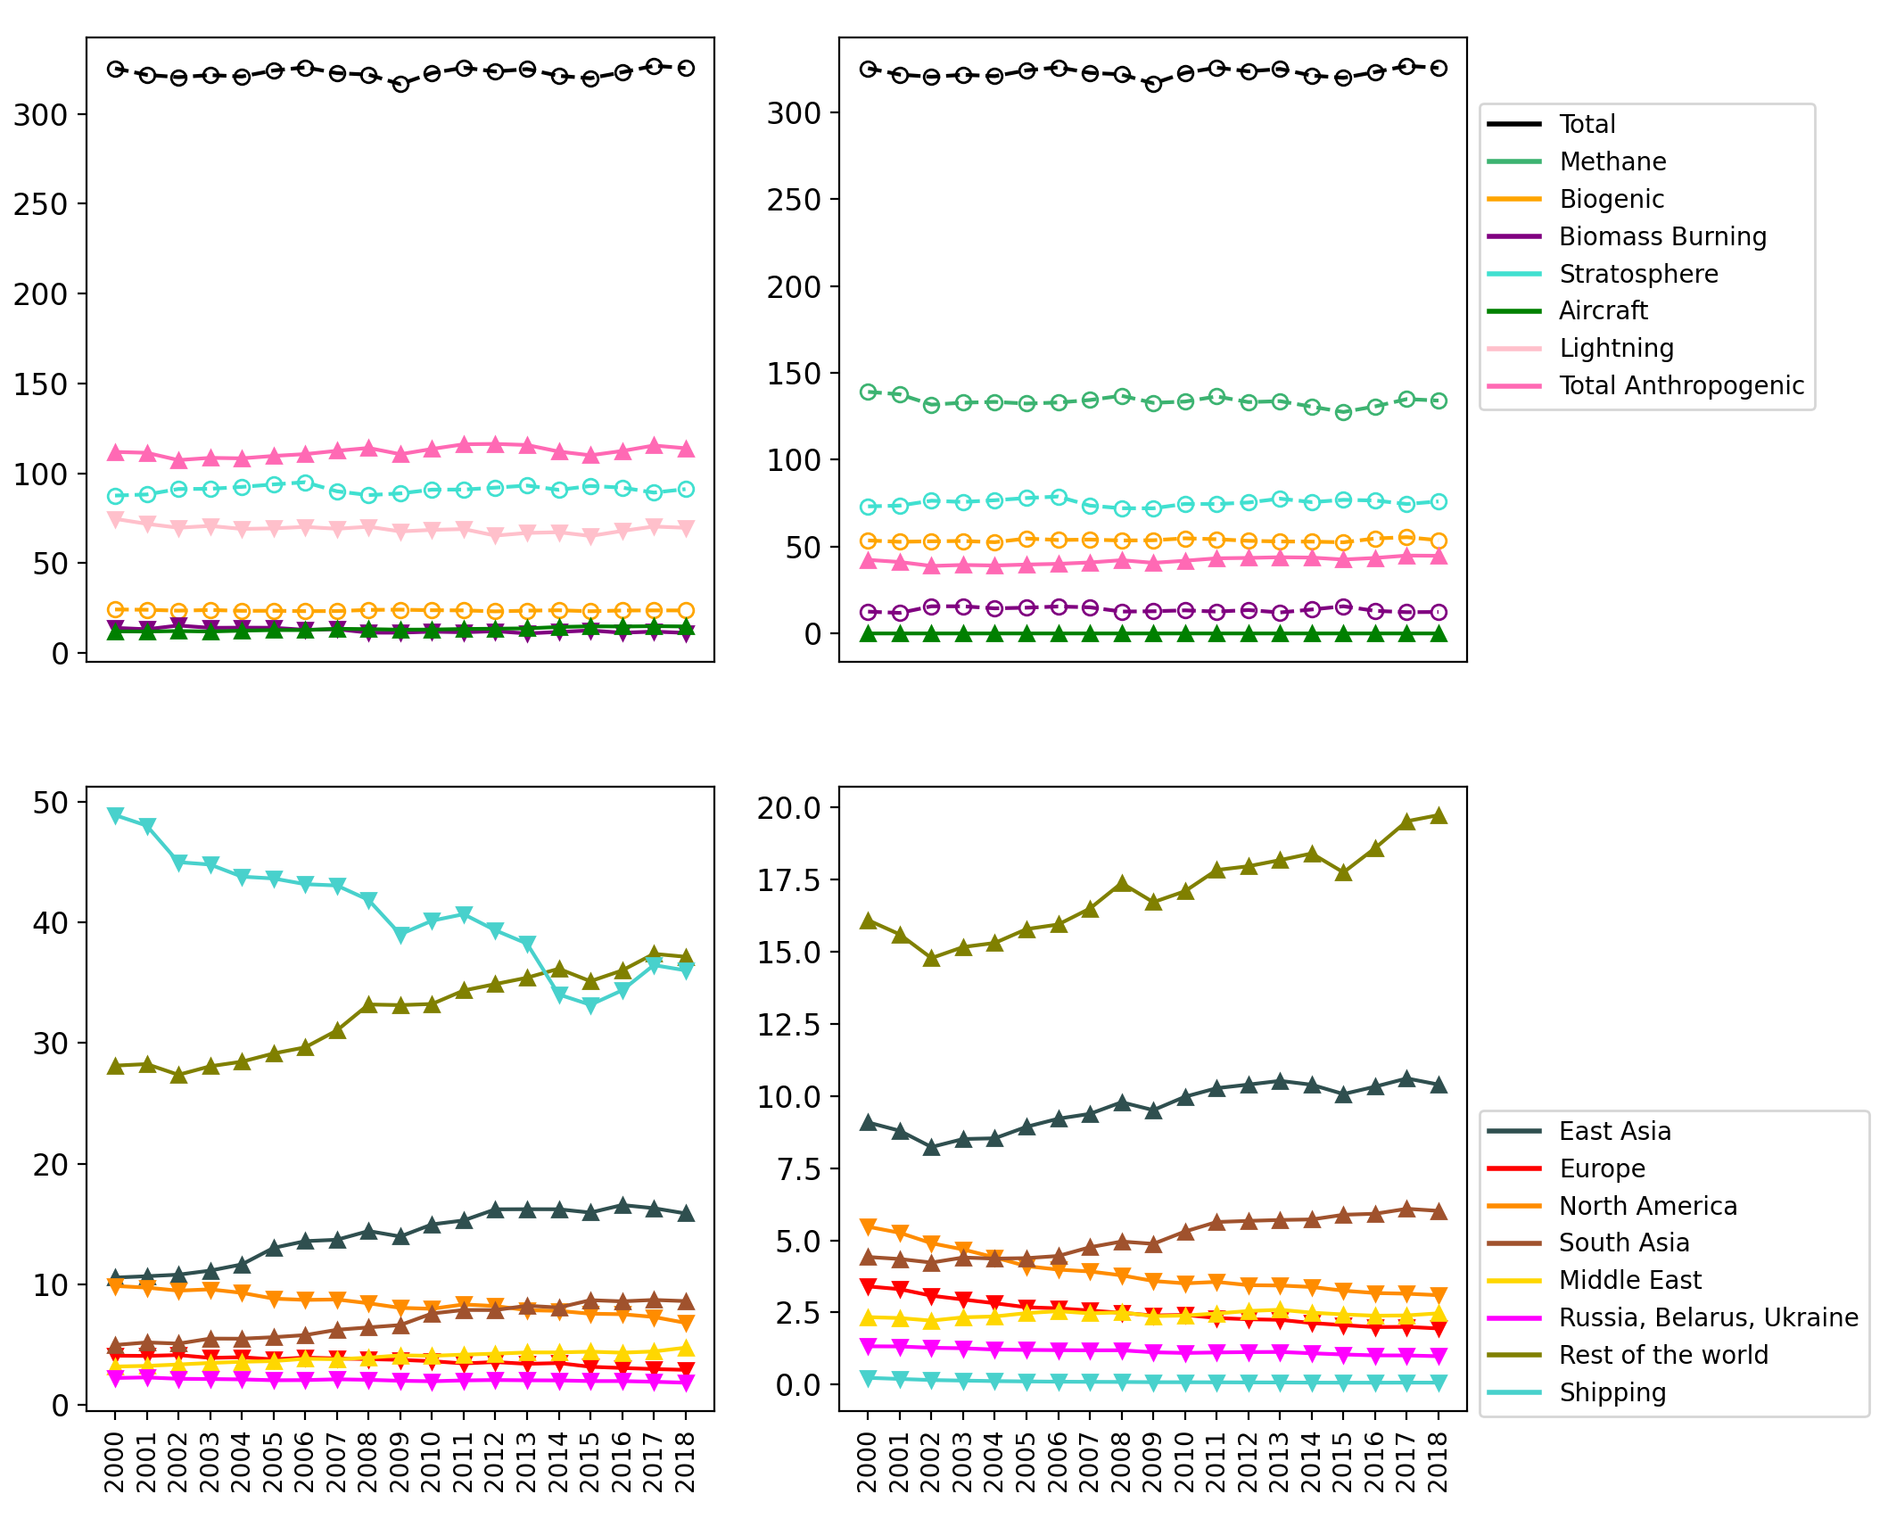
Results
Trop. O3 burden
(in Tg O3)
NOx-tagged
VOC-tagged
Anthro. contributions, both NOx and VOC increase significantly
Largest contributions: Anthro. NOx, methane, and stratosphere
Largest Anthro NOx contribution: Shipping and Rest of the world. Followed by East Asia, North America and South Asia.
Rest of the world produces more O₃ compared to East Asia despite smaller emissions (mainly for being situated at tropical regions )
Ship NOx emissions and Trop O3 burden contribution from ships is approximately double that of Butler et al. 2020
1
2
2
2
1
▲ Increasing trend
▼Decreasing trend
Օ No trend
Regional Contribution to Total Anthropogenic component
5
3
3
Compare with Global mean surface ozone:
Here
(Click back and forth)
4
Q
adinalam@zedat.fu-berlin.de

Slide 9
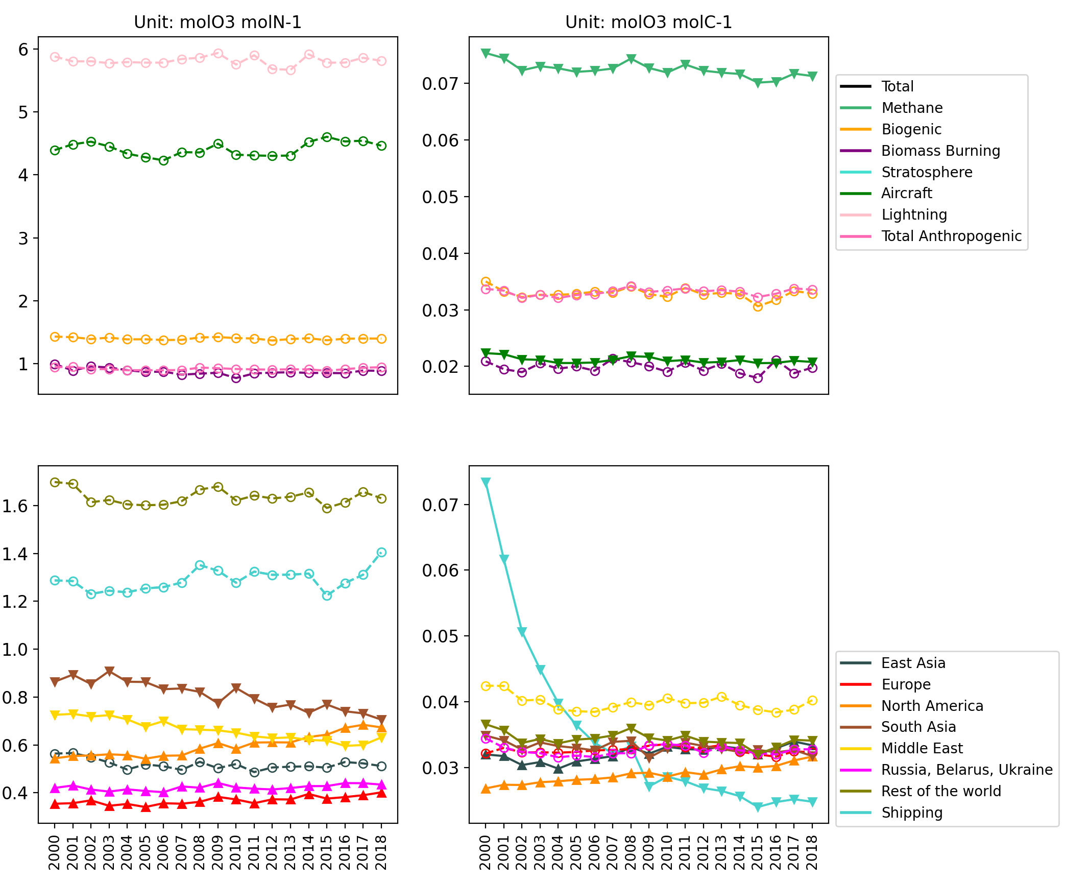
Results
Ozone production efficiency
NOx (mol O3 / mol N)
VOC (mol O3 / mol C)
1
2
Lightning and Aircraft NOx are most efficient at producing ozone
CH4 is the most efficient reactive carbon to produce ozone
Anthro. NOX: Ship, Rest of the world and South Asia are most efficient. Tropical regions are more efficient because of strong convection
OPE increases significantly when emissions decrease (Europe, North American and Russian emissions)
OPE decreases significantly when emissions increase (South Asian and Middle East)
▲ Increasing trend
▼Decreasing trend
Օ No trend
Regional Anthropogenic components
OPE-SHP-VOCs
3
Why is the efficiency of VOCs from ships showing a drastic decline?
Click to know more
OPE-SHP-VOCs
Q
adinalam@zedat.fu-berlin.de

Slide 10
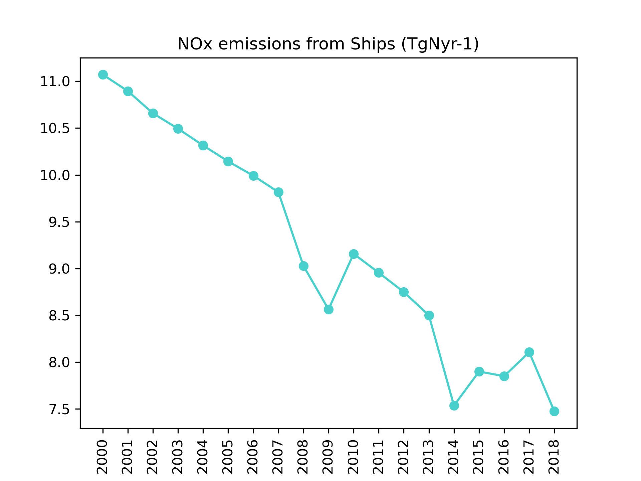
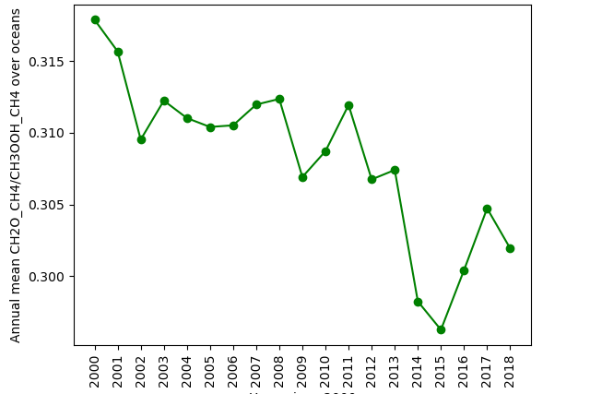
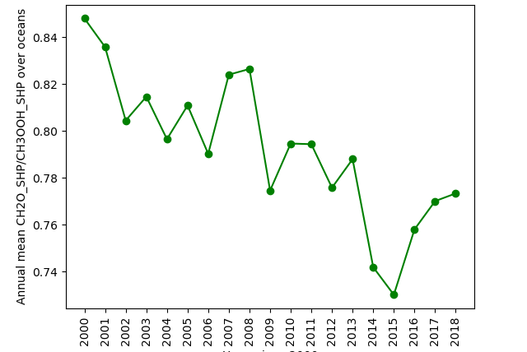
Results
OPE-SHIP-VOCs
Click here to go back to previous
Why is the efficiency of VOCs from ships showing a drastic decline?
We hypothesize that decreasing Ship NOx emissions leads to decreasing OPE Ship of Ship VOCs
CH2O (formaldehyde) is formed during high-nox oxidation of CH4
CH3OOH (methyl-peroxide) is formed during low-nox oxidation of CH4
CH2O/CH3OOH ratio indicates the strength of NOx regime
CH2O_SHP/CH3OOH_SHP ratio over oceans is mainly due to decreasing Ship NOx emissions
OPE-CH4 also reduces partly due to the same reason!
Q
adinalam@zedat.fu-berlin.de

Slide 11
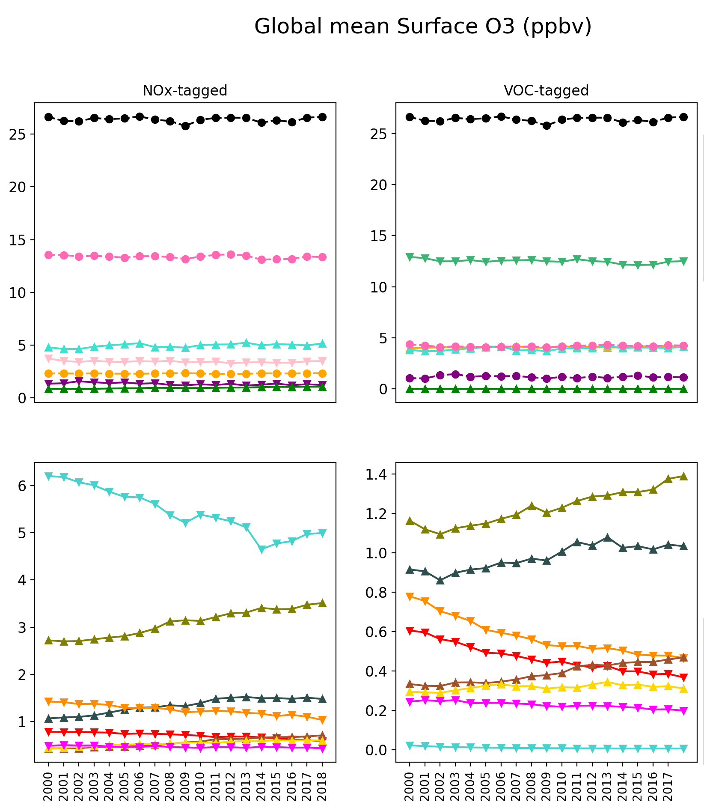
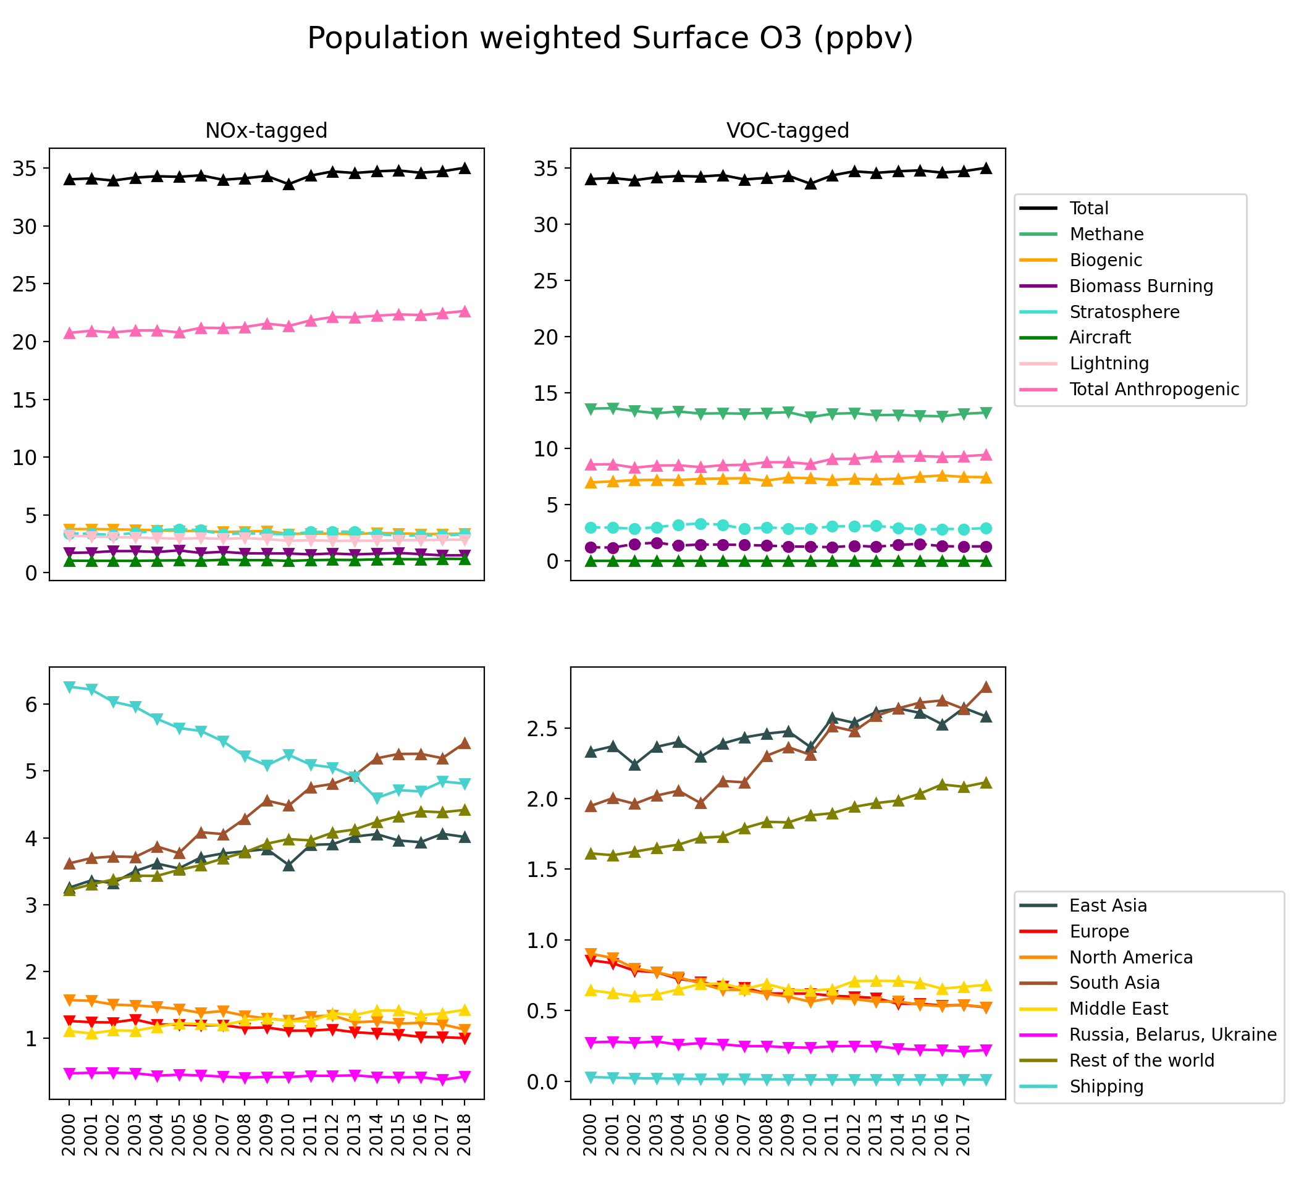
Results
Surface Ozone and exposure
Global mean population (2020) weighted surface ozone (ppbv)
(Ozone Exposure)
▲ Increasing trend
▼ Decreasing trend
● No trend
Why is ozone exposure from ships comparable to mean, as there is no population over the oceans?
Click below to discover!
2
2
1
1
SHPexp
Relative contributions of regions/sectors is similar for O3 burden and surface mean (except high altitude contributions: lightning, aircraft, stratosphere)
Total exposure increases significantly, as opposed to surface mean.
Mainly contributed by increasing anthropogenic emissions from SAS, ROW and EAS, and biogenic VOCs.
Larger contribution from populated regions (SAS, EAS and ROW) to the exposure compared to surface mean.
SHPexp
SHPexp
3
3
3
3
Compare with Trop O3 burden:
Here
(Click back and forth)
Q
adinalam@zedat.fu-berlin.de

Slide 12
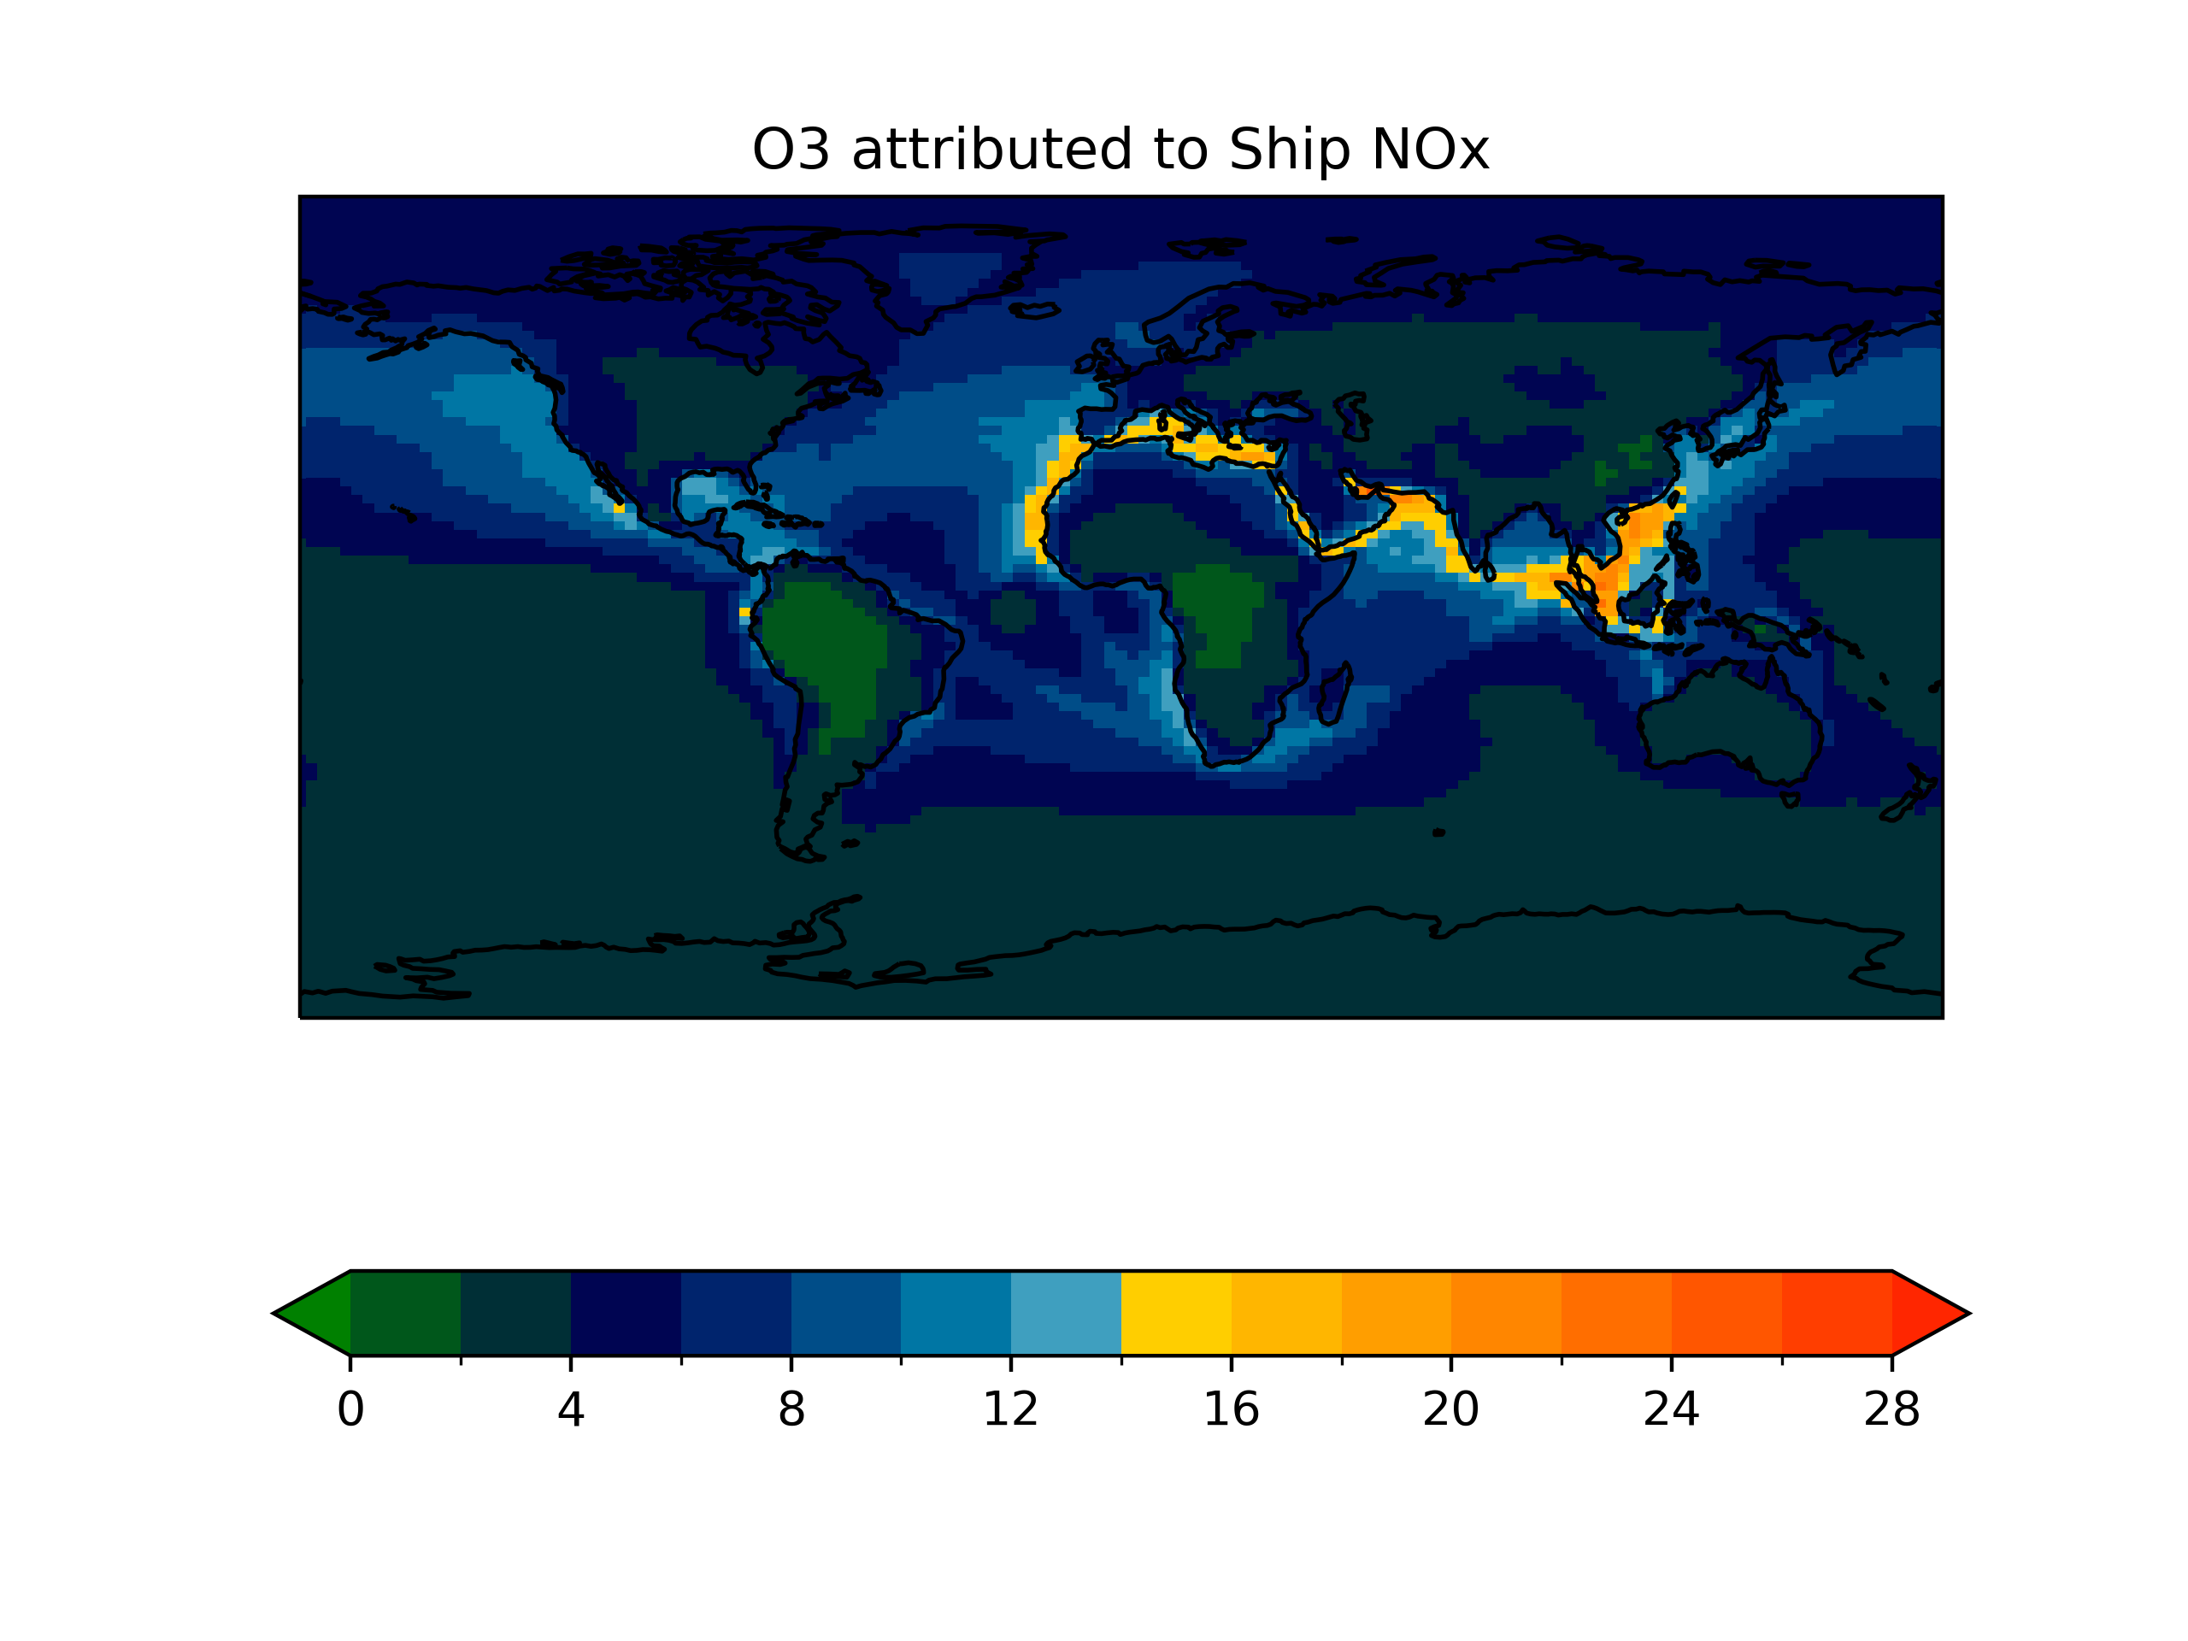
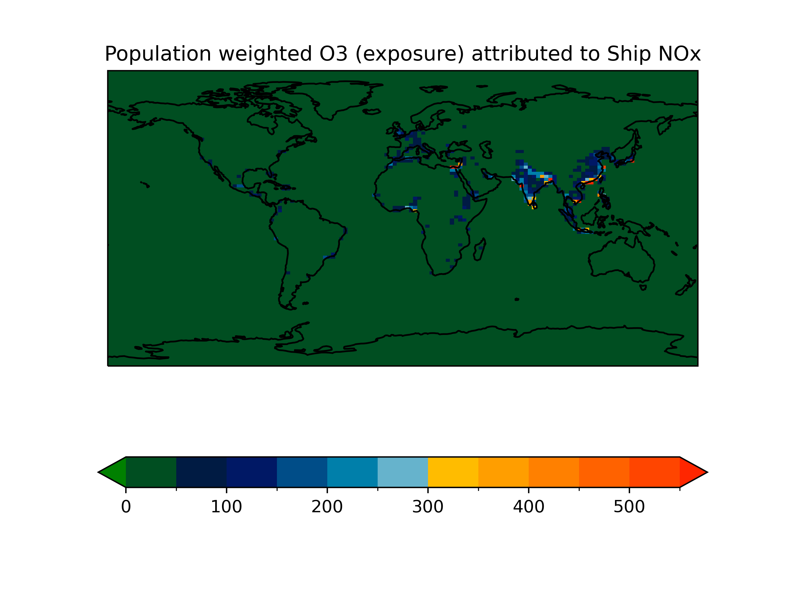
Results
Ship contribution to ozone exposure
Why is ozone exposure from ships comparable to mean, when there is no population over the oceans?
(ppb)
(ppb)
Large population in South Asia, East Asia and other coastal regions are exposed to ozone from ship-NOx.
Click here to go back to previous
Q
adinalam@zedat.fu-berlin.de

Slide 13
Summary
Contribution
What is the contribution from various regions/sectors to tropospheric O₃ burden?
Largest contribution from tropical anthropogenic NOx and Methane
Efficiency
How does the ozone production efficiency respond to changing precursor emissions during the 2000-2018 period?
OPE increases significantly when emissions decrease (Europe, North American and Russian emissions) and vice versa (South Asian and Middle East)
Contrast
Contributions to O3 burden vs global mean surface ozone vs ozone exposure
Relative contributions of regions/sectors is similar for O3 burden and surface mean
Tagging
Source attribution using Tagging of trop O3 has been implemented in CAM4-Chem
Separate NOx and VOC tagged simulations performed
Rest of the world produces more O3 compared to East Asia despite smaller emissions (mainly for being situated at tropical regions )
Using CAMS emissions for the 2000-2018 period
Various sectoral and regional anthropogenic tags included
OPE if CH4 and Ship VOCs reduces because of reducing Ship NOx emissions in our dataset!
Large population in South Asia, East Asia and other coastal regions are exposed to ozone from ship-NOx.
Total exposure increases significantly, as opposed to surface mean. Mainly contributed from increasing anthropogenic emissions from populated regions
Q
Status: Nalam et al. (2023) Manuscript in preparation
adinalam@zedat.fu-berlin.de

