Slide 1
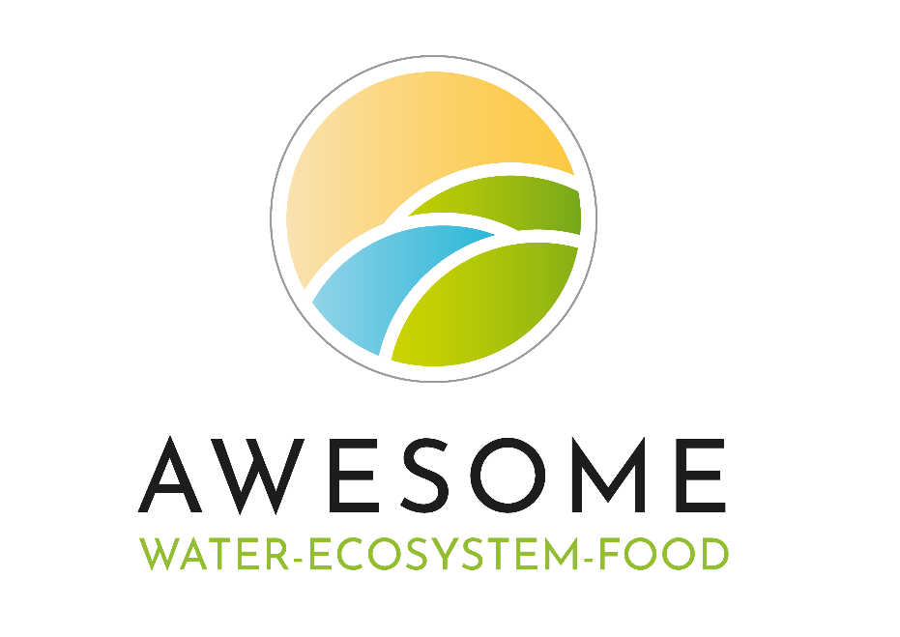

Developing policy recommendations to support innovation in soilless agriculture within the Nile River Basin: A participatory approach using Multi-Actor Working Groups
Dr. Ebun Akinsete
Lydia Stergiopoulou
Nouran El Said
Prof. Phoebe Koundouri
27/04/23

Slide 2









AWESOME project (2020-2023):
A decision analytic framework for managing Water Ecosystems and Food across sectors and scales in the South Mediterranean
https://awesome-prima.eu/

Slide 3
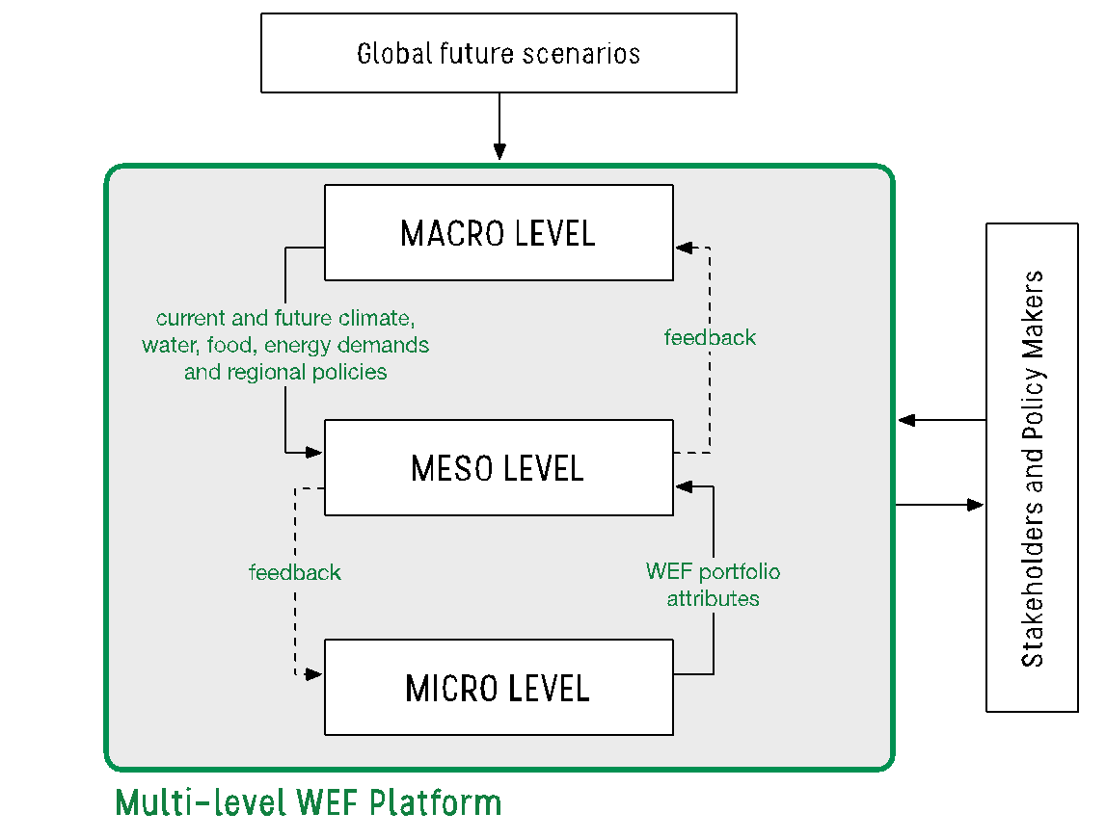
AWESOME MAIN OBJECTIVES
Develop a decision-analytic platform
- for assessing WEF planning portfolios
- based on a multi-level, integrated WEF model
- to better understand multi-sectoral WEF tradeoffs
- also exploring feedbacks across a hierarchy of spatial scales.
Notes:
AWESOME will consider multiple future evolutions of climate, society, and economics, and how these will shape portfolios robustness, resilience, and sustainability.

Slide 4
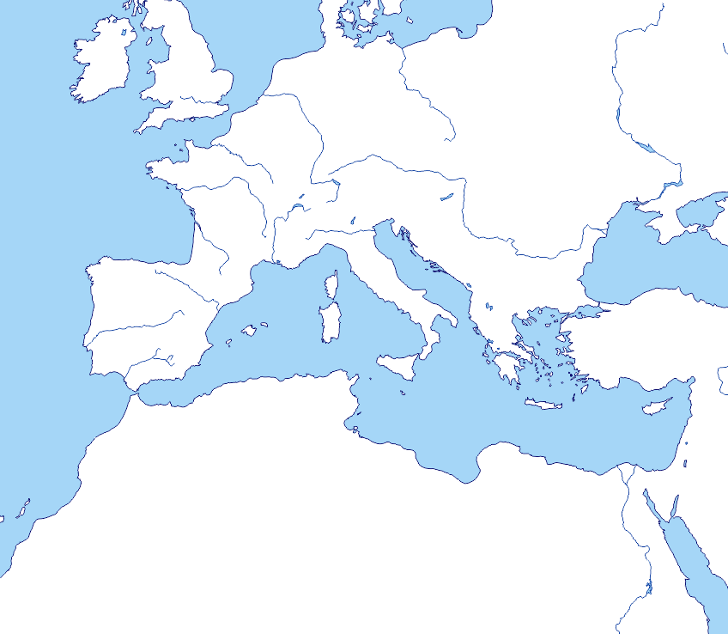
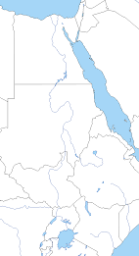
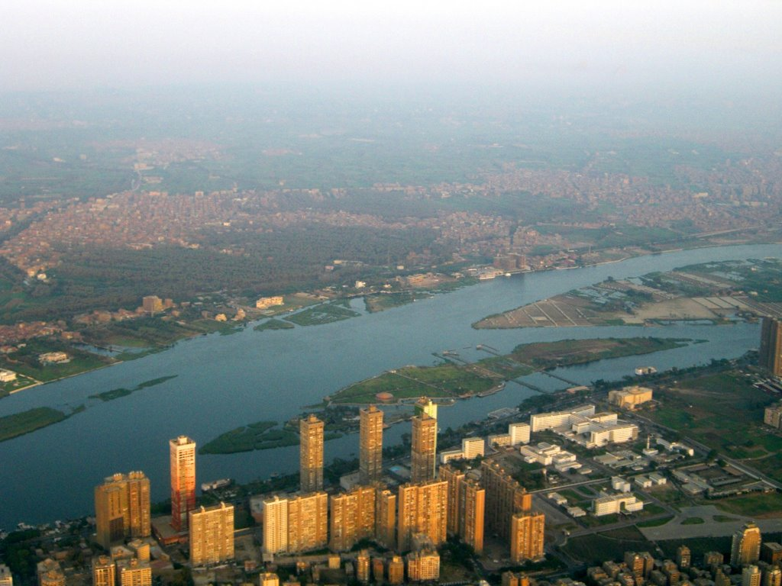

Three Levels of AWESOME
MACRO LEVEL
Mediterranean Region
MESO LEVEL
Nile river basin
MICRO LEVEL
Demo Site - Cairo
Notes:
4
4

Slide 5
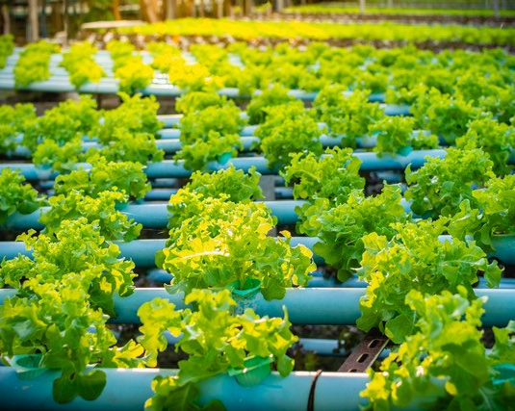
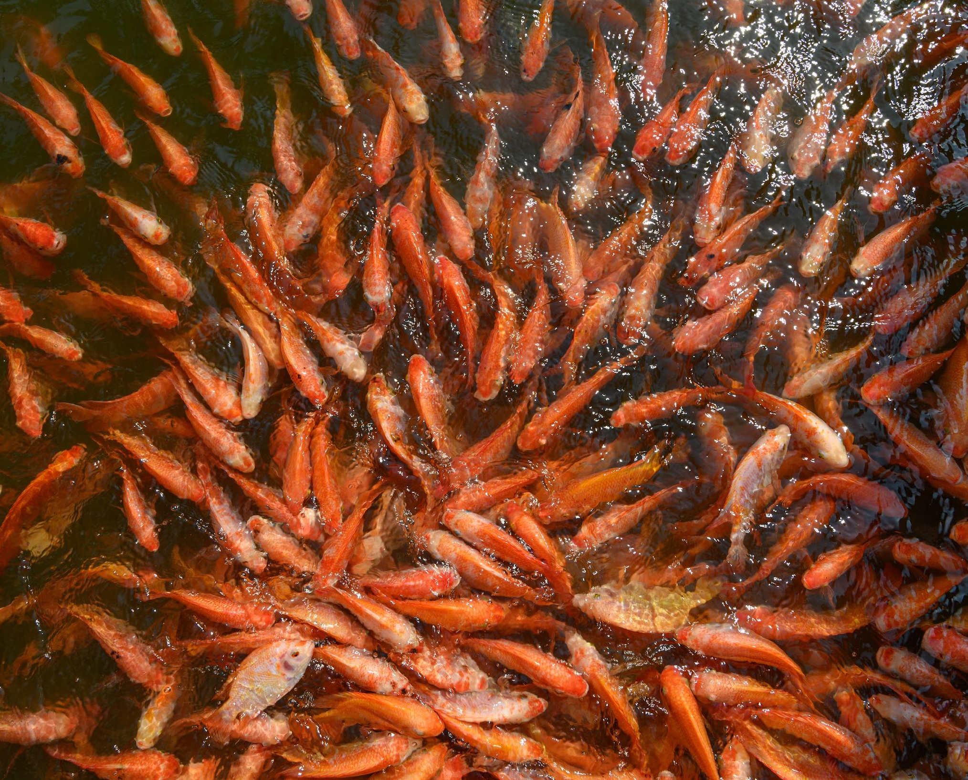
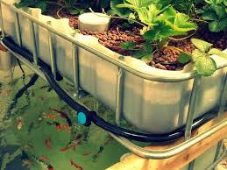
THE 3 LEVELS OF AWESOME
MICRO LEVEL
Exploring effectiveness of alternative smart food production options
Hydroponics
Aquaculture
Aquaponics
Notes:
Water use efficiency and food production security at the local level

Slide 6
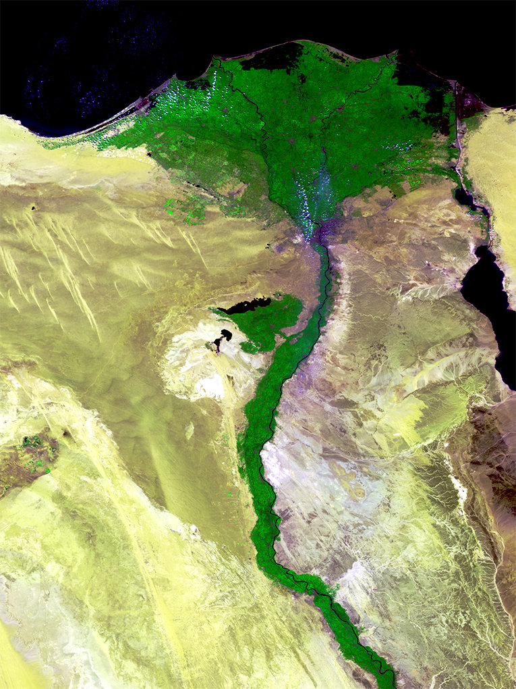
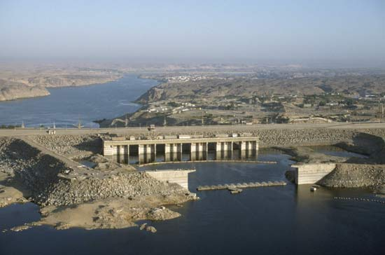
THE 3 LEVELS OF AWESOME
MESO LEVEL
Exploring integration and upscaling of smart food technologies in river basin management
Notes:
Optimal dam operation and optimal irrigation (and other water uses) measures

Slide 7
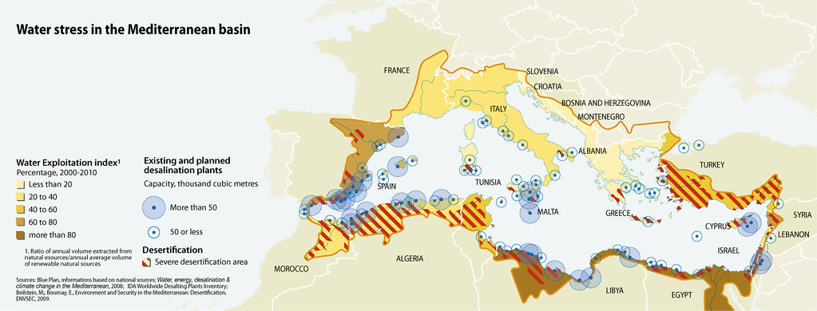
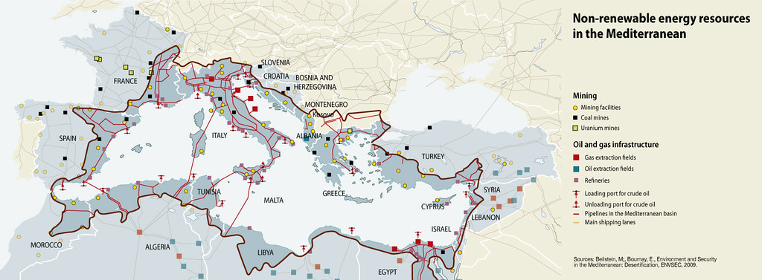
THE 3 LEVELS OF AWESOME
MACRO LEVEL
Generating future population, food, energy and water scenarios and regional policies to the meso scale
Notes:
Demographic, climate, and socio-economic projections at the large scale to explore future scenarios

Slide 8
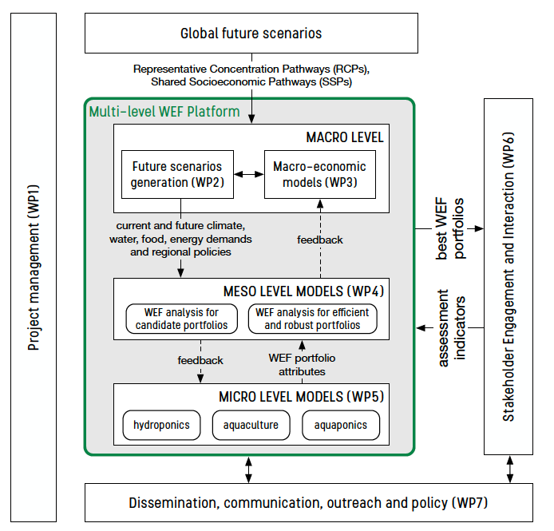
AWESOME MODELING FRAMEWORK
Notes:
Complex modeling framework and interdisciplinary interaction
We will provide brief highlights from recent results and development touching the different aspect of the problem and a hint of the challenges (in progress and future)

Slide 9
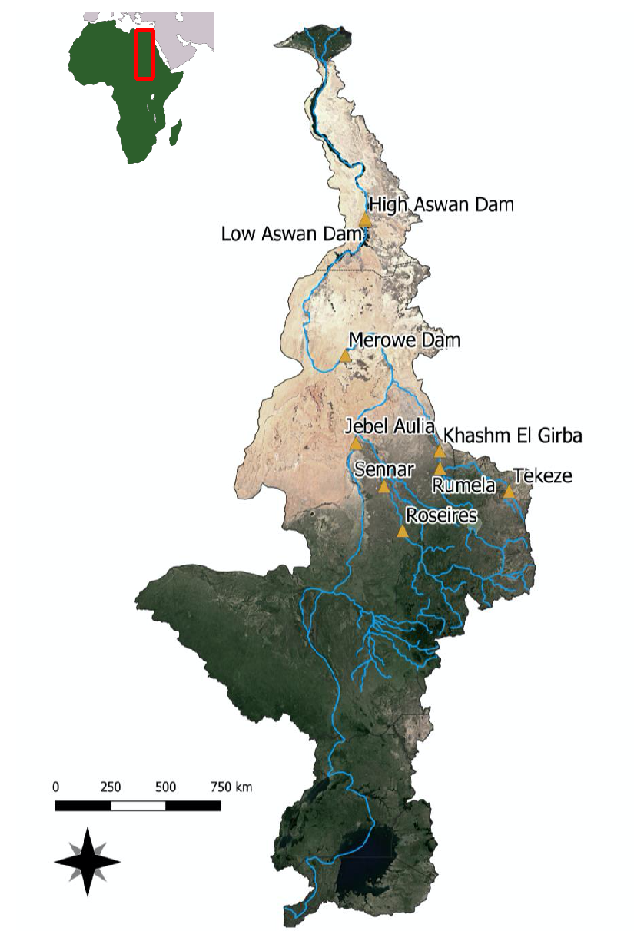
AWESOME CASE STUDY
Population growth
Climate change
Transboundary agreements
Water management measures
water availability
food security
economic development and environment
MAIN CHALLENGES IN THE NILE
THREAT FOR
Improve water efficiency, by
Reduce household consumption
Coordination within IWRM
Regulatory framework revised and updated
- Expanding desalination in coastal and remote areas
- Pumping GW rationally and sustainably
- Expanding greenhouse cultivations (e.g., hydroponics)
- Promoting less consuming and salt tolerant crops
STRATEGIC MEASURES & OBJECTIVES IN EGYPT (NILE DELTA)
(MWRI, 2017)
Notes:
Literature sources to define possible actions representing the Water Ecosystems Food and Energy Nexus and indicators to evaluate the effect of these actions
--
Some of the specific objectives of NWRP 2037 (water)
By 2030 at least 70% of water resources available is allocated for Agriculture
By 2030 1.5 BCM are added to the water balance
New legislation for water management to reflect IWRM principles

Slide 10
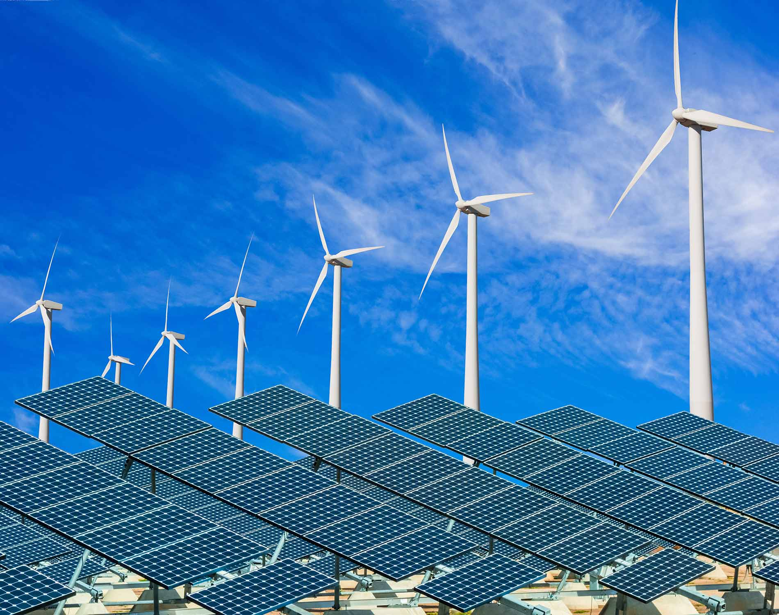
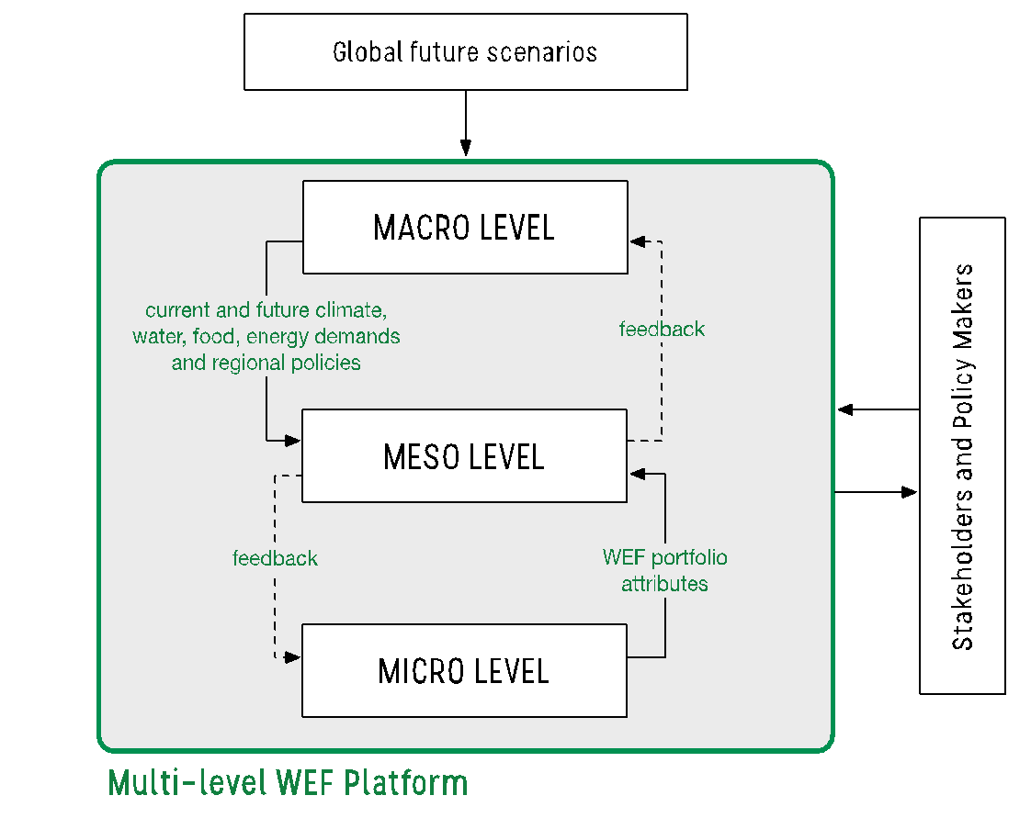
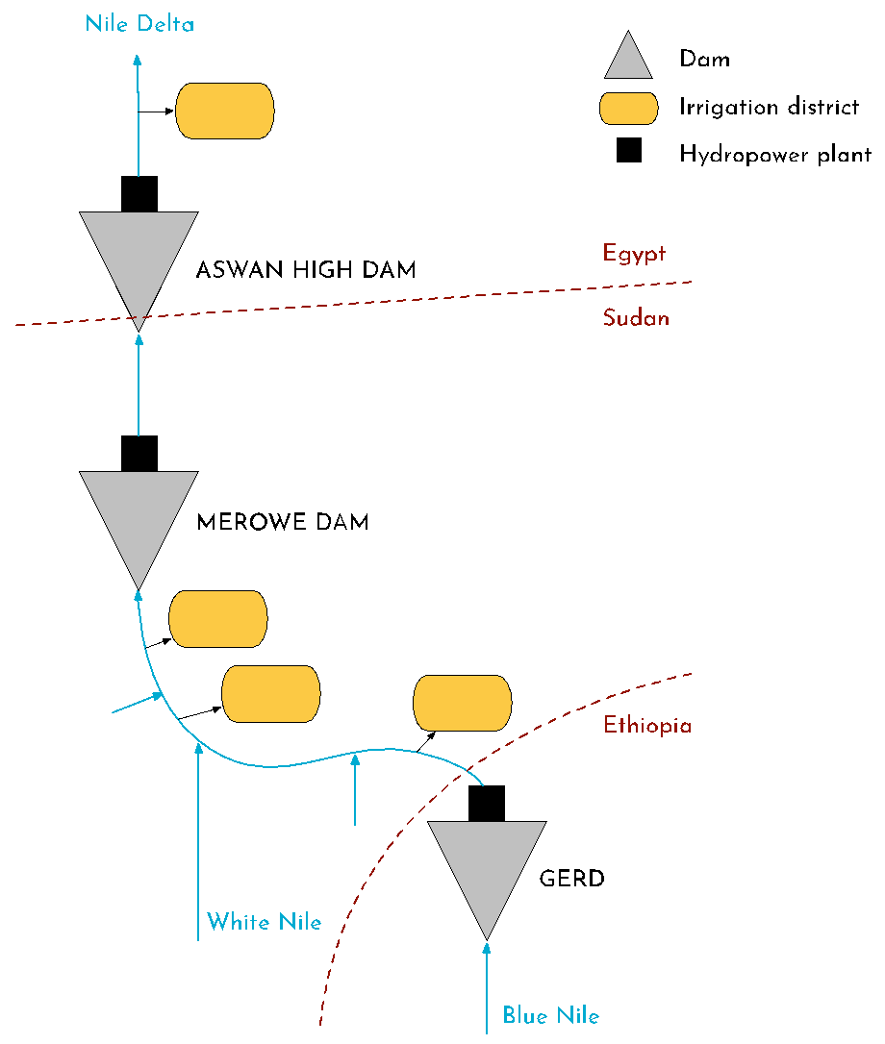

AWESOME WEFE PLANNING PORTFOLIOS
Regional policy for RES incentives
% of replacement of agriculture with aquaponics
Water management strategy and irrigation supply
Notes:
RES incentives (different energy sources, e.g. PV)
Water management (different water sources, water efficiency)
Replacement of soilless agriculture

Slide 11
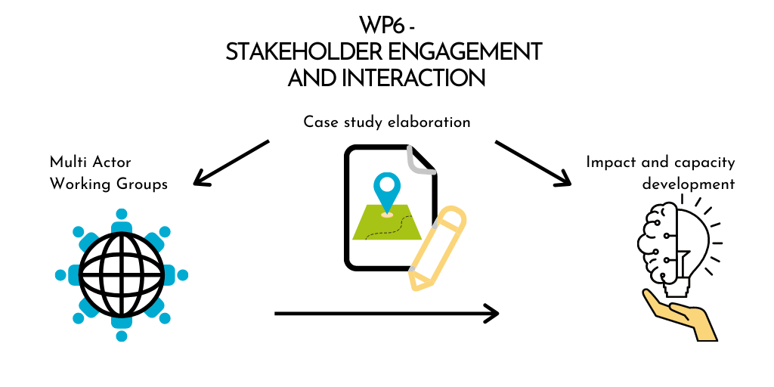
WP6 – STAKEHOLDERS ENGAGEMENT AND INTERACTION
TASKS
Task 6.1 – Case study elaboration (M3-12)
Task 6.2 – Multi-Actor Working Groups (M9-42)
Task 6.3 – Impact and capacity development (M25-42)
Notes:
ADD SLIDES AS FOR WP2 AND WP4

Slide 12
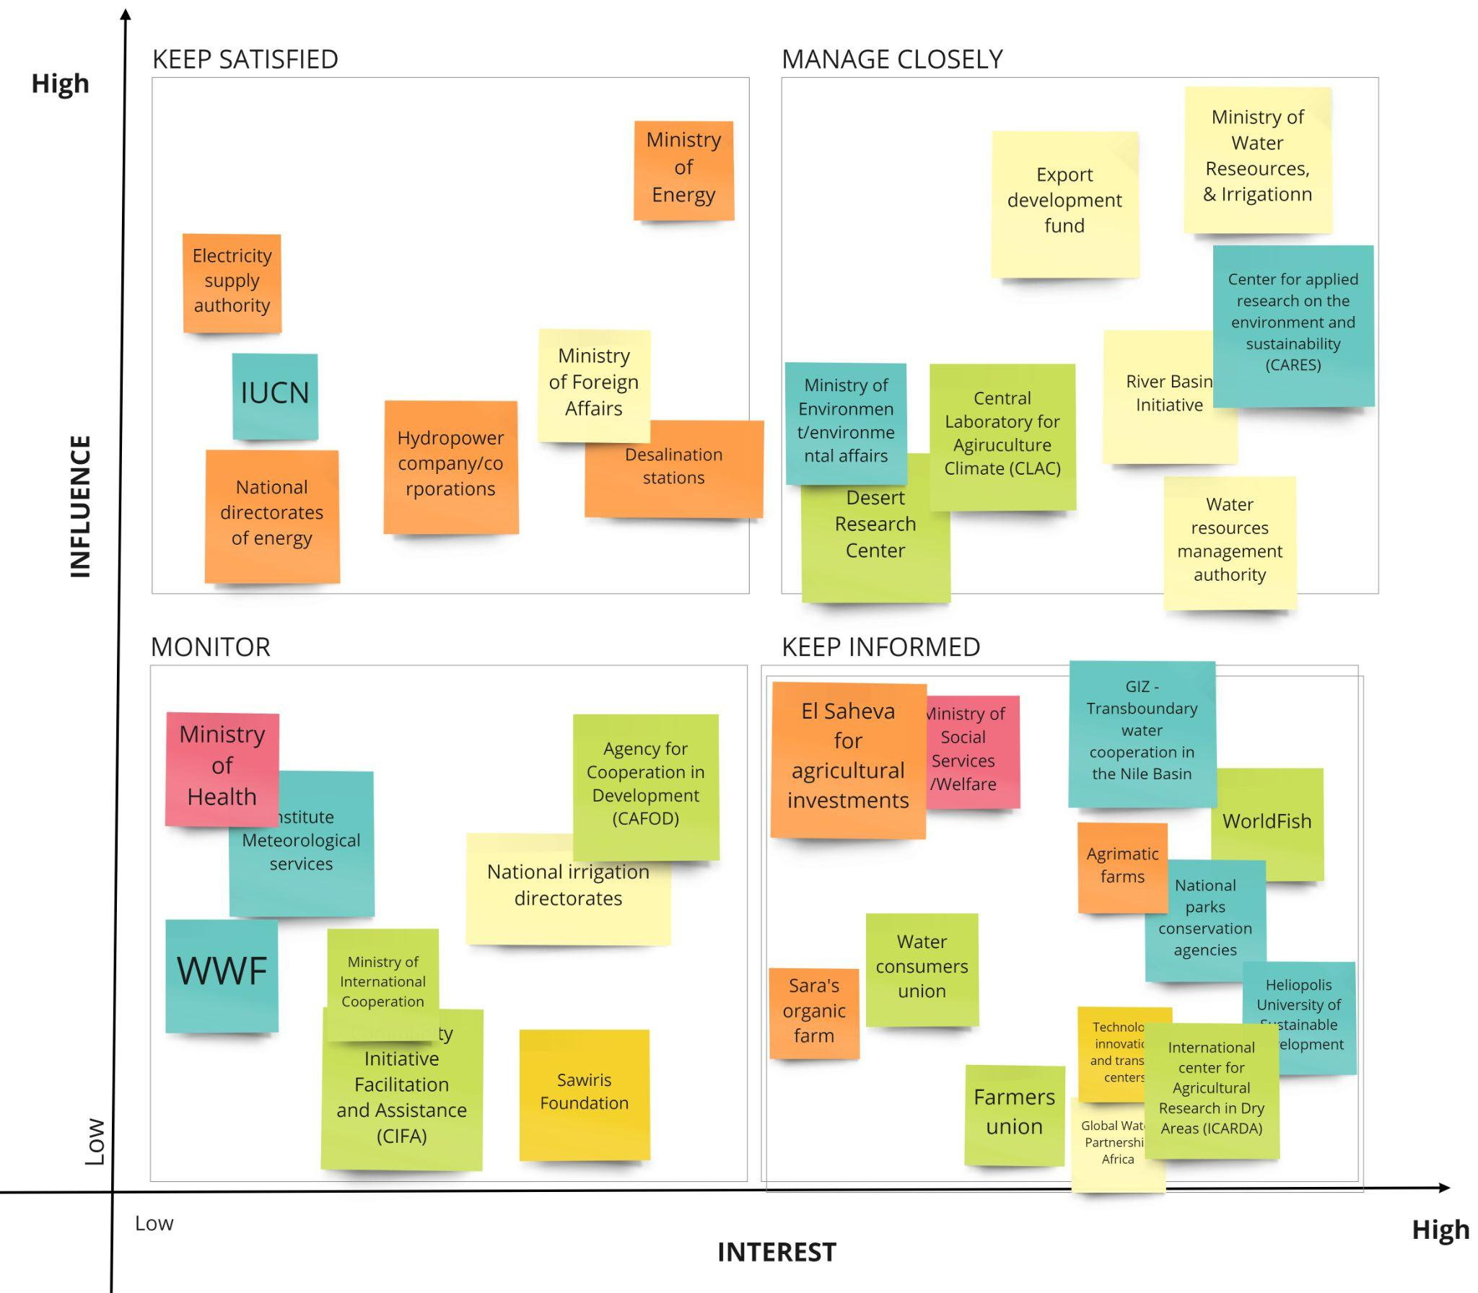
Case study elaboration
Stakeholders mapping
and analysis
Description of the case study, elaboration
of the key WEFE Nexus issues, key ES, and stakeholders engagement

Slide 13
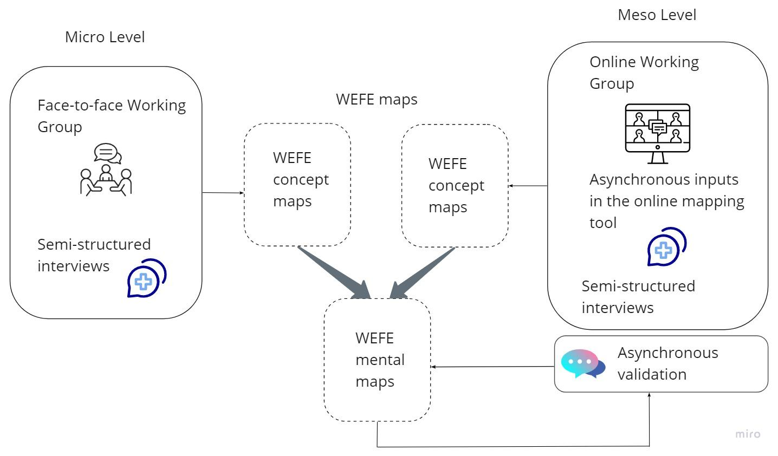
Multi-Actor Working Groups (MAWGs)
Micro and meso level MAWGs interplay
WEFE mental mapping tool:
incorporates local experts’ knowledge
communicates complex interactions
shows the bigger picture
engages stakeholders in research

Slide 14
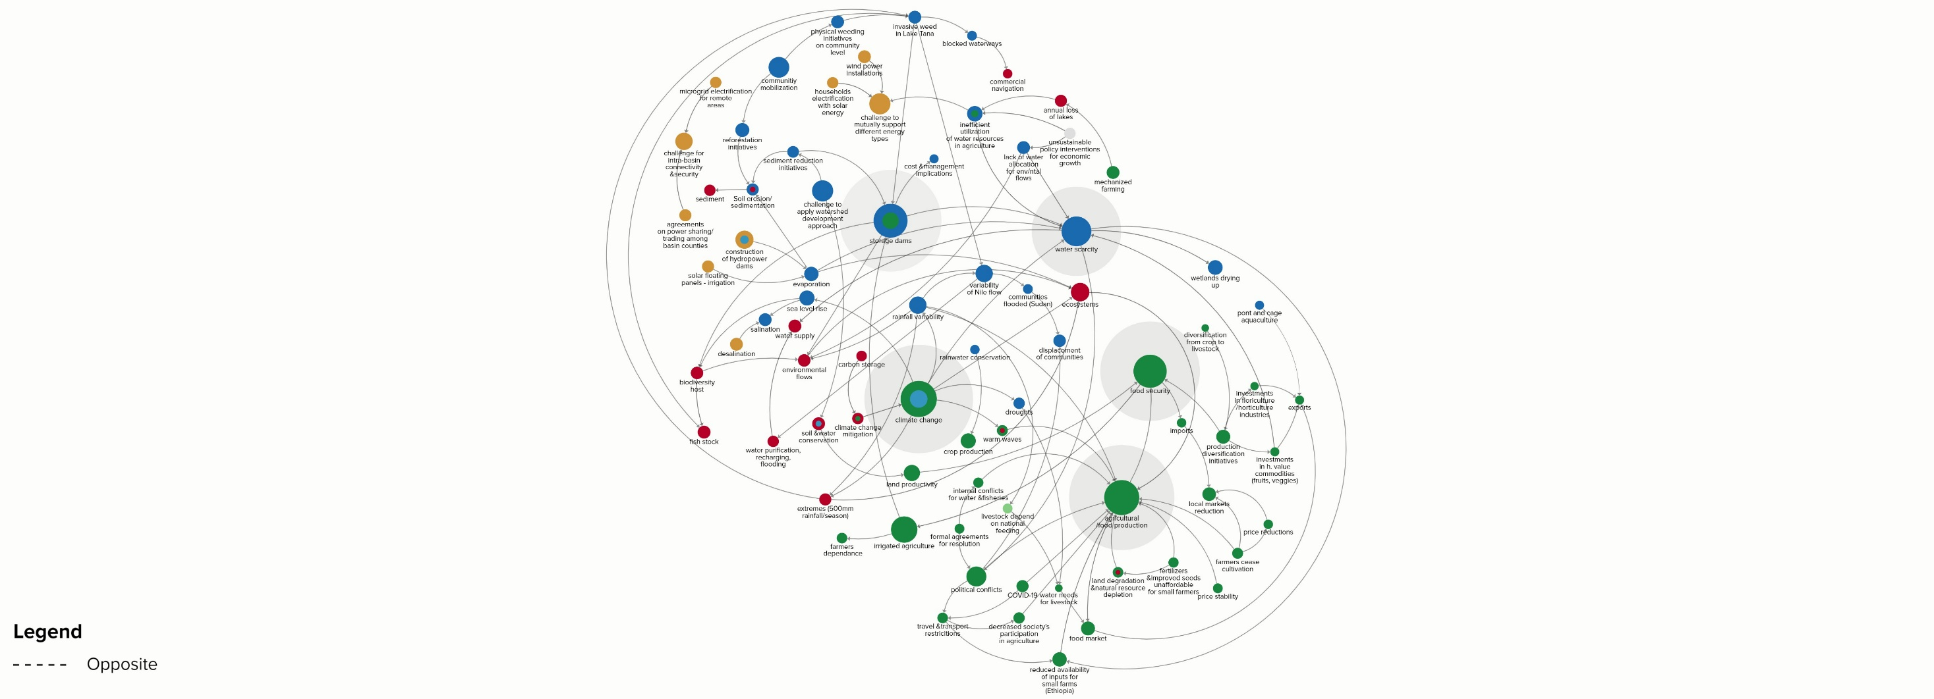
WEFE Nexus mental model

Slide 15
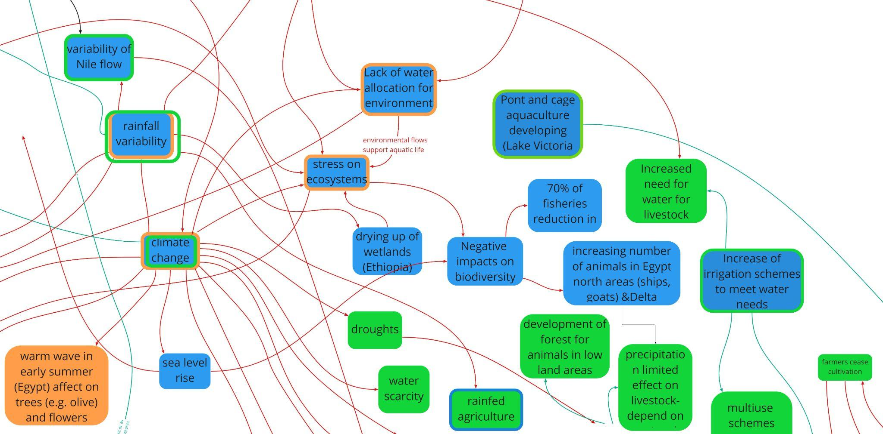
Findings
Findings for Water:
Findings for the Food:
High variability of flow
Flooding issues
Dams impacting aquatic biodiversity, sedimentation & evaporation
Climate change
Inefficient water utilization
Opportunities for cooperative management of dams
Promotion of irrigated agriculture
Increased water demand
Watershed development
Internal conflicts
Impacts from the pandemics
Inputs availability (seeds, fertilizers)
Exports increase
Findings for the Energy:
Interconnectivity between basin countries
Opportunity for combinations, initiatives and energy security
Findings for the Ecosystems:
Rich and diverse ecosystem types
Ecosystem services
Need for integrated watershed approach and participatory planning

Slide 16
References
Alkema, L., Raftery, A. E., Gerland, P., Clark, S. J., Pelletier, F., Buettner, T., & Heilig, G. K. (2011). Probabilistic projections of the total fertility rate for all countries. Demography, 48 (3), 815-839.
Azose, J. J., & Raftery, A. E. (2015). Bayesian probabilistic projection of international migration. Demography, 52 (5), 1627-1650.
Fouré, J., Bénassy‐Quéré, A., & Fontagné, L. (2013). Modelling the world economy at the 2050 horizon. Economics of Transition, 21(4), 617-654.
Hare, M. (2011), Forms of participatory modelling and its potential for widespread adoption in the water sector, Environmental Policy and Governance, vol. 21, pp. 386–402
Lutz, W., Butz, W. P., & Samir, K. E. (Eds.). (2014). World population and human capital in the twenty-first century. OUP Oxford.
Özesmi, Uygar & Maurer, Stacy. (2004). Ecological models based on people's knowledge: A multi-step fuzzy cognitive mapping approach. Ecological Modelling. 176. 43-64. 10.1016/j.ecolmodel.2003.10.027.
Raftery, A. E., Chunn, J. L., Gerland, P., & Ševčíková, H. (2013). Bayesian probabilistic projections of life expectancy for all countries. Demography, 50 (3), 777-801.
Raftery, A. E., Li, N., Ševčíková, H., Gerland, P., & Heilig, G. K. (2012). Bayesian probabilistic population projections for all countries. Proceedings of the National Academy of Sciences, 109(35), 13915-13921.
Tiller, R., & Richards, R. (2015), Once bitten, twice shy: Aquaculture, stakeholder adaptive capacity, and policy implications of iterative stakeholder workshops; the case of Frøya, Norway, Ocean & Coastal Management, 1-12.
Voinov, A., Kolagani, N., McCall, M. K., Glynn, P. D., Kragt, M. E., Ostermann, F. O., and Ramu, P. (2016), Modelling with stakeholders - Next generation, Environmental Modelling and Software, 77, 196-220

Slide 17
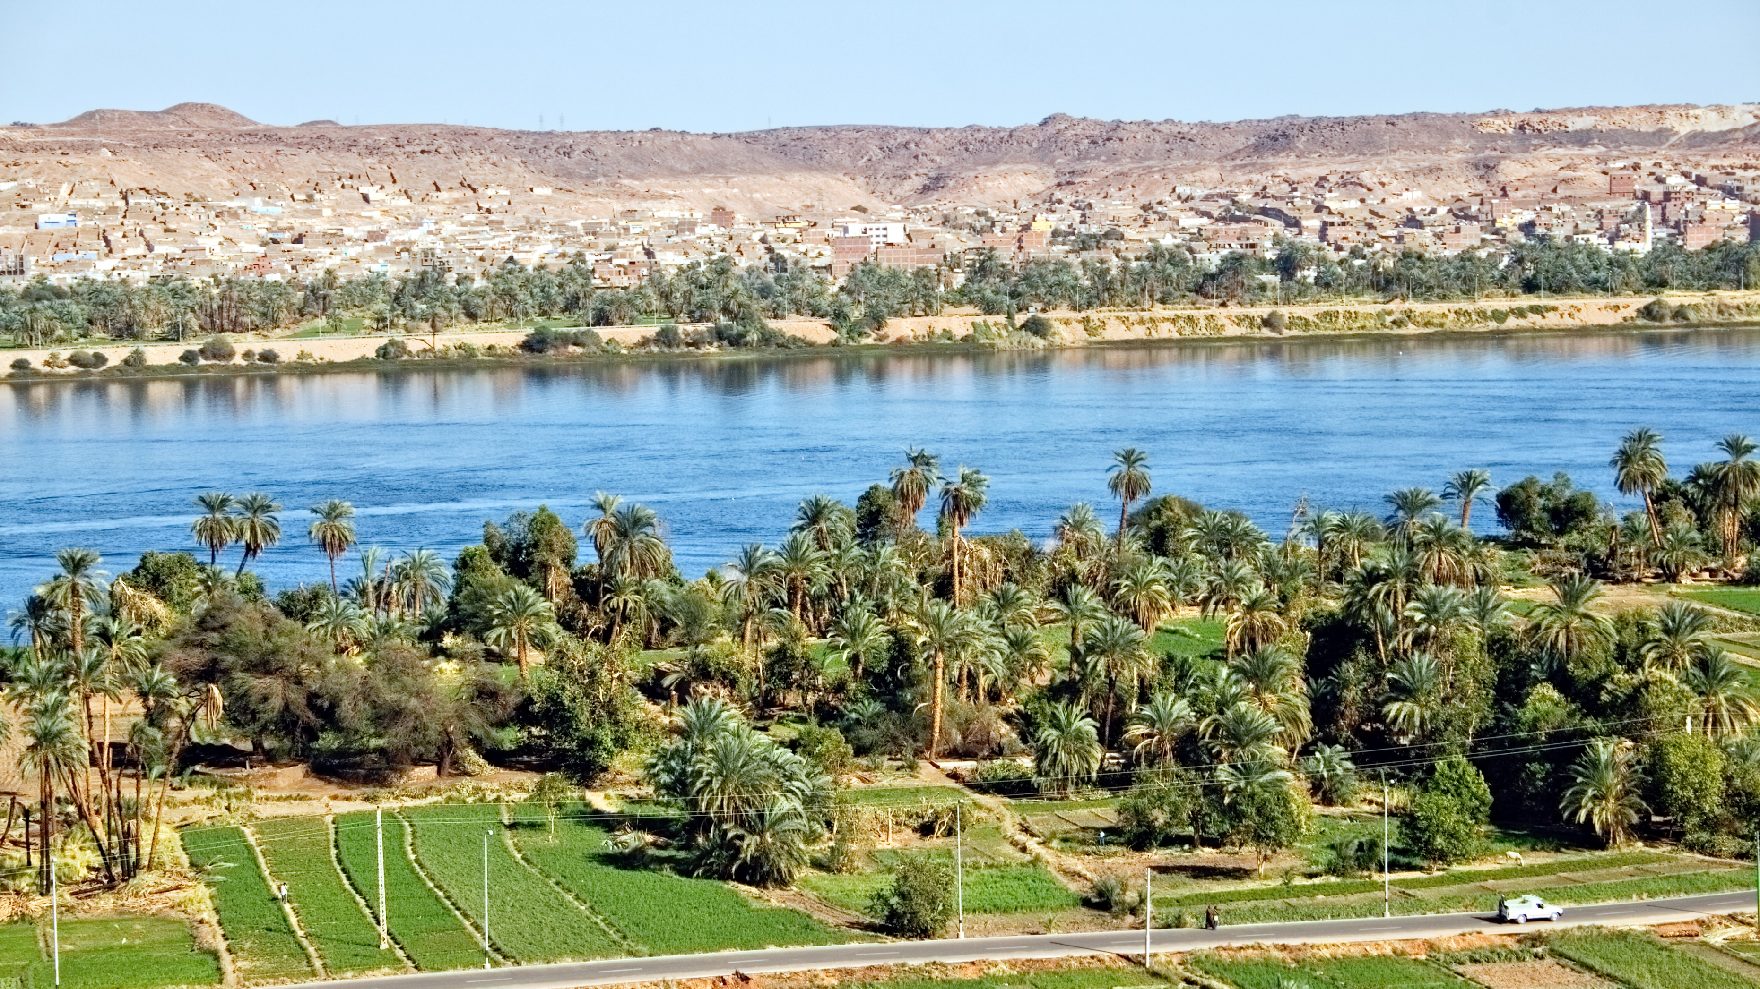
Questions?
Notes:
17
17

Slide 18

This project is part of the PRIMA Programme supported by the European Union, having received funding from it under grant agreement No 1942
Notes:
18
18

