Slide 1
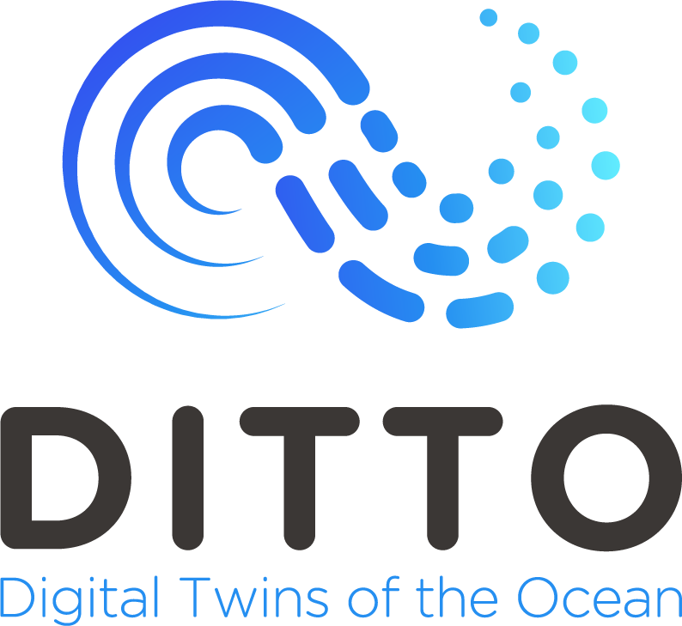
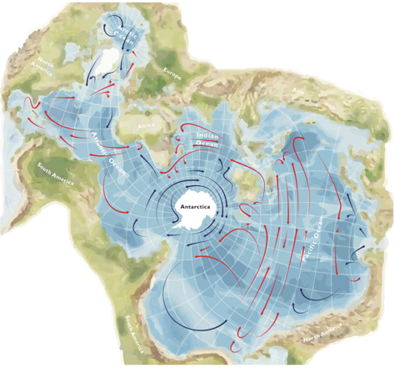
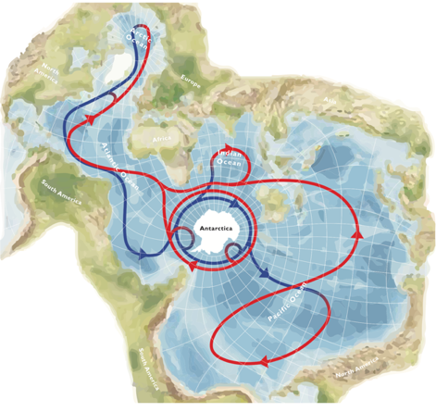
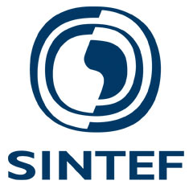
Digital Twins of the Ocean - DITTO
Opportunities to inform sustainable ocean governance
Martin Visbeck
GEOMAR Helmholtz Center for Ocean Research
Kiel, Germany
"Jamie Oliver, British Antarctic Survey"
Ute Brönner
SINTEF Ocean Trondheim
Norway
EGU General Assembly
April 2023
Notes:
what will ditto do

Slide 2
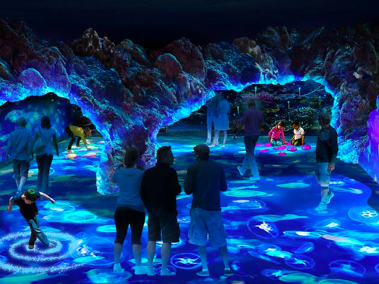
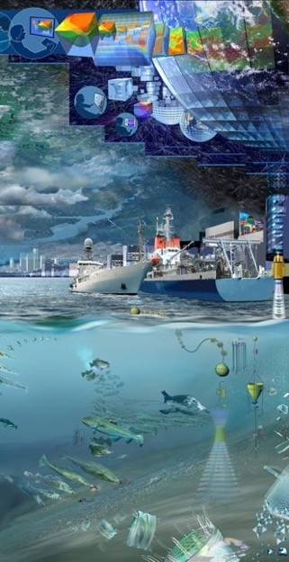
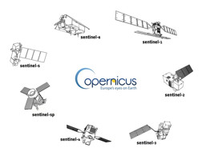
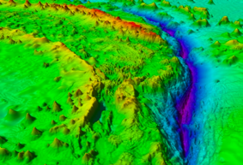
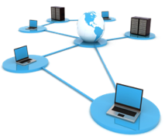
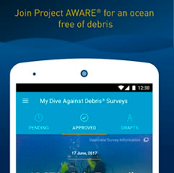
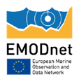
Digital Twins of the Ocean
Observations Data Knowledge

Slide 3
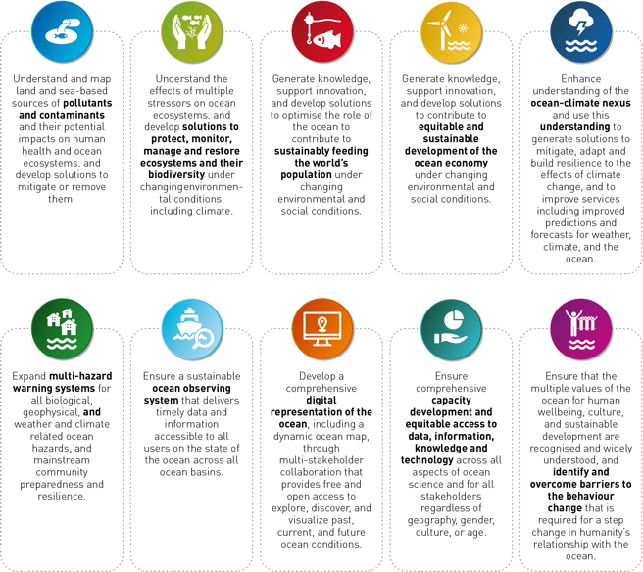
DITTO and the UN Ocean Decade
“The science we need for the ocean we want”
OCEAN DECADE Challenge Questions
Transform business-as-usual science, technology, & policy
Facilitate new partnerships, discoveries & benefits
Challenge 8
Through multi-stakeholder collaboration, develop a comprehensive digital representation of the ocean, including a dynamic ocean map, which provides free and open access for exploring, discovering, and visualizing past, current, and future ocean conditions in a manner relevant to diverse stakeholders.
Notes:
Ditto fits into one of the challenge areas identified by the un decade

Slide 4
Digital Twins of the Ocean - DITTO
An accessible ocean with open and equitable access to data, information, and technology and innovation.
Digital Twins of the Ocean are a virtual representation of the real ocean and have a two-way connection with it. Observations from the real ocean change and refine the twin; manipulating the twin can highlight regions of the real ocean in need of better or different observations.
Digital Twins will enable users to address ‘What if’ questions based on shared data, models and knowledge.
Digital Twins empower ocean professionals, citizen scientists, policymakers, and the general public alike to visualise and explore ocean knowledge, data, models and forecasts.
Develop a comprehensive digital representation of the ocean.
Notes:
what will ditto do

Slide 5
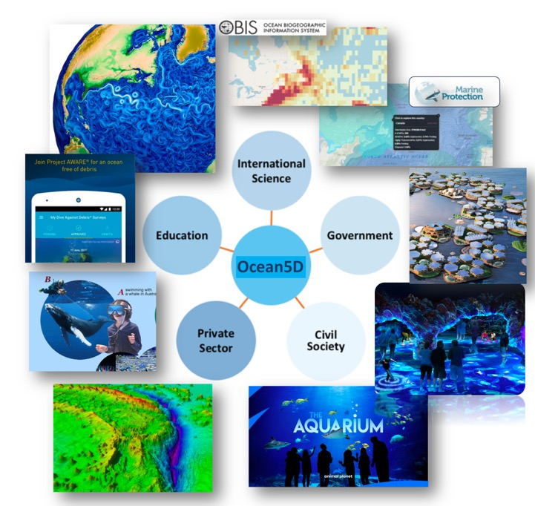
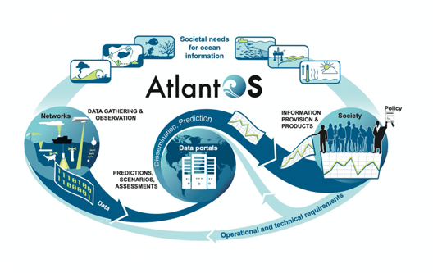
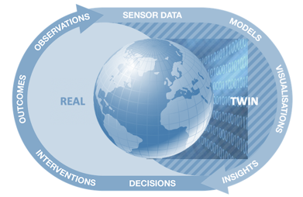
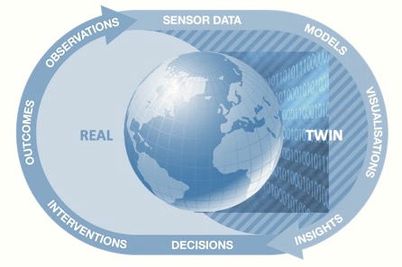
Digital Twins of the Ocean - DITTO
Value chain and frames of intervention
Ocean Information
supporting Services
Ocean Information assessing Interventions
Notes:
how will it do it

Slide 6
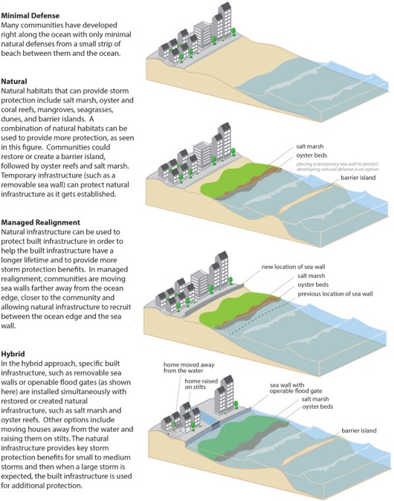
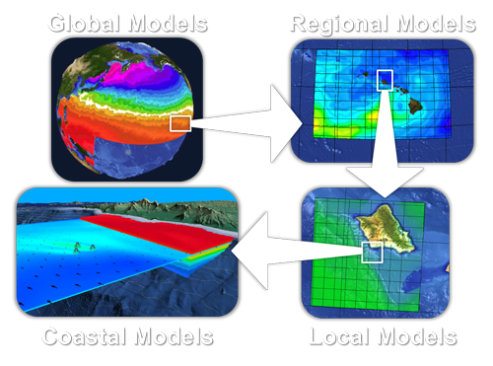
Digital Twin “Prototype”
What is the most cost effective option to mitigate the coastal impact of sea level rise?
Notes:
how will it do it

Slide 7
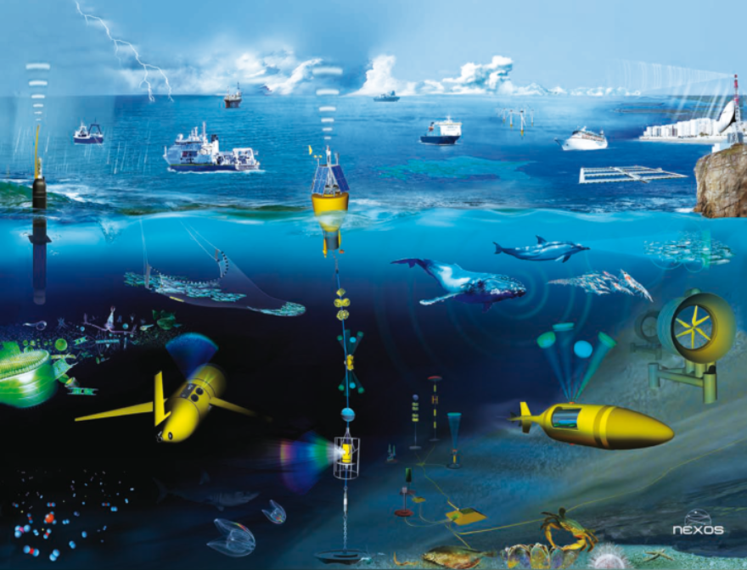
Digital Ocean - Ocean Observing Needs
A co-design approach to developing the observing networks needed for Digital Twins
DTOs will create a ‘virtuous circle’, where information from the Digital Twin can be used to provide key inform
DTOs will optimise the observing network, whilst benefiting from it.
An observing system is the fundamental underpinning to any digital twin
Notes:
LInks to IODE

Slide 8
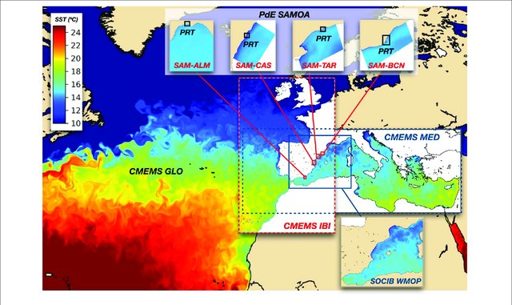
Digital Ocean - Ocean Prediction
The Decade Collaborative Centre for Ocean Prediction
Ocean predictive multi scale modelling frameworks.
Artificial intelligence / machine learning to create, manipulate and analyse marine information.
The ability to simulate change to the system by human intervention and to explore their consequences.
Notes:
LInks to IODE

Slide 9
Digital Ocean - Data Perspective –
Digital Ecosystem Needs
The Mission: Creating a robust and extensible foundation of our planet’s digital ocean ecosystem
We need to ‘democratize’ the data world.
We need to establish ‘trust’ in open data.
Who need to ensure wide and equitable access.
Notes:
LInks to IODE

Slide 10
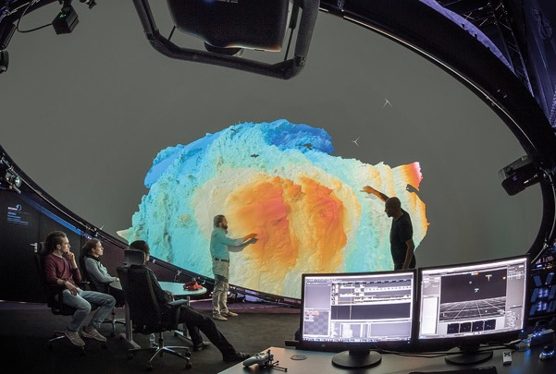
Delivering Digital Twin Information
Decision making theaters – Browser based systems – Jupiter Notebooks – 3D immersive environments
Notes:
LInks to IODE

Slide 11
Digital Twins of the Ocean - DITTO
DITTO's vision is a world where DTOs are used to support ocean protection, ocean governance and a sustainable Blue Economy.
DITTO's mission is to develop and share a common understanding of DTOs; to establish best practices in their development; and to advance a DTO digital framework.
Please join DITTO to contribute to its Working Groups:
Supportive ocean observations & data systems
Data analytics & prediction engines
Data lakes & interoperability
Interactive layers & visualizations
Framework: architecture, design & implementation
Education, training & capacity development
Notes:
LInks to IODE

Slide 12
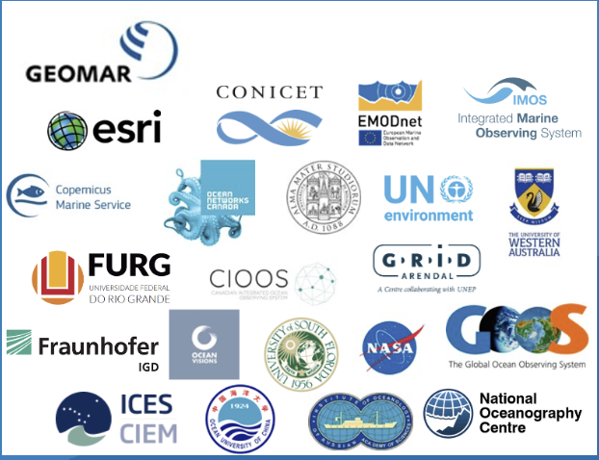
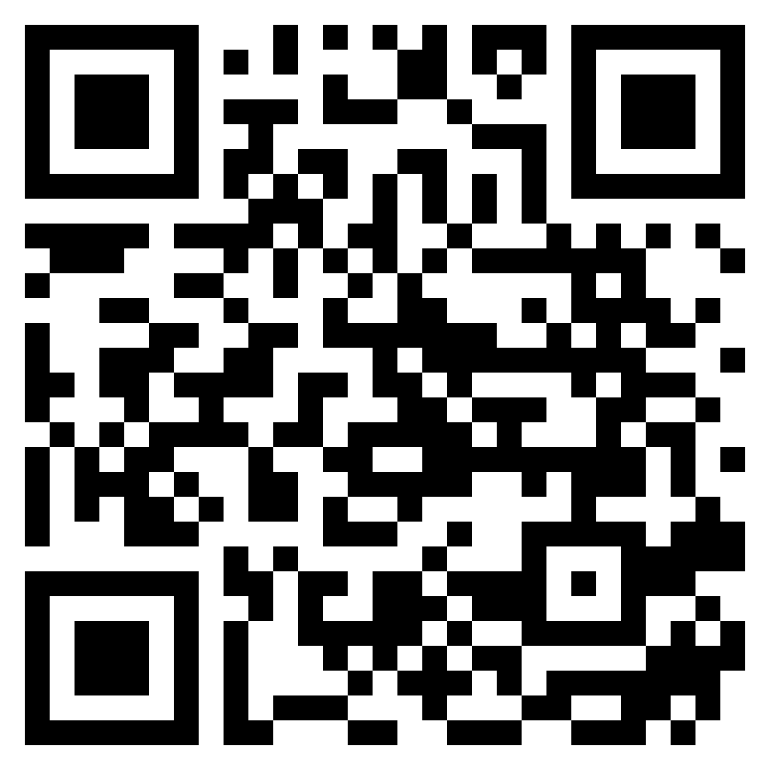
Become a DITTO Partner!
Partner Application
The objective of the partnership is to support each other through a network of DITTO partners.
Once you have submitted the application the DITTO team will review the information and
send you a memorandum of understanding (MOU) to be mutually agreed on.
Scan to join the DITTO Community!
https://ditto-oceandecade.org

Slide 13
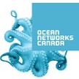
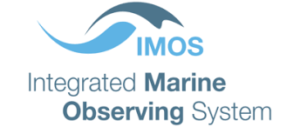
Digital Twins of the Ocean - Next Steps
Digital Twin Ocean Summit in Xiamen, China (9-12 November)
Governance and ToRs
Technical White Paper
30 Partners from around the world
Notes:
The ambition of the summit is to:
advance community understanding of Digital Twins, their applications and benefits,
bring together the users and developers to learn how digital twins may benefit society,
share knowledge about Digital Twins and best practice,
promote co-design of digital twins and establish joint actions.

