Slide 1
Paper EGU23-15726
Is multidecadal prediction of flood patterns possible for infrastructure planning purposes using the 10000 year cosmogenic isotope (10Be and 14C) record?
Michael Asten¹ and Ken McCracken²
¹Earth Insight, Hawthorn, Vic. Australia (michael.asten.ei@gmail.com
Cell and SMS: +61 412 348682
²Retired (cosmogenic64@gmail.com)
SUPPLEMENTARY MATERIAL
(includes all oral presentation slides)

Slide 2
EGU23-15726 On-site presentation
Is multidecadal prediction of flood patterns possible for infrastructure planning purposes using the 10000 year cosmogenic isotope (10Be and 14C) record?
Michael Asten and Ken McCracken
We compare spectral decomposition of flood data from three sites in Australia (south-east coast, east-inland, east-central) with the El Nino Southern Oscillation Index (ENSO), and with those from the Brahmaputra River (Bangladesh) and Nile River (Egypt). All show clear evidence of spectral maxima at medium periods approximating 50, 85, 130 and 200-240 years, which correspond with the maxima in the power spectra of the cosmogenic 10Be and 14C observations obtained from ice cores with ages covering the past 9400 years. We find that the Gleissberg cycle (~85 yr period) for Australian sites is in opposite phase to that for the Brahmaputra River. All sites also show spectral maxima at short periods 6-20 yr as expected from the ENSO cycle; flood associations varying over these short periods are generally accepted. We explore the possibility that the medium periods can be used to assist in the prediction of flood and drought activity several decades into the future. We consider the hypothesis of a correlation or causal relationship existing between solar activity (including its effects on the intensity of galactic cosmic rays on the Earth) and flood cycles for the medium periods.
The Australian SE coast and east-inland sites, and the Brahmaputra River, show strong medium-period maxima. The phase of the medium periods is obtained by optimized fitting of multiple sine curves with periods obtained from the spectra; the Australian SE coast and east-inland sites show summed sine curves with high correlation. The Brahmaputra River shows similar correlation at medium periods (in particular the Gleissberg 85-year period) but in opposite phase.
The Australian east-central site (Murray-Darling Basin MDB) shows only weak evidence for the Gleissberg medium-period maxima which raises the question whether ocean proximity is a factor for this influence. The available Nile River (Egypt) flood data (682-1484 CE) shows high correlation of spectral maxima with the Brahmaputra River full dataset (1319-2001 CE) and with the 9400 yr cosmogenic data set. We speculate that the strong medium-period cyclic flood patterns of these five data sets (possibly excepting the short MDB data) are associated with the solar and/or cosmic ray cycles, observed in the cosmogenic record, where the causative mechanisms are yet to be established. We conclude that the association of floods in medium-period cycles in addition to the association with the better-known short period (6-22 yr) variations associated with the ENSO cycle, provides opportunity for empirical predictions of flood patterns over ~80 years, and for the further more general investigation of possible causative mechanisms linking solar phenomena to oceanic indices and multi-decadal flood patterns.
How to cite: Asten, M. and McCracken, K.: Is multidecadal prediction of flood patterns possible for infrastructure planning purposes using the 10000 year cosmogenic isotope (10Be and 14C) record?, EGU General Assembly 2023, Vienna, Austria, 24–28 Apr 2023, EGU23-15726, 2023

Slide 3
FIVE SITES USED IN THIS STUDY
Nile River
Bahadurabad
Brahmaputra River Bangladesh
Murray-Darling Basin
Hawkesbury River, coastal NSW
Lake George eastern NSW

Slide 4
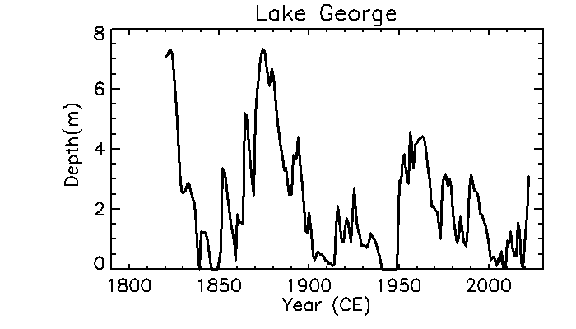
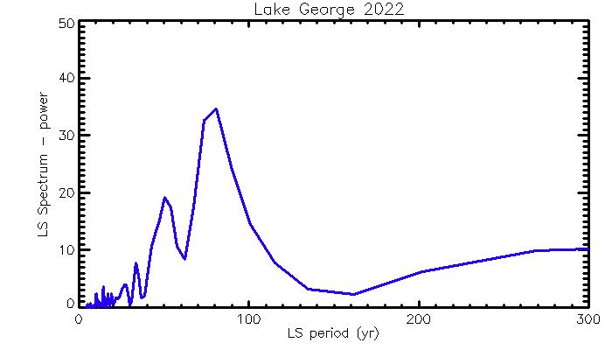
LAKE GEORGE NSW
LAKE GEORGE
Time range 1820-2022CE
Short et al, 2020
79.6 yr
SPECTRUM LAKE GEORGE
Time range 1820-2022CE
50 yr
LOMB-SCARGLE POWER SPECTRUM
use3 periods
79.6, 50,220 yr

Slide 5
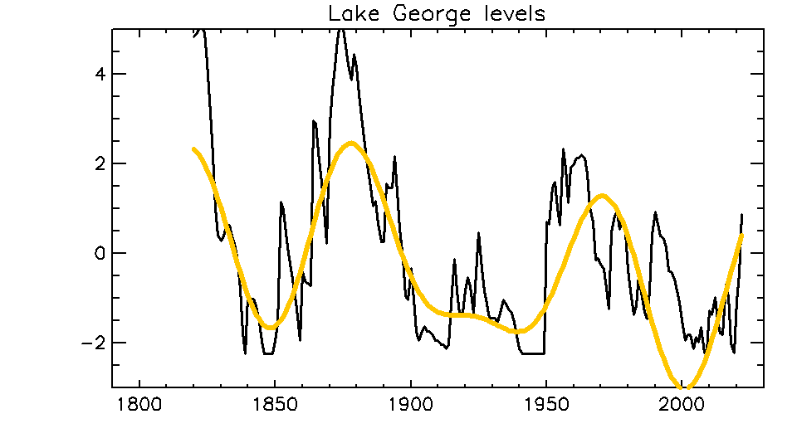
LAKE GEORGE NSW
LAKE GEORGE NSW
Time range 1820-2022CE
Relative depth (m)
Yellow line: Use 3 periods
79.6 50 220 yr
to reconstruct multi-decadal fraction of variations
79.6 yr
SPECTRUM LAKE GEORGE
Time range 1820-2022CE
50 yr
LOMB-SCARGLE POWER SPECTRUM
Use 3 periods
79.6 50 280 yr
Mar 2023 version to year 2022

Slide 6
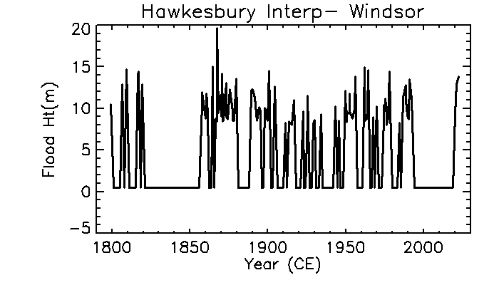
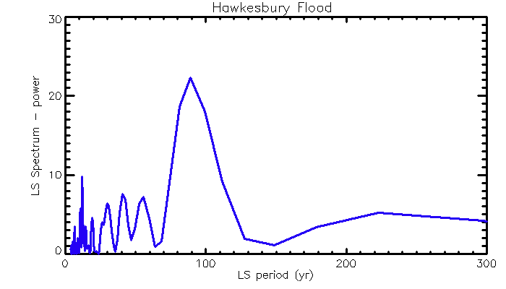
HAWKESBURY RIVER
Coastal NSW
Data from Infrastructure NSW
88.8 yr
11 yr
LOMB-SCARGLE POWER SPECTRUM
55 yr
42 yr
Recalculation using latest interpolated data 1 feb 2023
220 yr

Slide 7
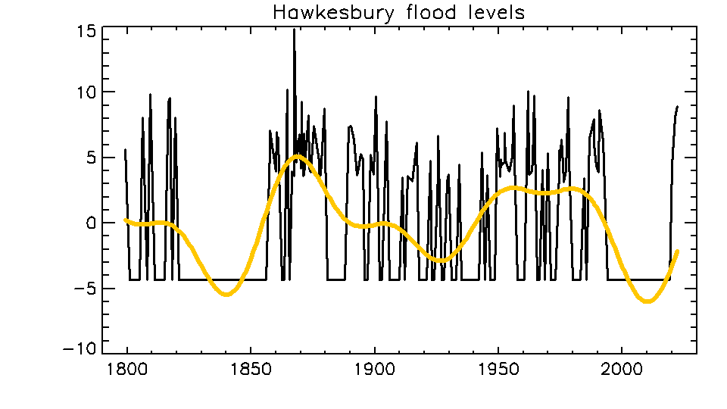
HAWKESBURY RIVER
Coastal NSW
Relative flood level (m)
Yellow line: Use 4 periods
88.8 55 42 220 yr
to reconstruct multi-decadal fraction of variations
Use 4 periods 88.8 55 42 220 yr
88.8 yr
11 yr
LOMB-SCARGLE POWER SPECTRUM
55 yr
42 yr
220 yr

Slide 8
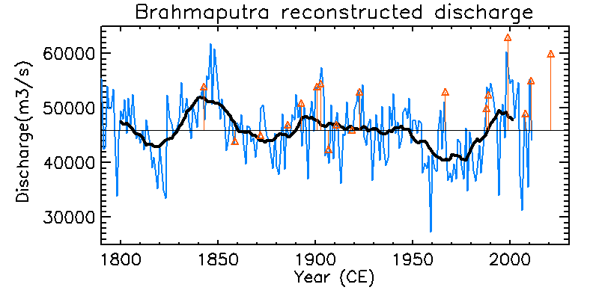
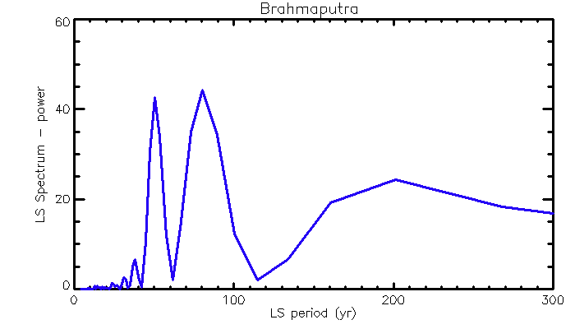
BRAHMAPUTRA RIVER
discharge rate
?
Restricted Time range 1800-2001CE
Data from Rao et al, 2020
SPECTRUM BRAHMAPUTRA RIVER
Time range 1800-2001CE
LOMB-SCARGLE POWER SPECTRUM
period 80.4 yr, p=0
~Gleissberg period
50 yr
200 yr

Slide 9
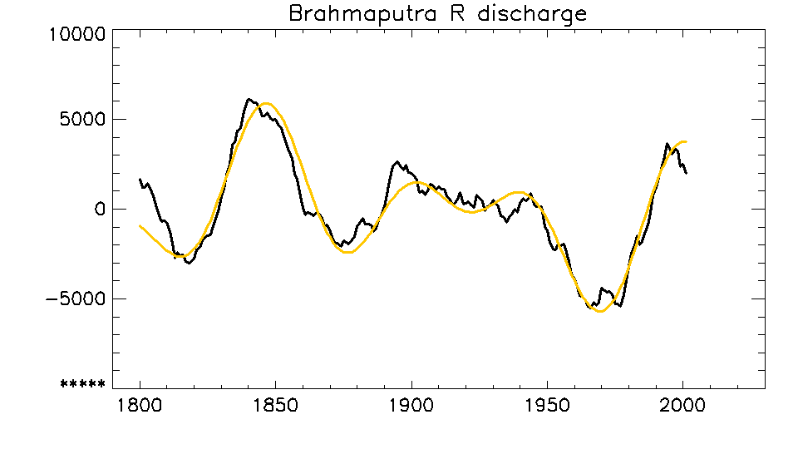
BRAHMAPUTRA
Restricted Time range 1800-2001CE
BRAHMAPUTRA RIVER
Restricted time span 1800-2001 CE
Yellow line: Use 3 periods
80.4 50 200 yr
to reconstruct multi-decadal fraction of variations
Relative discharge rate
Restricted to past 200 years only
?
Use 3 periods 80.4 50 200 yr
SPECTRUM BRAHMAPUTRA
Time range 1800-2001CE
period 80.4 yr, p=0
~Gleissberg period
50 yr
200 yr

Slide 10
COMPARE SPECTRA FOR 3 SITES
LAKE GEORGE
Time range 1820-2022CE
50 yr
←200 yr LAKE GEORGE NSW
Power Power Power
88.8 yr
Hawkesbury R
Time span 1800-2020
11 yr
55 yr
42 yr
←220 yr HAWKESBURY R
Coastal NSW
220 yr
50 yr
Brahmaputra
Time span 1800-2001
80.4 yr
←200 yr BRAHMAPUTRA R DISCHARGE
205 yr
0 100 200 300
Period (years)

Slide 11
LAKE GEORGE NSW and HAWKESBURY R – multi-decadal fraction is (close to) in phase)
LAKE GEORGE NSW
Time range 1820-2022CE
HAWKESBURY R

Slide 12
COMPARE PHASE OF MULTI-DECADAL FRACTIONS
LAKE GEORGE NSW
Time range 1820-2022CE
BRAHMAPUTRA RIVER
NOTE PHASE INVERSION

Slide 13
Now compare Lake George with ocean indices for date ~1800CE to present :
ENSO (with reconstruction by Datwyler, 2020)
AMO
IOD (>1870 CE)
PDO (>1900 CE)
Some indices are less informative at periods <100 yr:
SAM (with reconstruction by Abram)
Sunspot index

Slide 14
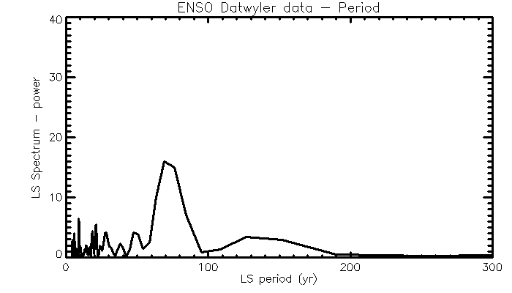
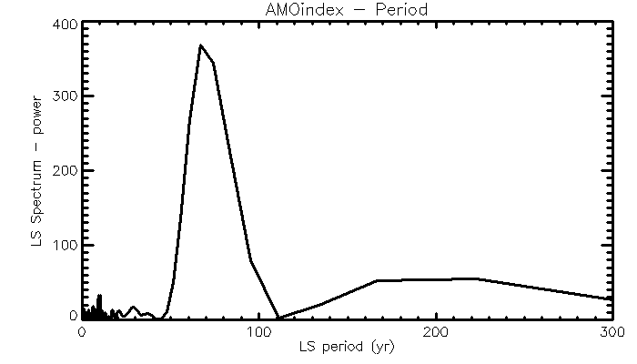
SPECTRUM ENSO index
Data 1800-1990
Data from Datwyler et al, 2020
SPECTRUM AMO index
Data 1850-2020
79.6 yr
SPECTRUM LAKE GEORGE
Data 1820-2020
50 yr

Slide 15
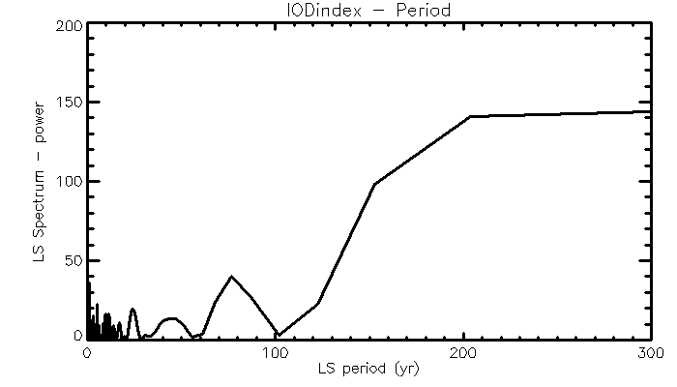
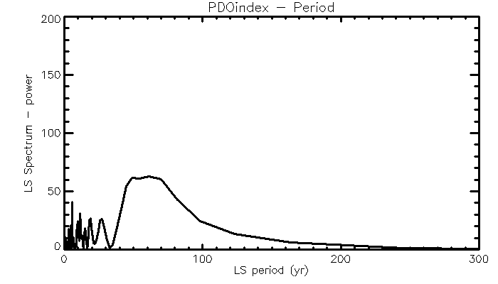
SPECTRUM ENSO index
Data 1800-1990
SPECTRUM IOD
Data 1870-2020
Data from Datwyler et al, 2020
SPECTRUM AMO index
Data 1850-2020
SPECTRUM PDO
Data 1900-2020
SPECTRUM LAKE GEORGE
Data 1820-2020
79.6 yr
SPECTRUM LAKE GEORGE
Data 1820-2020
79.6 yr
50 yr
50 yr

Slide 16
Observation re Ocean and atmospheric indices:
ENSO and AMO provide best correlations in spectral peaks with the 200 year rainfall-flood records
What causes oceanic indices from widely separated regions (ENSO, AMO, IOD, PDO) to show similar multi-decadal spectral maxima?

Slide 17
Now compare spectrum of
cosmic ray data (EDML 9400 year), with
700 year Brahmaputra River spectra
200 year Lake George
See correspondence of of spectral peaks
Gleissberg period 87 yr
unnamed period 132 year
de Vries period 208+ year

Slide 18
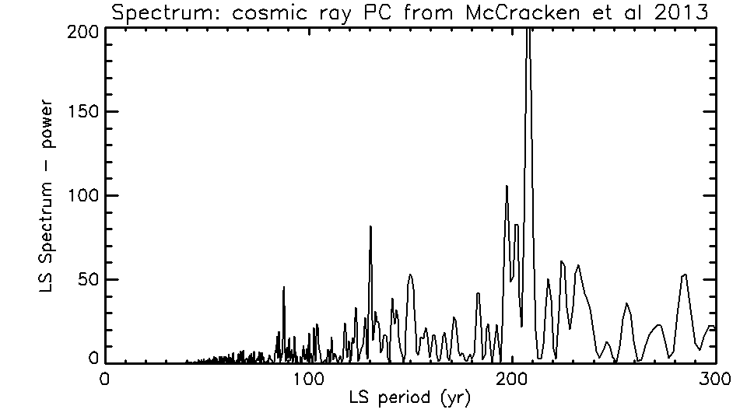
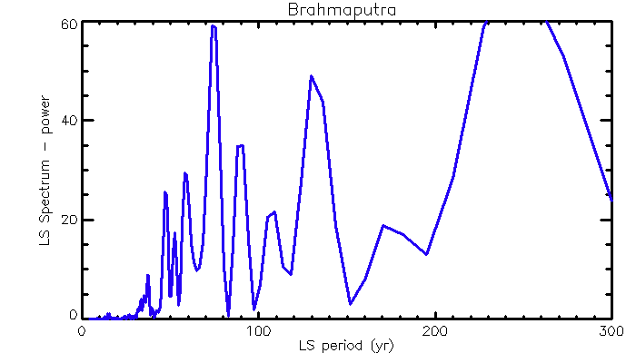
SPECTRAL PROPERTIES
Gleissberg
De Vries
←9400yr COSMIC RAY 1.PC
(10Be and 14C)
McCracken et al, 2013
75
132
Time span 1319-2001
47
90
←700 yr BRAHMAPUTRA DISCHARGE
Power Power Power
242
38
59
108
79.6 yr
Time span 1820-2022
50 yr
←200 yr LAKE GEORGE NSW
0 100 200 300
Period (years)

Slide 19
Now compare spectrum of cosmic ray data with
Lake George
Hawkesbury River, and
Brahmaputra River spectra

Slide 20
De Vries
SPECTRAL PROPERTIES
Gleissberg
←9400yr COSMIC RAY 1.PC
(10Be and 14C)
79.6 yr
LAKE GEORGE
Time range 1820-2022CE
50 yr
←200 yr LAKE GEORGE NSW
Power Power Power Power
88.8 yr
Hawkesbury R
Time span 1800-2020
11 yr
55 yr
42 yr
←220 yr HAWKESBURY R
Coastal NSW
220 yr
50 yr
Brahmaputra
Time span 1800-2001
80.4 yr
←200 yr BRAHMAPUTRA R DISCHARGE
205 yr
0 100 200 300
Period (years)

Slide 21
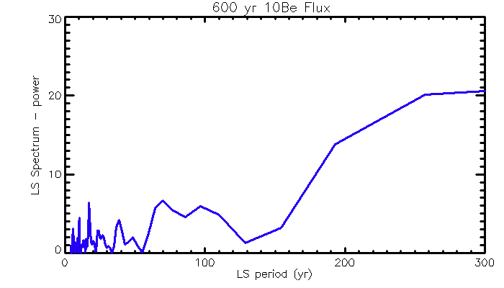
Gleissberg?
COSMIC RAY RESTRICTED
Time range 1800-1995CE
SPECTRAL PROPERTIES
De Vries?
←200yr NGRIP COSMIC RAY
HIRES ANNUAL 10Be flux
79.6 yr
LAKE GEORGE
Time range 1820-2022CE
50 yr
←200 yr LAKE GEORGE NSW
Power Power Power Power
88.8 yr
Hawkesbury R
Time span 1800-2020
11 yr
55 yr
42 yr
←220 yr HAWKESBURY R
Coastal NSW
220 yr
50 yr
Brahmaputra
Time span 1800-2001
80.4 yr
←200 yr BRAHMAPUTRA R DISCHARGE
205 yr
0 100 200 300
Period (years)

Slide 22
The short 200 yr segment of NGRIP 10Be data shows a diffuse spectral peak ~60 - 100 yr period.
This is lower resolution than shown in the Lake George and Brahmaputra data sets
Cosmic ray spectra show some correlation with multi-decadal rainfall variations
solar mechanisms associated with cosmic ray phenomena may influence earth cloud-rainfall phenomena

Slide 23
SOME CONSIDERATIONS ON SOLAR ACTIVITY AND COSMIC RAY SPECTRA
McCracken et al 2013 show that cos ray spectra show variations in spectral maxima for data from times of
Time spans containing Grand Minima (GM)
Compared with time spans without GM
Most recent GM ended after Dalton GM (1400-1850 CE)
Hence Brahmaputra data from 1319 is dominated by GM
Records from 1800-present dominated by absence of GM

Slide 24
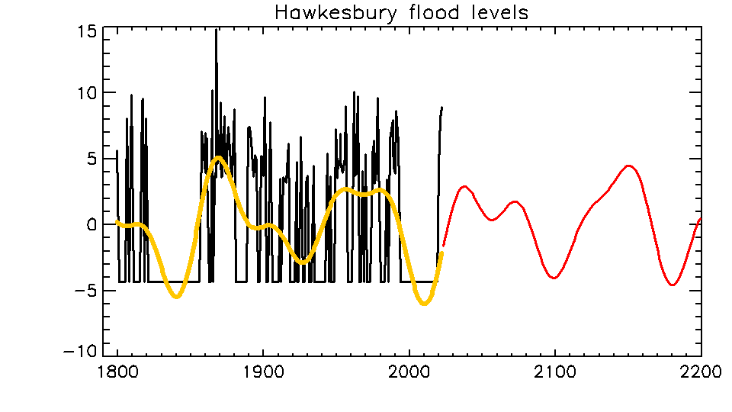
FUTURE FLOOD-DOMINANT PERIODS FOR HAWKESBURY RIVER – PROJECTED FROM 220 yr HISTORY
Historical floods
Future projected multi-decadal cycles
Relative flood level (m)
Multi-decadal cycles in historical data
Highest risk predicted for 2032-2042
Year CE
Asten and McCracken, EGU 2023

Slide 25
CONCLUSIONS – SUMMARY
Spectra of rainfall/floods in 3 parts of the globe show similar peak periods; ~50 yr, Gleissberg (~85 yr) and de Vries (200-280 yr)
Oceanic indices ENSO and AMO show similar peak periods
Similarity of spectra in different locations, with cosmic ray spectra (10Be, 14C), suggests a driver associated with solar and interplanetary magnetic field variations
Stable spectra at inter-decadal periods suggests opportunity to predict drought or flood-dominant decades ~80 years into future – eg Hawkesbury
River NSW

Slide 26
CONCLUSIONS - SUPPLEMENTARY
Rainfall/flood patterns at 2 sites in SE Australia have similar spectra over past 200 years
(approx. 50, 85, 200+ multi-decadal spectral peaks)
Brahmaputra River has similar spectrum BUT
multi-decadal peak periods have opposite phase
ENSO and AMO oceanic indices show similar peaks
These peaks are clear in 10Be and 14C cosmic ray proxies of past 10K years
Peaks in cos ray data less clear but identifiable for data of past 200 years – peaks may be affected by inclusion/exclusion of sunspot Grand Minima

Slide 27
CONCLUSIONS – SUPPLEMENTARY continued
Speculate a driver for multi-decadal rainfall/flood and ENSO cycles, correlated with solar and interplanetary magnetic field variations
Observed multi-decadal cycles allow prediction of future flood-dominant decades

Slide 28
APPENDIX
Brief notes on Murray Darling Basin (East Australia, inland)
and
Nile River, Egypt

Slide 29
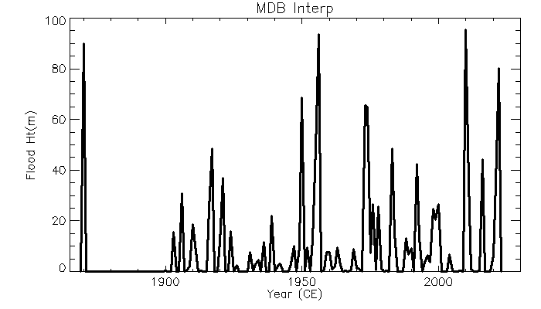
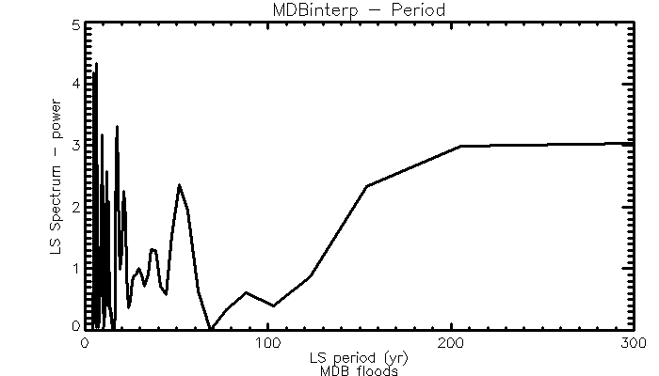
Rainfall % area
RAINFALL HISTORY MURRAY-DARLING BASIN (E. Australia)
Annual rain percentage area (Callaghan 2022) – limited time length 1870-2022.
Spectrum: Gleissberg period (~80 yr) is muted.
But SOI (=atmospheric index) has a similar 50 yr peak – see next slide).
Appears that MDB dominated by the major SOI period peaks 50yr and 80-90 yr (plus sunspot cycles 5 to 22 yr periods)
50 yr
88 yr

Slide 30
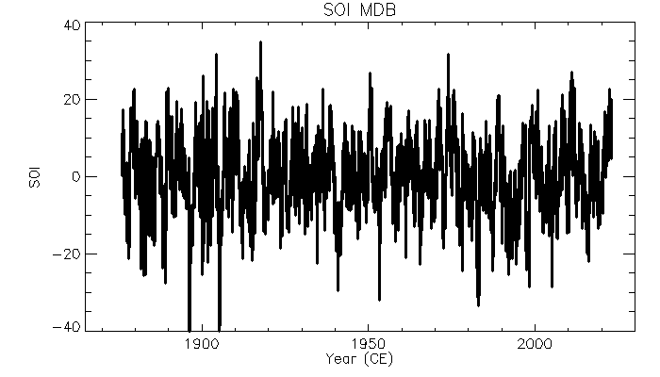
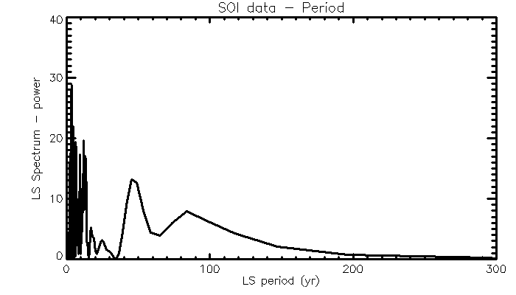
SOI index
(atmospheric circulation)
Since 1870
50 yr
Spectrum of SOI
88 yr

Slide 31
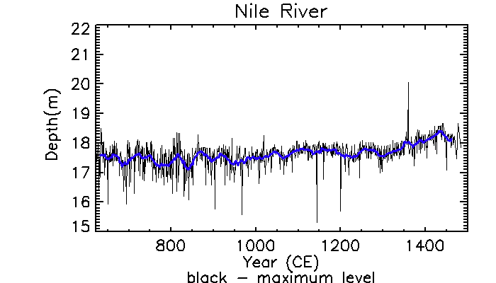
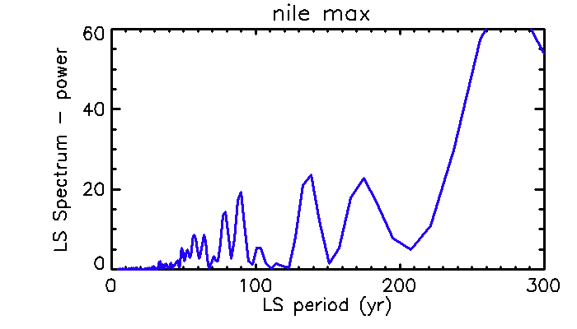
NILE RIVER 622-1484CE
Data as used by Ruzmaikin&Feynman 2005
Blue line – 21-yr smoothing
Spectrum of smoothed Nile river data
31

Slide 32
Now compare spectra for
full length of Brahmaputra River data (700 yr)
with
full length of Ruzmaikin-Feynman Nile R data
→ Spectral peaks show high level of corresponding periods (even though time spans are different)

Slide 33
SPECTRAL PROPERTIES
Gleissberg
De Vries
←9400yr COSMIC RAY 1.PC
(10Be and 14C)
McCracken et al, 2013
75
132
Time span 1319-2001 CE
47
90
←700 yr BRAHMAPUTRA DISCHARGE
Power Power Power
108
242
38
59
Time span 622-1484 CE
←800 yr NILE RIVER FLOOD LEVEL
0 100 200 300
Period (years)

Slide 34
ACKNOWLEDGEMENTS
Jeff Callaghan (Bureau of Meteorology – retired) provided data for the Murray- Darling Basin
Brad Pillans (Australian National Univ) provided data and multiple insights into the Lake George (NSW) water level history
Mukund Palat Rao (Columbia Univ, NY) assisted with location of historical data for the Brahmaputra River
Stephen Yeo (Infrastructure NSW) assisted with location of historical data relating to the Hawkesbury-Nepean river system

Slide 35
REFERENCES
Asten, MW and McCracken, KG, 2021, Time-series analysis of extreme rainfall and flood events in two water catchments of Eastern New South Wales shows an indicative link to Gleissberg 87 yr cycles, Abstract ID#:
850985, AGU 2021, New Orleans.
The interactive poster is viewable at
agu2021fallmeeting-agu.ipostersessions.com/Default.aspx?s=15-EC-92-A3-1D-16-E6-E7-17-CF-0F-06-DE-01-7E-3E
(click on the various windows to enlarge segments of the iposter)
A downloadable pdf of the full content of the poster is available at doi.org/10.1002/essoar.10510770.1
Asten, M.W. and McCracken, K.G., 2022, Submission regarding the management and prediction of major floods in eastern NSW. Submitted to the NSW Independent Flood Inquiry, 7 April 2022. Submission 0818, https://www.nsw.gov.au/nsw-government/projects-and-initiatives/floodinquiry
Asten, MW and McCracken, KG, 2022, Discharge and flood cycles of the Brahmaputra River past present and future; implications for possible global mechanisms, Paper EGU22-8090 , European Geophysical Union, Vienna, May 2022.
Callaghan, J. (2022) The Eastern Australian Floods of February 2022 and Climate Change. Journal of energy and power technology, 4(1), doi:10.21926/jept.2201xxx
Dätwyler, C., Martin Grosjean, Nathan J. Steiger, and Raphael Neukom (2020) Teleconnections and relationship between the El Nino-Southern Oscillation (ENSO) and the Southern Annular Mode (SAM) in reconstructions and models over the past millennium. Climate of the Past 16(2) 743-756, DOI: 10.5194/cp-16-743-2020
Infrastructure NSW, Hawkesbury-Nepean Valley Regional Flood Study July 2019 -Overview, https://www.infrastructure.nsw.gov.au/media/2162/ec_insw_hawkesbury-nepean_fss-document_web.pdf .(https://www.infrastructure.nsw.gov.au/media/2162/ec_insw_hawkesbury-nepean_fss-document_web.pdf)
Leamon, McIntosh and Marsh, 2020, Termination of Solar Cycles and Correlated Tropospheric Variability, ArXiv:1812.02692v2 [astro-ph.SR] 4Feb 2020
Leamon, R. J., McIntosh, S. W., & Marsh, D. R., 2021, Termination of solar cycles and correlated
tropospheric variability. Earth and Space Science, 8, e2020EA001223. https://doi.org/10.1029/2020EA001223
McCracken, K.G., Beer, J., Steinhilber, F., Abreu, J., 2013. A phenomenological study of the cosmic ray variations over the past 9400 years, and their implications regarding solar activity and the solar dynamo. Sol. Phys. 286, 609–627, doi:10.1007/s11207-013- 0265-0 .
McNoldy, B, 2021, http://bmcnoldy.rsmas.miami.edu/tropics/oni/ONI_NINO34_1854-2021.txt, accessed 20 Nov 2021
Rao, M.P., E.R. Cook, B.I. Cook, R.D. D'Arrigo, J.G. Palmer, U. Lall, C.A. Woodhouse, B.M. Buckley, M. Uriarte, D.A. Bishop, J. Jian, and P.J. Webster, 2020: Seven centuries of reconstructed Brahmaputra River discharge demonstrate underestimated high discharge and flood hazard frequency. Nat. Commun., 11, no. 1, 6017, doi:10.1038/s41467-020-19795-6.
Ruzmaikin A, Feynman J, Yung YL, 2006, Is solar variability reflected in the Nile River? Journal of
Geophysical Research, Vol. 111, D21114, doi:10.1029/2006JD007462
Ruzmaikin, A, J Feynman, 2015, The Earth’s climate at minima of Centennial Gleissberg Cycles, Advances in Space Research 56, 1590–1599, http://dx.doi.org/10.1016/j.asr.2015.07.010
Short , M.A., R. S. Norman , B. Pillans , P. De Deckker , R. Usback , B. N. Opdyke , T.R. Ransley , S. Gray & D. C. McPhail (2020): Two centuries of water-level records atLake George, NSW, Australian Journal of Earth Sciences,https://doi.org/10.1080/08120099.2020.1821247 .

Slide 36
[ENDS]

