Slide 1
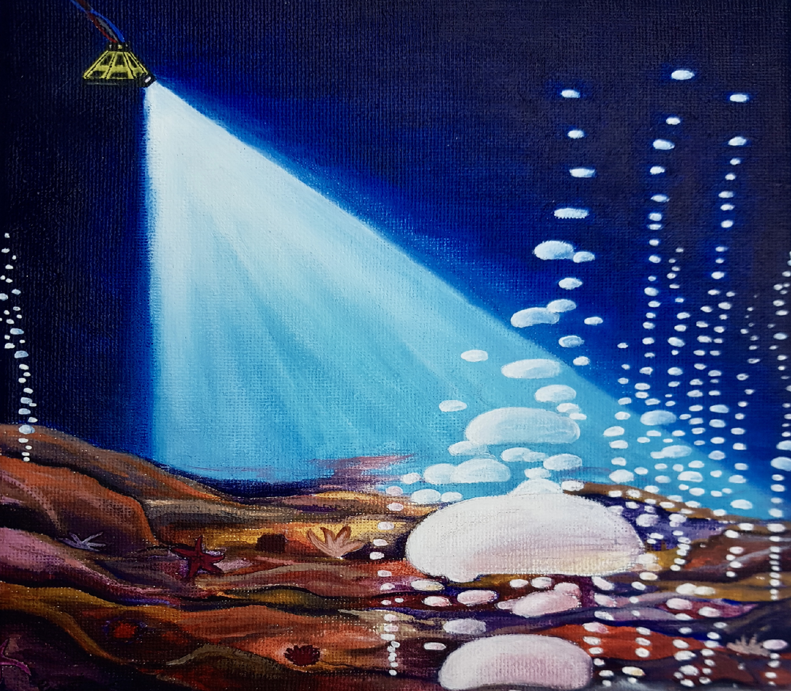
Link to manuscript: https://gi.copernicus.org/articles/11/293/2022/
Code repository: https://github.com/KnutOlaD/Deconv_code_data

