Slide 1
Extension and evaluation of the Integrated Forecast System (IFS) cycle 49R1 to stratospheric aerosols and chemistry
for the global Copernicus Atmospheric Monitoring Service (CAMS)
Christine Bingen, Simon Chabrillat, Quentin Errera, Vincent Huijnen, Daniele Minganti, Samuel Rémy, Swen Metzger, Jason Williams, and Johannes Flemming
Contact: Christine.Bingen@aeronomie.be
Stratospheric
aerosols:
How realistic is IFS’ representation of aerosols in the stratosphere ?
The
IFS-Composition model used by CAMS
Stratospheric chemistry:
How does the BASCOE upgrade improve composition forecasts for 7 selected « ozone hole » events ?
Evaluation against:
Evaluation against:
Abstract
GloSSAC (Climatology)
Aura-MLS (N₂O, H₂O, HNO₃, HCl, ClO, O₃)
GOMOS (solar occultation)
Conclusions
Concl.
Notes:
The list of the chemical species is provided in the order of discussion and corresponds to a real scan of IFS’ performance covering specific aspects of the evaluation:
N20: tracer => evaluation of the transport and meteo
H2O: tracer, but present in different (gas, solid) phases => evaluation transport, temperature, PSCs
HNO3: PSC compound => evaludation PSC chemistry
HCl: PSC compound, one of the chorine intervening in ozone destruction => evalutaion PSC chemistry, impact on ozone
ClO: depletes ozone following a catalytic cycle (like BrO, also evaluated, but non presented here) => evaluation ozone and ozone hole time evolution

Slide 2
Abstract
The ECMWF’s Integrated Forecast System (IFS) is the global atmospheric model used by the Copernicus Atmospheric Monitoring Service (CAMS) to provide analyses and forecasts on atmospheric composition.
Currently, the CAMS global model includes IFS’ aerosol model, the aerosol module IFS-AER making use of a sectional-bulk scheme, and the chemistry scheme based on a CB05-based carbon-bond mechanism, with the option to couple this to stratospheric chemistry module BASCOE. The combined BASCOE will be used operationally in the CAMS global system starting from the upgrade to cycle 48R1 planned in June 2023. This abstract focuses on further developments related to stratospheric chemistry and aerosols that are to be implemented in the future operational cycle 49R1, as well as on a first evaluation of IFS’ performances in representing stratospheric aerosols and chemistry against different datasets.
Initially focussing on the troposphere, IFS-AER has been extended to include and represent stratospheric sulfate aerosol processes, keeping the existing tracers. The extended IFS-AER(strato) has been coupled to IFS(BASCOE) through the gaseous sulphuric acid tracer, to the IFS radiation scheme, and to the 4Dvar assimilation scheme. The evaluation of aerosol aspects makes use of aerosol datasets (aerosol extinction, AOD, ...) from the Global Ozone Monitoring by Occultation of Stars (GOMOS, onboard Envisat), and the Global Space-based Stratospheric Aerosol Climatology (GloSSAC), based on different cases studies including quiescent and (highly) volcanic periods.
BASCOE includes a simple PSC parameterization, which has been updated and tuned in cycle 49R1. In order to assess the impact of this upgrade, we evaluate the composition of the polar lower stratosphere during the winter-spring seasons ("ozone hole" events) of 2008, 2009 and 2020 above the Antarctic and 2009, 2011, 2012 and 2020 above the Arctic, with a focus on 5 key species observed by Aura-MLS. This evaluation demonstrates the capacity of IFS(BASCOE) to forecast the chemical composition of the polar lower stratosphere above both the Arctic and the Antarctic for several years with different evolution of the polar vortex. While further improvements are desirable and will require an overhaul of the PSC parameterization, the current performance allows to study the interannual variability of ozone hole events.
Abstract
Home
Concl.

Slide 3
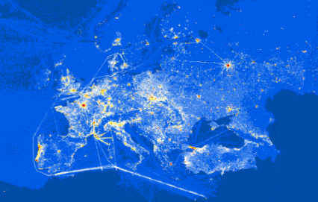
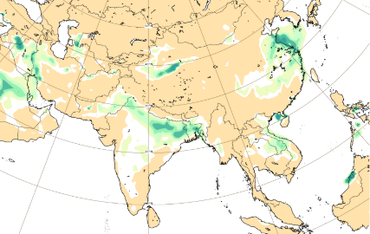
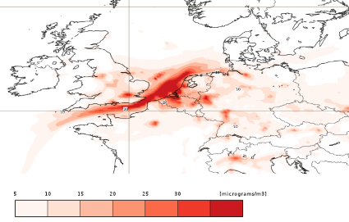
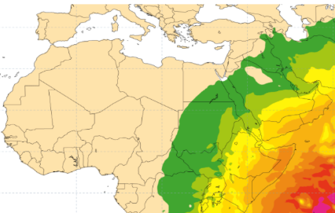
CAMS: the Copernicus service to monitor atmospheric composition
Using assimilation of Earth Observations, CAMS provides operational and quality-controlled data for:
past, current and near-future (forecasts) global atmospheric composition;
European air quality;
emissions and surface fluxes of key pollutants and greenhouse gases;
solar radiation;
climate radiative forcing;
the ozone layer.
The IFS-Composition model
A service implemented by the European Center for Medium-range Weather Forecasts
… and developed through many competitive contracts
Home
Concl.
Notes:
CAMS proposes 5-day forecast (i.e. short-term).
CAMS most used application = air quality, but here, we focus on the aspects related to the ozone layer.
The present work concerns model developments realized in the framework of the cams2_35 contract

Slide 4
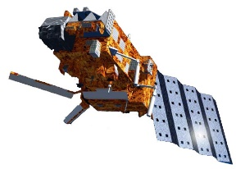
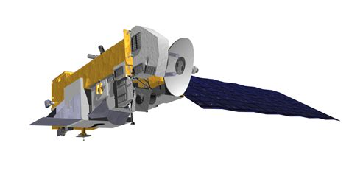
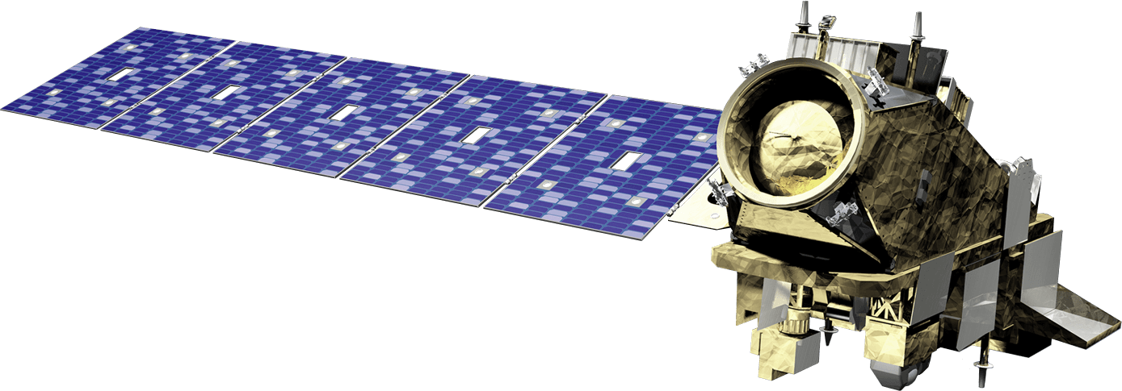
Atmospheric Composition in the currently operational (Cy47r3) global IFS (Integrated Forecast System)
Obs operators
The IFS-Composition model
Data assimilation:
4D-VAR, 12h
Strato chemistry: BASCOE (64 species)
Strato aerosols: sulphate
NWP model:
dynamics, physics, transport
Strato O₃ parameterization
Tropo chemistry: CB05 (71 species)
Tropo aerosols: IFS-AER (7 species)
GHG: CO₂ , CH₄
Deposition
Emissions: external (inventories) & on-line
Home
Concl.
Notes:
This is a very simplified view of the IFS assimilation system.
This slide show the current situation of the operational IFS assimilation system (cycle 47.3).
The left and right pannels show an overview of the chemistry and the aerosol asêcts, respectively. It should be noted that they are not connected, reflecting the fact that they a re not included in the current operational system. The central part of the diagram show the data assimilation system fed by by the observation operator and the NWP model, and providing analyses every 24h.
The parameterization of chemical productions and losses for stratospheric O3 (function of season & latitude) currently used by IFS is quite rough and not very accurate. The BASCOE module, on the other hand, provides an extended overview of the stratospheric chemistry, This justifies the idea to replace it by the ozone field computed by the BASCOE module.
Why is there a separate box for GHG ? -> processes related to GHG emission and dispersion require special treatment and are provided by specific module.
The tropospheric chemistry module CBO5 is a very elaborate chemistry module which is necessary to correctly describe air quality, a main application for IFS.
Concerning the aerosol part, originally, IFS-AER only considered tropospheric aerosols. It is now extended with a stratospheric module that only takes into accound sulphate aerosols (thus, in particular no carbonaceous aerosols)

Slide 5
Atmospheric Composition in the next operational (Cy49r1) global IFS (Integrated Forecast System)
Obs operators
The IFS-Composition model
Data assimilation:
4D-VAR, 12h
Strato chemistry: BASCOE (64 species)
Strato aerosols: sulphate
NWP model:
dynamics, physics, transport
Tropo chemistry: CB05 (71 species)
Tropo aerosols: IFS-AER (7 species)
GHG: CO₂ , CH₄
Deposition
Emissions: external (inventories) & on-line
Home
Concl.
Notes:
We see here a schematic view of the next operational cycle (Cy49) that should be launched by end June this year. Final tests are currently ongoing.
It should be noted that the O3 parameterization has disappeared, and that the stratospheric chemistry and aerosol modules are now connected to IFS: these module will now be part of the operational system.

Slide 6
IFS-AER: extension to Stratospheric aerosols
Originally, IFS-AER concerns tropospheric aerosols
Extension toward the Stratosphere:
First approach: coupling with GLOMAP (aerosol microphysical model) and use across troposphere + stratosphere
=> excessive computational costs
=> limitations in data-assimilation context
Second approach: IFS-AER
Use of a dedicated tracer for stratospheric sulfate
Mass fixer (essential for large quantities, sharp gradients) for volcanic aerosols
Assumed size distribution; possibility to make it function of aerosol abundance
Sedimentation included; adjustment of sulphuric acid production to take into account sulphuric acid depletion during particle formation
Implementation of a suitable coupling mechanisms between troposphere and stratosphere
=> simple, but efficient
See Presentation
S. Rémy et al., EGU23-15355
(this session)
The IFS-Composition model
Home
Concl.

Slide 7
Aerosol validation
The capability of IFS to describe the evolution of stratospheric aerosols is evaluated using 3 test cases with varying stratospheric aerosol load.
The validation datasets consist of
GloSSAC multi-instrument climatology
GOMOS: stellar occultation instrument on board Envisat
Stratospheric aerosol load | Period | Planned simulation period | Validation datasets
High | Pinatubo relaxation | 06/1991-12/1995 | GloSSAC
Very low | Quiescent period following Pinatubo relaxation | 06/1997-12/2002 | GloSSAC
Low/increasing | Early Envisat period | 06/2002-12/2010 | GOMOS, GloSSAC
Aerosol validation
to GloSSAC
to GOMOS
to Test runs
Home
Concl.

Slide 8
The GloSSAC climatology
Global Space-based Stratospheric Aerosol Climatology
(Thomason et al. 2018; Kovilakam et al., 2020)
Multi-sensor aerosol climatology, covering period 1979-2018 (up to 2021 in V. 2.2)
Mainly based on satellite (solar occultation) instruments
For the time period considered here, almost entirely relying on SAGE II
During 1.5 year from the Pinatubo eruption, gap in the 40°S-40°N range due to heavy aerosol load
Products:
Aerosol Extinction Coefficient
Stratospheric AOD*
at 525 nm (+ 1020 nm in V. 2.0)
Monthly zonal means; 5° latitude intervals from 77.5°S to 77.5°N
The GloSSAC Climatology
Source: Kovilakam et al., ESSD, 2020
Home
* AOD: Aerosol Optical Depth
Concl.

Slide 9
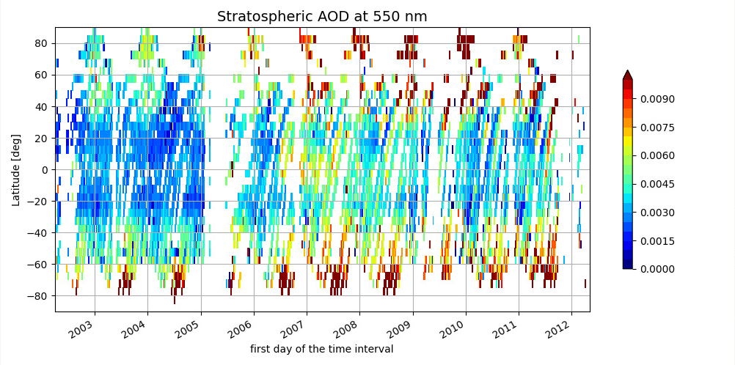
The GOMOS dataset
Global Ozone Monitoring by Occultation of Stars: stellar occultation experiment onboard Envisat (2002-2012)
measuring in the UV-Vis
high measurement rate (300 stars used for GOMOS measurements)
low signal-to-noise ratio
sensitivity to scintillation
Retrieval algorithm AerGOM:
Optimised for aerosol retrieval
(Vanhellemont et al., 2016)
Validation: Robert et al., 2016
C3S-GOMOS: gridded dataset
from AerGOM (Bingen and Robert, 2018)
Products: (Bingen et al., 2017)
Extinction coefficient profiles and derived products (355, 440, 470, 550, 750 nm)
Spatial resolution of 5° latitude, 60° longitude, 1 km resolution, 5-day intervals
The GOMOS dataset
Home
Concl.
Notes:
“300 stars used for GOMOS” -> “300 stars used for aerosol retrievals” ?

Slide 10
GloSSAC vs GOMOS
 | GloSSAC | GOMOS
Type dataset | Multi-sensor climatology | Experimental dataset
Experimental technique | Mainly solar occultation instr., but also use of other instr. (limb sounder, lidar/insitu for gap filling) | Stellar occultation
Dataset continuity | Gap free | Gaps due to experimental conditions
Time resolution | Monthly zonal mean | 5-day time resolution => suited to track signatures of aerosol event Some longitudinal resolution
Products | Stratospheric extinction coefficient and AOD (+ others) | Stratospheric extinction coefficient and AOD (+ others)
Wavelengths | 525 nm | 355, 440, 470, 550, and 750 nm
Home
Concl.

Slide 11
Aerosol evaluation: Test runs
First series of runs shows several issues (too fast removal of aerosol load, overestimated volcanic plume height for Pinatubo, …)
A second series of runs was then started where the aerosol size was made dependent of its abundance
Aerosol load | Test case | Time period | First series | 2nd series (varying aerosol size)
High | Pinatubo | 1991-06-01 to 1993-06-05 | PINA
High | Pinatubo | 1991-06-01 to 1993-05-02 |  | PINA-2
Very low | Quiescent | 1997-06-01 to 1999-01-19 | QUIES
Very low | Quiescent | 1997-06-01 to 1999-02-28 |  | QUIES-2
Low/increasing | Early Envisat | 2002-06-01 to 2003-10-21 | ENVI
Low/increasing | Early Envisat | 2002-06-01 to 2004-04-30 |  | ENVI-2
Aerosol evaluation: Test runs
See Case 1 - results
See Case 2 - results
See Case 3 - results
Home
Concl.

Slide 12
Evaluation of the total sulphur content
Case of the Pinatubo eruption (decay over 2 years)
=> IFS-AER describes correctly the maximum value and subsequent decrease of the sulphur aerosol content
SAGE
HIRD
IFS-Glomap
PINA (IFS-AER)
IFS-GloMAP
IFS-AER
*
Aerosol evaluation
Home
High - Pinatubo
Low - Quiescent
Low/increasing – Early Envisat
Concl.

Slide 13
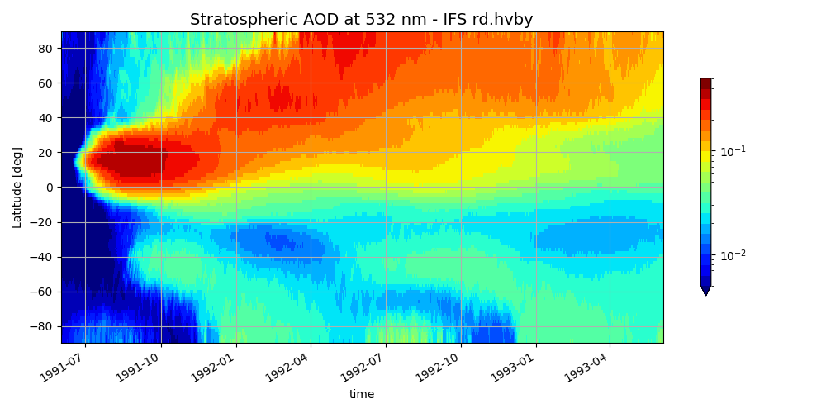
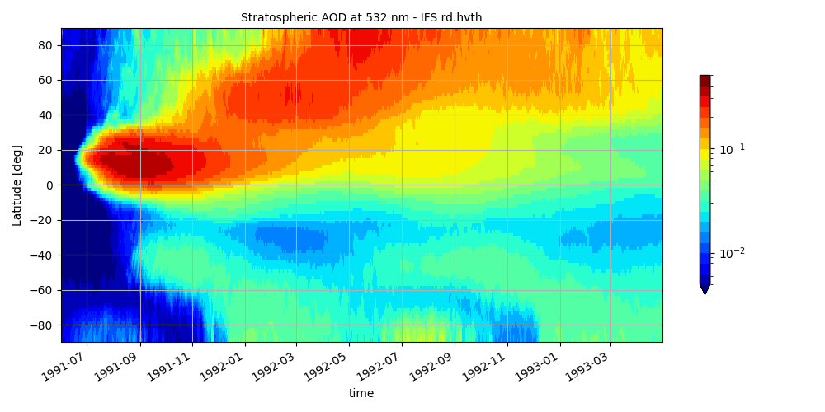
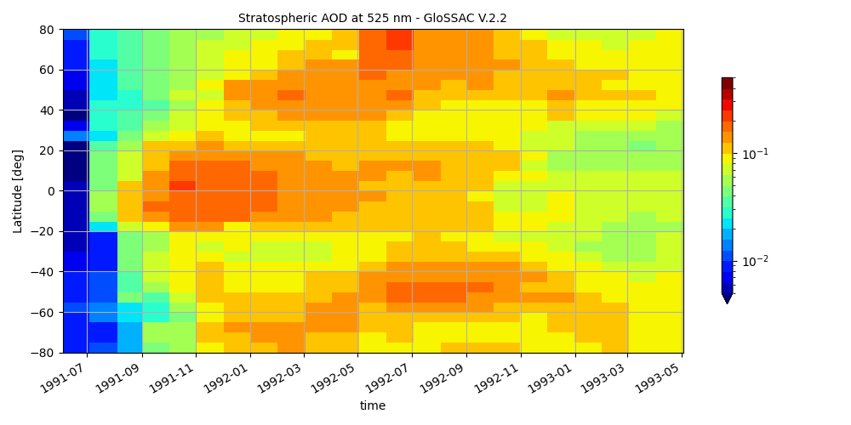
Pinatubo eruption: Stratospheric Aerosol Optical Depth
PINA (532 nm)
PINA-2 (532 nm)
GloSSAC (525 nm)
Case 1 - Pinatubo (1991-1993)
Home
High - Pinatubo
Low - Quiescent
Low/increasing – Early Envisat
Concl.

Slide 14
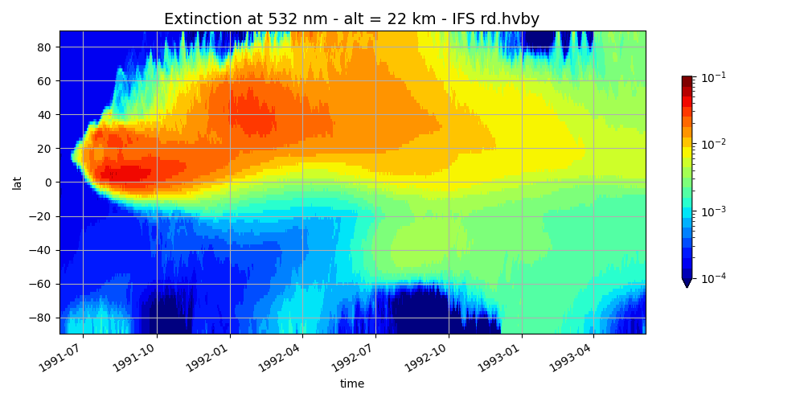
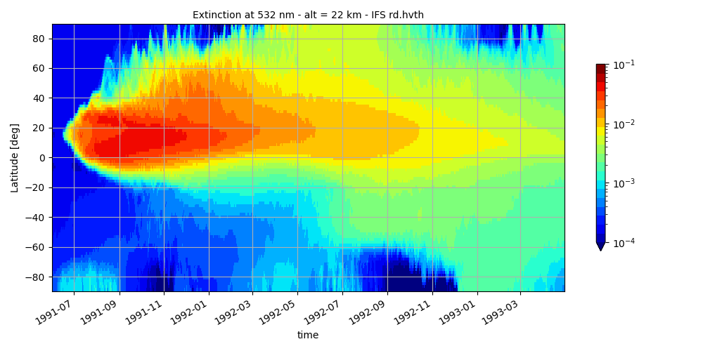
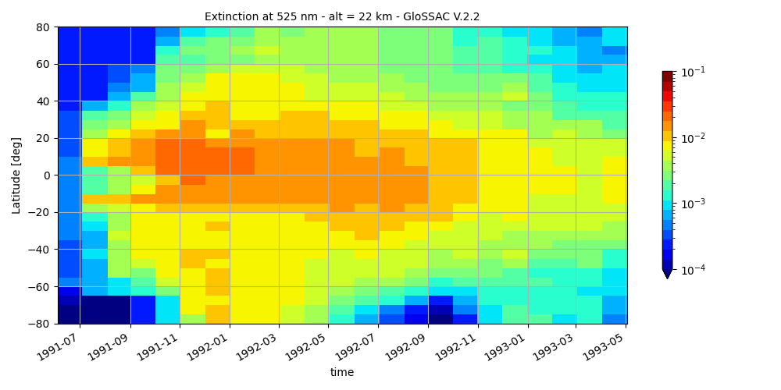
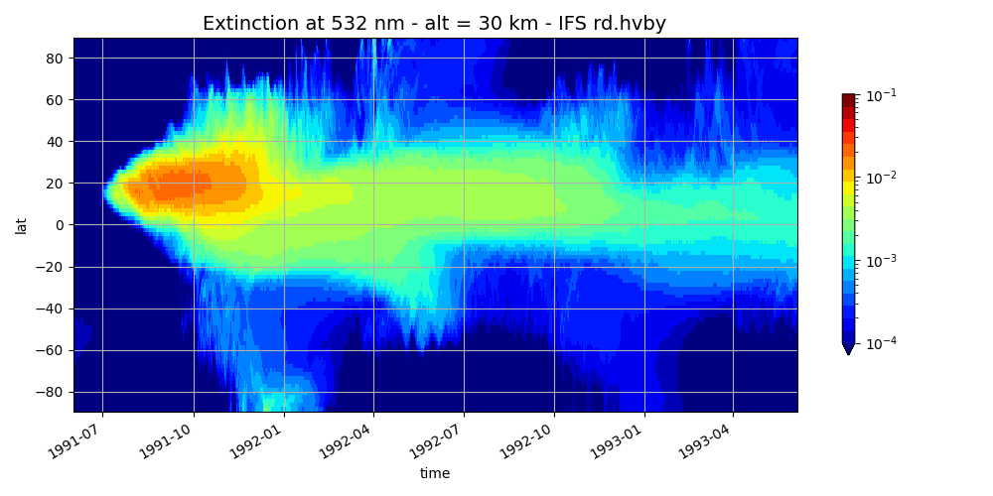
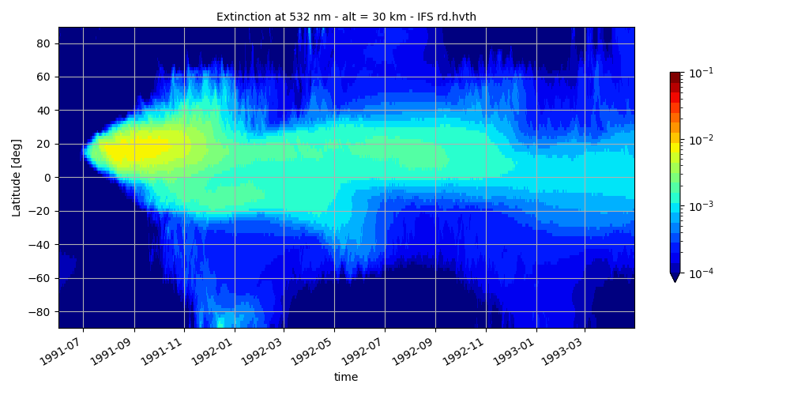
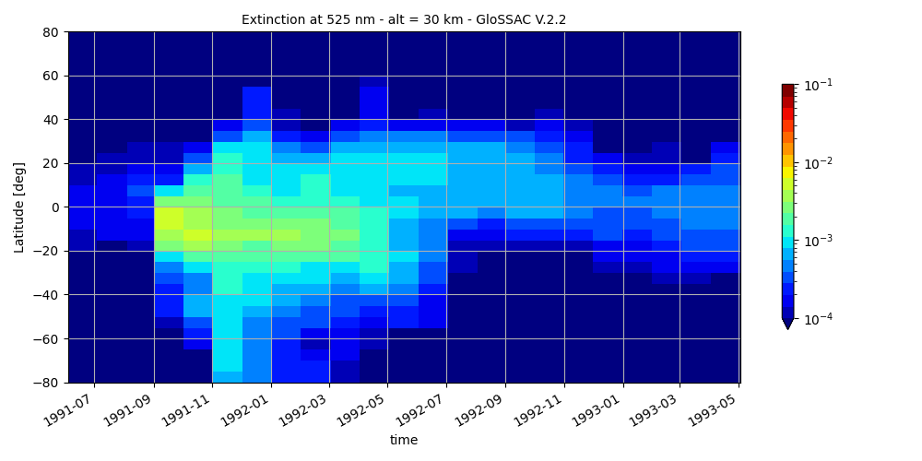
Pinatubo eruption: Stratospheric Aerosol Extinction
At 22 km:
At 30 km:
PINA (532 nm)
PINA-2 (532 nm)
GloSSAC (525 nm)
Case 1 - Pinatubo (1991-1993)
Home
High - Pinatubo
Low - Quiescent
Low/increasing – Early Envisat
Concl.

Slide 15
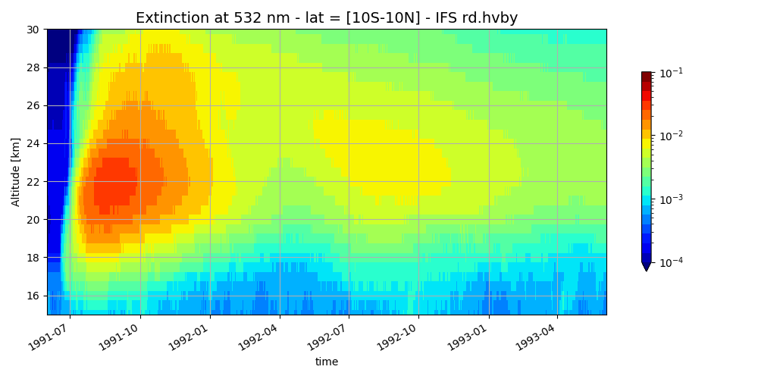
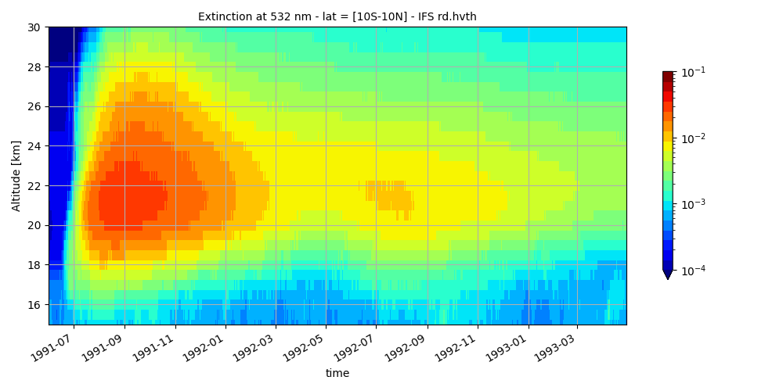
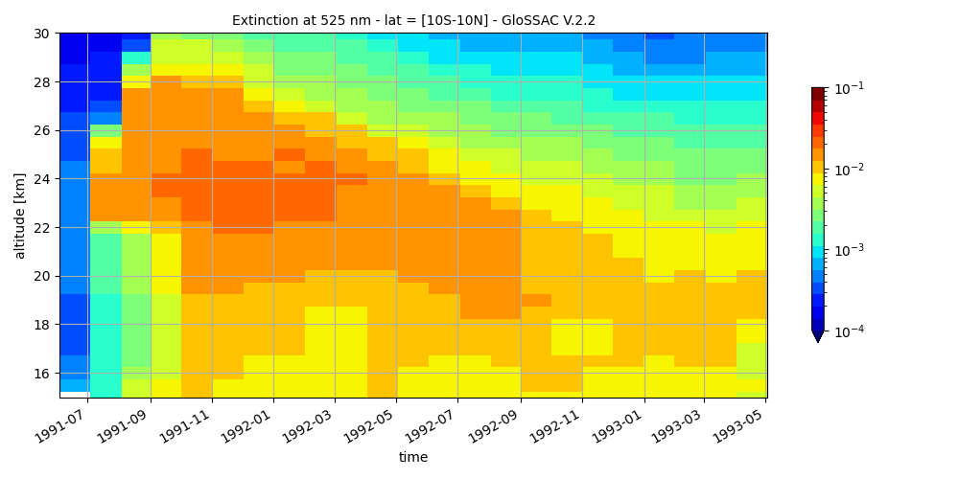
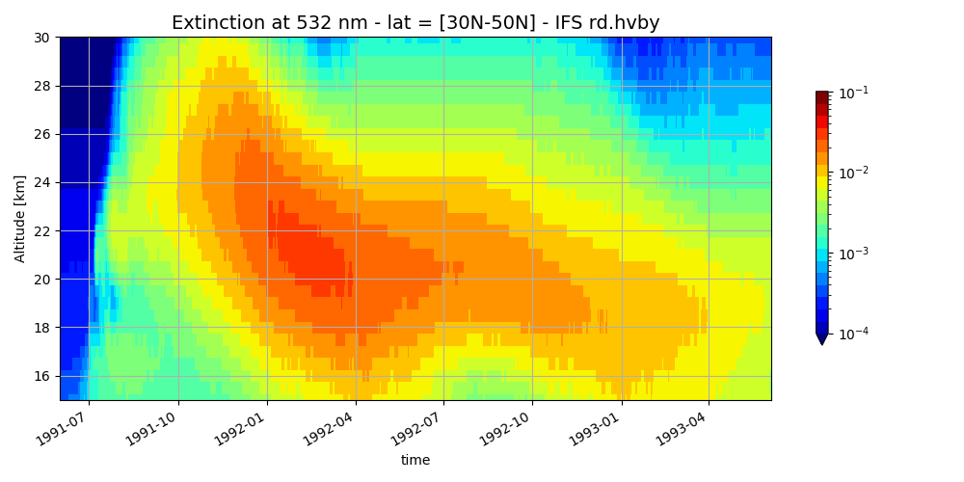
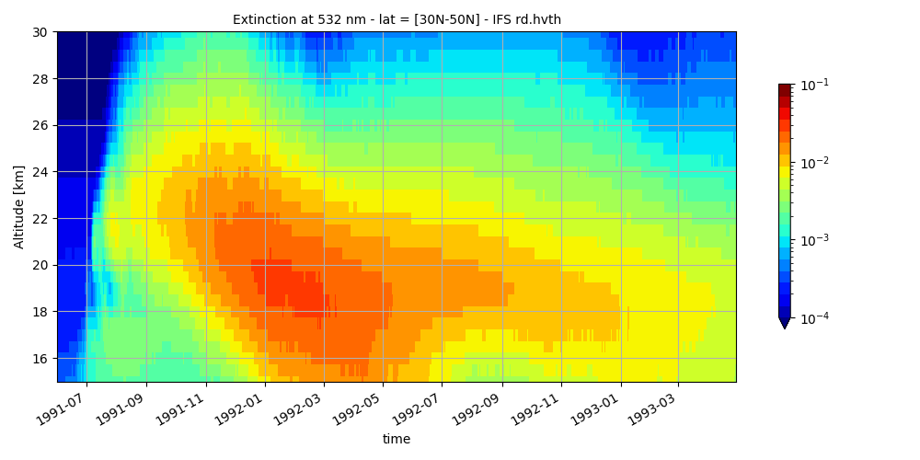
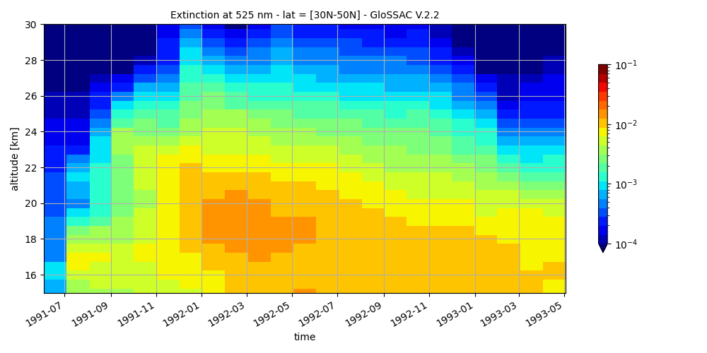
Pinatubo eruption: Stratospheric Aerosol Extinction
At tropical latitudes (10°S-10°N):
At northern mid-latitude (30°N-50°N):
PINA (532 nm)
PINA-2 (532 nm)
GloSSAC (525 nm)
Case 1 - Pinatubo (1991-1993)
Home
High - Pinatubo
Low - Quiescent
Low/increasing – Early Envisat
Concl.

Slide 16
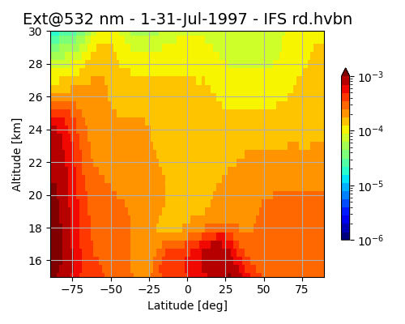
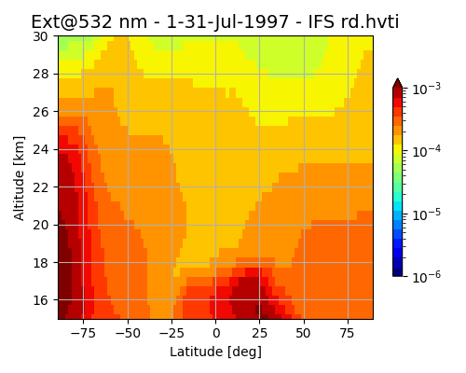
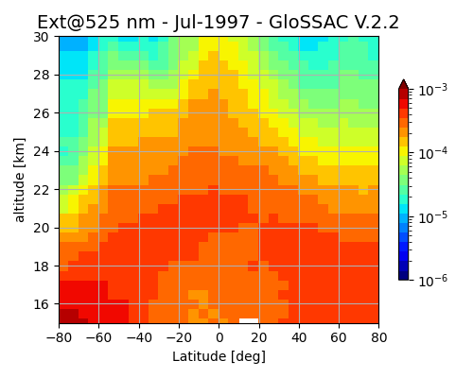
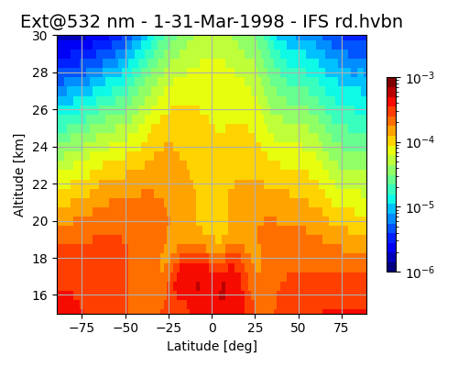
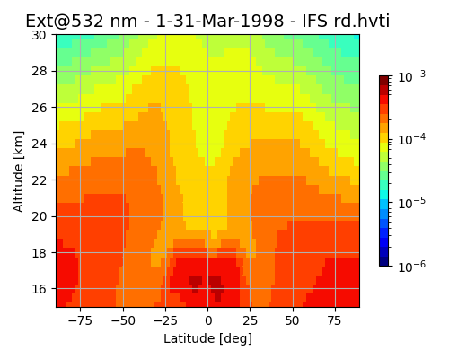
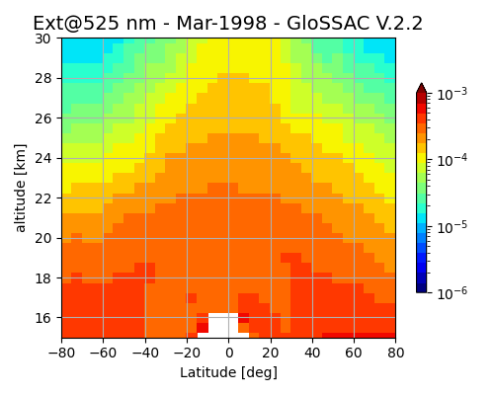
Quiescent period: Stratospheric Aerosol Extinction
July 1997:
March 1998:
PINA (532 nm)
PINA-2 (532 nm)
GloSSAC (525 nm)
Case 2 – Quiescent (1997-1999)
Home
High - Pinatubo
Low - Quiescent
Low/increasing – Early Envisat
Concl.

Slide 17
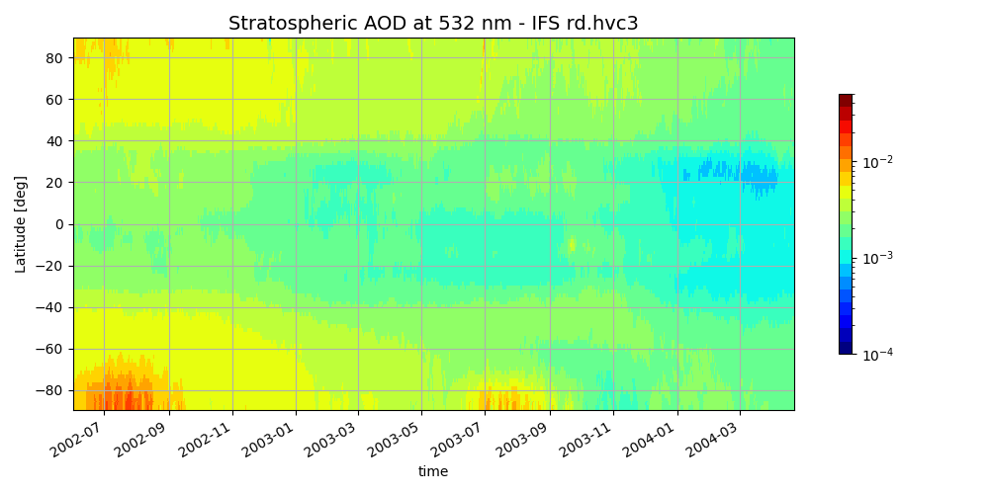
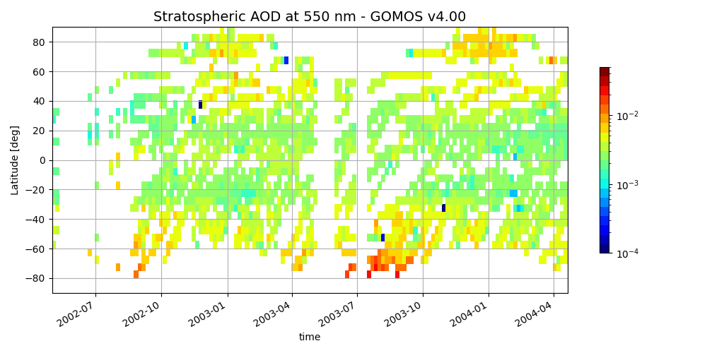
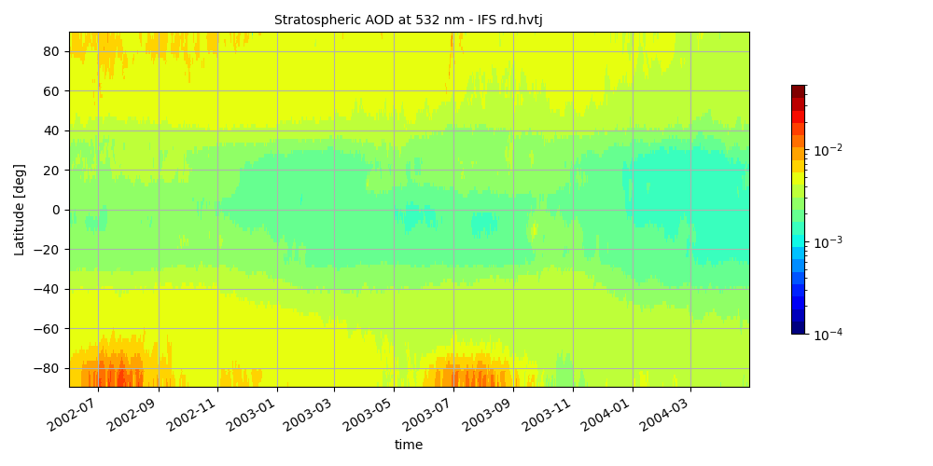
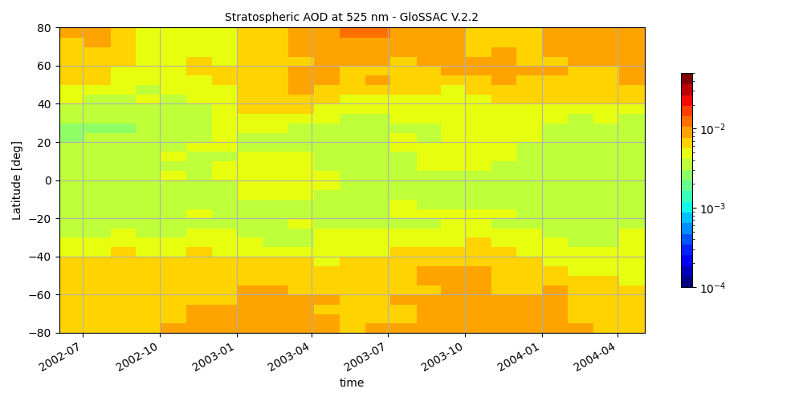
Early envisat period: Stratospheric Aerosol Optical Depth
PINA (532 nm)
GOMOS (550 nm)
Case 3 – Early Envisat (2002-2004)
PINA-2 (532 nm)
GloSSAC (525 nm)
Home
High - Pinatubo
Low - Quiescent
Low/increasing – Early Envisat
Concl.

Slide 18
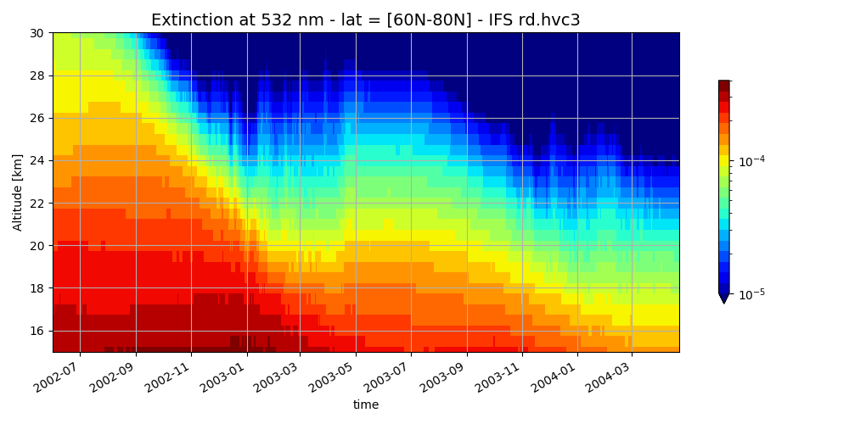
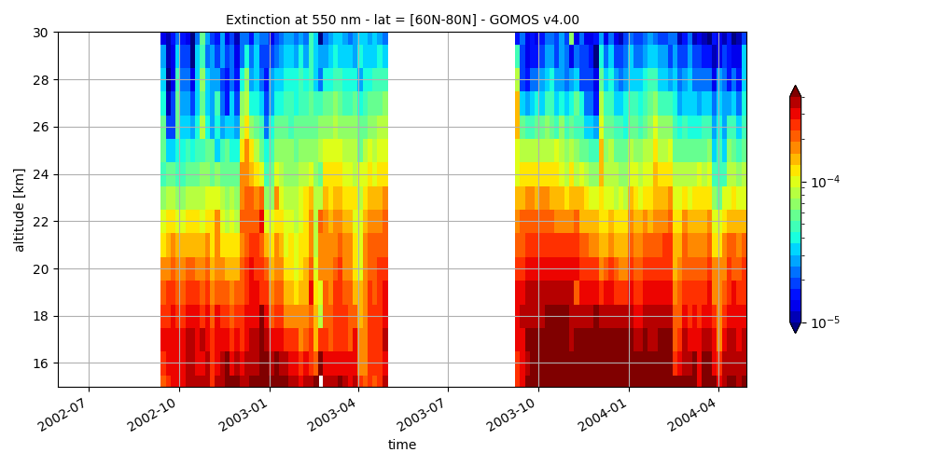
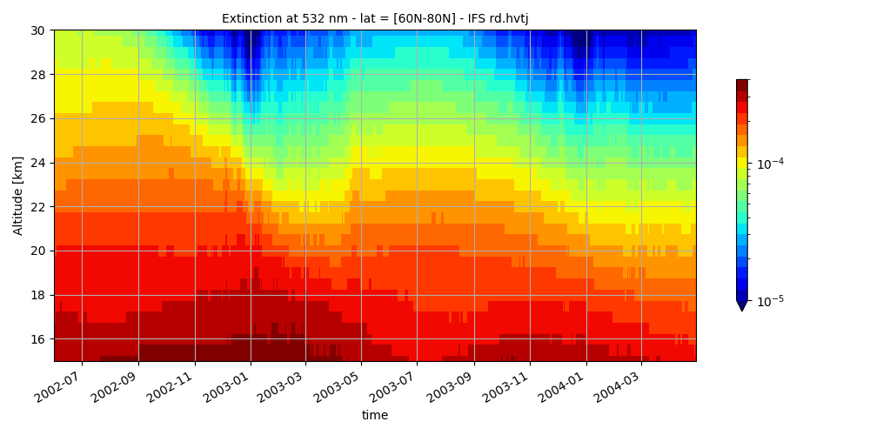
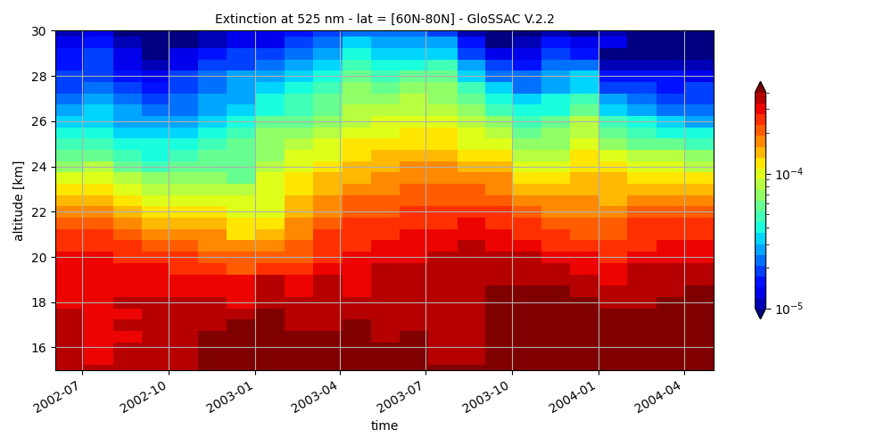
Early Envisat Period: Stratospheric Aerosol Extinction
PINA (532 nm)
GOMOS (550 nm)
Case 3 – Early Envisat (2002-2004)
Latitude:
60°-80°N
PINA-2 (532 nm)
GloSSAC (525 nm)
Home
High - Pinatubo
Low - Quiescent
Low/increasing – Early Envisat
Concl.

Slide 19
The BASCOE module for stratospheric chemistry in IFS
Extracted from BASCOE CTM/CDA system (Chabrillat et al., ACP, 2018; Errera et al., ACP, 2019)
64 gas-phase species
157 gas-phase reactions: rates mostly from JPL-2020 compilation
53 photolytic reactions:
σ mostly from JPL-2020
TUV + look-up tables
9 heterogeneous reactions on Sulfate Aerosols (SA), NAT and ICE PSC:
SA either online (AER module) or offline (CMIP6 input)
NAT & ICE PSC from very simple param depending on HNO₃ & H₂O condensation partial pressures
Numerical solver: KPP (Sandu & Sander, 2006)
Stratospheric chemistry
Home
Concl.
Notes:
The BASCOE chemistry-transport model was developed at BIRA-IASB; this model is simpler than IFS, with a lower resolution and Meteo fields computed off-line: basically, we use ERA5 reanalyses.
The stratospheric chemistry module has been specifically designed for data assimilation applications, which is particularly useful for its integration in the data assimilation system used in CAMS.
Due to its effective stratospheric chemical module, the BASCOE offline chemical Data Assimilation System assimilates a large set of stratospheric gaseous species (contrarily to CAMS where only ozone is assimilated) taking into account a large amount of relevant chemical reactions, thus providing a quite exhaustive analysis of the chemical state of the stratosphere.
[The gas-phase and heterogeneous reaction rates are taken from the JPL evaluation JPL-2020, respectively. Look-up tables of photolysis rates were computed offline by the TUV package (Madronich and Flocke, 1999) as a function of log-pressure altitude, ozone overhead column and solar zenith angle. (16) (PDF) C-IFS-CB05-BASCOE: stratospheric chemistry in the Integrated Forecasting System of ECMWF. Available from: https://www.researchgate.net/publication/307904973_C-IFS-CB05-BASCOE_stratospheric_chemistry_in_the_Integrated_Forecasting_System_of_ECMWF [accessed Apr 25 2023].]
Although there is no full aerosol module in BASCOE, 9 heterogeneous reactions on sulphate aerosols and PSC make the link with these particulate species.
The ozone destruction by stratospheric aerosols is quantified using the aerosol SAD. There are 2 options available in the latest version (pre-Cy49) of IFS-CB05-BASCOE-AER:
The use of SAD observation data read in a file (here: CMIP6 dataset)
The connection of BASCOE with SAD computed online by IFS-AER
The parameterizaton of NAT and ice PSCs is a very simple parameterization in function of the condensation partial pressure and the temperature, a “switch on/switch off” test indicating if PSCs are present or not. If yes, we used a prescribed constant value of the SAD to compute the ozone depletion. It is thus necessary to check if such simple parameterization is sufficient to correctly describe ozone depletion leading to the polar ozone hole, and this is the motivation here to use polar ozone hole events over several years: our evaluation must take interannual variability into account.
The algorithm used to run BASCOE is the KPP numerical solver by Sandu & Sander, 2006.

Slide 20
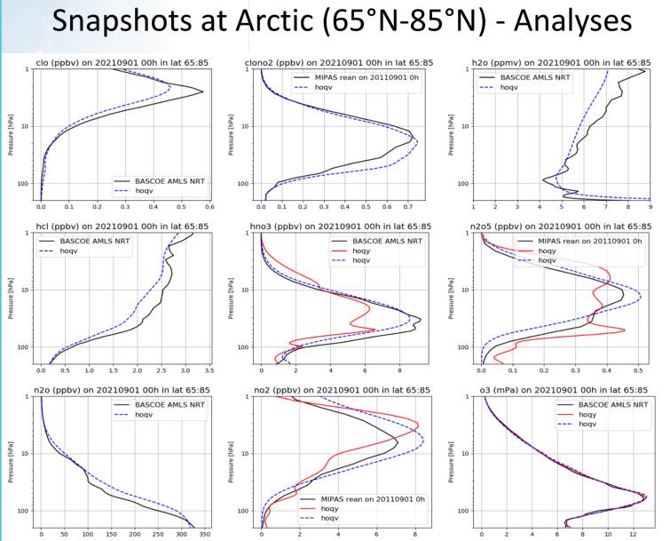
Next upgrade of IFS for CAMS includes BASCOE
Late June 2023, IFS for CAMS will be upgraded to Cy48R1.0: first operational version using BASCOE module i.e. modelling stratospheric composition.
Advantages:
Strato ozone analyses will resist much better to the 2025 demise of Aura-MLS (currently the assimilation of Aura-MLS is required to provide good analyses).
Ozone forecasts will improve, especially during polar ozone depletion events.
As in the troposphere, many modelled species will become available in addition to the operational (assimilated) products.
Here we evaluate polar ozone depletion events with the next version (Cy49R1) using updated heterogeneous chemistry rates.
Stratospheric chemistry
Analyses (ref)
Operational
Next version
Home
Concl.
Notes:
As explained previously, the next upgrade of the operational CAMS-IFS (Cycle 49R1) system will include BASCOE (target: end June 2023). The operational CAMS-IFS will then be the very first version including the modelling of stratospheric composition, thanks to the integration of the BASCOE chemical module. Several benefits are expected from this upgrade:
Currently, the simple ozone parameterization by CAMS-IFS requires very dense ozone observations, that are currently provided by the Aura-MLS satellite instrument. However, Aura-MLS will be switched off in 2025 at the latest. Full modelling of ozone chemistry will alleviate the impact on ozone analyses of the loss of Aura-MLS [Lefever et al., ACP 2015].
The use of BASCOE will also have a positive impact on the forecasts provided by CAMS, in particular for polar ozone hole conditions (i.e. springtime polar lower strato). This is crucial in the perspective of extending the duration of the forecasts.
As already mentioned, BASCOE provides an exhaustive analysis of the chemical state of the stratosphere, including species that are not assimilated by CAMS-IFS. The right panel shows 9 examples of species provided by IFS thanks to its new BASCOE module (observation reanalyses in black, used here as reference) compared to the values provided by the currently operational IFS model with its parameterization of strato ozone chemistry (operational version Cy47r3 in red, next version Cy49r1 in light blue).

Slide 21
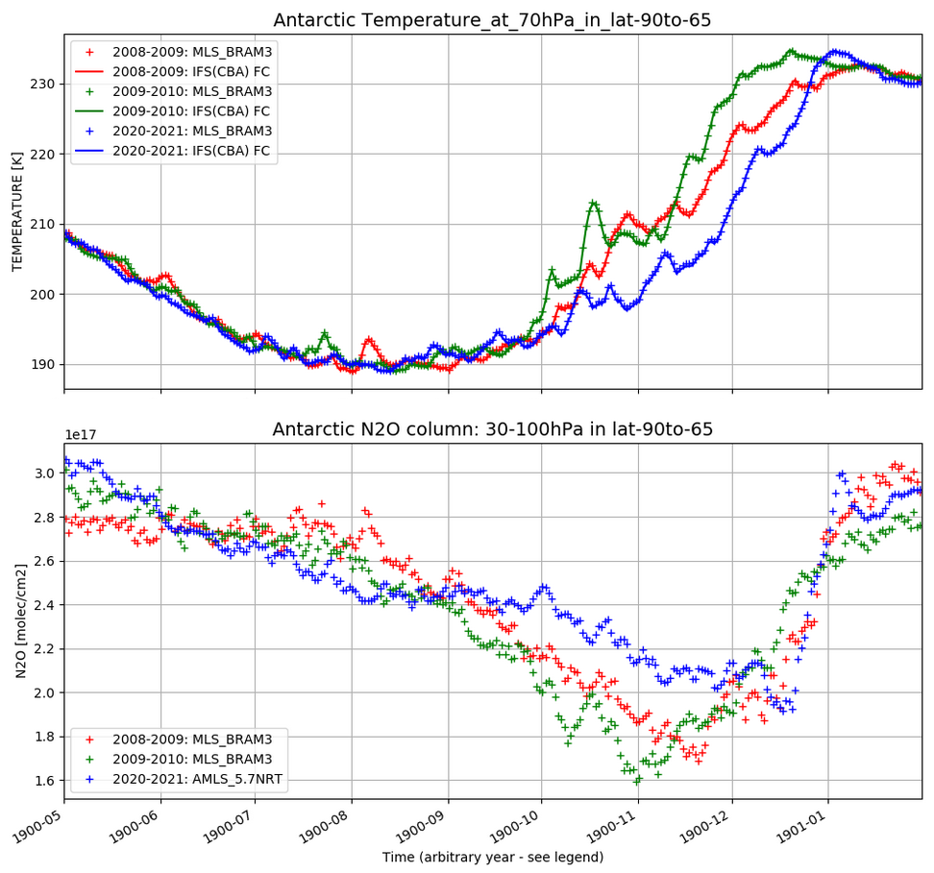
Setup of chemical forecasts & Selection of 7 polar ozone depletion events
Dynamics contrained by ERA5 reanalysis • SA offline: no coupling with new strato AER module
9-month chemical forecasts using the BASCOE Reanalysis of Aura-MLS (BRAM) as I.C. and ref. dataset
Antarctic winter-spring: 2008, 2009, 2020
Arctic winter-spring: 2009, 2011, 2012, 2020
T (ERA5)
Stratospheric chemistry
N₂O
(BRAM)
Home
Concl.
Notes:
This slide describes the experiences used for the evaluation of the stratospheric chemistry computed by IFS (BASCOE configuration, periods considered).
BASCOE configuration:
Even though IFS is able to forecast dynamical fields (winds, T), here we keep these fields constrained by re-setting them the ERA-5 reanalysis. Hence we perform chemical forecasts but not dynamical forecasts,
In this case, sulphate aerosols are provided by observations; we don’t use the aerosols provided by the new stratospheric IFS-AER module
IFS-BASCOE performs 9-month chemical forecasts using BRAM data (= offline BASCOE reanalysis of Aura-MLS) as initial conditions for these chemical forecasts and as reference dataset to evaluate them.
Considered periods:
In order to test IFS in a broad range of configurations, no less than 7 winter-spring periods are considered. In the Arctic, an ozone hole was observed for two of them (years 2011 and 2020).
Antarctic:
2008 is quite representative of a “normal” case of ozone hole
2009: Ozone depletion was interrupted early due to a stratospheric sudden (SSW) episode
2020: Contrarily to 2009, this ozone hole episode was particularly long and intense. Several authors attribute this exceptional duration to the influence of the extreme Australian busfires in 2019-2020.
The particularities of these 3 years are visible in the evolution of the temperature (e.g. temperature maximum in mid-Oct 2009 due to the SSW, and earlier increase of the temperature when the polar vortex is broken. The second plot shows N2O, which is a tracer showing the evolution of the dynamics: gradual decrease of N2O column reflets the situation of air subsidence in the polar vortex. When the polar vortex breaks, air penetrates from mid-latitudes and brings fresh N2O into this region. This is marked by the steep increase of N2O from mid-January.
Arctic:
2009 (i.e. winter 2008-2009): no ozone hole. The strong peak in the temperature profile (around end January-February 2009) is due to a SSW.
2011 (i.e. winter 2010-2011): ozone hole, leading to exceptionally low temperatures and a pronounced air subsidence marked by a decrease of N2O in the polar vortex.
2012 (i.e. winter 2011-2012): no ozone hole.
2020 (i.e. winter 2019-2020): ozone hole. As for 2011, temperature reaches very low values during the duration of the ozone hole, until the polar vortext breaks.
NB: here, the columns are computed between 65° and 90° (S for Antarctic, N for Arctic), which roughly corresponds to the position of the polar region, but the exact locationof the polar vortex is not taken into account. This leads to small variations w.r.t. what exactly happens inside the polar vortex.

Slide 22
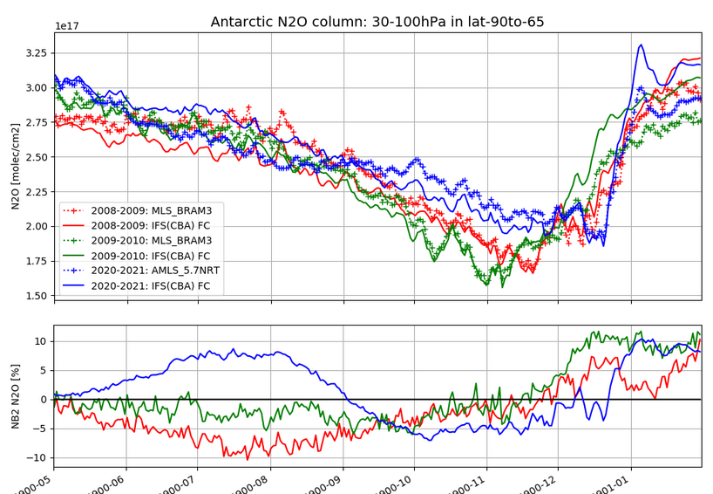
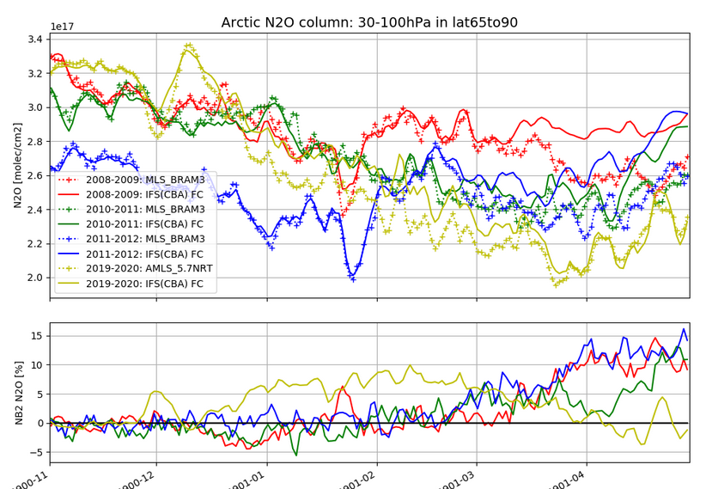
Dynamics and transport: N₂O
Biases develop due to errors in IFS dynamics/transport. End of Spring, both in the Arctic and Antarctic, biases remain within +/-15% after 9 months
N₂O
H₂O
Evaluation against BRAM
HNO₃
HCl
ClO
O₃
Home
Concl.
Notes:
As already mentioned, N2O is an excellent tracer to evaluate the dynamics (=winds) and the transport (= transport of species) modelled by IFS.
At the start of the experience, the model is initialized using BRAM, and there is no bias. In the Antarctic, a bias (positive in 2020-2021, negative in 2008-2009) gradually increases due to the errors in IFS dynamics and/or transport.
In 2008-2009 (in red), IFS decreases too fast due to the transport, what leads to a negative bias down to ~10%.
In 2020-2021 (in blue), the decrease of N2O indicates either too slow vertical advection or too intense horizontal mixing with extra-polar air masses.
In all cases for the Antarctic, the biases becomes more positive at the end of the ozone hole period, showing an overestimation of the amount of N2O coming from mid-latitudes after the break-out of the polar vortex.
Overall, the bias between Antarctic N2O column computed by IFS and the BRAM reference dataset remains within 10% during the whole period.
In the Arctic, the agreement is much better between IFS and BRAM, except for 2020, a year showing an ozone hole. In the other cases, the agreement is very good until March. Afterwards, the comparison shows again an overestimation of the N2O amount from mid-latitudes. The bias in the Arctic never exceeds 15% over the 9-month duration.

Slide 23
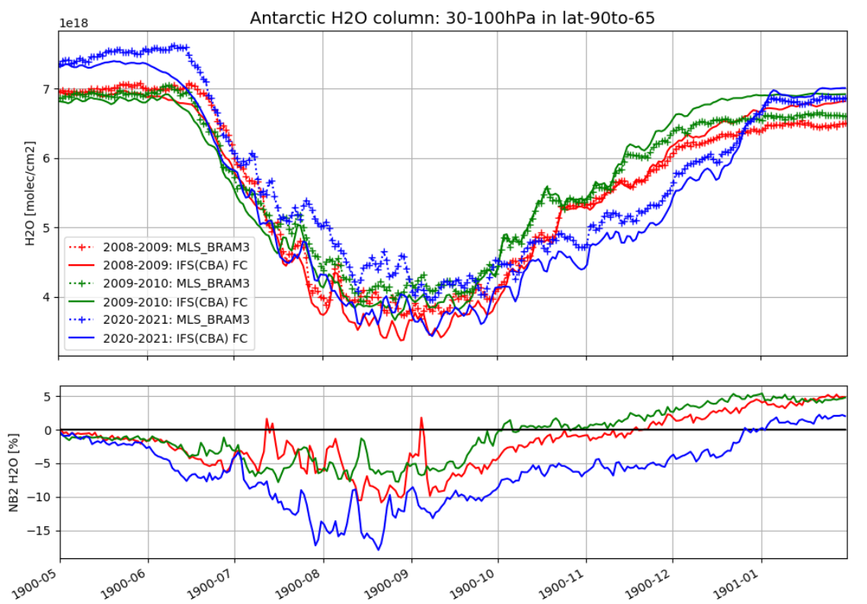
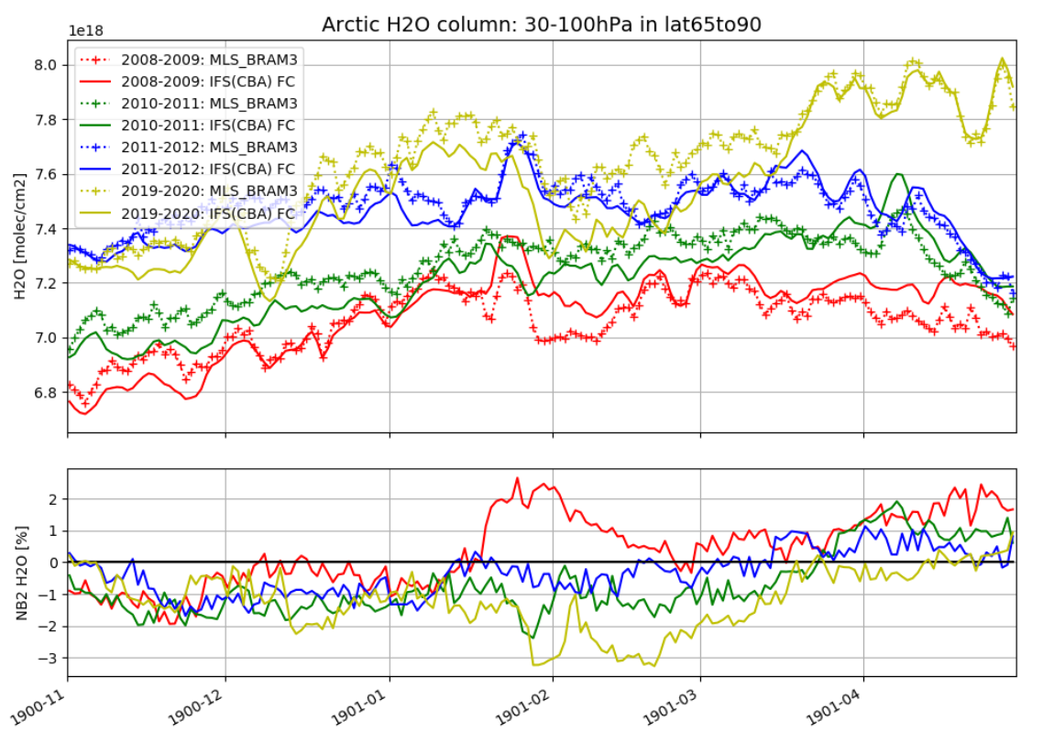
Dehydration: H₂O
Dehydration too fast in Antarctic due to ice PSC param. Biases up to -15% in August 2020 (exceptional year!). Arctic very good: biases always < 3% - no ice PSC in Arctic, even in 2011 and 2020. Overall biases remain limited for 7 events with very different meteorological conditions.
N₂O
H₂O
Evaluation against BRAM
HNO₃
HCl
ClO
O₃
Home
Concl.
Notes:
H2O is a species transported by the winds, but also present in two different phases. Dehydration of the stratosphere also depends on the temperature. Evaluating IFS H2O is thus a much harder test of IFS performance.
In Antarctic, H2O decreases too fast in all cases, showing some weakness in the PSC parameterization. As before, the bias becomes positif again after the break-out of the polar vortex, showing an overestimation of the H2O coming from latitudes out of the vortex.
This phenomenon is not observed in the Arctic where ice PSC are never observed. This explains the very small biases (up to 2%), and this although we consider here very different test cases.

Slide 24
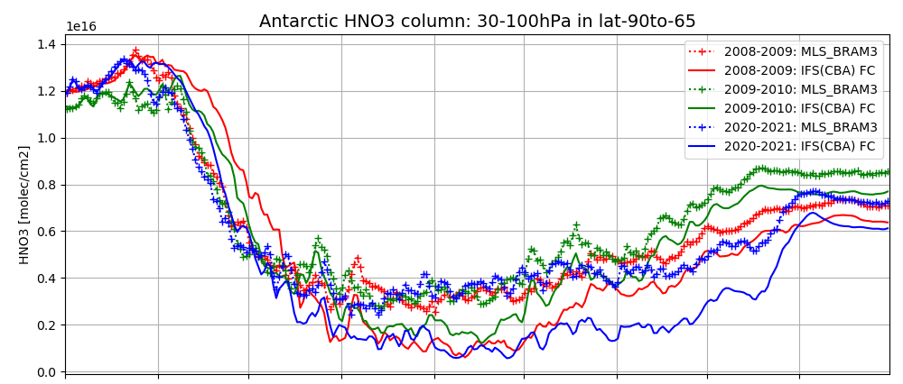
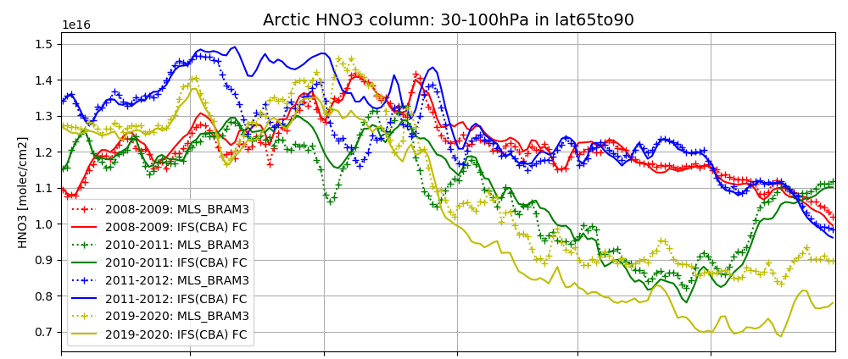
Heterogeneous chemistry and denitrification: HNO₃
HNO₃ depletion is too intense once formation of NAT PSC kicks in (Antarctic all years; Arctic 2020). Causes: oversimplistic parameterization of PSC formation and of denitrification due to PSC sedimentation.
N₂O
H₂O
Evaluation against BRAM
HNO₃
HCl
ClO
O₃
Home
Concl.
Notes:
HNO3 is an important compound in PSC chemistry. It is produced by heterogeneous chemistry, and gives rise to the formation of NAT PSCs that leads to a denitrification of the stratosphere by sedimentation.
The modelling of PSC formation is complex and relies on many approximations in BASCOE, and this evaluation is thus a strong test in the evaluation of IFS.
Comparisons between IFS and BRAM for the Antarctic cases show first a too strong production of HNO3 (in June-July) (probably in gas phase, instead of condensed phase – How do you know this ?) followed by a too strong depletion once the PSC sedimentation occurs (July-Oct). This indicates that the parameterization of the sedimentaion is too strong.
Please note that the recovery is slower in 2020 as expected in this case of long polar ozone depletion period, and occurs more suddenly in 2009 when the SSW was observed.
In the Arctic, there was no ozone hole, and no PSC in 2008-2009 (red) and 2010-2011 (blue). Increase in HNO3 column is probably due to limited heterogeneous chemistry and possibly the present of nitrate in aerosols ?
In 2011 and 2020, two years where an ozone hole took place, the strong decrease of the HNO3 after the maximum values indicates the presence of NAT PSC sedimentation (which shows that NAT PSCs can be formed in the Arctic, an observation already published by other authors). Despite the simple parameterization, IFS is able to capture the formation of NAT PSC. Again, sedimentation looks overestimated, which is particularly visible during the strong in 2020.

Slide 25
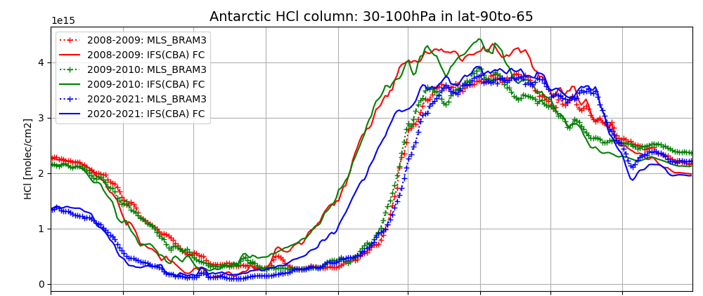
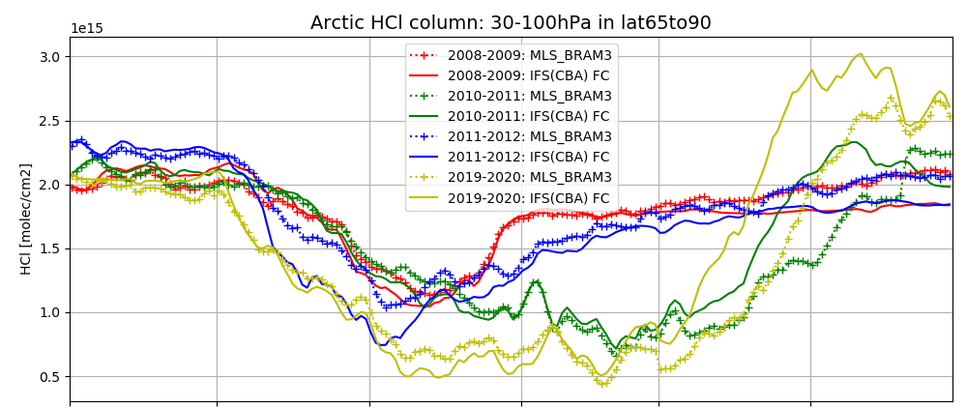
Key signature of PSC activity: HCl
Very good results at start of season. Large interannual variability in biases but large overestimations in middle of all polar vortex seasons. These biases are prime target to guide potential improvements of the PSC parameterization.
N₂O
H₂O
AURA-MLS
HNO₃
HCl
ClO
O₃
Home
Concl.
Notes:
HCl is a key signature of PSC activity. It is destroyed by heterogeneous chemistry (chlorine activation of HCl reservoir to ClO with catalytic reaction of O3 depletion) This loss mechanism is generally very difficult to reproduce by models (e.g. the EMAC model), but IFS is quite successful in reproducing this loss as shown by the very small bias at the beginning of the polar vortex season.
Biases increase at the end of the polar vortex season when the period of HCl depletion is too short, before increasing again due to mixing of polar air masses with extra-polar air masses. This phases is difficult to catch at the right moment by the model (IFS is too early) and shows a large interannual variability.
This problem is the object of current research. Different reasons are possible: maybe the fact that there is no treatment of HCl in the condensed phases. Another possibility mught be that some chemical reaction could be missing.
The problem is less acute in the Arctic for the years without ozone hole due to the absence of PSCs. The difference between the cases of ozone hole (2011, 2020) and the cases without ozone holes is clearly visible, with a longer period of HCl depletion related with the chlorine activation (see ClO increase in next slide) during ozone depletion.
It should ne noted that these issues are also found in other models, and that the biases obtained here are similar to what is found for other models.

Slide 26
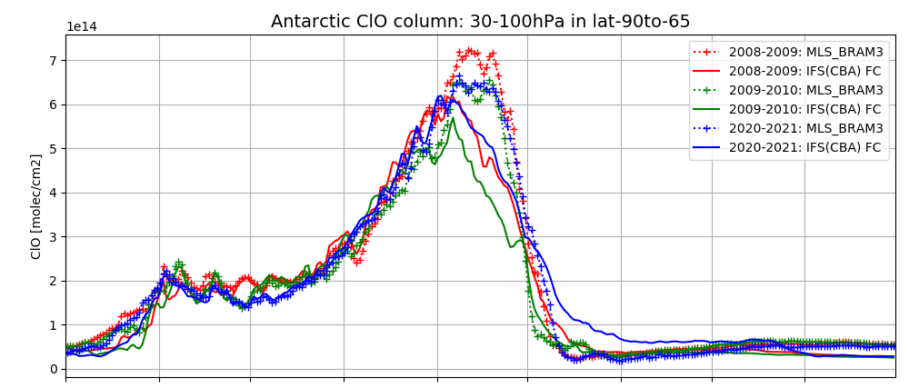
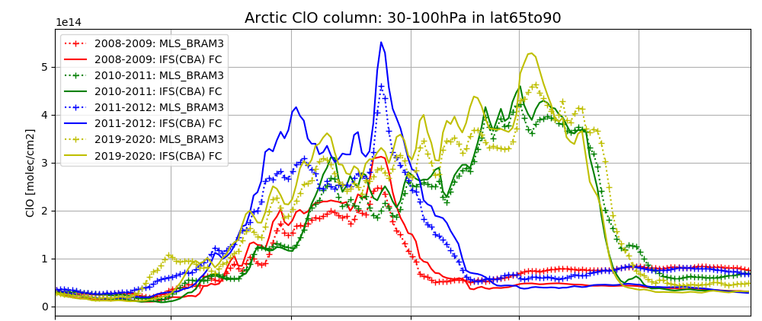
Active chlorine: ClO
Very well modelled in Arctic and wintertime Antarctic but fails to reach sufficiently high concentrations in September due to the early return to the HCl reservoir.
N₂O
H₂O
AURA-MLS
HNO₃
HCl
ClO
O₃
Home
Concl.
Notes:
ClO is only affected by the chemistry (short-lived species active in the chlorine catalytic cycle of ozone depletion). It is very well reproduced by IFS in the Arctic and in the Antarctic, except at the moment of the recovery of the HCl reservoir: we have seen that IFS shows a too fast recovery of the HCl reservoir (strong negative bias in September), and consistently, ClO drop is too fast.
In the Arctic, IFS performance is again very good. ClO shows an relatively limited overestimation at the middel of the season. You can see very well the difference between the cases of ozone hole (2011, 2020) and the cases without ozone holes.
NB: even in absence of ozone hole, there is allways presence of active chlorine during the winter period, and the natural variability of ClO is well reproduced by the model.
It should be noted that the bias here is given in absolute values instead of % because out of the ozone hole, the amount of ClO is very small.

Slide 27
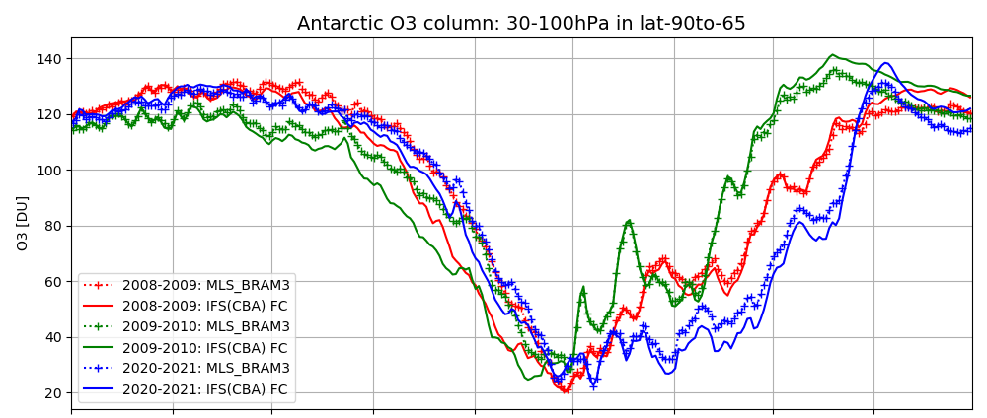
Ozone in the Antarctic
Very good forecasts despite PSC shortcomings, because full chlorine activation does not depend on details of PSC processes (Tritscher et al., 2021).
Exaggerated depletion at beginning of season. During the exceptional Antarctic 2020 ozone hole the evolution of the biases is unusual but negative bias remains ≤ 10%
This is in contrast with underestimated depletion in SD-WACCM (Solomon et al., 2015).
N₂O
H₂O
AURA-MLS
HNO₃
HCl
ClO
O₃
Home
Concl.
Notes:
Despite the limitation of the PSC parameterizations, the ability of IFS to describe the ozone evolution is very good. This is due to the fact that chlorines deplete ozone in both gas and solid phase, and this mechanism is not sensitive to the details of the PSC modelling.
Note that the interannual variability is very well reproduced by the model, including for the strong and unusually long case of 2020 ozone hole.
Still, it has to be noted that ozone decrease is too strong in IFS at the beginning of the season. This might be linked to the problem in the dynamics or transport identified in the evaluation of N2O.
In most models (e.g. WACCM), it is hard to catch a sufficient decrease of ozone at the beginning of the seaon. Here, it is the contrary, we get too fast decrease. This might be partly related to the resolution of the model, which is much better (0.5° x 0.5°) for IFS than for WACCM (1° x 1°)
Overall, the bias remains below 10%.

Slide 28
Ozone in the Arctic
Overall very good.
The two exceptional NH ozone depletion events (February-March 2011 and 2020) are exaggerated as in the Antarctic, again in contrast with underestimated depletion in SD-WACCM (Solomon et al., ACP, 2015)
AURA-MLS
Home
Concl.
Notes:
In the Arctic case, the conclusions are quite similar as for the Antarctic. The ozone evolution in the seasons without ozone hole is very well described.
In the two cases with ozone holes (2011 and 2020), IFS shows, like for the Antarctic case, a too fast decrease of ozone. Also in this case, this is in contrast with other models such as WACCM that underestimate the ozone depletion.

Slide 29
Conclusions (1)
Stratospheric aerosols
Overall, IFS-AER represents quite well the large-scale features of a major stratospheric volcanic eruption
Extension of the volcanic plume to the southern hemisphere is underestimated
In quiescent conditions, too strong removal of the aerosol load, probably due to a too strong sedimentation or to some issue in the transport mechanisms
Also complex interaction between radiation and aerosols could play a role
Making the particle size dependent of its abundance improves the problem of too strong removal of the aerosol load, but does not solve the problem
Besides these issues, IFS-AER is able to correctly describe seasonal patterns of stratospheric aerosols when they are not perturbed by volcanic input
Conclusions
Home
Concl.

Slide 30
Conclusions (2)
Stratospheric chemistry and polar ozone depletion
Late June 2023, IFS for CAMS will fully model stratospheric composition using the BASCOE module.
9-month chemical forecasts during 7 winter-spring seasons on polar lower strato are evaluated with a reanalysis of Aura-MLS N₂O, H₂O, HNO₃, HCl, ClO, O₃ . This demonstrates the capacity of IFS-CAMS to forecast “ozone holes” for several years with very different evolutions of the polar vortex.
Next steps: online coupling of new strato aerosols; improve PSC parameterization to decrease biases in HNO₃ and HCl (hence ClO).
Ozone forecasts are very good already because chlorine activation does not depend on details of PSC modelling.
Conclusions
Home

