Slide 1


AS3.18: Trends and impacts of tropospheric ozone
Fri, 28 Apr | PICO spot 5.4
Footprint of Growing Stratospheric Transport Contribution in Tropospheric Ozone
Ma et al., in revision
Observed Finding:
A rapid O₃ increase in the upper troposphere over Northwestern Pacific Coastal regions (about 25-35⁰N)
— Spring, Summer
— Autumn, Winter
Start of The Montreal Protocol
“ozone recovery”
Scientific questions:
What is the primary factor driving the observed O₃ increase: stratospheric intrusion vs. export from the boundary layer (photochemical production)?
What is the percentage contribution of stratospheric intrusions to the O₃ increase?
Conclusions:
The implementation of the Montreal Protocol, leading to O₃ recovery in the stratosphere, is the primary driver of the observed O₃ increase in the upper troposphere over the study region.
A modeling study using EMAC suggests that stratospheric intrusion explains up to 90% of the obeserved O₃ increase.
p < 0.01
Ozone-sonde observations
Data Source: https://woudc.org/data/explore.php
*p < 0.01

Slide 2


AS3.18 | PICO spot 5.4
Footprints of Growing Stratospheric Transport Contribution in Tropospheric Ozone
Apr 28 2023 I Xiaodan Ma
Jianping Huang, Michaela I. Hegglin,
Michael Sprenger, Patrick Jöckel, and Tianliang Zhao
Thank You!

Slide 3
AS3.18: Trends and impacts of tropospheric ozone
Fri, 28 Apr | PICO spot 5.4
Footprint of Growing Stratospheric Transport Contribution in Tropospheric Ozone
Ma et al., in revision
Observed Finding:
A rapid O₃ increase in the upper troposphere over Northwestern Pacific Coastal regions (about 25-35⁰N)
Scientific questions:
What is the primary factor driving the observed O₃ increase: stratospheric intrusion vs. export from the boundary layer (photochemical production)?
What is the percentage contribution of stratospheric intrusions to the O₃ increase?
Ozone-sonde observations
Data Source: https://woudc.org/data/explore.php
*p < 0.01
SS: spring, summer (3-8) AW: autumn. Winter (9-12-2)

Slide 4
AS3.18 | PICO spot 5.4
P1: 2000-2008
P2: 2009-2017
Hong Kong (22ºN)
Conclusions:
The implementation of the Montreal Protocol, leading to O₃ recovery in the stratosphere, is the primary driver of the observed O₃ increase in the upper troposhere over the study regions.
A modeling study using EMAC suggests that stratospheric intrusion explains up to 90% of the O₃ increase.
Start of The Montreal Protocol
Naha (26ºN)
“ozone recovery”
Tsukuba (36ºN)
EMAC O₃s: P2-P1
p < 0.01
Sapporo (43ºN)
Month-height distribution of ozone

Slide 5
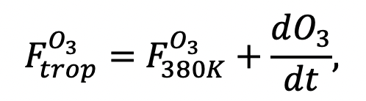



AS3.18 | PICO spot 5.4
Observation data quality control
Calculation of STE O₃ flux:
$$−$$
Positive: downward transport
$$F_{380K}^{O_{3}}$$
: the 380K cross-isentrope ozone mass flux, calculated by the diabatic heating rate (𝑄) and the isentropic density (𝜎).
: the change rate of O₃ mass in the lowermost stratosphere (LMS), between the 380 K isentrope and the tropopause, which is defined as the 3.5 potential vorticity unit (PVU) isentropic surface (Wang and Fu, 2021, https://doi.org/10.1029/2021JD035159).
$$\frac{dO_{3}}{dt}$$
Data used: MERRA2 reanalysis
https://gmao.gsfc.nasa.gov/reanalysis/MERRA-2/data_access/
Reference: (Liao et al., 2020, https://doi.org/10.1029/2020JD033054 )

Slide 6
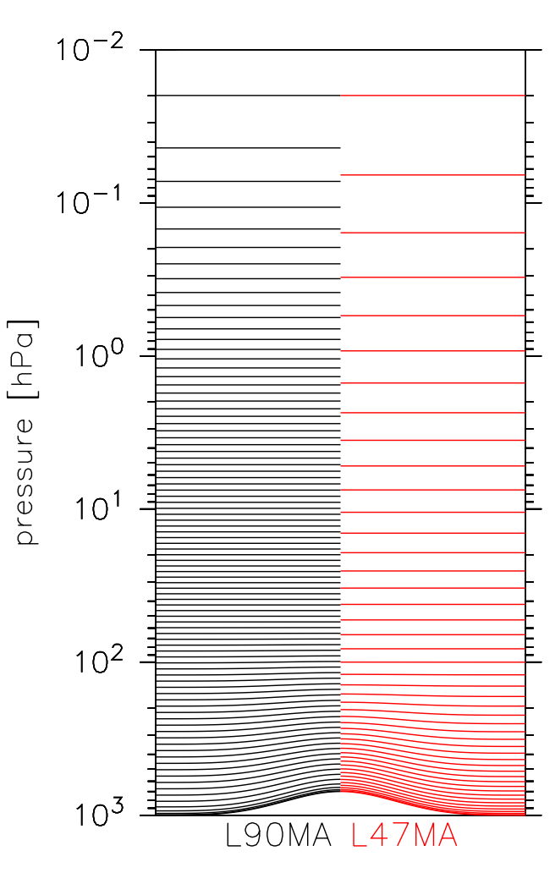
AS3.18 | PICO spot 5.4
Brief introduction of climate model EMAC
Model performance vs Observations
Ozone in Tsukuba
Full name: The European Centre for Medium-Range Weather Forecasts – Hamburg (ECHAM)/Modular Earth Submodel System (MESSy) Atmospheric Chemistry (EMAC) model
Period 1
(2000-2008)
Capability: the chemistry and dynamics of the stratosphere and troposphere are being studied and modelled as a single entity.
Period 2
(2009-2017)
Time period: Hindcast simulations with specified dynamics (1979–2019), i.e. nudged towards ERA-Interim reanalysis data. The time step length was 720 s.
Spatial resolution: T42 (triangular) spectral resolution; corresponding to a quadratic Gaussian grid of 2.8◦× 2.8◦ in latitude and longitude); Vertical: 90 (L90MA) model levels from 1000hPa to 0.01hPa
Period 2-Period 1
Reference: Jöckel et al., 2016,
https://doi.org/10.5194/gmd-9-1153-2016

