Slide 1
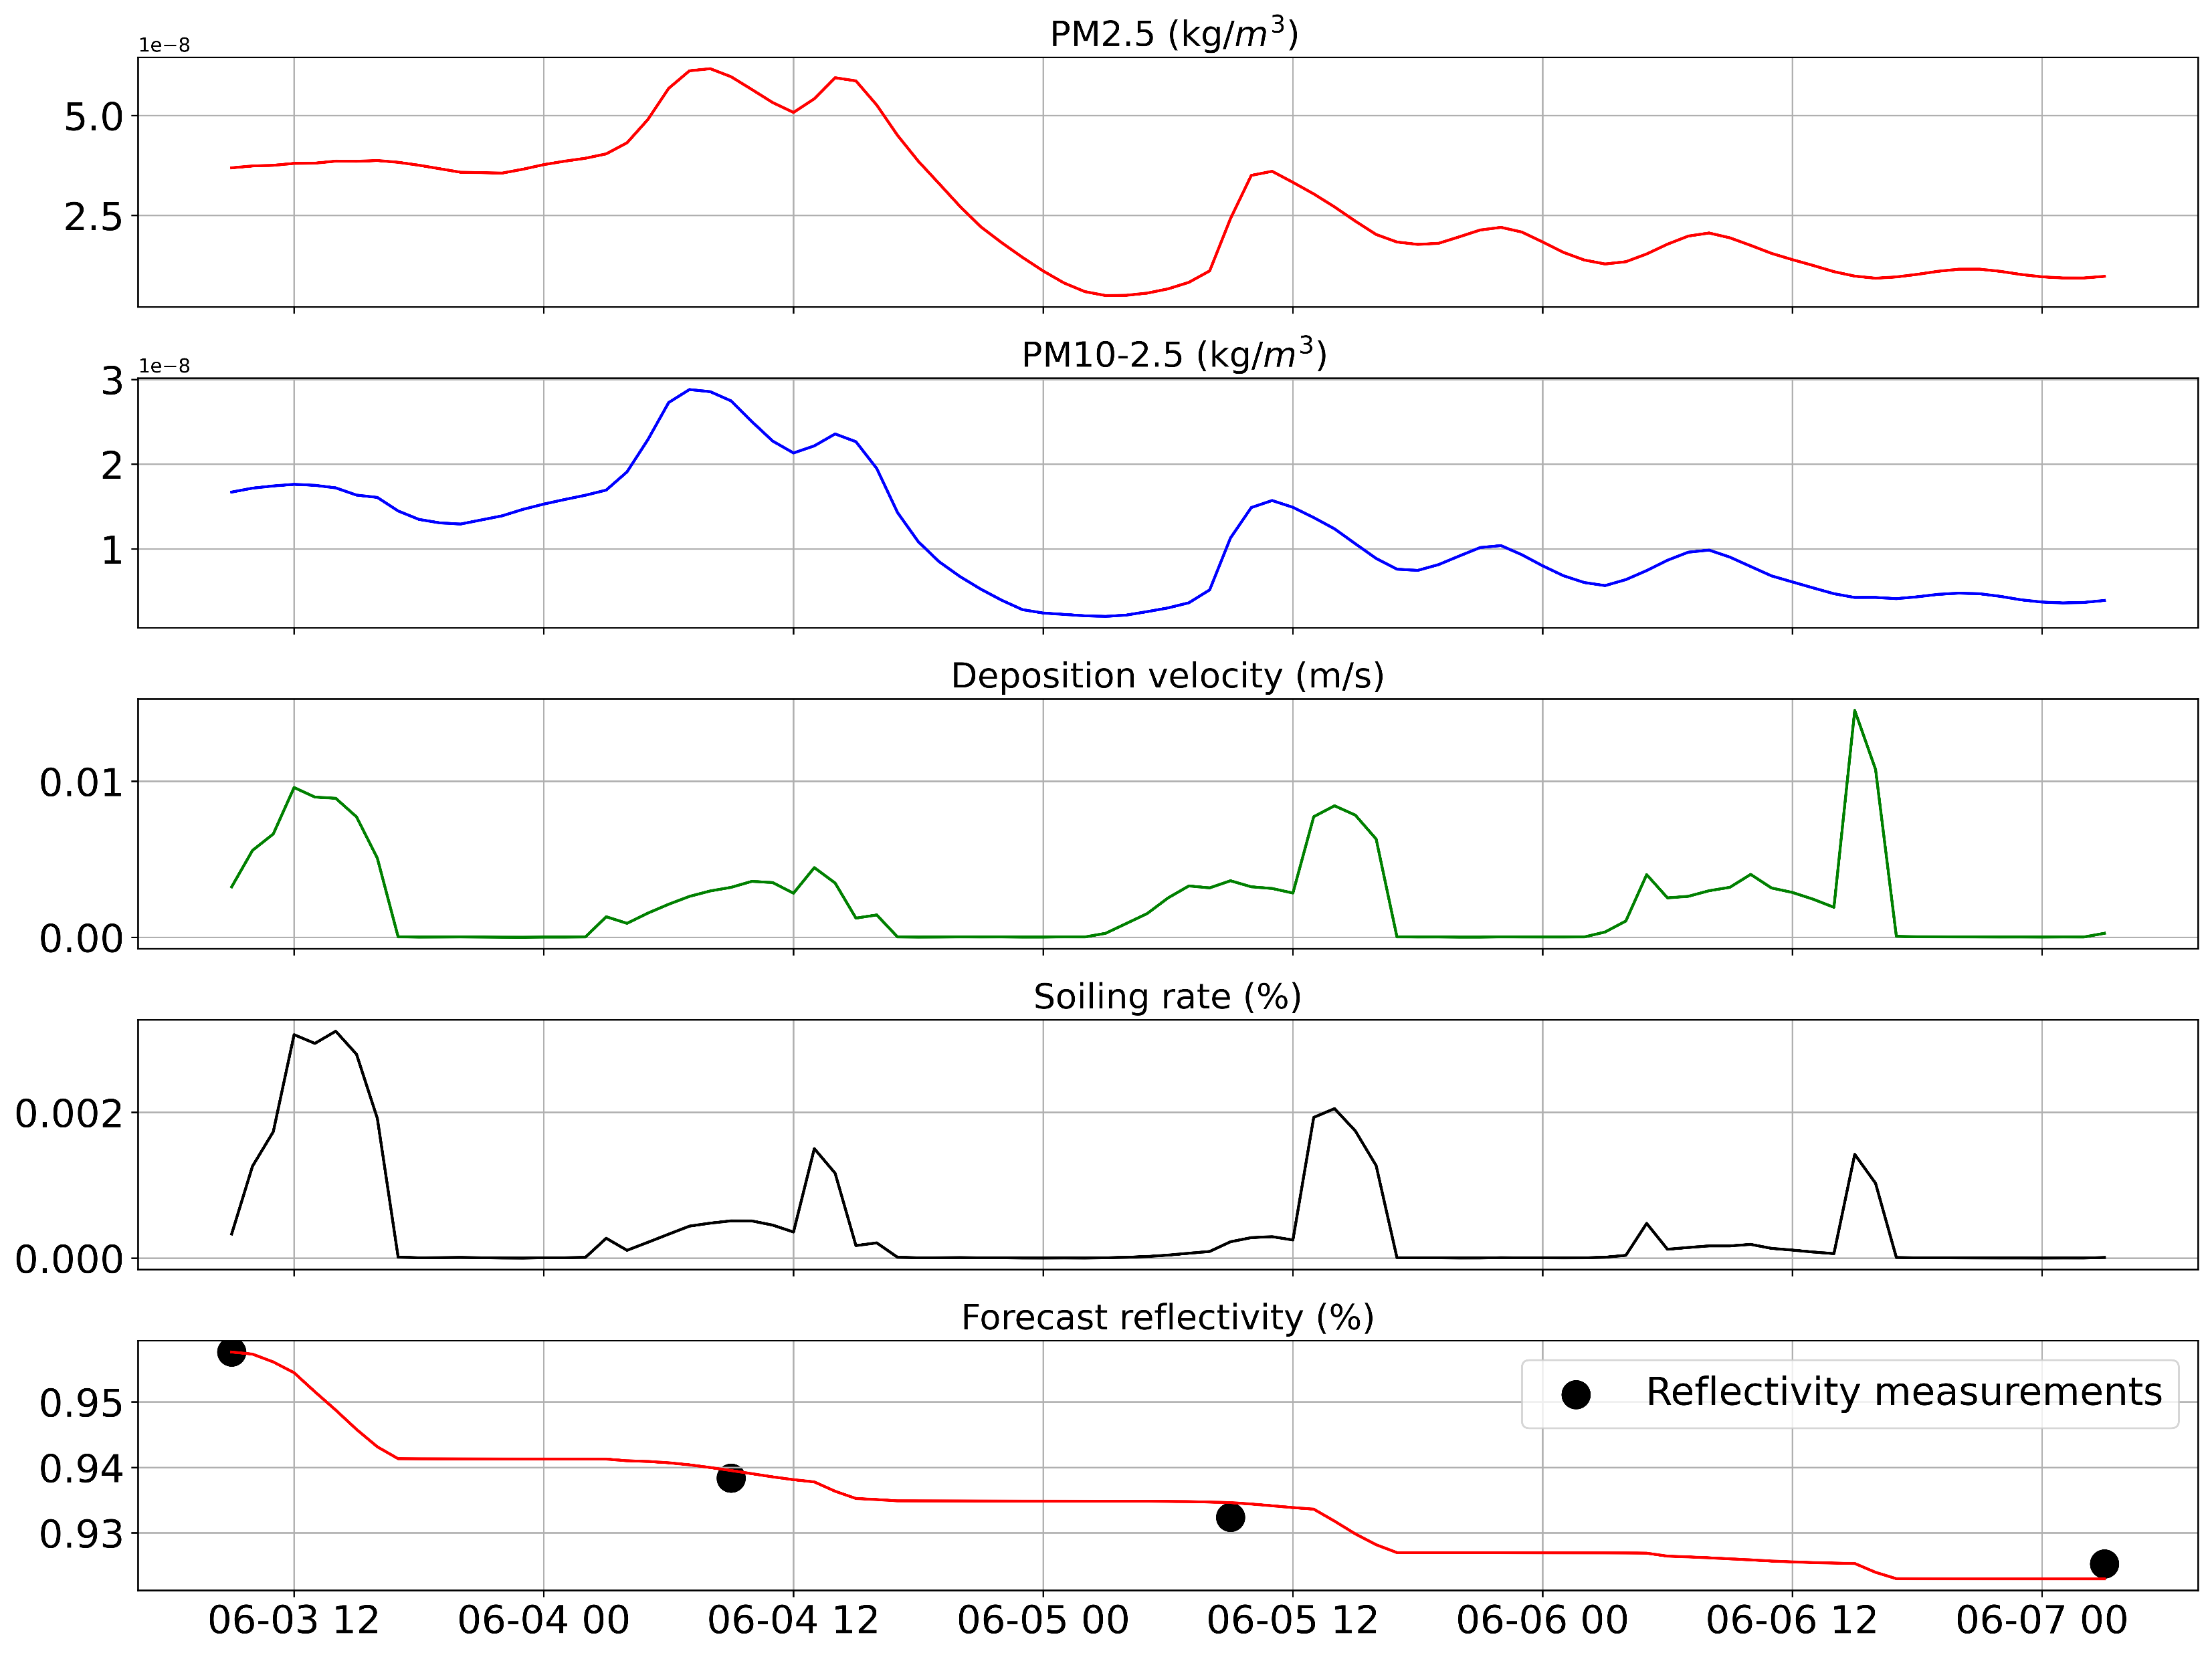
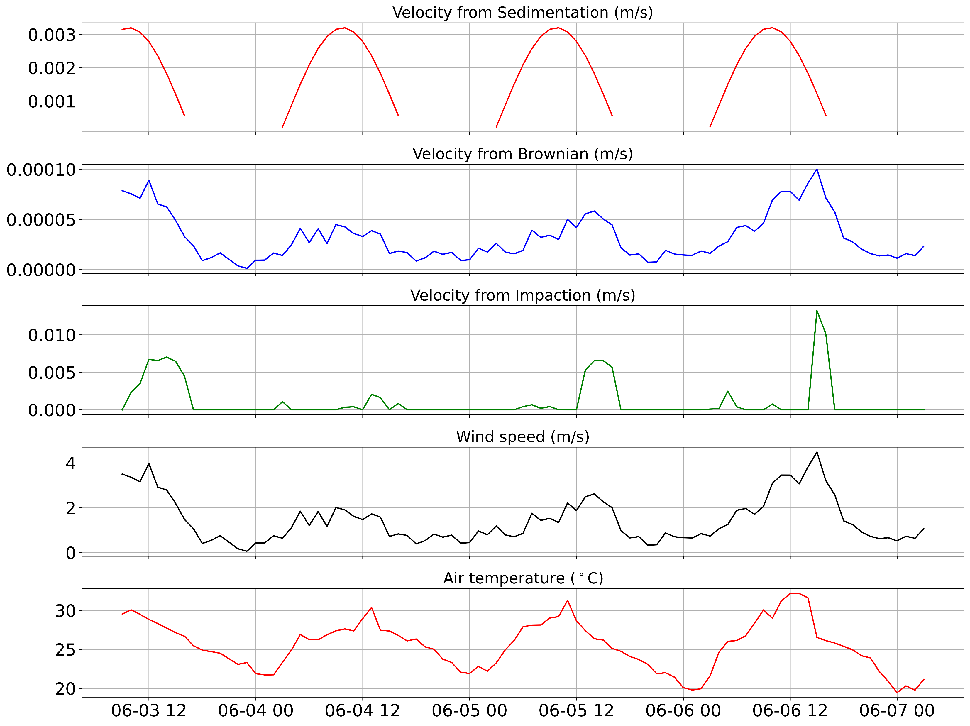
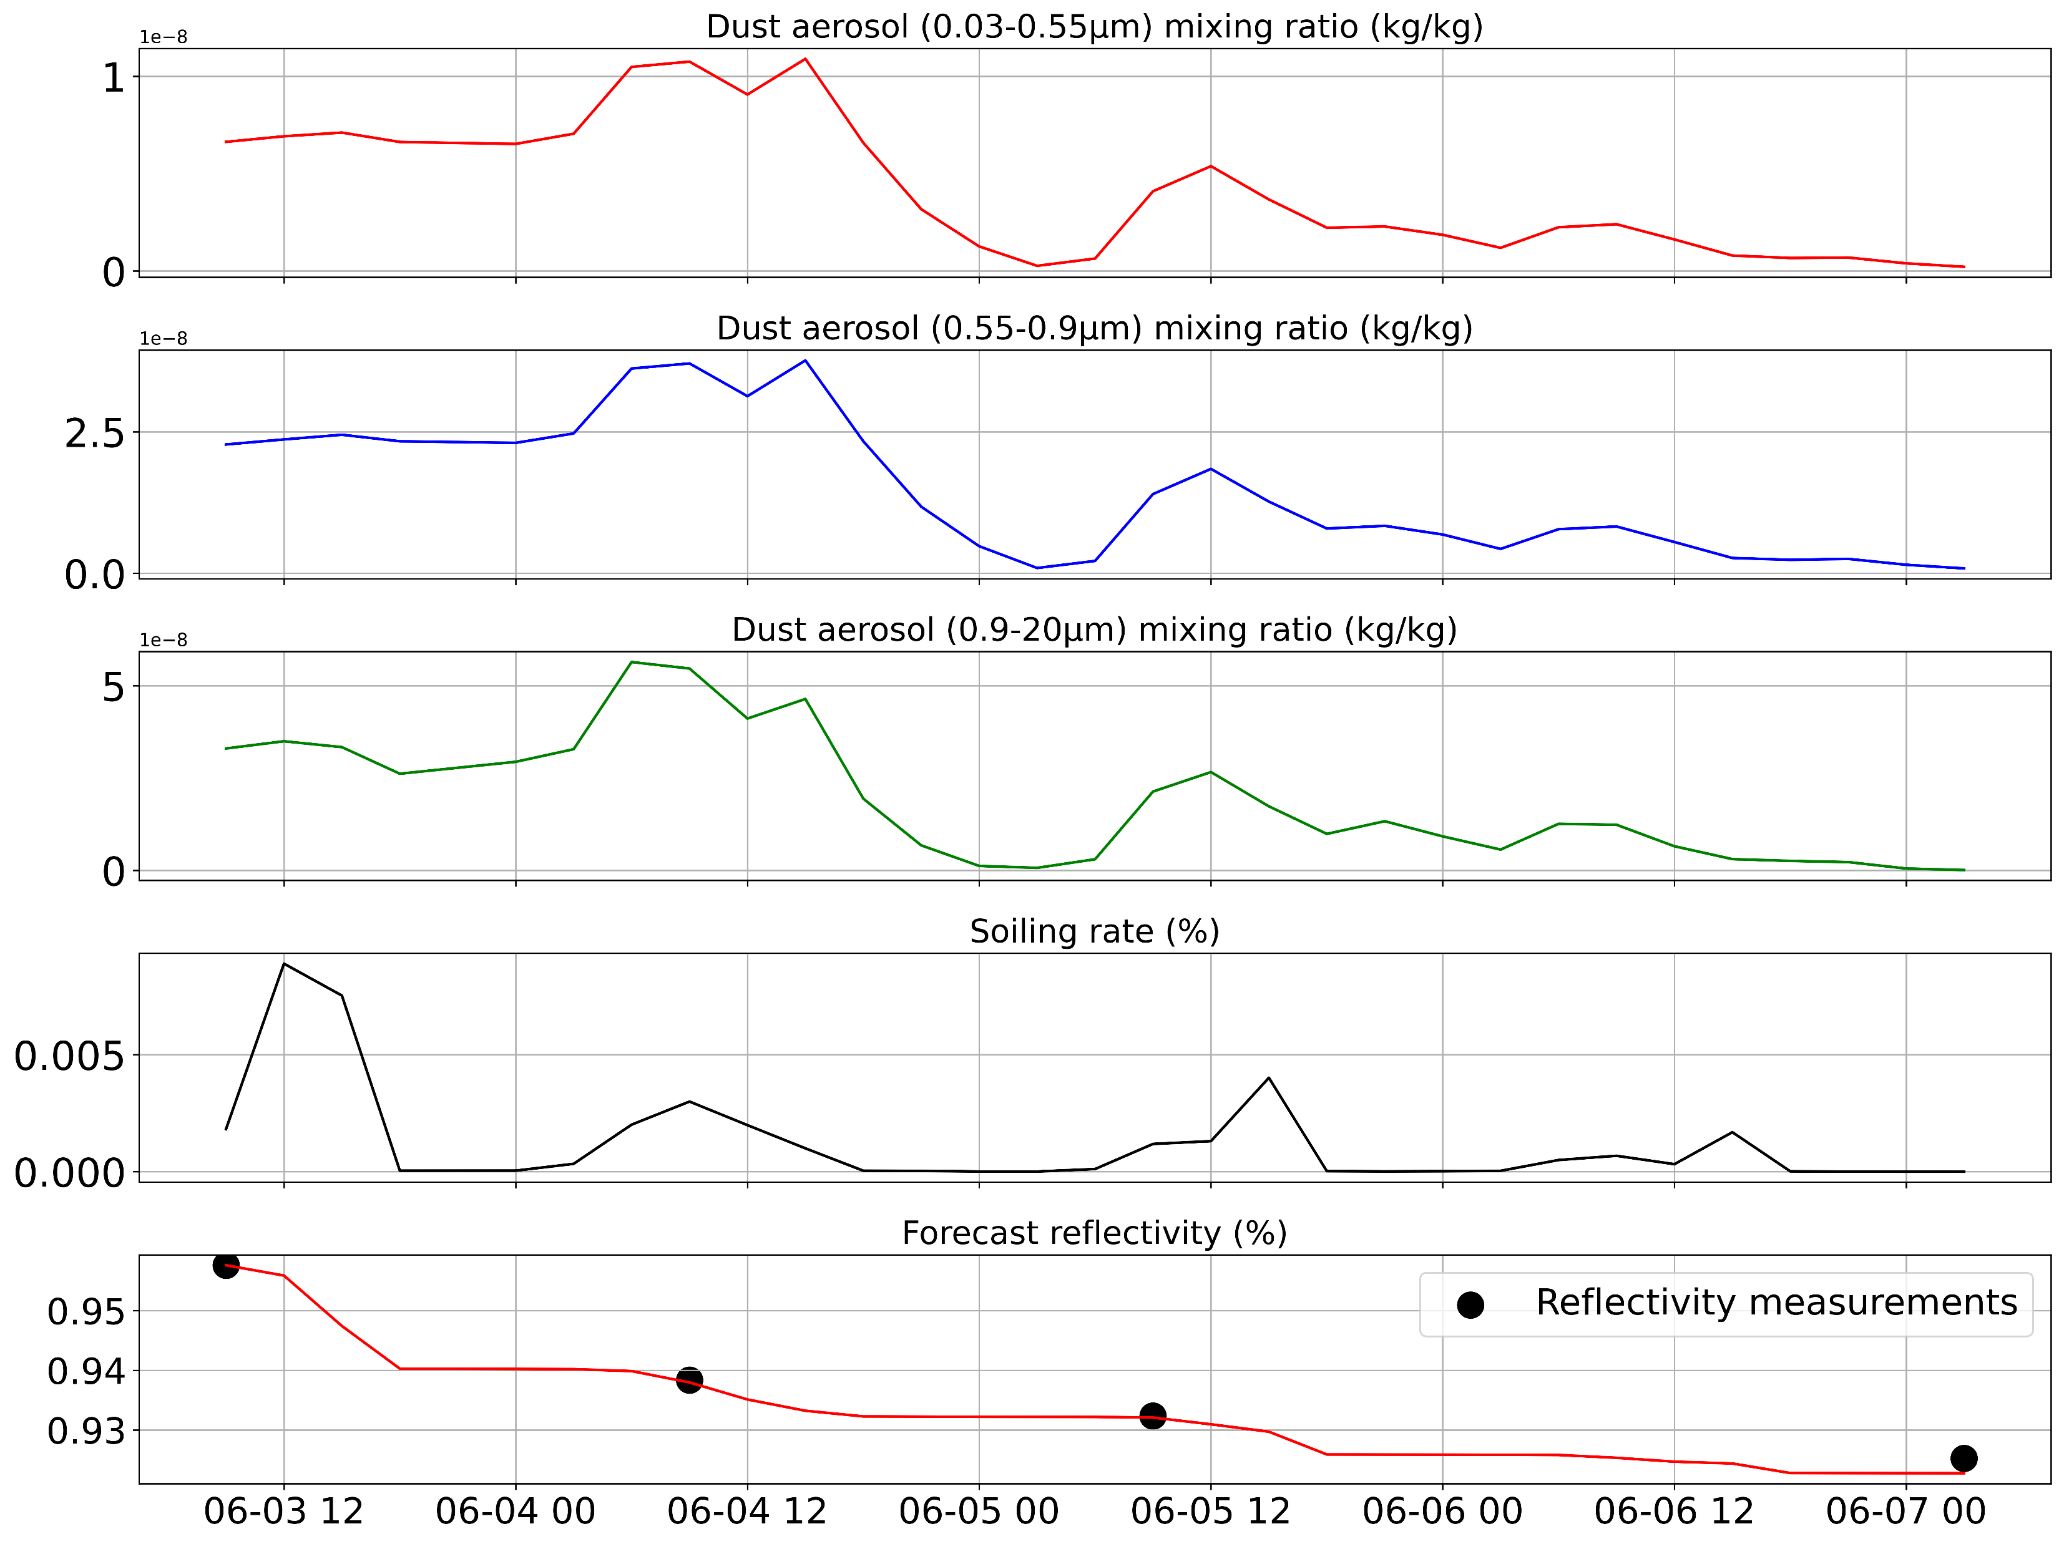
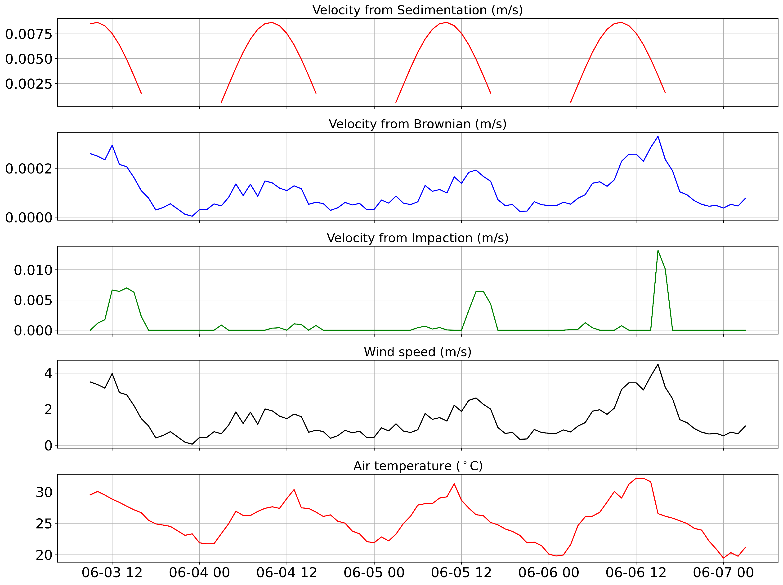
General Assembly of the European Geosciences Union (EGU), April 23-29, 2023, Vienna, Austria
A comparison of two approaches of dust deposition for Parabolic Trough Collector Mirrors
Athanasios Voukelatos^{1*}, Aggeliki Anastasiou¹, Johannes Christoph Sattler², Spiros Alexopoulos², Siddharth Dutta³, Ioannis Kioutsioukis¹
¹ University of Patras, Laboratory of Atmospheric Physics, 26504 Rio, Patras, Greece | ² Solar-Institut Jülich (SIJ) of the FH Aachen University of Applied Sciences, Heinrich-Mussmann-Str. 5, 52428 Jülich, Germany | ³ Protarget AG, Zeissstrasse 5, 50859 Cologne, Germany | * Presenting author : thanosbouke@gmail.com
Introduction
Methodology
Model 1
The SFT is based on existing models for the dry deposition of dust over geographic regions [2]. Dust accumulation from sedimentation, Brownian motion, and impaction are considered in the estimation of deposition velocity. Also, the impact of rainfall is considered. The mirror’s predicted reflectivity, ρ, is computed:
$ρ\left(t+1day\right)=ρ\left(t\right)−ρ_{Clean}∙SR\left(t\right)$
where $ρ_{Clean}$ is the clean mirror’s reflectivity (about 0.95). The Soiling Rate (SR) expresses the reduction in the mirror’s cleanliness with time.
Parabolic Through Collector (PTC) systems utilize solar radiation to generate power. In order to achieve their high performance, they are frequently deployed in arid regions where solar resources are abundant. In these regions, dust particles are prevalent, affecting the performance of PTC systems by reducing their reflectivity. Therefore, accurate and precise forecasting of cases of soiling is critical for optimal PTC utilization. This study presents a soiling forecasting tool (SFT) developed by the University of Patras in order to predict the deposition of dust on PTC mirrors. In addition, this poster compares the model's two distinct approaches as a consequence of different atmospheric input data.
Data | Results and discussion
Model 2
1. Meteorological data
The meteorological data used in the model's training were taken from a weather station at the company KEAN Soft Drinks Ltd. in Limassol, Cyprus (PTC location).
2. Atmospheric data
The particle concentrations were obtained from Copernicus global atmospheric forecasts. Two variants of the model were used. The Model 1 uses PM2.5 and PM10 (kg/m3). The Model 2 uses a wider distribution of aerosols. Specifically, dust aerosol mixing ratios in the bins 0.03-0.55 μm, 0.55-0.9 μm and 0.9-20 μm were utilized.
3. Reflectivity measurements
The validation measurement campaign was conducted from June 3rd to June 7th, 2019. Reflectivity records obtained from the previous project EDITOR [1] were compared with the reflectivity predictions from both models to confirm the effectiveness of the SFT.
Both models accurately captured the phasing and magnitude of reflectivity.
Sedimentation had the highest influence, while Brownian motion had the least among the soiling mechanisms.
The wider distribution of aerosols included in Model 2 and the corresponding deposition velocity of the coarse particles resulted in higher values for sedimentation and Brownian motion, while impaction had the same range between the two models since the wind is the dominant factor in this mechanism. Therefore, the coarser particles resulted in an increased influence of sedimentation and Brownian motion over
impaction in Model 2.
In general, Model 2 is more efficient than Model 1 over data covering a wider range of atmospheric conditions (not shown). However, the process of calibrating the SFT with data covering various meteorological and atmospheric conditions is still ongoing.
Acknowledgements Smart Solar System (S3) project is supported under the umbrella of SOLAR-ERA.NET Cofund by Projektträger Jülich – Forschungszentrum Jülich GmbH – Energie-Technologie-Nachhaltigkeit (ETN 1) and General Secretariat of Research and Innovation (GSRI). SOLAR-ERA.NET is supported by the European Commission within the EU Framework Programme for Research and Innovation HORIZON 2020 (Cofund ERA-NET Action, N° 691664). | References [1] P. K. Ktistis, R. A. Agathokleous, and S. A. Kalogirou, “Experimental performance of a parabolic trough collector system for an industrial process heat application,” Energy, vol. 215, p. 119288, Jan. 2021, doi: 10.1016/j.energy.2020.119288. [2] Athanasios Voukelatos, Aggeliki Anastasiou, Johannes Christoph Sattler, Spiros Alexopoulos, Siddharth Dutta, Ioannis Kioutsioukis. Design and Implementation of a Soiling Forecasting Tool for Parabolic Through Collector Mirrors, 28th SolarPACES Conference, Albuquerque, USA, September 27–30, 2022.

