Slide 1
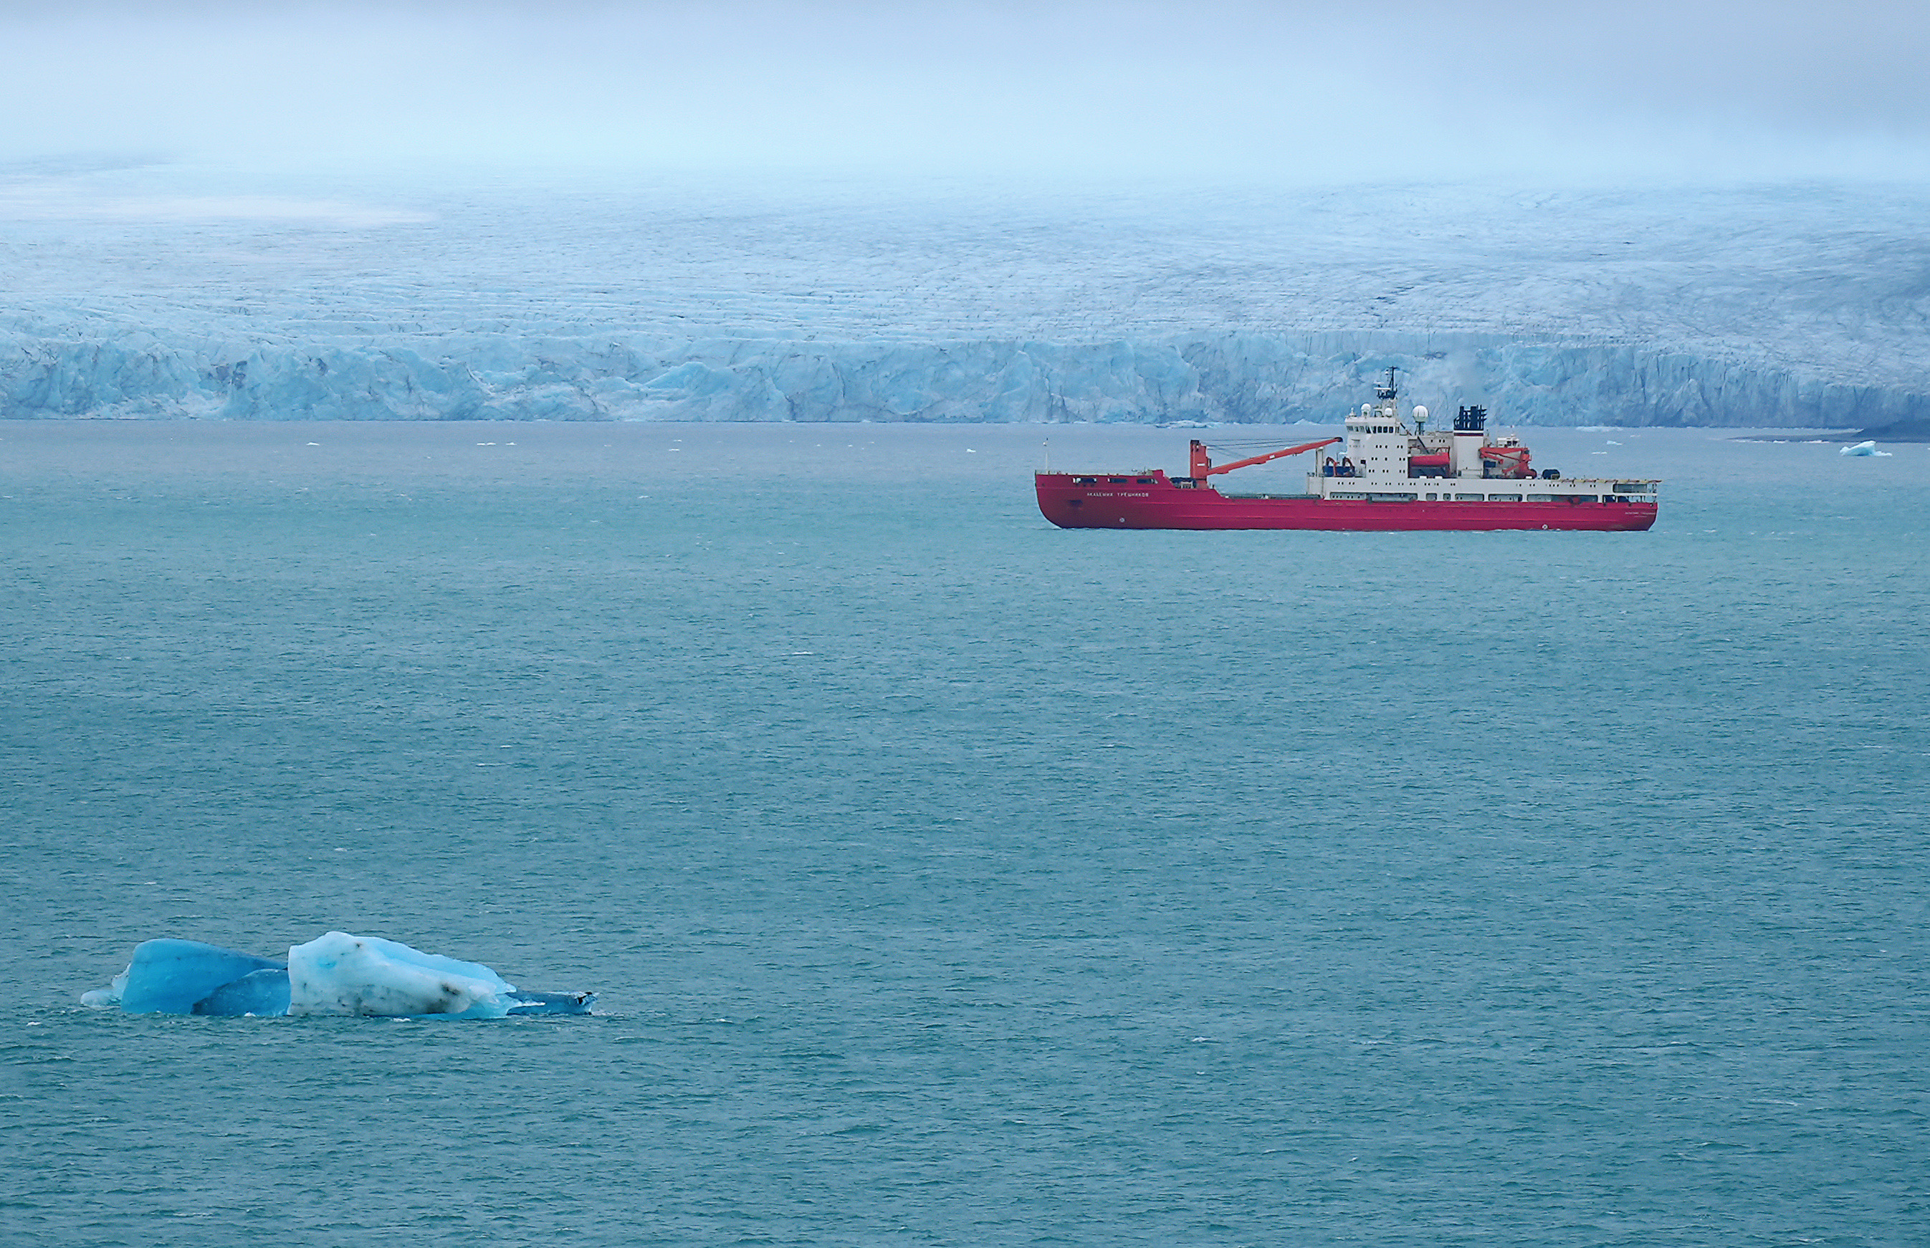







Understanding the Abundance, Variability and Sources of Ice Nucleating Particles (INPs) over the Kara and Laptev Seas in the Eurasian Arctic
Guangyu Li*, A. Welti, A. Rocchi, G. Pérez Fogwill, I. Thurnherr, M. Dall’Osto and Z. A. Kanji
*Institute for Atmospheric and Climate Science, ETH Zurich
EGU23-16059 PICO 5.14 25 April 2023
© 2021 Swiss Polar Institute, CC BY 4.0

Slide 2
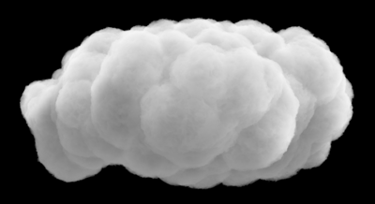
Measuring INPs in the Eurasian Arctic Ocean
Motivation
Research Questions
What is the abundance, variability and source of INPs in the Eurasian Arctic?
How do INPs partition at the ocean-air interface?
Shortwave radiation
Longwave radiation
Overview of the Field Measurement
Cloud radiative feedback (? Arctic amplification)
Ice crystals
Supercooled cloud droplets
Ice-nucleating particles (INPs)

Slide 3
Geographical variability of INP concentrations
Lower latitudes
◯ Open ocean (sea ice coverage < 15%)
◇ Marginal ice zone (MIZ, 15% < sea ice coverage < 80%)
▽ Ice packs (sea ice coverage > 80%)
↑ N_{INP}
Lower sea ice extent
Li et al., 2023a, in prep

Slide 4
Sources and Origins of INPs over the Eurasian Arctic Ocean
Li et al., 2023a, in prep
Marine biogenic aerosols & mineral dust are important sources of INPs

Slide 5
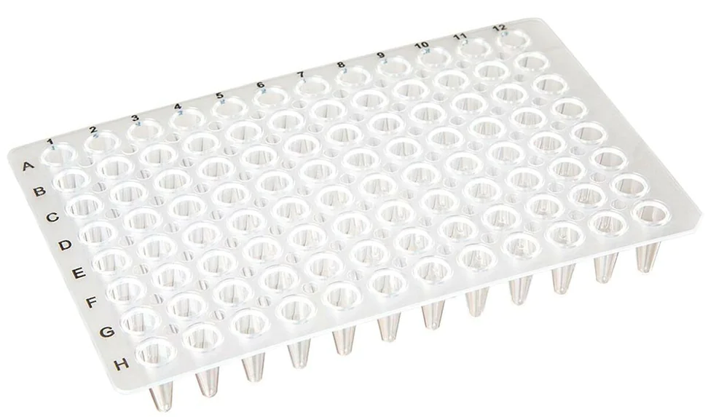
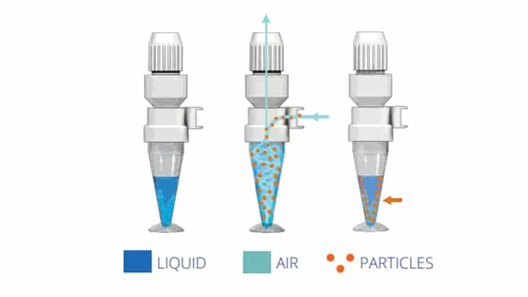

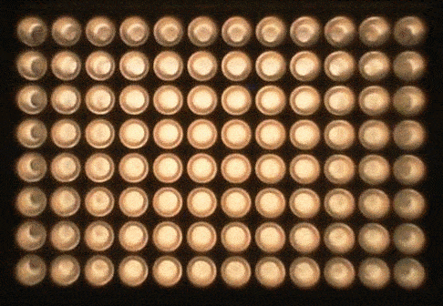
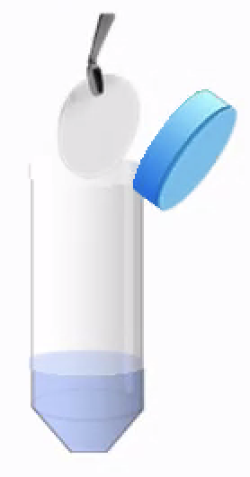


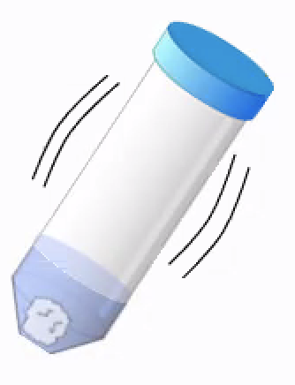

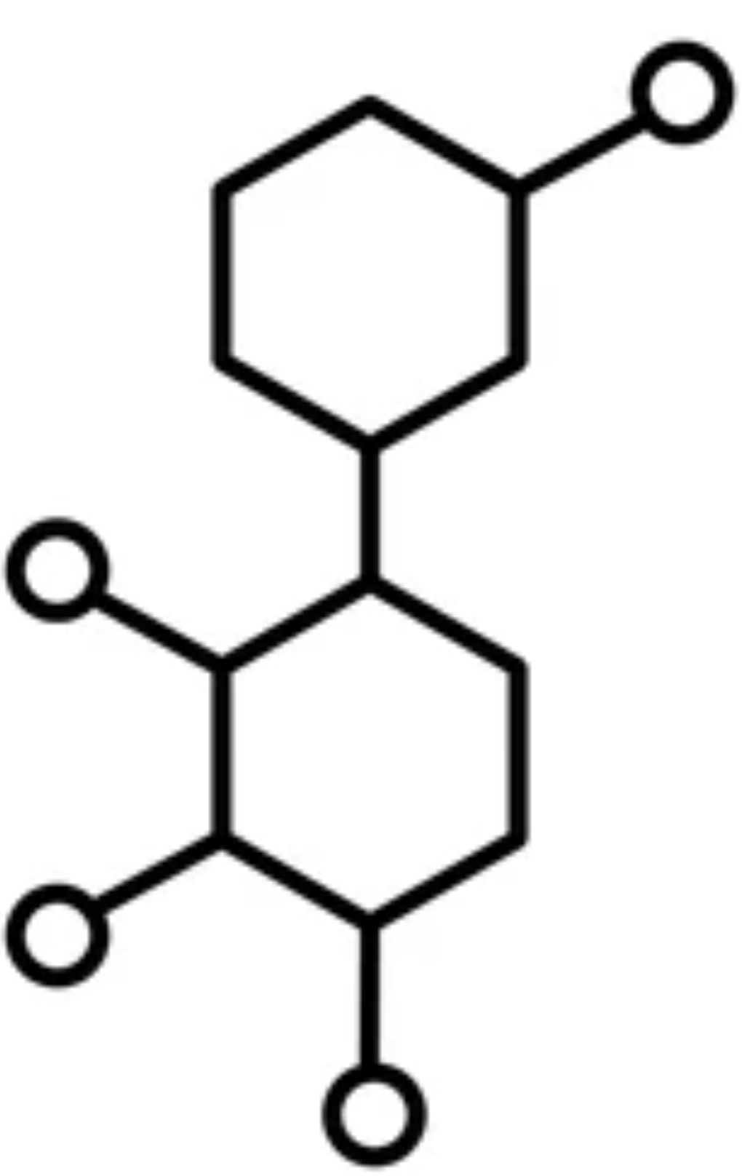

INP and associated measurements
Offline ambient aerosol sampling
INP measurements via DRINCZ
Online INP measurement with HINC
Continuously monitoring (25 min) the N_{INP} at T = -30 °C & -34 °C
Coriolis impinger
Warm plate
Dispense sample suspension into 96 × 50 μL PCR tray and place in a chiller with gradient cooling (0 ~ -25 °C)
Particle-free sheath air
Aerosol sample layer (T, RH_{i})
INP detection
Collection of air into pure water for 3 h
Particle-free sheath air
Cold plate
PM₁₀ filter sample
Coolant
Parallel measurments
Log the fraction of frozen droplets and freezing temperatures
Meteorological conditions
Heat treatment
$$N_{INP}\left(T\right)=−\frac{log⁡(1−FF\left(T\right))}{V_{a}}$$
Particle size distribution
Collection of aerosols onto polycarbonate filter for 12 h
Vali, 1971
Filter suspended in pure water and release particles by shaking
Chemical composition
Fluorescent (biological) particles
DRINCZ: DRoplet Ice Nuclei Counter Zurich; PCR: Polymerase Chain Reaction; N_{INP}: INP concentrations; HINC: Horizontal Ice Nucleation Chamber; RH_{i}: Relative Humidity w.r.t. ice

Slide 6
Heat-sensitive INPs indicate biogenic source
Heat-degradable (biological) INPs (%)
Li et al., 2023a, in prep
Biological INPs are dominant species of INP population, particularly at warmer freezing temperatures (T > -15 °C)

Slide 7
INP-resolved backward trajectories of air masses
Li et al., 2023a, in prep
◯ Ocean (sea ice coverage < 15%)
◇ Marginal ice zone (MIZ, 15% < sea ice coverage < 80%)
▽ Ice packs (sea ice coverage > 80%)

Slide 8
Air mass history of high/low INP cases
Li et al., 2023a, in prep

Slide 9
Case study: aerosol physicochemical properties
Li et al., 2023a, in prep
Higher particle loading was observed for high INP case at all size ranges (esp. > 5 μm)
Increased mineral dust particles at the coastal ice-free regions (Novaya Zemlya) may be responsible for high INP
Abundant sulfur in the high INP case, indicating possible sources from marine biogenic aerosols

Slide 10
Sources of INP in aerosolized seawater
OPC: Optical Particle Counter
SMPS: Scanning Mobility Particle Sizer
WIBS: Waveband Integrated Bioaerosol Sensor
N_{INP}: INP concentrations
Li et al., 2023b, in prep
N_{INP} generated from sea spray aerosols significantly correlates with the abundance of components (chlorophyll-a, fluorescent particle concentration, phosphate and silicate) in seawater

Slide 11
INP abundance in aerosolized seawater
Li et al., 2023b, in prep
Sea spray aerosolized INP concentrations (N_{INP}-BT) are influenced by the access to terrestrial land and the coverage of sea ice

Slide 12
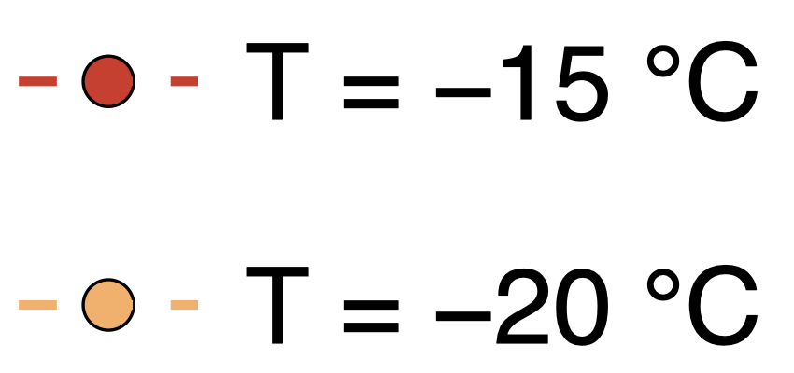
INP abundance in the ambient air vs. aerosolized seawater
(a)
(b)
r = 0.847
N_{INP}
N_{INP}
r = 0.405
N_{INP}
N_{INP}
Li et al., 2023b, in prep
Ambient N_{INP} significantly correlates with the that generated from sea spray aerosols, but weakly to no correlation with the N_{INP} from the seawater → aerosolization process matters!

Slide 13
Key findings
RQ1: Abundance and variability and Source of Arctic atmospheric INPs
Higher N_{INP} associated with lower sea ice concentration
Marine biogenic aerosols are important sources of INPs at higher freezing temperatures over the remote Arctic Ocean
RQ2: How do INPs partition at the ocean-air interface?
Sea spray aerosolized INP concentrations are influenced by the water source access to terrestrial land and the coverage of sea ice
Aerosolization process plays a role at INP partitioning at the ocean-air interface

