Slide 1
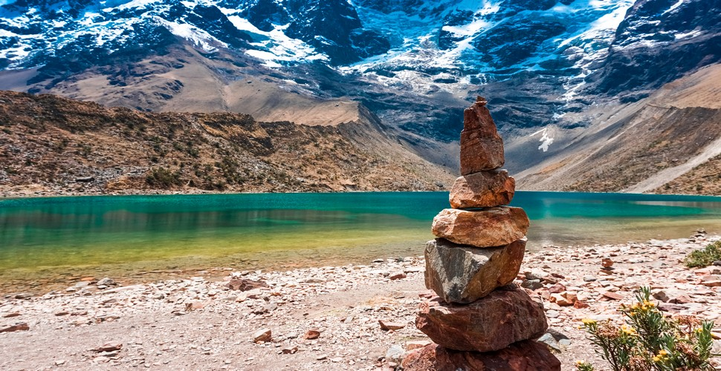


AUSTRIA, Vienna, 26 April, 2023
Cryospheric Sciences- Frozen ground, debris-covered glaciers and geomorphology- Remote Sensing of Cold Regions
ESTIMATION OF PERSISTENCE
ON GLACIAL LAKES
IN THE (PERUVIAN) TROPICAL ANDES MOUNTAIN-RANGE
WITH 2000-2020 PERIOD LANDSAT SERIES IMAGES
Pozo, J., Celmi, G., Fernandez, J., Curo, Y., Mejía, M., Robles, D., and Castañeda, A

Slide 2
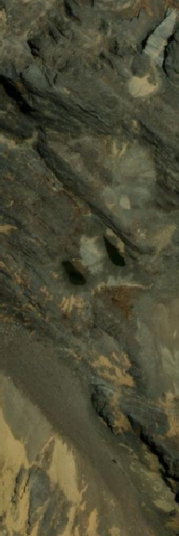
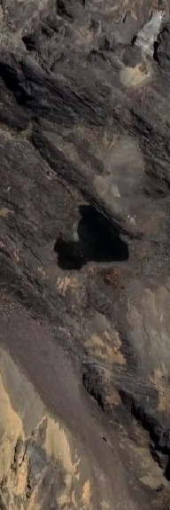
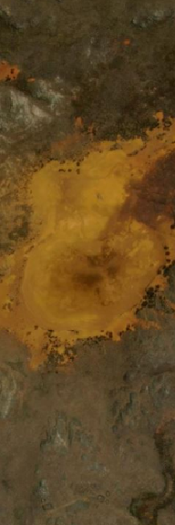
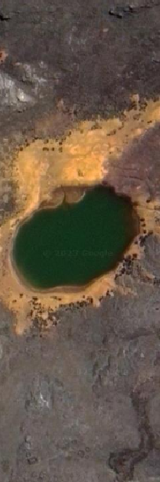
AUSTRIA, Vienna, 26 April, 2023
Cryospheric Sciences- Frozen ground, debris-covered glaciers and geomorphology- Remote Sensing of Cold Regions
----- LAKE’S CHALLENGUE -----
High variability / temporality.
National Inventory approach.
Monitoring of water volume.
Climate Change.
“Peru (1.3 M Km2) has 12 000 glacial lakes under its 38 climatic classes (Warren Thornthwaite, SENAMHI, 2020) excluding the great Titicaca lake (8 372 Km2).”

Slide 3
AUSTRIA, Vienna, 26 April, 2023
Cryospheric Sciences- Frozen ground, debris-covered glaciers and geomorphology- Remote Sensing of Cold Regions
----- OBJECTIVES -----
Global Persistence index -> 0 - 100 %
Ocasional lakes - Partially persistant lakes - Permanent lakes
Monthly Persistence index -> January - December
Summer lake - Wet season lake - All-year lake (artificial ?)
Colective Persistence index -> Mountain range dry and wet lakes regime
Climatic and short term
extreme meteorologic events ->
EL NIÑO SOUTHERN OSCILATION (ENSO) EL NIÑO COSTERO

Slide 4
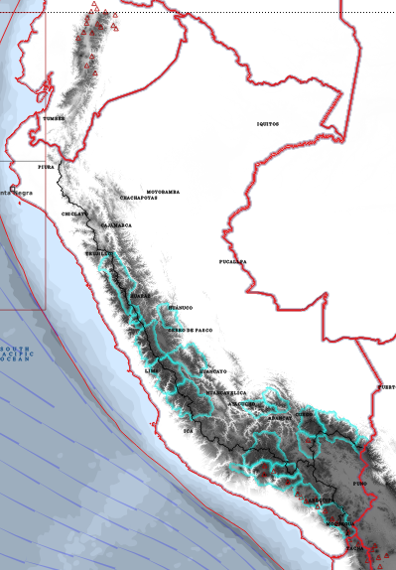
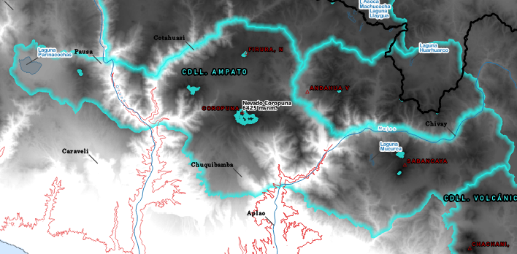
AUSTRIA, Vienna, 26 April, 2023
Cryospheric Sciences- Frozen ground, debris-covered glaciers and geomorphology- Remote Sensing of Cold Regions
----- STUDY AREAS (20 glacier mountain-ranges) -----

Slide 5


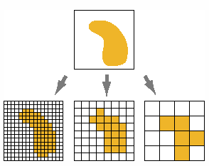
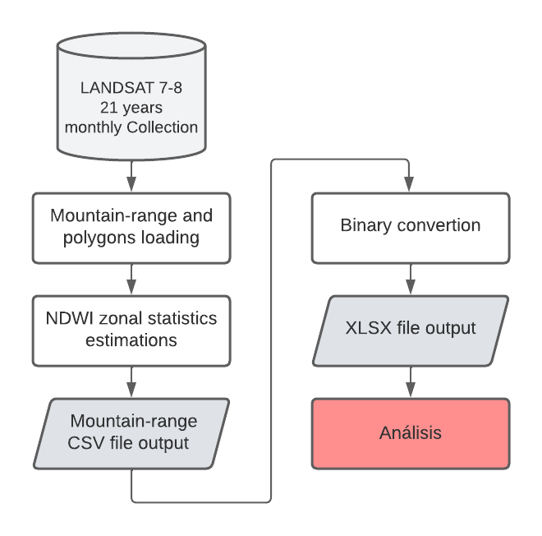
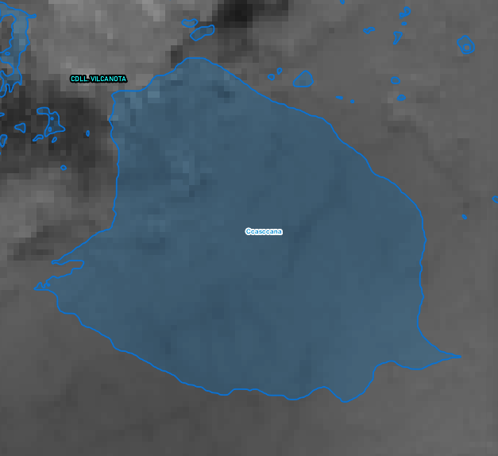
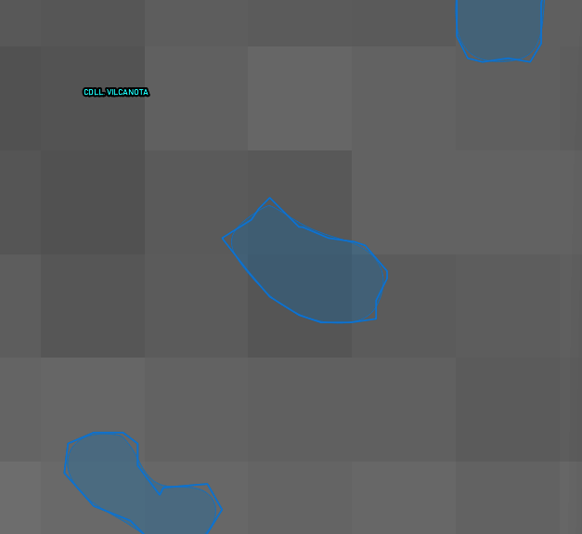
AUSTRIA, Vienna, 26 April, 2023
Cryospheric Sciences- Frozen ground, debris-covered glaciers and geomorphology- Remote Sensing of Cold Regions
----- GENERAL METHODOLOGY -----
Operating mode conflict:
Softwares can ponderate the pixels inside the polygon or they can ignore pixels partially inside the polygon.
Large area polygon
Small area polygon

Slide 6
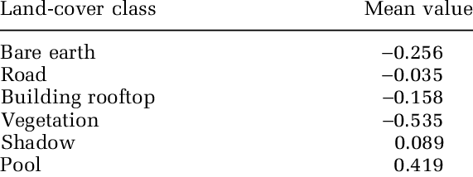
AUSTRIA, Vienna, 26 April, 2023
Cryospheric Sciences- Frozen ground, debris-covered glaciers and geomorphology- Remote Sensing of Cold Regions
----- REDUCTOR SELECTION -----
NDWI Threshold
Arranged NDWI values
descending
No water in the polygon
Sánchez (2023)
P75 + + + + -
P50 (median) + + + - -
P25 + + - - -
mean + + - - -
-1 . . . 0.2 . . . 1
Considerably Shrunk Binary Index
0 1

Slide 7
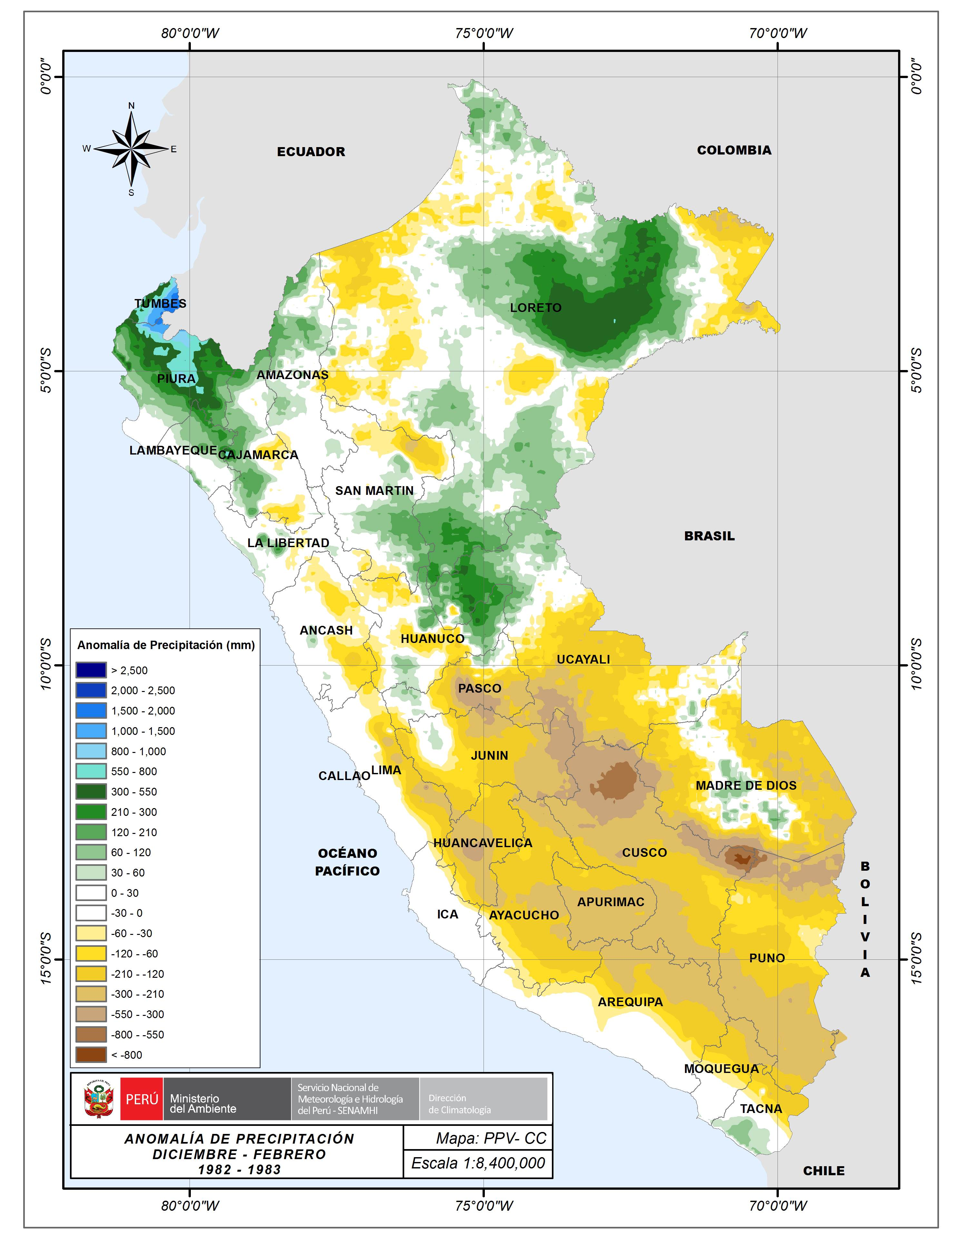
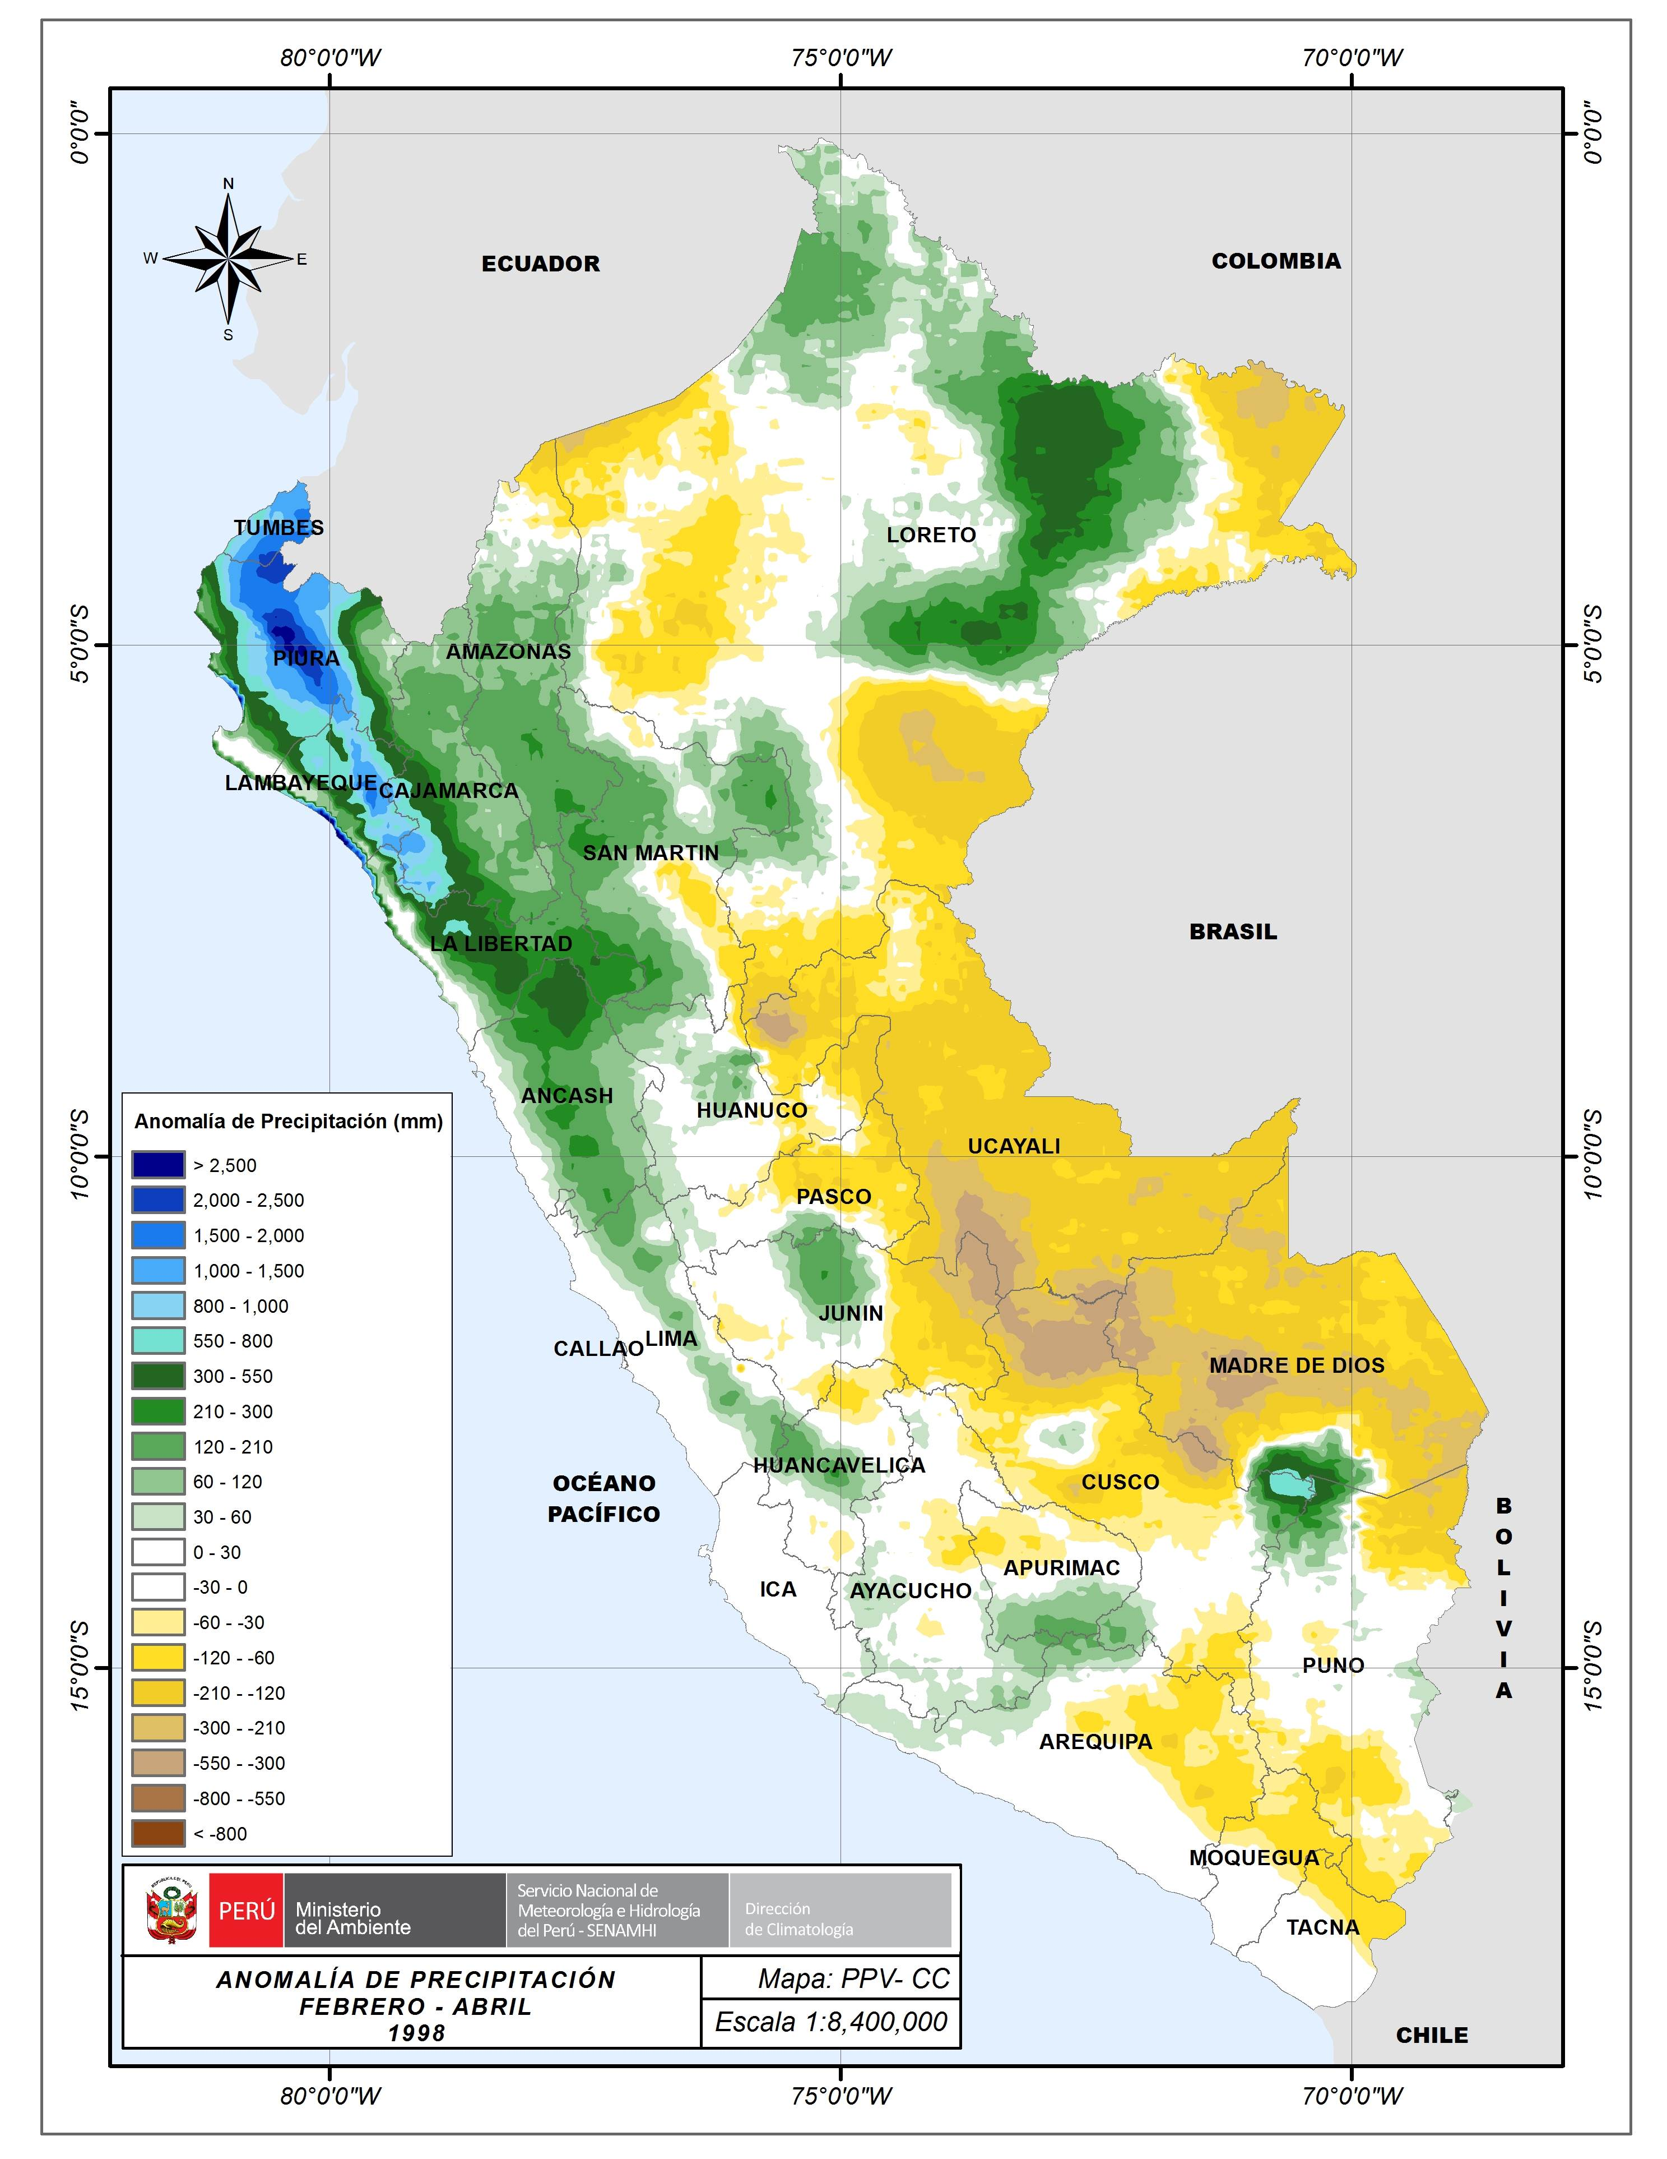
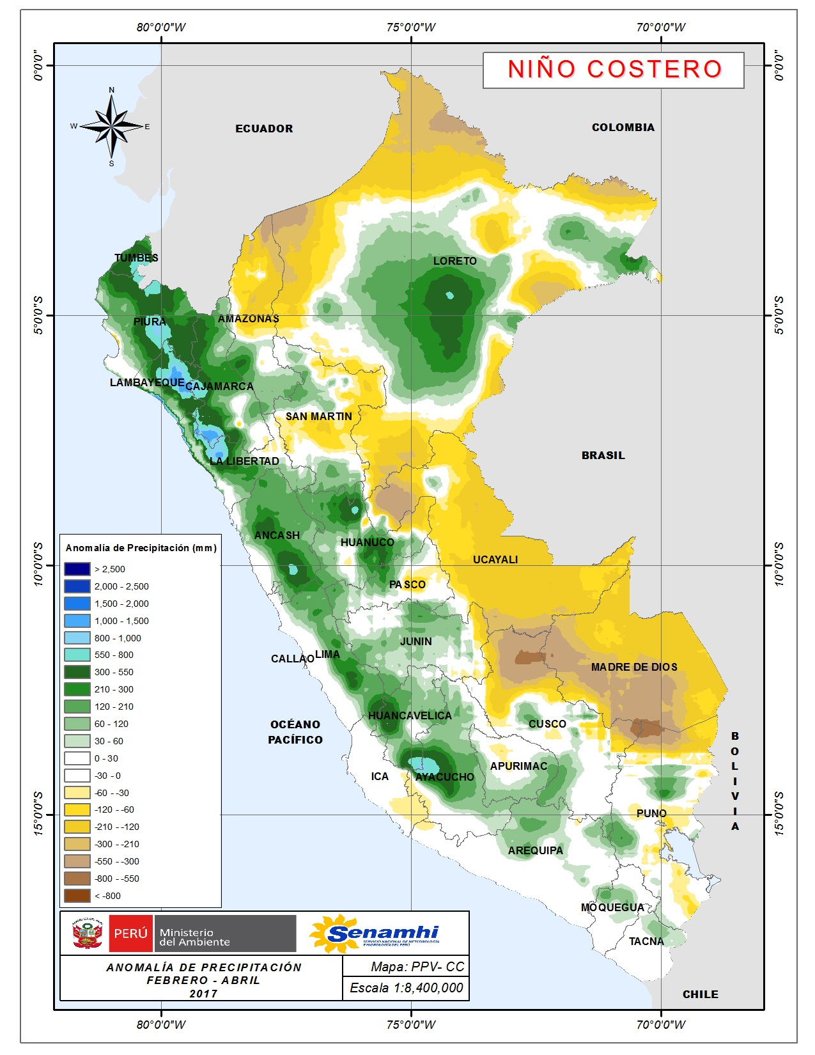
AUSTRIA, Vienna, 26 April, 2023
Cryospheric Sciences- Frozen ground, debris-covered glaciers and geomorphology- Remote Sensing of Cold Regions
EXTRAORDINARY EL NIÑO EVENTS: 1983 and 1997
EL NIÑO COSTERO: 2017 and 2023
SENAMHI, PERU

Slide 8
AUSTRIA, Vienna, 26 April, 2023
Cryospheric Sciences- Frozen ground, debris-covered glaciers and geomorphology- Remote Sensing of Cold Regions
R E S U L T S
----- GLOBAL PERSISTENCE ----
“Once we trusted the cotinuous existing data, calculated as percentage of all 252 imágenes of the 21 year period analisis, we can get a raw weight of the times the lake has appeared overcoming the NDWI threshold.”

Slide 9
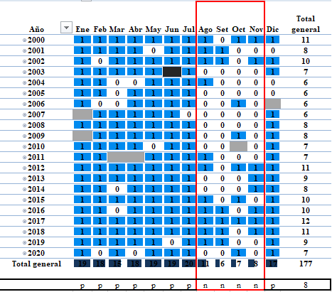
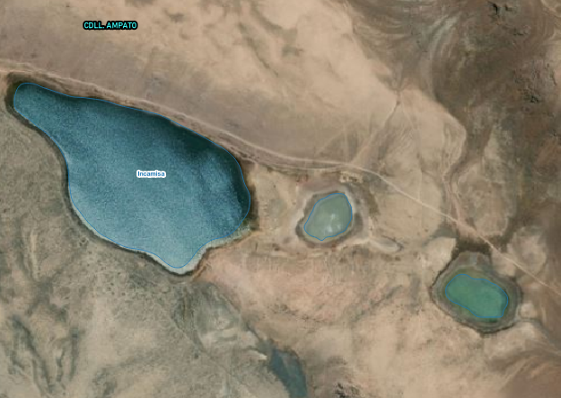
AUSTRIA, Vienna, 26 April, 2023
Cryospheric Sciences- Frozen ground, debris-covered glaciers and geomorphology- Remote Sensing of Cold Regions
----- SPECIFIC PERSISTENCE ----
Mountain range: Ampato
Region: south
Name: Incamisa
Elevation: 6613 msnm.
Major watershed: Pacific
A lake’s record is shown as his critic volumes of water correspond to winter season as expected.
Black box is a default missing data/date.
Grey boxes are relative, missed values depending on internal factors such as cloud cover image or technical satellite issues.
A normality is extracted using 75th percentiles, laying down a two-dimension signature.

Slide 10
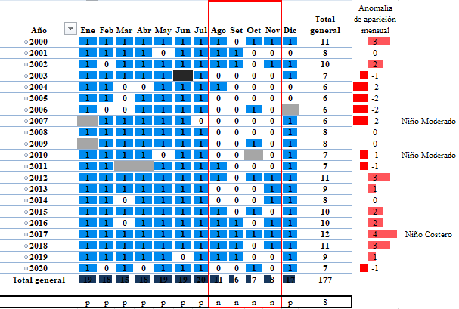
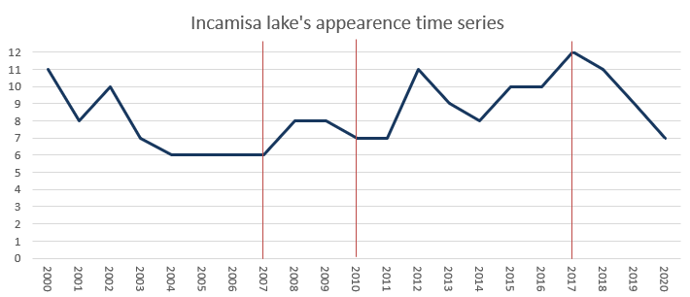
AUSTRIA, Vienna, 26 April, 2023
Cryospheric Sciences- Frozen ground, debris-covered glaciers and geomorphology- Remote Sensing of Cold Regions
----- METEOROLOGICAL IMPACT ----

Slide 11
AUSTRIA, Vienna, 26 April, 2023
Cryospheric Sciences- Frozen ground, debris-covered glaciers and geomorphology- Remote Sensing of Cold Regions
----- COLECTIVE PERSISTENCE----
We can say Ampato mountain range has less presence of lakes on the month of october by the sum of all the appearances, which marks its driest month in the period of time evaluated, and March having the most presence of lakes.
In the table seen here, the lakes are ordered from the most persistent ones in all the years of study, to the most eventual lakes (land minor depressions), through the ones that present a evidente stationality.

Slide 12
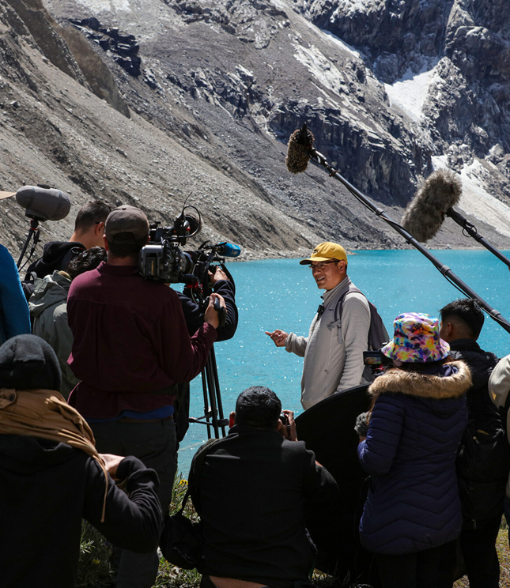
AUSTRIA, Vienna, 26 April, 2023
Cryospheric Sciences- Frozen ground, debris-covered glaciers and geomorphology- Remote Sensing of Cold Regions
----- CONCLUSIONS----
In this research, we constructed a record of the lake’s persistence based on a Landsat NDWI series.
We found that the global persistence values presents a range from 10 to 100% values indicanting some lakes have low continuity, hence a marked stationality, to the ones being present in almost all images in a almost considerably non-affected way.
Colectivelly, the Ampato mountain range has less presence of lakes in the month of october, and, obeying the precipitation regimes in Peru, reaching its peak at this time of the year.
El Niño Costero is the meteorological event which affects the most to the superficial water area.

Slide 13
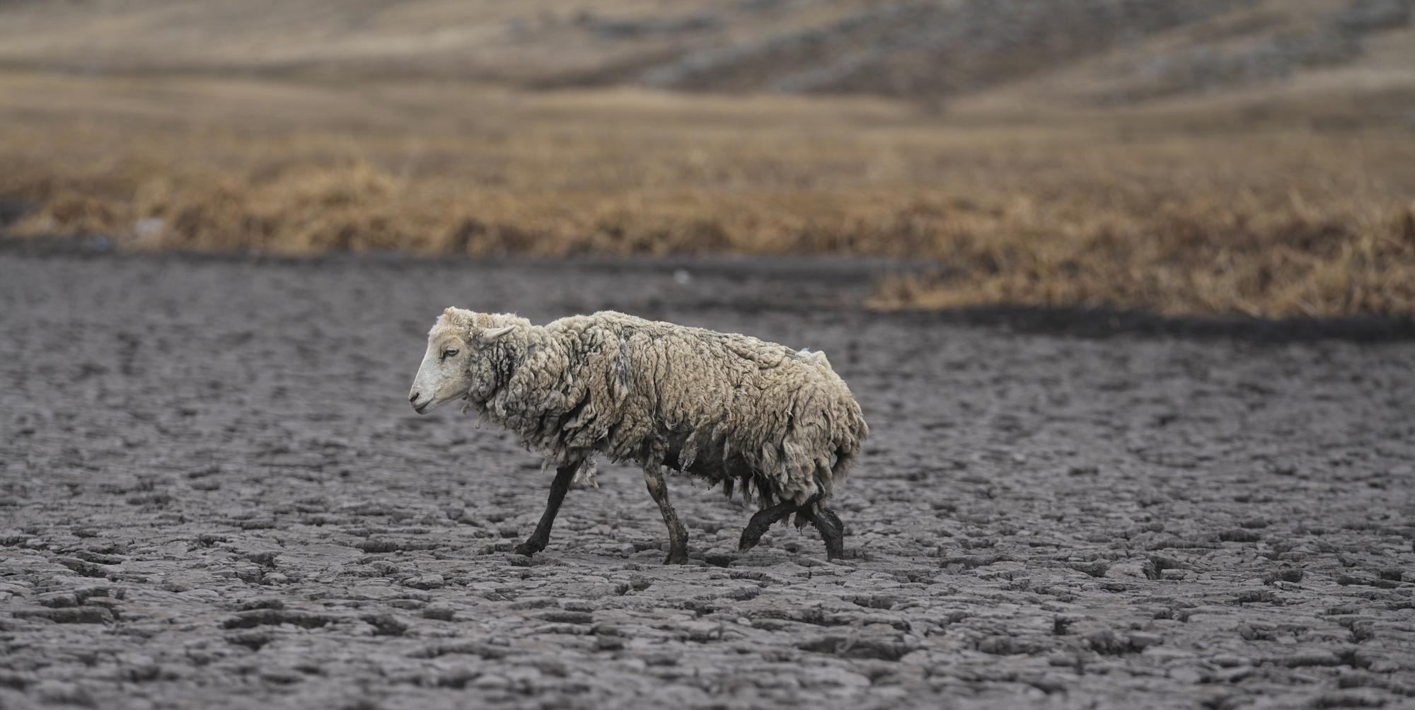
AUSTRIA, Vienna, 26 April, 2023
Cryospheric Sciences- Frozen ground, debris-covered glaciers and geomorphology- Remote Sensing of Cold Regions
References:
Aschonitis, V., Touloumidis, D., Veldhuis, M., & Coenders-Gerrits, M. (2022). Correcting Thornthwaite potential evapotranspiration using a global grid of local coefficients to support temperature-based estimations of reference evapotranspiration and aridity indices. Earth Syst. Sci. Data, 14, 163–177.
El Comercio. (2023). Santa Rosa de Quives: desborde de laguna Yarcan afectó viviendas y zonas de cultivo. https://elcomercio.pe/lima/sucesos/lluvias-en-lima-reportan-que-desborde-de-laguna-yarcan-afecto-viviendas-y-zonas-de-cultivo-en-santa-rosa-de-quives-canta-arahuay-noticia/
INAIGEM. (2018). Inventario Nacional de Glaciares: Las cordilleras Glaciares del Perú.
Los Ángeles Times. (2022). Desaparece laguna por peor sequía reciente en Andes de Perú. https://www.latimes.com/espanol/internacional/articulo/2022-12-02/desaparece-laguna-por-peor-sequia-reciente-en-andes-de-peru
Thornthwaite, C. (1984). An Approach toward a Rational Classification of Climate. Geogr. Rev., 38, 55–94. https://doi.org/10.2307/210739
Contact: pozotjesus@gmail.com
LinkedIn: linkedin.com/in/jesús-pozo-trelles-560b4a235
Telf: +51 923884838

