Slide 1
Supplementary material

Slide 2
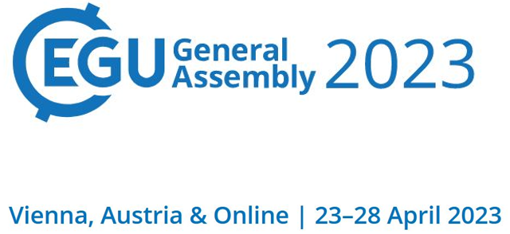







HS7.4: Steps towards future hydroclimatic scenarios for water resources management in a changing world | PICO
An advanced methodology for field visits towards efficient flood management on building block level
Stavroula Sigourou¹, Alexia Tsouni¹, Vasiliki Pagana¹, G-Fivos Sargentis², Panayiotis Dimitriadis², Romanos Ioannidis², Efthymios Chardavellas², Dimitra Dimitrakopoulou², Nikos Mamasis², Demetris Koutsoyiannis², and Charalampos (Haris) Kontoes¹
¹ National Observatory of Athens (NOA), Institute for Astronomy, Astrophysics, Space Applications and Remote Sensing (IAASARS), Operational Unit “BEYOND Centre of EO Research & Satellite Remote Sensing”
²National Technical University of Athens (NTUA), School of Civil Engineering, Department of Water Resources and Environmental Engineering, Research Group ITIA

Slide 3

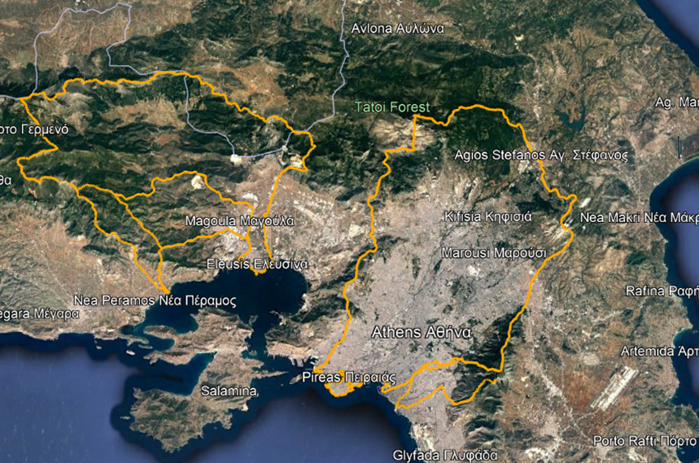
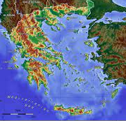
Description of study areas
The Prefecture of Attica constitutes a region with special features, such as long coastline, large inland area, various geoenvironmental units, high population density (3.792.469 residents, 36,4% of the country’s population according to the Hellenic Statistical Authority [1], critical infrastructures and social economic activities
The Operational Unit BEYOND / IAASARS / NOA in cooperation with the Research Group ITIA/ School of Civil Engineering/ NTUA study five river basins (Pikrodafni, Giorgis, Sourres and Agia Aikaterini streams and Sarantapotamos and Kifisos rivers) in the Region of Attica, which are included in 23 Municipalities.
The five river basins in the Region of Attica

Slide 4
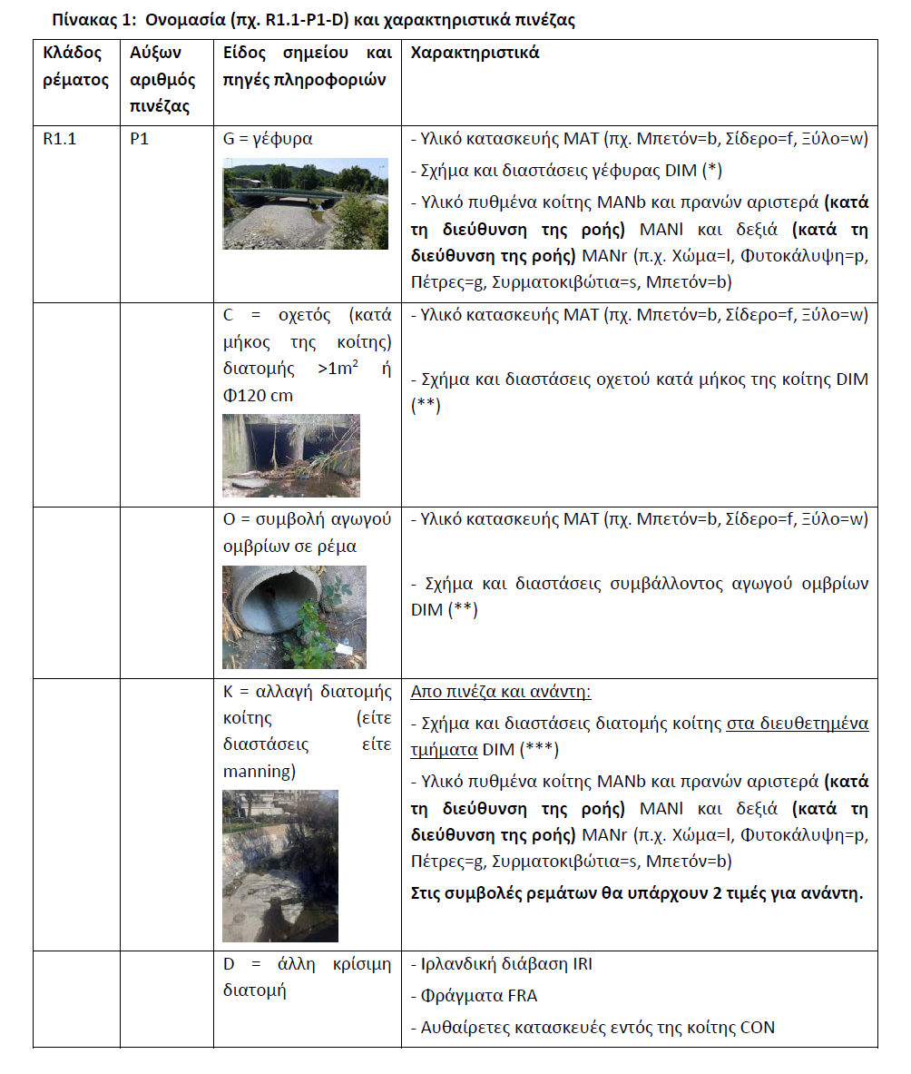
Materials and Methods
  Methodology of field visits
      Encoding of critical points based on the substream, the location and the type of the observation
      Recording of the characteristics of the critical points, such as the construction material, the material of the , dimensions, etc.
      Evaluation of the points based on the potential risk

Slide 5
Innovations of the methodology
All the pre-existing & collected data are combined alongside the produced data and the scientific analysis becoming available via a web platform to all Prefecture’s and Municipalities’ services.
The uncertainty analysis is achieved comparing with past studies.
It’s the first time that such a detailed approach for field research is implemented on building block level in Greece, which has a significant impact on flood risk assessment.
Enhanced models are created using both earth observation, spatial data and field data. Field measurements are combined with data collected from studies in order to modify the terrain for more accurate hydraulic modelling.
An added value of the methodology is the improvement of flood risk analysis in terms of flood mitigation impact, since the methodology is based on regional scale.

Slide 6

Future work
  The research continues…
Use of more friendly applications and on the field, such as ArcGIS Field Maps
Need to monitor the streams and embody every change, such as river diversion, underground rivers and channels, change in river bed, etc.
→ update the database, further prevention of flood before crisis

Slide 7

References
1. M. Z. Hossain and T. Sakai, Severity of Flood Embankments in Bangladesh and Its Remedial Approach, Agricultural Engineering International: the CIGR Ejournal. Manuscript LW 08 004. Vol. X. May, 2008.
2. T. H. Assumpção, I. Popescu, A. Jonoski , and D. P. Solomatine, Citizen observations contributing to flood modelling: opportunities and challenges, HESS, 22, 1473–1489, doi.org/10.5194/hess-22-1473-2018, 2018.
3. G.-F. Sargentis, T. Iliopoulou, S. Sigourou, P. Dimitriadis, and D. Koutsoyiannis, Evolution of clustering quantified by a stochastic method — Case studies on natural and human social structures, Sustainability, 12 (19), 7972, doi:10.3390/su12197972, 2020.
4. S. Sigourou, V. Pagana, P. Dimitriadis, A. Tsouni, T. Iliopoulou, G.-F. Sargentis, R. Ioannidis, E. Chardavellas, D. Dimitrakopoulou, N. Mamassis, C. Contoes, and D. Koutsoyiannis, Proposed methodology for urban flood-risk assessment at river-basin level: the case study of the Pikrodafni river basin in Athens, Greece, Global Flood Partnership 2022 Annual Meeting, Leeds, UK, 2022.

Slide 8
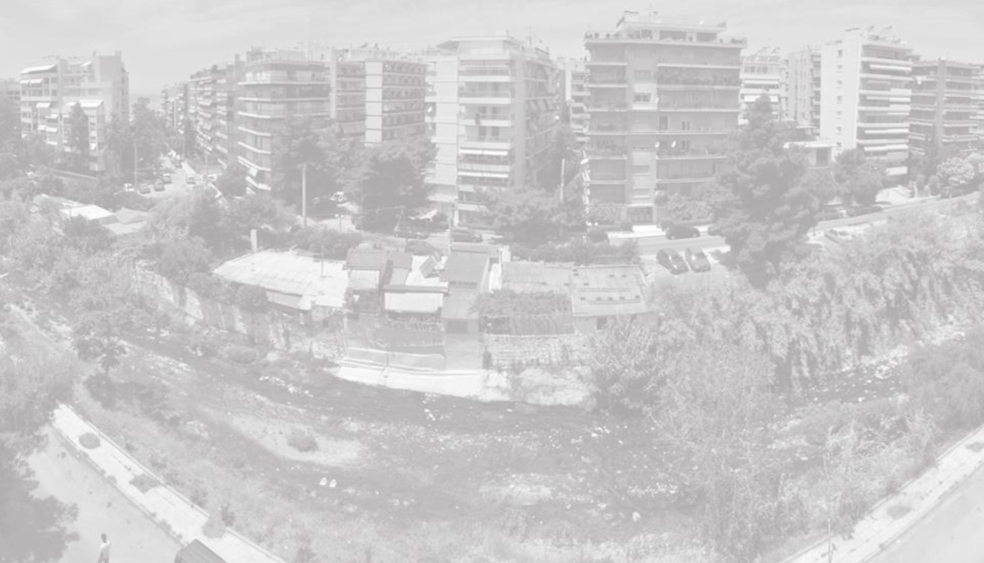


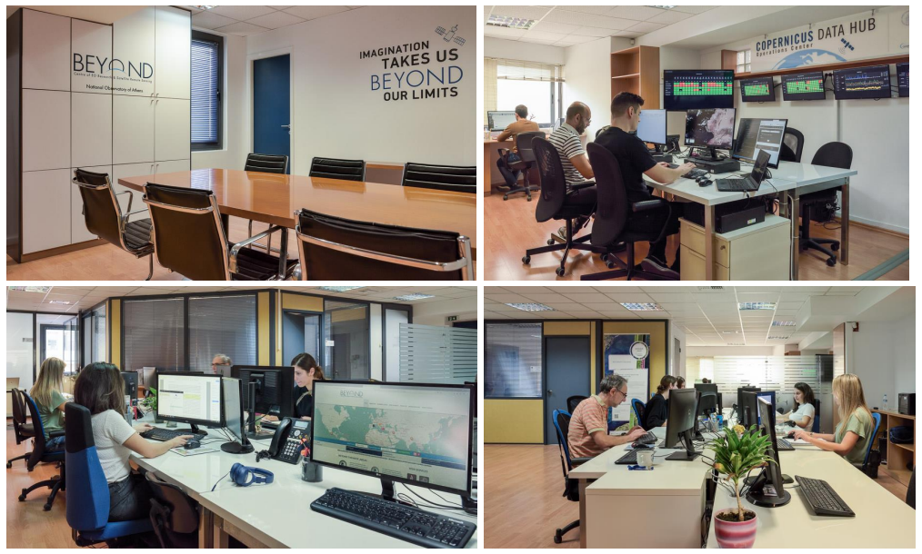

Thank you for your attention
Stavroula Sigourou
PhD candidate, School of Civil Engineering, National Technical University of Athens, Research Associate, Operational Unit BEYOND of IAASARS/NOA,
MSc., Dipl. Rural and Surveying Engineer
sigourou@noa.gr
http://beyond-eocenter.eu/
https://www.itia.ntua.gr/en/

