Slide 1





Supplementary slides
Rise in Rainfall of South Asian Monsoon Low Pressure Systems
S Vishnu, William R. Boos,
Mark D. Risser, Travis A. O’Brien, Paul A. Ullrich, & William D. Collins
26, April, 2023

Slide 2
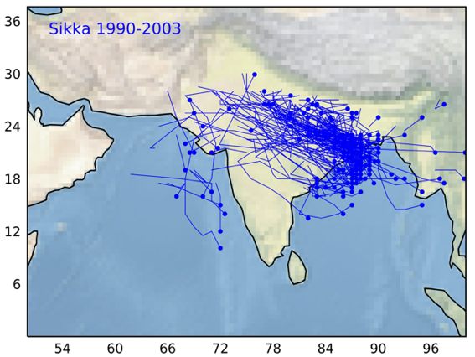
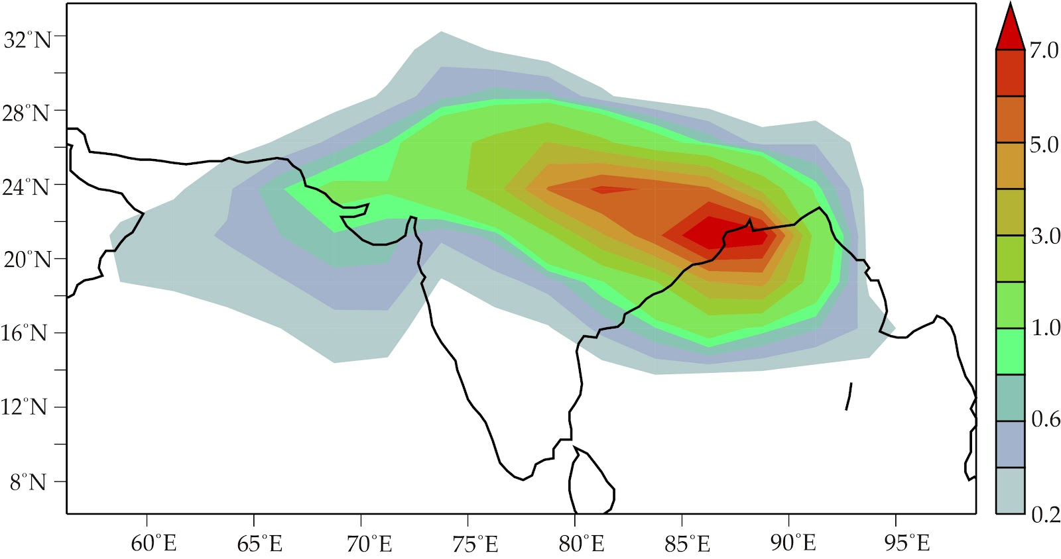

Low Pressure Systems (LPS) : Climatology
The India Meteorological Department (IMD) has tracked monsoon depressions for over a century.
Forms over Head bay of Bengal and move northwestward/ westward towards India.
Fig: Genesis (dot) and Track (line) of LPS
Fig: LPS track density

Slide 3
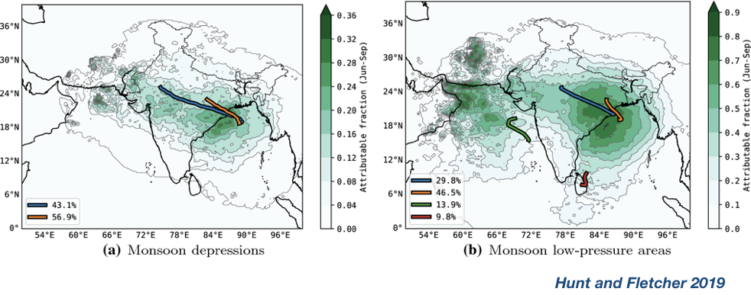
LPS Impact: Seasonal Total Rainfall
Fig: Monsoon Lows and MD contribution to Seasonal rainfall
LPS has a significant contribution to seasonal total rainfall

Slide 4
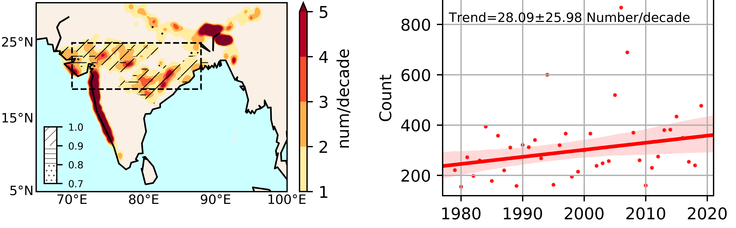
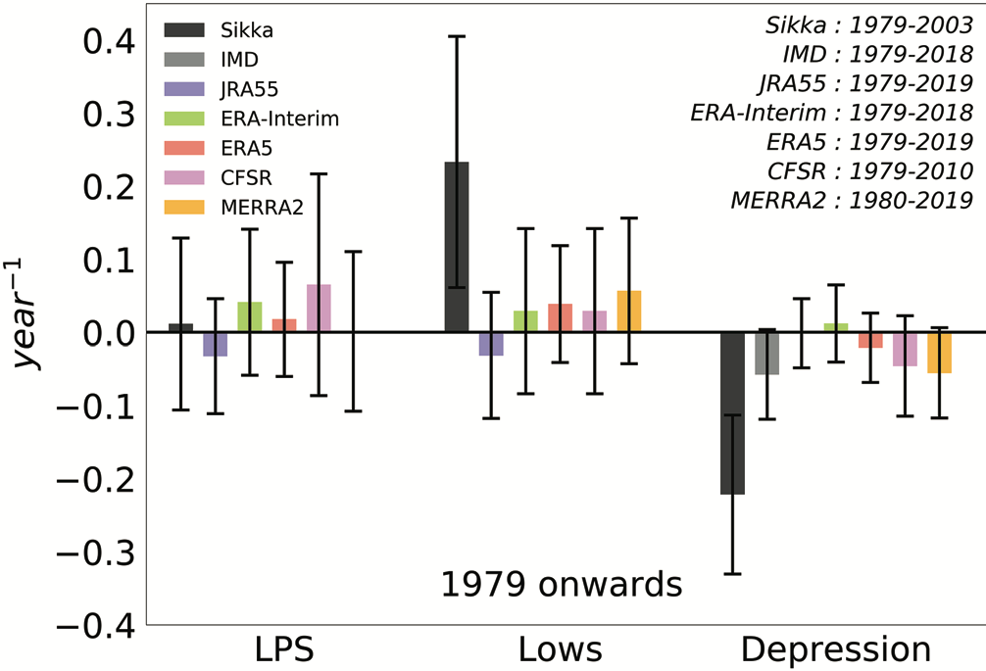
LPS and extreme events
Fig: Trend in extreme events over central India
Fig: Extreme events (shaded) and LPS contribution (stippling /hatching)
Most of the extreme rainfall events are associated with monsoon Low pressure systems (LPS).
Extreme rainfall events show an increasing trend
even no trend in the LPS activities.
So, the possibility of changes in LPS rainfall.
Fig: Trend in LPS, MD and Lows

Slide 5
LPS rainfall
Widely believed that monsoon lows (Weaker LPS) produce tremendous rainfall as monsoon depression.
Monsoon depression produced almost double the amount of rainfall than monsoon lows
Fig: Vortex-centric composite of monsoon depression rainfall. Stippling indicates the percentage monsoon depression precipitation exceeds that of monsoon lows. (f-g) storm average and storm accumulate rainfall distribution

Slide 6
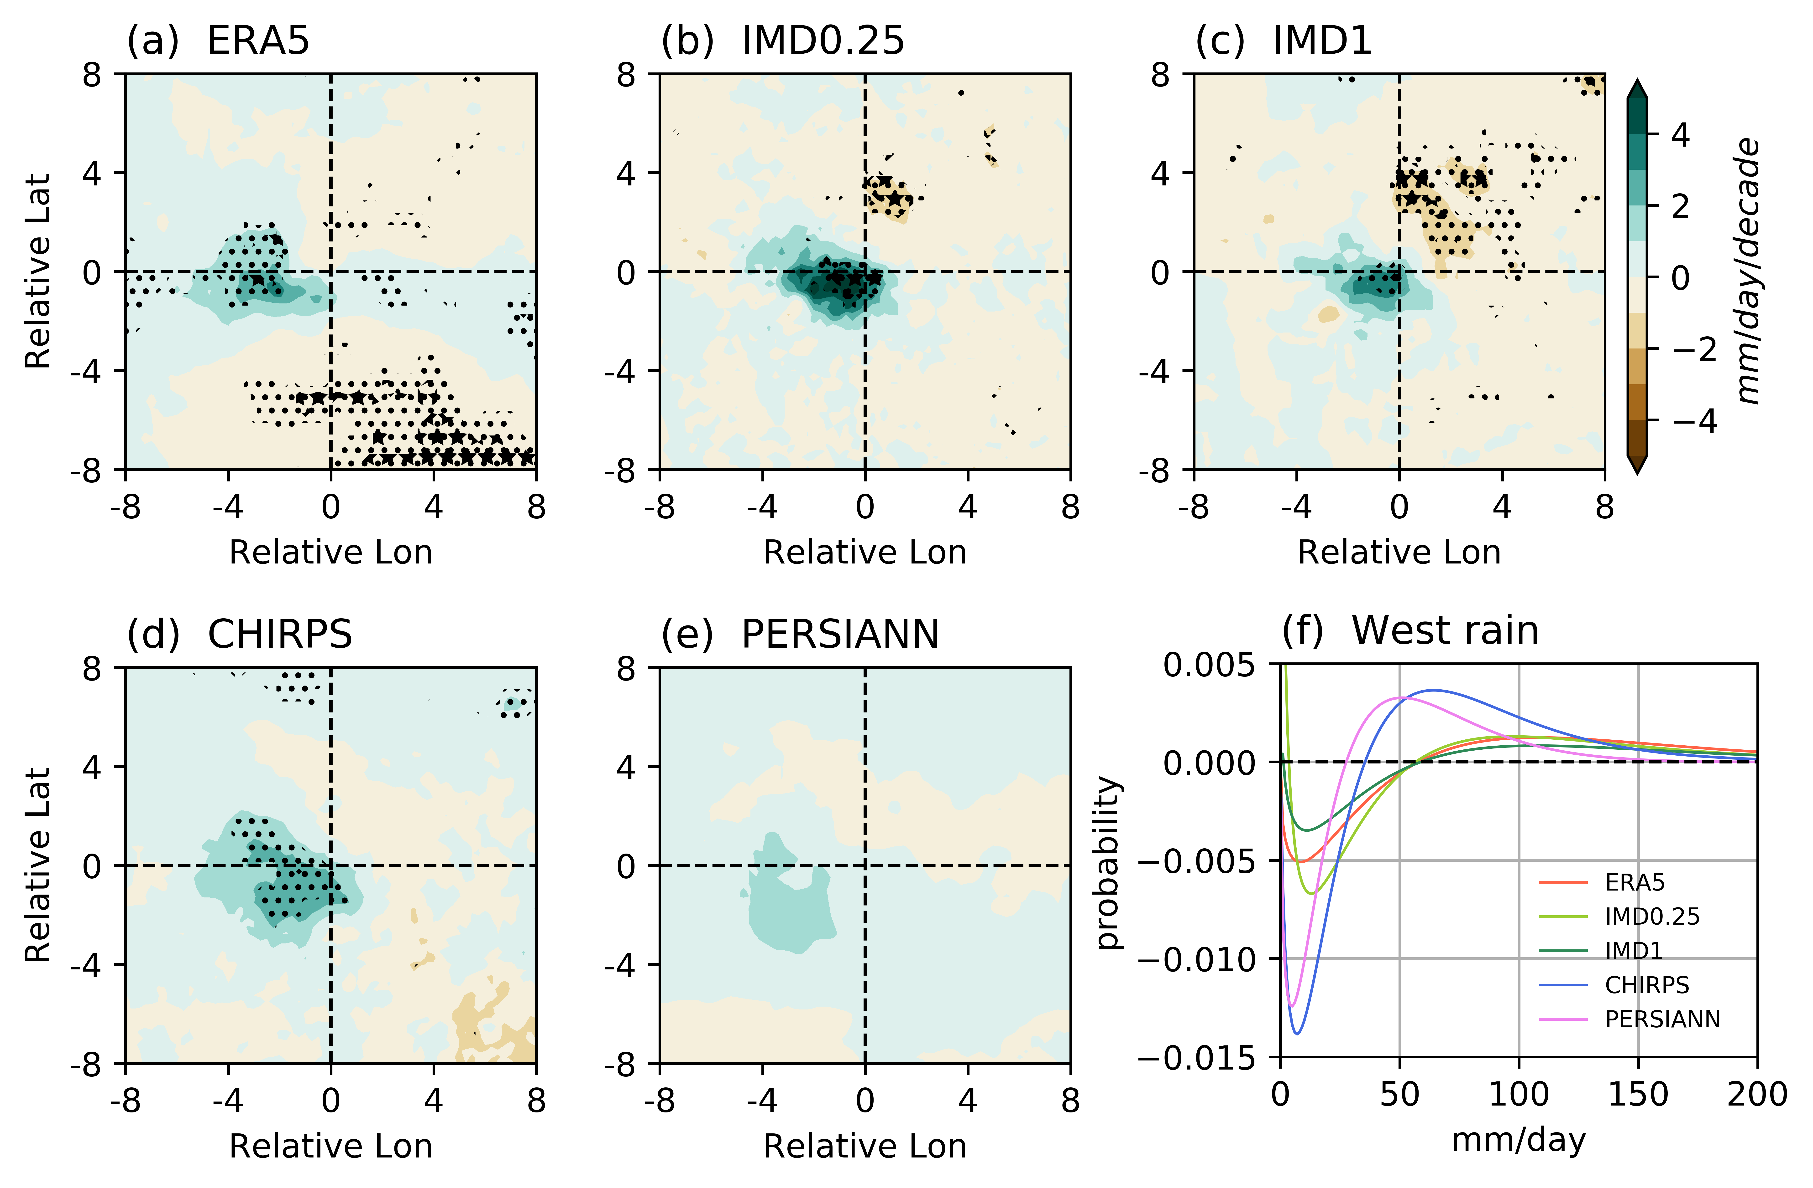
MD rainfall trend
Monsoon depression rainfall increases where the maximum amount of rainfall occurs.
Distribution changed to produce more heavy rainfall.
Fig: Trend in Vortex-centric composite of monsoon depression rainfall. (f) Change in rainfall distribution

Slide 7
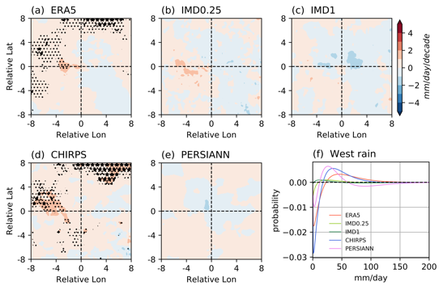
Lows rainfall trend
Lows’ rainfall increases where the maximum amount of rainfall occurs.
Distribution changed but no increase in rainfall above 150 mm/day
Fig: Trend in Vortex-centric composite of monsoon lows rainfall. (f) Change in rainfall distribution

Slide 8
humidity peak over Indian region
Fig: Linear trend of summer (June-September) mean values of (a) surface air temperature and (b) surface air specific humidity (color shading shows ERA5 trends, while the black contour marks regions where HadISDH trends are larger than 0.5 K decade⁻¹
No trend in surface air temperature over the last 40 years in central India
South Asia has humidified rapidly
Larger than those over any other land region globally

Slide 9
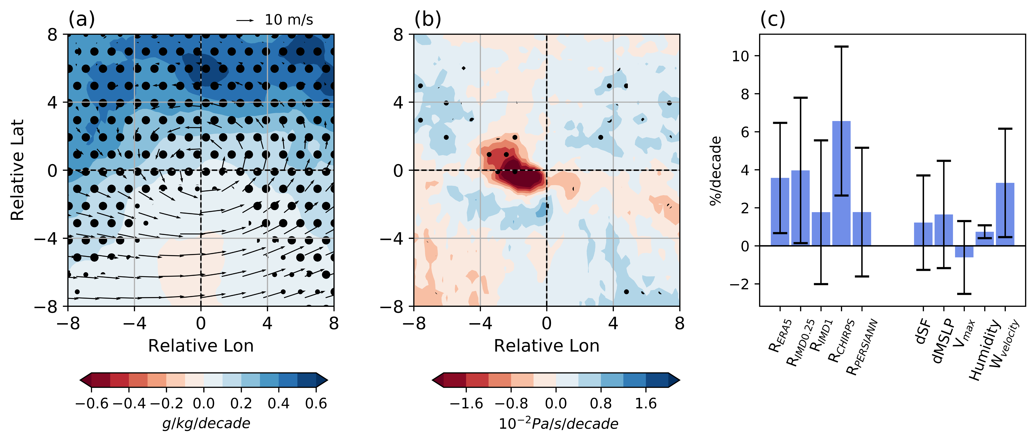
Increase in vertical velocity and humidty
Fig: Linear trend (a) specific humidity and (b) vertical velocity and (c) rainfall and intensity parameters
Humidity trend show a meridional gradient with high value over north of vortex.
  Moisture vortex instability?
Vertical motion increases where convection occurs
No trend in intensity of horizontal circulation

Slide 10
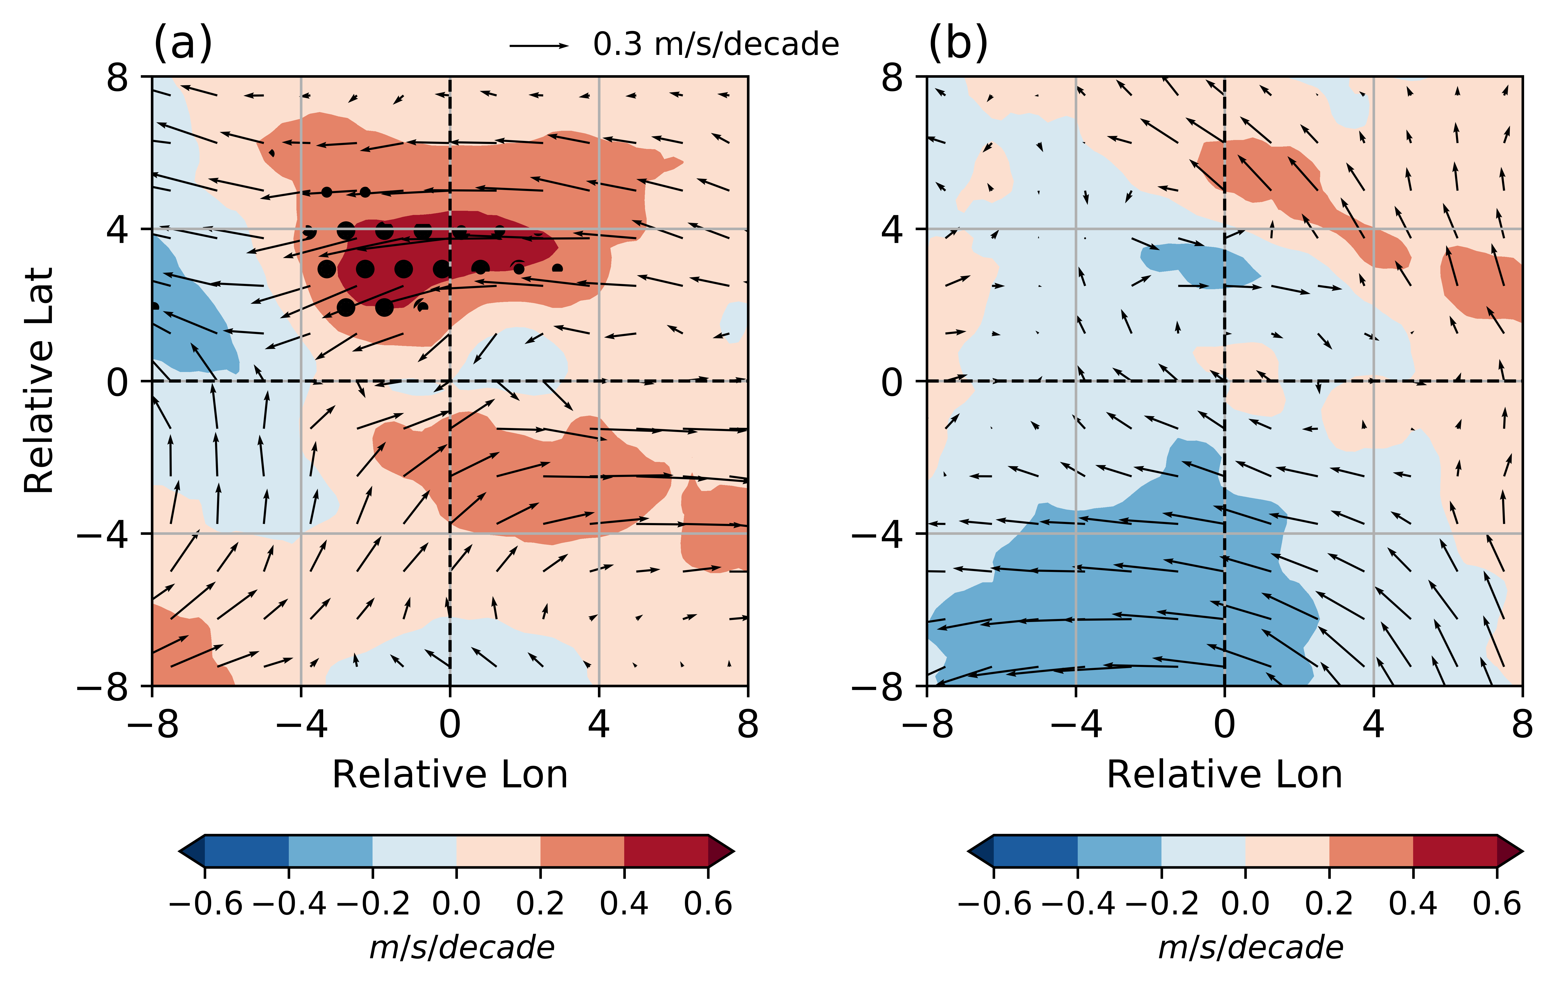
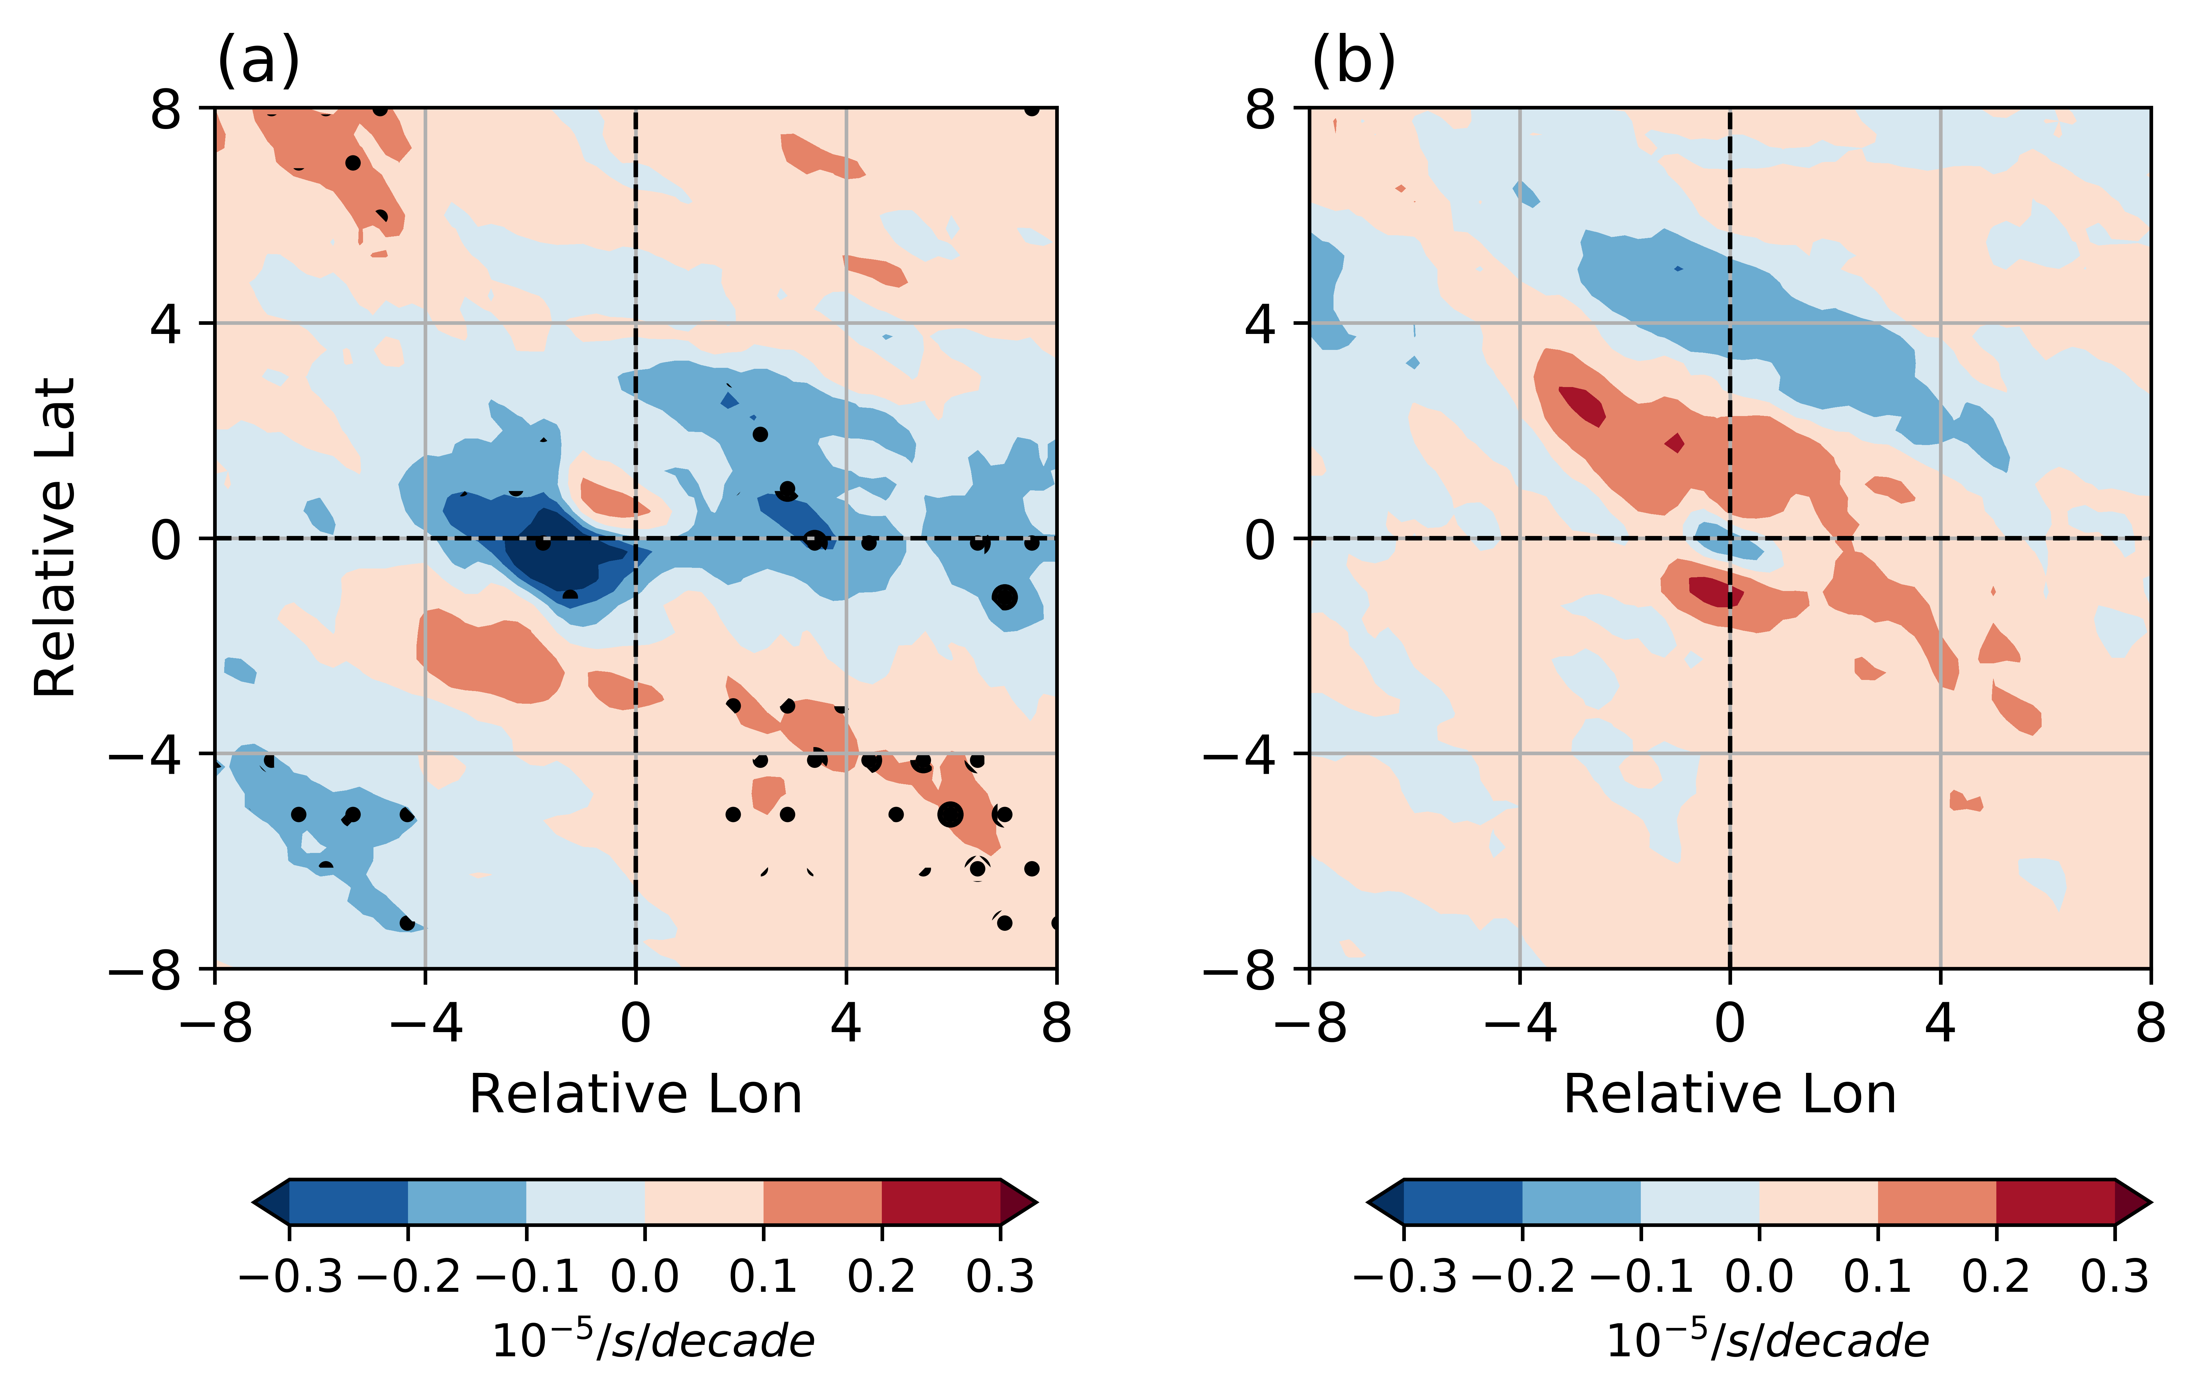
Change in circulation pattern
Circulation pattern changed with more zonal flow which create a shear vorticity.
Enhanced the convergence hence the vertical movement
Fig: Linear trend (left) horizontal circulation at 850 hPa (shaded is the magnitude )and (right) divergence

Slide 11
CMIP6-HighResMip: Success in capturing LPS
Multi-model Mean (MMM) captures monsoon depressions' structure as cyclonic wind pattern with pressure minima and southwest quadrant rainfall maxima and even weaker monsoon lows
Fig 1: Vortex centric composite of (top) SLP (shaded) and horizontal wind at 850 hPa (shaded) and (bottom) rainfall.

Slide 12
CMIP6-HighResMIP: Count and genesis trend
Do not show any significant trend in the 21st century,
However, LPS (mainly MD) genesis over Indian land increases with a decrease over the Bay of Bengal (Fig e).
Fig : Trend (b-c) and genesis density (d-e).

Slide 13
HighResMIP: Rise in rainfall and plausible reason
Lows and MD show an increase in trend in the various periods from 1980 to 2100.
The increase in rainfall for some models is near-C-C (7%/K)
An increase in monsoon depression intensity and specific humidity might increase the rainfall of monsoon depression.
For Monsoon lows, only the increase in specific humidity made the much wetter.
Fig : (a-b) Trend in rainfall, (c-h) changes in various parameters.
Bar: Near future (2020-2049)-historical (1980-2009)
Bar with strip: End of 21st century (2070-2099)-historical (1980-2009)

Slide 14
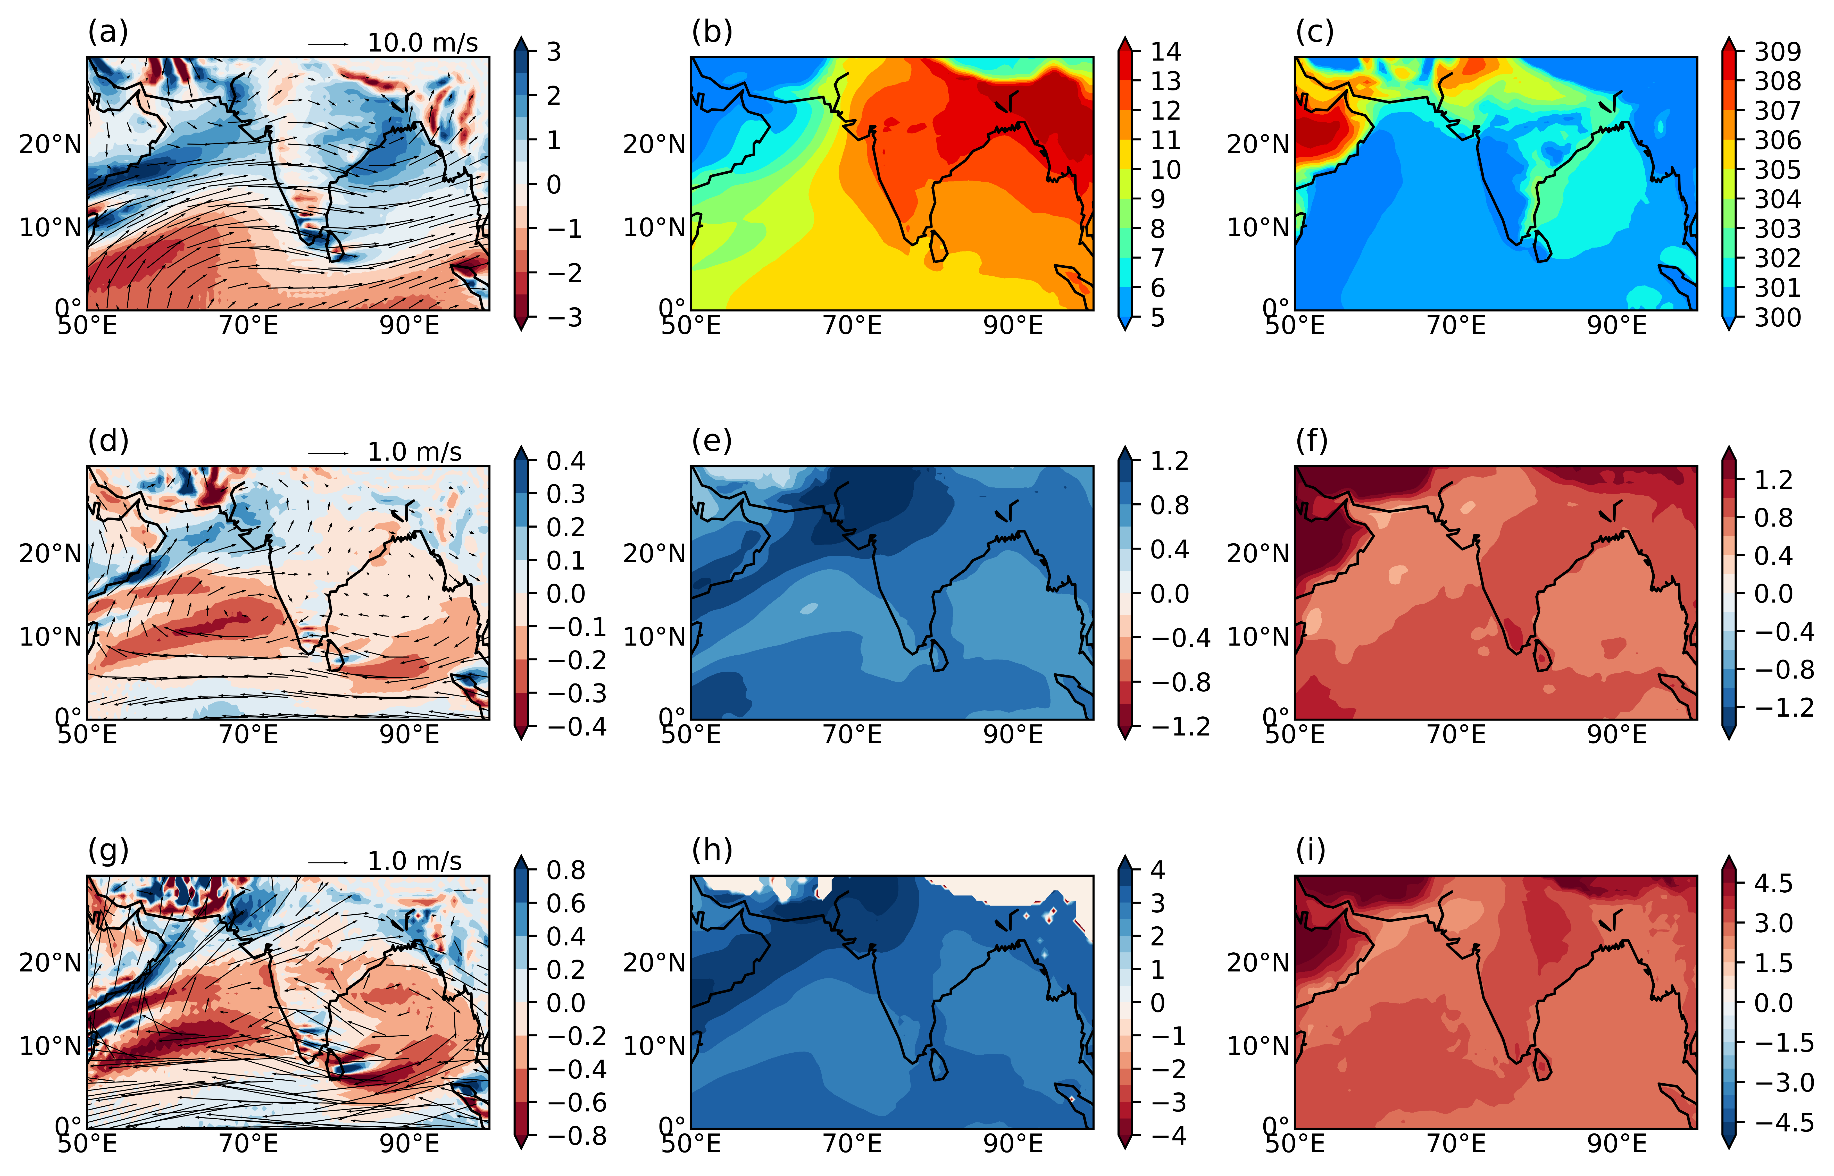
HighResMIP: Plausible reason
Vorticity
Humidity
Specific humidity shows a increase gradient with maxima over the north-western Indian region
Poleward shift of monsoon circulation that advected moisture from the Arabian sea region into northern India
Meridional gradient of specific humidity with more genesis over Land in the future favours the moist-vortex instability that might enhance the rainfall
Change in near future [(2020-2049)-(1980-2009)
Change in end of 21st century [(2070-2099)-(1980-2009)

Slide 15
HighResMIP: Impact of LPS on extreme and Seasonal rainfall
Change in near future [(2020-2049)-(1980-2009)
Change in end of 21st century [(2070-2099)-(1980-2009)
Seasonal rainfall
Seasonal rainfall
From LPS
LPS to Total
From LPS
LPS to Total
Extreme rainfall
Extreme rainfall
From LPS
LPS to Total
From LPS
LPS to Total

Slide 16
Summary
Increased in extreme rainfall events in central India mainly from monsoon low pressure systems (LPS).
Rise in LPS rainfall.
Increase in background humidity with strengthened ascent enhanced rainfall
Future Projection
LPS rainfall will increase in future projections near the C-C ratio.
This increase is responsible for the increase in
  seasonal total rainfall and
  extreme events

Slide 17
Thank You

