Slide 1

SSP1.7/TS6.13
Reconstructing paleogeography and evolution of the Western Mediterranean area
from Variscan to Present
Convener:
Rosanna Maniscalco
Co-conveners:
Gaia Siravo
Riccardo Asti
Sabatino Ciarcia
Nicolas Saspiturry
Roberta Somma
Sebastiano Ettore Spoto

Slide 2
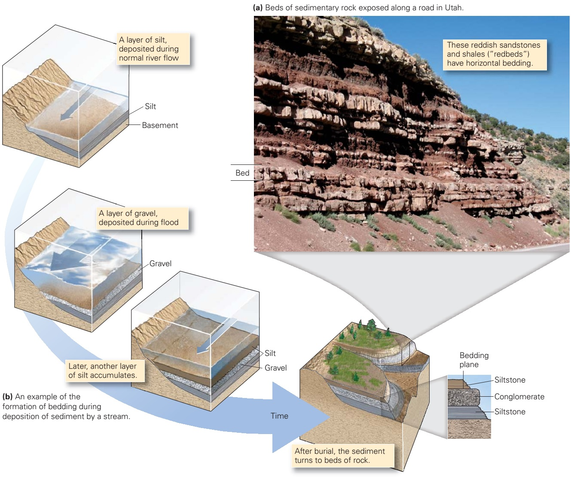
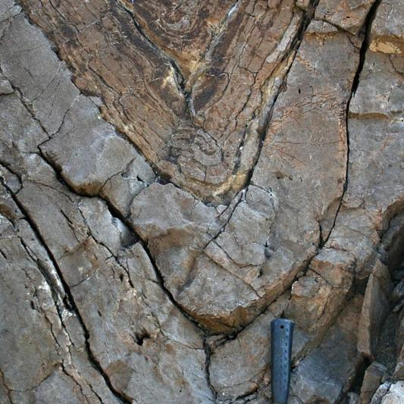
Stratigraphy (SSP) + Tectonics (TS)
SSP 1.7 / TS6.13 Reconstructing paleogeography and evolution of the Western Mediterranean area from Variscan to Present

Slide 3
Paleogeographic reconstructions in W Mediterranean
Stamplfi and Borel 2002
SSP 1.7 / TS6.13 Reconstructing paleogeography and evolution of the Western Mediterranean area from Variscan to Present

Slide 4
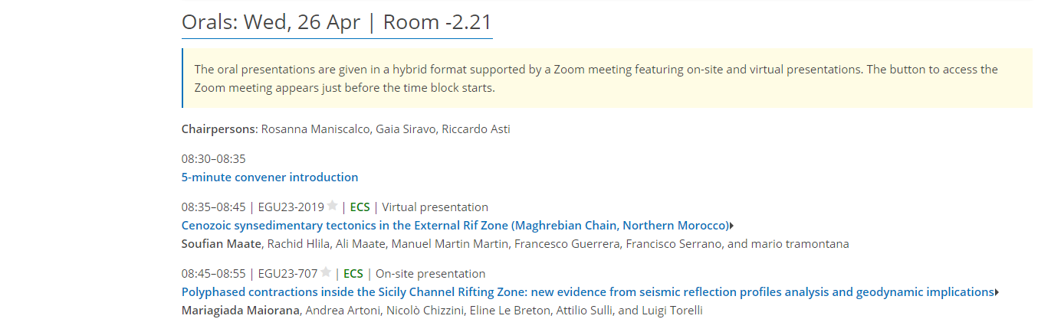
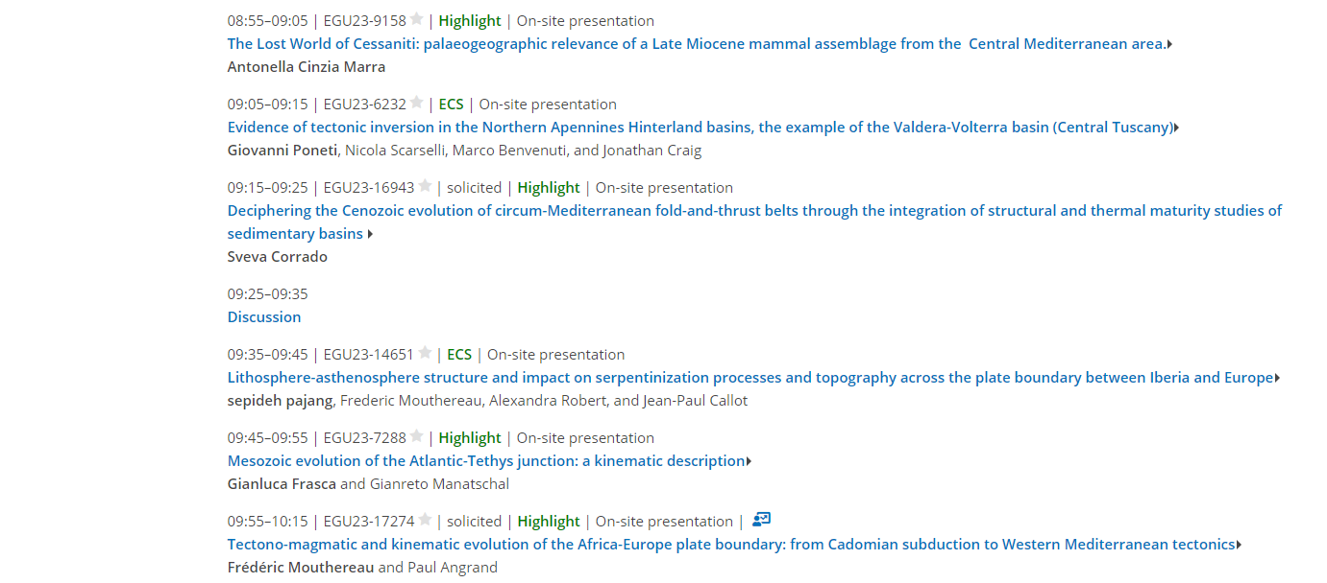
Oral contributions
SSP 1.7 / TS6.13 Reconstructing paleogeography and evolution of the Western Mediterranean area from Variscan to Present

Slide 5
Oral contributions
SSP 1.7 / TS6.13 Reconstructing paleogeography and evolution of the Western Mediterranean area from Variscan to Present

Slide 6
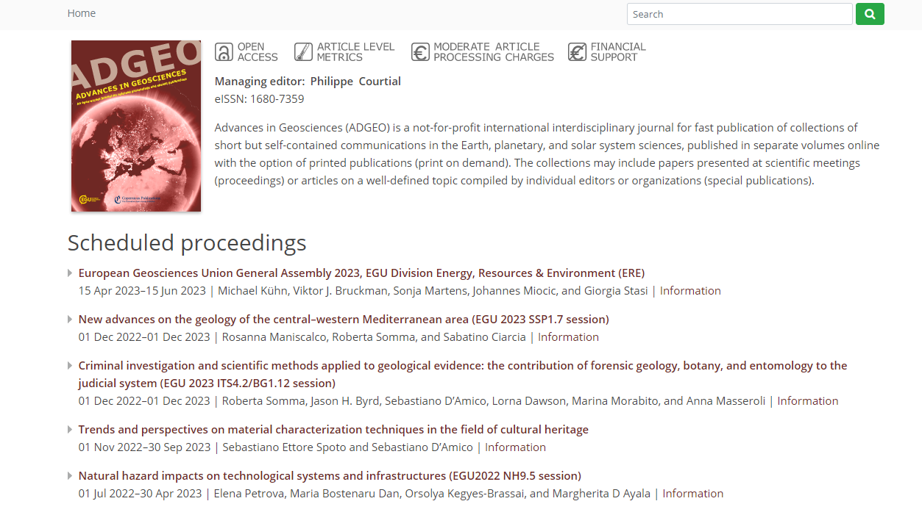
Special Issue
https://www.advances-in-geosciences.net/
SSP 1.7 / TS6.13 Reconstructing paleogeography and evolution of the Western Mediterranean area from Variscan to Present

Slide 7
Special Issue
https://www.advances-in-geosciences.net/
SSP 1.7 / TS6.13 Reconstructing paleogeography and evolution of the Western Mediterranean area from Variscan to Present

