Slide 1
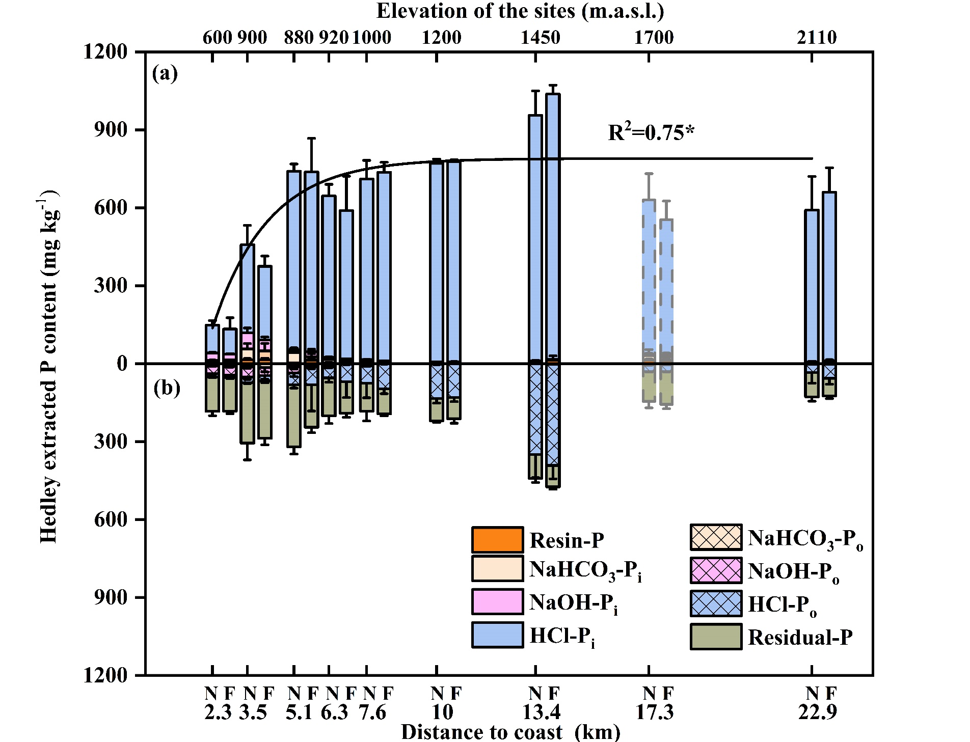
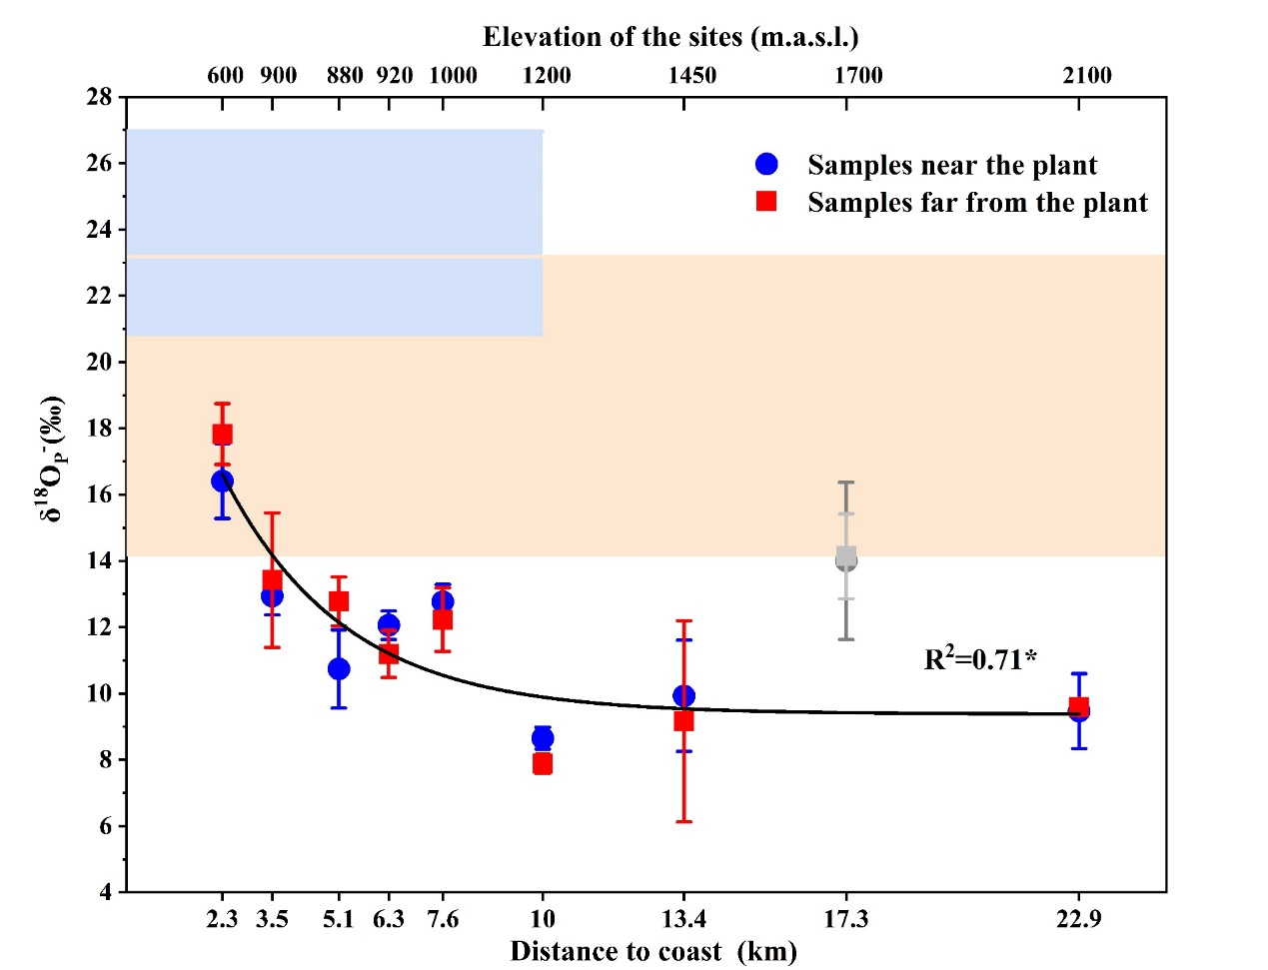
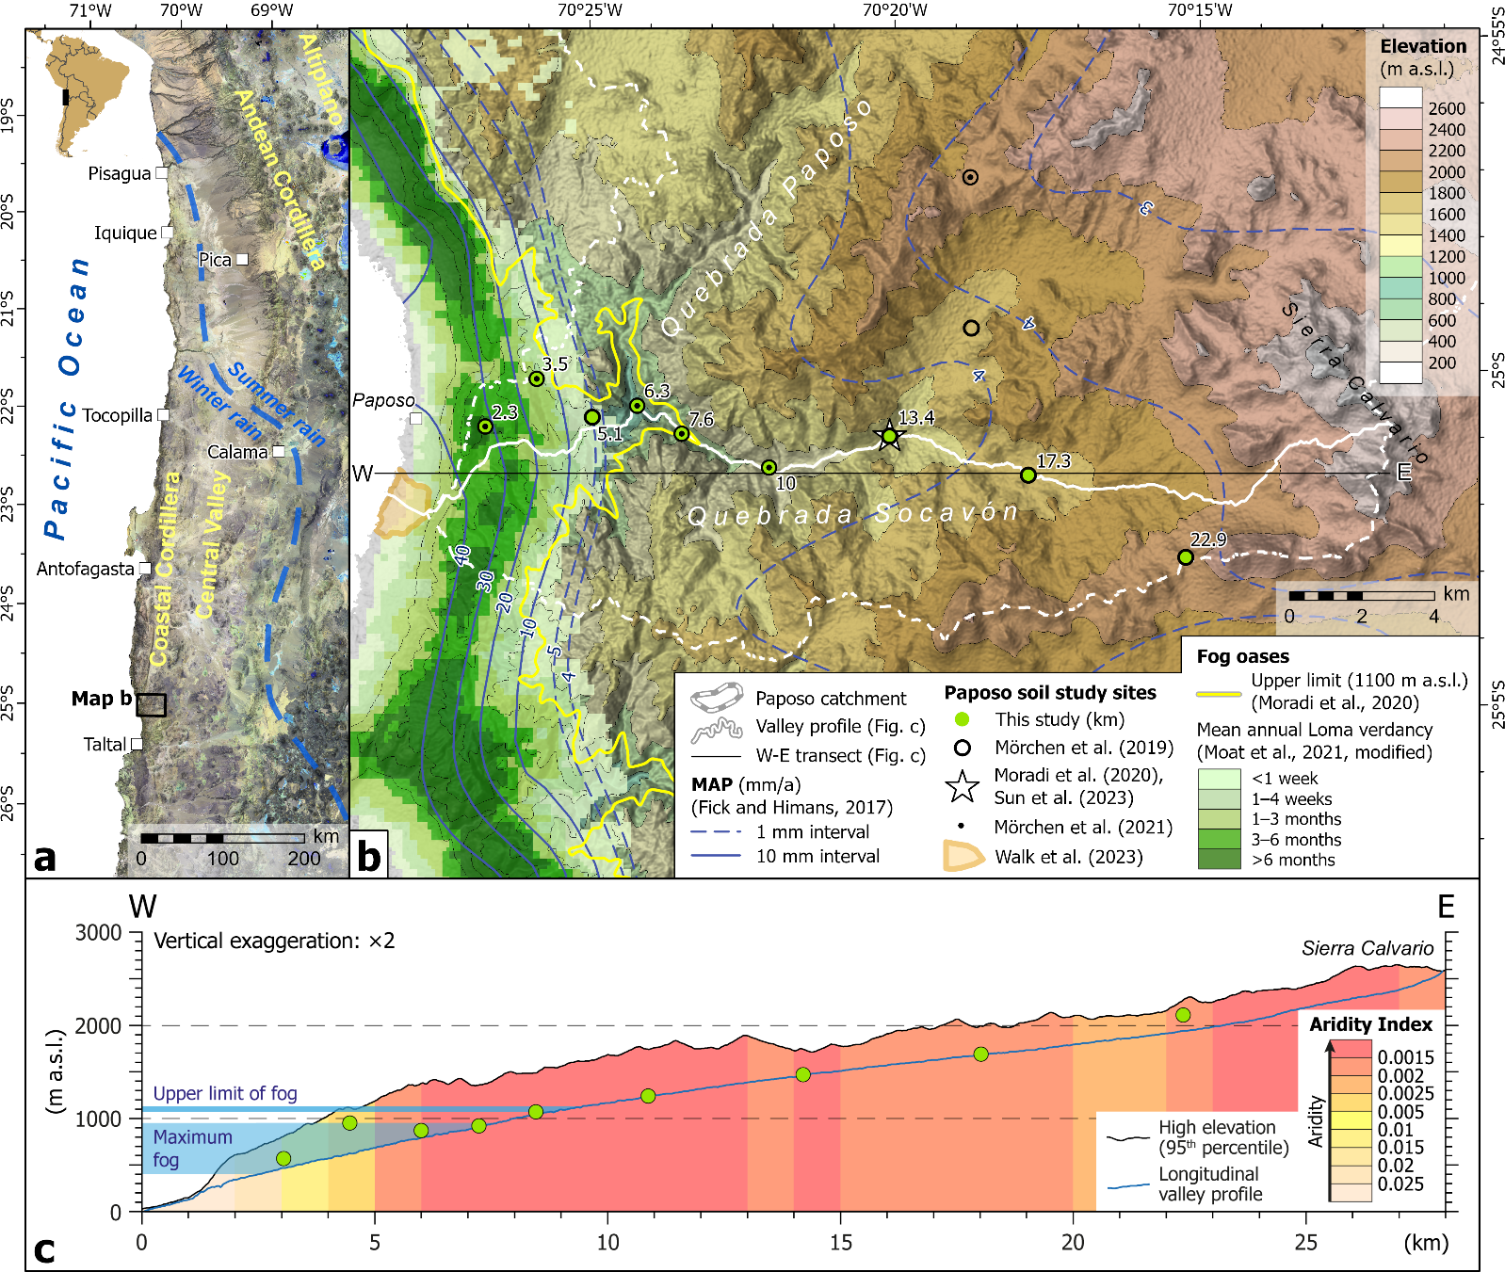
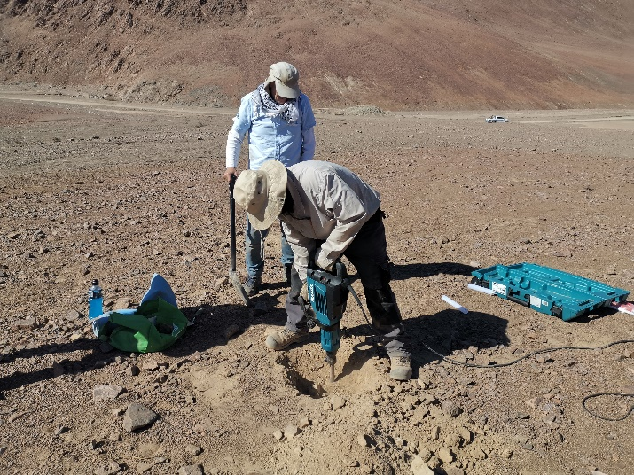
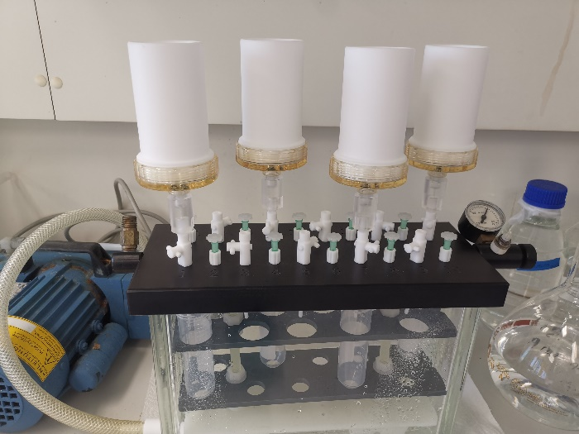
Phosphate pools and oxygen signature in the hyper-arid Atacama Desert
Xiaolei Sun¹,Wulf Amelong², Janek Walk³, Ramona Mörchen², Federica Tamburini⁴, Erwin Klumpp¹, Roland Bol^{1,5}
¹ Institute of Bio- and Geosciences, Agrosphere (IBG-3), Forschungszentrum Jülich, 52425, Jülich, Germany
² Institute of Crop Science and Resource Conservation (INRES)-Soil Science and Soil Ecology, Rheinische Friedrich-Wilhelms-University Bonn, 53115 Bonn, Germany
³ Department of Geography and Regional Research, University of Vienna, 1010 Vienna, Austria
⁴ Institute of Agricultural Sciences, ETH Zürich, Eschikon 33, 8315 Lindau, Switzerland
⁵ School of Natural Sciences, Environment Centre Wales, Bangor University, Bangor, United Kingdom.
Introduction
Results
Background
The Atacama Desert, one of the oldest and most arid deserts on Earth, usually serves as an analogue for Mars.
Transient episodes of increased water availability (infrequent inland fog and sporadic rainfall) leave long-lasting traces in the harsh conditions.
The distinct trend of chemical and microbiological soil properties usually serves as proxies to decipher the effect of climate on pedogenic processes
Hypotheses
The biogeochemical P transformation would (i) change along with the large-scale aridity gradient and (ii) locally be affected by the scarce presence of plants within the extreme water-limited environment.
Materials & Methods
Samples were taken from 9 elevations with 0-10 cm (Fig. 1);
6 samples per site: N1-N3 near the plant (0-10 cm), F1-F3 more >1 m away
Hedley sequential P fractionation was undertaken
The oxygen isotope values of HCl-extractable P_{i} (δ¹⁸O_{HCl}-_{Pi}) were tested ¹
The theoretical equilibrium range of δ¹⁸O_{P} was calculated²
Figure. 2 Concentration of different P pools extracted by sequential Hedley P fractionation method (mg kg⁻¹) plotted against the distance to the coast at Paposo. N and F represent the samples taken near the plant (0-10 cm) and far from the plant (>1 m), respectively. Error bars indicate the standard deviation of the mean (n = 3). The content in (a) represents the inorganic P pool (Pi) extracted following the Hedley fractionation and the black solid line in (a) is the mono-exponential regression line between HCl-extracted inorganic P content and the distance to the coast without the site 17.3 km.
Figure. 4 δ¹⁸O of HCl-extractable Pi (δ¹⁸O_{HCl-Pi}) values at the surface soils (0-10 cm) along the distance to coast in Paposo. The light orange area shows the equilibrium range of δ¹⁸O_{HCl-Pi} calculated based on the δ¹⁸O of rainfall (δ¹⁸O_{R}). The blue area represents the equilibrium range of δ¹⁸O_{HCl-Pi} calculated by the δ¹⁸O of fog (δ¹⁸O_{F}), which only applies to the sites affected by coastal fog (≤1100 m a.s.l). The black line is the mono-exponential regression line between δ¹⁸O_{HCl-Pi} and the distance to the coast without the site 17.3 km.
P_{t} elevated significantly with increasing distance to coast, mainly due to the lower depletion of primary mineral P
The δ¹⁸O_{HCl}-_{Pi} at the near-coastal site (2.3 km) within the equilibrium range of rainfall, indicating all Ca-P pool was biological.
The descending δ¹⁸O_{HCl}-_{Pi} with distance away from the coast could be described by a mono-exponential regression model.
Localised plants showed no significant effect on the soil surface δ¹⁸O_{HCl}-_{Pi}.
Figure. 1 (a) Satellite imagery overview map of the Atacama Desert in northern Chile (USGS Landsat-8 false-colour [SWIR-2/SWIR-1/NIR] composite of scenes from 23/12/2016 to 21/04/2017); highlighted is the dry diagonal (blue dashed line) after Houston (2006)³. (b) Relief, precipitation, and vegetation along the Paposo trnsect in the southern central Atacama Desert. (c) W-E profiles of the high topography and Aridity Index after Zomer et al. (2022)⁴ assessed along a 6 km wide swath profile (see central profile line in b) by calculating the 95th percentile of elevation and mean Aridity Index, respectively.
Conclusions
In site scale: localised plants had limited effect on P cycling
In landscape scale: soil surface P cycling induced by physicochemical weathering and microbial activity was controlled by water availability.
References & Acknowledgements
We would like to thank Christian Giese (University of Bonn) and Eva Lehndroff (Department Soil Ecology, University of Bayreuth) for support with the sampling, thank Ye Wang (University of Bonn) and Sara L. Bauke (University of Bonn) for support with Hedley sequential fractionation analysis and δ¹⁸O_{HCl-P} analysis.
(1) Tamburini, F., et al., 2010. A method for the analysis of the δ¹⁸O of inorganic phosphate extracted from soils with HCl. European Journal of Soil Science, 61, 1025‒1032. (2) Chang & Blake, 2015. Precise calibration of equilibrium oxygen isotope fractionations between dissolved phosphate and water from 3 to 37℃. Geochemica et Cosmochimica Acta, 150, 314‒329. (3) Houston, J., 2006. Variability of precipitation in the Atacama desert: Its causes and hydrological impact. International Journal of Climatology, 26, 2181‒2198. (4) Zomer, R.J., Xu, J., Trabucco, A., 2022. Version 3 of the Global Aridity Index and Potential Evapotranspiration Database. Scientific Data 9, 409.

