Slide 1
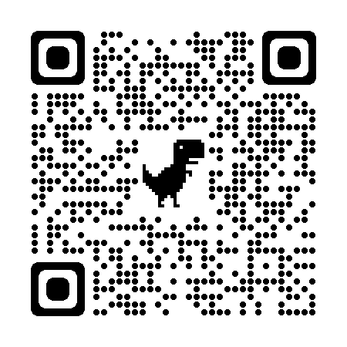
Smart sensors to detect movements of cobbles and large woody debris dams. Insights from lab experiments.
Alessandro Sgarabotto*, Irene Manzella, Alison Raby, Kyle Roskilly, Martina Egedusevic, Diego Panici, Miles Clark, Sarah Boulton, Aldina Franco, Georgie Bennett, Chunbo Luo
* alessandro.sgarabotto@plymouth.ac.uk

Slide 2
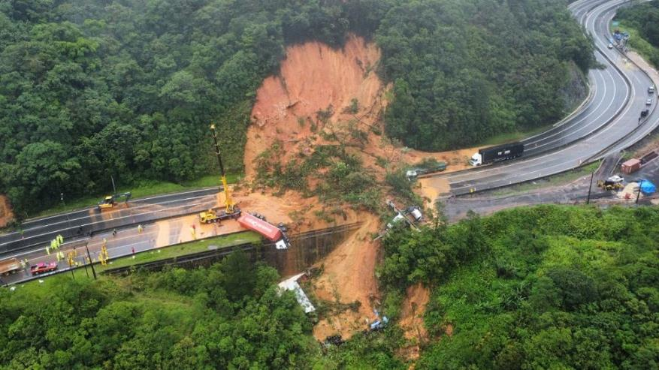
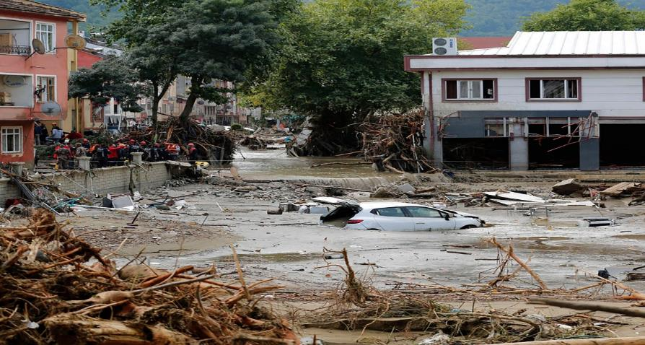
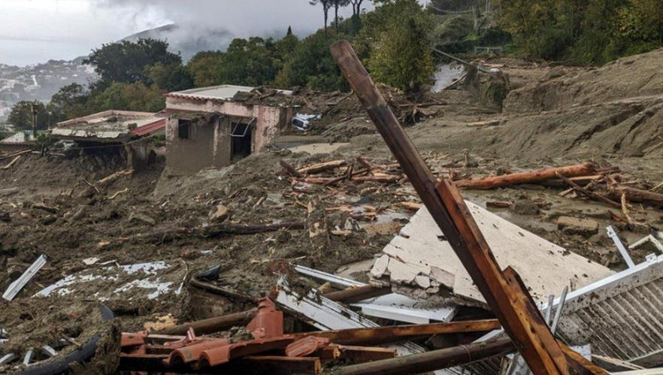
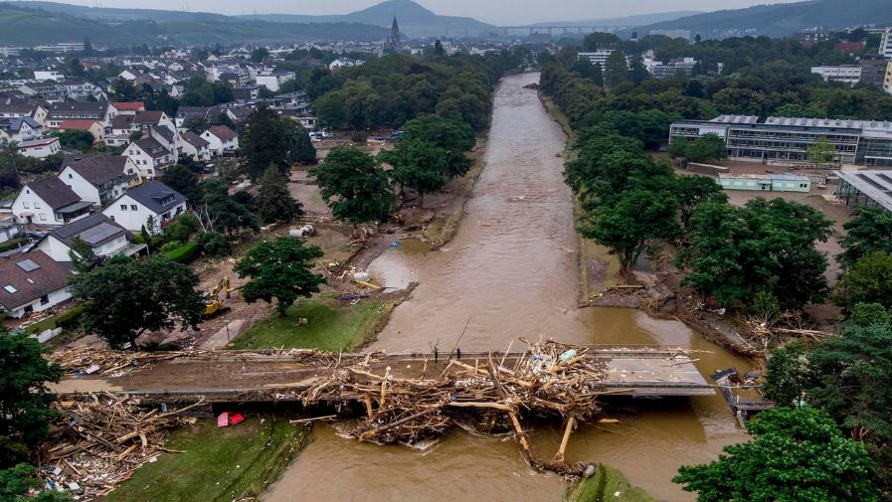
Motivation
Landslides hazard
Floods hazard
[Utah, 2018]
Guaratuba, Paraná state, Brazil – December 2022
Kastamonu, Turkey – August 2021
Ischia, Italy – November 2022
Bad Neuenahr-Ahrweiler, Germany, July 2021
Notes:
Under climate change, landslides and floods hazard has increased worldwide.
Population growth, urbanization and change in land use (deforestation) have made more people vulnerable to these hazards.

Slide 3
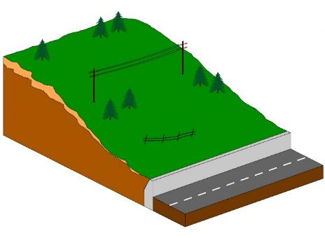
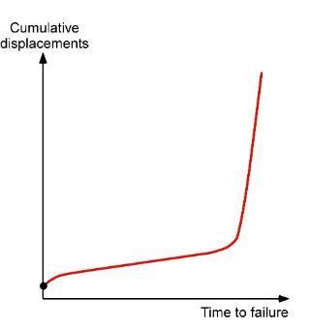
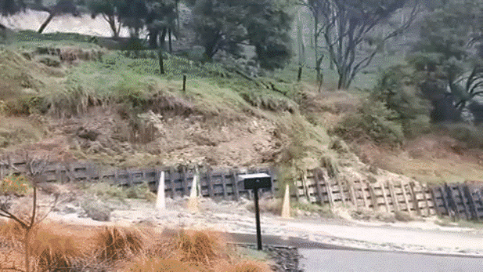
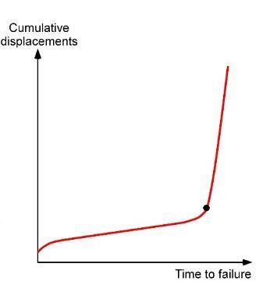
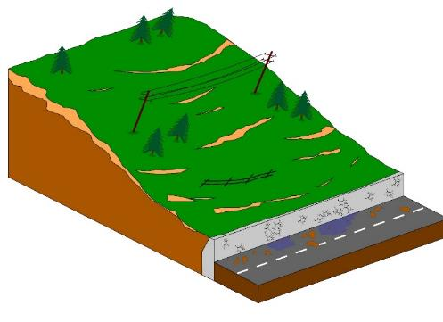
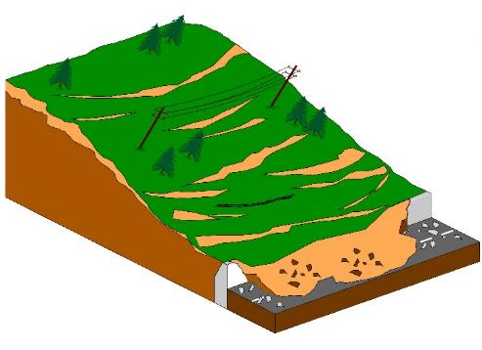
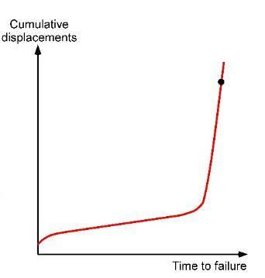
Slow-moving landslides
Marybank, Nelson, New Zealand
https://www.youtube.com/watch?v=p70sOgxfa_g
Notes:
Slow-moving landslides typically occur on high slopes composed of clay-dominated soil with a complex drainage network sensitive to seasonal rainfalls. These systems usually move to catastrophic failure by gradually increasing the displacements or alternating seasonal or yearly periods of stability and movements.
Ground-based measurement could be useful to monitor their activity and predict their failure

Slide 4
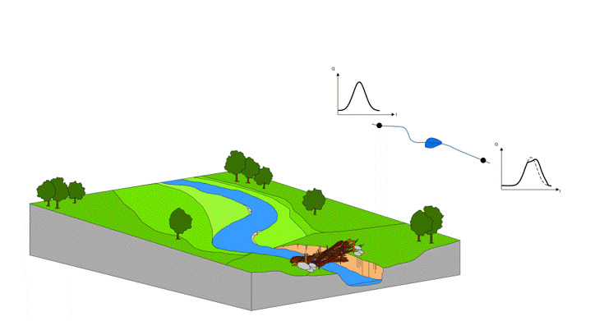
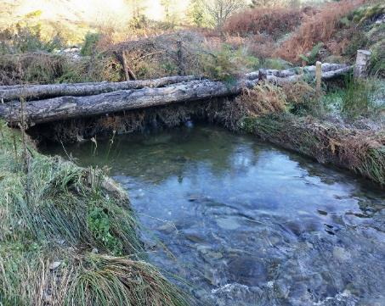
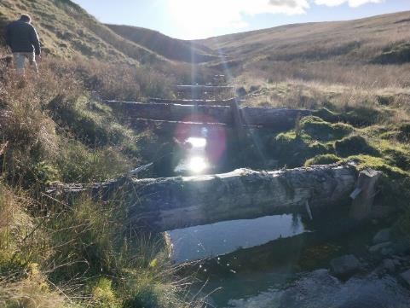
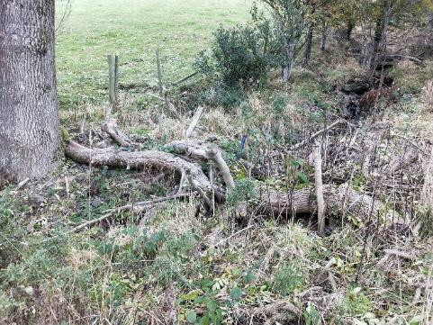
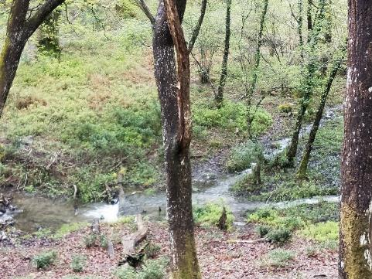
Large woody debris dams as nature-based solutions for flood mitigation
Large Woody Debris dams are built in small catchments as flood management interventions (e.g. Thomas & Nisbet, 2012; Hankin et al. 2020; Muhawenimana et al., 2021)
Whinlatter Forrest, UK
Tebay, UK
Sedbergh, UK
Yarner Woods, UK
Notes:
LWD dams have been reintroduced in small catchments as flood management interventions (Linstead & Gurnell, 1998; Thomas & Nisbet, 2012).
Leaky Woody Debris dams are built in small catchments as flood management interventions to aid in flood retention, improve habitat and biodiversity, and help improve water quality and reduce sediment transport [Thomas and Nisbet, 2012].
These structures are usually constrained at the river banks and possibly further stabilized by the use of cobbles laid at banks and vertical stakes dug into the river bed.
Depending on the size of the catchment, these structures show a wide range of care and rationale for their installation. Indeed, some large woody dams are highly engineered, others are based on random arrangements of wooden logs with minor human interventions.
LWD dams depend also on land owner.

Slide 5
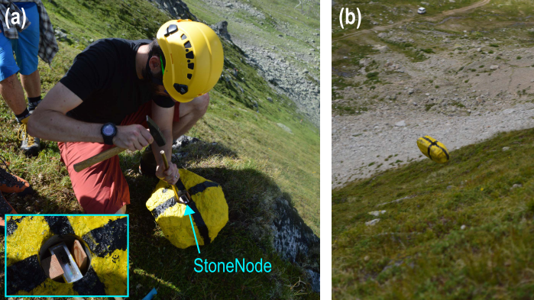
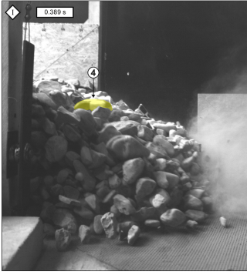
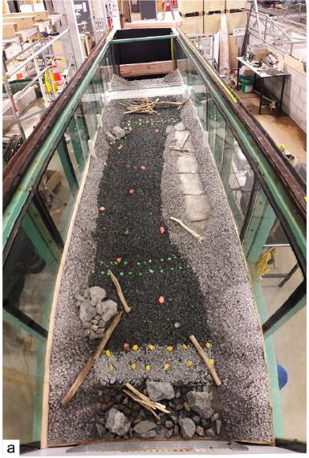
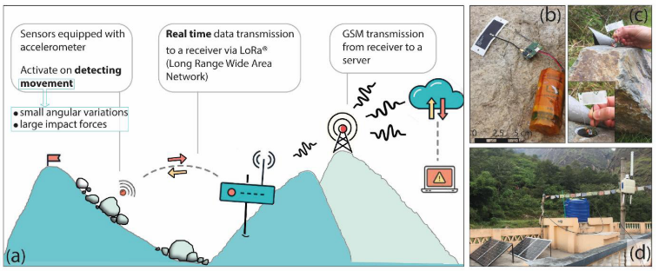
Applications of sensors to detect movements
IMU sensors to study rock falls and granular flows
IMU sensors to study woody logs incipient motion
Cavieziel et al., 2018
Dost et al., 2020
Smart sensors to detect movements of boulders and transmit data to the cloud
Dini et al., 2021
Spreitzer et al., 2019
Notes:
Recent advances in technologies, microelectronics and machine learning offer new opportunities to effectively monitor stability of boulder and woody debris on landslides and in flood-prone rivers. In this framework, smart sensors embedded in elements within the landslide body and the river catchment can be potentially used for monitoring purposes and for developing early warning systems.
Smart sensors are small, light-weight, and able to collect different environmental data with low battery consumption and communicate to a server through a wireless connection.
IMU sensors have been used in many geomorphology applications both in lab and field experiments.
Boulders have drawn attention to study hazards due to their role in these events [Miller et al. 2014, Bennett et al., 2016; Shobe et al. 2021].
Woody debris to investigate the condition when the movements starts
Their reliability still need to be evaluated for monitoring purposes and for the development of early warning systems.
Is it possible to use smart sensors to detect movement
Is it possible to develop an early warning system based on this technology
To answer these questions, we use experiments.

Slide 6
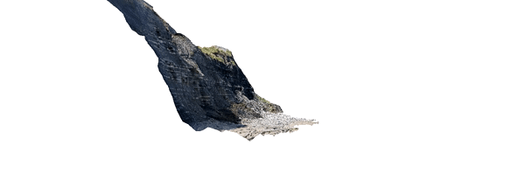
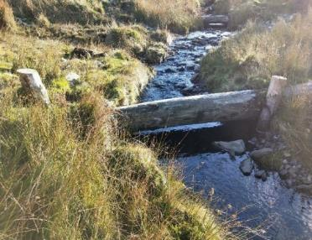
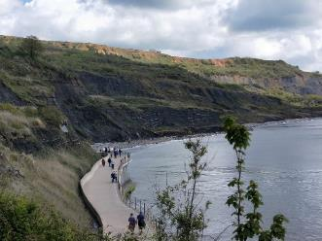
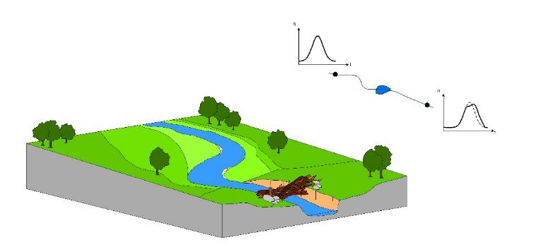
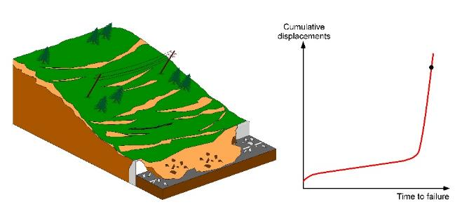
Smart sensors and their possible applications
Tebay (UK)
Lyme Regis (UK)
Is it possible to use IMU sensors to detect movements and grasp the magnitude of movements?
Is it possible to use IMU sensors to classify modes of movements?
Is possible to use IMU sensors for early warning systems?
Notes:
Boulders have drawn attention to study hazards due to their role in these events [Miller et al. 2014, Bennett et al., 2016; Shobe et al. 2021].
IMU sensors have been used in many geomorphology applications both in lab and field experiments.
Their reliability still need to be evaluated for monitoring purposes and for the development of early warning systems.
Questions still need to be addressed are:
Is it possible to use smart sensors to detect movement and grasp the magnitude of movement
Is it possible to use smart sensors to classify movements
Is it possible to develop an early warning system based on this technology
To answer these questions, we use experiments.

Slide 7
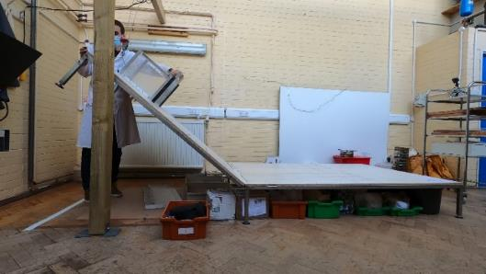
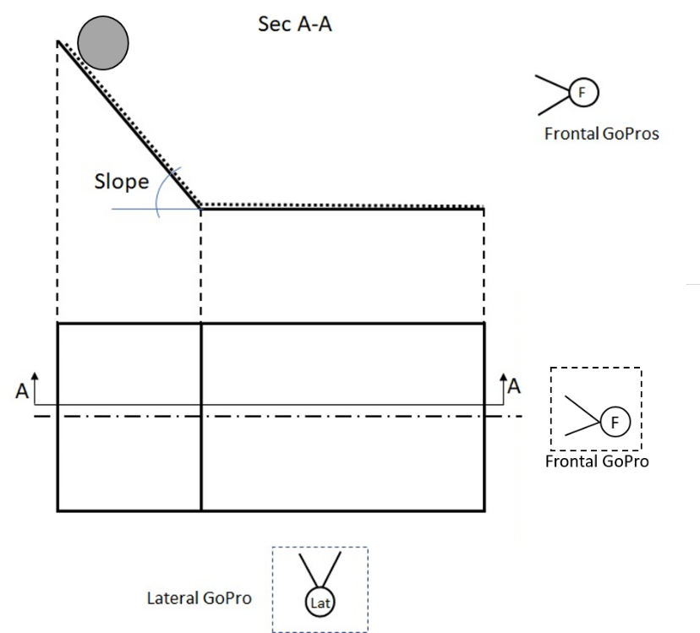
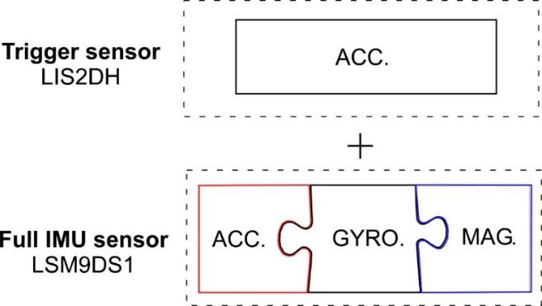
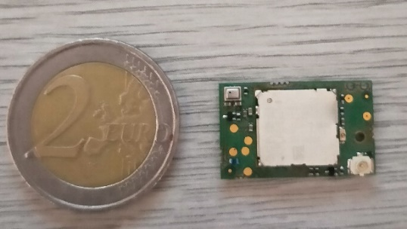
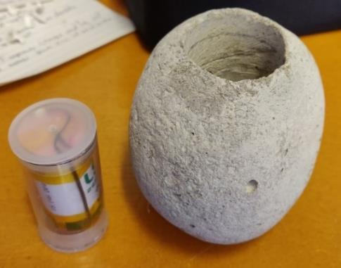
Factors changed:
Slope angles: 18˚, 25˚, 30˚, 35˚, 40˚, 45˚, 50˚, 55˚;
Modes of movement: rolling/boucing, sliding
Sensor tag = accelerometer, gyroscope and magnetometer
Kyle Roskilly, SENSUM team
5 cm
Miles Clark, SENSUM team
Notes:
To answer those questions, we use also simple lab experiments.
A tag equipped with an accelerometer, a gyroscope, and a magnetometer sensor has been installed inside a cobble of 10.0 cm diameter within a borehole of 4.0 cm diameter, closed hermetically before each experiment (a reference to Miles and to Kyle). The experiments consisted in letting the cobble fall on an experimental table composed of an inclined plane of 1.5 m, followed by a horizontal one of 2.0 m.
The plan was to investigate the sensor output for different slopes and modes of movement.
The inclined plane can be tilted at different angles (18˚- 55˚) and different types of movement have been generated by letting the cobble roll, bounce, or slide. Sliding was generated by embedding the cobble within a layer of sand. The position of the cobble travelling down the slope was derived from camera videos by a tracking algorithm developed within the study.

Slide 8
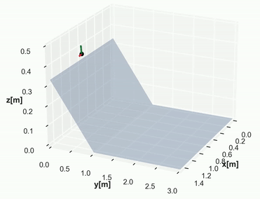
Combining sensors together
Camera + Accelerometer + Gyroscope + Magnetometer
Notes:
Raw datasets are useful to separate modes of movement but do not provide reasonable values of accelerations and do not give insight into velocity, orientation angles and positions. For this reason, multi-sensor data fusion approach has to be used. The plan is to combine inertia sensor outputs and measurements of positions together.
This filter aims at computing reliable values for positions, orientations angles, velocity and accelerations.
Using the filtered data is possible to compute the total energy referring to cobble motion travelling down the table. This metric is more reliable to discern the potential hazards related to each boulder embedded in the body of a landslide.

Slide 9
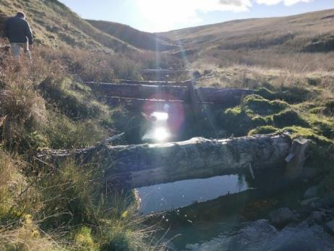
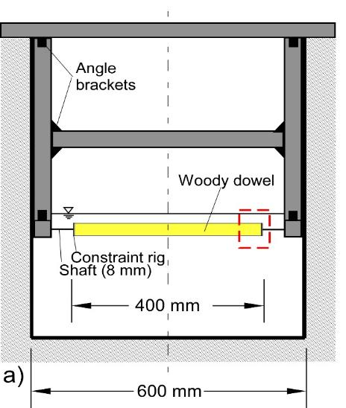
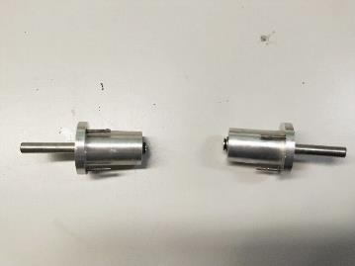
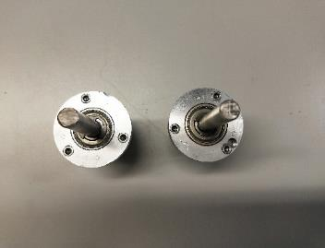
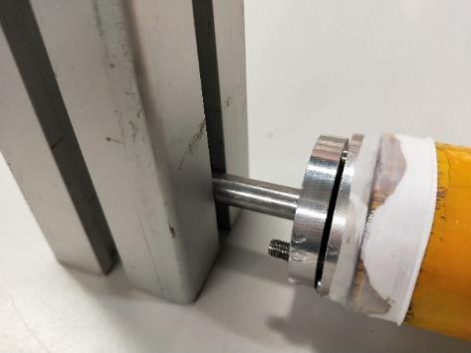
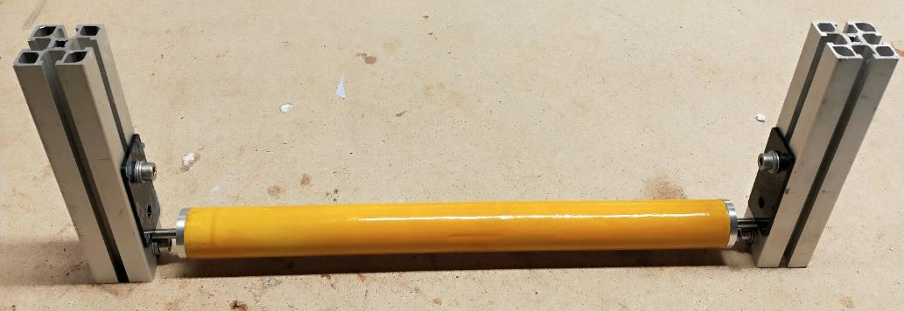
Flume experiments: From a LWD dam to a physical-analogue model
Factors changed:
Flow condition (partially and fully submerged)
Dam orientation (horizontal, slanted)
Constraint configuration (fixed, rotations allowed, horizontal displacements allowed or vertical displacements allowed)
The constraint configuration is changed by working on these two regions
PTFE tape
Thanks to UoP technicians
Shaft collar
David Keeler
Neil Fewings
Notes:
A tag equipped with an accelerometer, a gyroscope, and a magnetometer sensor has been installed inside a hollow woody dowel 400 mm long. The longitudinal borehole has a diameter of 25 mm and is closed hermetically before each experiment by two metal caps equipped with a shaft. The shaft and the metal caps allow to reproduce simple mode of movements, such as horizontal translation, vertical translation and simple rotation. The woody dowel is mounted on a supporting frame within the flume
The experiments consisted in collecting sensor recordings for different flow conditions, constraint setup and dam inclination
The experiments were carried out in the COAST lab at the University of Plymouth

Slide 10
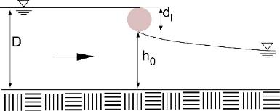
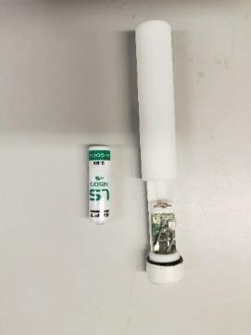
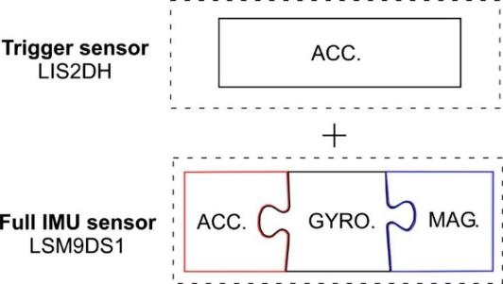
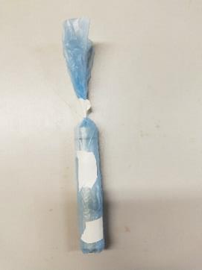
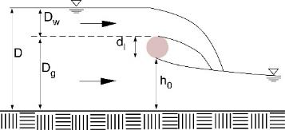
Sensor tag within the woody dowel records any small movements
Partially-submerged flow condition
upstream
The sensor tag records movements and stores the data;
The data is downloaded by USB cable (no gateway is used for these experiments) ;
Each test is repeated 10 times;
Sensor tag
Downstream
Sensor tag = accelerometer, gyroscope and magnetometer
Partially-submerged flow condition
D [m] | Q [m³/s] | Fr [-]
0.232 | 0.387 | 0.369
Fully-submerged flow condition
D [m] | Q [m³/s] | Fr [-]
0.232 | 0.387 | 0.369
Notes:
The sensor tag records movements and stores the data;
The data is downloaded by USB cable (no gateway is used for these experiments) ;
Each test is repeated 10 times;

Slide 11
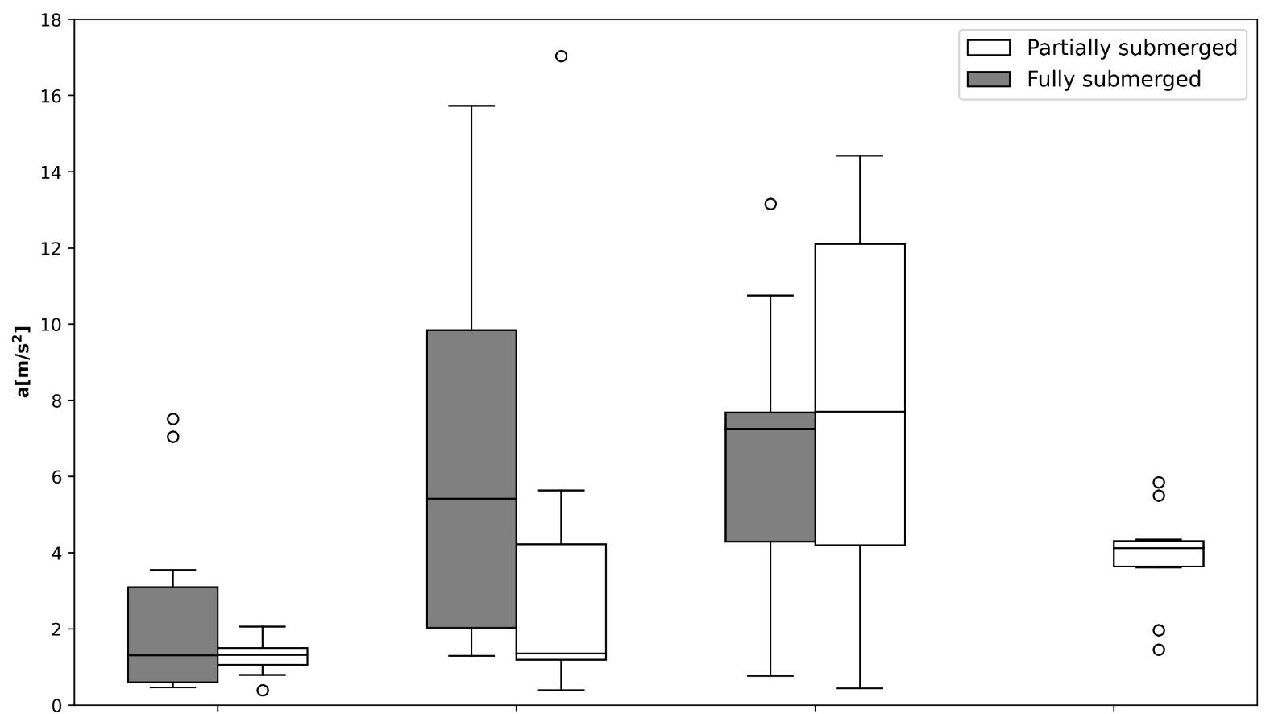
Accelerometer detects changes in constraints setups
Labels legend:
Fixed. No movement is allowed.
Rotational. Only rotations are allowed.
Vertical. Only vertical displacements are allowed.
Horizontal. Only horizontal displacements are allowed.
Fixed
(no movement allowed)
Rotations allowed
Horizontal displacements
allowed
Vertical displacements
allowed
Notes:
- Among constraints configurations, the fixed case has the smallest linear acceleration that in not zero because of the supporting frame vibration
- Beside horizontal displacement, the fully-submerged condition (= larger depth and discharge) makes the linear acceleration sample larger.

Slide 12
Conclusions
Physical experiments were carried out to test the feasibility of smart sensors to detect movements of a cobble travelling down a slope
- Combining sensors together improves the data reliability for monitoring purposes
Physical experiments were carried out to test the feasibility of smart sensors to detect movements of LWD dams for different flow conditions and dam orientation
Sensors are able to detect to changes in constraint setups and flow conditions.
Smart sensors have the potential to characterise the activity of boulders and woody logs.

