Slide 1
FireRisk: A Web Platform for next day fire forecasting
Stella Girtsou, PhD Candidate
Alex Apostolakis, Giorgos Giannopoulos, Harris Kontoes
EGU23 Vienna, Austria 27/04/2023
*Co-funded by Greece and the European Union

Slide 2
Problem definition and background

Slide 3
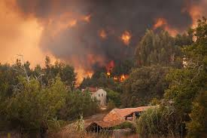
Fire disasters examples
2019 : 1.65 million hectares burned in New South Wales of Australia and 83% increase in 2019.
Brazilian Space Agency has reported an 83% increase in fire occurrences compared to the same period of the previous year.
2018 Attica wildfires spread up to a speed of 124 km/h resulting to more than a hundred casualties.
2021 Greece wildfires burned>10⁶ hectares
Climate change provoke more and more droughts and heat waves and as a result more frequent and strong fires
Problem overview
Need
Systems that provide valuable information to the civil protection services for prevention and preparness, like fire incidents online alerting and monitoring, fire risk prediction and and spread prediction
Complexity
Forest fire occurrence and behaviour are the product of several interrelated factors, including ignition source, fuel composition, weather, and topography. The mathematic relations of those factors are not known, thus it is not easy to model the behaviour using physics based/theoretical models.
Concept
Data-driven models are good in discovering unknown relations between data. Exploit historical data from fire events and fire related parameters to train machine learning algorithms for predictive modeling.

Slide 4
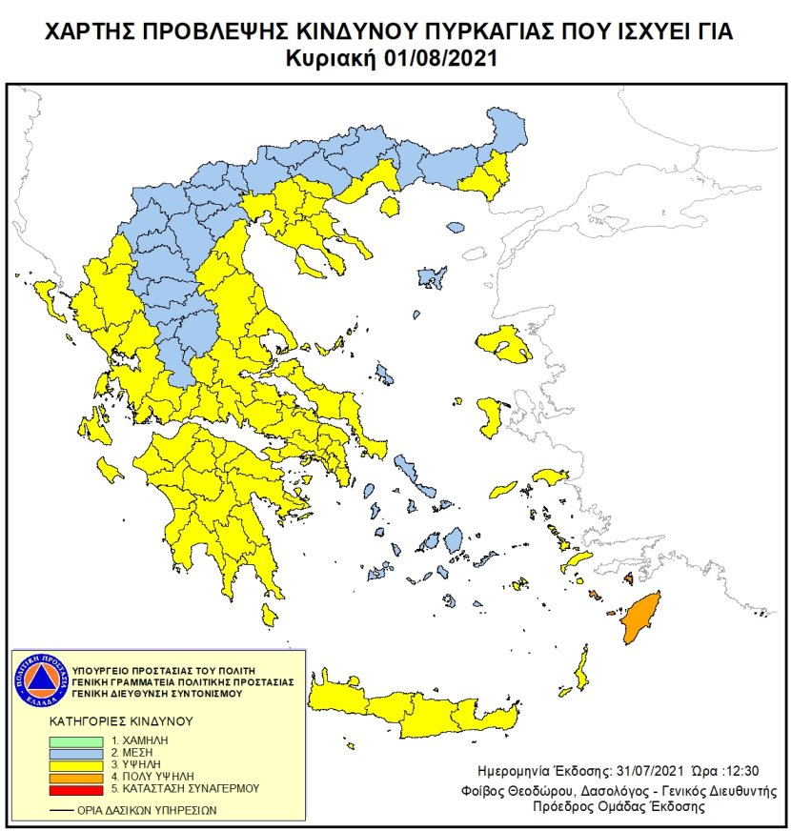
Motivation
Essential tool for daily operational organization of fire services
Current service of Civil Protection

Slide 5
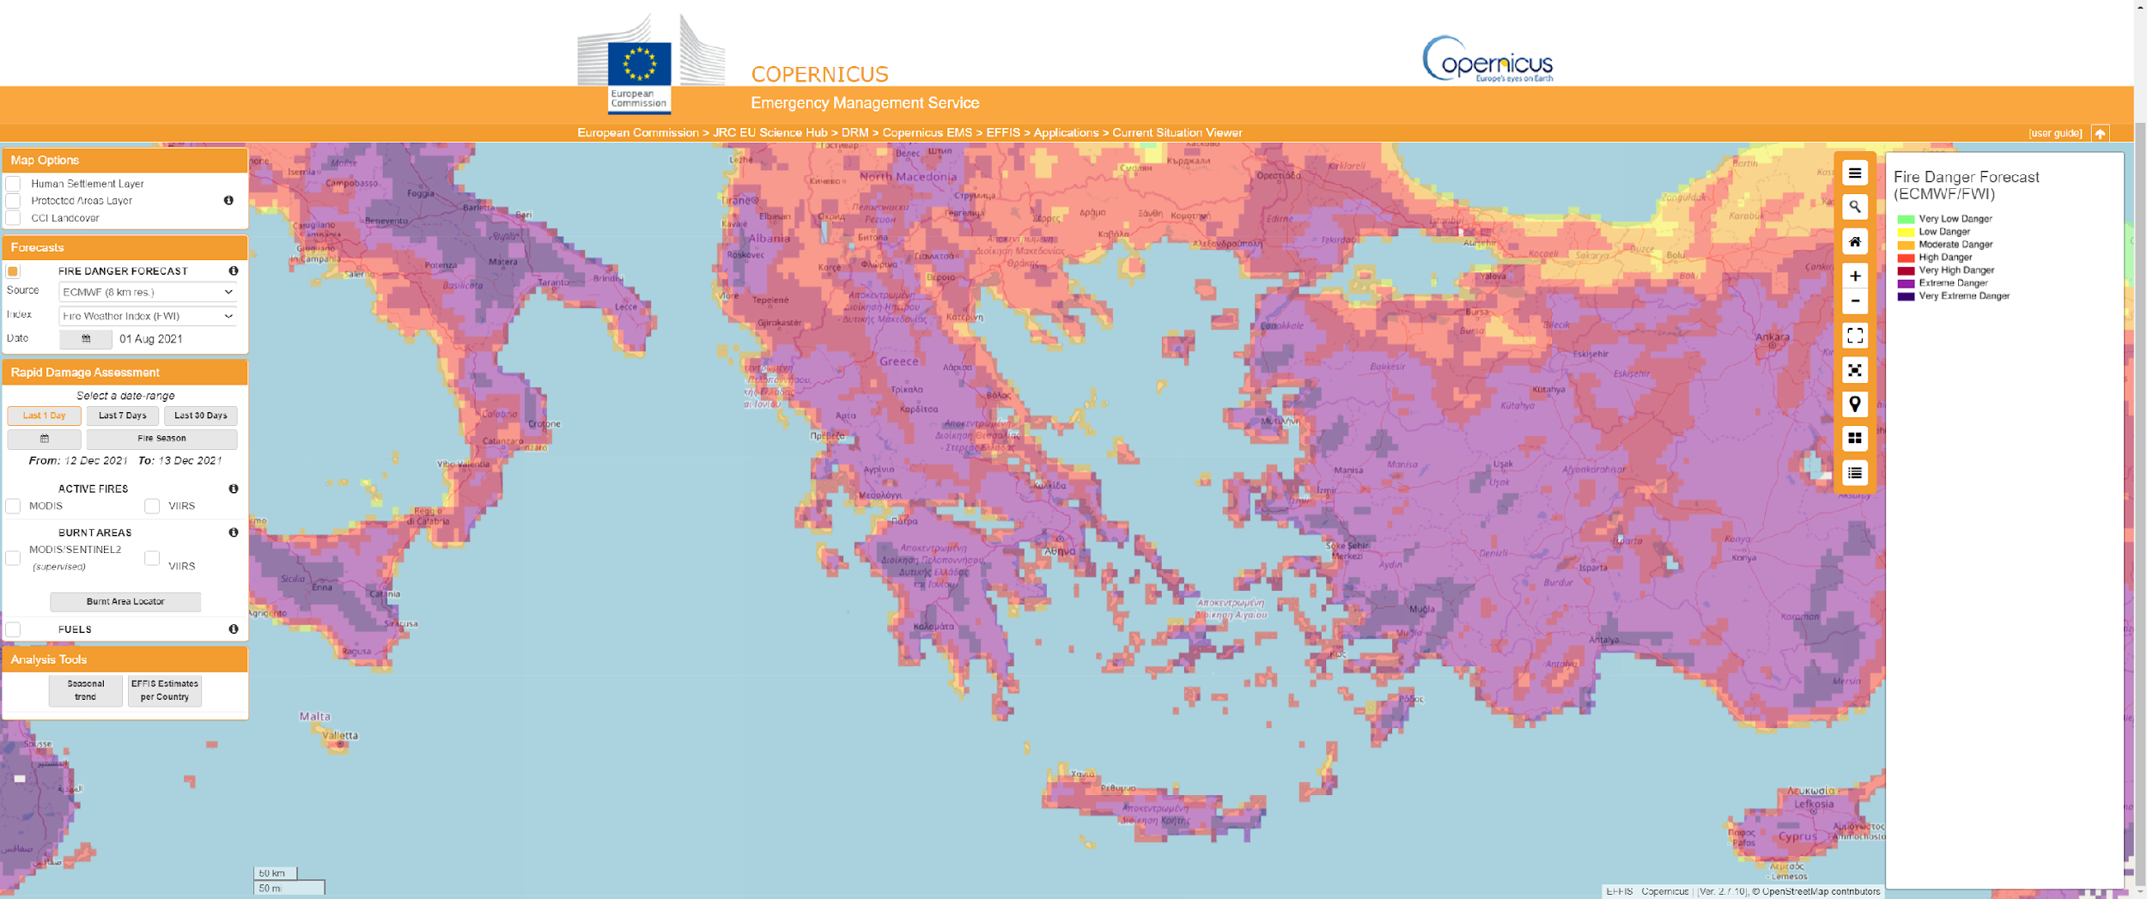
Motivation
Essential tool for daily operational organization of fire services
Current service of Copernicus EFFIS

Slide 6
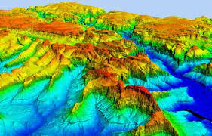
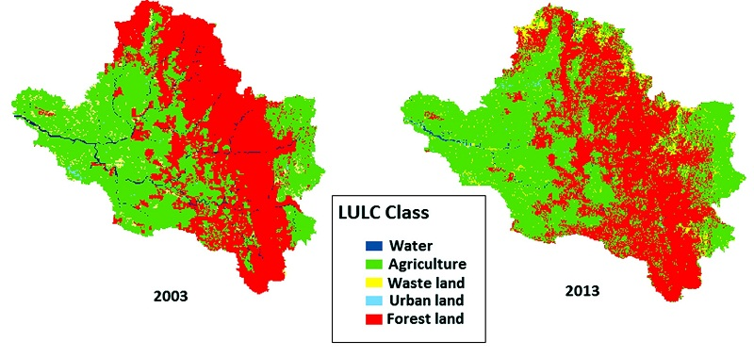
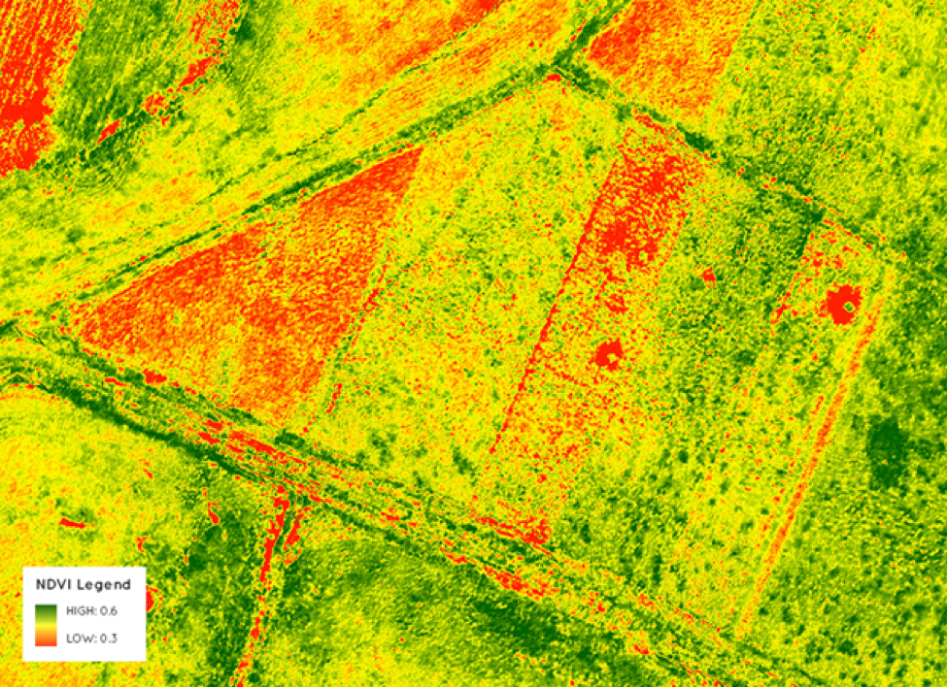
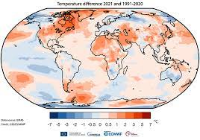
The Fire Drivers usually adopted in literature that form the input features for the modeling
Static or slow change
Dynamic
Ground Morphology: Elevation, Slope, Curvuture
Land Use - Land Cover
Satellite :
Vegetation indices
Surface temperature
Soil moisture
Location Related: Distance from roads, urban environment, power grids, machinery, rivers
Climate: statistics of weather parameters
Meteorology / Weather forecast: Temperature, Wind, Precipitation, Humidity

Slide 7
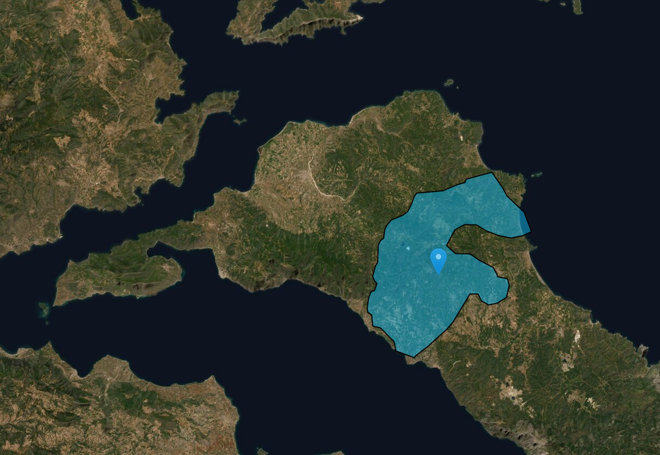
Target variable - Fire / No Fire classes
Use of burn scar maps to annotate fire class on a specific area at a specific time frame
Fire Class (1)
Problem is solved as supervised classification.
For each day all cells which suffered a fire event are assigned the "fire" class whereas all other cells belong to the "no fire" class. Right? Not exactly!
No Fire Class (0)
Each parameter input vector is assigned to a cell grid for a specific date
Burn scar polygon

Slide 8
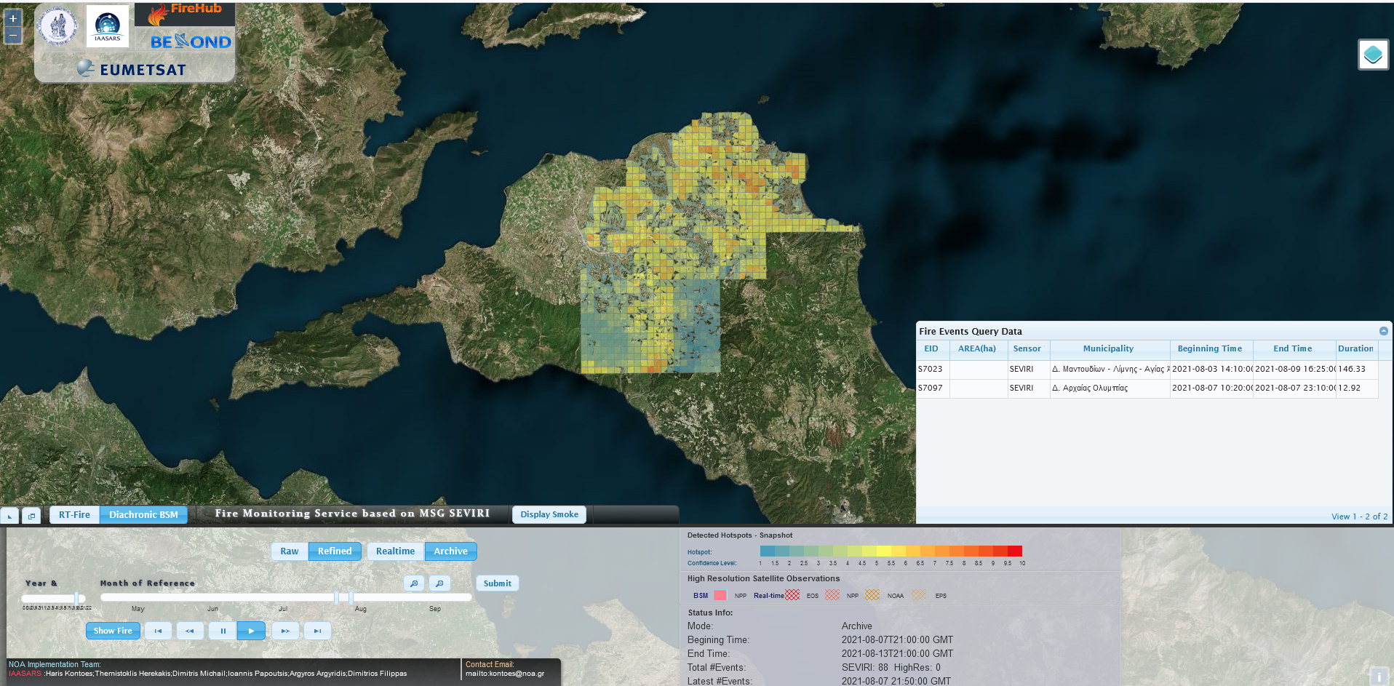
Problem definition - Next day Fire risk prediction
Predict the risk of fire occurrence in an area for a day k, exploiting information for the area exclusively gathered up until day k-1
Essentially handled as binary {fire, no-fire} classification problem, due to label availability (historical fires)
Ideally, a reliable confidence (probability of risk) level should be output
Each area corresponds to a 500m cell of a grid (fireHub grid)
Grid covers the whole Greek territory
Detailed historical data from 2010-2020
> 800M instances

Slide 9
Problem complications and usual pitfalls
Data Leakage may occur creating the train and validation datasets.
Alexis Apostolakis, Stella Girtsou, Charalampos Kontoes, Ioannis Papoutsis, and Michalis Tsoutsos. “Implementation of a Random Forest Classifier to Examine Wildfire Predictive Modelling in Greece Using Diachronically Collected Fire Occurrence and Fire Mapping, 2021
Annotating absence of fire as “no fire” class does not mean zero probability for fire. “No-fire” class is essentially a pseudo-absence.
Bar Massada, Avi; Syphard, Alexandra D.; Stewart, Susan I.; Radeloff, Volker C. 2012 Wildfire ignition-distribution modelling: a comparative study in the Huron-Manistee National Forest, Michigan, USA. International Journal of Wildland Fire.
Huge imbalance between classes “fire” and “no fire”
Girtsou, Stella, Alexis Apostolakis, Giorgos Giannopoulos, and Charalampos Kontoes. “A Machine Learning Methodology for Next Day Wildfire Prediction.” In IGARSS 2021 .
Which metric to optimize?
Alexis Apostolakis, Stella Girtsou, Giorgos Giannopoulos, Nikolaos S. Bartsotas, and Charalampos Kontoes. “Estimating Next Day’s Forest Fire Risk via a Complete Machine Learning Methodology, 2022

Slide 10
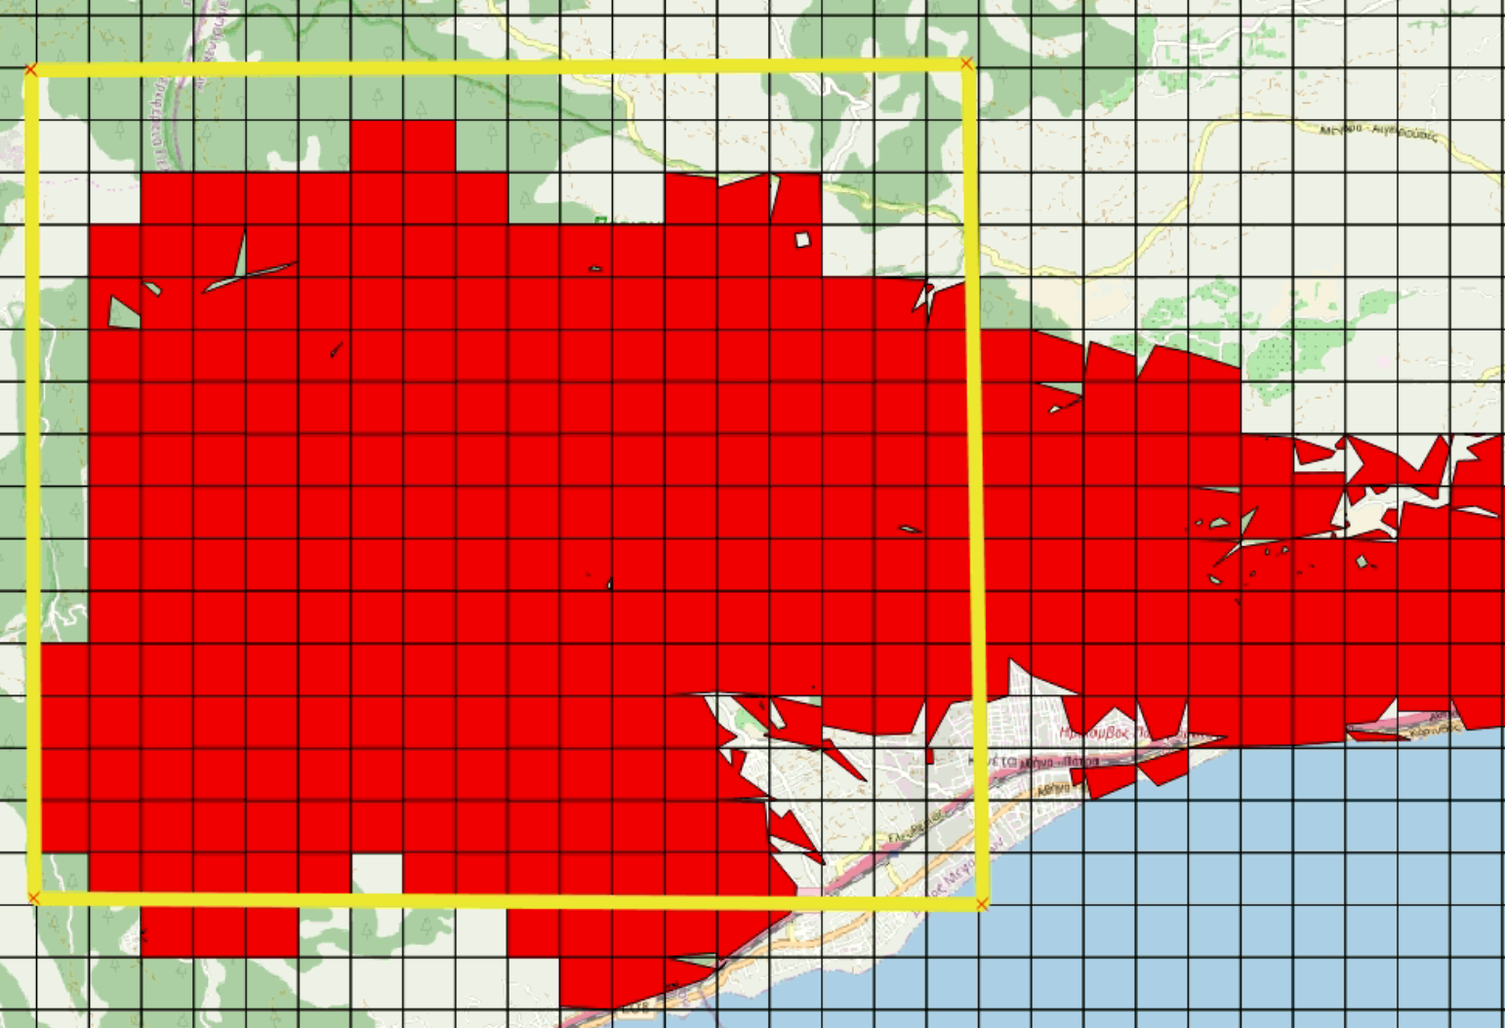
Problem complications and usual pitfalls
Classifier may become "too successful" when shuffling instances to produce train-validation sets
Training Set
When shuffling, cells from the same fire event with almost same feature vectors may participate both in training and validation set, causing data leakage
Validation Set
ERA5Land cell
Grid 500x500m
Fire cells

Slide 11
Problem complications and usual pitfalls
Non-fire cells may have a very similar feature vector with fire cell
Fire Cell
No fire Cell
ERA5Land cell
Grid 500x500m
Fire cells

Slide 12
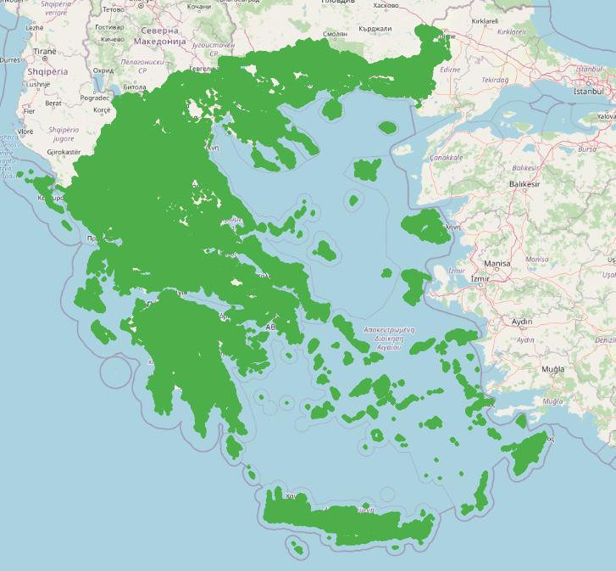
Problem complications and usual pitfalls
Big data and huge class imbalance
Real world Dataset comprise of ~270000 feature vectors (grid cells) per day. Each vector has 90 parameters (including one-hot). Only 1/100000 is a fire cell
…..........
11-7-2022
12-7-2022
13-7-2022
14-7-2022
15-7-2022
…..............

Slide 13
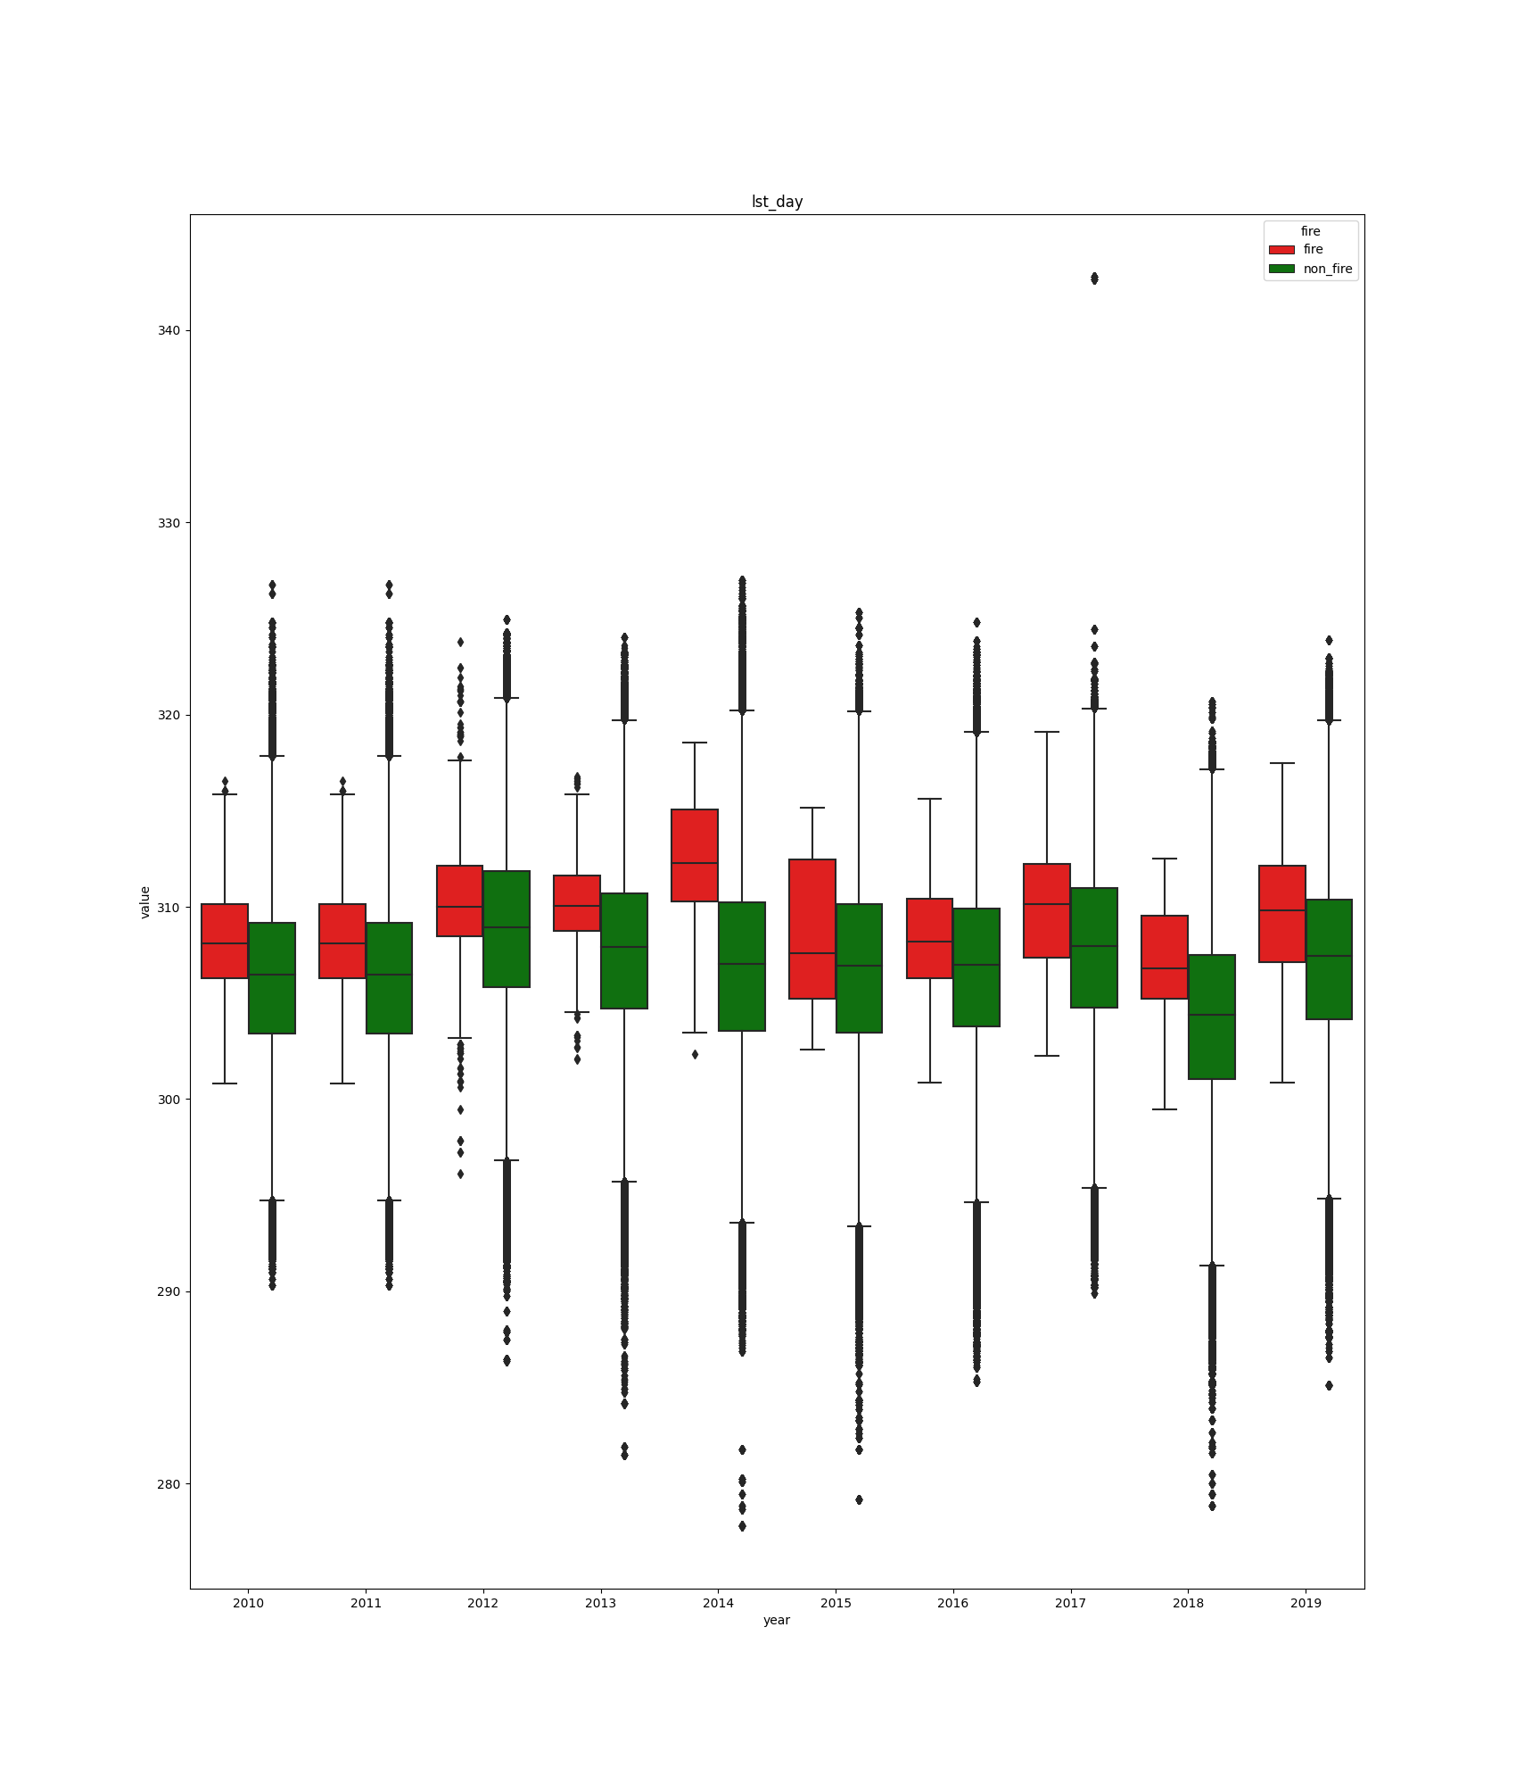
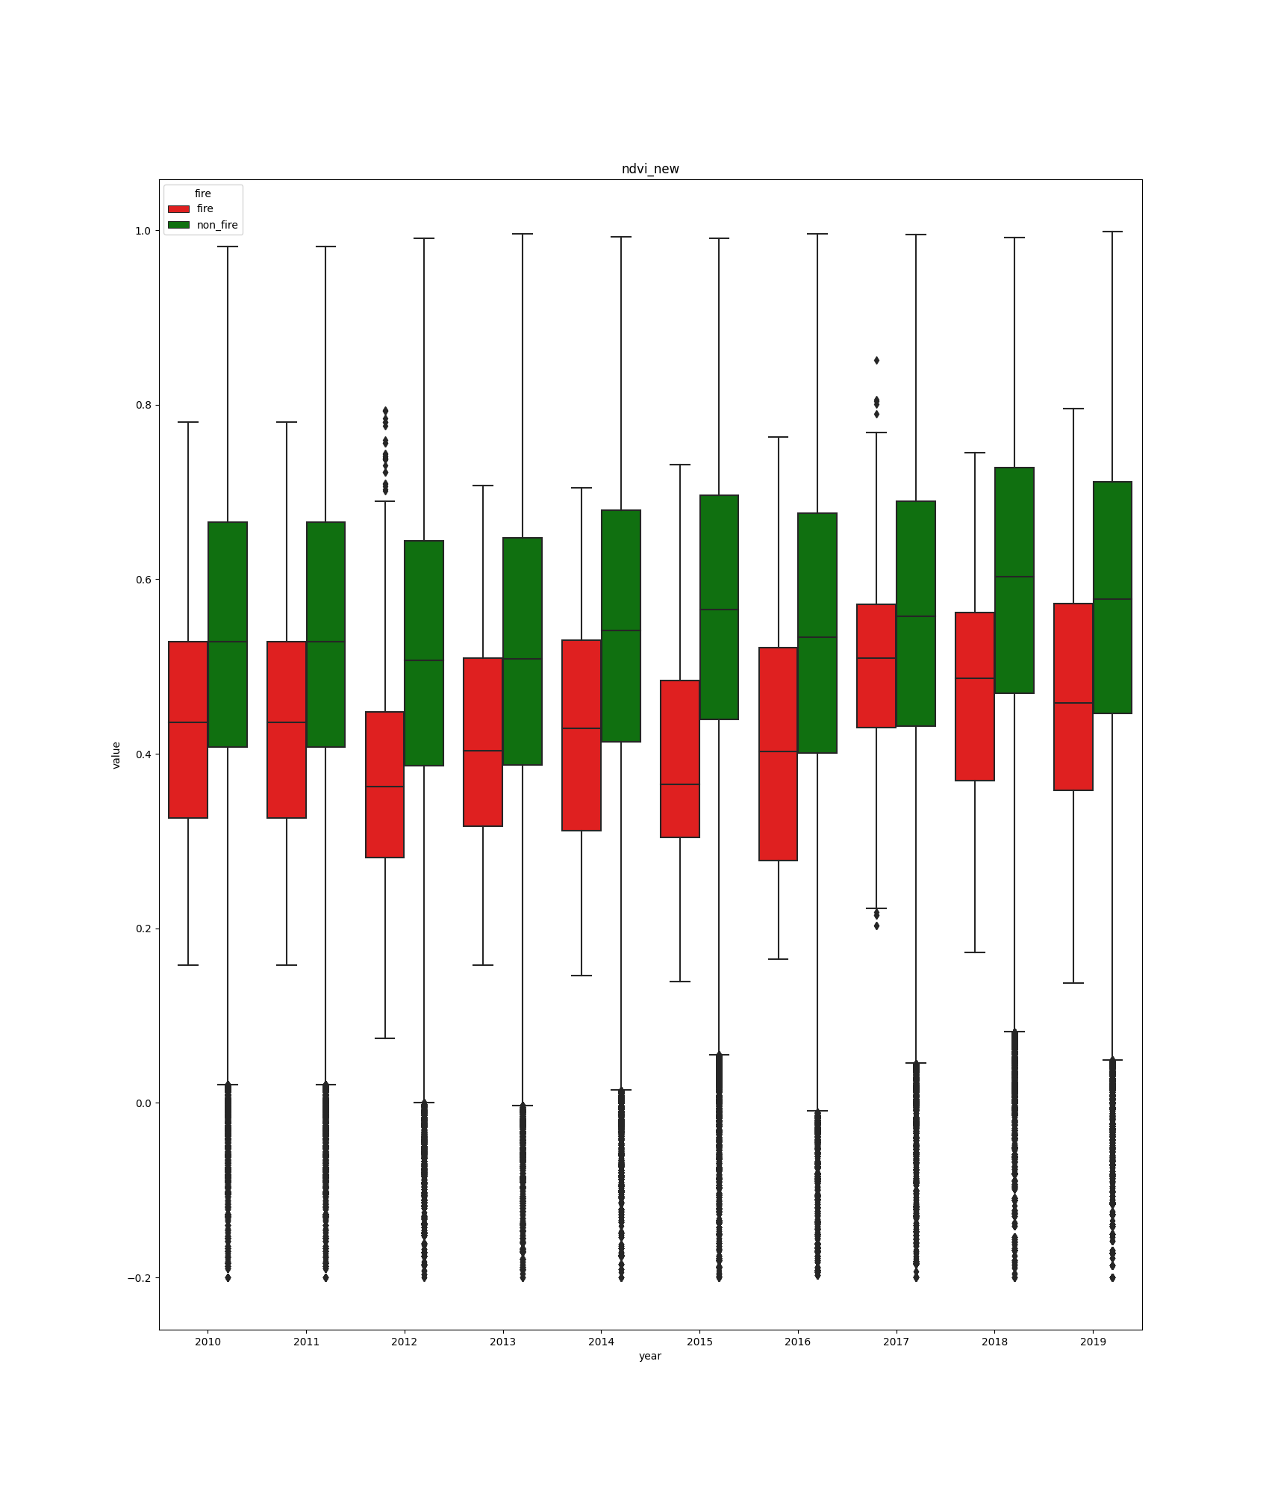
Problem complications and usual pitfalls
Concept drift

Slide 14
Problem complications and usual pitfalls
Extreme data imbalance
Ratio of ~1:100K between fire/no-fire cells
Large data scale
Challenging to properly perform model selection
Absence of fire phenomenon
Areas that should have a fire occurrence but did not by chance
🡪 Chance = lack of impossible to capture features
(i.e. a person’s decision to start a fire, a cigarette thrown by a driver, a lightning)
Spatio-temporal correlations
Adjacent cells are expected to be nearly-identical
Previous years’ incidents might affect the short-term behavior of an area
Optimization metric
Which is the ideal metric to optimize? A high recall/sensitivity does not mean anything if it is combined with a low specificity on a "real world" dataset
Problematic even for imbalance handling methods

Slide 15
Problem complications and usual pitfalls
Related works – General observations
Unfit model selection/assessment 🡪 poor generalizability
Balanced train/validation/test setting
Usually poor/non-existent hyperparameter search
Related works – Deep learning
Convolutional NNs label every "patch" as fire or no-fire oversampling fire class and lowering the prediction resolution arbitrary (according the patch size)
patch
Works that employ simple Deep NNs instead of applying an extensive hyperparameterization methodology to determine the network's architecture, they define the depth of the network a priori.

Slide 16
Motivation
What comprises a meaningful/useful result?
Predict most of the fires
Try not to predict for the majority of the territory (country) high risk for fire
Translation: a good balance between sensitivity/specificity*
Ideal: {>95%, >90%}
Realistic:
{>90%, >70%}
{>80%, >80%}
Depends on the exact application setting/needs
🡪 could reach the ideal if reformulate the problem 🡪 mid-term work
TN >> FP
TN+FP ≈ TN
N >> P
N+P ≈ N
TP
*Sensitivity = ——
(P=TP+FN) P
Fires predicted corrrectly
———————
Actual fire
TN
*Specificity = ——
(N=TN+FP) N
Area of Low Risk
——————————
Area of whole territory

Slide 17
ML Method and Results

Slide 18
Establishment of a complete ML workflow
Formalize the problem as binary classification
Utilize model’s prediction confidence for quantifying risk probability
Extract an extended set of features
Meteorological, topographical, vegetation, earth observation, and historical characteristics of the areas
Utilize state of the art classification algorithms
Random Forest, XGBoost, ExtraTrees, Neural Networks
Explore large hyperparameter spaces of the algorithms

Slide 19
Establishment of a complete ML workflow
Perform appropriate cross-validation
Proper train-validation-test splits
Ensure
Avoiding data leakage
Assessing the methods on the real-world dataset distribution
Agility in adjusting sensitivity/specificity trade-off
Generalizability
Select/define appropriate measures for model selection and evaluation
In our extremely imbalance setting, distinguishing between model selection and evaluation is important

Slide 20
1. Feature extraction
Category | Features | Spatial Res. | Temp.Res. | Source
DEM | Dem, slope, curvature | 25 m | - | Copernicus DEM
Land cover | corine | 100 m | 3 years | Corine Land Cover
Temperature | max, min, mean | 9 km | hourly | ERA5 land
Dewpoint | max, min mean | 9 km | hourly | ERA5 land
Wind speed | dom_vel | 9 km | hourly | ERA5 land
Wind direction | dir_max, dom_dir | 9 km | hourly | ERA5 land
Precipitation | rain_7days | 9 km | hourly | ERA5 land
Vegetation | ndvi, evi | 500 m | 8 days | NASA MODIS
LST | lst_day, lst_night | 1 km | 8 days | NASA MODIS
Fire history | Frequency, f81 (smoothed) | 500 m | daily | FireHub BSM
Coordinates | xpos, ypos | 500 m | daily | FireHub cell grid
Calendar Cycles | month, wkd | 500 m | daily | Fire Inventory date field

Slide 21
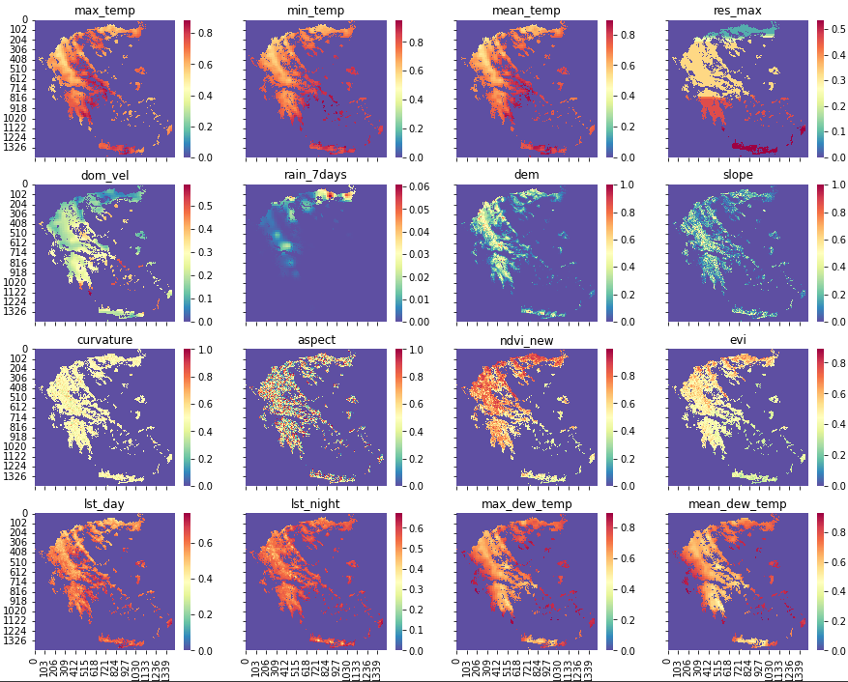
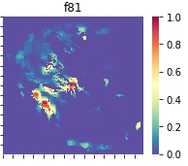
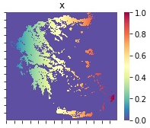
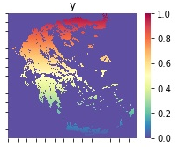
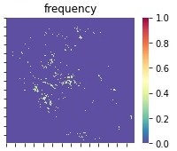

Slide 22
2. Classification algorithms
Neural Networks
Up to 5 layers depth
Up to 2000 nodes per layer
With/out dropout
Adam optimizer
Tree Ensembles
Random Forest
XGBoost
ExtraTrees
Deep Learning
Siamese (Metric Learning)
U-Net (Segmentation)

Slide 23
2. Classification algorithms
space_FCNN = {’n_internal_layers’: hp.choice(’n_internal_layers’,
[
(0, {’layer_1_0_nodes’: hp.quniform(’layer_1_0_w_nodes’, 100, 2100, 100)}),
(1, {’layer_1_1_nodes’: hp.quniform(’layer_1_1_w_nodes’, 100, 2100, 100),
’layer_2_1_nodes’: hp.quniform(’layer_2_1_w_nodes’, 100, 2100, 100)}),
(2, {’layer_1_2_nodes’: hp.quniform(’layer_1_2_w_nodes’, 100, 2100, 100),
’layer_2_2_nodes’: hp.quniform(’layer_2_2_w_nodes’, 100, 2100, 100),
’layer_3_2_nodes’: hp.quniform(’layer_3_2_w_nodes’, 100, 2100, 100)}),
(3, {’layer_1_3_nodes’: hp.quniform(’layer_1_3_w_nodes’, 100, 2100, 100),
’layer_2_3_nodes’: hp.quniform(’layer_2_3_w_nodes’, 100, 2100, 100),
’layer_3_3_nodes’: hp.quniform(’layer_3_3_w_nodes’, 100, 2100, 100),
’layer_4_3_nodes’: hp.quniform(’layer_4_3_w_nodes’, 100, 2100, 100)}),
(0, {’layer_1_0_nodes’: hp.quniform(’layer_1_0_nodes’, 10, 100, 10)}),
(1, {’layer_1_1_nodes’: hp.quniform(’layer_1_1_nodes’, 10, 100, 10),
’layer_2_1_nodes’: hp.quniform(’layer_2_1_nodes’, 10, 100, 10)}),
(2, {’layer_1_2_nodes’: hp.quniform(’layer_1_2_nodes’, 10, 100, 10),
’layer_2_2_nodes’: hp.quniform(’layer_2_2_nodes’, 10, 100, 10),
’layer_3_2_nodes’: hp.quniform(’layer_3_2_nodes’, 10, 100, 10)}),
(3, {’layer_1_3_nodes’: hp.quniform(’layer_1_3_nodes’, 10, 100, 10),
’layer_2_3_nodes’: hp.quniform(’layer_2_3_nodes’, 10, 100, 10),
’layer_3_3_nodes’: hp.quniform(’layer_3_3_nodes’, 10, 100, 10),
’layer_4_3_nodes’: hp.quniform(’layer_4_3_nodes’, 10, 100, 10)}),
(4, {’layer_1_4_nodes’: hp.quniform(’layer_1_4_nodes’, 10, 100, 10),
’layer_2_4_nodes’: hp.quniform(’layer_2_4_nodes’, 10, 100, 10),
’layer_3_4_nodes’: hp.quniform(’layer_3_4_nodes’, 10, 100, 10),
’layer_4_4_nodes’: hp.quniform(’layer_4_4_nodes’, 10, 100, 10),
’layer_5_4_nodes’: hp.quniform(’layer_5_4_nodes’, 10, 100, 10)})
]
),
’dropout’: hp.choice(’dropout’,[0.1, 0.2, 0.3]),
#’dropout’: hp.choice(’dropout’,[None]),
’class_weights’: hp.choice(’class_weights’, [{0:1, 1:1}, {0:1, 1:2}, {0:2,1:3},
{0:1, 1:5}, {0:1, 1:10}]),
’feature_drop’: hp.choice(’feature_drop’,[[’dir_max’, ’dom_dir’,’month’, ’wkd’]]),
’max_epochs’: hp.choice(’max_epochs’, [2000]),
’optimizer’: hp.choice(’optimizer’,[
{’name’:’Adam’,’adam_params’:hp.choice(’adam_params’,[None])}]),
’ES_monitor’:hp.choice(’ES_monitor’, [’loss’]),
’ES_patience’:hp.choice(’ES_patience’, [10]),
’ES_mindelta’:hp.choice(’ES_mindelta’, [0.0001]),
’batch_size’:hp.choice(’batch_size’, [512])
}
space_RF = {’algo’: hp.choice(’algo’, [’RF’]),
’n_estimators’: hp.choice(’n_estimators’, [50, 100, 120, 150,170,200, 250, 350,
500, 750, 1000,1400, 1500]),
’min_samples_split’: hp.choice(’min_samples_split’,[2, 10, 50, 70,100,120,150,180,
200, 250,400,600,1000, 1300, 2000]),
’min_samples_leaf’ :hp.choice(’min_samples_leaf’,[1, 10,30,40,50,100,120,150]),
’criterion’:hp.choice(’criterion’,["gini", "entropy"]),
’max_features’:hp.quniform(’max_features’, 1,10,1), # the x/10 of the total features
’bootstrap’:hp.choice(’bootstrap’,[True, False]),
’max_depth’: hp.choice(’max_depth’, [10, 20, 100, 200, 400,500, 700, 1000, 1200,2000, None]),
’feature_drop’: hp.choice(’feature_drop’, [[]]),
’class_weights’:hp.choice(’class_weight’,[{0:1,1:300},{0:1,1:400},{0:1,1:500},{0:1,1:1000}])
}
space_XT = { ’algo’: hp.choice(’algo’, [’XT’]),
’n_estimators’: hp.choice(’n_estimators’,[10, 20, 40, 60, 80, 100, 200, 400, 600, 800, 1000]),
’criterion’: hp.choice(’criterion’,[’gini’, ’entropy’]),
’max_depth’: hp.quniform(’max_depth’,2, 40, 2),
’min_samples_split’: hp.choice(’min_samples_split’,[2, 10, 50, 70, 100, 120, 150, 180,
200, 250, 400, 600, 1000, 1300, 2000]),
’min_samples_leaf’: hp.choice(’min_samples_leaf’,[5, 10, 15, 20, 25, 30, 35, 40, 45]),
’max_features’: hp.quniform(’max_features’, 1,10,1), # the x/10 of the total features
’bootstrap’: hp.choice(’bootstrap’,[True, False]),
’class_weights’: hp.choice(’class_weights’,[{0: 4, 1: 6}, {0: 1, 1: 10}, {0: 1, 1: 50},
{0: 1, 1: 70}]),
’feature_drop’: [],
}
space_XGB = { ’algo’: hp.choice(’algo’, [’XGB’]),
’max_depth’: hp.quniform(’max_depth’,2, 100, 2),
’n_estimators’: hp.choice(’n_estimators’,[10, 20, 40, 60, 80, 100, 200, 400, 600, 800, 1000]),
’subsample’: hp.choice(’subsample’,[0.5, 0.6, 0.7, 0.8, 0.9, 1]),
’alpha’: hp.choice(’alpha’, [0, 1, 10, 20, 40, 60, 80, 100]),
’gamma’: hp.choice(’gamma’,[0, 0.001, 0.01, 0.1, 1, 10, 100, 1000]),
’lambda’: hp.quniform(’lambda’,1, 22, 1),
’scale_pos_weight’: hp.choice(’scale_pos_weight’,[9, 15, 50, 70, 100, 200, 500]),
’feature_drop’: [],
}
Neural Networks
Up to 5 layers depth
Up to 2000 nodes per layer
With/out dropout
Adam optimizer
Tree Ensembles
Random Forest
XGBoost
ExtraTrees
Exploration of a large hyperparameter space

Slide 24
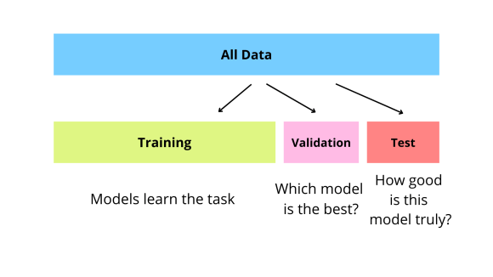
3. Cross validation
Train-validation-test
Two schemes for cross validation on train-validation splits
Train-validation set on years 2010-2018
Proper dataset splitting for model selection and evaluation
Ensure that events from the same day/fire event are not distributed in different folds
Test sets always maintains the initial, extremely imbalanced distribution
Years 2019 and 2020
https://galaxyinferno.com/what-is-validation-data-used-for-machine-learning-basics/

Slide 25
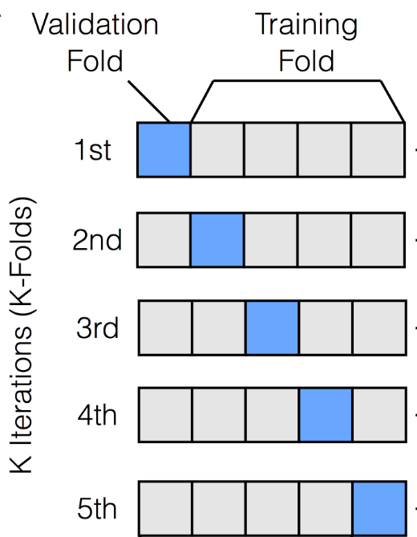
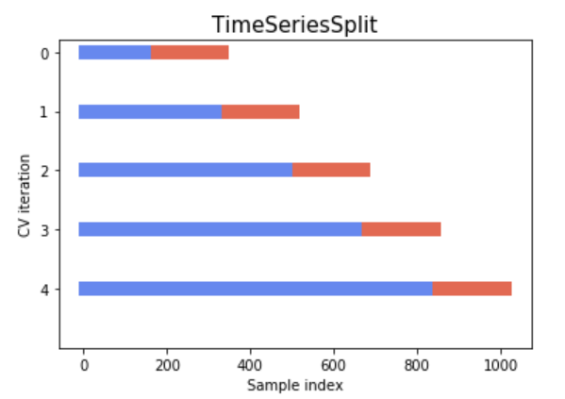
3. Cross validation
Two alternative schemes for cross validation
Default:
Consider all the fire (minority) instances of the training set
Geographically sample the no-fire (majority) instances to create a balanced set
Perform k-fold cross-validation and select models on the average best validation scores
Alternative:
Make the training set balanced, but keep the validation sets highly imbalanced
Adjust so that each training set precedes the respective validation set on a yearly level
Perform model selection on highly imbalanced folds closer to the real distribution
https://androidkt.com/pytorch-k-fold-cross-validation-using-dataloader-and-sklearn/ https://udaygajavalli1996.medium.com/cross-validation-and-its-types-e07dc257c72

Slide 26
4. Measures for model selection

Slide 27
Results
Realistic targets (sensitivity/specificity):
{>90%, >70%}
{>80%, >80%}
Achieved:
{90%, 67%}, {95%, 67%}
 | 2019 |  | 2020
 | Sensitivity | Specificity | Sensitivity | Specificity
RF-sh5-defCV | 0.9 | 0.55 | 0.97 | 0.56
ET-rh5-altCV | 0.92 | 0.59 | 0.96 | 0.59
XGB-sh2-altCV | 0.91 | 0.59 | 0.96 | 0.58
NN-rh5-defCV | 0.9 | 0.66 | 0.95 | 0.67
NNd-rh5-defCV | 0.91 | 0.65 | 0.95 | 0.66
NNd-sh2-defCV | 0.9 | 0.67 | 0.95 | 0.67
NNd-sh5-defCV | 0.93 | 0.59 | 0.96 | 0.62
NN-auc-altCV | 0.9 | 0.61 | 0.97 | 0.59
NN-rh5-altCV | 0.9 | 0.61 | 0.97 | 0.58
NN-sh5-altCV | 0.91 | 0.61 | 0.96 | 0.58
NN-sh10-altCV | 0.93 | 0.62 | 0.97 | 0.58
NNd-sh10-altCV | 0.91 | 0.61 | 0.97 | 0.6

Slide 28
Results
Agility for different configurations:
 | AUC |  | f-Score |  | rh2 |  | rh5 |  | sh2 |  | sh5 |  | sh10
 | Sens. | Spec. | Sens. | Spec. | Sens. | Spec. | Sens. | Spec. | Sens. | Spec. | Sens. | Spec. | Sens. | Spec.
Default Cross-Validation
RF | 0.87 | 0.66 | 0.86 | 0.67 | 0.78 | 0.71 | 0.88 | 0.59 | 0.87 | 0.61 | 0.9 | 0.55 | 0.94 | 0.47
ET | 0.57 | 0.83 | 0.79 | 0.69 | 0.75 | 0.73 | 0.81 | 0.68 | 0.79 | 0.69 | 0.94 | 0.54 | 0.79 | 0.68
XGB | 0.54 | 0.8 | 0.57 | 0.75 | 0.67 | 0.74 | 0.74 | 0.69 | 0.68 | 0.71 | 0.91 | 0.56 | 0.93 | 0.51
NN | 0.71 | 0.77 | 0.67 | 0.8 | 0.72 | 0.78 | 0.9 | 0.66 | 0.83 | 0.68 | 0.92 | 0.58 | 0.96 | 0.47
NNd | 0.66 | 0.84 | 0.77 | 0.78 | 0.79 | 0.76 | 0.91 | 0.65 | 0.9 | 0.67 | 0.93 | 0.59 | 0.97 | 0.47
Alternative Cross-Validation
RF | 0.74 | 0.8 | 0.13 | 0.99 | 0.82 | 0.71 | 0.87 | 0.64 | 0.91 | 0.47 | 0.91 | 0.47 | 0.91 | 0.47
ET | 0.32 | 0.96 | 0.27 | 0.97 | 0.85 | 0.69 | 0.92 | 0.59 | 0.94 | 0.52 | 0.93 | 0.52 | 0.95 | 0.45
XGB | 0.7 | 0.77 | 0.34 | 0.94 | 0.74 | 0.69 | 0.82 | 0.62 | 0.91 | 0.59 | 0.95 | 0.46 | 0.95 | 0.46
NN | 0.9 | 0.61 | 0.48 | 0.88 | 0.84 | 0.67 | 0.9 | 0.61 | 0.84 | 0.64 | 0.91 | 0.61 | 0.93 | 0.62
NNd | 0.81 | 0.71 | 0.51 | 0.87 | 0.85 | 0.68 | 0.89 | 0.64 | 0.88 | 0.66 | 0.91 | 0.59 | 0.91 | 0.61

Slide 29
Results
Agility for different configurations:
 | AUC |  | f-Score |  | rh2 |  | rh5 |  | sh2 |  | sh5 |  | sh10
 | Sens. | Spec. | Sens. | Spec. | Sens. | Spec. | Sens. | Spec. | Sens. | Spec. | Sens. | Spec. | Sens. | Spec.
Default Cross-Validation
RF | 0.87 | 0.66 | 0.86 | 0.67 | 0.78 | 0.71 | 0.88 | 0.59 | 0.87 | 0.61 | 0.9 | 0.55 | 0.94 | 0.47
ET | 0.57 | 0.83 | 0.79 | 0.69 | 0.75 | 0.73 | 0.81 | 0.68 | 0.79 | 0.69 | 0.94 | 0.54 | 0.79 | 0.68
XGB | 0.54 | 0.8 | 0.57 | 0.75 | 0.67 | 0.74 | 0.74 | 0.69 | 0.68 | 0.71 | 0.91 | 0.56 | 0.93 | 0.51
NN | 0.71 | 0.77 | 0.67 | 0.8 | 0.72 | 0.78 | 0.9 | 0.66 | 0.83 | 0.68 | 0.92 | 0.58 | 0.96 | 0.47
NNd | 0.66 | 0.84 | 0.77 | 0.78 | 0.79 | 0.76 | 0.91 | 0.65 | 0.9 | 0.67 | 0.93 | 0.59 | 0.97 | 0.47
Alternative Cross-Validation
RF | 0.74 | 0.8 | 0.13 | 0.99 | 0.82 | 0.71 | 0.87 | 0.64 | 0.91 | 0.47 | 0.91 | 0.47 | 0.91 | 0.47
ET | 0.32 | 0.96 | 0.27 | 0.97 | 0.85 | 0.69 | 0.92 | 0.59 | 0.94 | 0.52 | 0.93 | 0.52 | 0.95 | 0.45
XGB | 0.7 | 0.77 | 0.34 | 0.94 | 0.74 | 0.69 | 0.82 | 0.62 | 0.91 | 0.59 | 0.95 | 0.46 | 0.95 | 0.46
NN | 0.9 | 0.61 | 0.48 | 0.88 | 0.84 | 0.67 | 0.9 | 0.61 | 0.84 | 0.64 | 0.91 | 0.61 | 0.93 | 0.62
NNd | 0.81 | 0.71 | 0.51 | 0.87 | 0.85 | 0.68 | 0.89 | 0.64 | 0.88 | 0.66 | 0.91 | 0.59 | 0.91 | 0.61
Sensitivity/Specificity

Slide 30
Results
Feature importance
Measured via feature permutation
Rank | NNd (rh2-defCV) Feature Imp. (%) |  | RF (rh5-defCV) Feature Imp. (%) |  | XGB (rh5-defCV) Feature Imp. (%)
1 | dom_vel | 6.07 | dom_vel | 12.94 | dom_vel | 7.47
2 | evi | 2.38 | evi | 2.37 | evi | 2.24
3 | f81 | 1.99 | f81 | 2.18 | dem | 1.68
4 | xpos | 1.47 | ndvi_new | 2.13 | max_temp | 1.63
5 | ypos | 1.18 | mean_temp | 1.72 | xpos | 1.58
6 | dem | 1.17 | max_temp | 1.71 | pos | 1.48
7 | rain_7days | 0.57 | lst_day | 1.48 | f81 | 1.36
8 | max_temp | 0.44 | xpos | 1.2 | rain_7days | 0.8
9 | frequency | 0.26 | ypos | 1.12 | mean_dew_temp | 0.67
10 | slope | 0.19 | mean_dew_temp | 1.11 | mean_temp | 0.47

Slide 31
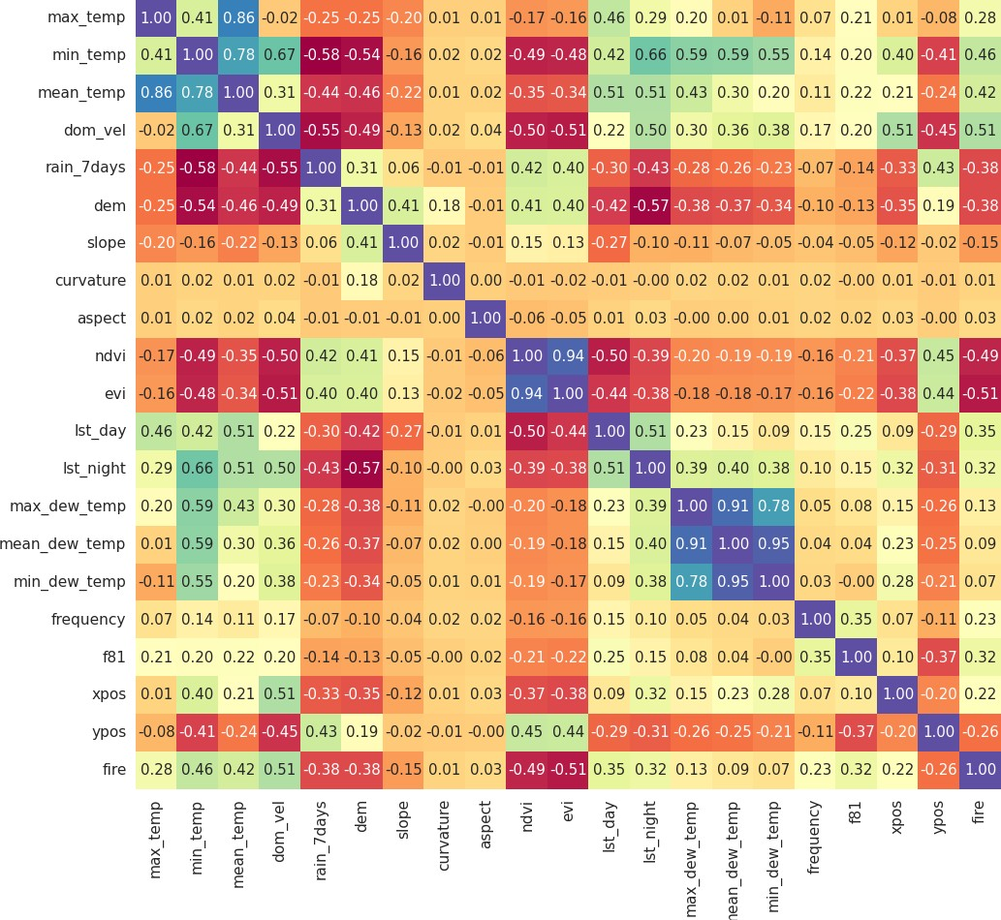
Results
Feature importance
Measured via feature correlation

Slide 32
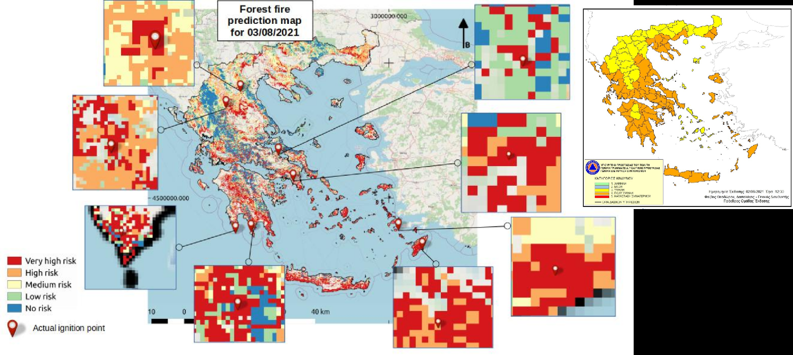
Results

Slide 33
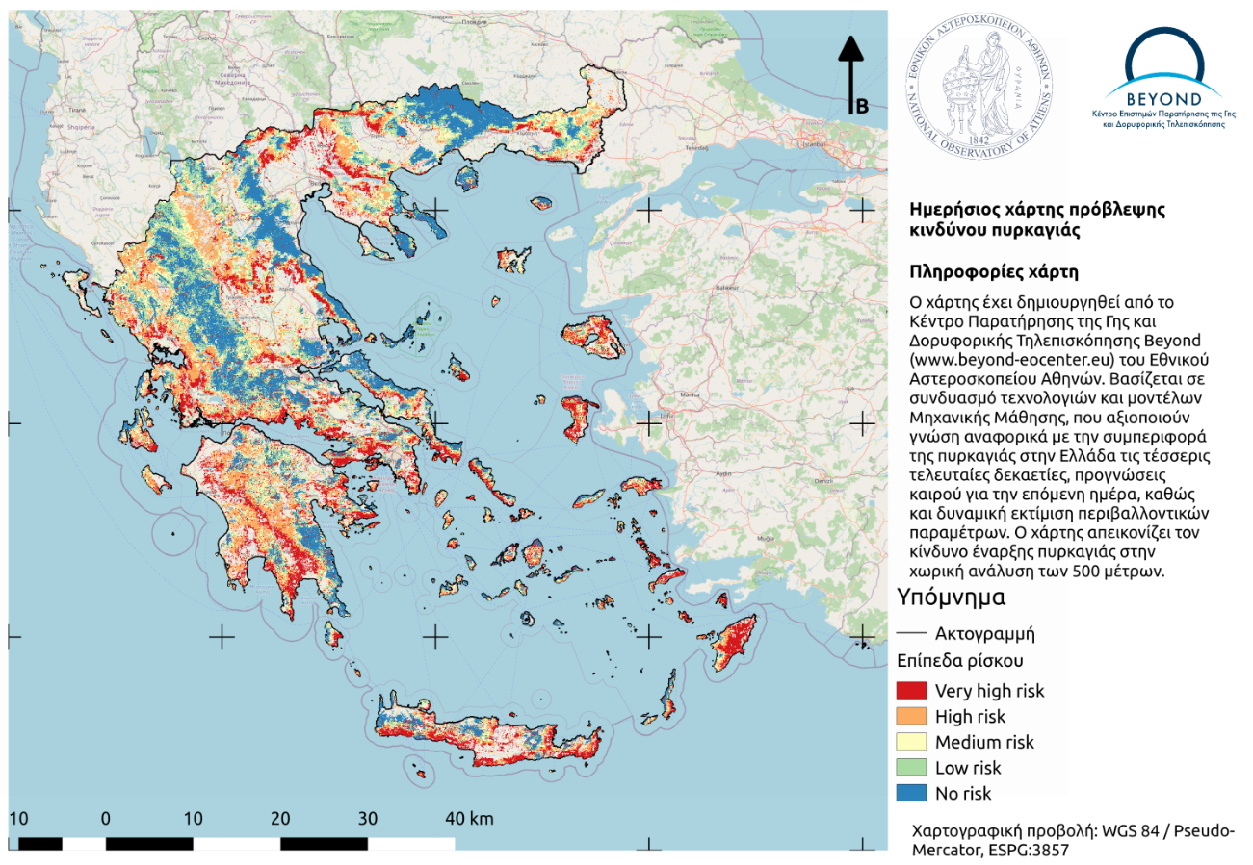
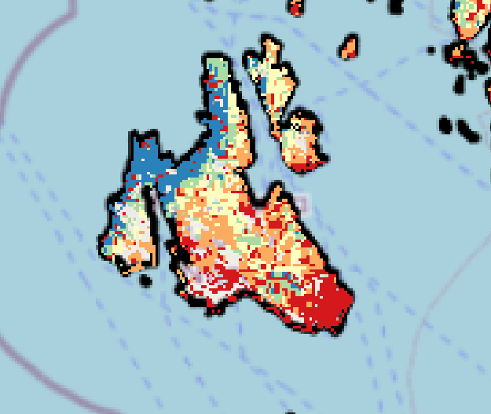
Results
Forest Fire Prediction for 03/07/2021
Cephalonia island
Fire ignition

Slide 34
System architecture

Slide 35
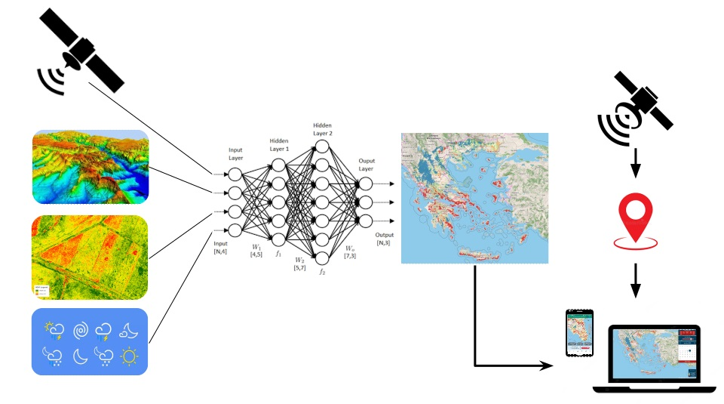
Operational system
Architecture concept
LUCAS

Slide 36
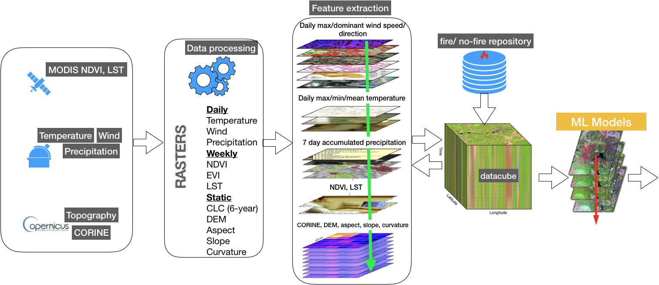
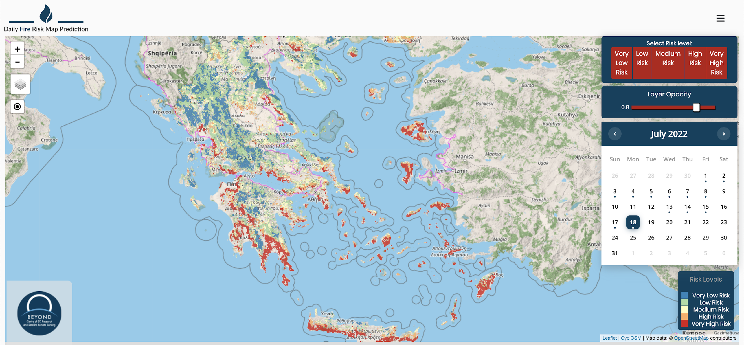
Operational system
Back-end processing

Slide 37
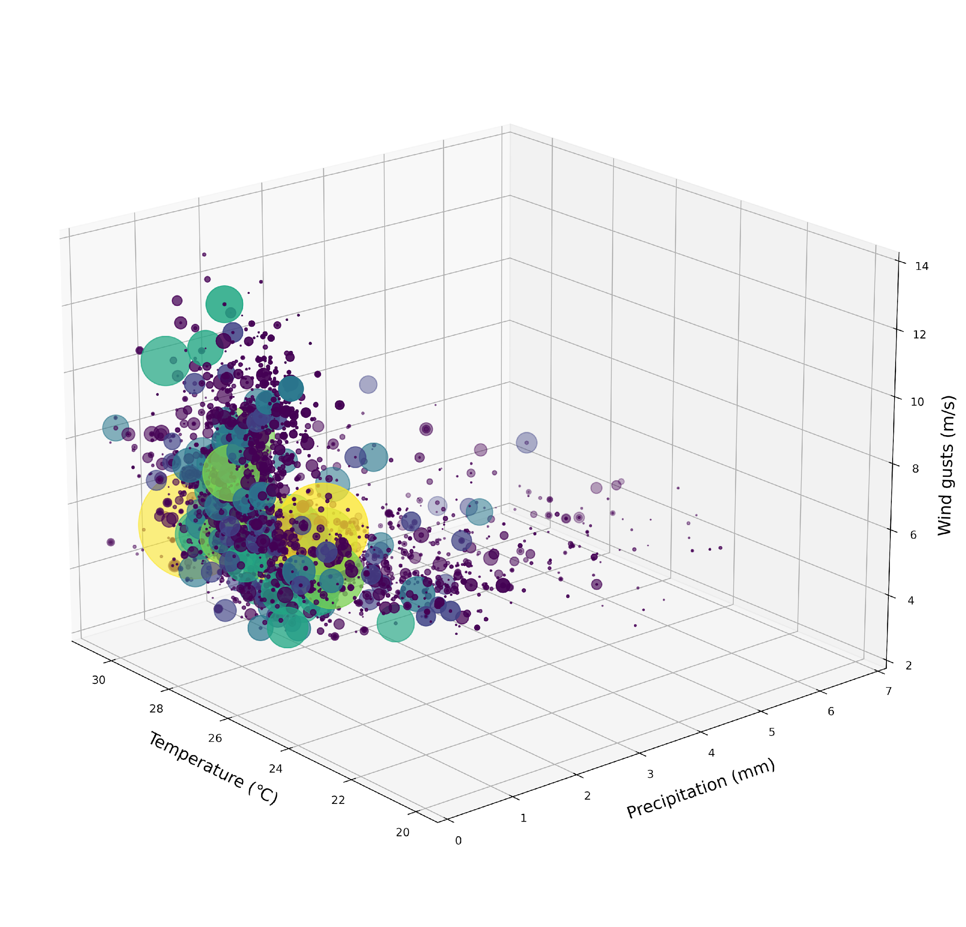
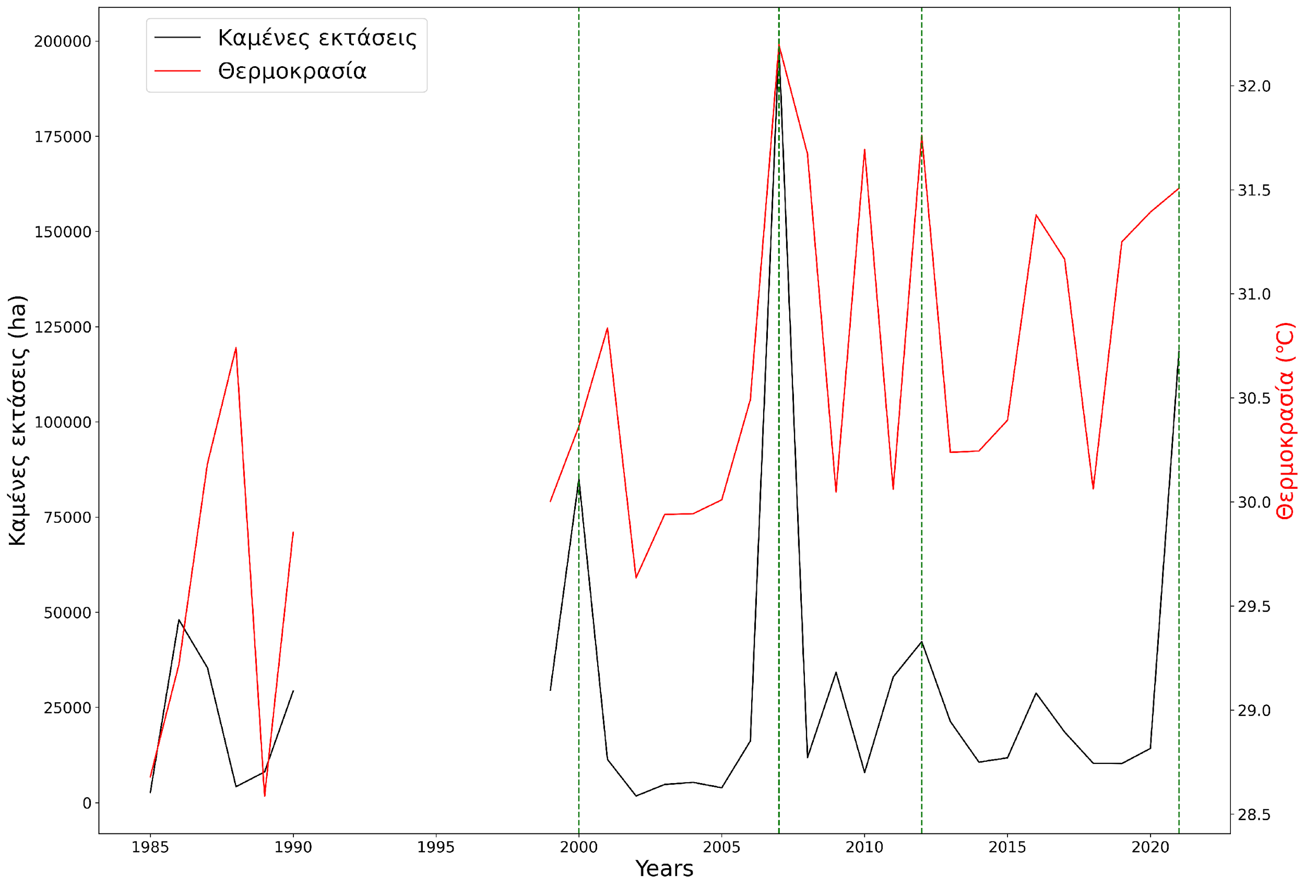
Operational system
Datacube insights

Slide 38
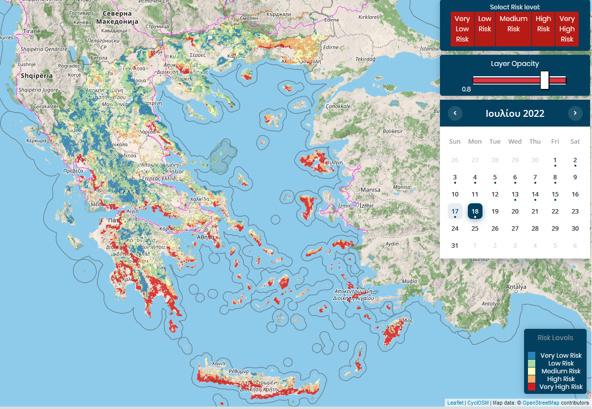
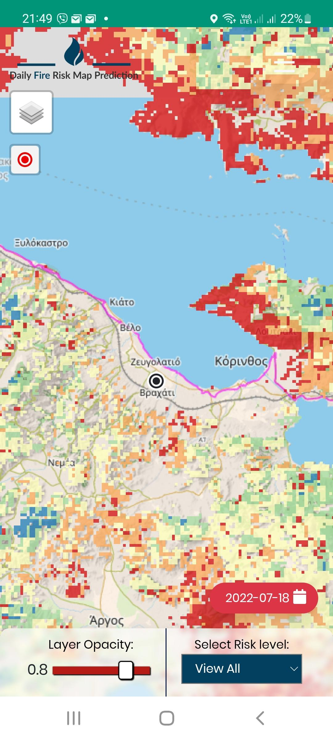
Operational system
Desktop/mobile front-end
Desktop
Mobile
GNSS Location
https://riskmap.beyond-eocenter.eu/

Slide 39
Current work

Slide 40
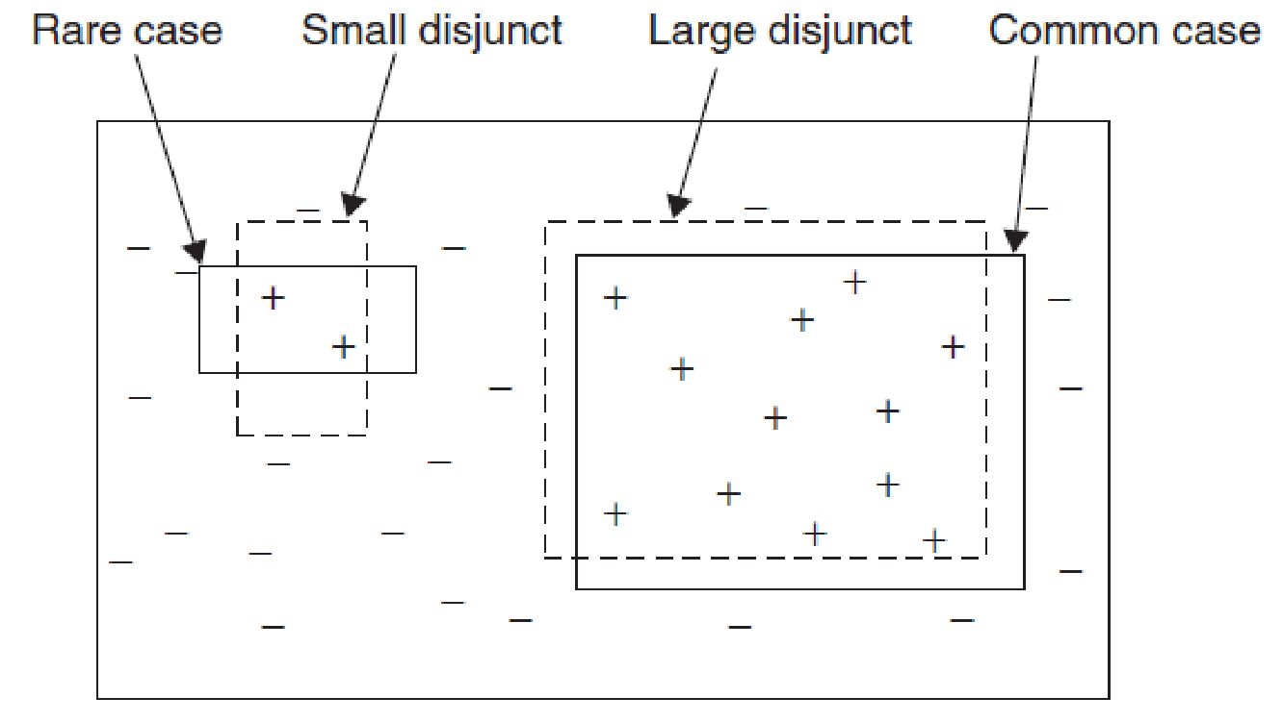
Directions
Handle absence of fire phenomenon
No-fire instances that are very close to fire instances
Problematic for learning proper boundaries
Reduces specificity by default
Better handle imbalance
Existing schemes are only half-measures
Training/validation/test on different distributions
Examine rare cases and small disjuncts
Indications that fire instances form discrete clusters within the hyperspace
Handle data sizes
Try to limit undersampling as much as possible to exploit the whole dataset
Imbalanced Learning_ Foundations, Algorithms, and Applications (2013, Wiley-IEEE Press)

Slide 41
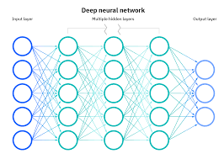
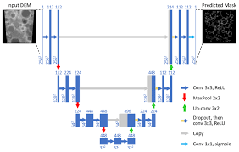
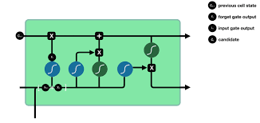
Why Deep learning : A DL model is a neural network model composed of multiple processing layers. They have proven to be highly efficient in finding intricate structures and learning data with multiple levels of abstraction
Complex feature correlations
Deep neural networks (DNN) may produce more meaningful representations in deeper layers.
Dimensionality of the input data.
The instances in this problem refer to specific locations that have spatial correlations. Convolutional NNs can discover that kind of relations where traditional ML algorithms (such as ANN, SVM, weak learner ensembles) are likely to fail.
Time Series
The risk of fire ignition and spread can be related to long periods of drought or periods with high temperatures (long heat waves) that form the suitable conditions for a fire to start. DL LSTM takes into account past states for learning and are suitable to detect those correlations.

Slide 42
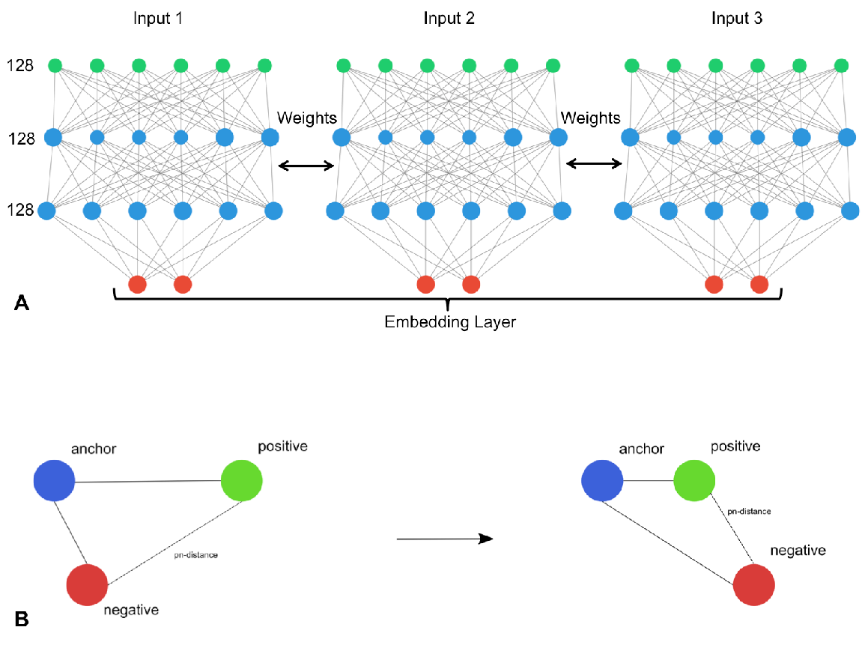
Approach 1: Siamese NNs
Architectures that aim at learning a similarity function
Comprise of parallel NN architectures that receive different inputs but learn the same parameters
SNNs provide the framework for handling several of the aforementioned issues
Particularly triplet loss based SNNs
Input as triplets of {anchor, positive, negative}
Structure-preserving visualisation of high dimensional single-cell datasets

Slide 43
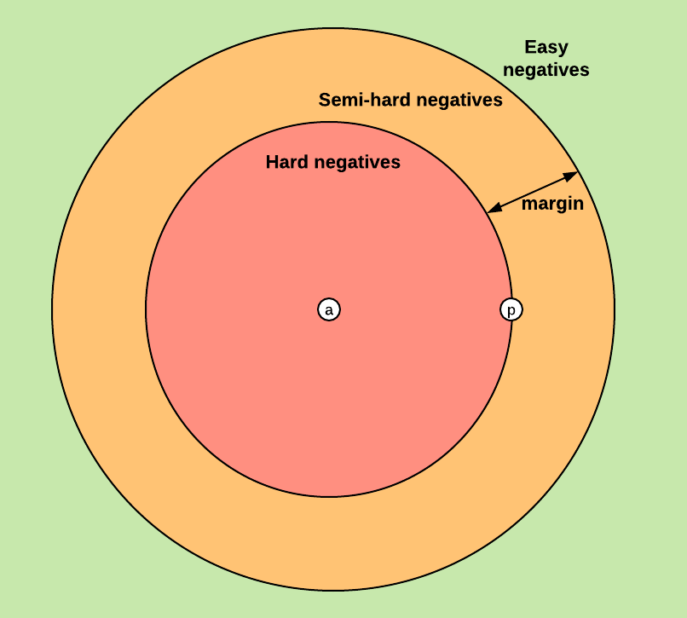
Approach 1: Siamese NNs
Absence of fire and extreme imbalance can be handled to some extent by properly constructing {anchor, positive, negative} triplets
Hard negatives can be ignored or transformed into positives
Semi-hard should probably be emphasized
Variations of undersampling techniques can be combined
https://medium.com/@enoshshr/triplet-loss-and-siamese-neural-networks-5d363fdeba9b

Slide 44
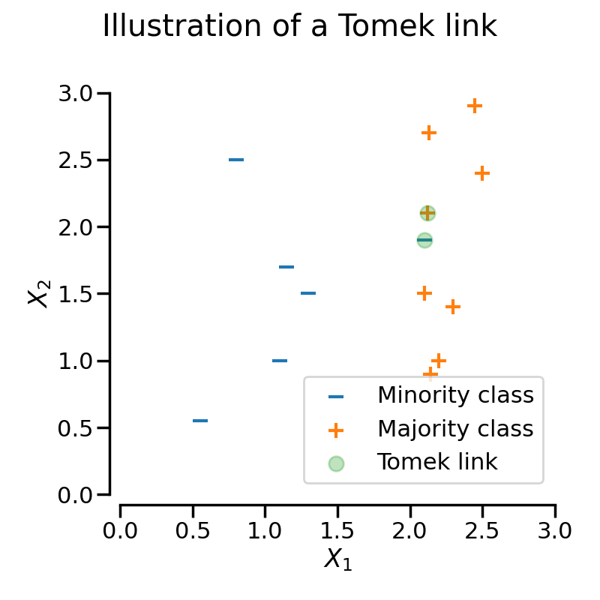
Approach 1: Siamese NNs
Variations of undersampling techniques can be combined
E.g. Tomek links
Removing majority instances
Transforming majority into minority instances
https://imbalanced-learn.org/stable/under_sampling.html

Slide 45
Approach 1: Siamese NNs
Rare cases and small disjuncts
Consider more than one fire classes
E.g. by clustering
Properly adjust the triplet generation function
Learn more “clear” boundaries per fire class
Limit the absence of fire phenomenon

Slide 46
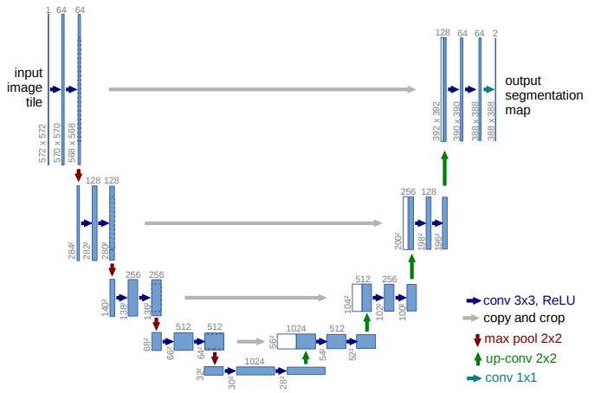
Approach 2: Semantic Segmentation
CNN architectures that aim at performing image classification on the pixel level
Utilized when the exact shape of an item (class) needs to be identified
Applications
Aerial images
Medical images
https://towardsdatascience.com/semantic-segmentation-with-deep-learning-a-guide-and-code-e52fc8958823

Slide 47
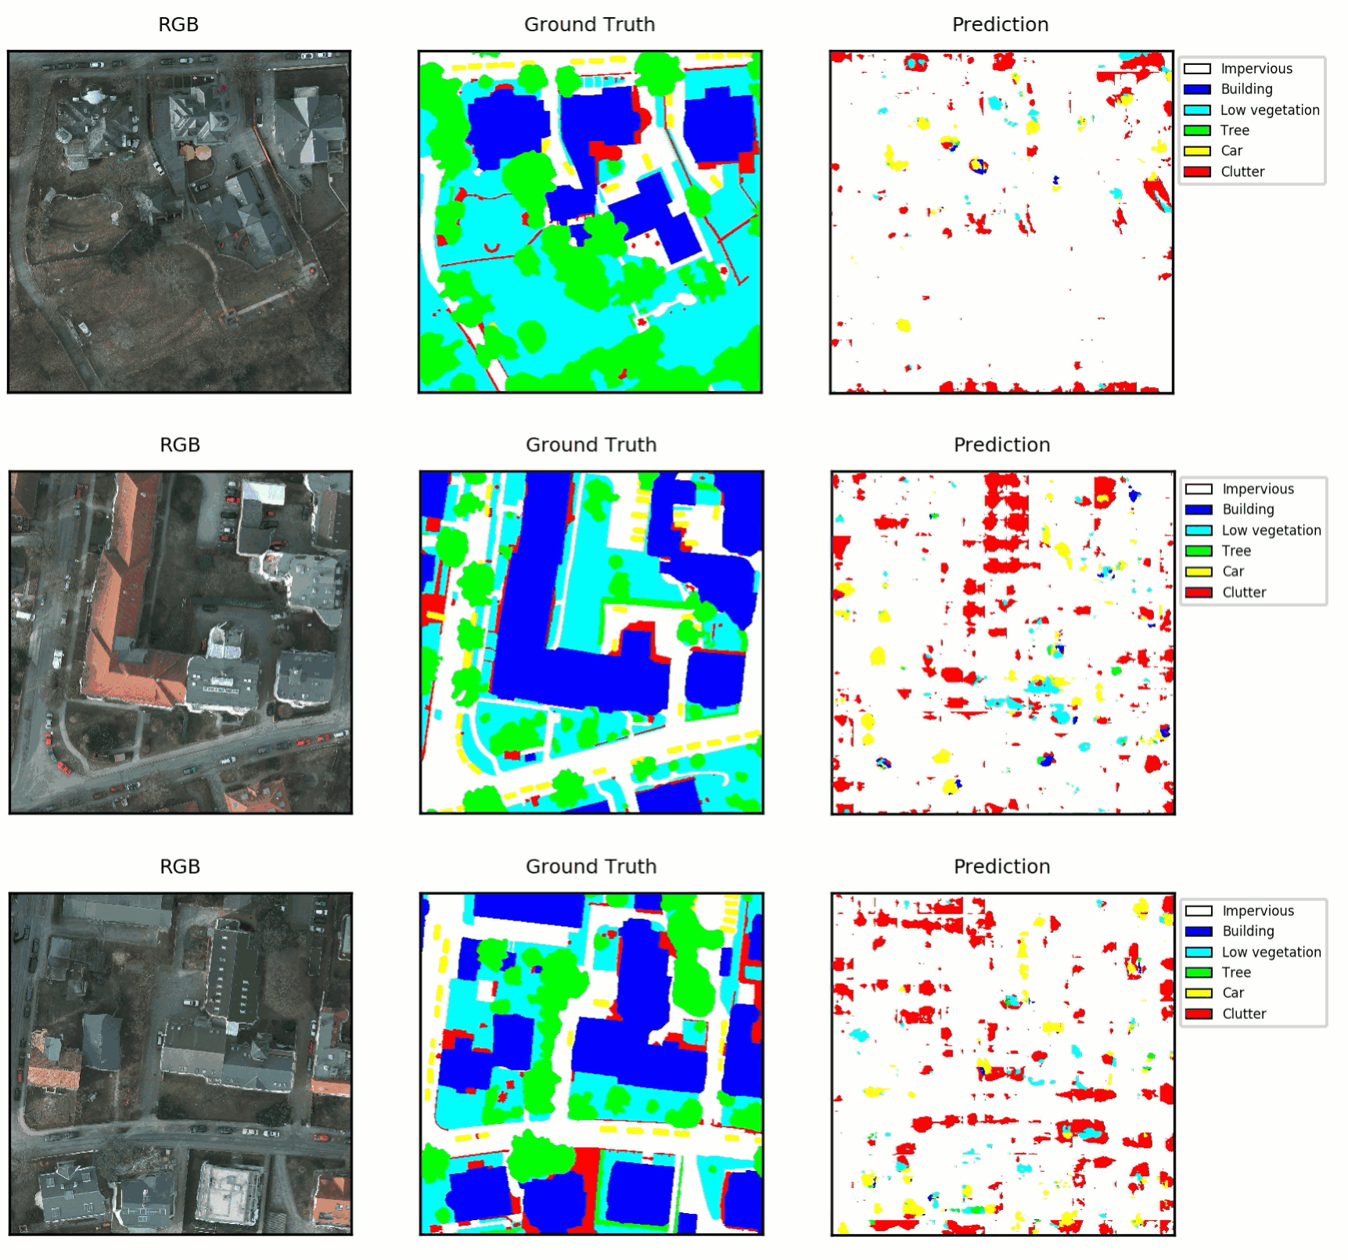
Approach 2: Semantic Segmentation
CNN architectures that aim at performing image classification on the pixel level
Utilized when the exact shape of an item (class) needs to be identified
Applications
Aerial images
Medical images
https://www.azavea.com/blog/2017/05/30/deep-learning-on-aerial-imagery/

Slide 48
Approach 2: Semantic Segmentation
But we do not have images in our setting?
Each grid cell can be considered as a pixel of an image corresponding to the whole considered territory
Each feature of each cell can be considered as a different channel of the image
Potential gains
Direct consideration of spatial correlations
Dataset significantly reduced to a few tenths of thousands of images
manageable
Imbalance can be handled orthogonally

Slide 49
Other Directions
Model Explainability
A difficult challenge in machine learning and especially deep learning is to provide explanations for the model's predictions.
New methods have been developed (SHAP, DL adjusted permutation importance, Partial Dependence Plots) to assist the interpretation of the results of deep learning as applied to provide
Potential gains
Identify most influencing factors for each prediction
Determine/discover meaningful latent features

Slide 50
Publications
A. Apostolakis, S. Girtsou, G. Giannopoulos, N. S. Bartsotas, and C. Kontoes, “Estimating Next Day’s Forest Fire Risk via a Complete Machine Learning Methodology,” Remote Sensing, vol. 14, no. 5, p. 1222, Mar. 2022, doi: 10.3390/rs14051222. ​
S. Girtsou, A. Apostolakis, G. Giannopoulos, and C. Kontoes, “A Machine Learning Methodology for Next Day Wildfire Prediction,” Jul. 2021. doi: 10.1109/igarss47720.2021.9554301. ​
A. Apostolakis, S. Girtsou, C. Kontoes, I. Papoutsis, and M. Tsoutsos, “Implementation of a Random Forest Classifier to Examine Wildfire Predictive Modelling in Greece Using Diachronically Collected Fire Occurrence and Fire Mapping Data,” in MultiMedia Modeling, Springer International Publishing, 2021, pp. 318–329. doi: 10.1007/978-3-030-67835-7_27. ​
A. Apostolakis, “Next Day Forest Fire Risk Prediction in Greece Using Machine Learning,” SafeGreece 2021. ​
CEST 2021 conference, oral presentation: “Daily Forest Fire Prediction modeling and Forest Fire Information System (FFIS)”
Συγγραφή κεφαλαίου στην Επιτροπή Έρευνας της Ανθεκτικότητας των Ελληνικών Δασικών Οικοσυστημάτων (Ε.Α.Δ.Ο.)

Slide 51
Team
Stella Girtsou
Alexis Apostolakis
Giorgos Giannopoulos
Charalampos Kontoes
EGU23 Vienna, Austria 27/04/2023

