Slide 1
Resource Nexus Issues Revealed by COVID-19 for Professional Communities in the Agri-Food Supply Chain​
Governance for Sustainable and Resilient Agri-Food Systems​:
The Role of Participation in achieving Sustainable and Resilient Agri-Food Systems in the face of emerging external shocks
Taha Loghmani

Slide 2
01
02
03
04
05
Sustainable Development
Agri-Food Systems
Transformation
Science-Policy Interface
Theoretical Framing
Why do we need a radical change?
Sustainability and Resilience
Supply, Demand, Food Security
Participation, Sustainable Participation
Importance, Urgency
06
07
08
09
10
Citizen Science
Nature-Based Sanitation Solutions
Hypothesis
1st Research paper
Impact
Ecological design
Research Questions
Output, Outcome, Impact, SDGs, Collaborations
Research Paper to cohort topic
Black water, Grey water

Slide 3
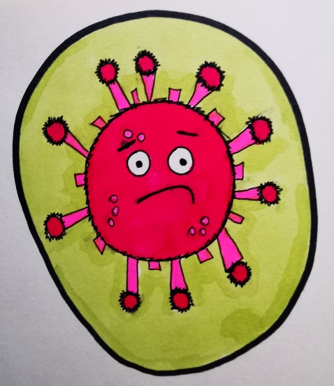
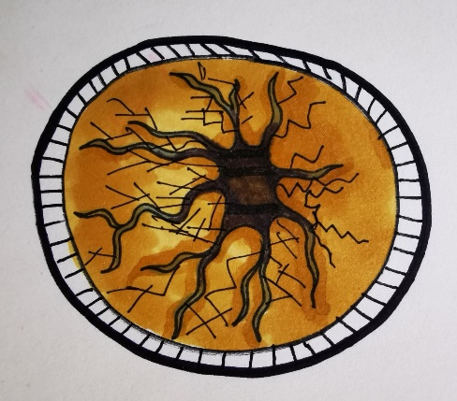
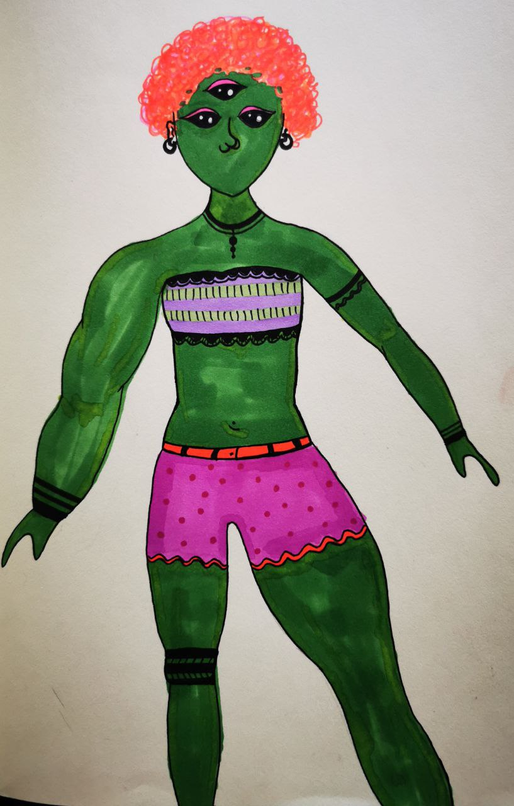
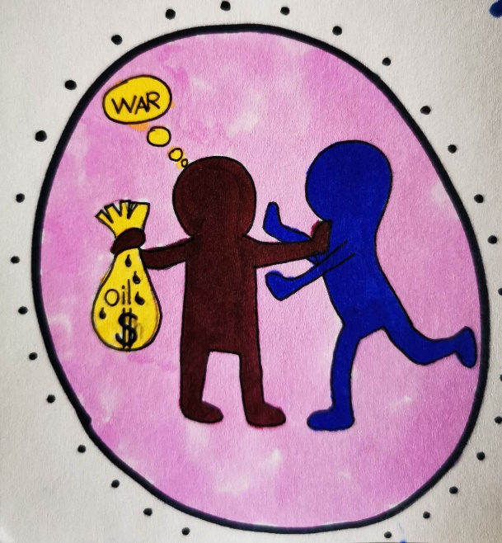
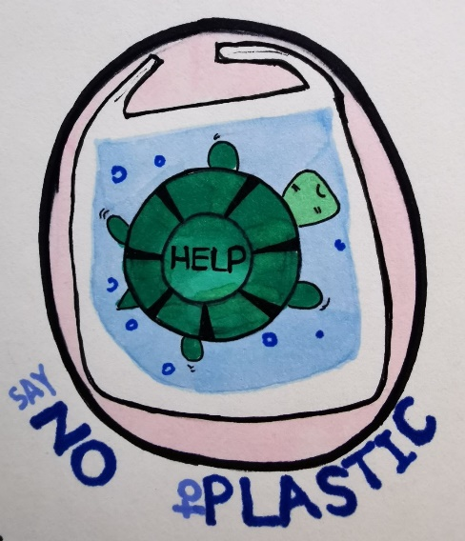
Sustainable Development
Sustainability
Resilience

Slide 4
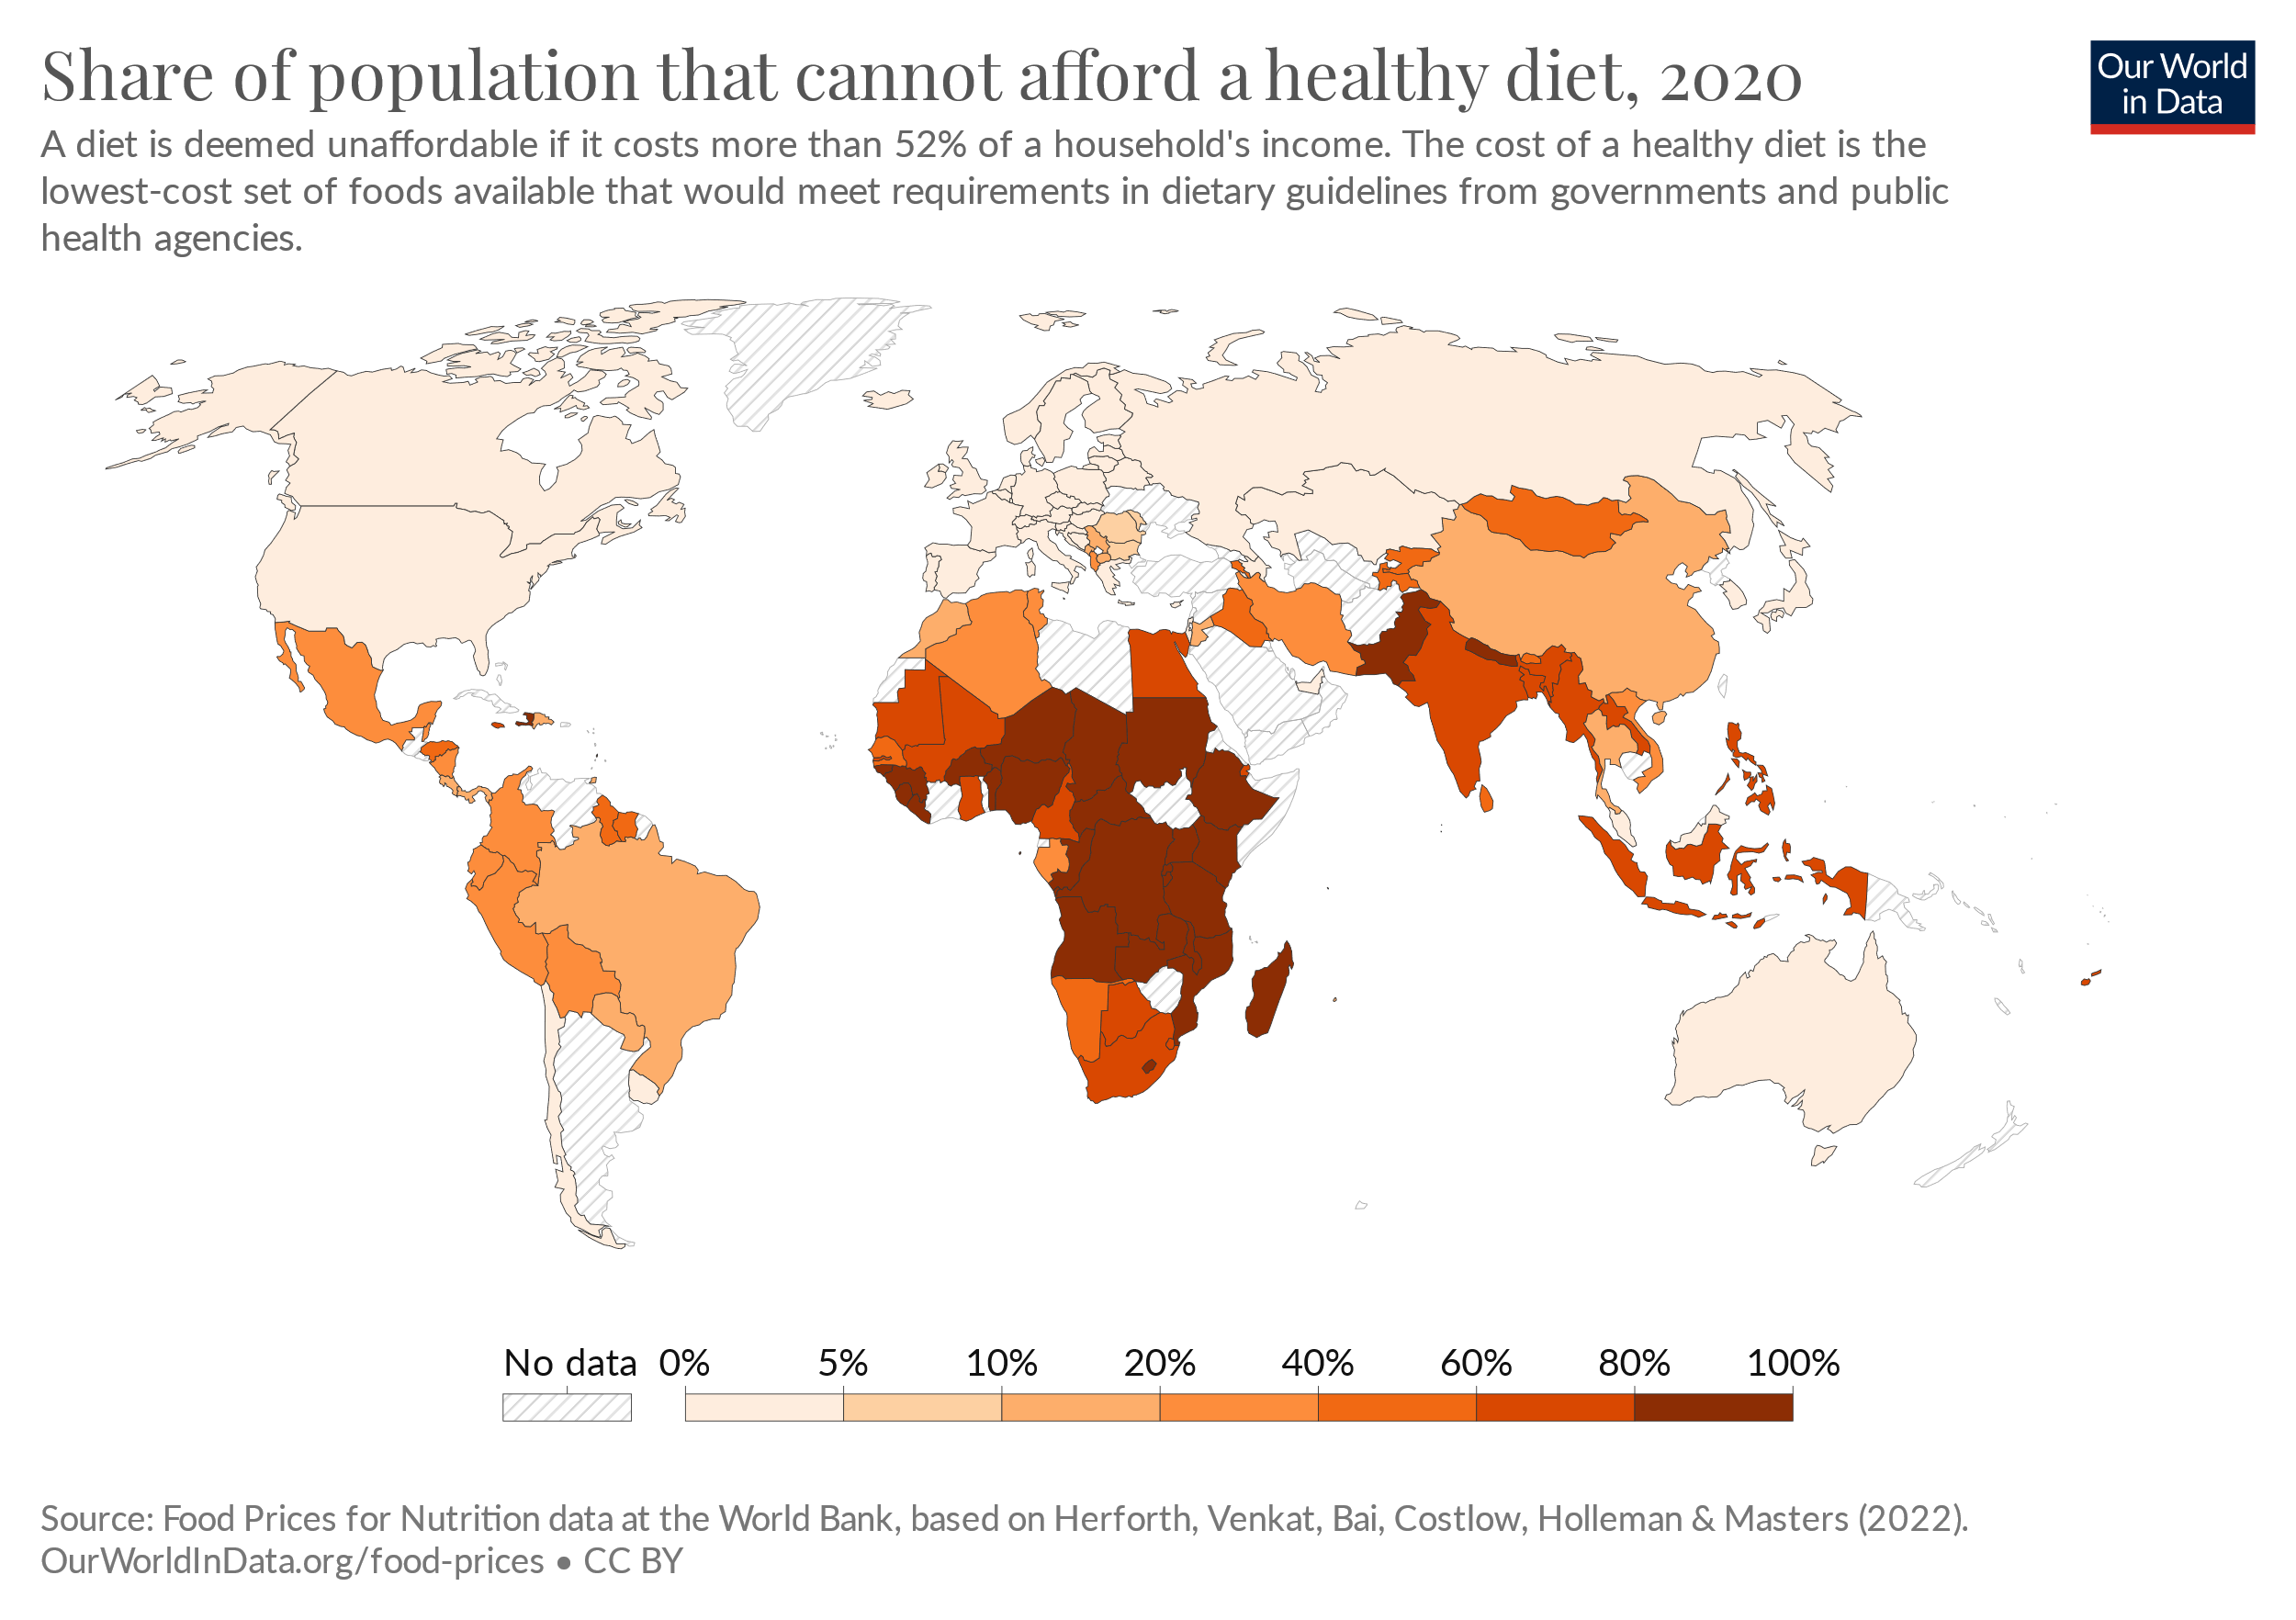
Agri-Food Systems
Food security
Demand
Supply
Global north
Receives resources
Processing
Export (added value)
Global south
Supplies resources
Basic processing
Export of raw material
Socio-economic
Climate
Governance

Slide 5
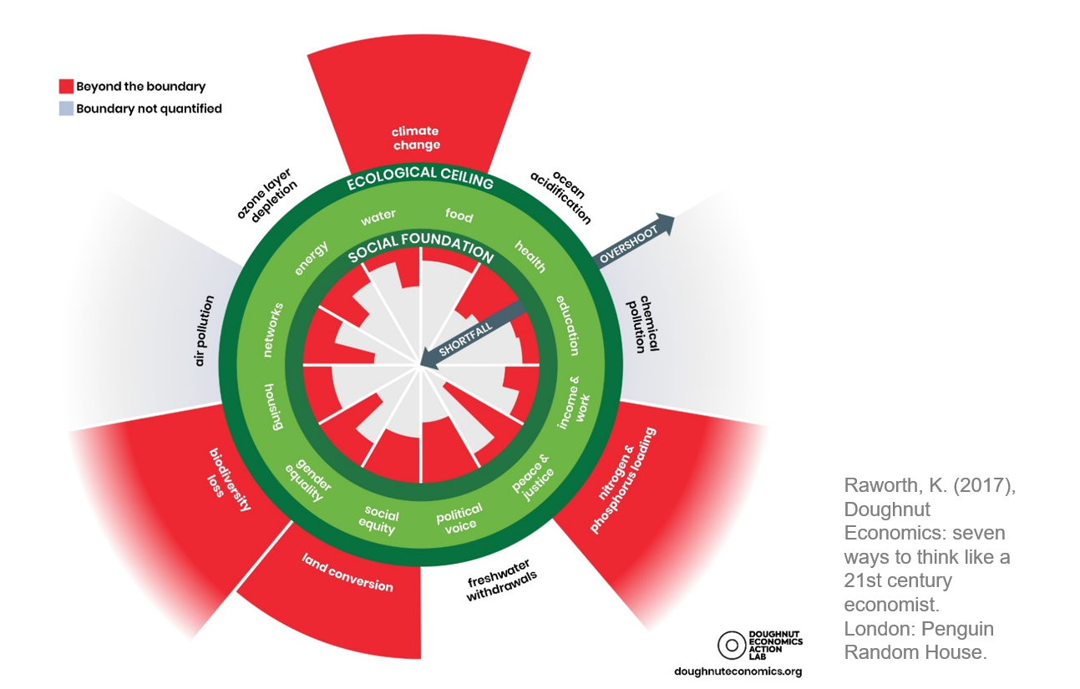
Need for a Change
Systems
TRANSFORMATION!
Tipping Points
Socio-Technical
Natural
Notes:
Current approaches: Knowledge, awareness, policy measures, new tech and efficienty (IGBP 2015: The great acceleration)
All are part of the solution, but not complete!! AT ALL!
Knowledge is loosely coupled with action!
Don't overestimate knowledge! Awareness does not lead to action automatically!
We need 75% reduction in CO2 emissions, by 2050. (Paris Agreement)
Don't wait for politics. It takes long. We need design sector, civil society, administrative capacity.
All tech (even renewable) needs resource! Consumes resources. We need space! We go beyond our capacity, even with available land.
Rebound effects: We want to achieve a certain effect, by doing so, they are over-compensated by the same measure. The more efficient we become, the bigger resources we use.
There is a collision of phasing-out systems, and new emerging systems. Many dependencies, uncertainties, and complexities.

Slide 6
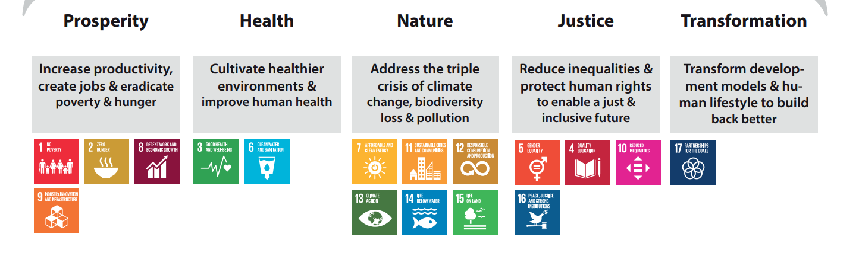
Transformation
Madani, 2022; UNEP EMG
A
Processes
B
Notes:
UN 2022 report: Inclusive Green Recovery: GDP based… Well-being and nature harmony should increase togthere

Slide 7
Science-Policy Interface
Small - Coherent - Participatory
Problem-oriented decision-making
Climate-Socio-economic-Governance
Vicious Casual Loops!!
High
Delay/Delegate
Address First
Relative Urgency
Eliminate/Ignore
Prepare/ Plan for
Low
Relative Importance
High
This Photo by Unknown Author is licensed under CC BY-SA
Source: Madani 2020
Notes:
Only a crisis makes it address first. We think like this, but the world goes otherwise. Gandom

Slide 8
Theoretical Framing
Behavior
Participation
Sustainable Participation
Transformative Participation
(CS-NBSS)
Attitude
Behavior
Citizen Science (CS)
Nature-Based Sanitation Solutions (NBSS)
How to make a behavioral change?
Attitude
Context
Source: (Adopted) Stern & Oskamp, 1987

Slide 9
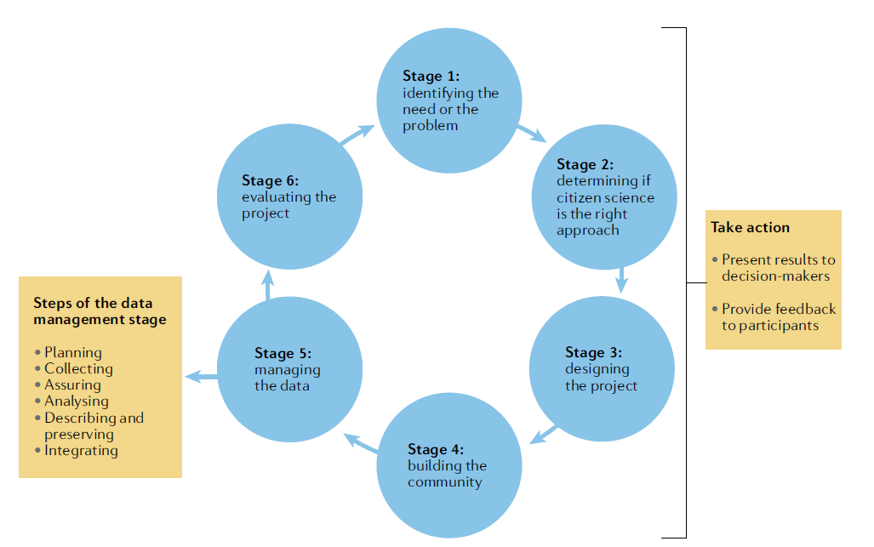
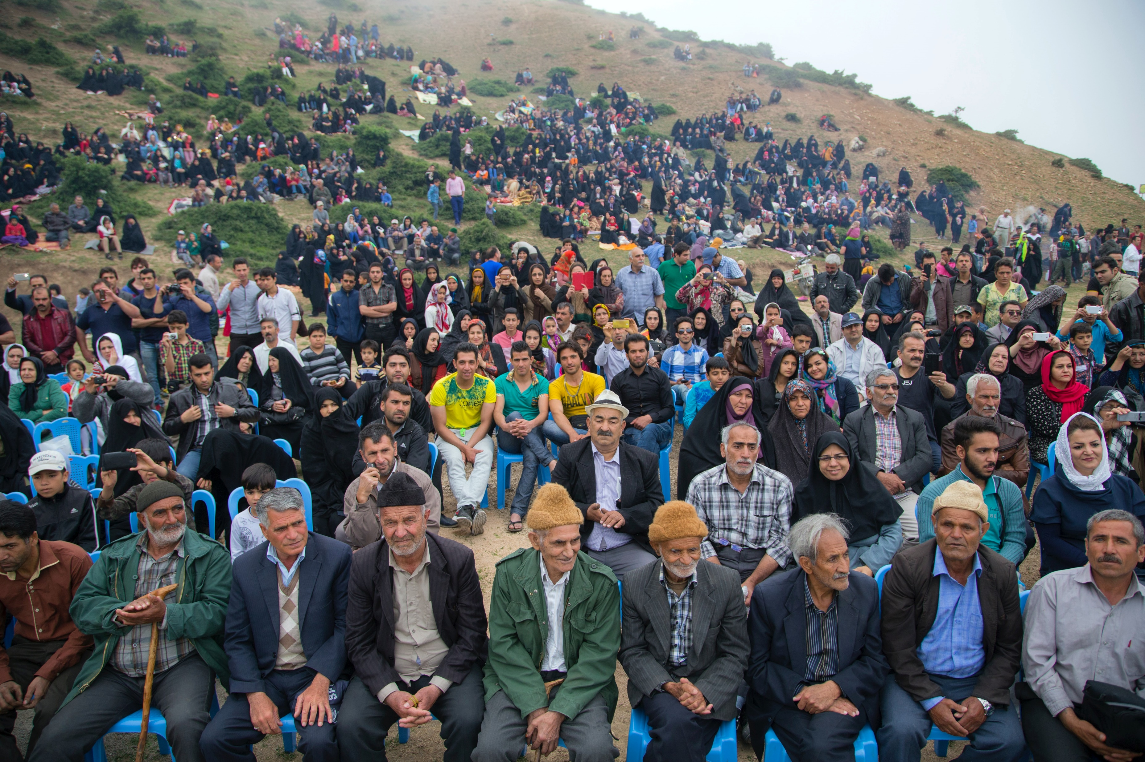
Citizen Science (CS): Science-Policy-Society
Academia
Municipality
Source: Dilek et al., 2022

Slide 10
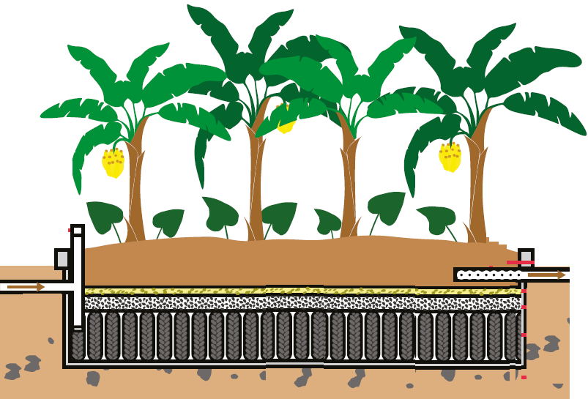
Nature-Based Sanitation Solution (Black Water)
Evapotranspiration Tank
TEvap
How it works
Zero discharge
Banana tree
Soil
Sand
Outflow pipe
Gravel
Blocks/stones
Impermeable tank
Tire
Septic Tank + Anaerobic Filter + Wetland
Design
2 m² for 1 p
Source: Loureiro Paulo et al., 2019; EAWAG
Notes:
Banana, Urine fertilizer, Biogas, Oyster mushrooms. C&D.

Slide 11
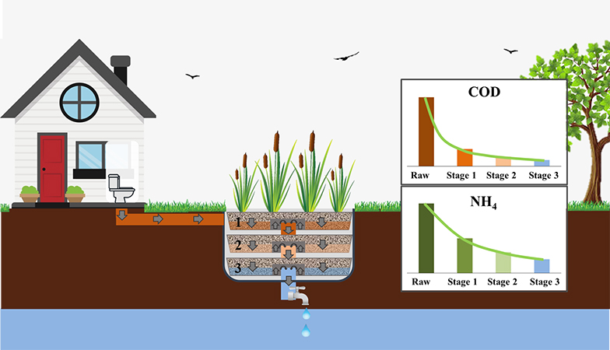
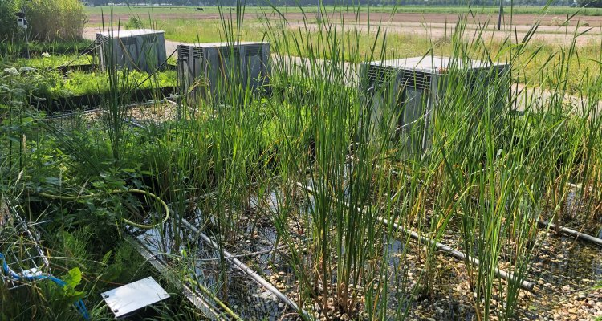
Nature-Based Sanitation Solution (Grey Water)
Source: Cabred et al., 2019
Open Pit + Anaerobic Filter + Wetland

Slide 12
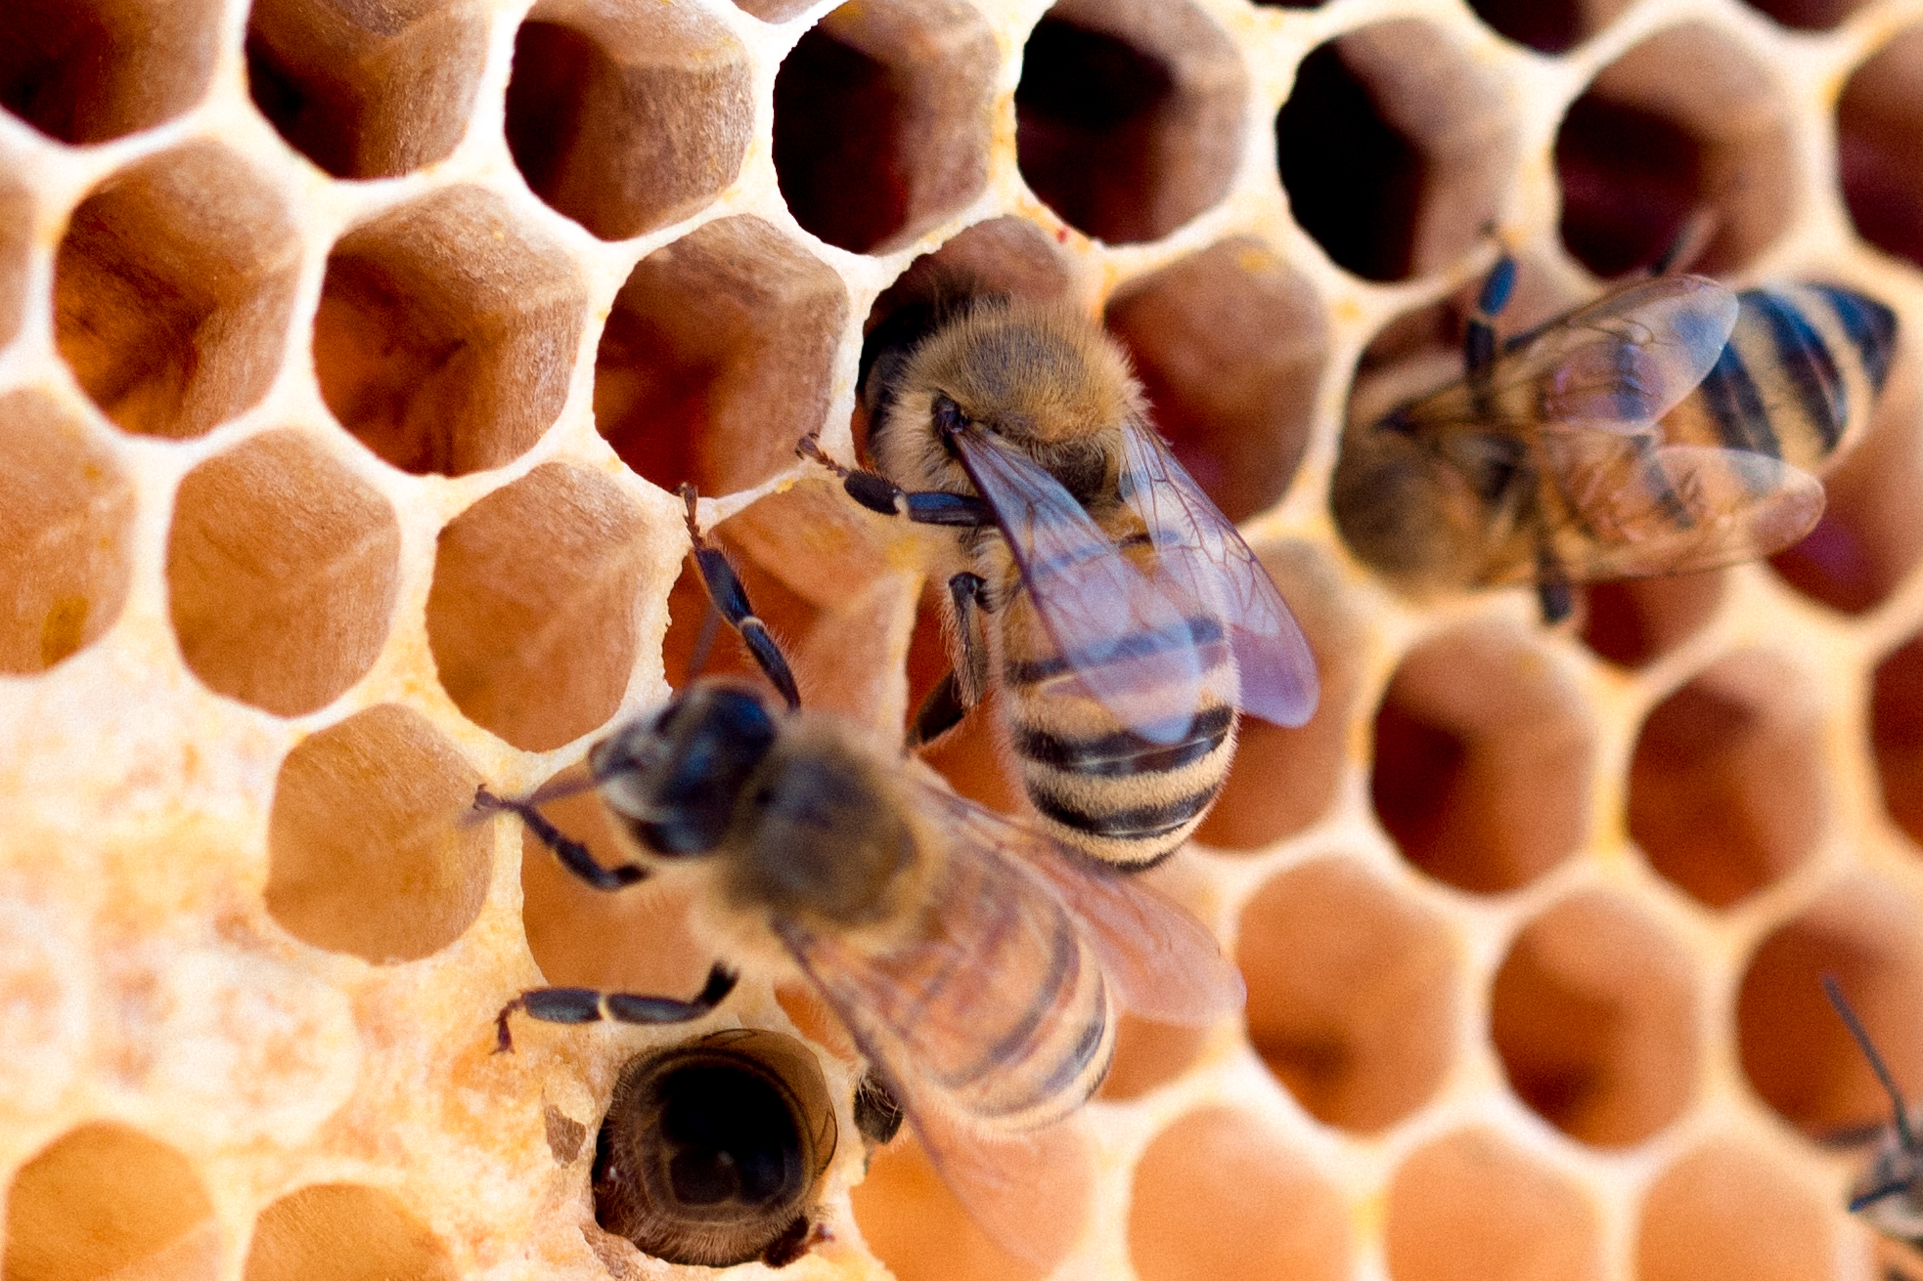
Agri-Food Chain
WHY NOT?
Photo by Meggyn Pomerleau on Unsplash
Notes:
CHANGE!!!!

Slide 13
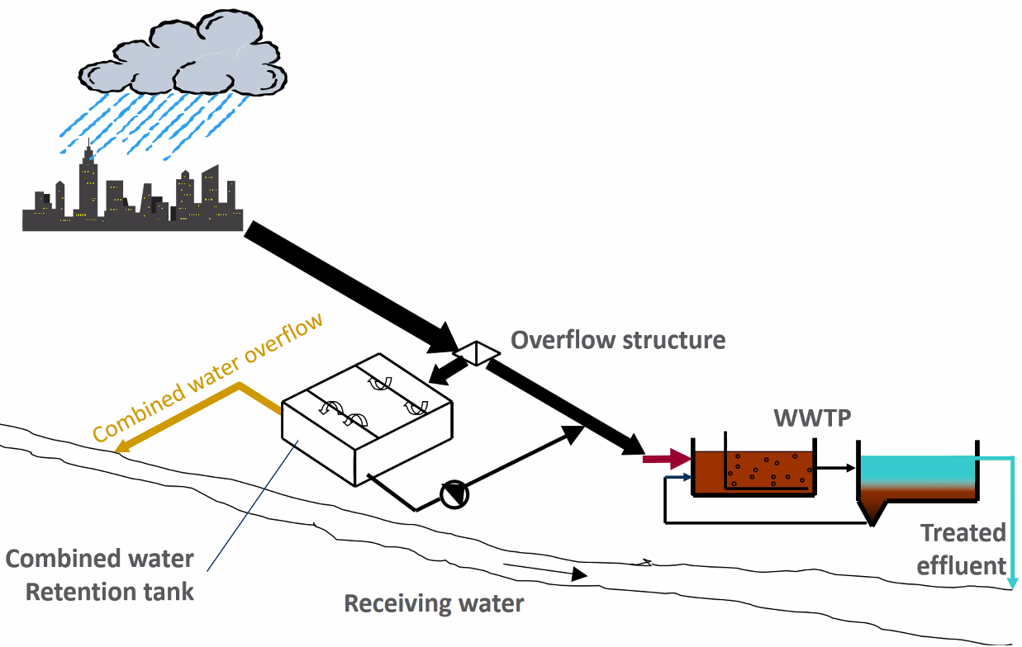
Main Hypothesis and Research Questions
Hypothesis:
The addition of coupled CS-NBS to the existing grey infrastructure around peri-urban areas would enable a transition towards sustainable and resilient agri-food systems.
How does the CS-NBS-related increase in green spaces contribute to providing ecosystem services?
How can CS-NBS enhance food security and socio-economic development in UPAs systems?
Cities as agents of Transformation.
Source: (Adopted) Schanze; CIPSEM SC 85
2/3 of Energy use; Waste production in cities
By 2100; 90% of the population
2-3 Degrees
Notes:
Going beyond empirical research on stakeholder engagement in public policy, focusing on how to establish, strengthen, and maintain long-term Science-Policy-Society interaction, based on shared goal setting and problem solving, ultimately leading to transformation in the direction of resiliency and sustainability
Jairo Urbanizartion and CC Hakeem

Slide 14
Questions and steps
Q1
P1
How does the literature reflect the role of CS and NBS in in positively affecting the Participation variable, with regards to sustainable and resilient UPA?
Literature review, Conceptual and Theoretical framing, Networking and case study selection
Step 1
Q2
P2
Design case-specific CS-NBS with project partners, and incorporate the Participation variable in the surveys, interviews, and actual implementation
How to incorporate the Participation variable in designing a context-specific CS-NBS system for UPA?
Step 2
Q3
P3
What are the effects of the decentralized implementation of coupled CS-NBS on UPA in relation to enabling active stakeholder participation in the direction of Sustainability?
Mixed-method analysis: Quantitative Data Analysis (QDA), and Qualitative Comparative Analysis (QCA) on the Participation variable
Step 3
Notes:
Papers, Collaborations
Ramoudane Participation (direct or indirect). Most of the indicators (51%), were in relation to Participation.. Why systematize? Agri-Food system defines the proper indicator. Spatial scale matters for the selection. Participation is not very well understood. There are no golden one!

Slide 15
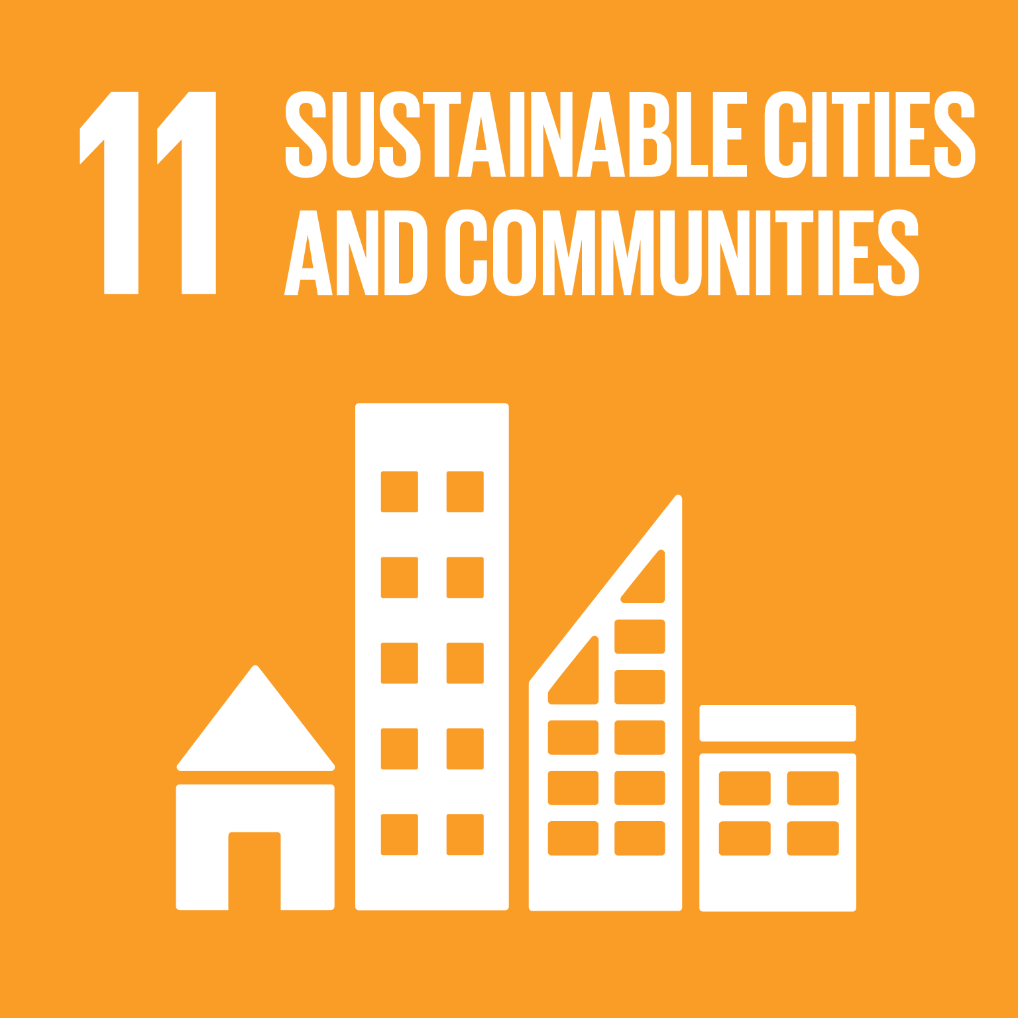
Climate change
Health
Sustainable Land Use-Agriculture
Ecosystem Services, Green Spaces, Resource Nexus
WASH, Food
Multi-functionality, Increase of Cultivated land
Education-Skills-Jobs
Areas of Transformation
for SDGs
Sustainable Cities
Agri-Food, CS, Permaculture, WASH, Food Safety
Agri-Food, Construction & Demolition, Urban Sustainability & Resiliency
Digital Revolution
CS, Nexus AID, Digital Utilization & Education
Sachs et al., 2019

Slide 16
References
Brouwer, S., van der Wielen, P., Schriks, M., Claassen, M., & Frijns, J. (2018). Public Participation in Science: The Future and Value of Citizen Science in the Drinking Water Research. Water, 10(3), 284. https://doi.org/10.3390/w10030284
Canfield, M. C., Duncan, J., & Claeys, P. (2021). Reconfiguring Food Systems Governance: The UNFSS and the Battle Over Authority and Legitimacy. Development, 64(3–4), 181–191. https://doi.org/10.1057/s41301-021-00312-1
de Amorim, W. S., Valduga, I. B., Ribeiro, J. M. P., Williamson, V. G., Krauser, G. E., Magtoto, M. K., & de Andrade Guerra, J. B. S. O. (2018). The nexus between water, energy, and food in the context of the global risks: An analysis of the interactions between food, water, and energy security. Environmental Impact Assessment Review, 72, 1–11. https://doi.org/10.1016/j.eiar.2018.05.002
Fraisl, D., Campbell, J., See, L., Wehn, U., Wardlaw, J., Gold, M., Moorthy, I., Arias, R., Piera, J., Oliver, J. L., Masó, J., Penker, M., & Fritz, S. (2020). Mapping citizen science contributions to the UN sustainable development goals. Sustainability Science, 15(6), 1735–1751. https://doi.org/10.1007/s11625-020-00833-7
Fraisl, D., Hager, G., Bedessem, B., Gold, M., Hsing, P.-Y., Danielsen, F., Hitchcock, C. B., Hulbert, J. M., Piera, J., Spiers, H., Thiel, M., & Haklay, M. (2022). Citizen science in environmental and ecological sciences. Nature Reviews Methods Primers, 2(1), 64. https://doi.org/10.1038/s43586-022-00144-4
Glass, L.-M., & Newig, J. (2019). Governance for achieving the Sustainable Development Goals: How important are participation, policy coherence, reflexivity, adaptation and democratic institutions? Earth System Governance, 2, 100031. https://doi.org/10.1016/j.esg.2019.100031

Slide 17
References
Kirschke, S., Zhang, L., & Meyer, K. (2018). Decoding the Wickedness of Resource Nexus Problems—Examples from Water-Soil Nexus Problems in China. Resources, 7(4), 67. https://doi.org/10.3390/resources7040067
Kirschke, S., Bennett, C., Bigham Ghazani, A., Kirschke, D., Lee, Y., Loghmani Khouzani, S.T., Nath, S.
(2022). Design impacts of citizen science. A comparative analysis of water monitoring projects
(Unpublished manuscript).
Madani, K. (2020). How International Economic Sanctions Harm the Environment. Earth’s Future, 8(12), e2020EF001829. https://doi.org/10.1029/2020EF001829
Nature-based solutions in agriculture: The case and pathway for adoption. (2021). FAO and TNC. https://doi.org/10.4060/cb3141en
Sachs, J. D., Schmidt-Traub, G., Mazzucato, M., Messner, D., Nakicenovic, N., & Rockström, J. (2019). Six Transformations to achieve the Sustainable Development Goals. Nature Sustainability, 2(9), 805–814. https://doi.org/10.1038/s41893-019-0352-9
Stephens, E. C., Martin, G., van Wijk, M., Timsina, J., & Snow, V. (2020). Editorial: Impacts of COVID-19 on agricultural and food systems worldwide and on progress to the sustainable development goals. Agricultural Systems, 183, 102873. https://doi.org/10.1016/j.agsy.2020.102873
Stern, P. C. (2000). New Environmental Theories: Toward a Coherent Theory of Environmentally Significant Behavior. Journal of Social Issues, 56(3), 407–424. https://doi.org/10.1111/0022-4537.00175

Slide 18
Thank you. Questions? loghmani@unu.edu

