Slide 1
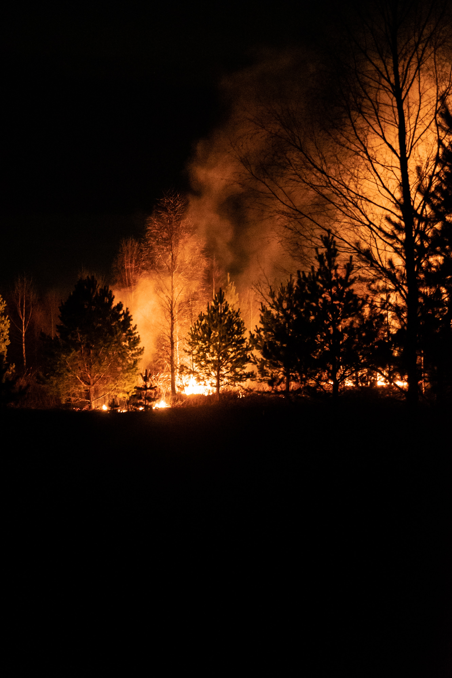
Proposal of Forest Restoration Plan for Forest Fire Damage for Preservation of Permafrost in Alpine Region of Mongolia
Enerel Bayarmagnai ¹ , Seong Woo Jeon ^{1,2}
¹ Korea University (enerel@korea.ac.kr) , ² Ojeong Resilience Institute
1. Overview
4. Methods
2. Introduction
5. Results and Discussion
3. Materials
6. Conclusions
This work was supported by Korea Environment Industry &Technology Institute (KEITI) through "Climate Change R&D Project for New Climate Regime.", funded by Korea Ministry of Environment (MOE) (2022003570003)

Slide 2
Proposal of Forest Restoration Plan for Forest Fire Damage for Preservation of Permafrost in Alpine Region of Mongolia
1. Overview
4. Methods
Enerel Bayarmagnai ¹ , Seong Woo Jeon ^{1,2}
¹ Korea University (enerel@korea.ac.kr) , ² Ojeong Resilience Institute
2. Introduction
5. Results and Discussion
3. Materials
6. Conclusions
[Overview]
Mongolia's permafrost lies under forest lands, which contributes significantly to the water replenishment of southern Mongolia's vegetation, as it affects soil water cycle processes.
However, fragmentation as some forests are lost to high-intensity and frequent fires makes the existence of permafrost less likely.
Preserving and restoring permafrost in forest areas may not have an immediate impact on preventing drought and desertification, but it can be a fundamental long-term solution.
Zoom in
<Time series change of forest from 2000 to 2020>
This work was supported by Korea Environment Industry &Technology Institute (KEITI) through "Climate Change R&D Project for New Climate Regime.", funded by Korea Ministry of Environment (MOE) (2022003570003)

Slide 3
Proposal of Forest Restoration Plan for Forest Fire Damage for Preservation of Permafrost in Alpine Region of Mongolia
1. Overview
4. Methods
Enerel Bayarmagnai ¹ , Seong Woo Jeon ^{1,2}
¹ Korea University (enerel@korea.ac.kr) , ² Ojeong Resilience Institute
2. Introduction
5. Results and Discussion
3. Materials
6. Conclusions
[Overview]
Deriving forest areas with permafrost damaged by fire
Analysis of the difference in soil moisture, soil temperature change trend, and soil texture distribution before and after fire in the derived fire-damaged forest area
In the future, we plan to propose a restoration plan that reflects the characteristics of the damaged area by additionally analyzing the soil characteristics, topography, climate, and vegetation of the area damaged by forest fire.
This work was supported by Korea Environment Industry &Technology Institute (KEITI) through "Climate Change R&D Project for New Climate Regime.", funded by Korea Ministry of Environment (MOE) (2022003570003)

Slide 4
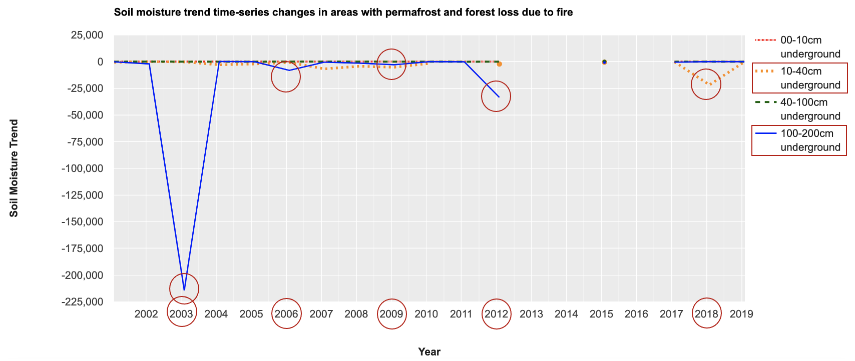
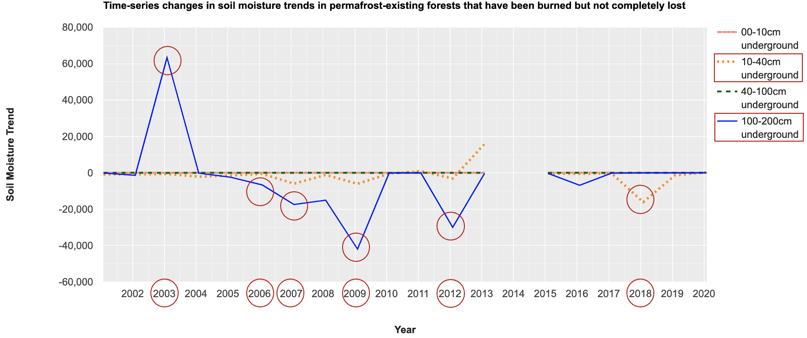
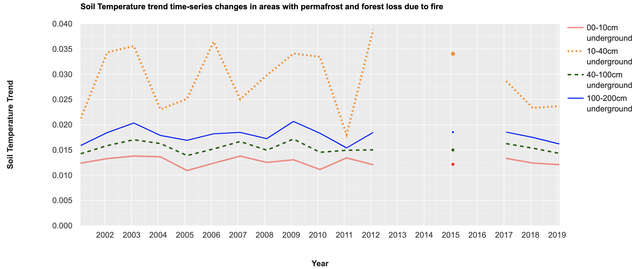
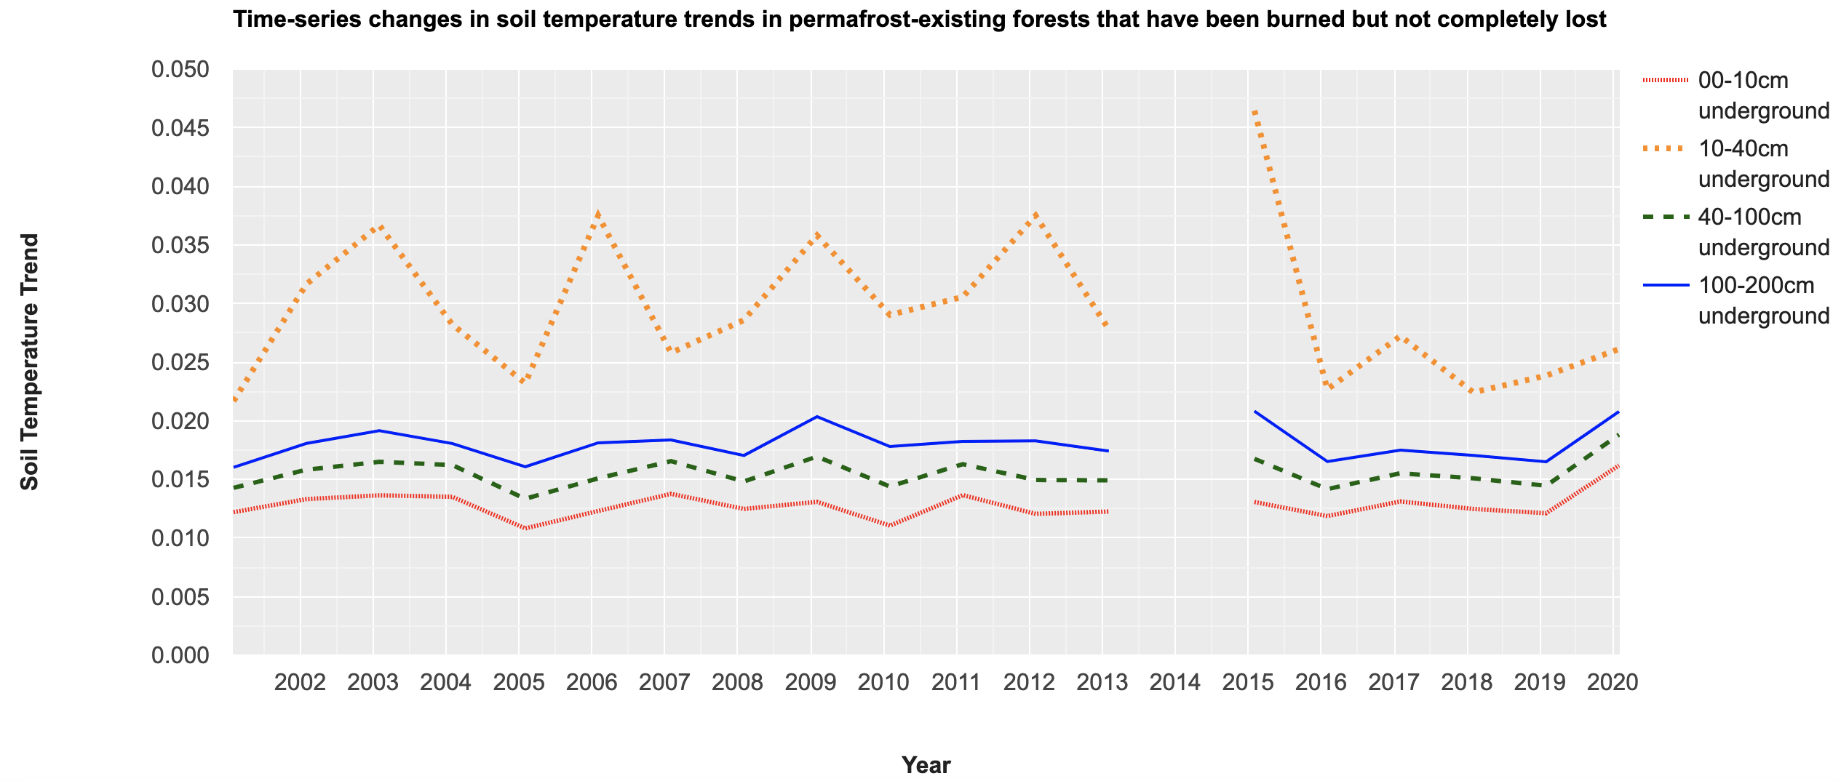
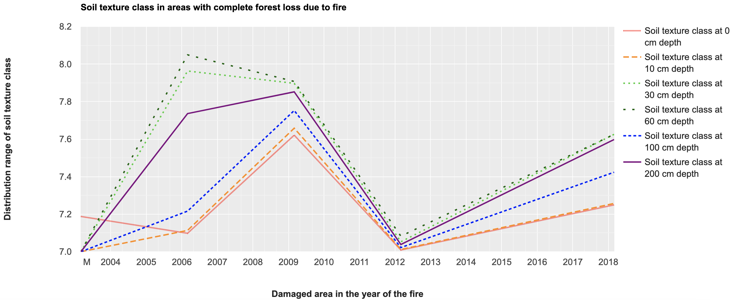
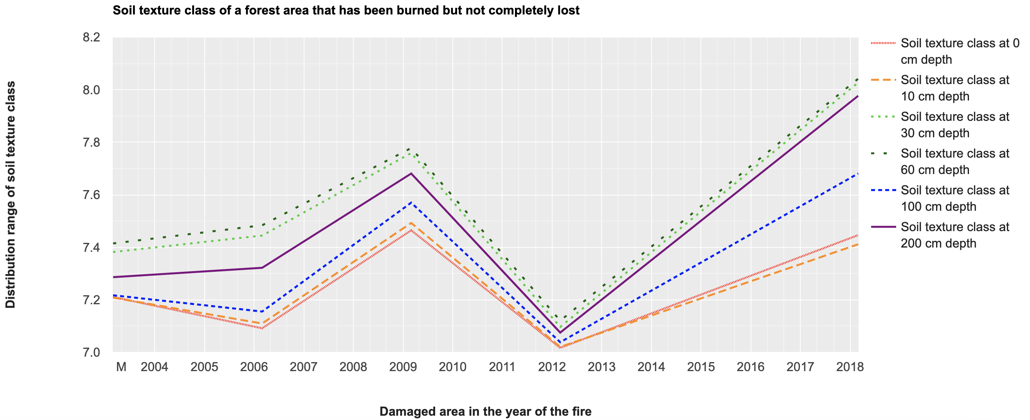
Proposal of Forest Restoration Plan for Forest Fire Damage for Preservation of Permafrost in Alpine Region of Mongolia
1. Overview
4. Methods
Enerel Bayarmagnai ¹ , Seong Woo Jeon ^{1,2}
¹ Korea University (enerel@korea.ac.kr) , ² Ojeong Resilience Institute
2. Introduction
5. Results and Discussion
[Overview]
3. Materials
6. Conclusions
A time-series soil characterization was performed for areas affected by fires for about 20 years from 2000 to 2020.
Fires occurred in 2003, 2006, 2009 and 2012 that significantly affected soil moisture and soil temperature.
The response and resilience of soils in areas with and without forest loss to fire were different.
Areas with no forest loss have more soil moisture and permafrost than areas with complete loss.
However, since 2003, the permafrost layer has been continuously disappearing due to the continuous increase in fire damage, and soil moisture has become increasingly scarce.
As a result, fluctuations in soil moisture and soil temperature were reduced even in the event of a fire.
Type 1) Forest areas with permafrost that have been completely lost due to fires
Type 2) Forests with permafrost that have been burned but not completely lost
Time series soil moisture trend
Time series soil temperature trend
Soil texture in damaged area
This work was supported by Korea Environment Industry &Technology Institute (KEITI) through "Climate Change R&D Project for New Climate Regime.", funded by Korea Ministry of Environment (MOE) (2022003570003)

Slide 5
Proposal of Forest Restoration Plan for Forest Fire Damage for Preservation of Permafrost in Alpine Region of Mongolia
1. Overview
4. Methods
Enerel Bayarmagnai ¹ , Seong Woo Jeon ^{1,2}
¹ Korea University (enerel@korea.ac.kr) , ² Ojeong Resilience Institute
2. Introduction
5. Results and Discussion
3. Materials
6. Conclusions
[Introduction]
Background
Mongolia's permafrost lies under forest lands, which contributes significantly to the water replenishment of southern Mongolia's vegetation, as it affects soil water cycle processes.
However, fragmentation as some forests are lost to high-intensity and frequent fires makes the existence of permafrost less likely.
Preserving and restoring permafrost in forest areas may not have an immediate impact on preventing drought and desertification, but it can be a fundamental long-term solution.
Purpose
Deriving forest areas damaged by fires for 20 years from 2000 to 2020
Analysis of differences in soil characteristics of damaged areas according to the degree of damage
Proposal of restoration plan by reflecting soil characteristics of damaged forest area
This work was supported by Korea Environment Industry &Technology Institute (KEITI) through "Climate Change R&D Project for New Climate Regime.", funded by Korea Ministry of Environment (MOE) (2022003570003)

Slide 6
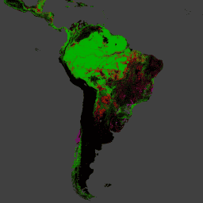
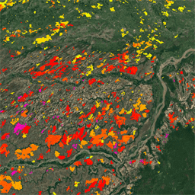
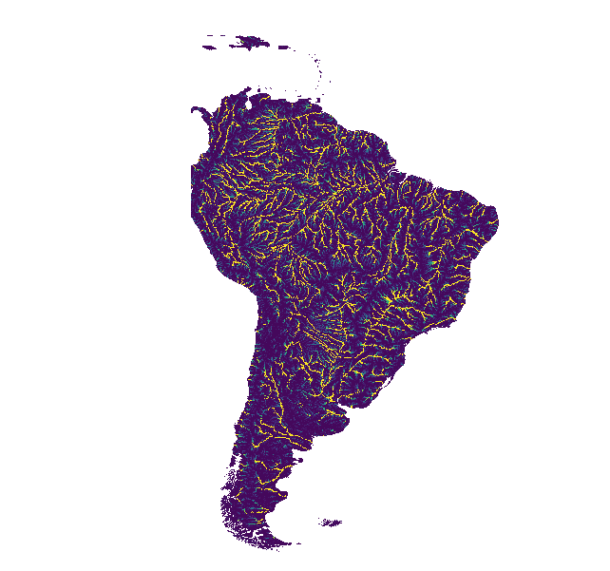
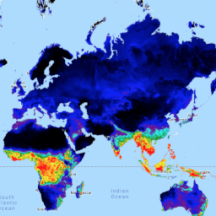
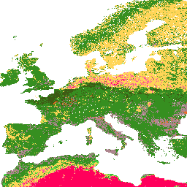
Proposal of Forest Restoration Plan for Forest Fire Damage for Preservation of Permafrost in Alpine Region of Mongolia
1. Overview
4. Methods
Enerel Bayarmagnai ¹ , Seong Woo Jeon ^{1,2}
¹ Korea University (enerel@korea.ac.kr) , ² Ojeong Resilience Institute
2. Introduction
5. Results and Discussion
3. Materials
6. Conclusions
[Materials]
Google Earth Engine Data Catalog
Forest area : 1) Hansen Global Forest Change v1.9 (2000-2021)
Burned area : 2) FireCCI51: MODIS Fire_cci Burned Area Pixel Product, Version 5.1
Permafrost exist area : 3) WWF HydroATLAS Basins Level 12
Soil moisture & Soil temperature : 4) FLDAS: Famine Early Warning Systems Network (FEWS NET) Land Data Assimilation System
Soil texture classes : 5) OpenLandMap Soil Texture Class (USDA System)
1)
2)
3)
4)
5)
This work was supported by Korea Environment Industry &Technology Institute (KEITI) through "Climate Change R&D Project for New Climate Regime.", funded by Korea Ministry of Environment (MOE) (2022003570003)

Slide 7
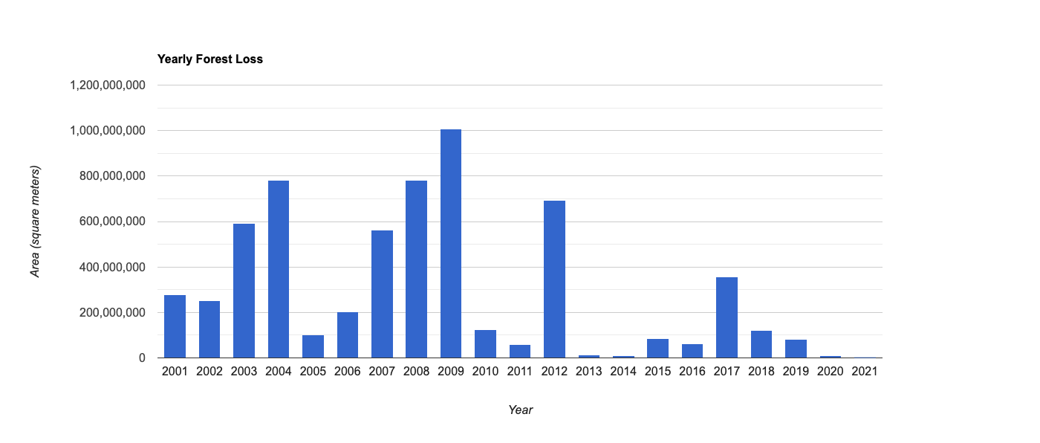
Proposal of Forest Restoration Plan for Forest Fire Damage for Preservation of Permafrost in Alpine Region of Mongolia
1. Overview
4. Methods
Enerel Bayarmagnai ¹ , Seong Woo Jeon ^{1,2}
¹ Korea University (enerel@korea.ac.kr) , ² Ojeong Resilience Institute
2. Introduction
5. Results and Discussion
3. Materials
6. Conclusions
[Methods]
Forest mapping (2000-2020)
We processed the global map and built a forest map by year for 20 years.
From 2000 to 2020, Mongolia's forest area shows a continuous decreasing trend.
Method for deriving forest area with permafrost damaged by fire(2000-2020)
More than 80% of fires in Mongolia occur between March and mid-June of the year.
click on video
Forest map
(2000-2020)
Possibility map of permafrost
(25%-100%)
Spring fire map
(Mar 1st – Jun 15th)
Forest loss
Forests with permafrost
Forest loss(o) + Permafrost exist + burned
Forest loss(x) + Permafrost exist + burned
Zoom in
<Yearly forest loss area from 2001 to 2020>
<Time series change of forest from 2000 to 2020>
This work was supported by Korea Environment Industry &Technology Institute (KEITI) through "Climate Change R&D Project for New Climate Regime.", funded by Korea Ministry of Environment (MOE) (2022003570003)

Slide 8
Proposal of Forest Restoration Plan for Forest Fire Damage for Preservation of Permafrost in Alpine Region of Mongolia
1. Overview
4. Methods
Enerel Bayarmagnai ¹ , Seong Woo Jeon ^{1,2}
¹ Korea University (enerel@korea.ac.kr) , ² Ojeong Resilience Institute
2. Introduction
5. Results and Discussion
3. Materials
6. Conclusions
[Methods]
Analysis of soil characteristics in fire-damaged forest areas (2000-2020)
Soil moisture change trend analysis results (from Feb(before fire) to Jul(after fire)
Type 1) Forest loss(o) + Permafrost exist + burned
Type 1 soil moisture change trend
Type 1 soil texture
Type 1 soil temperature change trend
Type 1 soil texture
Soil texture
map
Type 2 soil moisture change trend
Type 2 soil texture
Soil temperature change trend analysis results (from Feb(before fire) to Jul(after fire)
Type 2) Forest loss(x) + Permafrost exist + burned
Type 2 soil temperature change trend
Type 2 soil texture
This work was supported by Korea Environment Industry &Technology Institute (KEITI) through "Climate Change R&D Project for New Climate Regime.", funded by Korea Ministry of Environment (MOE) (2022003570003)

Slide 9
Proposal of Forest Restoration Plan for Forest Fire Damage for Preservation of Permafrost in Alpine Region of Mongolia
1. Overview
4. Methods
Enerel Bayarmagnai ¹ , Seong Woo Jeon ^{1,2}
¹ Korea University (enerel@korea.ac.kr) , ² Ojeong Resilience Institute
2. Introduction
5. Results and Discussion
3. Materials
6. Conclusions
[Results and Discussion]
Type 1) Forest areas with permafrost that have been completely lost due to fires (2000-2020)
Type 2) Forests with permafrost that have been burned but not completely lost (2000-2020)
click on video
click on video
Zoom in
Zoom in
This work was supported by Korea Environment Industry &Technology Institute (KEITI) through "Climate Change R&D Project for New Climate Regime.", funded by Korea Ministry of Environment (MOE) (2022003570003)

Slide 10
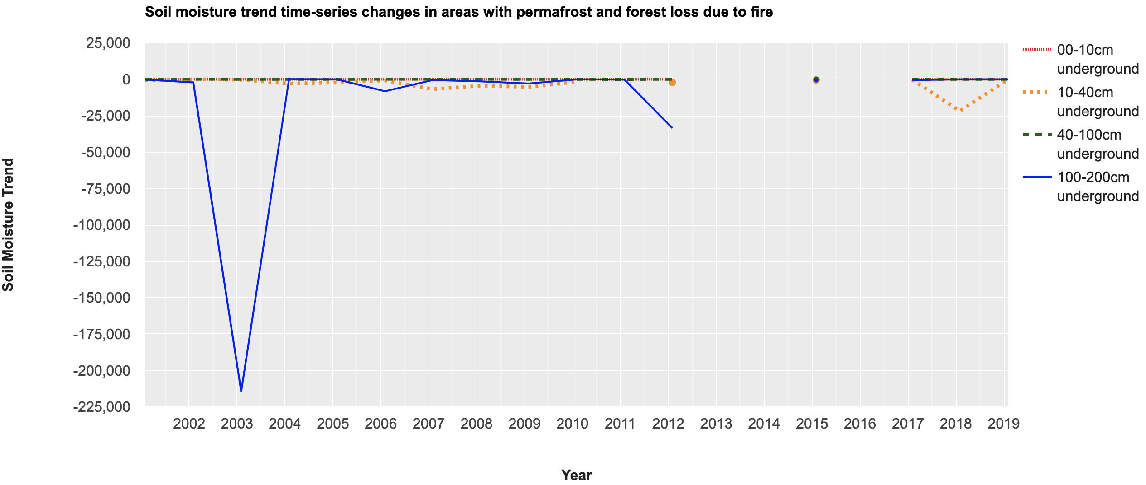
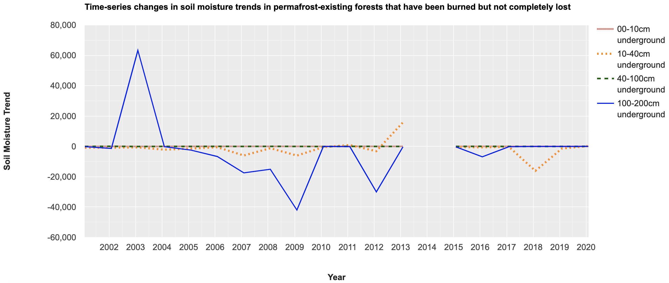
Proposal of Forest Restoration Plan for Forest Fire Damage for Preservation of Permafrost in Alpine Region of Mongolia
1. Overview
4. Methods
Enerel Bayarmagnai ¹ , Seong Woo Jeon ^{1,2}
¹ Korea University (enerel@korea.ac.kr) , ² Ojeong Resilience Institute
2. Introduction
5. Results and Discussion
3. Materials
6. Conclusions
[Results and Discussion]
Soil moisture change trend of type 1 (2000-2020)
Soil moisture change trend of type 2 (2000-2020)
Zoom in
Zoom in
Permafrost exists under forests because forests protect the permafrost's cool temperatures from sunlight.
Fire causes the permafrost to melt, so the permafrost gets deeper.
As forest density increases, permafrost depth tends to decrease.
This work was supported by Korea Environment Industry &Technology Institute (KEITI) through "Climate Change R&D Project for New Climate Regime.", funded by Korea Ministry of Environment (MOE) (2022003570003)

Slide 11
Proposal of Forest Restoration Plan for Forest Fire Damage for Preservation of Permafrost in Alpine Region of Mongolia
1. Overview
4. Methods
Enerel Bayarmagnai ¹ , Seong Woo Jeon ^{1,2}
¹ Korea University (enerel@korea.ac.kr) , ² Ojeong Resilience Institute
2. Introduction
5. Results and Discussion
3. Materials
6. Conclusions
[Results and Discussion]
Soil moisture change trend of type 1 (2000-2020)
Soil moisture change trend of type 2 (2000-2020)
Zoom in
Zoom in
Soil moisture and soil temperature are indicators of changes in permafrost depth, and changes in soil moisture with fire-induced soil depth are indicators of how much permafrost has thawed. Soil moisture at depths of 10–40 cm and 100–200 cm are most sensitive, with opposite trends. When 10–40 cm of permafrost melts, soil moisture moves to a deeper depth of 100–200 cm.
This work was supported by Korea Environment Industry &Technology Institute (KEITI) through "Climate Change R&D Project for New Climate Regime.", funded by Korea Ministry of Environment (MOE) (2022003570003)

Slide 12
Proposal of Forest Restoration Plan for Forest Fire Damage for Preservation of Permafrost in Alpine Region of Mongolia
1. Overview
4. Methods
Enerel Bayarmagnai ¹ , Seong Woo Jeon ^{1,2}
¹ Korea University (enerel@korea.ac.kr) , ² Ojeong Resilience Institute
2. Introduction
5. Results and Discussion
3. Materials
6. Conclusions
[Results and Discussion]
Soil moisture change trend of type 1 (2000-2020)
Soil moisture change trend of type 2 (2000-2020)
Zoom in
Zoom in
There tends to be larger increases or decreases in soil moisture at depths of 100–200 cm in forests where forest loss is not complete. This means that there was a larger area of permafrost in forest areas where the forest density was higher, and the fires did not result in complete forest loss, but the permafrost under the forest was significantly reduced.
This work was supported by Korea Environment Industry &Technology Institute (KEITI) through "Climate Change R&D Project for New Climate Regime.", funded by Korea Ministry of Environment (MOE) (2022003570003)

Slide 13
Proposal of Forest Restoration Plan for Forest Fire Damage for Preservation of Permafrost in Alpine Region of Mongolia
1. Overview
4. Methods
Enerel Bayarmagnai ¹ , Seong Woo Jeon ^{1,2}
¹ Korea University (enerel@korea.ac.kr) , ² Ojeong Resilience Institute
2. Introduction
5. Results and Discussion
3. Materials
6. Conclusions
[Results and Discussion]
Soil moisture change trend of type 1 (2000-2020)
Soil moisture change trend of type 2 (2000-2020)
Zoom in
Zoom in
Variation in soil moisture at 100–200 cm depth in areas where forest still exists is greater than variation in soil moisture at 100–200 cm depth in areas with complete forest loss.
This shows that areas where forest loss is not complete contain more soil moisture than areas where forest loss is not complete.
This work was supported by Korea Environment Industry &Technology Institute (KEITI) through "Climate Change R&D Project for New Climate Regime.", funded by Korea Ministry of Environment (MOE) (2022003570003)

Slide 14
Proposal of Forest Restoration Plan for Forest Fire Damage for Preservation of Permafrost in Alpine Region of Mongolia
1. Overview
4. Methods
Enerel Bayarmagnai ¹ , Seong Woo Jeon ^{1,2}
¹ Korea University (enerel@korea.ac.kr) , ² Ojeong Resilience Institute
2. Introduction
5. Results and Discussion
3. Materials
6. Conclusions
[Results and Discussion]
Soil moisture change trend of type 1 (2000-2020)
Soil moisture change trend of type 2 (2000-2020)
Zoom in
Zoom in
In the time series change of soil moisture, large fluctuations in soil moisture occurred in 2003, 2006, 2009, 2012, and 2018.
In 2003, there was a significant decrease in soil moisture at depths of 100–200 cm in areas with complete forest loss, whereas a significant increase in soil moisture at depths of 100–200 cm in areas without total forest loss.
This work was supported by Korea Environment Industry &Technology Institute (KEITI) through "Climate Change R&D Project for New Climate Regime.", funded by Korea Ministry of Environment (MOE) (2022003570003)

Slide 15
Proposal of Forest Restoration Plan for Forest Fire Damage for Preservation of Permafrost in Alpine Region of Mongolia
1. Overview
4. Methods
Enerel Bayarmagnai ¹ , Seong Woo Jeon ^{1,2}
¹ Korea University (enerel@korea.ac.kr) , ² Ojeong Resilience Institute
2. Introduction
5. Results and Discussion
3. Materials
6. Conclusions
[Results and Discussion]
Soil moisture change trend of type 1 (2000-2020)
Soil moisture change trend of type 2 (2000-2020)
Zoom in
Zoom in
The forest density in 2003 was high and had a lot of permafrost. In 2003, the permafrost in areas where the forest still remains has thawed, but has moved into deeper soils at 100-200 cm. However, in areas where forests were completely lost, permafrost was completely lost as even soil moisture was lost at a depth of 100-200 cm.
This work was supported by Korea Environment Industry &Technology Institute (KEITI) through "Climate Change R&D Project for New Climate Regime.", funded by Korea Ministry of Environment (MOE) (2022003570003)

Slide 16
Proposal of Forest Restoration Plan for Forest Fire Damage for Preservation of Permafrost in Alpine Region of Mongolia
1. Overview
4. Methods
Enerel Bayarmagnai ¹ , Seong Woo Jeon ^{1,2}
¹ Korea University (enerel@korea.ac.kr) , ² Ojeong Resilience Institute
2. Introduction
5. Results and Discussion
3. Materials
6. Conclusions
[Results and Discussion]
Soil temperature change trend of type 1 (2000-2020)
Soil temperature change trend of type 2 (2000-2020)
Zoom in
Zoom in
Soil temperature at a depth of 10-40 cm responds most sensitively to the effects of fire.
This soil layer has a shallow depth permafrost layer when the forest density is high and the soil temperature is low.
This work was supported by Korea Environment Industry &Technology Institute (KEITI) through "Climate Change R&D Project for New Climate Regime.", funded by Korea Ministry of Environment (MOE) (2022003570003)

Slide 17
Proposal of Forest Restoration Plan for Forest Fire Damage for Preservation of Permafrost in Alpine Region of Mongolia
1. Overview
4. Methods
Enerel Bayarmagnai ¹ , Seong Woo Jeon ^{1,2}
¹ Korea University (enerel@korea.ac.kr) , ² Ojeong Resilience Institute
2. Introduction
5. Results and Discussion
3. Materials
6. Conclusions
[Results and Discussion]
Soil temperature change trend of type 1 (2000-2020)
Soil temperature change trend of type 2 (2000-2020)
Zoom in
Zoom in
Soil moisture trend analysis showed large changes in 2003, 2006, 2009, 2012, and 2018, and soil temperature trend analysis also showed a tendency for soil temperature to increase significantly during the same period.
This work was supported by Korea Environment Industry &Technology Institute (KEITI) through "Climate Change R&D Project for New Climate Regime.", funded by Korea Ministry of Environment (MOE) (2022003570003)

Slide 18
Proposal of Forest Restoration Plan for Forest Fire Damage for Preservation of Permafrost in Alpine Region of Mongolia
1. Overview
4. Methods
Enerel Bayarmagnai ¹ , Seong Woo Jeon ^{1,2}
¹ Korea University (enerel@korea.ac.kr) , ² Ojeong Resilience Institute
2. Introduction
5. Results and Discussion
3. Materials
6. Conclusions
[Results and Discussion]
Soil texture class distribution range of type 1 (2003, 2006, 2009, 2012, 2018)
Soil texture class distribution range of type 2 (2003, 2006, 2009, 2012, 2018)
Zoom in
Zoom in
Soil textures were analyzed in areas with and without forest loss in 2003, 2006, 2009, and 2009, when changes in soil moisture and soil temperature were significant.
The analysis results show different trends in the distribution of soil texture classes in forest loss and non-loss areas.
This work was supported by Korea Environment Industry &Technology Institute (KEITI) through "Climate Change R&D Project for New Climate Regime.", funded by Korea Ministry of Environment (MOE) (2022003570003)

Slide 19
Proposal of Forest Restoration Plan for Forest Fire Damage for Preservation of Permafrost in Alpine Region of Mongolia
1. Overview
4. Methods
Enerel Bayarmagnai ¹ , Seong Woo Jeon ^{1,2}
¹ Korea University (enerel@korea.ac.kr) , ² Ojeong Resilience Institute
2. Introduction
5. Results and Discussion
3. Materials
6. Conclusions
[Conclusions]
Areas with complete lost and those without lost are both affected by fire, but show differences in their response to fire and their ability to recover.
There was a large difference in the trend of soil moisture change between areas where forests were completely lost due to fire and areas where forests were not lost.
Areas that have not completely lost forests have more soil moisture and permafrost than those that do.
Soil moisture is sensitive to fire at soil depths of 10-40 cm and 100-200 cm.
Soil temperature is sensitive to fire at a depth of 10-40 cm.
In 2003, 2006, 2009 and 2012, fires occurred that significantly affected soil moisture and soil temperature in forests.
From 2003 to the present, the moisture in the soil has been continuously reduced, and even in the event of a fire, there is no significant change in soil moisture.
This work was supported by Korea Environment Industry &Technology Institute (KEITI) through "Climate Change R&D Project for New Climate Regime.", funded by Korea Ministry of Environment (MOE) (2022003570003)

Slide 20
Proposal of Forest Restoration Plan for Forest Fire Damage for Preservation of Permafrost in Alpine Region of Mongolia
1. Overview
4. Methods
Enerel Bayarmagnai ¹ , Seong Woo Jeon ^{1,2}
¹ Korea University (enerel@korea.ac.kr) , ² Ojeong Resilience Institute
2. Introduction
5. Results and Discussion
3. Materials
6. Conclusions
[Conclusions]
Future research
Fires affect permafrost and soil hydrology.
Forest restoration to preserve the permafrost must first reflect the soil type and characteristics, topography, chemical characteristics, climate, and vegetation of the damaged area to be restored.
In this study, the current soil moisture, soil temperature, and soil texture were analyzed. In future studies, factors such as topography, climate, and chemical characteristics will be added and analyzed to better reflect the characteristics of the damaged area.
Currently, we are in the stage of analyzing the characteristics of each type of damaged land, and we plan to propose a restoration plan for each type of damage that reflects these characteristics in the future.
This work was supported by Korea Environment Industry &Technology Institute (KEITI) through "Climate Change R&D Project for New Climate Regime.", funded by Korea Ministry of Environment (MOE) (2022003570003)

Slide 21
Proposal of Forest Restoration Plan for Forest Fire Damage for Preservation of Permafrost in Alpine Region of Mongolia
1. Overview
4. Methods
Enerel Bayarmagnai ¹ , Seong Woo Jeon ^{1,2}
¹ Korea University (enerel@korea.ac.kr) , ² Ojeong Resilience Institute
2. Introduction
5. Results and Discussion
3. Materials
6. Conclusions
Go back
click on video
This work was supported by Korea Environment Industry &Technology Institute (KEITI) through "Climate Change R&D Project for New Climate Regime.", funded by Korea Ministry of Environment (MOE) (2022003570003)

Slide 22
Proposal of Forest Restoration Plan for Forest Fire Damage for Preservation of Permafrost in Alpine Region of Mongolia
1. Overview
4. Methods
Enerel Bayarmagnai ¹ , Seong Woo Jeon ^{1,2}
¹ Korea University (enerel@korea.ac.kr) , ² Ojeong Resilience Institute
2. Introduction
5. Results and Discussion
3. Materials
6. Conclusions
click on video
Go back
This work was supported by Korea Environment Industry &Technology Institute (KEITI) through "Climate Change R&D Project for New Climate Regime.", funded by Korea Ministry of Environment (MOE) (2022003570003)

Slide 23
Proposal of Forest Restoration Plan for Forest Fire Damage for Preservation of Permafrost in Alpine Region of Mongolia
1. Overview
4. Methods
Enerel Bayarmagnai ¹ , Seong Woo Jeon ^{1,2}
¹ Korea University (enerel@korea.ac.kr) , ² Ojeong Resilience Institute
2. Introduction
5. Results and Discussion
3. Materials
6. Conclusions
click on video
Go back
This work was supported by Korea Environment Industry &Technology Institute (KEITI) through "Climate Change R&D Project for New Climate Regime.", funded by Korea Ministry of Environment (MOE) (2022003570003)

Slide 24
Proposal of Forest Restoration Plan for Forest Fire Damage for Preservation of Permafrost in Alpine Region of Mongolia
1. Overview
4. Methods
Enerel Bayarmagnai ¹ , Seong Woo Jeon ^{1,2}
¹ Korea University (enerel@korea.ac.kr) , ² Ojeong Resilience Institute
2. Introduction
5. Results and Discussion
3. Materials
6. Conclusions
Go back
This work was supported by Korea Environment Industry &Technology Institute (KEITI) through "Climate Change R&D Project for New Climate Regime.", funded by Korea Ministry of Environment (MOE) (2022003570003)

Slide 25
Proposal of Forest Restoration Plan for Forest Fire Damage for Preservation of Permafrost in Alpine Region of Mongolia
1. Overview
4. Methods
Enerel Bayarmagnai ¹ , Seong Woo Jeon ^{1,2}
¹ Korea University (enerel@korea.ac.kr) , ² Ojeong Resilience Institute
2. Introduction
5. Results and Discussion
3. Materials
6. Conclusions
Go back
This work was supported by Korea Environment Industry &Technology Institute (KEITI) through "Climate Change R&D Project for New Climate Regime.", funded by Korea Ministry of Environment (MOE) (2022003570003)

Slide 26
Proposal of Forest Restoration Plan for Forest Fire Damage for Preservation of Permafrost in Alpine Region of Mongolia
1. Overview
4. Methods
Enerel Bayarmagnai ¹ , Seong Woo Jeon ^{1,2}
¹ Korea University (enerel@korea.ac.kr) , ² Ojeong Resilience Institute
2. Introduction
5. Results and Discussion
3. Materials
6. Conclusions
Go back
This work was supported by Korea Environment Industry &Technology Institute (KEITI) through "Climate Change R&D Project for New Climate Regime.", funded by Korea Ministry of Environment (MOE) (2022003570003)

Slide 27
Proposal of Forest Restoration Plan for Forest Fire Damage for Preservation of Permafrost in Alpine Region of Mongolia
1. Overview
4. Methods
Enerel Bayarmagnai ¹ , Seong Woo Jeon ^{1,2}
¹ Korea University (enerel@korea.ac.kr) , ² Ojeong Resilience Institute
2. Introduction
5. Results and Discussion
3. Materials
6. Conclusions
Go back
This work was supported by Korea Environment Industry &Technology Institute (KEITI) through "Climate Change R&D Project for New Climate Regime.", funded by Korea Ministry of Environment (MOE) (2022003570003)

Slide 28
Proposal of Forest Restoration Plan for Forest Fire Damage for Preservation of Permafrost in Alpine Region of Mongolia
1. Overview
4. Methods
Enerel Bayarmagnai ¹ , Seong Woo Jeon ^{1,2}
¹ Korea University (enerel@korea.ac.kr) , ² Ojeong Resilience Institute
2. Introduction
5. Results and Discussion
3. Materials
6. Conclusions
Go back
This work was supported by Korea Environment Industry &Technology Institute (KEITI) through "Climate Change R&D Project for New Climate Regime.", funded by Korea Ministry of Environment (MOE) (2022003570003)

Slide 29
Proposal of Forest Restoration Plan for Forest Fire Damage for Preservation of Permafrost in Alpine Region of Mongolia
1. Overview
4. Methods
Enerel Bayarmagnai ¹ , Seong Woo Jeon ^{1,2}
¹ Korea University (enerel@korea.ac.kr) , ² Ojeong Resilience Institute
2. Introduction
5. Results and Discussion
3. Materials
6. Conclusions
Go back
This work was supported by Korea Environment Industry &Technology Institute (KEITI) through "Climate Change R&D Project for New Climate Regime.", funded by Korea Ministry of Environment (MOE) (2022003570003)

Slide 30
Proposal of Forest Restoration Plan for Forest Fire Damage for Preservation of Permafrost in Alpine Region of Mongolia
1. Overview
4. Methods
Enerel Bayarmagnai ¹ , Seong Woo Jeon ^{1,2}
¹ Korea University (enerel@korea.ac.kr) , ² Ojeong Resilience Institute
2. Introduction
5. Results and Discussion
3. Materials
6. Conclusions
Thank you for your attention.
This work was supported by Korea Environment Industry &Technology Institute (KEITI) through "Climate Change R&D Project for New Climate Regime.", funded by Korea Ministry of Environment (MOE) (2022003570003)

