Slide 1
Public involvement in the design and implementation of infrastructure projects.
Dimitra Dimitrakopoulou, Romanos Ioannidis, Panayiotis Dimitriadis, Theano Iliopoulou, George-Fivos Sargentis, Efthymios Chardavellas, Nikos Mamassis, and Demetris Koutsoyiannis
National Technical University of Athens, School of Civil Engineering, Department of Water Resources and Environmental Engineering, Greece (dimitrakopoulou.dimitra@gmail.com)

Slide 2
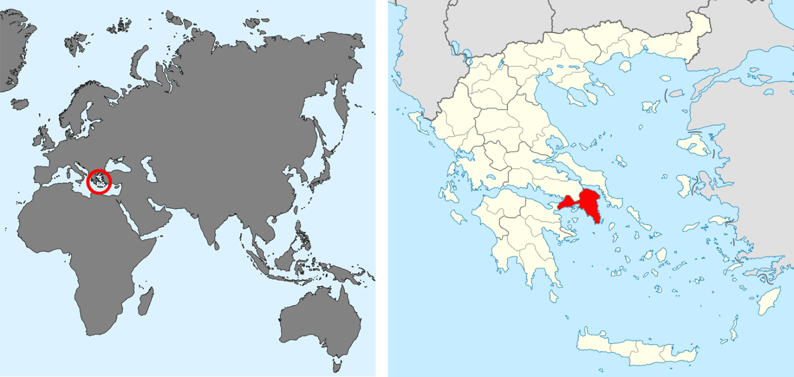
Public involvement in the design and implementation of infrastructure projects.
Infrastructure projects, although associated with public health and well-being, are often faced with opposition movements during their design and implementation. In this work, public engagement is investigated as means for comprehending the reasons behind any public opposition during the implementation of civil infrastructure works.

Slide 3
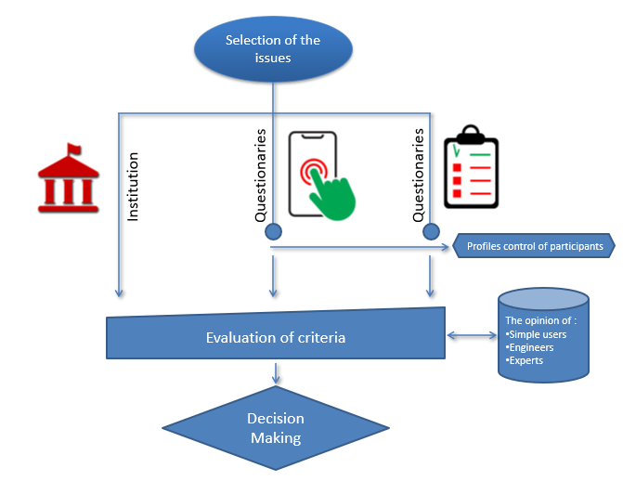
Public involvement in the design and implementation of infrastructure projects.
Three courses of actions were taken in order to initiate public engagement in the design process, i.e.,
the collaboration with municipalities, institutes and universities for collection of data and previous studies in the area,
the indirect communication with the public through online questionnaires, and
the direct communication with the public during field works and by loose-format interviews regarding their experiences.
After statistically evaluating the information acquired by the input data, it is concluded that the combination of the above actions can enhance the engineers’ knowledge at the area of interest, and thus, may result in a more efficient design of public works, but also, in the public engagement during and after their implementation.

Slide 4
Collaboration with institutions and agencies
Academic and research institutes, local-government authorities and environmental agencies are all necessary for the combination of both the theoretical and the practical knowledge and experience to optimize the risk-assessment study, and to achieve an inter-sectoral cooperation.
A targeted methodology was formed including a process of successive cycles of communications with those agencies and institutes, aiming to utilize both their qualitative and quantitative knowledge and overall, to set a solid data-based foundation for the later stages of the flood-risk analysis.
The process initiated by gathering all the necessary contact details to establish communication not only of the people in charge but also of the ones having something to share to the research. The communication included, firstly, a conversation over the phone with the appropriate introductions and presentations of the project. Once the first contact was accomplished and interest has been provoked, the need for an immediate contribution was highlighted. Afterwards, the communication proceeded by sending formal e-mails, mentioning in written the initial established oral communication. It is concluded that the conversation over the phone prior to the communication over the internet, is considered important, since in this way, a more personal contact is established, which leads to more fruitful collaboration. These simple utilized practices can be applied to generate useful insights for similar projects that include the collaboration of research and governmental institutions for risk analyses in the general field of engineering.

Slide 5
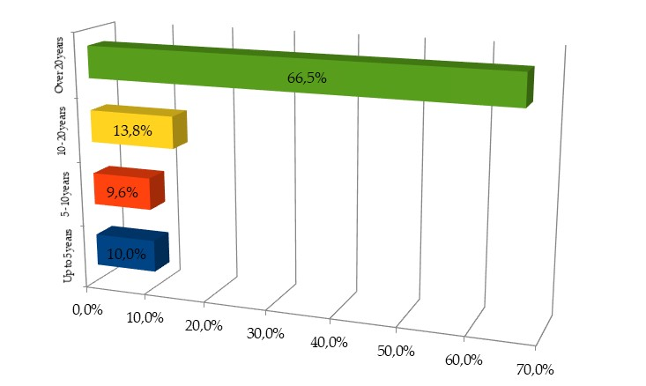
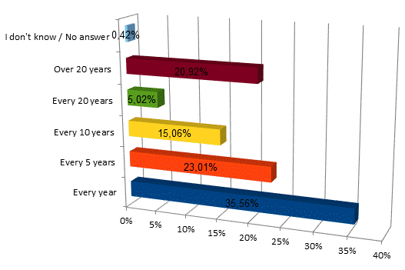
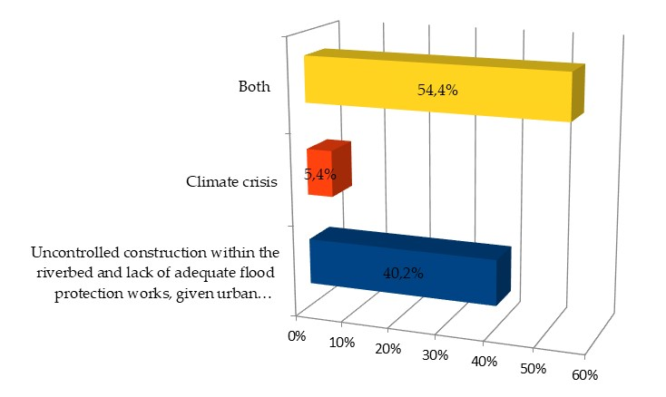
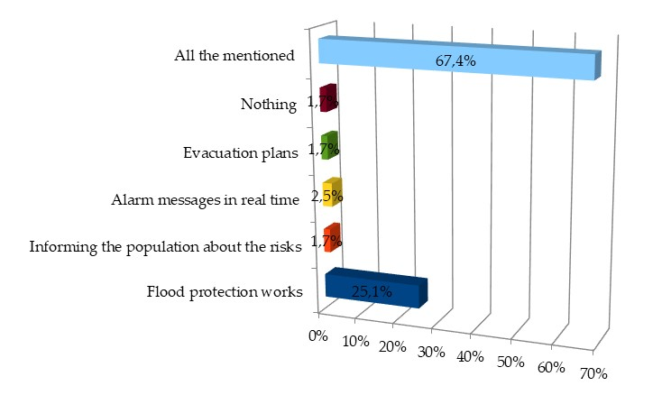
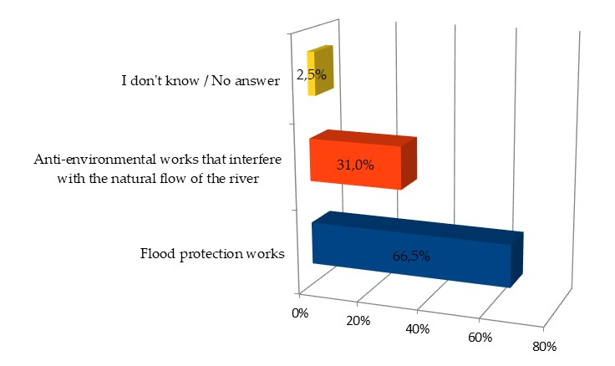
Indirect communication with the public (online questionnaires)
How many years do you live in your area?
How often would you characterize the flooding incidents in your area?
What, in your opinion, is the main cause of the flooding incidents?.
Which measures would you prefer to be taken to decrease the flood risk?
Do you consider the river settlement works as:

Slide 6
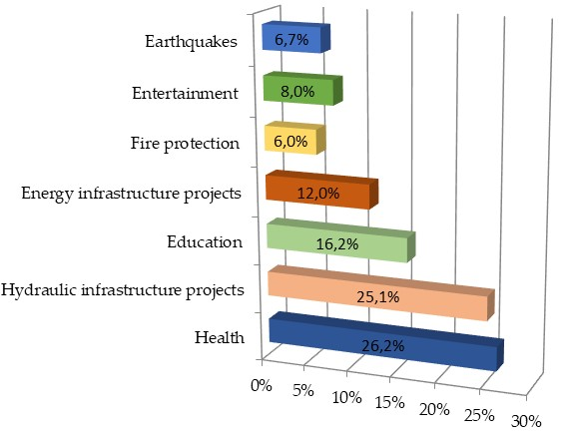
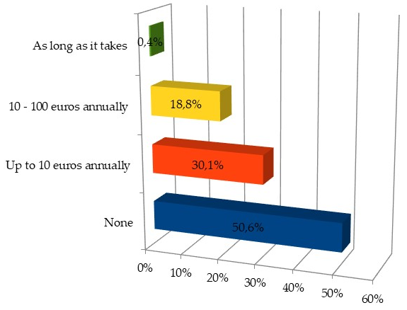
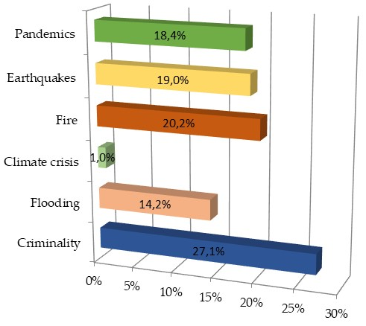
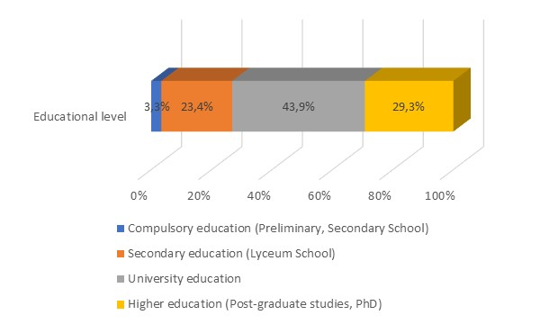
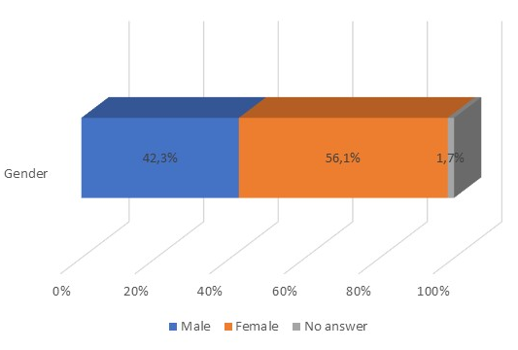
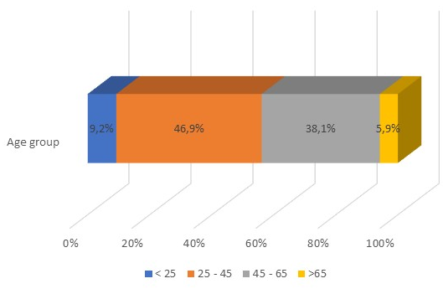
Indirect communication with the public (online questionnaires)
Which are your most important needs - priorities for financing of infrastructure projects in your area?
If money was required for infrastructure projects, would you be willing to contribute and how much?
For which sector would you like to be taken measures for your protection?

Slide 7
Conclusions
The results of this study demonstrate that applying public engagement provides a holistic approach in the process of designing infrastructure projects.
Direct communicating with residents helps in collecting information based on their local experience upon the area of interest. The communication with the public enriches the field research, while also investigating public attitudes on the integration of civil works within the urban area. Additional information can be obtained with the successful participation of governmental institutions.
It is argued that the residents should play an active role in the conception, design and implementation of infrastructure works and social persuasion is a prerequisite. In general, the acceptance of any civil works by the residents is a prerequisite for their successful implementation, without opposition and delays and with reduced impact to quality of life of local communities.
The results of this study demonstrate that applying (a) field research, (b) public engagement and (c) institutions’ collaboration in the process of defining high flood risk areas is highly effective and provides a rather holistic approach in flood risk assessment.
Field research in combination with the knowledge gained from communicating with residents with local experience helps in locating areas prone to flooding that, in many cases, would not manifest through digital flood-risk assessment tools. The communication with the public enriches the field research, while also investigating public attitudes on the integration of civil works within the urban area [2,3]. Additional flood-risk related information was obtained with the successful participation of governmental institutions.
It is argued that the residents should play an active role in the conception, design and implementation of flood protection works and social persuasion is a prerequisite [4]. In general, the acceptance of any civil works by the residents is a prerequisite for their successful implementation, without opposition and delays and with reduced impact to quality of life of local communities.

