Slide 1
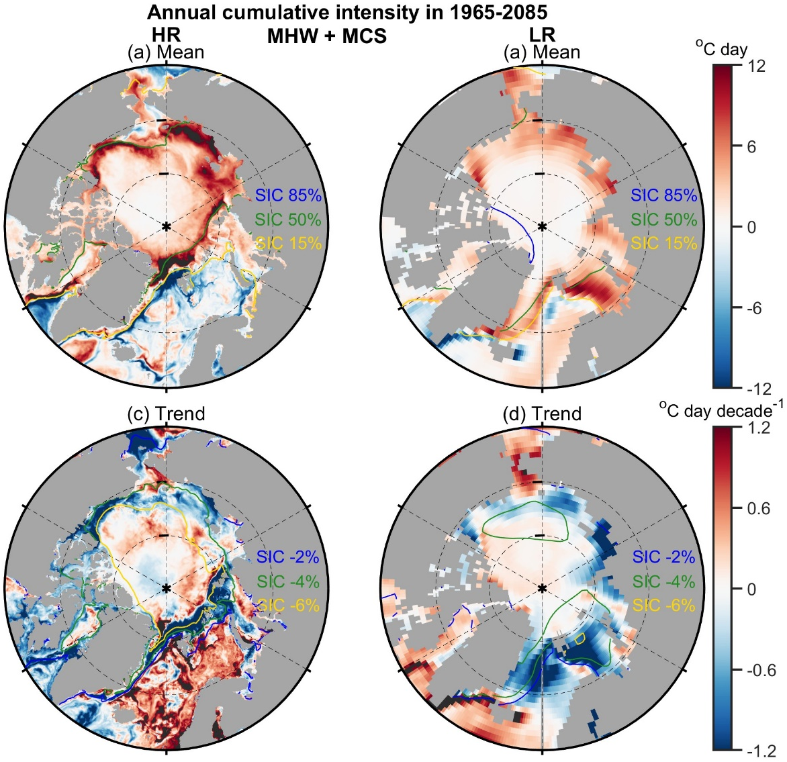
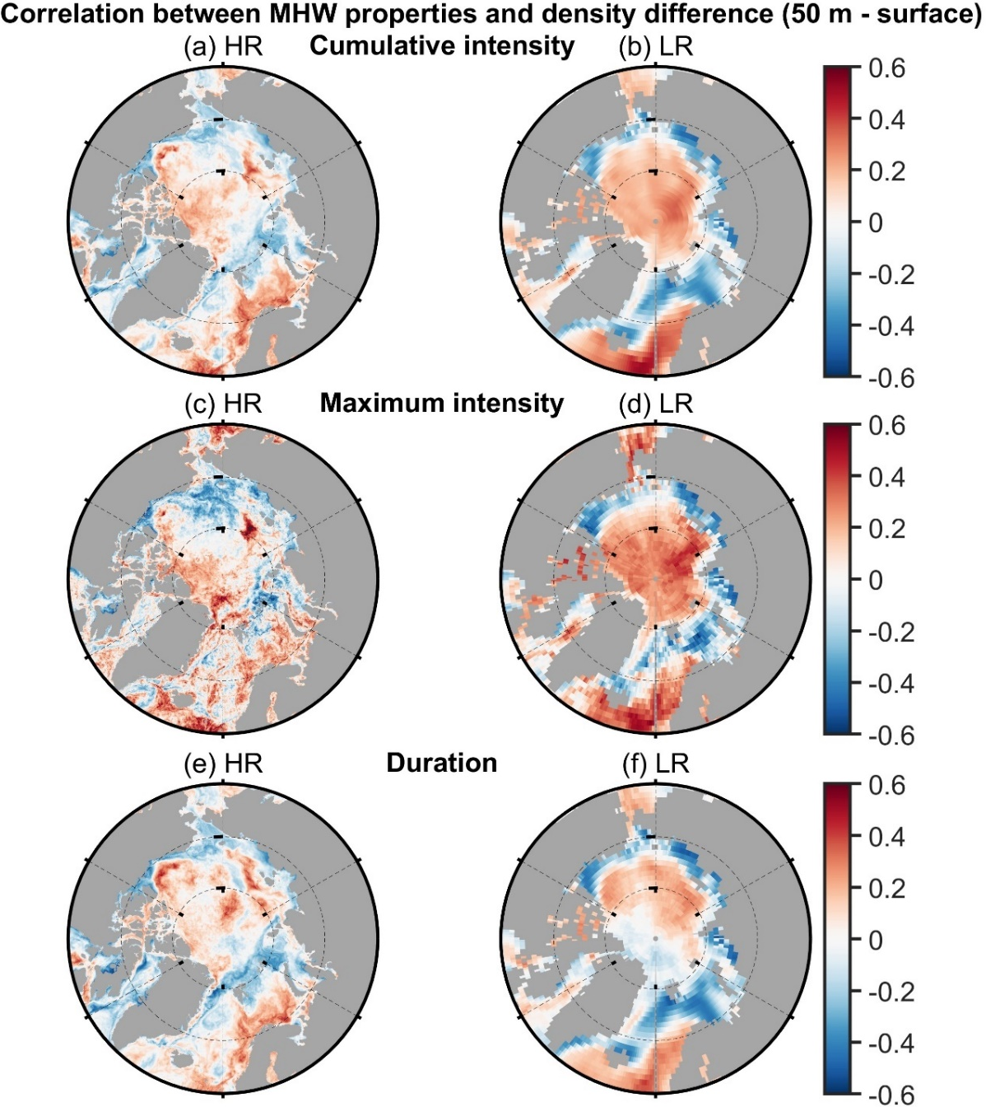
Changing nature of polar warming and marine extremes in high-resolution model for the 21st century
Ruijian Gou, Gerrit Lohmann, Lixin Wu
Background
High-resolution model resolves small-scale extremes
Unknown polar marine extremes
Model
0.1° CESM-HR, 1° CESM-LR
Time span: 1950-2100 (historical+RCP8.5)
Comparing HR to LR
Stronger Arctic warming
Less SO warming
Stronger marine heat waves in Arctic
Extremes induce trends?
Stronger marine cold spells in SO
Extremes in LR is mainly induced by background states (i.e., vertical stratification)
Extremes in HR is mainly induced by ocean internal dynamics (i.e., eddy activity)
Conclusion
In HR, more Arctic warming and less SO warming than LR might be induced by stronger MHW in the Arctic and MCS in the SO – formulating an conceptual model for proving this
The extremes in HR are mainly induced by eddy activity, while in LR are mainly induced by stratification
Contact: 1371242614@qq.com

