Slide 1


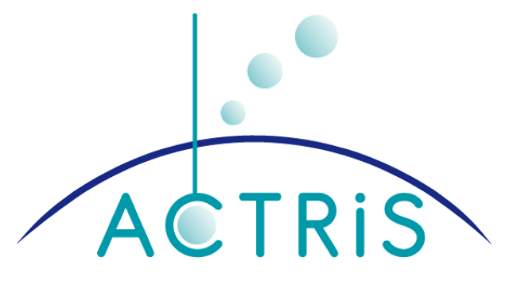

ASKOS Campaign 2021/2022: Overview of measurements and applications
Eleni Marinou, Vassilis Amiridis, Peristera Paschou, Ioanna Tsikoudi, Alexandra Tsekeri, Vassiliki Daskalopoulou, Holger Baars, Athina Floutsi, Dimitra Kouklaki, Razvan Pirloaga, Franco Marenco, Maria Kezoudi, Ewan O Connor, Lukas Pfitzenmaier, Cordula Zenk, Claire Ryder, Jonas Von Bismarck, and Thorsten Fehr and the ASKOS team

Slide 2
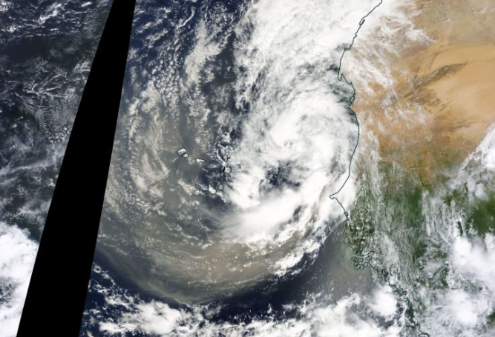
ASKOS experiment
Outline:
Overview of ASKOS dataset
Some applications on:
Validation and Enhancement of satellite products
Data Assimilation
Atmospheric dust processes
Cabo Verde
23/09/2022

Slide 3
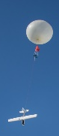
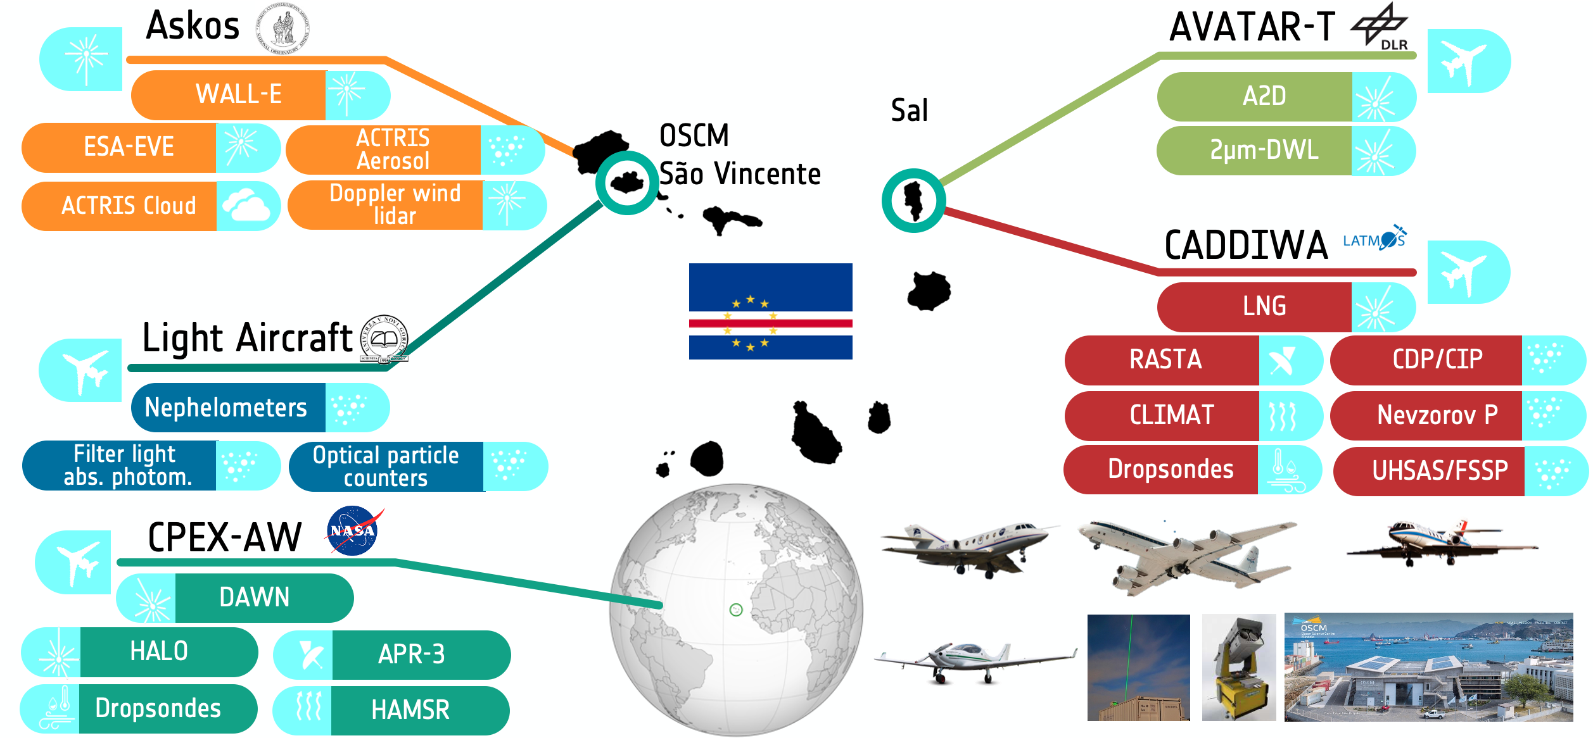
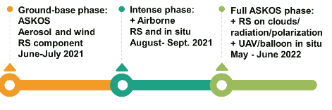
ASKOS: the ground base component of the JATAC campaign
WHERE:
Mindelo, Sao Vicente, Cabo Verde
WHEN:
September 2021: Along with other experiments in the framework of JATAC
June 2022: Collocated with the ERC D-TECT experiment
September 2022: Along with NASA CPEX-CV experimental campaign
CPEX-CV
Source: ESA
ASKOS in JATAC 2021
ASKOS full phase 2022
ASKOS Science Objectives:
Aeolus Validation
Provide an unprecedented amount of quality assured datasets for more applications (e.g. Support to future ESA missions: EarthCARE, WIVERN; improvements in desert dust models)
Science (e.g. dust effect of cloud/radiation/deposition/electrification)
Ground-based RS aerosol, cloud, wind
Sept. 2021
+ radiation, polarization, electricity, in-situ
June & September 2022

Slide 4

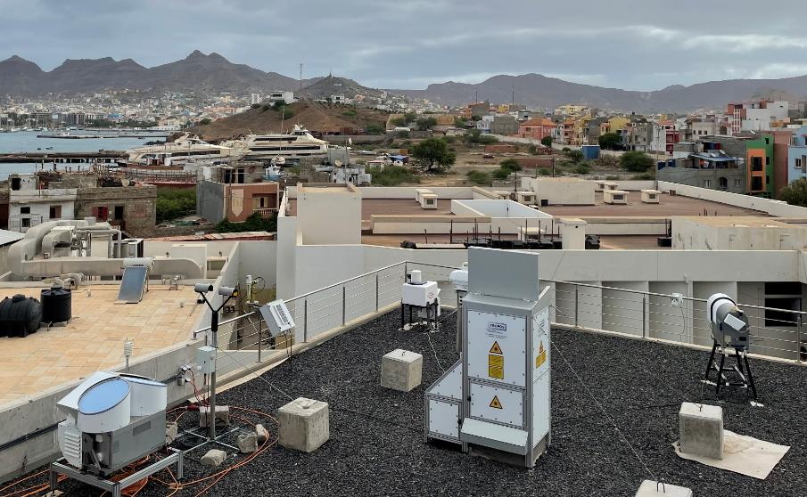
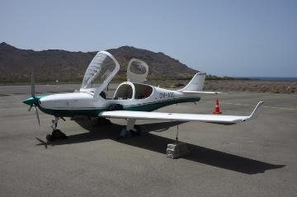
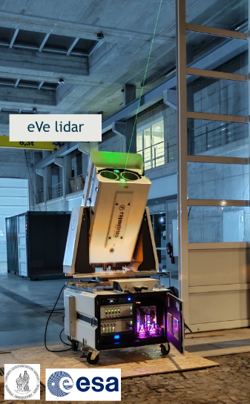










ASKOS Instrumentation since September 2021
ACTRIS Aerosol & Cloud remote sensing facilities
eVe lidar for Aeolus Cal/Val
can mimic Aeolus observations
PollyXT lidar
AERONET
Sun-photometer
Microwave radiometer
CAWA AW:
Airborne in-situ
• 0 – 3 km
• Aerosol conc.
• Size dist.
• Absorption
• Scattering
• Samples
• Solar irradiance
• CO2 sensor
Cloud radar
Wind lidar
Paschou et al., AMT, 2022
Data visualization:
PollyXT: Polly.tropos.de
All other instruments: askos.space.noa.gr
Aerosol, cloud, wind ground-based RS
Yus Díez et al., EGU, 2023
AS1.37 Wednesday

Slide 5
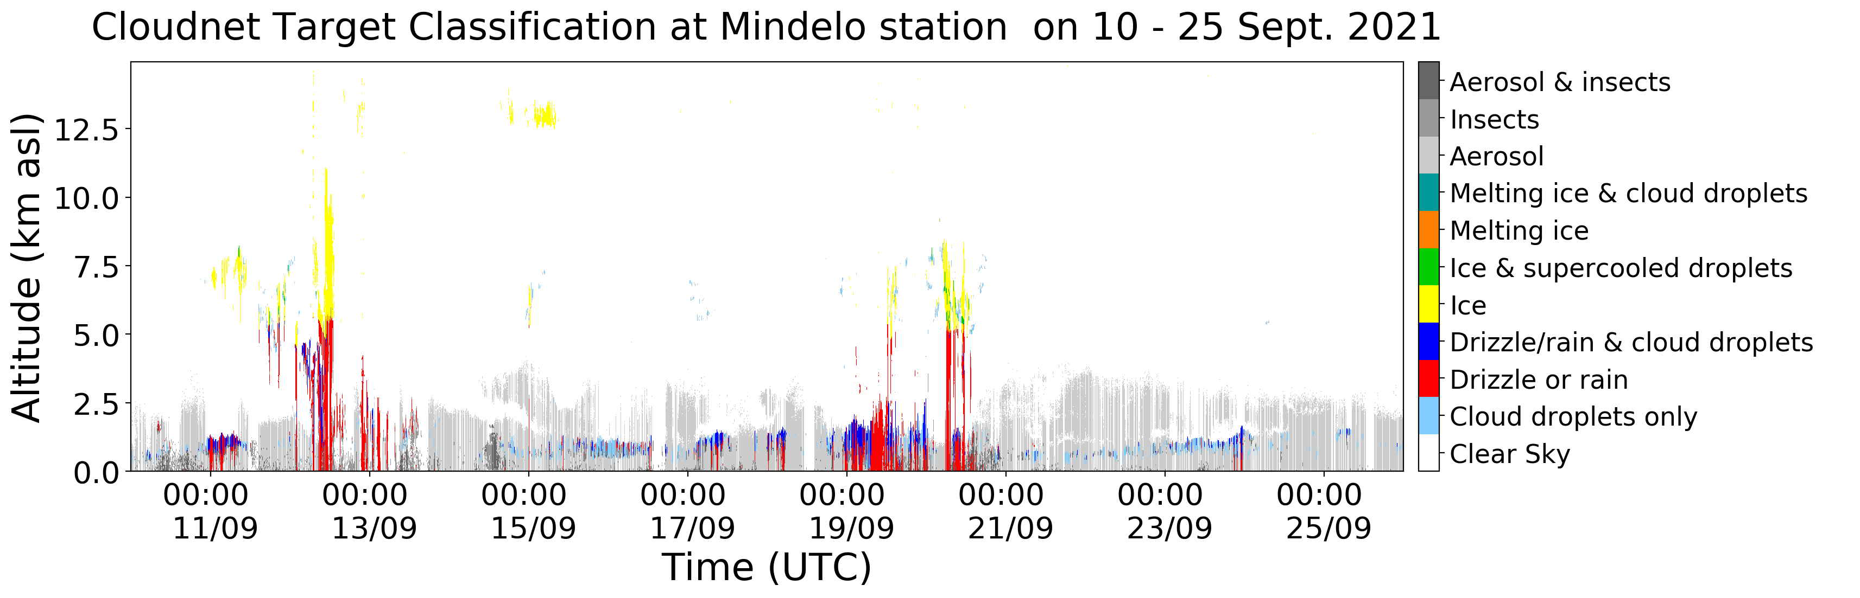
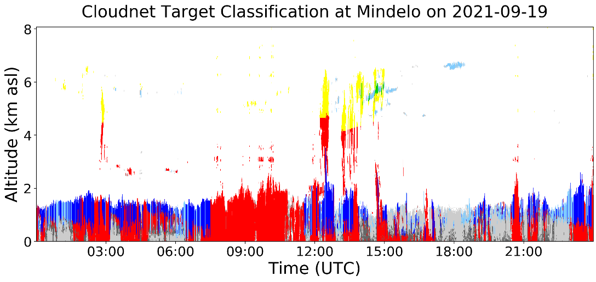
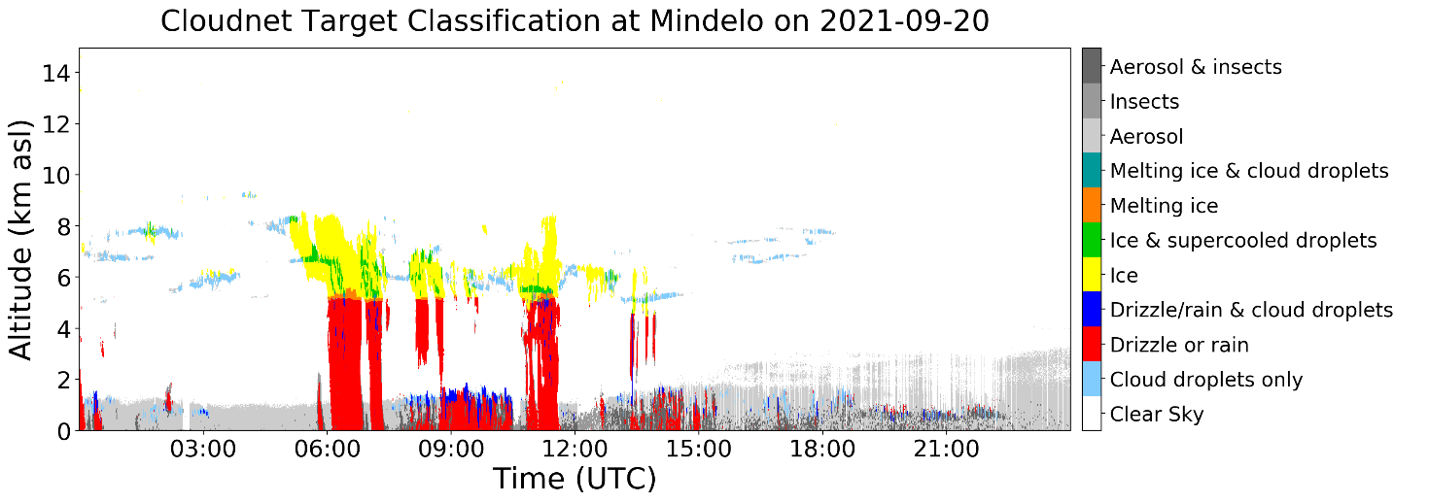
September 2021 – Clouds & Precipitation
nearby Aeolus overpasses & flights
Safire
+DLR
Clouds
Safire
DLR
DLR
Ice
Safire
+DLR
MPC
Rain
water
Rain
water
Safire
Mixed phase

Slide 6
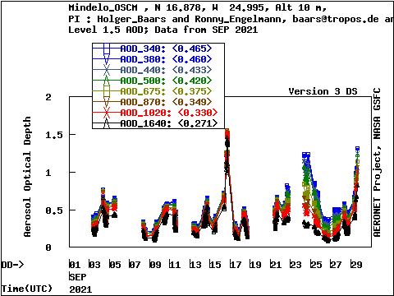
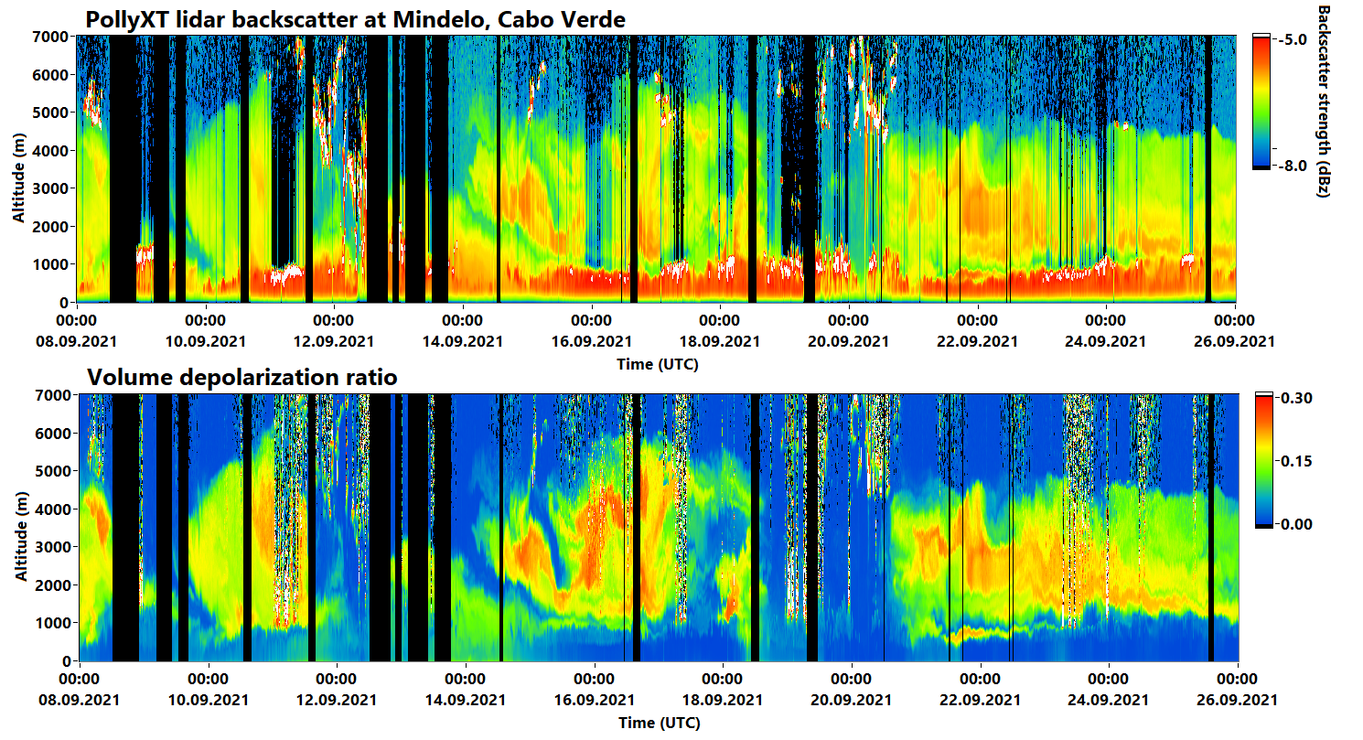
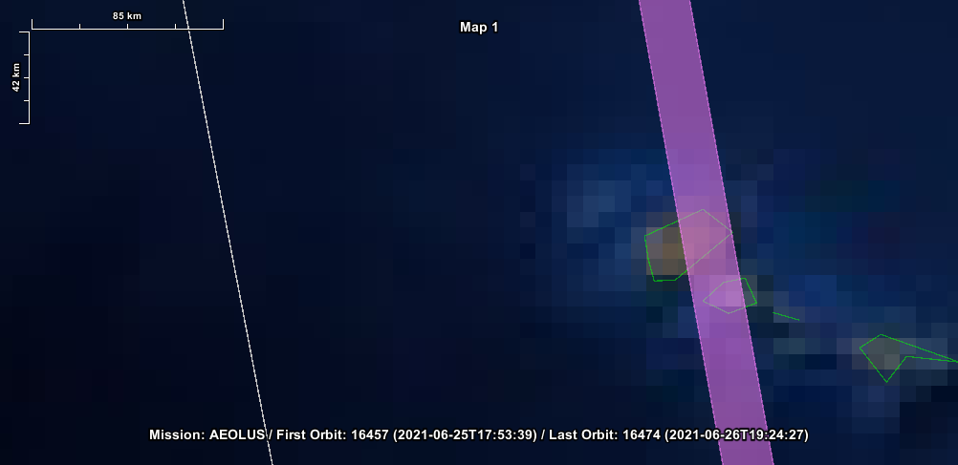
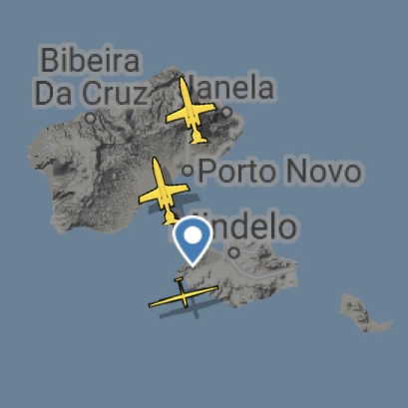
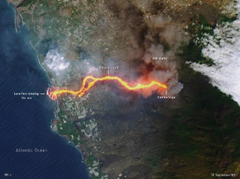
September 2021 - Aerosols
nearby Aeolus overpasses & flights
Clouds
Clouds
Safire
DLR
DLR
Safire
+DLR
Safire
+DLR
Safire
+DLR
Volcanic aerosol
Aeolus overpass
Golden cases on
10 & 17/9/2021 (overflights)
Dust
Dust
Dust
Volcanic
Las Palmas
Canary Islands
Dust
Safire
Marine
DLR
ACTRIS
UNG

Slide 7
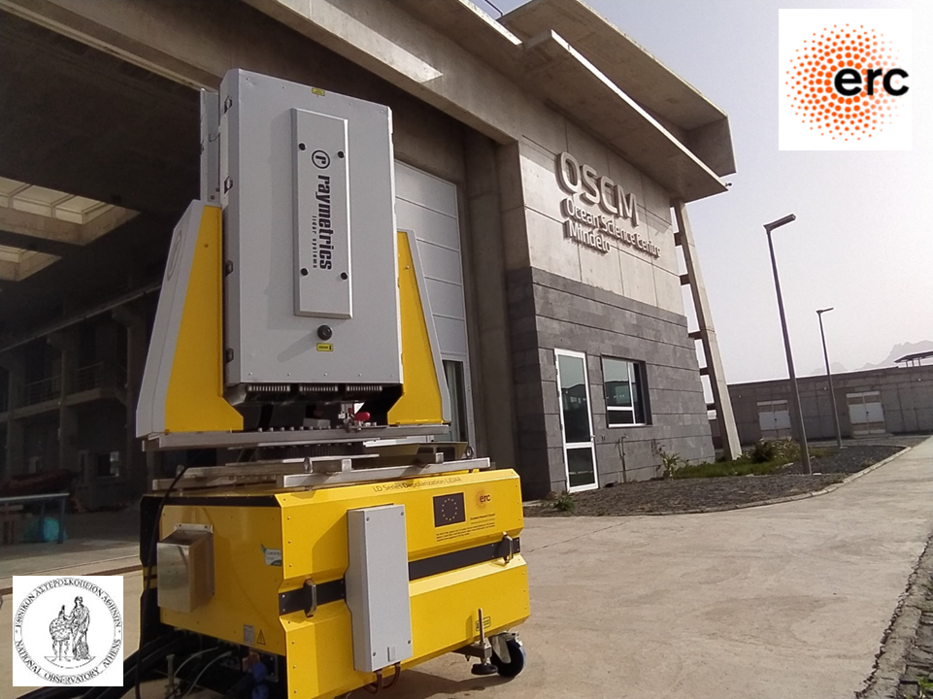
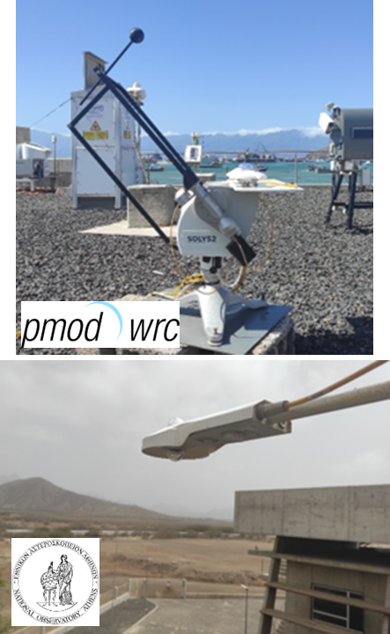
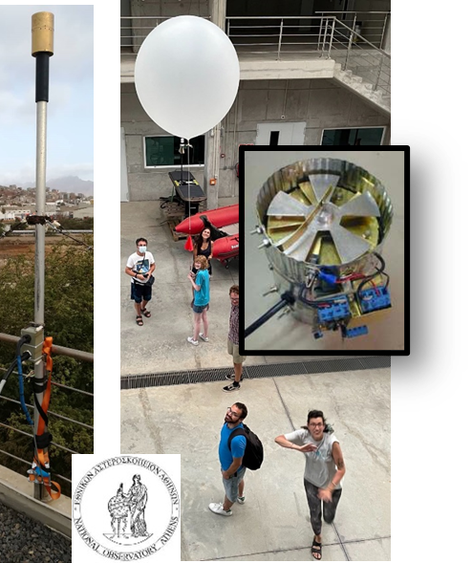
Enhanced remote sensing measurements in 2022
Wall-E polarization lidar
Emits linearly- and elliptically-polarized light at 1064 nm
Designed to measure particle preferential orientation
Measurements of the atmospheric electricity
Electric field
Electric charge
+radiosondes
Radiation measurements
Two pyranometers and pyrheliometer for total, direct and diffuse irradiance
Tsekeri et al., AMT, 2021
Tsekeri et al., EGU23, Dust orientation measurements
Daskalopoulou et al., ACP, 2021

Slide 8

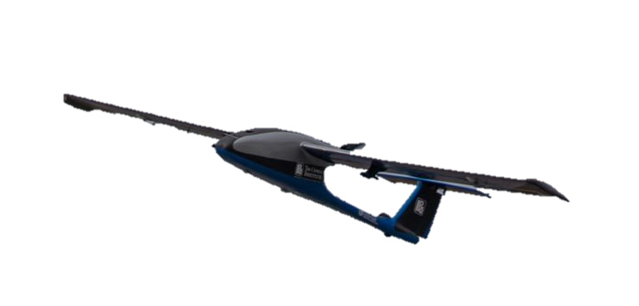
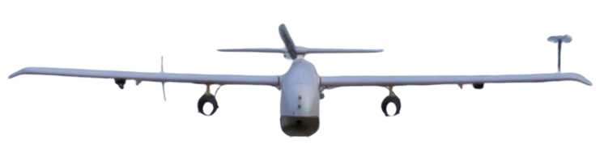
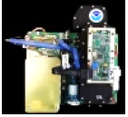
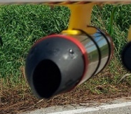
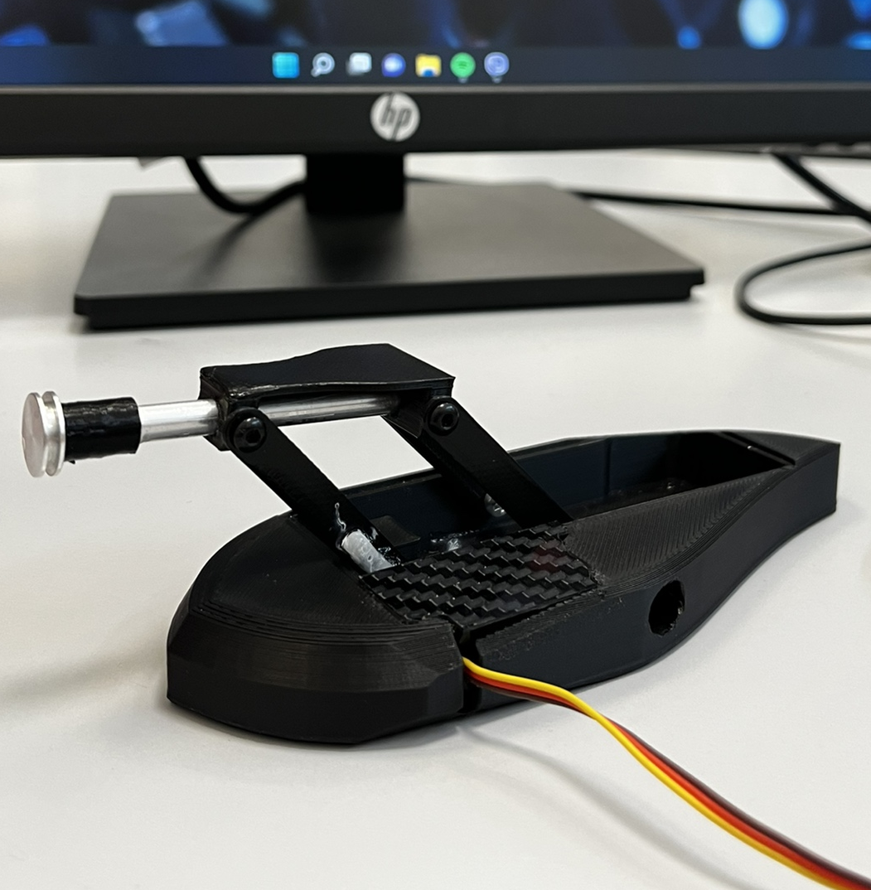
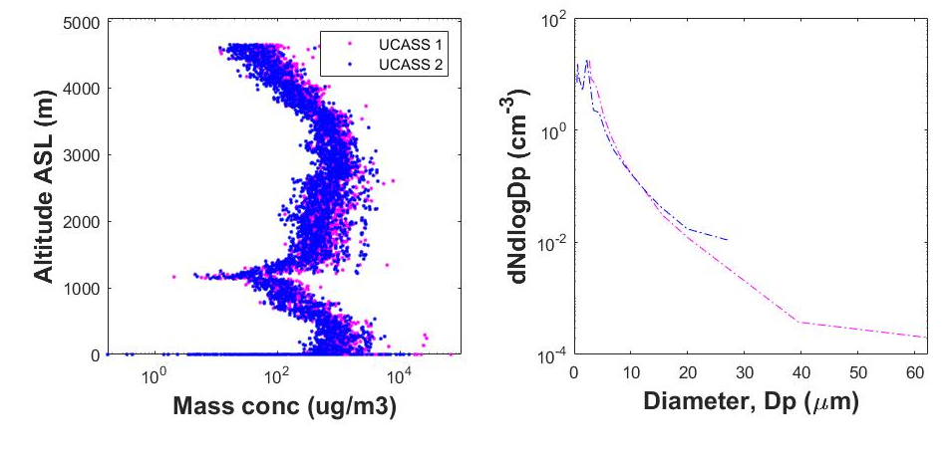
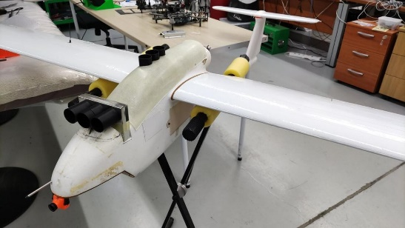
In situ measurements onboard UAVs – June 2022
A. POPs & UCASS OPCs measurements (0.1 – 80 μm)
Skywalker UAV
CoBi (Composite Bird) UAV
POPS
Impactor 1
Impactor 2
UCASS 1
UCASS 2
25 flights
max altitude reached: 5,300 m ASL up to the top of SAL
B. GPAC Impactor sampling (up to 100 μm)
C. COBALD UAV backscatter sondes for particle orientation
Kezoudi et al., EGU, 2023
AS1.37 Wednesday
Dust layer
Marenco et al., EGU, 2023
AS1.37 Wednesday
MBL

Slide 9
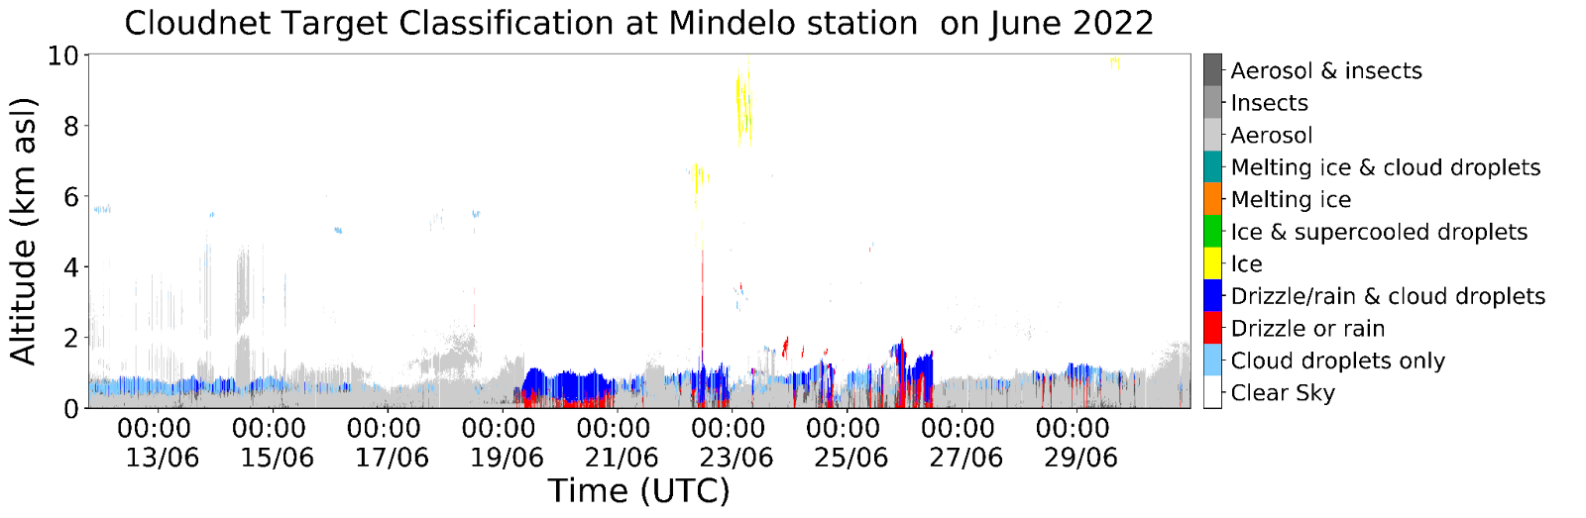
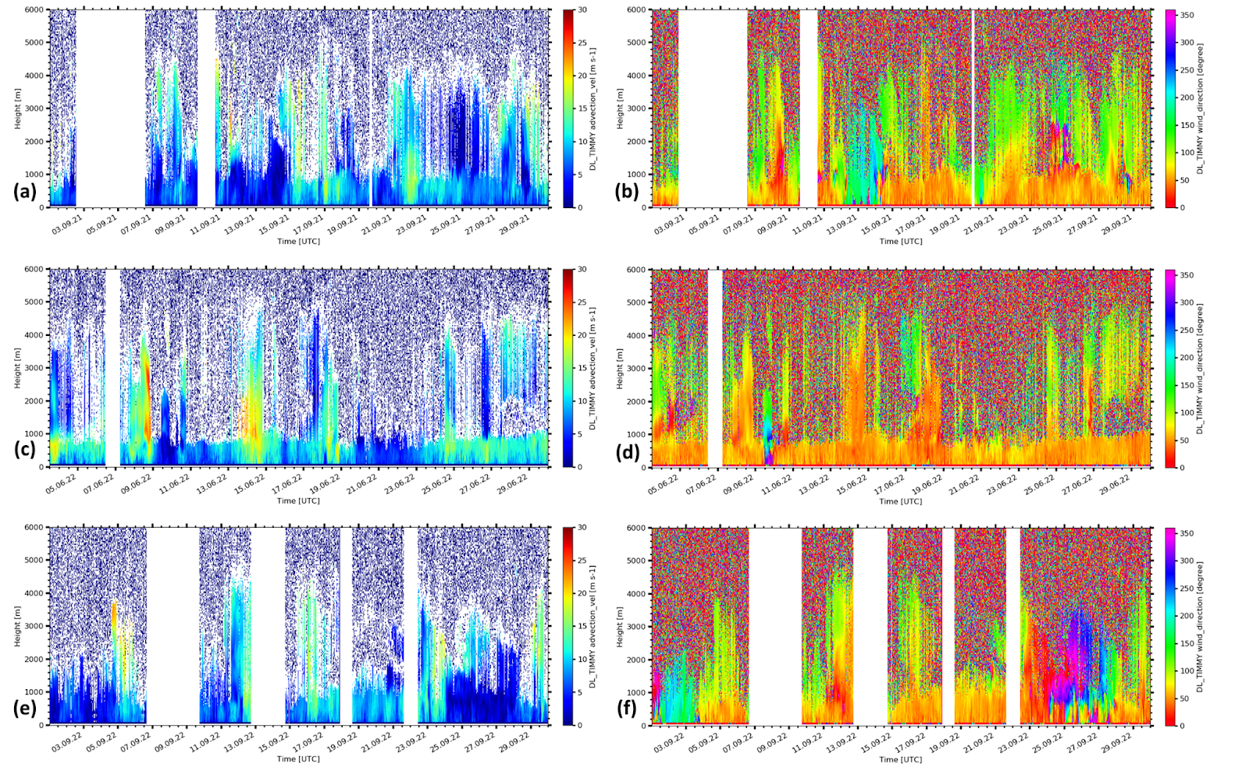
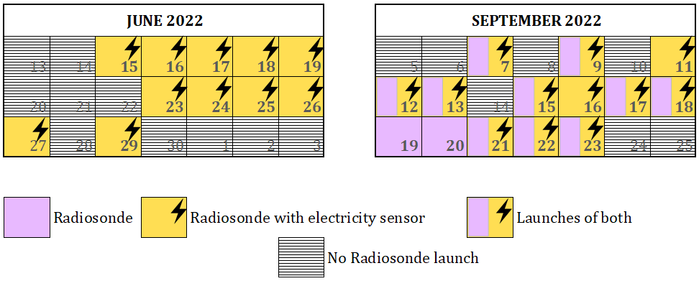
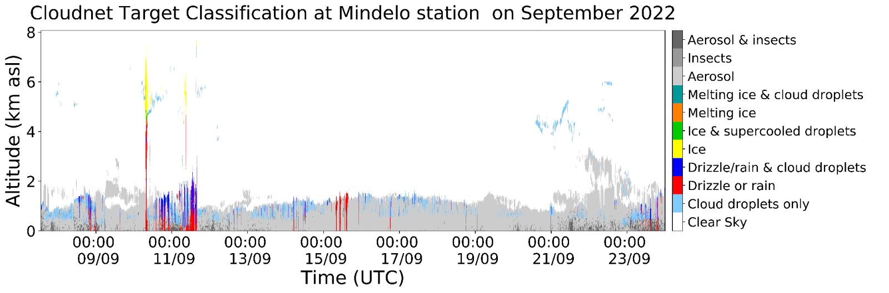
June & September 2022 – Cloud/Precipitation/Wind
10-30 June 2022
June 2022
Horizontal velocity (m/s)
Radiosondes
& electrosondes
nearby Aeolus overpasses
Cloud types
water
Rain
Wind speeds up to 25m/s
6-26 September 2022
September 2022
Horizontal velocity (m/s)
Cloud types
Mixed phase
water
20m/s
water

Slide 10
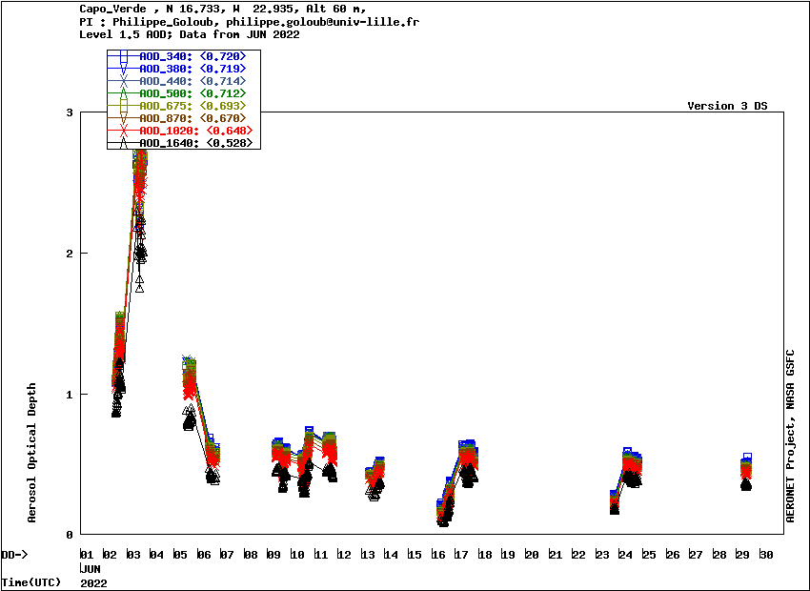
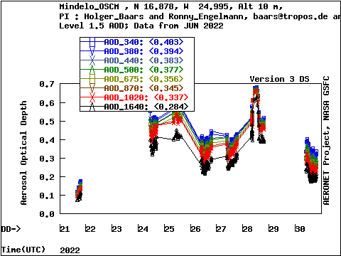
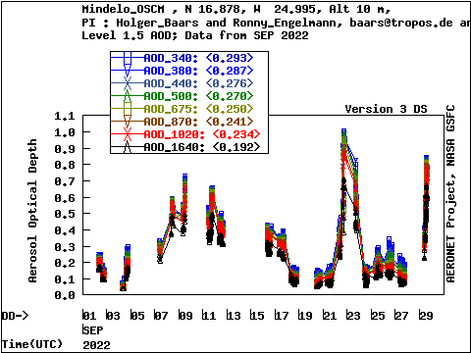
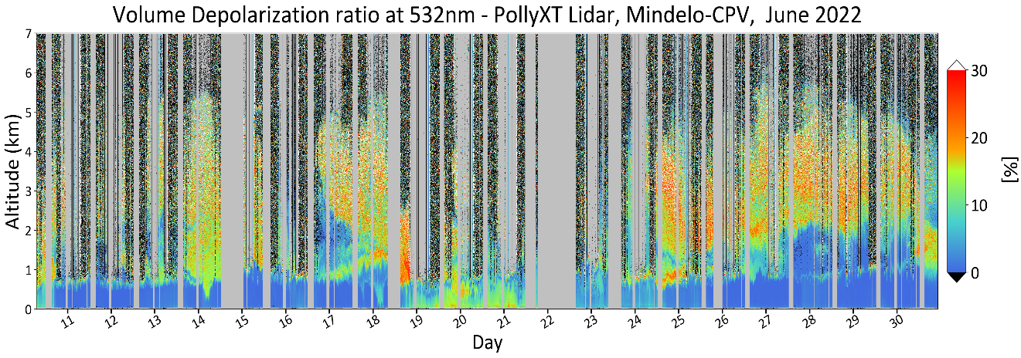
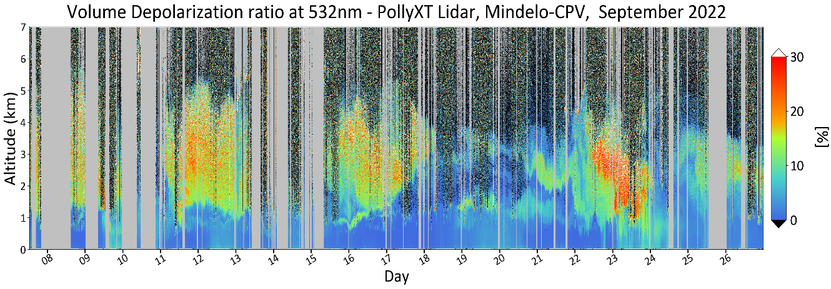
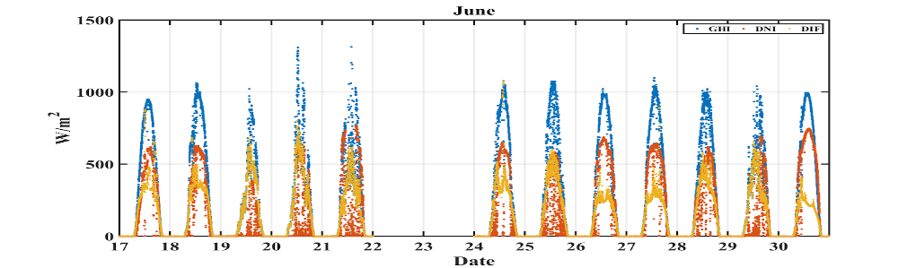
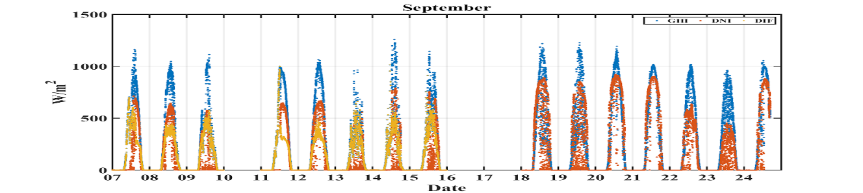
June & September 2022 - Aerosols
Capo Verde (Sal)
Mindelo
Mindelo
Nasa
Dust
Dust
Dust
Dust
Dust
Dust
+Nasa
+Nasa
+Nasa
Nearby Aeolus overpasses
Global Horizontal Irradiance (GHI)
Direct Normal Irradiance (DNI)
Diffuse Irradiance (DFI)
-25% GHI
-50% DNI

Slide 11
Use of ASKOS measurements for:
Validation and Enhancement of satellite products

Slide 12
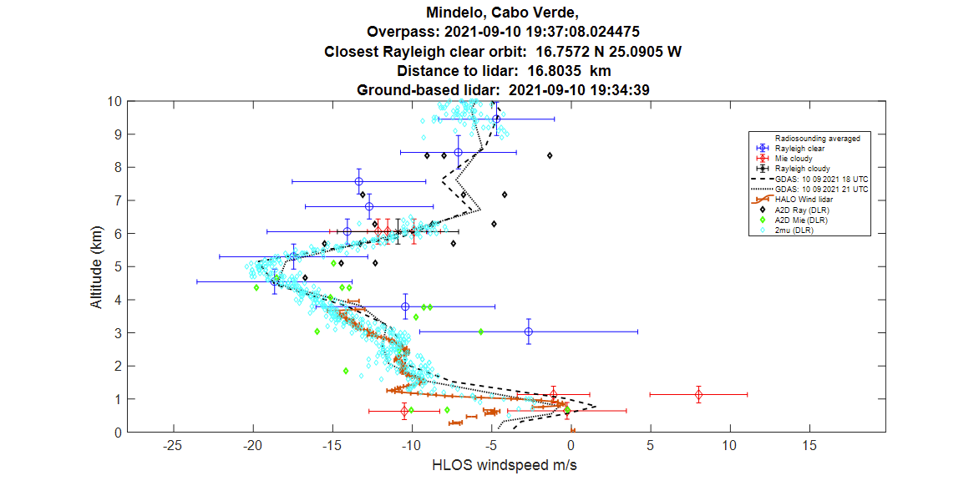
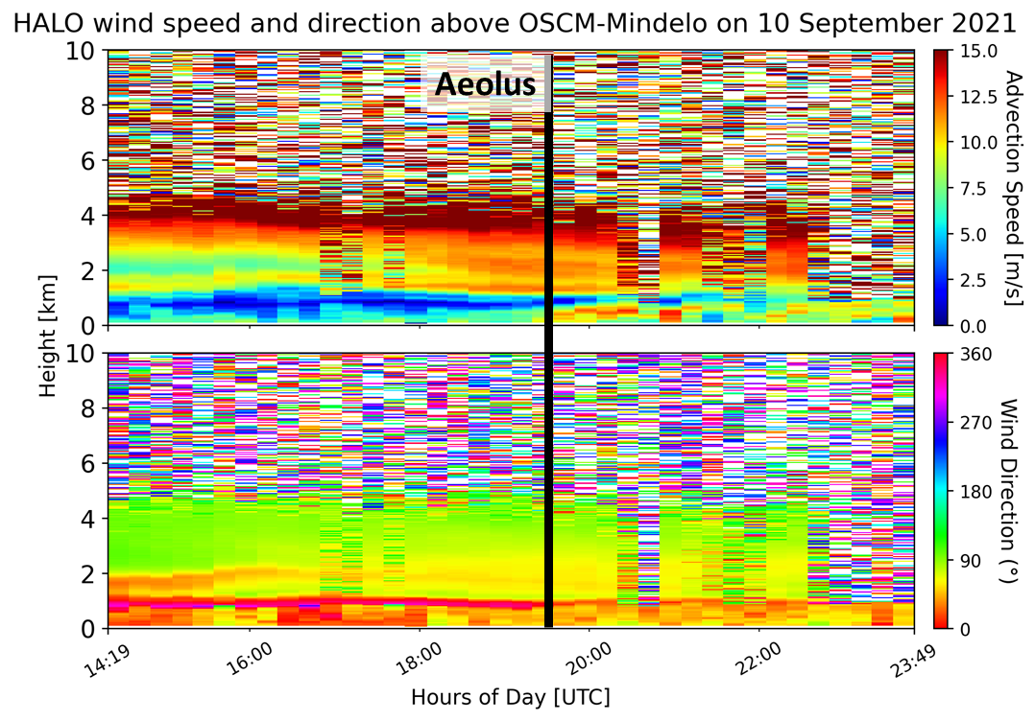
Validation of satellite products - wind
Evaluation of Aeolus wind retrievals

Slide 13

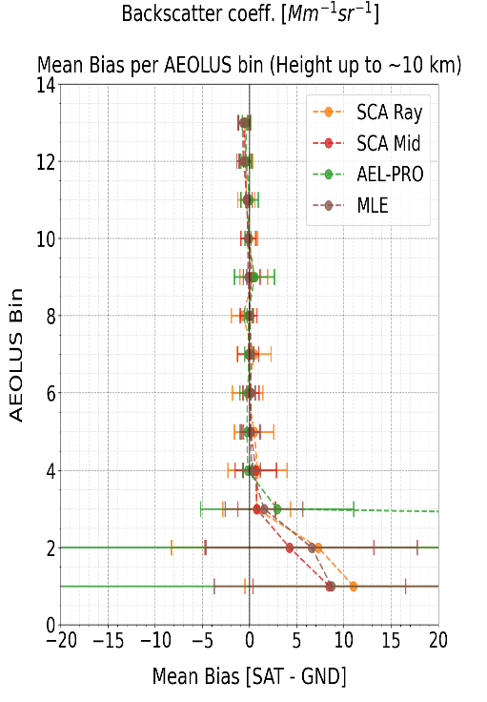
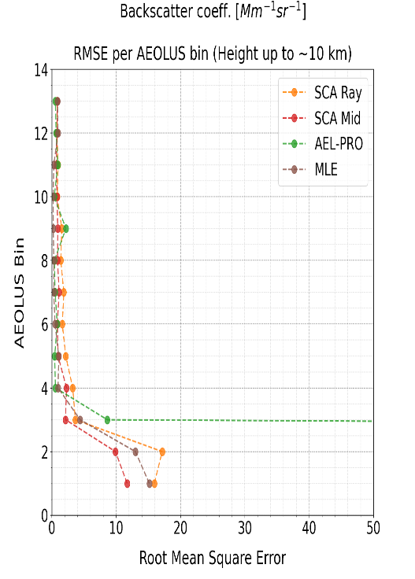
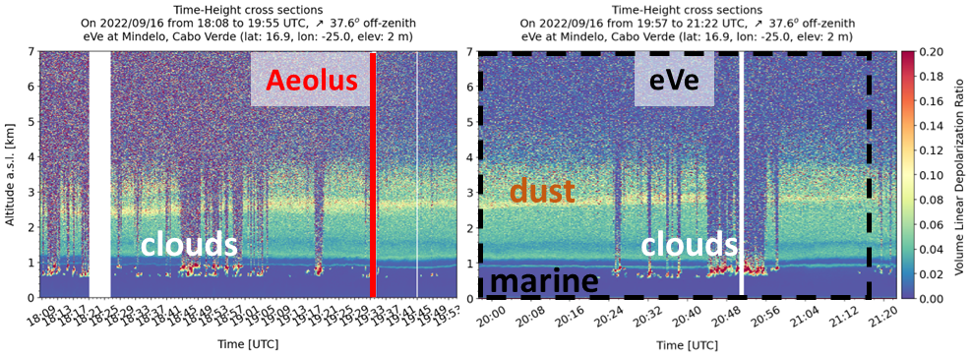
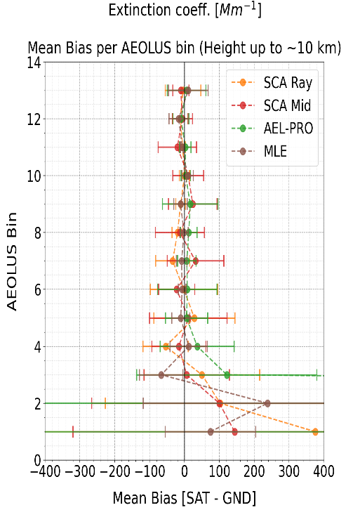
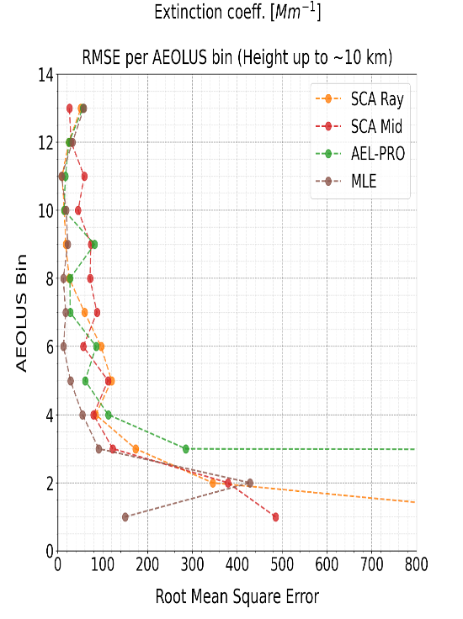
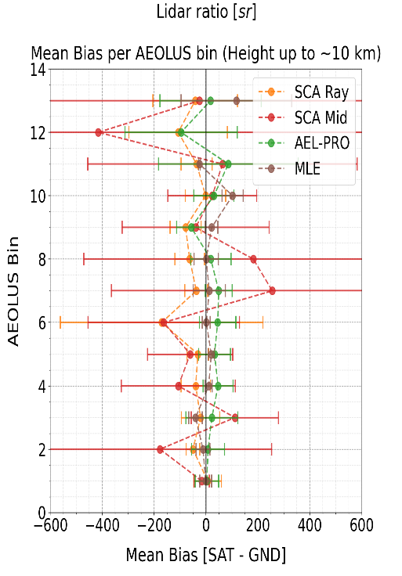
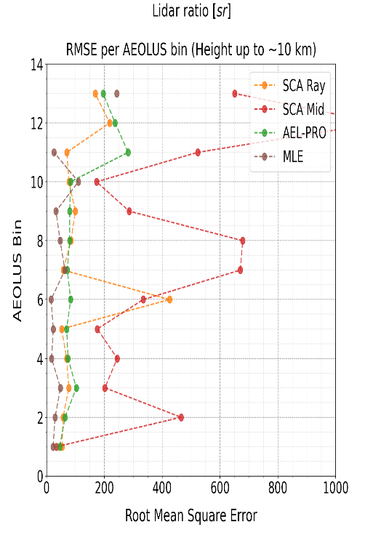
Validation of satellite products - aerosol
Evaluation of Aeolus aerosol retrievals using eVe collocated measurements
Backscatter
Coeff. RMSE
MB < 0.9
MB < 0.7
MB < 0.5
MB < 0.5
~2.5 km
Extinction
Coeff. RMSE
MB < 54
MB < 32
MB < 36
MB < 17
14 collocated cases
Lidar Ratio
RMSE
MB < 50
MB < 177
MB < 22
MB < 40
~2.5 km
~2.5 km
Paschou et al., EGU, 2023
AS1.37 Wednesday

Slide 14

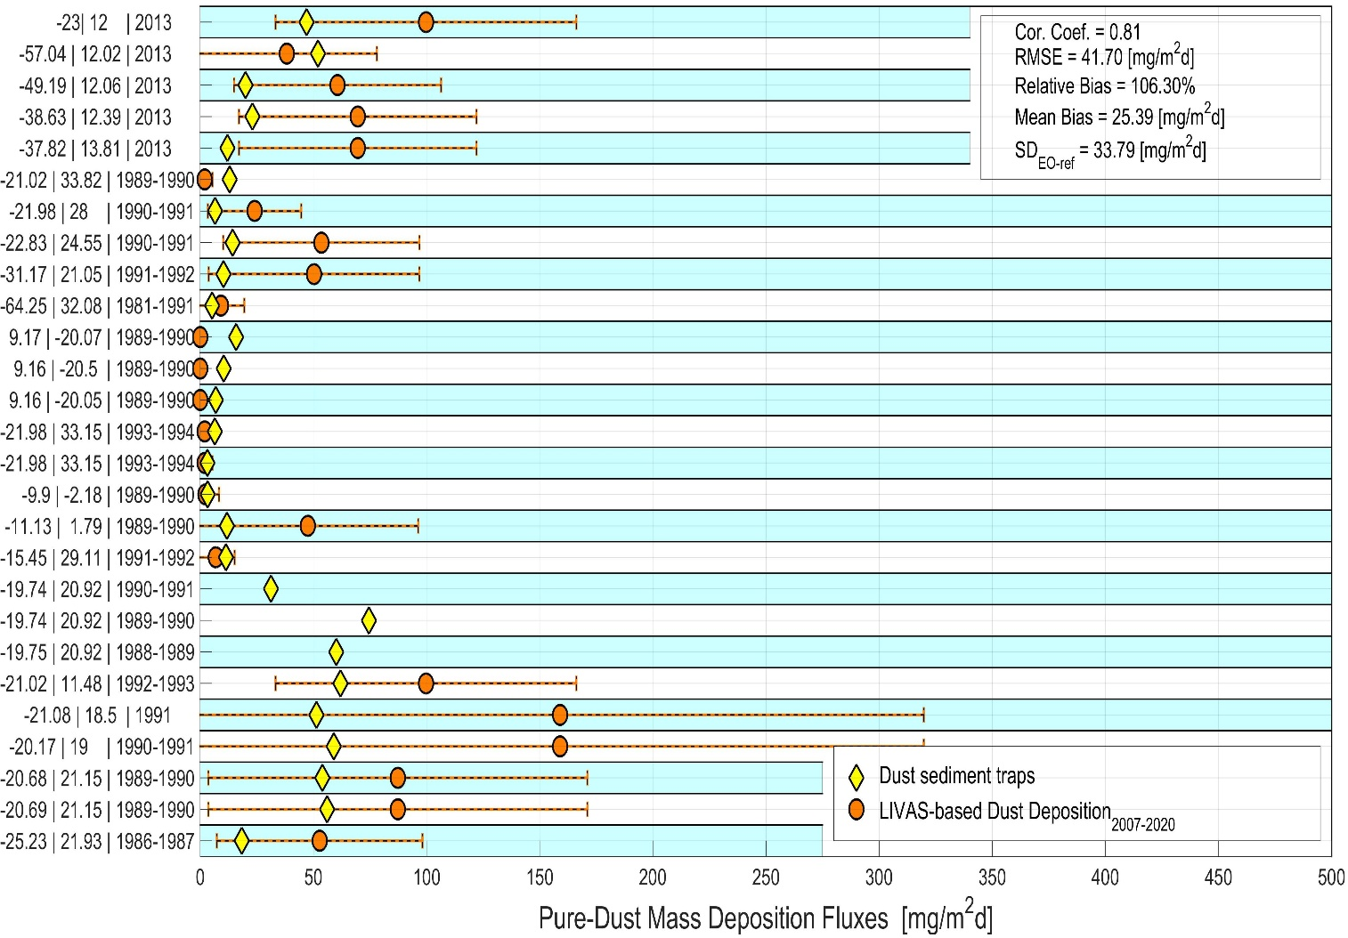
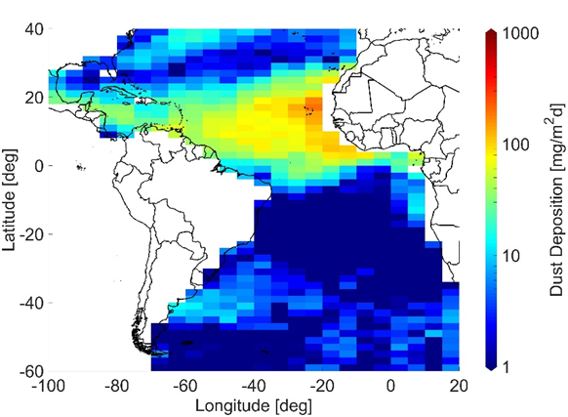
Validation and enhancement of deposition product
LIVAS dust deposition retrievals
DOMOS LIVAS-based Dust Deposition Rate evaluation
Inputs:
LIVAS Pure-Dust Mass Concentration
+ ERA5 meteorological fields (u, v, w)
Outputs:
LIVAS Total Dust Deposition Rate (2007-2020)
LIVAS-based dust deposition
Dust sediments traps
DOMOS ESA Study
PI: A. Benedetti
NOA product developer:
E. Proestakis proestakis@noa.gr
Preliminary results
Fiedler et al., EGU, 2023
AS1.37 Tuesday

Slide 15
Use of ASKOS measurements for:
Data Assimilation and impact assessment

Slide 16
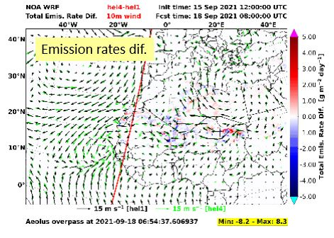
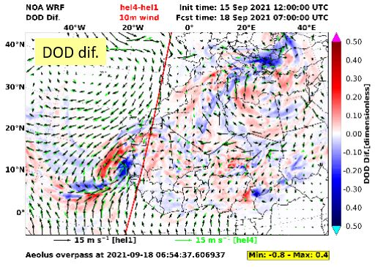
Data Assimilation – Newton study
Aeolus winds assimilation impact on dust transport models
NEWTON ESA Study
Emission rates dif.
DOD dif.
Large deviations of the dust emission rates in the main Saharan dust sources
Deviations on dust emission rates become more evident at lead times close to Aeolus overpass
Variations on wind speed and direction drive the Saharan outflows patterns
DOD differences up to 0.4 are evident in downwind areas

Slide 17






Data assimilation - ADD-CROSS study
Aeolus-like Total vs Parallel aerosol assimilation: impact on dust transport models
Aeolus-like co-polar Backscatter
Coefficient
(355 nm circular)
CALIPSO aerosol products -> Spectral conversion -> Conversion from linear to circular -> Derivation of Aeolus-like (circular) co-polar backscatter and of Aeolus-like (theoretical) cross-polar backscatter
Wind Speed Differences during the 2nd dust event of ASKOS/JATAC (Sept. 2021)
CALIPSO profiles
Aeolus-like cross-polar Backscatter
Coefficient
(355 nm circular)
> 2 m/s difference in wind speed assimilation due to the missing aerosol cross-polar component
ASKOS measurements will evaluate the assimilations

Slide 18
Use of ASKOS measurements for:
Atmospheric dust processes

Slide 19



Physical Processes
Super-coarse mode and radiation
Direct radiative effect at TOA:
Super-coarse dust particles are found at greater distances than anticipated from model simulations
A warming effect above deserts
The impact is only minor during the transport above ocean, due to the small number of super-coarse particles simulated.
ASKOC data for closure studies
Weinzierl, 2017; Ryder et al., 2018
Ryder et al., 2019
Foudoulakis et al., in preparation

Slide 20


Physical Processes
Super-coarse mode and transport
Observations
CONTROL – no Reduction
20% Reduction
40% Reduction
60% Reduction
80% Reduction
WRF-L: Include dust super-coarse and giant modes in WRF model
A 60-80% reduction in the particles settling velocity is needed in the model to best fit the observations
Drakaki et al., ACP, 2022
Drakaki et al., EGU, 2023 ITS2.5/CL4.14 Tuesday

Slide 21





Physical Processes
Processes suggested for super-coarse mode:
Water vapor impact on convection
Electrostatic forces & particle orientation
Dynamics related to numerical diffusion and turbulence
Dust asphericity, shape
WALL-E measurements show no orientation of dust
Particle orientation and electric charge
Electric fields measured are no capable for orientation of dust particles
Mallios et al., 2021
Tsekeri et al., EGU, 2023
AS1.37 Wednesday

Slide 22




Physical Processes
Super-coarse mode: numerical diffusion
bin4 (D= 25.8 μm)
2D idealized WRF-L simulations
Advection equation due to gravitational settling
Using UNO3: The heavier particles are sustained in higher altitudes and can travel to greater distances, more than 1000 km further
$\frac{∂Q}{∂t}+∇∙(v$settl Q) = 0
UNO3 (Li et al , 2006) vs WRF Chem (v.4.2.1)
3rd order scheme vs 1st order
Cabo Verde
Barbados
5 days transport
Drakaki et al., EGU, 2023 ITS2.5/CL4.14 Tuesday

Slide 23


Physical Processes
Super-coarse mode: asphericity
Settling velocities differences for different shapes
Drakaki et al., EGU, 2023 ITS2.5/CL4.14 Tuesday

Slide 24






Physical Processes
Super-coarse mode and updrafts
Vertical wind speed
updrafts
downdrafts
updrafts
downdrafts
Theory
CPEX-HALO
20 x 20 km
4 x 4 km
1 x 1 km
Dust transport model updraft ~ 0.5 m/s
Impact of model resolution

Slide 25

Take-home message
ASKOS provide an unprecedented dataset for desert dust research
All data are available in EVDC (evdc.esa.int)
We haven’t solved the coarse mode paradox yet, but we will continue working on it
Studies using ASKOS datasets are more than welcome!
Many thanks to all the people involved!

Slide 26



Backup slide
La Palma eruption – Canary Islands
nearby Aeolus overpasses & flights
Clouds
Clouds
Safire
+DLR
Safire
+DLR
Safire
+DLR
Safire
DLR
DLR
Volcanic aerosol
Dust
Dust
Dust
Volcanic
Dust
Marine

Slide 27

Backup slide
Enhancement of satellite products – LR & PLDR
Enhancement of CALIPSO retrievals: investigate the variability of dust LR vs PLDR
Middle East
dust
Saharan dust
Central Asian dust
Floutsi et al., AMT, 2022

Slide 28




Backup slide
Data assimilation and the ESA L2A+ study
Goal: To enhance the Aeolus L2A product
by accounting for the missing cross-polar component in the presence of dust
Develop a refined L2A+ aerosol product
Examine the impact of L2A and L2A+ on aerosol assimilation and dust transport models
Examine the impact of both Aeolus wind and aerosol fields on DA
Access the climatological value of L2A+ for aerosol databases (e.g., ESA-LIVAS)
CAMS
Use ASKOS/JATAC measurements to evaluate assimilations
Contact person: E. Proestakis proestakis@noa.gr

Slide 29


Data Assimilation
Dust transport model MONARCH: forecast improvement through LIVAS assimilation
Assimilating LIVAS pure dust monthly mean profiles can improve the dust forecast profiles
Escribano et al., ACP, 2022

